Slide 1
Cryptography CS 555
Week 2:
Computational Security against Eavesdropper
Constructing Secure Encryption Schemes against Eavesdropper
Chosen Plaintext Attacks and CPA-Security
Readings: Katz and Lindell Chapter 3.1-3.4
Fall 2017

Slide 2
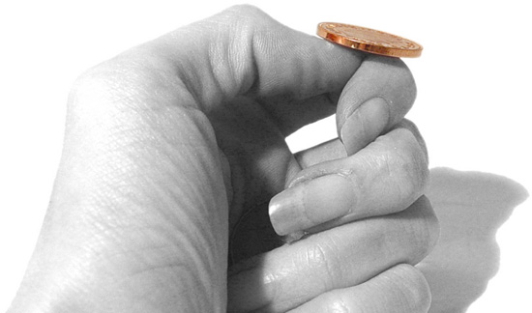
An Important Remark on Randomness
In our analysis we have made (and will
continue to make) a key assumption:
We have access to true “randomness”
to generate a secret key K (e.g. OTP)
Independent Random Bits
Unbiased Coin flips
Radioactive decay?

Slide 3
In Practice
Hard to flip thousands/millions of coins
Mouse-movements/keys
Uniform bits?
Independent bits?
Use Randomness Extractors
As long as input has high entropy, we can extract (almost) uniform/independent bits
Hot research topic in theory

Slide 4
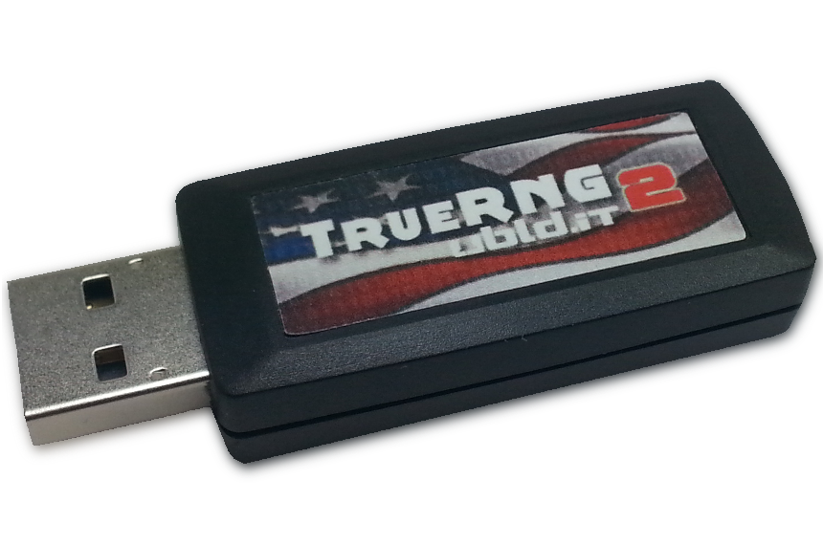
In Practice
Hard to flip thousands/millions of coins
Mouse-movements/keys
Customized Randomness Chip?

Slide 5
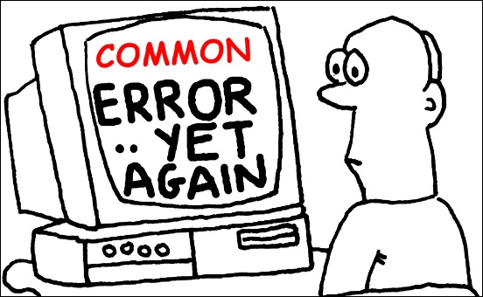
Caveat: Don’t do this!
Rand() in C stdlib.h is no good for cryptographic applications
Source of many real
world flaws

Slide 6
Week 2: Topic 1: Computational Security

Slide 7
Recap
Perfect Secrecy, One-time-Pads
Theorem: If (Gen,Enc,Dec) is a perfectly secret encryption scheme then
$$\left|𝒦\right|≥\left|ℳ\right|$$

Slide 8
What if we want to send a longer message?
K1,K2,K3
K1,K2,K3
$${Enc}_{k1}\left("Dear Alice, I wrote this poem for you"\right)$$
$${Enc}_{k2}\left("Roses are red, …."\right)$$
$${Enc}_{k3}\left("I am out of space, but the rest was awesome"\right)$$
Notes:
Alice doesn’t respond to Bob since they are out of one-time-pads so they stop talking. Can we save their relationship?

Slide 9
What if we want to send many messages?
K1,K2,K3
K1,K2,K3
$${Enc}_{k1}\left("Whats up, Alice?"\right)$$
$${Enc}_{k2}\left("Not too much, you?"\right)$$
$${Enc}_{k3}\left("Just chilling out?"\right)$$
Notes:
Alice doesn’t respond to Bob since they are out of one-time-pads so they stop talking. Can we save their relationship?

Slide 10
Can we save their relationship?
K1,K2,K3
K1,K2,K3
$${Enc}_{k1}\left("Whats up, Alice?"\right)$$
$${Enc}_{k2}\left("Not too much, you?"\right)$$
$${Enc}_{k3}\left("Just chilling out"\right)$$
Notes:
Alice doesn’t respond to Bob since they are out of one-time-pads so they stop talking. Can we save their relationship?

Slide 11
Perfect Secrecy vs Computational Security
Perfect Secrecy is Information Theoretic
Guarantee is independent of attacker resources
Computational Security
Security against computationally bounded attacker
An attacker with infinite resources might break security
Attacker might succeed with very small probability
Example: Lucky guess reveals secret key
Very Small Probability: $2^{−100},$ $2^{−1000}$, …

Slide 12
Current Goal
Define computational security in presence of eavesdropper who intercepts a single (long) message
If you don’t understand what you want to achieve, how can you possibly know when (or if) you have achieved it?
Show how to build a symmetric encryption scheme with computational security in the presence of an eavesdropper.
Define computational security against an active attacker who might modify the message
Define computational security for multiple messages in presence of an eavesdropper

Slide 13
Concrete Security
“A scheme is (t,ε)-secure if every adversary running for time at most t succeeds in breaking the scheme with probability at most ε”
Example: t = 2⁶⁰ CPU cycles
9 years on a 4GHz processor
< 1 minute on fastest supercomputer (in parallel)
Full formal definition needs to specify “break”
Important Metric in Practice
Caveat 1: difficult to provide/prove such precise statements
Caveat 2: hardware improves over time

Slide 14
Asymptotic Approach to Security
A scheme is secure if every probabilistic polynomial time (ppt) adversary “succeeds” with negligible probability.
Two Key Concepts
Polynomial time algorithm
Negligible Function
Definition: A function $f: ℕ⟶ℝ_{≥0}$ is negligible if for every positive polynomial p there is an integer N>0 such that for all n > N we have
$$f(n)<\frac{1}{p(n) }$$

Slide 15
Asymptotic Approach to Security
Definition: A function $f: ℕ⟶ℝ_{≥0}$ is negligible if for every positive polynomial p there is an integer N>0 such that for all n > N we have
$$f(n)<\frac{1}{p(n) }$$
Intuition: If we choose the security parameter n to be sufficiently large then we can make the adversaries success probability very small (negligibly small).

Slide 16
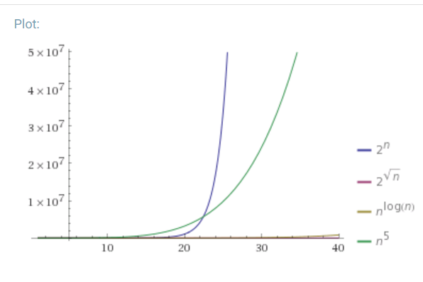
Asymptotic Approach to Security
Definition: A function $f: ℕ⟶ℝ_{≥0}$ is negligible if for every positive polynomial p there is an integer N>0 such that for all n > N we have
$$f(n)<\frac{1}{p(n) }$$
Which functions below are negligible?
${f\left(n\right)=2}^{−n}$
$f\left(n\right)=n^{−3}$
$f\left(n\right)={2^{−1000}1000n}^{1000}$
${f\left(n\right)=2^{100}2}^{−\sqrt{n}}$
${f\left(n\right)=2}^{−\log{n}}$

Slide 17
Asymptotic Approach to Security
Definition: A function $f: ℕ⟶ℝ_{≥0}$ is negligible if for every positive polynomial p there is an integer N>0 such that for all n > N we have
$$f(n)<\frac{1}{p(n) }$$
Which functions below are negligible?
${f\left(n\right)=2}^{−n}$
$f\left(n\right)=n^{−3}$
$f\left(n\right)={2^{−1000}1000n}^{1000}$
${f\left(n\right)=2^{100}2}^{−\sqrt{n}}$
${f\left(n\right)=2}^{−\log{n}}$

Slide 18
Asymptotic Approach to Security
Definition: An (randomized) algorithm A runs in polynomial time if there exists a polynomial p such that for every n-bit input x, A(x) terminates in at most p(n) steps in expectation.
Intuition: If an algorithm A does not run in polynomial time then, for sufficiently large n, it will quickly become impractical for any attacker to run the algorithm A.

Slide 19
Asymptotic Approach to Security
A scheme is secure if every probabilistic polynomial time (ppt) adversary “succeeds” with negligible probability.
General Attack 1: Test all possible secret keys $k′∈𝒦$
Doesn’t run in polynomial time, since $\left|𝒦\right|=2^{n}$
General Attack 2: Select random key $k^{′}∈𝒦,$check if it is correct (otherwise output $⊥$for “fail”).
Only successful with negligible probability $2^{−n}$

Slide 20
Advantages of Asymptotic Approach
Closure
If subroutine B runs in polynomial time and algorithm A makes p(n) queries to B then A also runs in polynomial time.
If f and g are negligible functions then h(n) = f(n)+g(n) is a negligible function
If p is a positive polynomial, and f is a negligible function then the function g(n)=f(n)p(n) is also negligible.
Church-Turing Thesis: “reasonable” model of computations are all polynomially equivalent.
Implication: No need to worry about different models of computation (circuits, random access machines, etc…)
Disadvantage: Limited guidance on how big to make security parameter n in practice.

Slide 21
Private Key Encryption Syntax (Revisited)
Message Space: $ℳ$
Key Space: $𝒦$
Three Algorithms
$\operatorname{Gen}{(1^{n};R)}$ (Key-generation algorithm)
Input: 1^{n} (security parameter in unary) + Random Bits R,
Output: Secret key $k∈𝒦$
$\operatorname{Enck}{(m;R)}$ (Encryption algorithm)
Input: Secret key $k∈𝒦$ and message $m∈ℳ$ + Random Bits R,
Output: ciphertext c
$\operatorname{Deck}{(c)}$ (Decryption algorithm)
Input: Secret key $k∈𝒦$ and a ciphertex$c$
Output: a plaintext message $m∈ℳ$ or $⊥(i.e$“Fail”)
Invariant: Dec_{k}(Enc_{k}(m))=m
Requirement: all three algorithms run in probabilistic polynomial time
Trusted Parties (e.g., Alice and Bob) must run Gen in advance to obtain secret k.
Typically picks $k∈𝒦$
uniformly at random

Slide 22
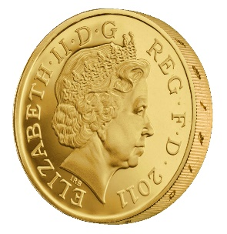
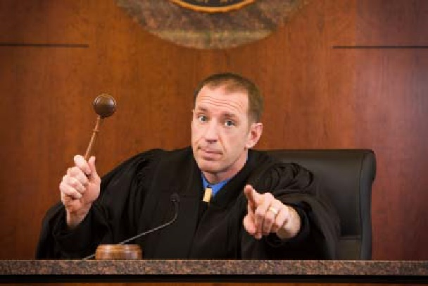
Adversarial Indistinguishability Experiment
m₀, m₁
Random bit b
K = Gen(.)
c = Enc_{K}(m_{b})
c
b’
$$∀\begin{matrix} & \\ & \\ & \end{matrix} Pr\left[\begin{matrix} & \\ & \end{matrix} Guesses b^{′}=b\right]≤\frac{1}{2}+μ(n)$$
$$ppt attacker$$
$$negligible function$$

Slide 23
Adversarial Indistinguishability Experiment
$$Formally, let Π= \left(Gen,Enc,Dec\right) denote the encryption scheme,$$
$$call the experiment{ PrivK}_{A,Π }^{eav} and define a random variable$$
${PrivK}_{A,Π }^{eav}=1 if b=b^{′}$
$${PrivK}_{A,Π }^{eav}=0 otherwise$$
$$Π has indistinguishable encryptions in the presence of$$
$$an eavesdropper if for all PPT adversary A, there is a$$
Negligible function $μ$ such that Pr[${PrivK}_{A,Π }^{eav}=1$] $≤\frac{1}{2}+μ(n)$
m₀, m₁
Random bit b
K = Gen(.)
c = Enc_{K}(m_{b})
c
b’
$$∀\begin{matrix} & \\ & \\ & \end{matrix} Pr\left[\begin{matrix} & \\ & \end{matrix} Guesses b^{′}=b\right]≤\frac{1}{2}+μ(n)$$
$$ppt attacker$$
$$negligible function$$

Slide 24
Semantic Security
m₀, m₁
Random bit b
K = Gen(.)
c = Enc_{K}(m_{b})
c
b’
$$∀\begin{matrix} & \\ & \\ & \end{matrix} Pr\left[\begin{matrix} & \\ & \end{matrix} Guesses b^{′}=b\right]≤\frac{1}{2}+μ(n)$$
$$ppt attacker$$
$$negligible function$$
Notes:
Suppose we have m,m’,c’ s.t. Pr[EncK(m)= c’] > Pr[EncK(m’)=c’] then adversary can select m0= m, m1=m’. If the ciphertext challenge c=c’ then the adversary outputs guess b’ = 1. Otherwise, the adversary outputs random guess b’.

Slide 25
Aside: Message and Ciphertext Length
In the previous game we typically require that |m₀|=|m₁|. Why?
It is impossible to support arbitrary length messages while hiding all information about plaintext length
Limitation: When could message length be sensitive?
Numeric data (5 figure vs 6 figure salary)
Database Searches: number of records returned can reveal information about the query
Compressed Data: Short compressed string indicates that original plaintext has a lot of redundancy. (CRIME attack on session cookies in HTTPS)

Slide 26
Implications of Indistinguishability
Theorem 3.10: Let (Gen, Enc, Dec) be a fixed-length private key encryption scheme for message of length $ℓ$ that satisfies indistinguishability (prior definition) then for all PPT attackers A and any $i≤ℓ$ we have
$$Pr\left[A\left(1^{n},{Enc}_{K}\left(m\right)\right)=m^{i}\right]≤\frac{1}{2}+negl(n)$$
Where the randomness is taken over $K←Gen\left(1^{n}\right)$, uniform $m∈{\left\{0,1\right\}}^{ℓ}$ and the randomness of $Enc$ and A.

Slide 27
Semantic Security
h(m) background knowledge the attacker might have about m.
Example:
f(m) = 1 if m > 100,000;
f(m) = 0 otherwise .
Definition 3.12: Let (Gen, Enc, Dec) be a fixed-length private key encryption scheme for message of length $ℓ$. We say that the scheme is semantically secure if for all PPT attackers A there exists a PPT algorithm A’ such that for any PPT algorithm Sample all any polynomial time computable functions f and h we have
$$\left|Pr\left[A\left(1^{n},{Enc}_{K}\left(m\right),h(m)\right)=f(m)\right]−Pr\left[A′\left(1^{n},\left|m\right|,h(m)\right)=f(m)\right]\right|≤negl(n)$$
Where the randomness is taken over $K←Gen\left(1^{n}\right)$, $m←Samp\left(1^{n}\right)$ and the randomness of $Enc$, A and A’.
A’ doesn’t even get to see an encryption of m! Just the length of m!

Slide 28
Homework 1 Released Thursday
Due in class on Thursday, September 14th (2 weeks)
Solutions should be typeset (preferably in Latex)
You may collaborate with classmates, but you must write up your own solution and you must understand this solution
Clarification questions: fall-2017-cs-55500-le1@lists.purdue.edu

Slide 29
Week 2: Topic 2: Constructing Secure Encryption Schemes

Slide 30
Recap
Sematic Security/Indistinguishable Encryptions
Concrete vs Asymptotic Security
Negligible Functions
Probabilistic Polynomial Time Algorithm

Slide 31
Recap: Semantic Security
m₀, m₁
Random bit b
K = Gen(.)
c = Enc_{K}(m_{b})
c
b’
$$∀\begin{matrix} & \\ & \\ & \end{matrix} Pr\left[\begin{matrix} & \\ & \end{matrix} Guesses b^{′}=b\right]≤\frac{1}{2}+μ(n)$$
$$ppt attacker$$
$$negligible function$$
Notes:
Suppose we have m,m’,c’ s.t. Pr[EncK(m)= c’] > Pr[EncK(m’)=c’] then adversary can select m0= m, m1=m’. If the ciphertext challenge c=c’ then the adversary outputs guess b’ = 1. Otherwise, the adversary outputs random guess b’.

Slide 32
Semantic Security
h(m) background knowledge the attacker might have about m.
Example:
f(m) = 1 if m > 100,000;
f(m) = 0 otherwise .
Definition 3.12: Let (Gen, Enc, Dec) be a fixed-length private key encryption scheme for message of length $ℓ$. We say that the scheme is semantically secure if for all PPT attackers A there exists a PPT algorithm A’ such that for any PPT algorithm Sample all any polynomial time computable functions f and h we have
$$\left|Pr\left[A\left(1^{n},{Enc}_{K}\left(m\right),h(m)\right)=f(m)\right]−Pr\left[A′\left(1^{n},\left|m\right|,h(m)\right)=f(m)\right]\right|≤negl(n)$$
Where the randomness is taken over $K←Gen\left(1^{n}\right)$, $m←Samp\left(1^{n}\right)$ and the randomness of $Enc$, A and A’.
A’ doesn’t even get to see an encryption of m! Just the length of m!

Slide 33
Another Interpretation of Semantic Security
World 2: Perfect Secrecy (Attacker doesn’t even see ciphertext).
For all attackers A’ (even unbounded) with background knowledge h(m) we have
$$Pr\left[A′\left(1^{n},\left|m\right|,h(m)\right)=f(m)\right]=Pr\left[f(m)\left| h\left(m\right),\right.\left|m\right|\right]$$
World 1: Attacker is PPT and sees ciphertext
Best World 1 attacker does no better than World 2 attacker
$\left|Pr\left[A\left(1^{n},{Enc}_{K}\left(m\right),h(m)\right)=f(m)\right]−Pr\left[A′\left(1^{n},\left|m\right|,h(m)\right)=f(m)\right]\right|≤negl(n)$
What is probability over?

Slide 34
New Goal
Define computational security
If you don’t understand what you want to achieve, how can you possibly know when (or if) you have achieved it?
Show how to build a symmetric encryption scheme with semantic security.
Define computational security against an attacker who sees multiple ciphertexts or attempts to modify the ciphertexts

Slide 35
Building Blocks
Pseudorandom Generators
Stream Ciphers

Slide 36
Pseudorandom Generator G
Input: Short random seed $s∈{\left\{0,1\right\}}^{n}$
Output: Longer “pseudorandom” string $G\left(s\right)∈{\left\{0,1\right\}}^{ℓ(n)}$ with $ℓ\left(n\right)>n$
$ℓ\left(n\right)$ is called expansion factor
PRG Security: For all PPT attacker A there is a negligible function negl s.t
$$\left|{Pr}_{s∈{\left\{0,1\right\}}^{n}}\left[A\left(G\left(s\right)\right)=1\right]−{Pr}_{R∈{\left\{0,1\right\}}^{ℓ(n)}}⁡\left[A\left(R\right)=1\right]\right|≤negl\left(n\right)$$

Slide 37
PRG Security as a Game
R
Random bit b
If b=1
$r←{\left\{0,1\right\}}^{n}$
R = G(r)
Else
$$R←{\left\{0,1\right\}}^{ℓ\left(n\right)}$$
b’
$$∀\begin{matrix} & \\ & \\ & \end{matrix} Pr\left[\begin{matrix} & \\ & \end{matrix} Guesses b^{′}=b\right]≤\frac{1}{2}+μ(n)$$
$$ppt attacker$$
$$negligible function$$
Notes:
Suppose we have m,m’,c’ s.t. Pr[EncK(m)= c’] > Pr[EncK(m’)=c’] then adversary can select m0= m, m1=m’. If the ciphertext challenge c=c’ then the adversary outputs guess b’ = 1. Otherwise, the adversary outputs random guess b’.

Slide 38
A Bad PRG
G(s) = s|1.
What is the expansion factor?
Answer: $ℓ\left(n\right)$=n+1
Task: Construct a distinguisher D which breaks PRG security for G
One Answer: D(x|1)=1 and D(x|0)=0 for all x.
Analysis: Pr[D(G(s)) = 1] = ?
Analysis: Pr[D(R) = 1] = ?
$\left|{Pr}_{s∈{\left\{0,1\right\}}^{n}}\left[D\left(G\left(s\right)\right)=1\right]−{Pr}_{R∈{\left\{0,1\right\}}^{ℓ(n)}}⁡\left[D\left(R\right)=1\right]\right|=\frac{1}{2}$

Slide 39
One-Time-Pads + PRGs
Encryption:
Secret key is the seed (K=s)
$$Encs(m)=G(s)⨁m$$
$$Decs(c)=G(s)⨁c$$
Advantage: $\left|m\right|=ℓ\left(n\right)≫\left|s\right|=n$
Computational Security vs Information Theoretic (Perfect) Security
Disadvantage: Still can only send one message
Theorem 3.18: If G is a pseudorandom generator then the above encryption scheme has indistinguishable encryptions in the presence of an eavesdropper.

Slide 40
One-Time-Pads + PRGs
$$Encs(m)=G(s)⨁m$$
$$Decs(c)=G(s)⨁c$$
Theorem 3.18: If G is a pseudorandom generator then the above encryption scheme has indistinguishable encryptions in the presence of an eavesdropper.
Proof by Reduction: Start with and attacker A that breaks security of encryption scheme and transform A into distinguisher D that breaks PRG security of G.
Why is this sufficient?

Slide 41
Breaking Semantic Security
m₀, m₁
$$c=G(s)⨁m_{b}$$
Random bit b
Random seed s
b’
$$\begin{matrix} & \\ & \\ & \end{matrix} Pr\left[\begin{matrix} & \\ & \end{matrix} Guesses b^{′}=b\right]≥\frac{1}{2}+f(n)$$
$$ppt attacker$$
$$non−negligible function$$
(possibly still small)
Notes:
Suppose we have m,m’,c’ s.t. Pr[EncK(m)= c’] > Pr[EncK(m’)=c’] then adversary can select m0= m, m1=m’. If the ciphertext challenge c=c’ then the adversary outputs guess b’ = 1. Otherwise, the adversary outputs random guess b’.

Slide 42
The Reduction
PRG Attacker
What is $Pr\left[\text{b}\text{’’}≠\text{b}\text{’}\left|\text{b}\text{=0}\right.\right]$?
Hint: What encryption scheme is used?
What is $Pr\left[\text{b}\text{’’}=\text{b}\text{’}\left|\text{b}\text{=1}\right.\right]$?
R
Random bit b
If b=1
$r←{\left\{0,1\right\}}^{n}$
R = G(r)
Else
$$R←{\left\{0,1\right\}}^{ℓ\left(n\right)}$$
Encryption Attacker
m₀, m₁
$$c=R⨁m_{b′}$$
Random b’
b’’
g
g = 1 if b”=b’
0 otherwise

Slide 43
Analysis
$$\left|{Pr}_{s∈{\left\{0,1\right\}}^{n}}\left[D\left(G\left(s\right)\right)=1\right]−{Pr}_{R∈{\left\{0,1\right\}}^{ℓ(n)}}⁡\left[D\left(R\right)=1\right]\right|$$
$$=\left|Pr\left[\text{b}\text{’’}=\text{b}\text{’}\left|\text{b}\text{=1}\right.\right]−Pr\left[\text{b}\text{’’}≠\text{b}\text{’}\left|\text{b}\text{=0}\right.\right]\right|=\left|Pr\left[\text{b}\text{’’}=\text{b}\text{’}\left|\text{b}\text{=1}\right.\right]−\text{½}\right|$$
$$≥\text{½ }\text{+} \text{f}\text{(}\text{n}\text{) }−\text{½}≥\text{f}\text{(}\text{n}\text{) }$$
Recall: f(n) was (non-negligible) advantage of encryption attacker.
Implication: PRG G is also insecure (contrary to assumption).
QED

Slide 44
Candidate PRG
Notation: Given string $x∈{\left\{0,1\right\}}^{n}$ and a subset $S⊂\left\{1,…,n\right\}$ let x_{S} $∈{\left\{0,1\right\}}^{|S|}$ denote the substring formed by concatenating bits at the positions in S.
Example: x=10110 and S = {1,4,5} x_{S}=110
$$P\left(x1,x2,x3,x4,x5\right)=x1+x2+x3+x4x5 mod{2}$$
Select random subsets $𝕊=$S₁,…,$S_{ℓ\left(n\right)}⊂\left\{1,…,n\right\}$ of size |S_{i}|=5 and with $ℓ\left(n\right)=n^{1.4}$
$$G𝕊\left(x\right)=\left.P\left(x_{S_{1}}\right)\right|…\left|P\left(x_{S_{ℓ\left(n\right)}}\right)\right.$$

Slide 45
Stream Cipher vs PRG
PRG pseudorandom bits output all at once
Stream Cipher
Pseudorandom bits can be output as a stream
RC4, RC5 (Ron’s Code)
st₀ := Init(s)
For i=1 to $ℓ$:
(y_{i},st_{i}):=GetBits(st_{i-1})
Output: y₁,…,y$ℓ$

Slide 46
The RC4 Stream Cipher
A proprietary cipher owned by RSA, designed by Ron Rivest in 1987.
Became public in 1994.
Simple and effective design.
Variable key size (typical 40 to 256 bits),
Output unbounded number of bytes.
Widely used (web SSL/TLS, wireless WEP).
Extensively studied, not a completely secure PRNG, when used correctly, no known attacks exist
Newer Versions: RC5 and RC6
Rijndael selected by NIST as AES in 2000

Slide 47
The RC4 Cipher
The cipher internal state consists of
a 256-byte array S, which contains a permutation of 0 to 255
total number of possible states is 256! ≈ 2¹⁷⁰⁰
two indexes: i, j
i = j = 0
Loop
i = (i + 1) (mod 256)
j = (j + S[i]) (mod 256)
swap(S[i], S[j])
output S[S[i] + S[j]] (mod 256)
End Loop

Slide 48
Limitations of Current Security Definition
Assumes adversary observes just one ciphertext
What if adversary observes two ciphertexts?
$$c_{1}=Encs(m_{1})=G(s)⨁m_{1}$$
$$c_{2}=Encs(m_{2})=G(s)⨁m_{2}$$
How could the adversary (Joe) attempt to modify c=Enc_{k}(m) below?
m = “Pay Joe the following amount (USD): 000000101”

Slide 49
Multiple Message Eavesdropping Experiment
(m_{0,1},…,m_{0,t}), (m_{1,1},…,m_{1,t})
(c₁,…,c_{t})
Random bit b
K = Gen(.)
c_{i} = Enc_{K}(m_{b,i})
b’
$$∀\begin{matrix} & \\ & \\ & \end{matrix} Pr\left[\begin{matrix} & \\ & \end{matrix} Guesses b^{′}=b\right]≤\frac{1}{2}+μ(n)$$
$$ppt attacker$$
$$negligible function$$

Slide 50
Multiple Message Eavesdropping Experiment
$$Formally, let Π= \left(Gen,Enc,Dec\right) denote the encryption scheme,$$
$call the experiment PrivKmult$ $and define a random variable$
${PrivK}_{A,Π }^{mult}=1 if b=b^{′}$
$${PrivK}_{A,Π }^{mult}=0 otherwise$$
$$Π has indistinguishable multiple encryptions in the presence of$$
$$an eavesdropper if for all PPT adversary A, there is a$$
Negligible function $μ$ such that Pr[${PrivK}_{A,Π }^{mult}=1$] $≤\frac{1}{2}+μ(n)$
m₀, m₁
Random bit b
K = Gen(.)
c = Enc_{K}(m_{b})
c
b’
$$∀\begin{matrix} & \\ & \\ & \end{matrix} Pr\left[\begin{matrix} & \\ & \end{matrix} Guesses b^{′}=b\right]≤\frac{1}{2}+μ(n)$$
$$ppt attacker$$
$$negligible function$$

Slide 51
A Simple Observation
If$Π$has indistinguishable multiple encryptions in the presence of an eavesdropper
then
$Π$ also has indistinguishable encryptions in the presence of an eavesdropper.
In fact indistinguishable multiple encryptions is a strictly stronger security notion.

Slide 52
Example
$$Encs(m)=G(s)⨁m$$
$$Decs(c)=G(s)⨁c$$
Recall: $Π= \left(Gen,Enc,Dec\right)$has indistinguishable encryptions in the presence of an eavesdropper.
Claim: $Π= \left(Gen,Enc,Dec\right)$does not have indistinguishable multiple encryptions in the presence of an eavesdropper.

Slide 53
Multiple Message Eavesdropping
(0^{ℓ(𝑛)}, 0^{ℓ(𝑛)}), (0^{ℓ(𝑛)}, 1^{ℓ(𝑛)})
$$(G(s)⨁\text{m}\text{b}\text{,}\text{1}\text{,} G(s)⨁\text{m}\text{b}\text{,2})$$
Random bit b
s = Gen(.)
c_{i} = Enc_{K}(m_{b,i})
b’
b’ = 0 if $c_{1}≠c_{2}$
1 otherwise
Analysis: If b=1 then c₁= $G(s)⨁$ 0^{ℓ(𝑛)} =c₂
Analysis: If b=0 then c₁= $G(s)⨁\text{0}\text{ℓ(}\text{n}\text{)}≠G(s)⨁$ 1^{ℓ(𝑛)} =c₂

Slide 54
Did We Cheat?
Attack specifically exploited the fact that we can ask to see multiple encryptions of the same message…
The above argument might appear to show that no encryption scheme provides secure indistinguishable multiple encryptions in the presence of an eavesdropper.
Theorem: If $Π$ is (stateless) encryption scheme and Enc is deterministic then $Π$ does not provide secure indistinguishable multiple encryptions

Slide 55
Did We Cheat?
Option 1: Weaken the security definition so that attacker cannot request two encryptions of the same message.
Undesirable!
Example: Dataset in which many people have the last name “Smith”
We will actually want to strengthen the definition later…
Option 2: Consider randomized encryption algorithms

Slide 56
Week 2: Topic 3: CPA-Security

Slide 57
Homework 1 Released
Due in class on Friday, February 3rd (2 weeks)
Solutions should be typeset (preferably in Latex)
You may collaborate with classmates, but you must write up your own solution and you must understand this solution
One question covers PRFs which we will cover early next week.
Clarification questions: spring-2017-cs-55500-wng@lists.purdue.edu

Slide 58
Recap
Sematic Security/Indistinguishable Encryptions against eavesdropping attacker with one ciphertext
Pseudorandom Number Generators
Today’s Goal: Multiple Message Security and CPA-Security.
Build CPA-secure encryption scheme

Slide 59
Chosen-Plaintext Attacks
Model ability of adversary to control or influence what the honest parties encrypt.
During World War 2 the British placed mines at specific locations, knowing that the Germans, upon finding the mines, would encrypt the location and send them back to headquarters. The encrypted messages helped cryptanalysts at Bletchley Park to break the German encryption scheme.
Notes:
Batle of Midway. In May 1942, US Navy cryptanal

Slide 60
Chosen-Plaintext Attacks
Model ability of adversary to control or influence what the honest parties encrypt.
Battle of Midway (WWII). US Navy cryptanalysts intercept and encrypted message which they are able to partially decode (May 1942).
The message stated that the Japanese were planning an attack on AF?
Cryptanalysts could not decode ciphertext fragment AF.
Best Guess: AF = “Midway Island.”
Notes:
Batle of Midway. In May 1942, US Navy cryptanal

Slide 61
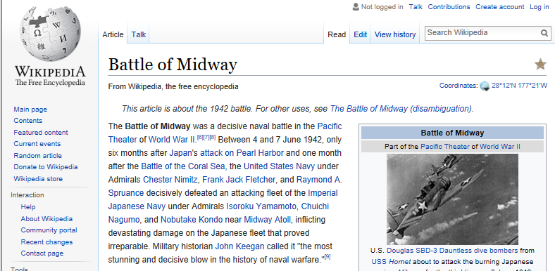
Battle of Midway (WWII).
US Navy cryptanalysts intercept and encrypted message which they are able to partially decode (May 1942).
Message stated that the Japanese were planning a surpise attack on “AF”
Cryptanalysts could not decode ciphertext fragment AF.
Best Guess: AF = “Midway Island.”
Washington believed Midway couldn’t possibly be the target.
Cryptanalysts then told forces at Midway to send a fake message “freshwater supplies low”
The Japanese intercepted and transmitted an encrypted message stating that “AF is low on water.”
Notes:
Batle of Midway. In May 1942, US Navy cryptanal

Slide 62
Battle of Midway (WWII).
US Navy cryptanalysts intercept and encrypted message which they are able to partially decode (May 1942).
Message stated that the Japanese were planning a surpise attack on “AF”
Cryptanalysts could not decode ciphertext fragment AF.
Best Guess: AF = “Midway Island.”
Washington believed Midway couldn’t possibly be the target.
Cryptanalysts then told forces at Midway to send a fake message “freshwater supplies low”
The Japanese intercepted and transmitted an encrypted message stating that “AF is low on water.”

Slide 63
Multiple Message Security and CPA-Attacks
Multiple Message Security
Attacker must select all messages at the same time.
Significant Limitation!
In the WWII attacks cryptanalysts selected the message adaptively
Selected message(s) to encrypt after observing target ciphertext

Slide 64
CPA-Security (Single Message)
m₀,m₁
c = Enc_{K}(m_{b})
m₂
c₂ = Enc_{K}(m₂)
m₃
c₃ = Enc_{K}(m₃)
…
$$∀PPT A ∃μ (negligible) s.t$$
$$Pr\left[A Guesses b^{′}=b\right]≤\frac{1}{2}+μ(n)$$
b’
Random bit b
K = Gen(.)

Slide 65
CPA-Security (Single Message)
m₀,m₁
$$Formally, let Π= \left(Gen,Enc,Dec\right) denote the encryption scheme,$$
$$call the experiment {PrivK}_{A,Π }^{cpa}and define a random variable$$
${PrivK}_{A,Π }^{cpa}=1 if b=b^{′}$
$${PrivK}_{A,Π }^{cpa}=0 otherwise$$
$$Π has indistinguishable encryptions under a chosen plaintext attack$$
$if for all PPT adversaries A, there is a$negligible function $μ$ such that
$Pr\left[{PrivK}_{A,Π }^{cpa}=1\right]$ $≤\frac{1}{2}+μ(n)$
c = Enc_{K}(m_{b})
m₂
c₂ = Enc_{K}(m₂)
m₃
c₃ = Enc_{K}(m₃)
…
$$∀PPT A ∃μ (negligible) s.t$$
$$Pr\left[A Guesses b^{′}=b\right]≤\frac{1}{2}+μ(n)$$
b’
Random bit b
K = Gen(.)

Slide 66
CPA-Security (Multiple Messages)
m_{0,1},m_{1,1}
c₁ = Enc_{K}(m_{b,1})
m_{0,2},m_{1,2}
c₂ = Enc_{K}(m_{b,2})
m_{0,3},m_{1,3}
c₃ = Enc_{K}(m_{b,3})
…
$$∀PPT A ∃μ (negligible) s.t$$
$$Pr\left[{PrivK}_{A,Π }^{cpa}\right]≤\frac{1}{2}+μ(n)$$
b’
Random bit b
K = Gen(.)

Slide 67
CPA-Security
Theorem: An encryption scheme $Π= \left(Gen,Enc,Dec\right)$ that is CPA-Secure for single encryptions is also CPA-secure for multiple encryptions.
We will simply say CPA-security for simplicity
To show CPA-Security it suffices to show CPA-security for single encryptions.
To reason about security of a protocol using $Π$ we can use game with multiple encryptions.

Slide 68
CPA-Security
CPA-security vs Multiple Message Encryption
CPA-security is stronger guarantee
Attacker can select messages adaptively
CPA-security minimal security notion for a modern cryptosystem
Limitations of CPA-Security: Does not model and adversary who
Attempts to modify messages
Can get honest party to (partially) decrypt some messages

Slide 69
CPA-Security and Message Length
Observation: Given a CPA-secure encryption scheme $Π= \left(Gen,Enc,Dec\right)$ that supports messages of a single bit ($ℳ=\left\{0,1\right\}$) it is easy to build a CPA-secure scheme $Π$’$= \left(Gen′,Enc′,Dec′\right)$ that supports messages m = m₁,…,m_{n}$∈\left\{0,1\right\}n$ of length n.
$${Enc}_{k}^{′}\left(m\right)=\left\langle {Enc}_{k}^{}\left(m1\right),…,{Enc}_{k}^{}\left(mn\right)\right\rangle$$
Exercise: How would you prove $Π$’ is CPA-secure?

Slide 70
Security Reduction
Step 1: Assume for contraction that we have a PPT attacker A that breaks CPA-Security.
Step 2: Construct a PPT distinguisher D which breaks PRF security.

Slide 71
Next Week
Read Katz and Lindell 3.5-3.7
Constructing CPA-Security with Pseudorandom Functions
Block Cipher Modes of Operation
CCA-Security (Chosen Ciphertext Attacks)

