Slide 1
Homework 5 Statistics
Minimum Value | 40
Maximum Value | 110.00
Range | 110.00
Average | 78.95
Median | 95.00
Standard Deviation | 31.79

Slide 2
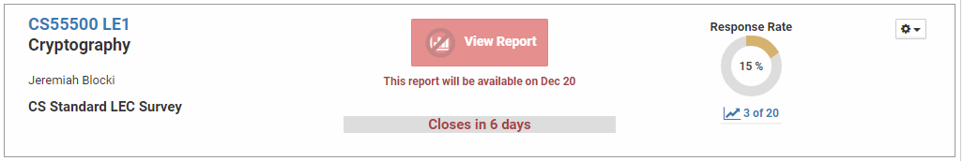
Course Business
Please Complete Your Course Evaluations
Your feedback is valuable!

Slide 3
Final Exam
Time: Tuesday, December 12th at 1PM
Location: LWSN 1106
Comprehensive
  …but heavier coverage of material covered in second half of semester
Format
  Multiple choice
  Fill in the blank
  true/false/more information
Solutions to practice exam distributed on Thursday

Slide 4
Cryptography
CS 555
Week 16:
Zero-Knowledge Proofs,
Hot Topics in Cryptography
Review for Final Exam
Readings: Katz and Lindell Chapter 10 & Chapter 11.1-11.2, 11.4
Fall 2017

Slide 5
CS 555:Week 15: Zero-Knowledge Proofs

Slide 6
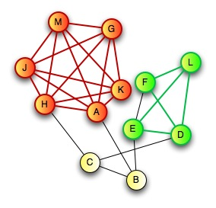
Zero-Knowledge Proof for all NP
CLIQUE
  Input: Graph G=(V,E) and integer k>0
  Question: Does G have a clique of size k?
CLIQUE is NP-Complete
  Any problem in NP reduces to CLIQUE
  A zero-knowledge proof for CLIQUE yields proof for all of NP via reduction
Prover:
  Knows k vertices v₁,…,v_{k} in G=(V,E) that form a clique

Slide 7

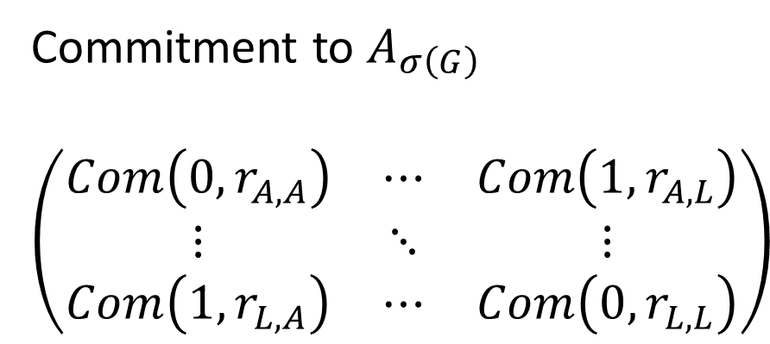
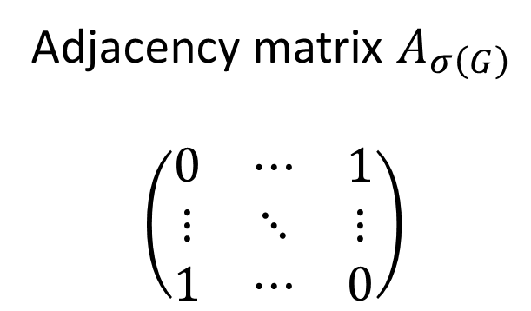
Zero-Knowledge Proof for all NP
C
D
$$σ\left(G\right)$$
E
H
G
A
F
B
J
I
L
K
Commitment to $A_{σ\left(G\right)}$
$$\left(\begin{matrix}Com\left(0,r_{A,A}\right) & ⋯ & Com\left(1,r_{A,L}\right) \\ ⋮ & ⋱ & ⋮ \\ Com\left(1,r_{L,A}\right) & ⋯ & Com\left(0,r_{L,L}\right)\end{matrix}\right)$$
Adjacency matrix $A_{σ\left(G\right)}$
$$\left(\begin{matrix}0 & ⋯ & 1 \\ ⋮ & ⋱ & ⋮ \\ 1 & ⋯ & 0\end{matrix}\right)$$
A
L
A
L
A
A
L
L

Slide 8
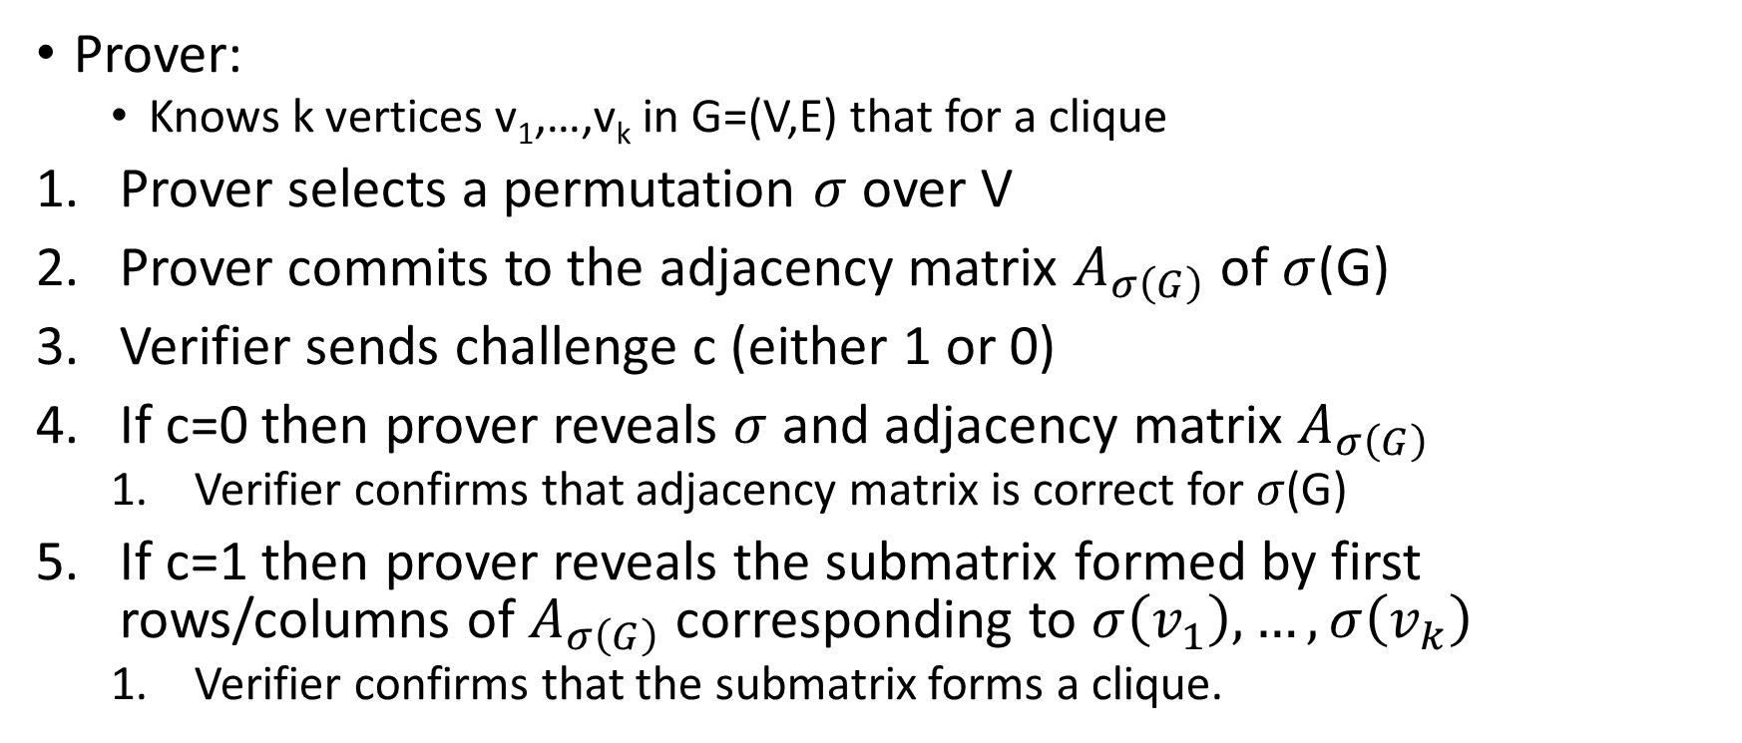
Zero-Knowledge Proof for all NP
C
D
E
H
G
A
F
B
J
Prover:
  Knows k vertices v₁,…,v_{k} in G=(V,E) that for a clique
Prover selects a permutation $σ$ over V
Prover commits to the adjacency matrix $A_{σ\left(G\right)}$ of $σ$(G)
Verifier sends challenge c (either 1 or 0)
If c=0 then prover reveals $σ$ and adjacency matrix $A_{σ\left(G\right)}$
  Verifier confirms that adjacency matrix is correct for $σ$(G)
If c=1 then prover reveals the submatrix formed by first rows/columns of $A_{σ\left(G\right)}$ corresponding to $σ\left(v_{1}\right),…,σ\left(v_{k}\right)$
  Verifier confirms that the submatrix forms a clique.
I
L
K

Slide 9


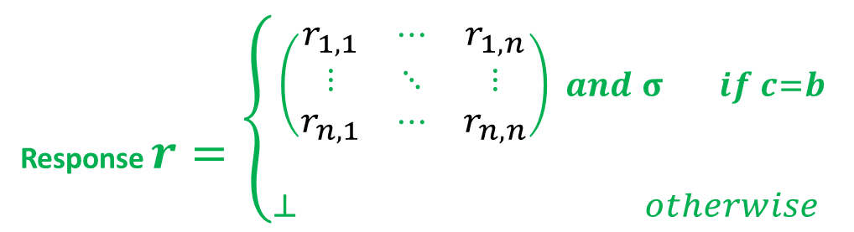
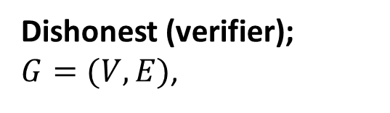
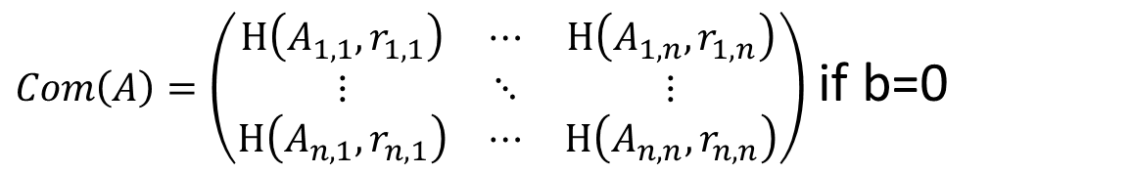

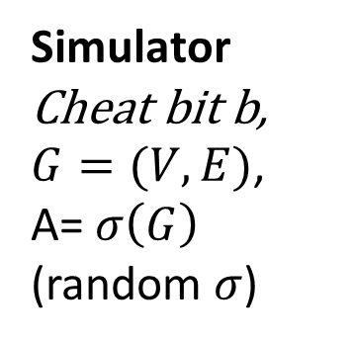

Zero-Knowledge Proof Simulator
$Com\left(A\right)=\left(\begin{matrix}H\left(A_{1,1},r_{1,1}\right) & ⋯ & H\left(A_{1,n},r_{1,n}\right) \\ ⋮ & ⋱ & ⋮ \\ H\left(A_{n,1},r_{n,1}\right) & ⋯ & H\left(A_{n,n},r_{n,n}\right)\end{matrix}\right)$ if b=0
$$challenge c=V′(G, Com\left(A\right))∈\left\{0,1\right\}$$
Response $r=\left\{{\begin{aligned}\left(\begin{matrix}r_{1,1} & ⋯ & r_{1,n} \\ ⋮ & ⋱ & ⋮ \\ r_{n,1} & ⋯ & r_{n,n}\end{matrix}\right) and σ if c=b \\ \end{aligned} \atop ⊥ otherwise }\right.$
Simulator
Cheat bit b,
$G=(V,E)$,
A= $σ\left(G\right)$
(random $σ$)
Dishonest (verifier);
$G=(V,E)$,
$$Decision d=V′(G, Com\left(A\right),c,r)$$
Zero-Knowledge: For all PPT V’ exists PPT Sim s.t ${View}_{V′}≡_{C}{Sim}^{V′(.)}\left(A\right)$
A
L
A
L

Slide 10
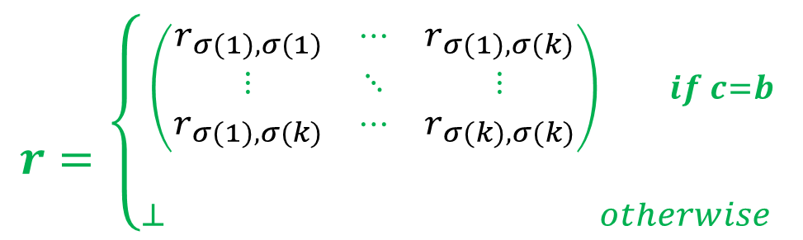
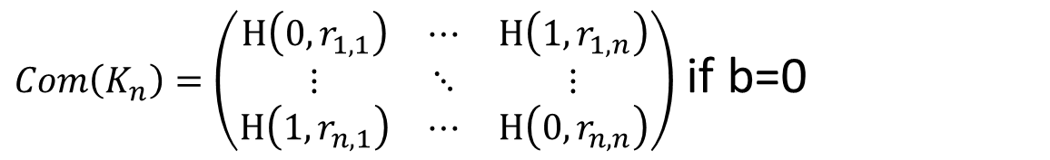
Zero-Knowledge Proof Simulator
$Com\left(K_{n}\right)=\left(\begin{matrix}H\left(0,r_{1,1}\right) & ⋯ & H\left(1,r_{1,n}\right) \\ ⋮ & ⋱ & ⋮ \\ H\left(1,r_{n,1}\right) & ⋯ & H\left(0,r_{n,n}\right)\end{matrix}\right)$ if b=0
$$challenge c=V′(G, Com\left(A\right))∈\left\{0,1\right\}$$
$r=\left\{{\begin{aligned}\left(\begin{matrix}r_{σ(1),σ(1)} & ⋯ & r_{σ(1),σ(k)} \\ ⋮ & ⋱ & ⋮ \\ r_{σ(1),σ(k)} & ⋯ & r_{σ(k),σ(k)}\end{matrix}\right) if c=b \\ \end{aligned} \atop ⊥ otherwise }\right.$
Simulator
Cheat bit b,
$G=(V,E)$,
A= $σ\left(G\right)$
(random $σ$)
Dishonest (verifier);
$G=(V,E)$,
$$Decision d=V′(G, Com\left(A\right),c,r)$$
Zero-Knowledge: For all PPT V’ exists PPT Sim s.t ${View}_{V′}≡_{C}{Sim}^{V′(.)}\left(A\right)$
A
L
A
L

Slide 11
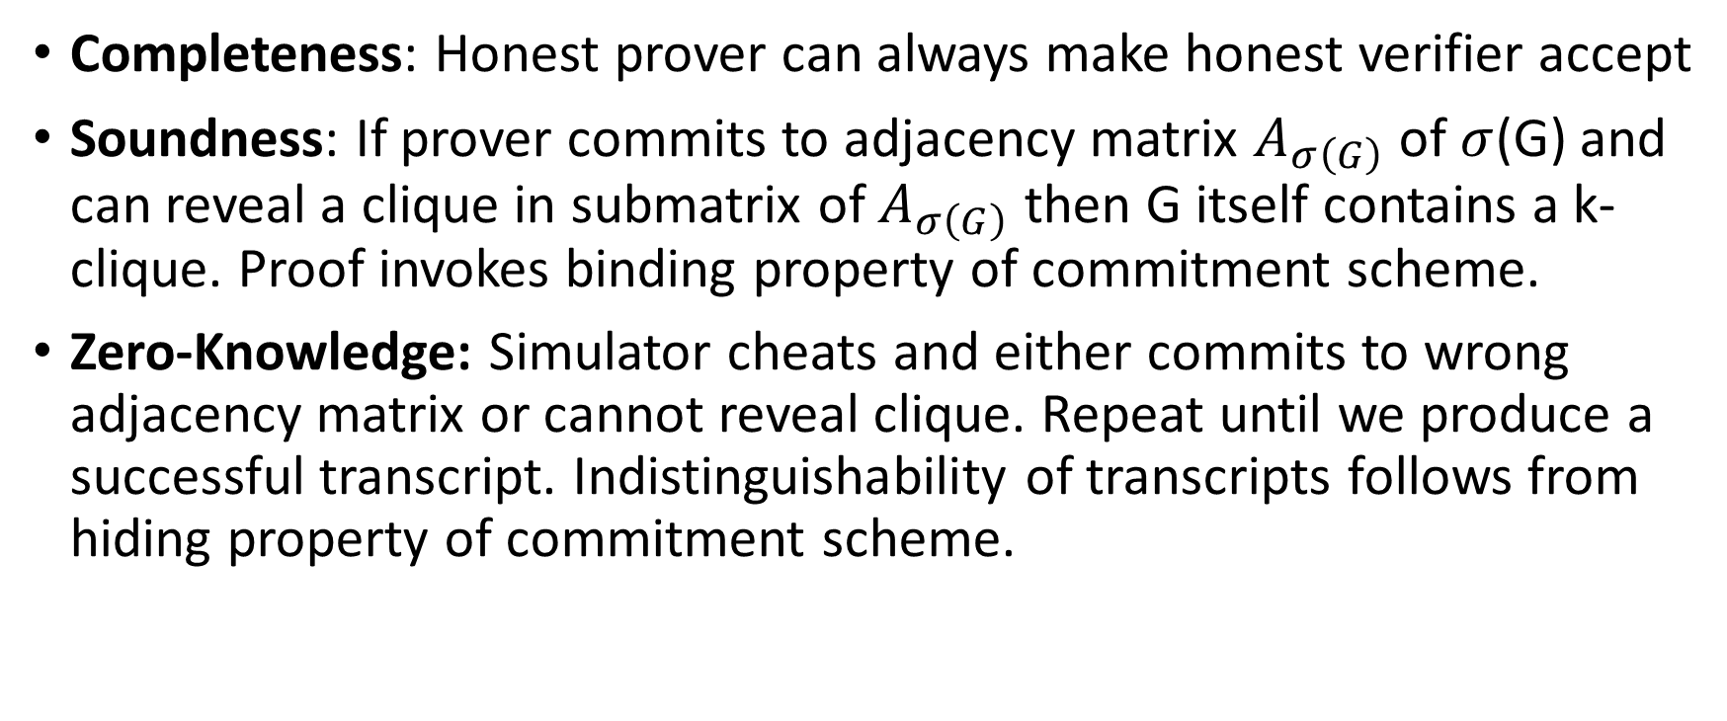
Zero-Knowledge Proof for all NP
Completeness: Honest prover can always make honest verifier accept
Soundness: If prover commits to adjacency matrix $A_{σ\left(G\right)}$ of $σ$(G) and can reveal a clique in submatrix of $A_{σ\left(G\right)}$ then G itself contains a k-clique. Proof invokes binding property of commitment scheme.
Zero-Knowledge: Simulator cheats and either commits to wrong adjacency matrix or cannot reveal clique. Repeat until we produce a successful transcript. Indistinguishability of transcripts follows from hiding property of commitment scheme.

Slide 12
Secure Multiparty Computation (Adversary Models)
Semi-Honest (“honest, but curious”)
  All parties follow protocol instructions, but…
  dishonest parties may be curious to violate privacy of others when possible
Fully Malicious Model
  Adversarial Parties may deviate from the protocol arbitrarily
    Quit unexpectedly
    Send different messages
  It is much harder to achieve security in the fully malicious model
Convert Secure Semi-Honest Protocol into Secure Protocol in Fully Malicious Mode?
  Tool: Zero-Knowledge Proofs
  Prove: My behavior in the protocol is consistent with honest party

Slide 13
CS 555:Week 15: Hot Topics

Slide 14

Shor’s Algorithm
Quantum Algorithm to Factor Integers
Running Time
O((log N)²(log log N)(log log log N))
Building Quantum Circuits is challenging, but...
RSA is broken if we build a quantum computer
  Current record: Factor 21=3x7 with Shor’s Algorithm
  Source: Experimental Realisation of Shor’s Quatum Factoring Algorithm Using Quibit Recycling (https://arxiv.org/pdf/1111.4147.pdf)
https://en.wikipedia.org/wiki/Shor%27s_algorithm

Slide 15
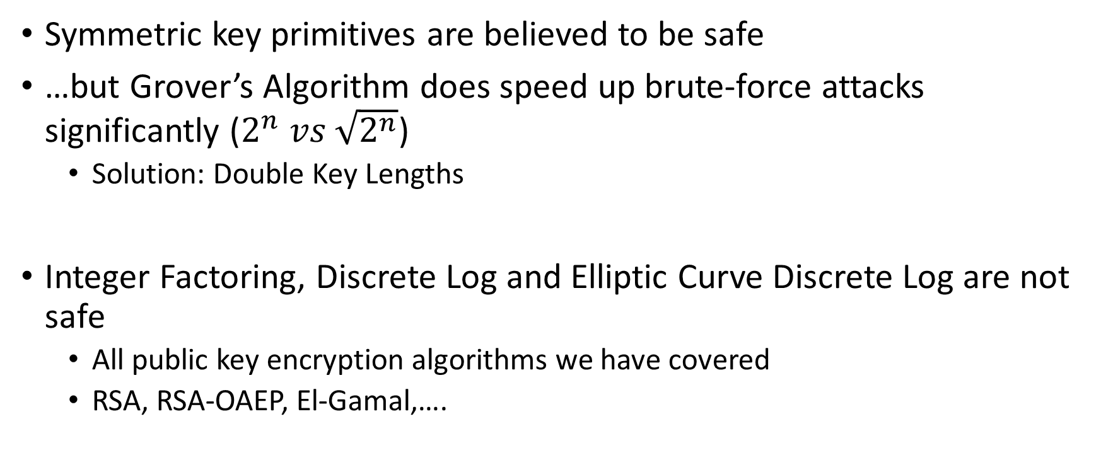
Quantum Resistant Crypto
Symmetric key primitives are believed to be safe
…but Grover’s Algorithm does speed up brute-force attacks significantly ($2^{n} vs \sqrt{2^{n}}$)
  Solution: Double Key Lengths
Integer Factoring, Discrete Log and Elliptic Curve Discrete Log are not safe
  All public key encryption algorithms we have covered
  RSA, RSA-OAEP, El-Gamal,….
https://en.wikipedia.org/wiki/Lattice-based_cryptography

Slide 16
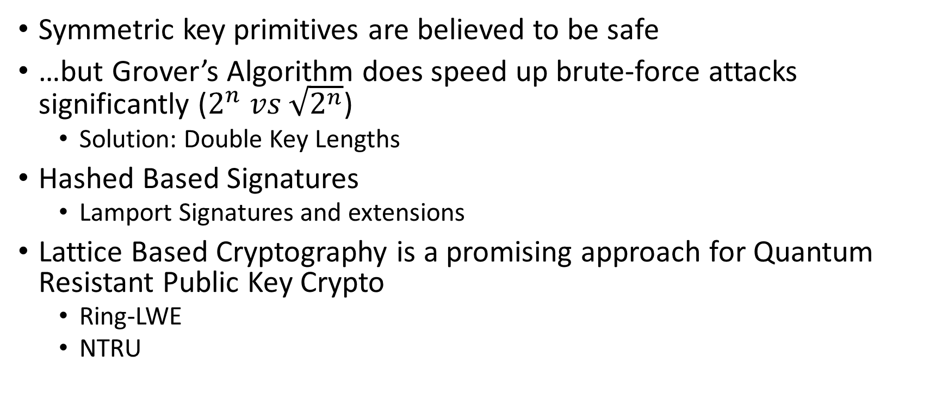
Post Quantum Cryptography
Symmetric key primitives are believed to be safe
…but Grover’s Algorithm does speed up brute-force attacks significantly ($2^{n} vs \sqrt{2^{n}}$)
  Solution: Double Key Lengths
Hashed Based Signatures
  Lamport Signatures and extensions
Lattice Based Cryptography is a promising approach for Quantum Resistant Public Key Crypto
  Ring-LWE
  NTRU
https://security.googleblog.com/2016/07/experimenting-with-post-quantum.html

Slide 17
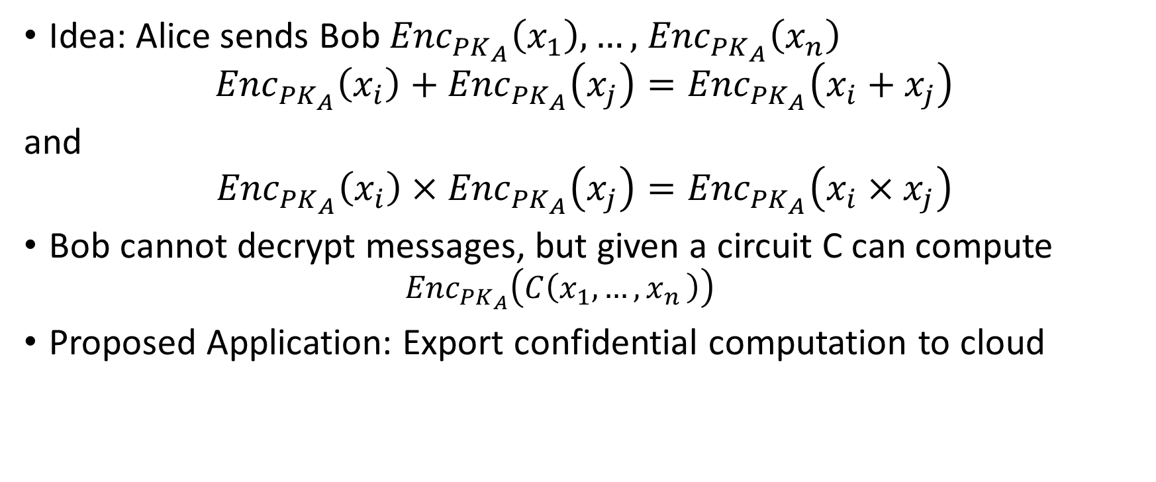
Fully Homomorphic Encryption (FHE)
Idea: Alice sends Bob ${Enc}_{{PK}_{A}}\left(x_{1}\right),…,$ ${Enc}_{{PK}_{A}}\left(x_{n}\right)$
$${Enc}_{{PK}_{A}}\left(x_{i}\right)+{Enc}_{{PK}_{A}}\left(x_{j}\right)={Enc}_{{PK}_{A}}\left(x_{i}+x_{j}\right)$$
and
$${Enc}_{{PK}_{A}}\left(x_{i}\right)×{Enc}_{{PK}_{A}}\left(x_{j}\right)={Enc}_{{PK}_{A}}\left(x_{i}×x_{j}\right)$$
Bob cannot decrypt messages, but given a circuit C can compute
  $${Enc}_{{PK}_{A}}\left(C\left(x_{1},…{,x}_{n}\right)\right)$$
Proposed Application: Export confidential computation to cloud
https://simons.berkeley.edu/talks/shai-halevi-2015-05-18a (Lecture by Shai Halevi)

Slide 18
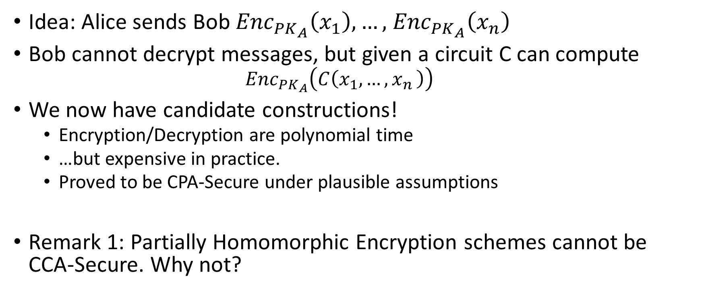
Fully Homomorphic Encryption (FHE)
Idea: Alice sends Bob ${Enc}_{{PK}_{A}}\left(x_{1}\right),…,$ ${Enc}_{{PK}_{A}}\left(x_{n}\right)$
Bob cannot decrypt messages, but given a circuit C can compute
  $${Enc}_{{PK}_{A}}\left(C\left(x_{1},…{,x}_{n}\right)\right)$$
We now have candidate constructions!
  Encryption/Decryption are polynomial time
  …but expensive in practice.
  Proved to be CPA-Secure under plausible assumptions
Remark 1: Partially Homomorphic Encryption schemes cannot be CCA-Secure. Why not?
https://simons.berkeley.edu/talks/shai-halevi-2015-05-18a (Lecture by Shai Halevi)

Slide 19
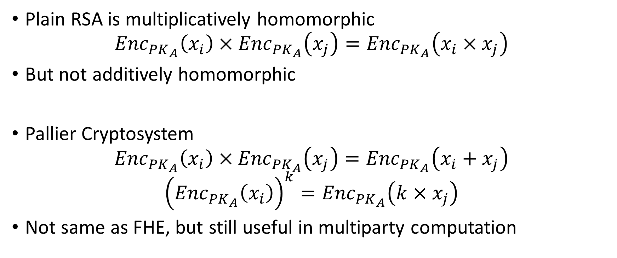
Partially Homomorphic Encryption
Plain RSA is multiplicatively homomorphic
$${Enc}_{{PK}_{A}}\left(x_{i}\right)×{Enc}_{{PK}_{A}}\left(x_{j}\right)={Enc}_{{PK}_{A}}\left(x_{i}×x_{j}\right)$$
But not additively homomorphic
Pallier Cryptosystem
$${Enc}_{{PK}_{A}}\left(x_{i}\right)×{Enc}_{{PK}_{A}}\left(x_{j}\right)={Enc}_{{PK}_{A}}\left(x_{i}+x_{j}\right)$$
$${\left({Enc}_{{PK}_{A}}\left(x_{i}\right)\right)}^{k}={Enc}_{{PK}_{A}}\left(k×x_{j}\right)$$
Not same as FHE, but still useful in multiparty computation
https://en.wikipedia.org/wiki/Paillier_cryptosystem

Slide 20

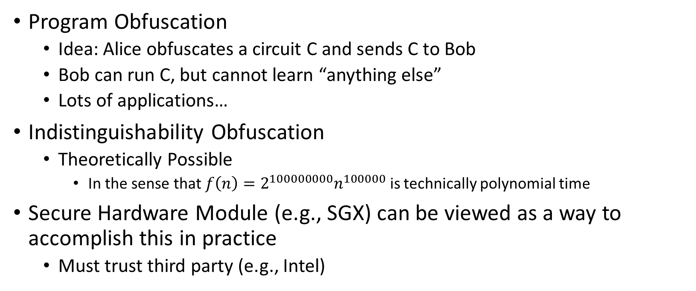
Program Obfuscation (Theoretical Cryptography)
Program Obfuscation
  Idea: Alice obfuscates a circuit C and sends C to Bob
  Bob can run C, but cannot learn “anything else”
  Lots of applications…
Indistinguishability Obfuscation
  Theoretically Possible
    In the sense that $f\left(n\right)=2^{100000000}n^{100000}$ is technically polynomial time
Secure Hardware Module (e.g., SGX) can be viewed as a way to accomplish this in practice
  Must trust third party (e.g., Intel)
https://simons.berkeley.edu/talks/amit-sahai-2015-05-19a (Lecture by Amit Sahai)

Slide 21
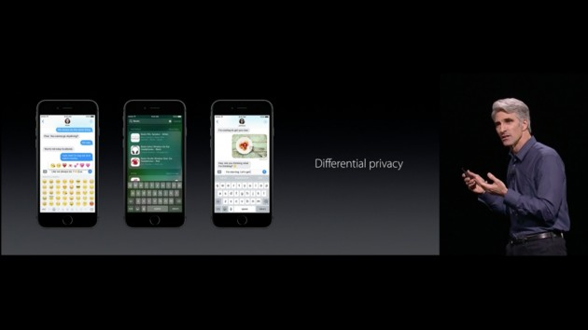



Differential Privacy

Slide 22


Release Aggregate Statistics?
Question 1: How many people in this room have cancer?
Question 2: How many students in this room have cancer?
The difference (A1-A2) exposes my answer!

Slide 23
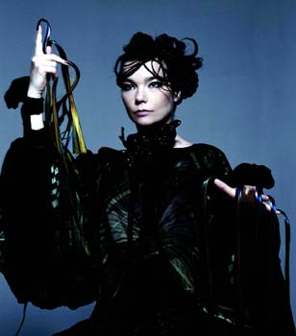
Differential Privacy: Definition
n people
Neighboring datasets:
  Replace x with x’
Name CS Prof? … STD?
Name CS Prof? … STD?
J Blocki +1 … -1
Bjork -1 … ???
[DMNS06, DKMMN06]
D
D’

Slide 24
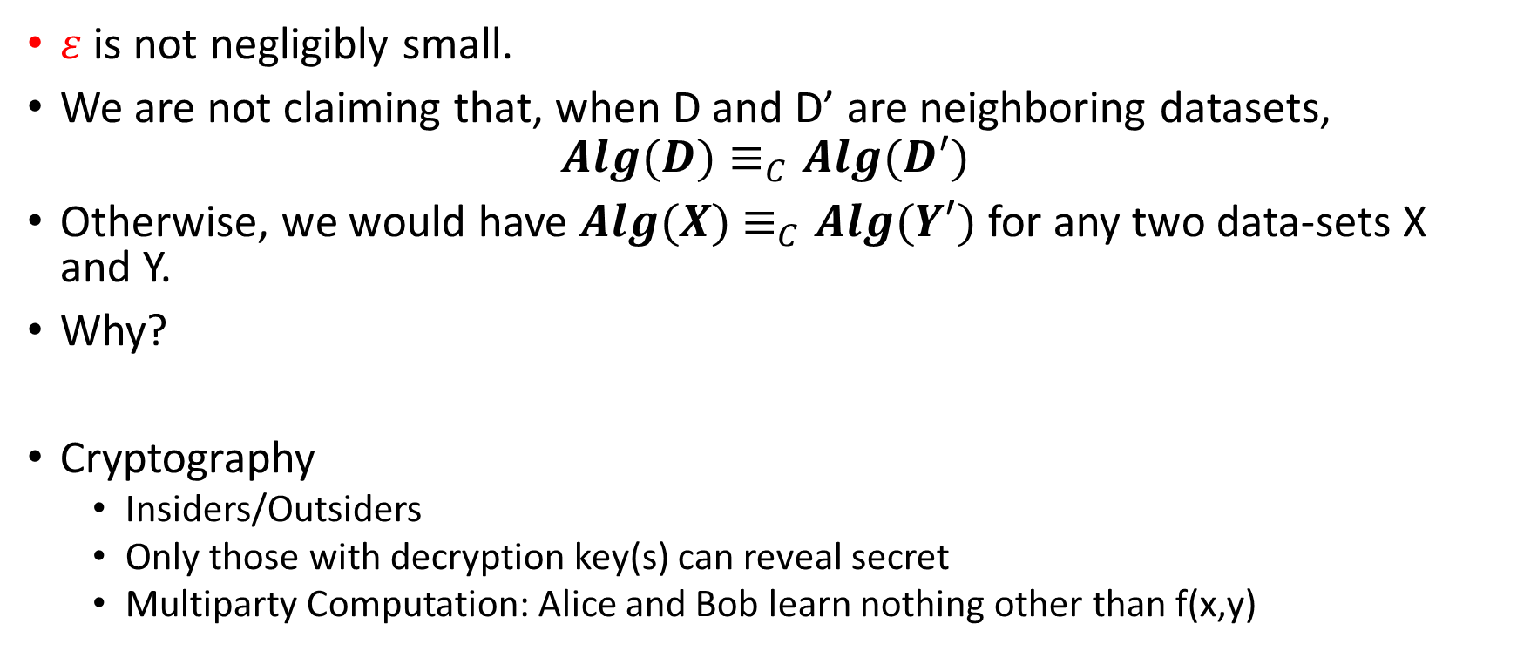
Differential Privacy vs Cryptography
$ε$ is not negligibly small.
We are not claiming that, when D and D’ are neighboring datasets,
$$Alg(D)≡_{C}Alg(D′)$$
Otherwise, we would have $Alg(X)$ $≡_{C}Alg(Y′)$ for any two data-sets X and Y.
Why?
Cryptography
  Insiders/Outsiders
  Only those with decryption key(s) can reveal secret
  Multiparty Computation: Alice and Bob learn nothing other than f(x,y)

Slide 25
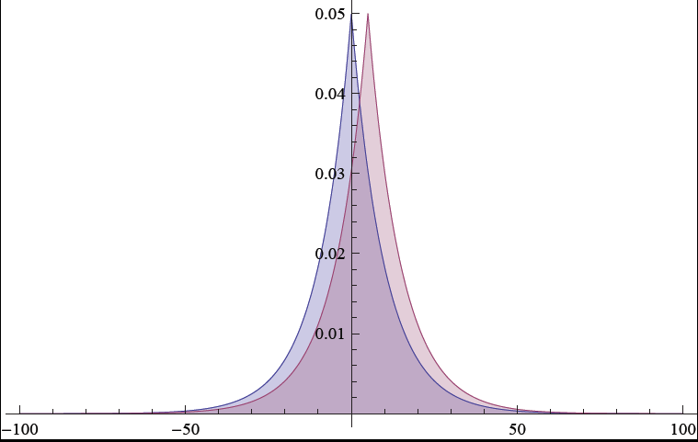
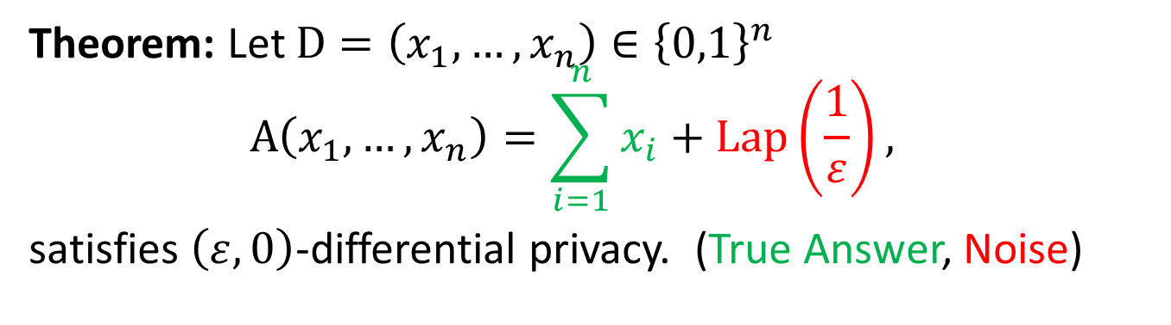
Traditional Differential Privacy Mechanism
Theorem: Let $D=\left(x_{1},…,x_{n}\right)∈{\left\{0,1\right\}}^{n}$
$$A\left(x_{1},…,x_{n}\right)=\sum_{i=1}^{n}{x_{i}}+\operatorname{Lap}\left(\frac{1}{ε}\right),$$
satisfies $\left(ε,0\right)$-differential privacy. (True Answer, Noise)

Slide 26
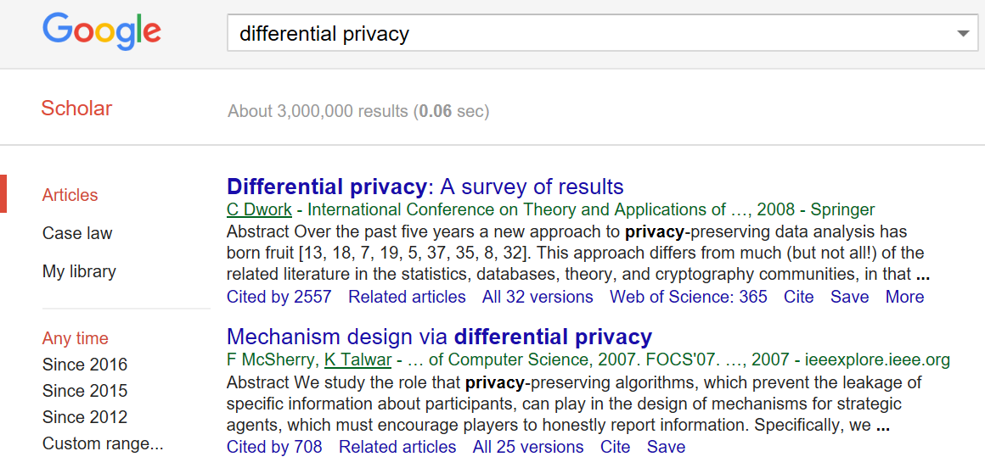
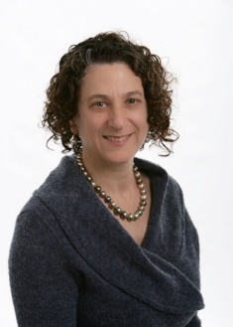


Slide 27

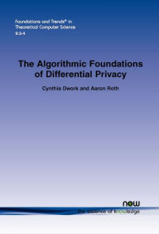

Resources
$99
Free PDF: https://www.cis.upenn.edu/~aaroth/Papers/privacybook.pdf

Slide 28





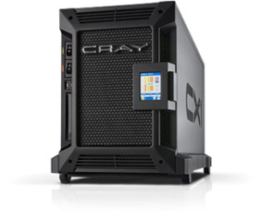

Password Storage and Key Derivation Functions
jblocki, 123456
Username
jblocki
Salt
89d978034a3f6
Hash
85e23cfe0021f584e3db87aa72630a9a2345c062
SHA1(12345689d978034a3f6)=85e23cfe0021f584e3db87aa72630a9a2345c062
+
Notes:
As a motivating example consider an adversary who breaks into an authentication server and steals a users crptographic hash value. The adversary can execute an offline attack against the password by comparing the hash value with the hashes of likely password guesses. The adversary is limited only by the resources that he is willing to invest cracking the passwords.

Slide 29













Offline Attacks: A Common Problem
Password breaches at major companies have affected millions billions of user accounts.
Notes:
Unfortunately, offline dictionary attacks are quite common. Password breaches at major companies have affected millions of users.

Slide 30
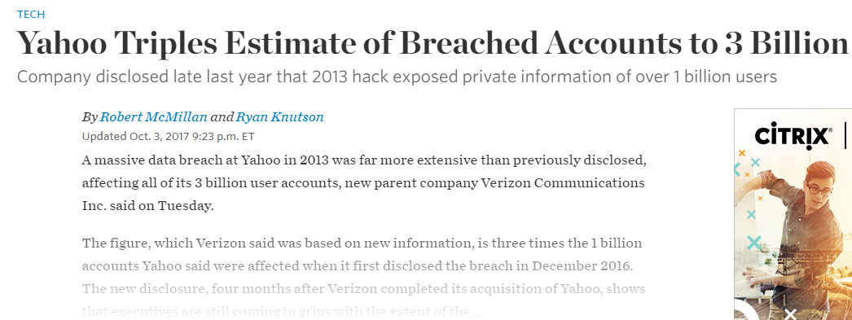
Offline Attacks: A Common Problem
Password breaches at major companies have affected millions billions of user accounts.
Notes:
Unfortunately, offline dictionary attacks are quite common. Password breaches at major companies have affected millions of users.

Slide 31
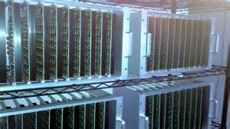



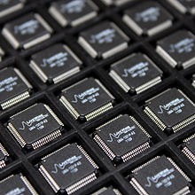
Goal: Moderately Expensive Hash Function
Fast on PC and
Expensive on ASIC?
Notes:
This motivates the need for moderately hard functions. The basic idea is to build a password hash function that is moderately expensive to compute to limit the number of guesses that an adversary would be willing to try. An honest server only needs to compute the function once during a typical authentication session. However, the adversary potentially has an advantage in this game. While the honest server must typically evaluate the function on standard hardware, the adversary could use potentially reduce the cost per password guess by developing customized hardware (GPUs, FPGAs, ASICs) to evaluate the password hash function. Thus, we want to ensure that the cost to evaluate this function is equitable across platforms.

Slide 32
Attempt 1: Hash Iteration
BCRYPT
PBKDF2
100,000 SHA256 computations
(iterative)
Estimated Cost on ASIC: $1 per billion password guesses [BS14]

Slide 33
The Challenge
Cost SHA256
USD $
Standard Patience Units
User Patience
Time
Disclaimer: This slide is entirely for humorous effect.

Slide 34
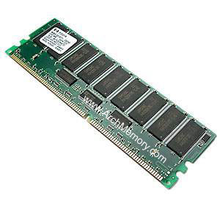



Memory Hard Function (MHF)
Intuition: computation costs dominated by memory costs
vs.
Data Independent Memory Hard Function (iMHF)
  Memory access pattern should not depend on input
Notes:
In this work we study a special type of memory hard function called data-independent memory hard functions. As the name suggests the memory access pattern will not depend on the input making the functions resistant to side-channel attacks.

Slide 35

(2013-2015)
https://password-hashing.net/

Slide 36

We recommend that you use Argon2…
(2013-2015)
https://password-hashing.net/

Slide 37
We recommend that you use Argon2…
There are two main versions of Argon2, Argon2i and Argon2d. Argon2i is the safest against side-channel attacks
(2013-2015)
https://password-hashing.net/

Slide 38

Depth-Robustness: The Key Property
Necessary [AB16] and sufficient [ABP16] for secure iMHFs

Slide 39

Question
Are existing iMHF candidates based on depth-robust DAGs?

Slide 40
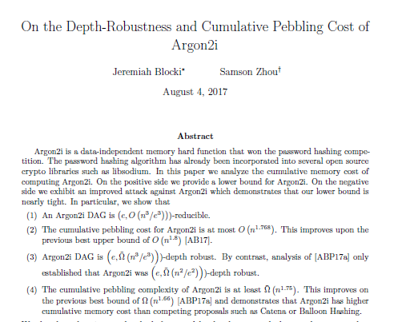
Answer: No

Slide 41

Can we build a secure iMHF?
Github: https://github.com/Practical-Graphs/Argon2-Practical-Graph

