Slide 1
Course Business
Homework 5 Due Thursday in Class
Practice Final Released Next Week
Homework 4 Statistics
Minimum Value | 26.00
Maximum Value | 110.00
Range | 84.00
Average | 86.16
Median | 90.00
Standard Deviation | 19.18

Slide 2
Cryptography
CS 555
Week 15:
Oblivious Transfer
Yao’s Garbled Circuits
Zero-Knowledge Proofs
Readings: Katz and Lindell Chapter 10 & Chapter 11.1-11.2, 11.4
Fall 2017

Slide 3


Oblivious Transfer (OT)
1 out of 2 OT
  Alice has two messages m₀ and m₁
  At the end of the protocol
    Bob gets exactly one of m₀ and m₁
    Alice does not know which one
Oblivious Transfer with a Trusted Third Party
m₀
b
1 out of 2 OT
m₁
m_{b}

Slide 4




Bellare-Micali 1-out-of-2-OT protocol
Oblivious Transfer without a Trusted Third Party
    g is a generator for a prime order group G_{q} in which CDH problem is hard
m₀
c
b
m₁
$$z0,z1$$
  $$C_{0}=\left[g^{r_{0}},H\left(z_{0}^{r_{0}}\right)⊕m_{0}\right]$$
  $$C_{1}=\left[g^{r_{1}},H\left(z_{1}^{r_{1}}\right)⊕m_{1}\right]$$
c ←_{R} G_{q}
k ←_{R} Z_{q}
$z_{b}=g^{k},$ $z_{1−b}=cg^{−k}$
Bob can decrypt C_{b}
$$z_{b}^{r_{b}}=g^{kr_{b}}$$

Slide 5

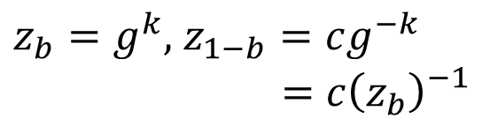
Bellare-Micali 1-out-of-2-OT protocol
Oblivious Transfer without a Trusted Third Party
    g is a generator for a prime order group G_{q} in which CDH is Hard
m₀
c
b
m₁
$$z0,z1$$
  $$C_{0}=\left[g^{r_{0}},H\left(z_{0}^{r_{0}}\right)⊕m_{0}\right]$$
  $$C_{1}=\left[g^{r_{1}},H\left(z_{1}^{r_{1}}\right)⊕m_{1}\right]$$
c ←_{R} G_{q}
k ←_{R} Z_{q}
Alice must check that
$$z_{1}=c{\left(z_{0}\right)}_{}^{−1}$$
$z_{b}=g^{k},$ $z_{1−b}=cg^{−k}$
$$=c{\left(z_{b}\right)}_{}^{−1}$$
Bob can decrypt C_{b}
$$z_{b}^{r_{b}}=g^{kr_{b}}$$

Slide 6

Bellare-Micali 1-out-of-2-OT protocol
Alice does not learn b because
$z_{1}=c{\left(z_{0}\right)}_{}^{−1}$ and
$z_{0}=c{\left(z_{1}\right)}_{}^{−1}$ and
$z_{1}$, $z_{0}$ are distributed uniformly at random subject to these condition.
This is an information theoretic guarantee!
Oblivious Transfer without a Trusted Third Party
    g is a generator for a prime order group G_{q} in which Discrete Log Problem is Hard
m₀
c
b
m₁
$$z0,z1$$
  $$C_{0}=\left[g^{r_{0}},H\left(z_{0}^{r_{0}}\right)⊕m_{0}\right]$$
  $$C_{1}=\left[g^{r_{1}},H\left(z_{1}^{r_{1}}\right)⊕m_{1}\right]$$
c ←_{R} G_{q}
k ←_{R} Z_{q}
Alice must check that
$$z_{1}=c{\left(z_{0}\right)}_{}^{−1}$$
$z_{b}=g^{k},$ $z_{1−b}=cg^{−k}$
$$=c{\left(z_{b}\right)}_{}^{−1}$$
Bob can decrypt C_{b}
$$z_{b}^{r_{b}}=g^{kr_{b}}$$

Slide 7

Bellare-Micali 1-out-of-2-OT protocol
Bob cannot decrypt C_{1-b}
Unless he queries random oracle at
$c^{r_{1−b}}g^{−kr_{1−b}}$
Given this value we can obtain $c^{r_{1−b}}$
Thus, we can break CDH assumption
given random ${c=g}^{m}$ and $g^{r_{1−b}}$ it is hard to find${ c}^{r_{1−b}}=g^{{mr}_{1−b}}$
Oblivious Transfer without a Trusted Third Party
    g is a generator for a prime order group G_{q} in which Discrete Log Problem is Hard
m₀
c
b
m₁
$$z0,z1$$
  $$C_{0}=\left[g^{r_{0}},H\left(z_{0}^{r_{0}}\right)⊕m_{0}\right]$$
  $$C_{1}=\left[g^{r_{1}},H\left(z_{1}^{r_{1}}\right)⊕m_{1}\right]$$
c ←_{R} G_{q}
k ←_{R} Z_{q}
Alice must check that
$$z_{1}=c{\left(z_{0}\right)}_{}^{−1}$$
$z_{b}=g^{k},$ $z_{1−b}=cg^{−k}$
$$=c{\left(z_{b}\right)}_{}^{−1}$$
Bob can decrypt C_{b}
$$z_{b}^{r_{b}}=g^{kr_{b}}$$

Slide 8
Yao’s Protocol
CS 380S
Vitaly Shmatikov

Slide 9
Yao’s Protocol
Compute any function securely
  … in the semi-honest model
First, convert the function into a boolean circuit
AND
AND
NOT
Alice’s inputs
Bob’s inputs
AND
OR
OR
z
z
x
y
z
x
y
z
AND
0
0
0
OR
0
0
0
Truth table:
0
1
0
Truth table:
0
1
1
x
y
1
0
0
x
y
1
0
1
1
1
1
1
1
1

Slide 10
AND
AND
NOT
Alice’s inputs
Bob’s inputs
AND
OR
OR
Overview:
Alice prepares “garbled” version C’ of C
Sends “encrypted” form x’ of her input x
Allows Bob to obtain “encrypted” form y’ of his input y via OT
Bob can compute from C’,x’,y’ the “encryption” z’ of z=C(x,y)
Bob sends z’ to Alice and she decrypts and reveals to him z
Crucial properties:
Bob never sees Alice’s input x in unencrypted form.
Bob can obtain encryption of y without Alice learning y.
Neither party learns intermediate values.
Remains secure even if parties try to cheat.

Slide 11
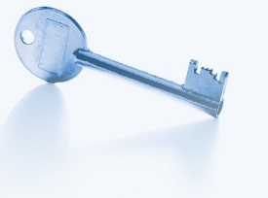

Intuition
c
AND
a
b

Slide 12

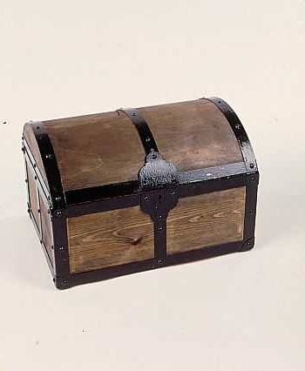



Intuition
a
b
a
b
c
a
b
AND
a
b
b
a
b
a

Slide 13
1: Pick Random Keys For Each Wire
Next, evaluate one gate securely
  Later, generalize to the entire circuit
Alice picks two random keys for each wire
  One key corresponds to “0”, the other to “1”
  6 keys in total for a gate with 2 input wires
k_{0z}, k_{1z}
z
AND
Alice
x
y
Bob
k_{0x}, k_{1x}
k_{0y}, k_{1y}

Slide 14
2: Encrypt Truth Table
Alice encrypts each row of the truth table by encrypting the output-wire key with the corresponding pair of input-wire keys
z
k_{0z}, k_{1z}
AND
Alice
x
y
Bob
k_{0x}, k_{1x}
k_{0y}, k_{1y}
E_{k0x}(E_{k0y}(k_{0z}))
x
y
z
E_{k0x}(E_{k1y}(k_{0z}))
0
0
0
Encrypted truth table:
Original truth table:
0
1
0
E_{k1x}(E_{k0y}(k_{0z}))
1
0
0
1
1
1
E_{k1x}(E_{k1y}(k_{1z}))

Slide 15
3: Send Garbled Truth Table
Alice randomly permutes (“garbles”) encrypted truth table and sends it to Bob
Does not know which row of garbled table corresponds to which row of original table
z
k_{0z}, k_{1z}
AND
Alice
x
y
Bob
k_{0x}, k_{1x}
k_{0y}, k_{1y}
E_{k1x}(E_{k0y}(k_{0z}))
E_{k0x}(E_{k0y}(k_{0z}))
E_{k0x}(E_{k1y}(k_{0z}))
E_{k0x}(E_{k1y}(k_{0z}))
Garbled truth table:
E_{k1x}(E_{k0y}(k_{0z}))
E_{k1x}(E_{k1y}(k_{1z}))
E_{k1x}(E_{k1y}(k_{1z}))
E_{k0x}(E_{k0y}(k_{0z}))

Slide 16
4: Send Keys For Alice’s Inputs
Alice sends the key corresponding to her input bit
  Keys are random, so Bob does not learn what this bit is
k_{0z}, k_{1z}
z
Learns K_{b’x} where b’ is Alice’s input bit, but not b’ (why?)
AND
Alice
x
y
Bob
k_{0x}, k_{1x}
If Alice’s bit is 1, she
simply sends k_{1x} to Bob;
if 0, she sends k_{0x}
k_{0y}, k_{1y}
E_{k1x}(E_{k0y}(k_{0z}))
Garbled truth table:
E_{k0x}(E_{k1y}(k_{0z}))
E_{k1x}(E_{k1y}(k_{1z}))
E_{k0x}(E_{k0y}(k_{0z}))

Slide 17
5: Use OT on Keys for Bob’s Input
Alice and Bob run oblivious transfer protocol
  Alice’s input is the two keys corresponding to Bob’s wire
  Bob’s input into OT is simply his 1-bit input on that wire
z
Knows K_{b’x} where b’ is Alice’s input bit and K_{by} where b is his own input bit
k_{0z}, k_{1z}
AND
Alice
x
y
Bob
k_{0x}, k_{1x}
Run oblivious transfer
Alice’s input: k_{0y}, k_{1y}
Bob’s input: his bit b
Bob learns k_{by}
What does Alice learn?
k_{0y}, k_{1y}
E_{k1x}(E_{k0y}(k_{0z}))
Garbled truth table:
E_{k0x}(E_{k1y}(k_{0z}))
E_{k1x}(E_{k1y}(k_{1z}))
E_{k0x}(E_{k0y}(k_{0z}))

Slide 18
6: Evaluate Garbled Gate
Using the two keys that he learned, Bob decrypts exactly one of the output-wire keys
  Bob does not learn if this key corresponds to 0 or 1
    Why is this important?
z
Knows K_{b’x} where b’ is Alice’s input bit and K_{by} where b is his own input bit
k_{0z}, k_{1z}
AND
Alice
x
y
Bob
k_{0x}, k_{1x}
Suppose b’=0, b=1
k_{0y}, k_{1y}
E_{k1x}(E_{k0y}(k_{0z}))
E_{k0x}(E_{k1y}(k_{0z}))
This is the only row
Bob can decrypt.
He learns K_{0z}
Garbled truth table:
E_{k1x}(E_{k1y}(k_{1z}))
E_{k0x}(E_{k0y}(k_{0z}))

Slide 19
7: Evaluate Entire Circuit
In this way, Bob evaluates entire garbled circuit
  For each wire in the circuit, Bob learns only one key
  It corresponds to 0 or 1 (Bob does not know which)
    Therefore, Bob does not learn intermediate values (why?)
Bob tells Alice the key for the final output wire and she tells him if it corresponds to 0 or 1
  Bob does not tell her intermediate wire keys (why?)
AND
AND
NOT
Alice’s inputs
Bob’s inputs
AND
OR
OR

Slide 20
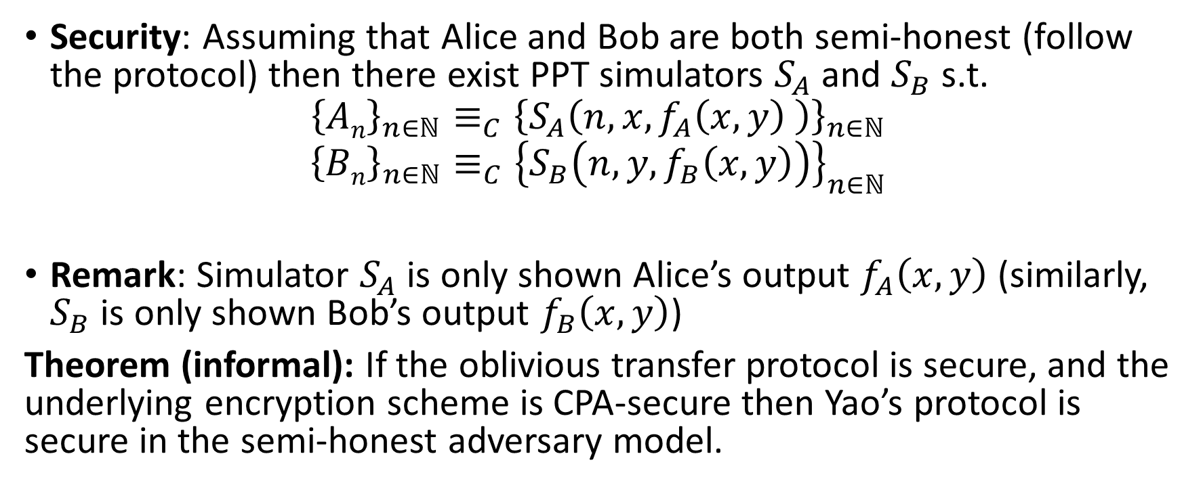
Security (Semi-Honest Model)
Security: Assuming that Alice and Bob are both semi-honest (follow the protocol) then there exist PPT simulators $S_{A}$ and $S_{B}$ s.t.
$${\left\{An\right\}}_{n∈ℕ}≡_{C}{\left\{S_{A}\left(n,x,f_{A}\left(x,y\right) \right)\right\}}_{n∈ℕ}$$
$${\left\{Bn\right\}}_{n∈ℕ}≡_{C}{\left\{S_{B}\left(n,y,f_{B}\left(x,y\right)\right)\right\}}_{n∈ℕ}$$
Remark: Simulator $S_{A}$ is only shown Alice’s output $f_{A}\left(x,y\right)$ (similarly, $S_{B}$ is only shown Bob’s output $f_{B}\left(x,y\right)$)
Theorem (informal): If the oblivious transfer protocol is secure, and the underlying encryption scheme is CPA-secure then Yao’s protocol is secure in the semi-honest adversary model.

Slide 21
Brief Discussion of Yao’s Protocol
Function must be converted into a circuit
  For many functions, circuit will be huge
If m gates in the circuit and n inputs from Bob, then need 4m encryptions and n oblivious transfers
  Oblivious transfers for all inputs can be done in parallel
Yao’s construction gives a constant-round protocol for secure computation of any function in the semi-honest model
  Number of rounds does not depend on the number of inputs or the size of the circuit!

Slide 22
Fully Malicious Security?
Alice could initially garble the wrong circuit C(x,y)=y.
Given output of C(x,y) Alice can still send Bob the output f(x,y).
Can Bob detect/prevent this?
Fix: Assume Alice and Bob have both committed to their input: c_{A}=com(xlr_{A}) and c_{B}=com(ylr_{B}).
  Alice and Bob can use zero-knowledge proofs to convince other party that they are behaving honestly.
  Example: After sending a message A Alice proves that the message she just sent is the same message an honest party would have sent with input x s.t. c_{A}=com(xlr_{A})
  Here we assume that Alice and Bob have both committed to correct inputs (Bob might use y which does not represent his real vote etc… but this is not a problem we can address with cryptography)

Slide 23
Fully Malicious Security
Assume Alice and Bob have both committed to their input: c_{A}=com(xlr_{A}) and c_{B}=com(ylr_{B}).
  Here we assume that Alice and Bob have both committed to correct inputs (Bob might use y which does not represent his real vote etc… but this is not a problem we can address with cryptography)
  Alice has c_{B} and can unlock c_{A}
  Bob has c_{A} and can unlock c_{B}
Alice sets C_{f} = GarbleCircuit(f,r).
  Alice sends to Bob.
  Alice convinces Bob that C_{f} = GarbleCircuit(f,r) for some r (using a zero-knowledge proof)
For each original oblivious transfer if Alice’s inputs were originally x₀,x₁
  Alice and Bob run OT with y₀,y₁ where y_{i}=Enc_{K}(x_{i})
  Bob uses a zero-knowledge proof to convince Alice that he received the correct y_{i} (e.g. matching his previous commitment c_{B})
  Alice sends K to Bob who decrypts y_{i} to obtain x_{i}

Slide 24
CS 555:Week 15: Zero-Knowledge Proofs

Slide 25
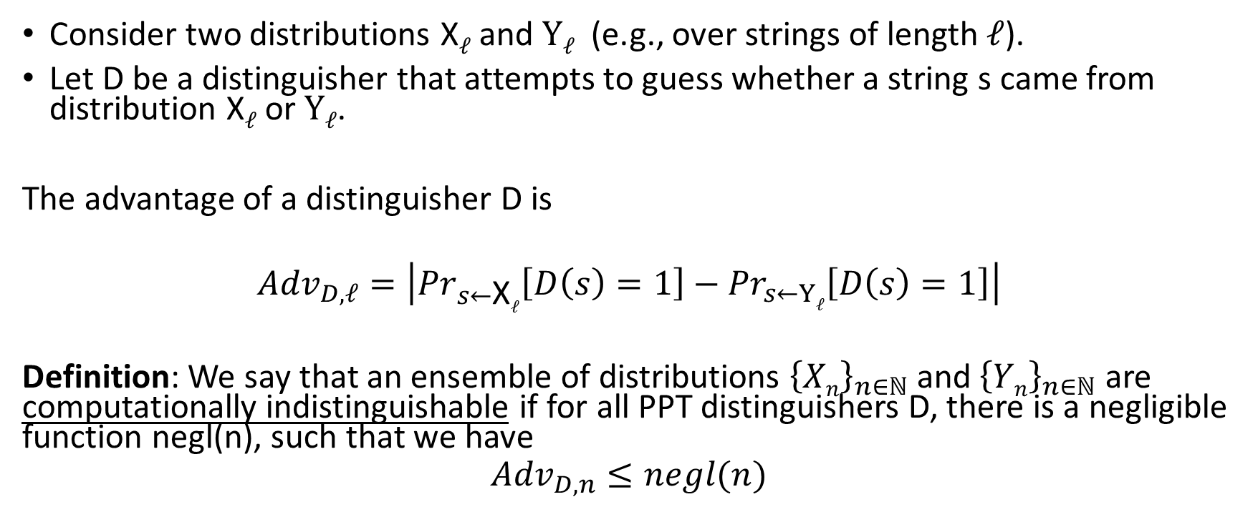
Computational Indistinguishability
Consider two distributions X$ℓ$ and $Yℓ$ (e.g., over strings of length $ℓ$).
Let D be a distinguisher that attempts to guess whether a string s came from distribution X$ℓ$ or $Yℓ$.
The advantage of a distinguisher D is
$${Adv}_{D,ℓ}=\left|{Pr}_{s←\text{X}ℓ}\left[D\left(s\right)=1\right]−{Pr}_{s←Yℓ}\left[D\left(s\right)=1\right]\right|$$
Definition: We say that an ensemble of distributions ${\left\{Xn\right\}}_{n∈ℕ}$ and ${\left\{Yn\right\}}_{n∈ℕ}$ are computationally indistinguishable if for all PPT distinguishers D, there is a negligible function negl(n), such that we have
$${Adv}_{D,n}≤negl(n)$$

Slide 26

Computational Indistinguishability
Notation: ${\left\{Xn\right\}}_{n∈ℕ}≡_{C}$ ${\left\{Yn\right\}}_{n∈ℕ}$ means that the ensembles are computationally indistinguishable.
Consider two distributions X$ℓ$ and $Yℓ$ (e.g., over strings of length $ℓ$).
Let D be a distinguisher that attempts to guess whether a string s came from distribution X$ℓ$ or $Yℓ$.
The advantage of a distinguisher D is
$${Adv}_{D,ℓ}=\left|{Pr}_{s←\text{X}ℓ}\left[D\left(s\right)=1\right]−{Pr}_{s←Yℓ}\left[D\left(s\right)=1\right]\right|$$
Definition: We say that an ensemble of distributions ${\left\{Xn\right\}}_{n∈ℕ}$ and ${\left\{Yn\right\}}_{n∈ℕ}$ are computationally indistinguishable if for all PPT distinguishers D, there is a negligible function negl(n), such that we have
$${Adv}_{D,n}≤negl(n)$$

Slide 27
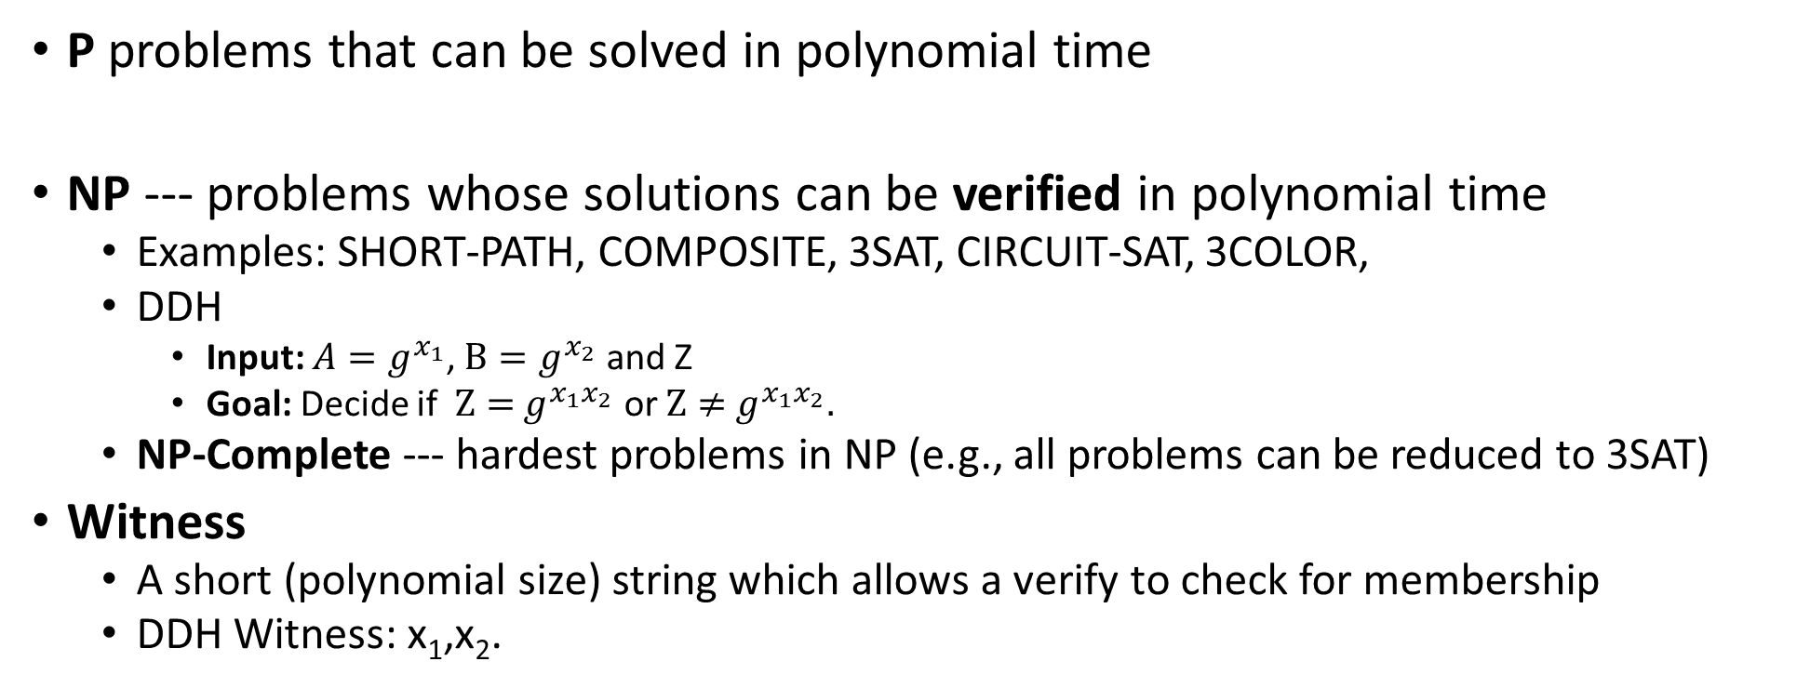
P vs NP
P problems that can be solved in polynomial time
NP --- problems whose solutions can be verified in polynomial time
  Examples: SHORT-PATH, COMPOSITE, 3SAT, CIRCUIT-SAT, 3COLOR,
  DDH
    Input: ${A=g}^{x_{1}}$, $B=g^{x_{2}}$ and Z
    Goal: Decide if $Z={ g}^{x_{1}x_{2}}$ or $Z≠{ g}^{x_{1}x_{2}}.$
  NP-Complete --- hardest problems in NP (e.g., all problems can be reduced to 3SAT)
Witness
  A short (polynomial size) string which allows a verify to check for membership
  DDH Witness: x₁,x₂.

Slide 28
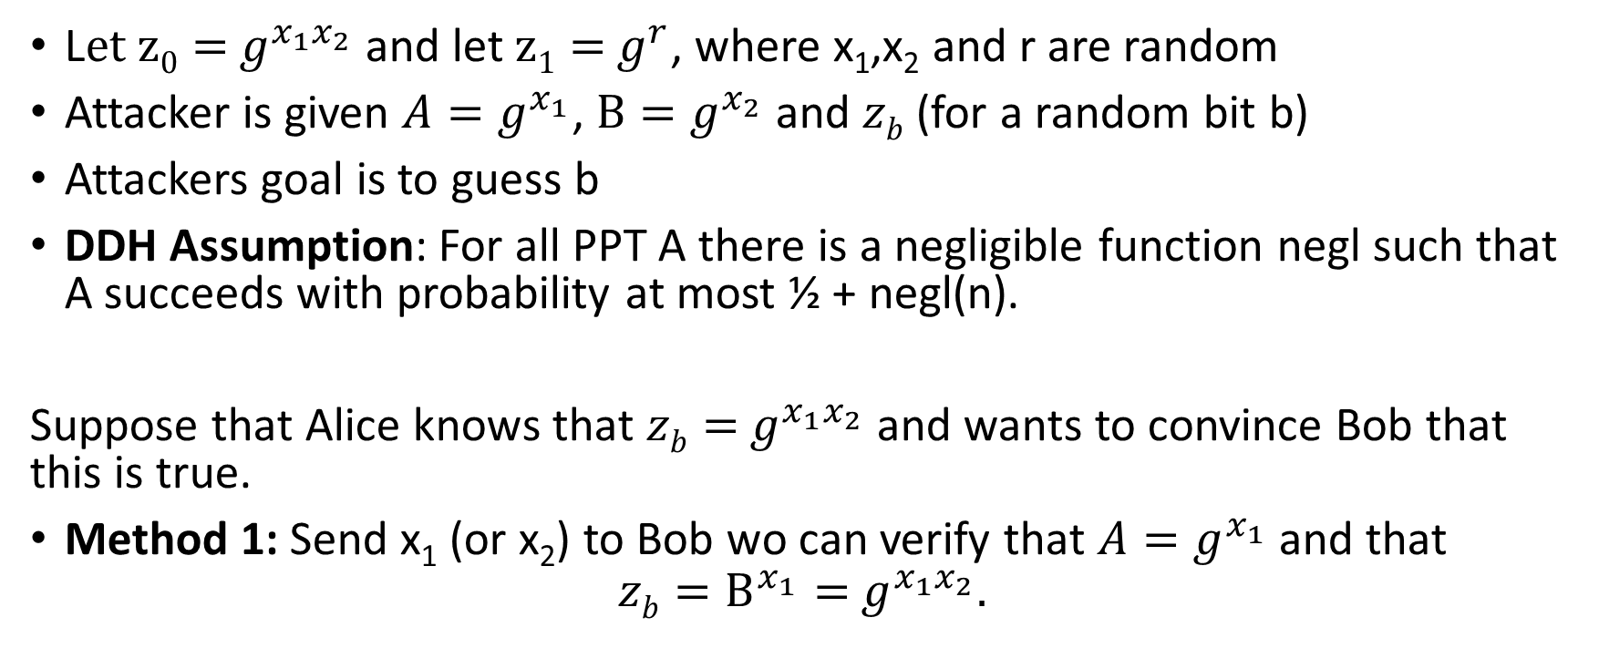
Decisional Diffie-Hellman Problem (DDH)
L$et z0={ g}^{x_{1}x_{2}}$ and let $z1={ g}^{r}$, where x₁,x₂ and r are random
Attacker is given ${A=g}^{x_{1}}$, $B=g^{x_{2}}$ and $zb$ (for a random bit b)
Attackers goal is to guess b
DDH Assumption: For all PPT A there is a negligible function negl such that A succeeds with probability at most ½ + negl(n).
Suppose that Alice knows that $zb={ g}^{x_{1}x_{2}}$ and wants to convince Bob that this is true.
Method 1: Send x₁ (or x₂) to Bob wo can verify that ${A=g}^{x_{1}}$ and that
$$zb=B^{x_{1}}={ g}^{x_{1}x_{2}}.$$

Slide 29
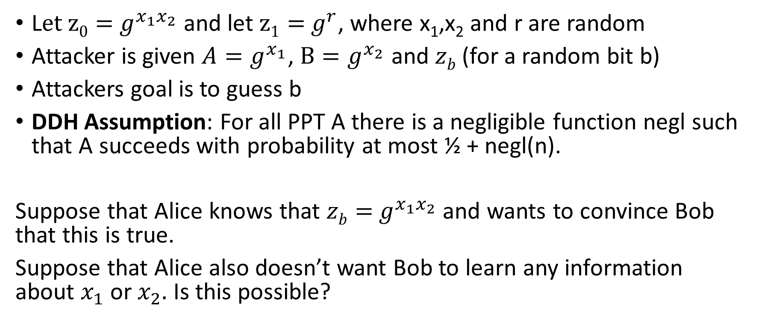
Decisional Diffie-Hellman Problem (DDH)
L$et z0={ g}^{x_{1}x_{2}}$ and let $z1={ g}^{r}$, where x₁,x₂ and r are random
Attacker is given ${A=g}^{x_{1}}$, $B=g^{x_{2}}$ and $zb$ (for a random bit b)
Attackers goal is to guess b
DDH Assumption: For all PPT A there is a negligible function negl such that A succeeds with probability at most ½ + negl(n).
Suppose that Alice knows that $zb={ g}^{x_{1}x_{2}}$ and wants to convince Bob that this is true.
Suppose that Alice also doesn’t want Bob to learn any information about $x_{1}$ or $x_{2}.$ Is this possible?

Slide 30
Zero-Knowledge Proof
Two parties: Prover P (PPT) and Verifier V (PPT)
(P is given witness for claim e.g., )
Completeness: If claim is true honest prover can always convince honest verifier to accept.
Soundness: If claim is false then Verifier should reject with probability at least ½. (Even if the prover tries to cheat)
Zero-Knowledge: Verifier doesn’t learn anything about prover’s input from the protocol (other than that the claim is true).
Formalizing this last statement is tricky
Zero-Knowledge: should hold even if the attacker is dishonest!

Slide 31
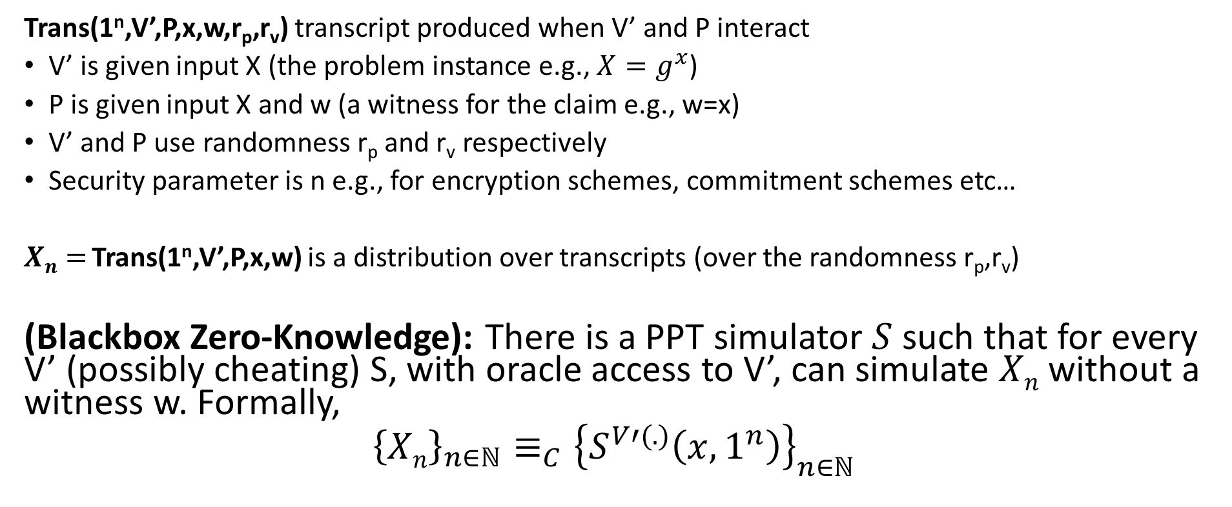
Zero-Knowledge Proof
Trans(1^{n},V’,P,x,w,r_{p},r_{v}) transcript produced when V’ and P interact
V’ is given input X (the problem instance e.g., ${X=g}^{x}$)
P is given input X and w (a witness for the claim e.g., w=x)
V’ and P use randomness r_{p} and r_{v} respectively
Security parameter is n e.g., for encryption schemes, commitment schemes etc…
$Xn=$Trans(1^{n},V’,P,x,w) is a distribution over transcripts (over the randomness r_{p},r_{v})
(Blackbox Zero-Knowledge): There is a PPT simulator $S$ such that for every V’ (possibly cheating) S, with oracle access to V’, can simulate $Xn$ without a witness w. Formally,
$${\left\{Xn\right\}}_{n∈ℕ}≡_{C}{\left\{S^{V′(.)}\left(x,1^{n}\right)\right\}}_{n∈ℕ}$$

Slide 32

Zero-Knowledge Proof
Trans(1^{n},V’,P,x,w,r_{p},r_{v}) transcript produced when V’ and P interact
V’ is given input x (the problem instance e.g., ${A=g}^{x_{1}}$, $B=g^{x_{2}}$ and $zb$ )
P is given input x and w (a witness for the claim e.g., x₁ and x₂)
V’ and P’ use randomness r_{p} and r_{w} respectively
Security parameter is n e.g., for encryption schemes, commitment schemes etc…
$Xn=$Trans(1^{n},V’,P’,x,w) is a distribution over transcripts (over the randomness r_{p},r_{w})
(Blackbox Zero-Knowledge): There is a PPT simulator $S$ such that for every V’ (possibly cheating) S, with oracle access to V’, can simulate $Xn$ without a witness w. Formally,
$${\left\{Xn\right\}}_{n∈ℕ}≡_{C}{\left\{S^{V′(.)}\left(x,1^{n}\right)\right\}}_{n∈ℕ}$$
Simulator S is not given witness w
Oracle V’(x,trans) will output the next message V’ would output given current transcript trans

Slide 33
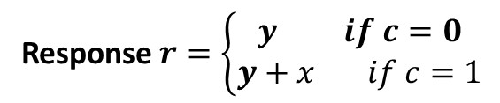

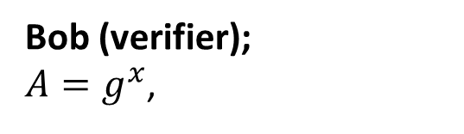
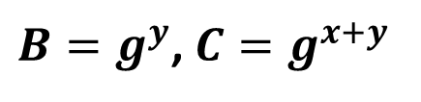
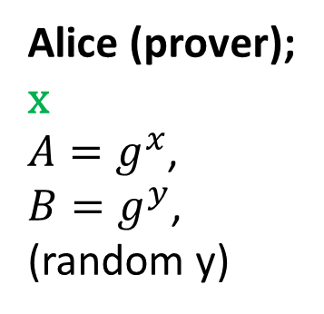
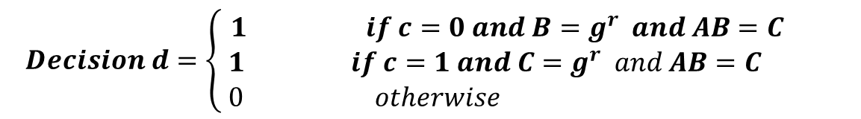
Zero-Knowledge Proof for Discrete Log Solution
$B=g^{y}$, $C=g^{x+y}$
$$challenge c∈\left\{0,1\right\}$$
Response $r=\left\{\begin{aligned}y if c=0 \\ y+x if c=1\end{aligned}\right.$
Bob (verifier);
${A=g}^{x}$,
Alice (prover);
x
${A=g}^{x}$,
${B=g}^{y}$,
(random y)
$$Decision d=\left\{ \begin{aligned}1 if c=0 and B=g^{r} and AB=C \\ 1 if c=1 and C=g^{r} and AB=C \\ 0 otherwise \end{aligned}\right.$$

Slide 34
Zero-Knowledge Proof for Discrete Log Solution
$B=g^{y}$, $C=g^{x+y}$
$$challenge c∈\left\{0,1\right\}$$
Response $r=\left\{\begin{aligned}y if c=0 \\ y+x if c=1\end{aligned}\right.$
Bob (verifier);
${A=g}^{x}$,
Alice (prover);
x
${A=g}^{x}$,
${B=g}^{y}$,
(random y)
$$Decision d=\left\{ \begin{aligned}1 if c=0 and B=g^{r} and AB=C \\ 1 if c=1 and C=g^{r} and AB=C \\ 0 otherwise \end{aligned}\right.$$
Correctness: If Alice and Bob are honest then Bob will always accept

Slide 35
Zero-Knowledge Proof for Discrete Log Solution
Case 1: Challenge (c=0)
$B=g^{y}$, $C=g^{x+y}$
$$challenge c∈\left\{0,1\right\}$$
Response $r=\left\{\begin{aligned}y if c=0 \\ y+x if c=1\end{aligned}\right.$
Bob (verifier);
${A=g}^{x}$,
Alice (prover);
x
${A=g}^{x}$,
${B=g}^{y}$,
(random y)
$$Decision d=\left\{ \begin{aligned}1 if c=0 and B=g^{r} and AB=C \\ 1 if c=1 and C=g^{r} and AB=C \\ 0 otherwise \end{aligned}\right.$$
Correctness: If Alice and Bob are honest then Bob will always accept

Slide 36
Zero-Knowledge Proof for Discrete Log Solution
Case 2: Challenge (c=1)
$B=g^{y}$, $C=g^{x+y}$
$$challenge c∈\left\{0,1\right\}$$
Response $r=\left\{\begin{aligned}y if c=0 \\ y+x if c=1\end{aligned}\right.$
Bob (verifier);
${A=g}^{x}$,
Alice (prover);
x
${A=g}^{x}$,
${B=g}^{y}$,
(random y)
$$Decision d=\left\{ \begin{aligned}1 if c=0 and B=g^{r} and AB=C \\ 1 if c=1 and C=g^{r} and AB=C \\ 0 otherwise \end{aligned}\right.$$
Correctness: If Alice and Bob are honest then Bob will always accept

Slide 37
Zero-Knowledge Proof for Discrete Log Solution
$B=g^{y}$, $C=g^{x+y}$
$$challenge c∈\left\{0,1\right\}$$
Response $r=\left\{\begin{aligned}y if c=0 \\ y+x if c=1\end{aligned}\right.$
Bob (verifier);
${A=g}^{x}$,
Alice (prover);
x
${A=g}^{x}$,
${B=g}^{y}$,
(random y)
$$Decision d=\left\{ \begin{aligned}1 if c=0 and B=g^{r} and AB=C \\ 1 if c=1 and C=g^{r} and AB=C \\ 0 otherwise \end{aligned}\right.$$
Soundness: If $A≠g^{x}$ for some x then (honest) Bob will reject w.p. ½ (even if
Alice cheats)

Slide 38
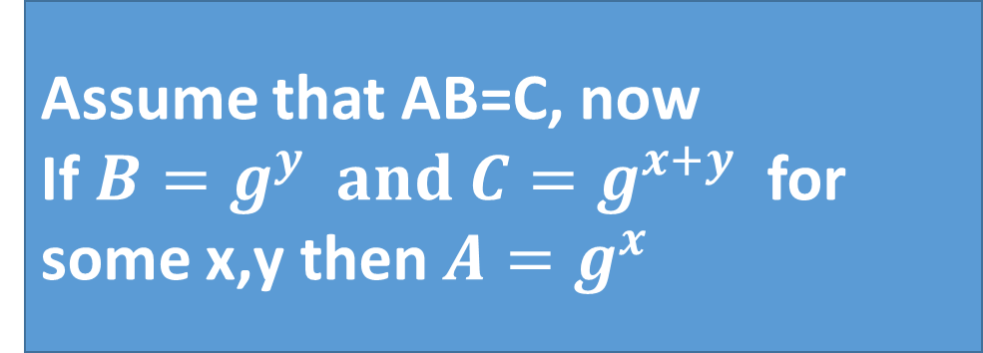
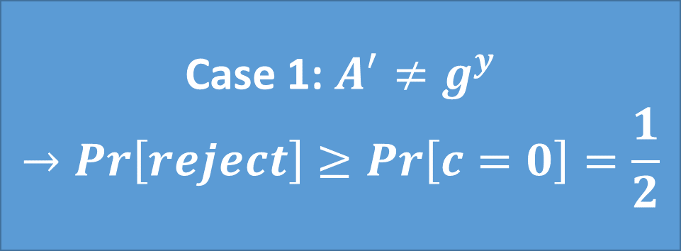
Zero-Knowledge Proof for Discrete Log Solution
Assume that AB=C, now
If $B=g^{y} and C=g^{x+y}$ for some x,y then $A=g^{x}$
$B=g^{y}$, $C=g^{x+y}$
$$challenge c∈\left\{0,1\right\}$$
Response $r=\left\{\begin{aligned}y if c=0 \\ y+x if c=1\end{aligned}\right.$
Bob (verifier);
${A=g}^{x}$,
Alice (prover);
x
${A=g}^{x}$,
${B=g}^{y}$,
(random y)
$$Decision d=\left\{ \begin{aligned}1 if c=0 and B=g^{r} and AB=C \\ 1 if c=1 and C=g^{r} and AB=C \\ 0 otherwise \end{aligned}\right.$$
Soundness: If $A≠g^{x}$ for some x then (honest) Bob will reject w.p. ½ (even if
Alice cheats)
Case 1: $A^{′}≠g^{y}$
$$→Pr\left[reject\right]≥Pr\left[c=0\right]=\frac{1}{2}$$

Slide 39


Zero-Knowledge Proof for Discrete Log Solution
Case 1: for all r $B≠g^{r}$
$$→Pr\left[reject\right]≥Pr\left[c=0\right]=\frac{1}{2}$$
Assume that AB=C, now
If $B=g^{y} and C=g^{x+y}$ for some x,y then $A=g^{x}$
$B=g^{y}$, $C=g^{x+y}$
$$challenge c∈\left\{0,1\right\}$$
Response $r=\left\{\begin{aligned}y if c=0 \\ y+x if c=1\end{aligned}\right.$
Bob (verifier);
${A=g}^{x}$,
Alice (prover);
x
${A=g}^{x}$,
${B=g}^{y}$,
(random y)
$$Decision d=\left\{ \begin{aligned}1 if c=0 and B=g^{r} and AB=C \\ 1 if c=1 and C=g^{r} and AB=C \\ 0 otherwise \end{aligned}\right.$$
Soundness: If $A≠g^{x}$ for some x then (honest) Bob will reject w.p. ½ (even if
Alice cheats)

Slide 40

Zero-Knowledge Proof for Discrete Log Solution
Case 2: for all r $C≠g^{r}$
$$→Pr\left[reject\right]≥Pr\left[c=0\right]=\frac{1}{2}$$
Assume that AB=C, now
If $B=g^{y} and C=g^{x+y}$ for some x,y then $A=g^{x}$
$B=g^{y}$, $C=g^{x+y}$
$$challenge c∈\left\{0,1\right\}$$
Response $r=\left\{\begin{aligned}y if c=0 \\ y+x if c=1\end{aligned}\right.$
Bob (verifier);
${A=g}^{x}$,
Alice (prover);
x
${A=g}^{x}$,
${B=g}^{y}$,
(random y)
$$Decision d=\left\{ \begin{aligned}1 if c=0 and B=g^{r} and AB=C \\ 1 if c=1 and C=g^{r} and AB=C \\ 0 otherwise \end{aligned}\right.$$
Soundness: If $A≠g^{x}$ for some x then (honest) Bob will reject w.p. ½ (even if
Alice cheats)

Slide 41


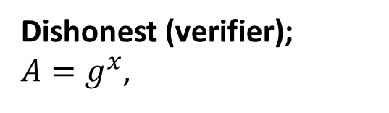

Zero-Knowledge Proof for Discrete Log Solution
$B=g^{y}$, $C=g^{x+y}$
$$challenge c=V′(A,\left(B,C\right))∈\left\{0,1\right\}$$
Response $r=\left\{\begin{aligned}y if c=0 \\ y+x if c=1\end{aligned}\right.$
Alice (honest);
x
${A=g}^{x}$,
${B=g}^{y}$,
(random y)
Dishonest (verifier);
${A=g}^{x}$,
$$Decision d=V′(A,\left(B,C\right),c,r)$$
Transcript: ${View}_{V′}=\left(A,\left(B,C\right),c,r,d\right)$

Slide 42

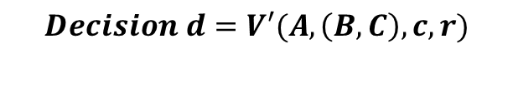
Zero-Knowledge Proof for Discrete Log Solution
$B=g^{y}$, $C=g^{x+y}$
$$challenge c=V′(A,\left(B,C\right))∈\left\{0,1\right\}$$
Response $r=\left\{\begin{aligned}y if c=0 \\ y+x if c=1\end{aligned}\right.$
Alice (honest);
x
${A=g}^{x}$,
${B=g}^{y}$,
(random y)
Dishonest (verifier);
${A=g}^{x}$,
$$Decision d=V′(A,\left(B,C\right),c,r)$$
Zero-Knowledge: For all PPT V’ exists PPT Sim s.t ${View}_{V′}≡_{C}{Sim}^{V′(.)}\left(A\right)$

Slide 43

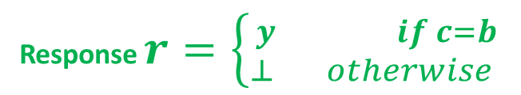
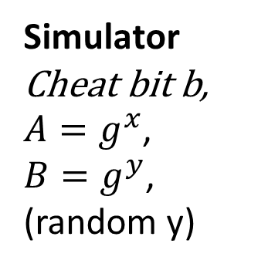
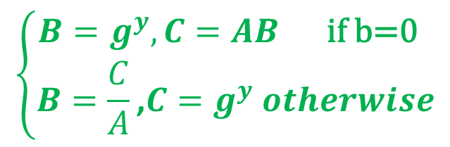
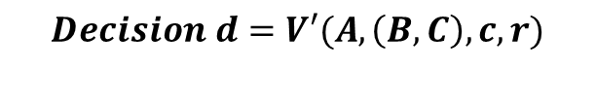
Zero-Knowledge Proof for Discrete Log Solution
$$\left\{\begin{aligned}B=g^{y},C=AB \text{if} \text{b}\text{=0} \\ B=\frac{C}{A}\text{,}C=g^{y} otherwise\end{aligned}\right.$$
$$challenge c=V′(A,\left(B,C\right))∈\left\{0,1\right\}$$
Response $r=\left\{{y if c=b \atop ⊥ otherwise }\right.$
Simulator
Cheat bit b,
${A=g}^{x}$,
${B=g}^{y}$,
(random y)
Dishonest (verifier);
${A=g}^{x}$,
$$Decision d=V′(A,\left(B,C\right),c,r)$$
Zero-Knowledge: For all PPT V’ exists PPT Sim s.t ${View}_{V′}≡_{C}{Sim}^{V′(.)}\left(A\right)$

Slide 44

Zero-Knowledge Proof for Discrete Log Solution
$$\left\{\begin{aligned}B=g^{y},C=AB \text{if} \text{b}\text{=0} \\ B=\frac{C}{A}\text{,}C=g^{y} otherwise\end{aligned}\right.$$
$$challenge c=V′(A,\left(B,C\right))∈\left\{0,1\right\}$$
Response $r=\left\{{y if c=b \atop ⊥ otherwise }\right.$
Simulator
Cheat bit b,
${A=g}^{x}$,
${B=g}^{y}$,
(random y)
Dishonest (verifier);
${A=g}^{x}$,
$$Decision d=V′(A,\left(B,C\right),c,r)$$
Zero-Knowledge: Simulator can produce identical transcripts (Repeat until $r≠⊥)$

Slide 45
Zero-Knowledge Proof for Discrete Log Solution
$$\left\{\begin{aligned}B=g^{y},C=AB \text{if} \text{b}\text{=0} \\ B=\frac{C}{A}\text{,}C=g^{y} otherwise\end{aligned}\right.$$
$$challenge c=V′(A,\left(B,C\right))∈\left\{0,1\right\}$$
Response $r=\left\{{y if c=b \atop ⊥ otherwise }\right.$
Simulator
Cheat bit b,
${A=g}^{x}$,
${B=g}^{y}$,
(random y)
Dishonest (verifier);
${A=g}^{x}$,
$$Decision d=V′(A,\left(B,C\right),c,r)$$
Zero-Knowledge: If ${A=g}^{x}$ for some x then ${View}_{V′}≡_{C}{Sim}^{V′(.)}\left(A\right)$

Slide 46
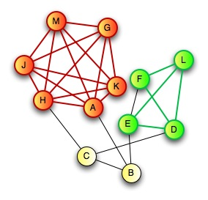
Zero-Knowledge Proof for all NP
CLIQUE
  Input: Graph G=(V,E) and integer k>0
  Question: Does G have a clique of size k?
CLIQUE is NP-Complete
  Any problem in NP reduces to CLIQUE
  A zero-knowledge proof for CLIQUE yields proof for all of NP via reduction
Prover:
  Knows k vertices v₁,…,v_{k} in G=(V,E) that form a clique

Slide 47

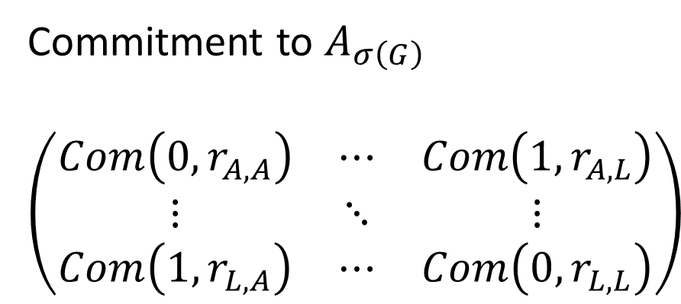
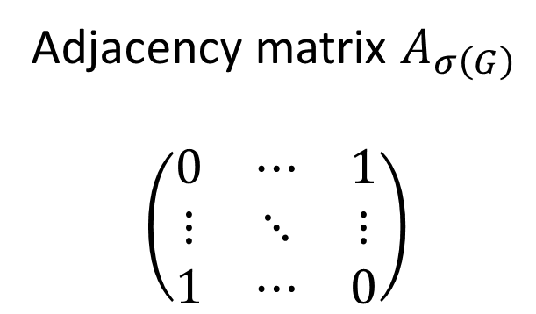
Zero-Knowledge Proof for all NP
C
D
$$σ\left(G\right)$$
E
H
G
A
F
B
J
I
L
K
Commitment to $A_{σ\left(G\right)}$
$$\left(\begin{matrix}Com\left(0,r_{A,A}\right) & ⋯ & Com\left(1,r_{A,L}\right) \\ ⋮ & ⋱ & ⋮ \\ Com\left(1,r_{L,A}\right) & ⋯ & Com\left(0,r_{L,L}\right)\end{matrix}\right)$$
Adjacency matrix $A_{σ\left(G\right)}$
$$\left(\begin{matrix}0 & ⋯ & 1 \\ ⋮ & ⋱ & ⋮ \\ 1 & ⋯ & 0\end{matrix}\right)$$
A
L
A
L
A
A
L
L

Slide 48
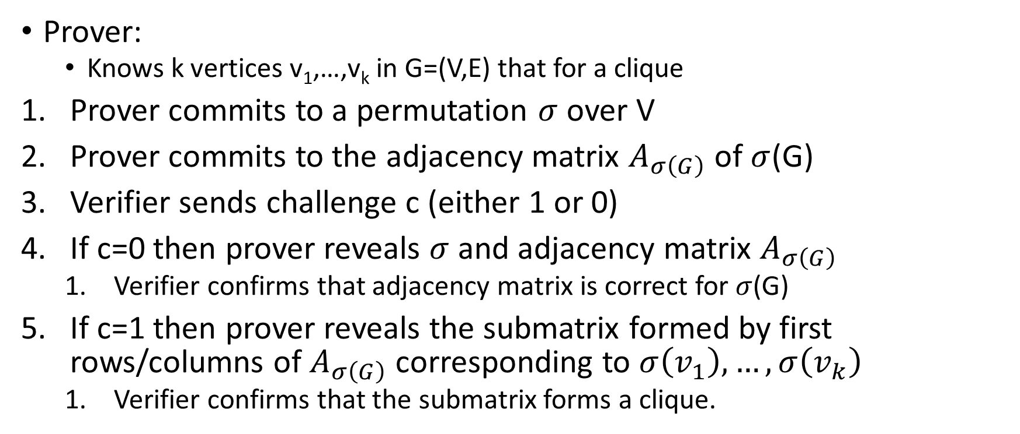
Zero-Knowledge Proof for all NP
C
D
E
H
G
A
F
B
J
Prover:
  Knows k vertices v₁,…,v_{k} in G=(V,E) that for a clique
Prover commits to a permutation $σ$ over V
Prover commits to the adjacency matrix $A_{σ\left(G\right)}$ of $σ$(G)
Verifier sends challenge c (either 1 or 0)
If c=0 then prover reveals $σ$ and adjacency matrix $A_{σ\left(G\right)}$
  Verifier confirms that adjacency matrix is correct for $σ$(G)
If c=1 then prover reveals the submatrix formed by first rows/columns of $A_{σ\left(G\right)}$ corresponding to $σ\left(v_{1}\right),…,σ\left(v_{k}\right)$
  Verifier confirms that the submatrix forms a clique.
I
L
K

Slide 49
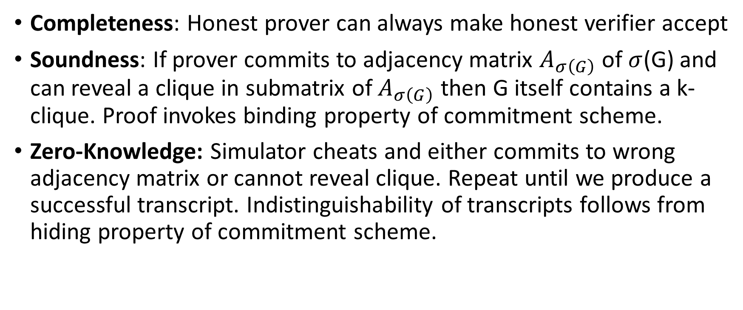
Zero-Knowledge Proof for all NP
Completeness: Honest prover can always make honest verifier accept
Soundness: If prover commits to adjacency matrix $A_{σ\left(G\right)}$ of $σ$(G) and can reveal a clique in submatrix of $A_{σ\left(G\right)}$ then G itself contains a k-clique. Proof invokes binding property of commitment scheme.
Zero-Knowledge: Simulator cheats and either commits to wrong adjacency matrix or cannot reveal clique. Repeat until we produce a successful transcript. Indistinguishability of transcripts follows from hiding property of commitment scheme.

Slide 50
Secure Multiparty Computation (Adversary Models)
Semi-Honest (“honest, but curious”)
  All parties follow protocol instructions, but…
  dishonest parties may be curious to violate privacy of others when possible
Fully Malicious Model
  Adversarial Parties may deviate from the protocol arbitrarily
    Quit unexpectedly
    Send different messages
  It is much harder to achieve security in the fully malicious model
Convert Secure Semi-Honest Protocol into Secure Protocol in Fully Malicious Mode?
  Tool: Zero-Knowledge Proofs
  Prove: My behavior in the protocol is consistent with honest party

