Slide 1
Course Business
Homework 5 Released
Bonus Problem (10 Points)
Homework 4 Statistics
Minimum Value | 26.00
Maximum Value | 110.00
Range | 84.00
Average | 86.16
Median | 90.00
Standard Deviation | 19.18

Slide 2
Cryptography
CS 555
Week 14:
Digital Signatures Continued
Multiparty Computation
Yao’s Garbled Circuits
Readings: Katz and Lindell Chapter 10 & Chapter 11.1-11.2, 11.4
Fall 2017

Slide 3
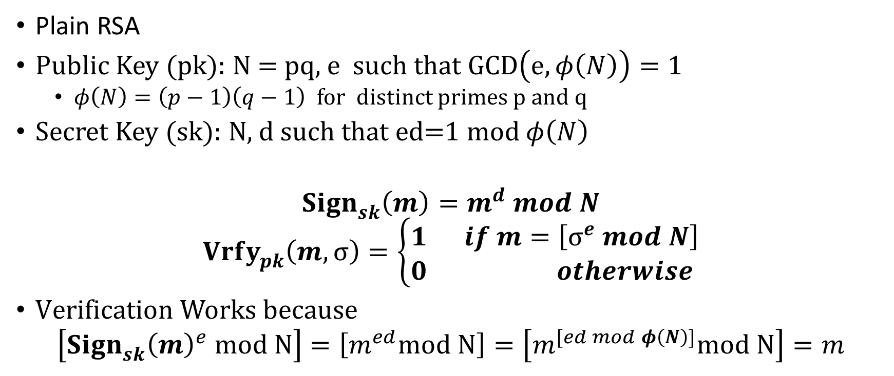
Plain RSA Signatures
Plain RSA
Public Key (pk): N = pq, e such that $GCD\left(e,φ\left(N\right)\right)=1$
  $φ\left(N\right)=\left(p−1\right)\left(q−1\right)$ for distinct primes p and q
Secret Key (sk): N, d such that ed=1 mod $φ\left(N\right)$
$${Sign}_{sk}^{}\left(m\right)=m^{d} mod N$$
$${Vrfy}_{pk}^{}\left(m,σ\right)=\left\{\begin{aligned}1 if m=\left[σ^{e} mod N\right] \\ 0 otherwise \end{aligned}\right.$$
$Verification Works because$
$$\left[{{Sign}_{sk}^{}\left(m\right)}^{e} mod N\right]=\left[m^{ed}mod N\right]=\left[m^{[ed mod φ\left(N\right)]}mod N\right]=m$$

Slide 4
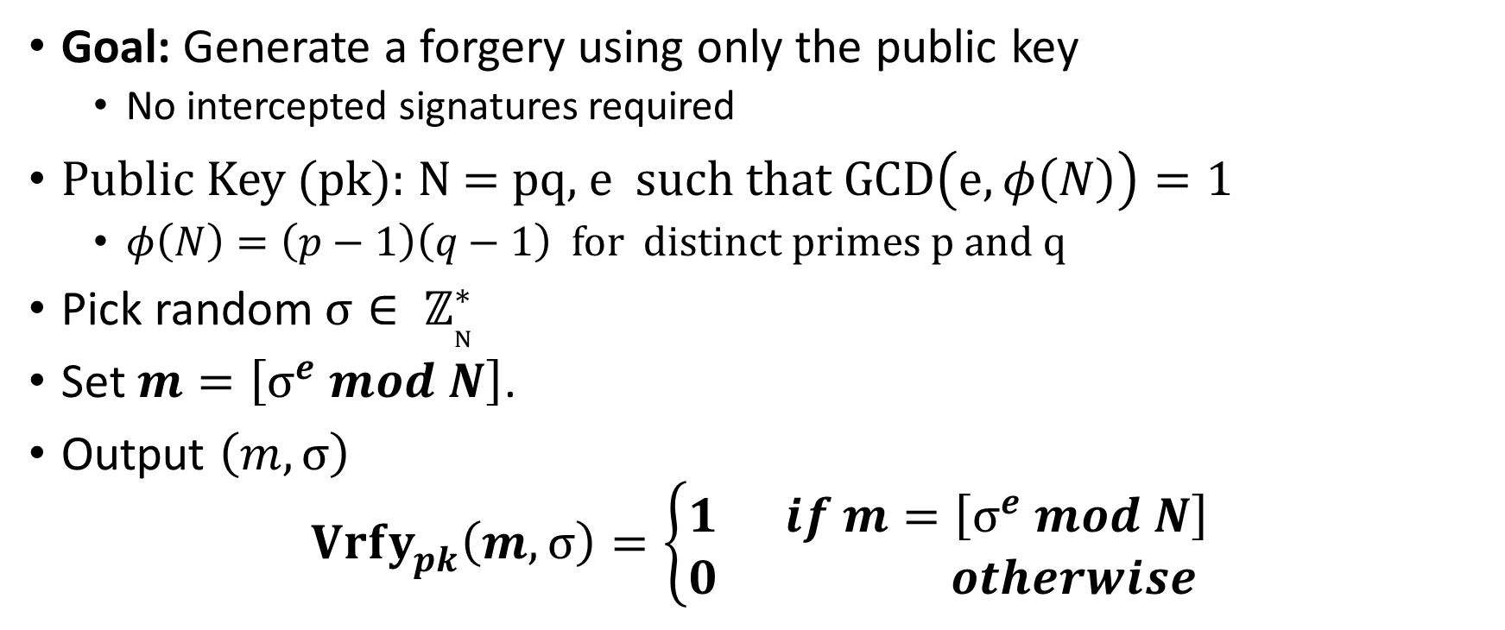
No Message Attack
Goal: Generate a forgery using only the public key
  No intercepted signatures required
Public Key (pk): N = pq, e such that $GCD\left(e,φ\left(N\right)\right)=1$
  $φ\left(N\right)=\left(p−1\right)\left(q−1\right)$ for distinct primes p and q
Pick random$σ∈ ℤ_{N}^{∗}$
Set $m=\left[σ^{e} mod N\right]$.
Output $\left(m,σ\right)$
$${Vrfy}_{pk}^{}\left(m,σ\right)=\left\{\begin{aligned}1 if m=\left[σ^{e} mod N\right] \\ 0 otherwise \end{aligned}\right.$$

Slide 5
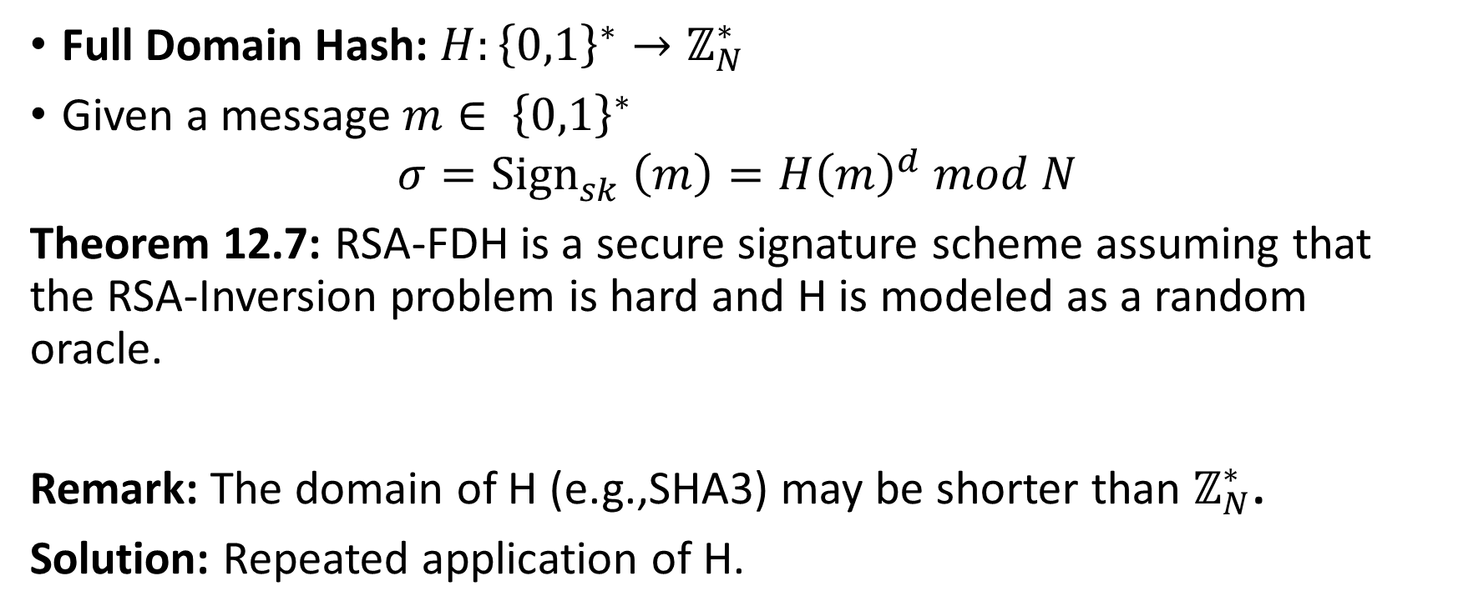
RSA-FDH
Full Domain Hash: $H:{\left\{0,1\right\}}^{∗}→ℤ_{N}^{∗}$
Given a message $m∈ {\left\{0,1\right\}}^{∗}$
$$σ={Sign}_{sk}^{}\left(m\right)=H{\left(m\right)}^{d} mod N$$
Theorem 12.7: RSA-FDH is a secure signature scheme assuming that the RSA-Inversion problem is hard and H is modeled as a random oracle.
Remark: The domain of H (e.g.,SHA3) may be shorter than $ℤ_{N}^{∗}$.
Solution: Repeated application of H.

Slide 6
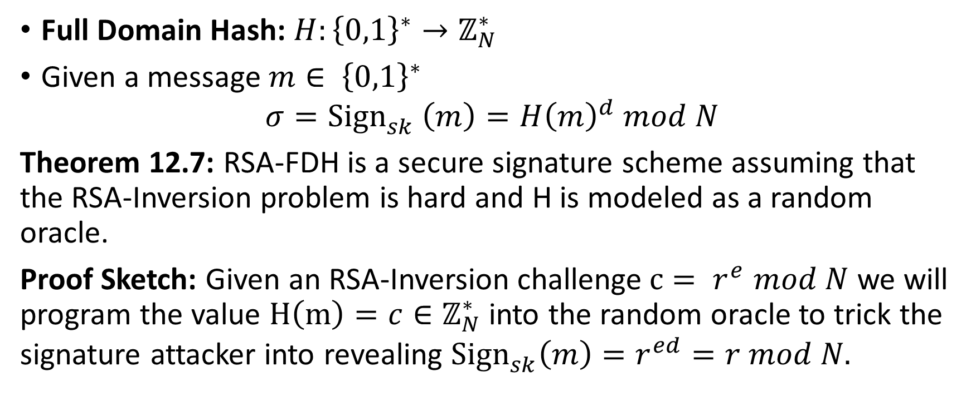
RSA-FDH
Full Domain Hash: $H:{\left\{0,1\right\}}^{∗}→ℤ_{N}^{∗}$
Given a message $m∈ {\left\{0,1\right\}}^{∗}$
$$σ={Sign}_{sk}^{}\left(m\right)=H{\left(m\right)}^{d} mod N$$
Theorem 12.7: RSA-FDH is a secure signature scheme assuming that the RSA-Inversion problem is hard and H is modeled as a random oracle.
Proof Sketch: Given an RSA-Inversion challenge$c= r^{e}$ $mod N$ we will program the value $H\left(m\right)={c∈ℤ}_{N}^{∗}$ into the random oracle to trick the signature attacker into revealing ${Sign}_{sk}^{}\left(m\right)=r^{ed}=r mod N.$

Slide 7
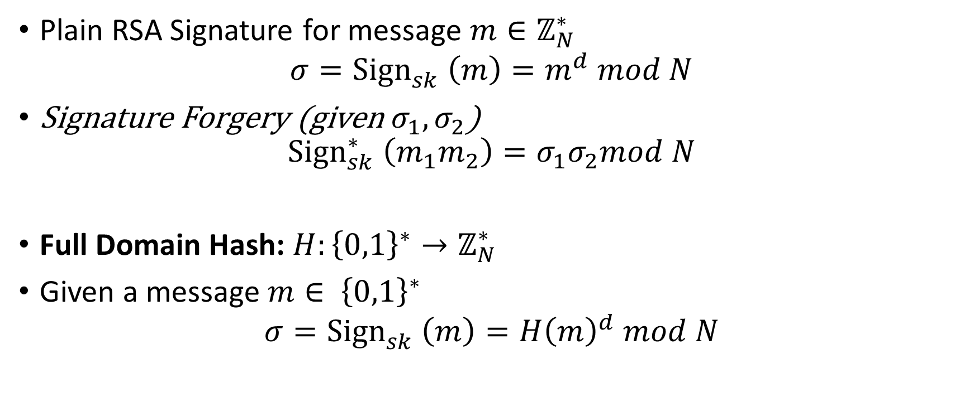
RSA-FDH
Plain RSA Signature for message $m∈ℤ_{N}^{∗}$
$$σ={Sign}_{sk}^{}\left(m\right)=m^{d} mod N$$
Signature Forgery (given $σ_{1},σ_{2}$)
$${Sign}_{sk}^{∗}\left(m_{1}m_{2}\right)=σ_{1}σ_{2}mod N$$
Full Domain Hash: $H:{\left\{0,1\right\}}^{∗}→ℤ_{N}^{∗}$
Given a message $m∈ {\left\{0,1\right\}}^{∗}$
$$σ={Sign}_{sk}^{}\left(m\right)=H{\left(m\right)}^{d} mod N$$

Slide 8
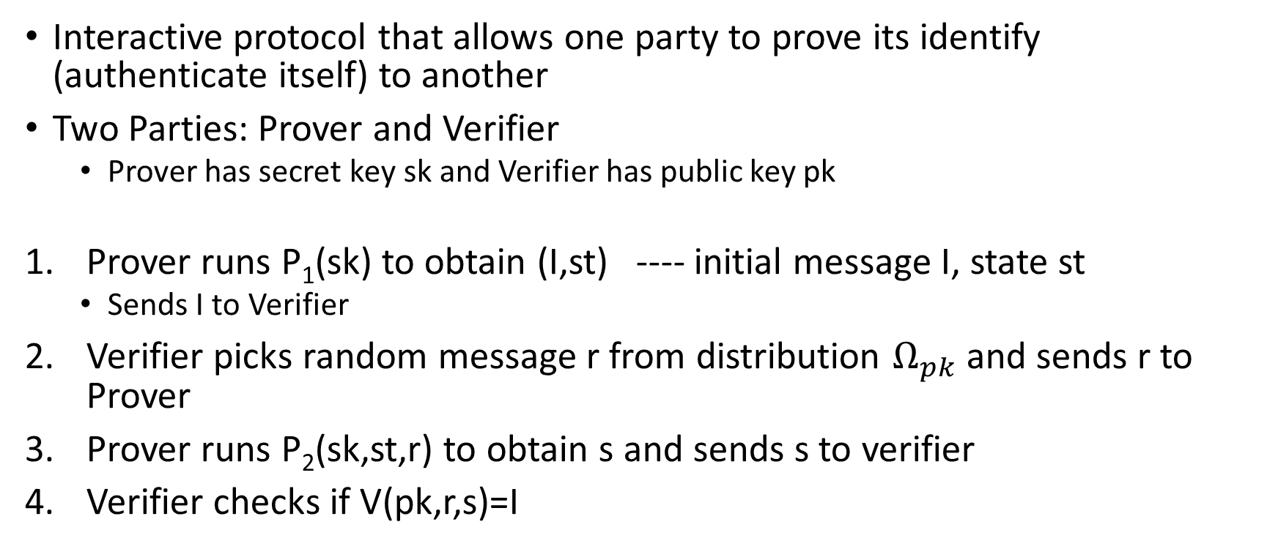
Identification Scheme
Interactive protocol that allows one party to prove its identify (authenticate itself) to another
Two Parties: Prover and Verifier
  Prover has secret key sk and Verifier has public key pk
Prover runs P₁(sk) to obtain (I,st) ---- initial message I, state st
  Sends I to Verifier
Verifier picks random message r from distribution $Ω_{pk}$ and sends r to Prover
Prover runs P₂(sk,st,r) to obtain s and sends s to verifier
Verifier checks if V(pk,r,s)=I

Slide 9
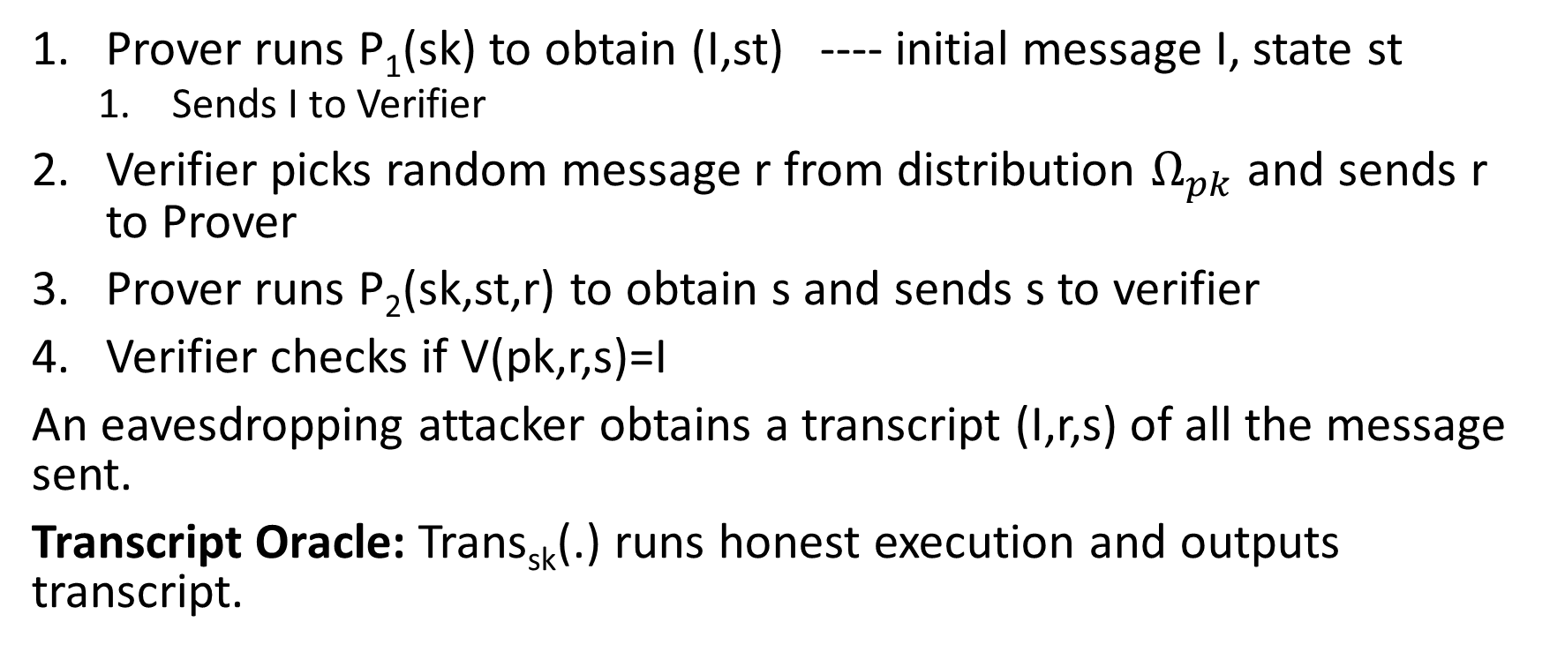
Identification Scheme
Prover runs P₁(sk) to obtain (I,st) ---- initial message I, state st
  Sends I to Verifier
Verifier picks random message r from distribution $Ω_{pk}$ and sends r to Prover
Prover runs P₂(sk,st,r) to obtain s and sends s to verifier
Verifier checks if V(pk,r,s)=I
An eavesdropping attacker obtains a transcript (I,r,s) of all the message sent.
Transcript Oracle: Trans_{sk}(.) runs honest execution and outputs transcript.

Slide 10


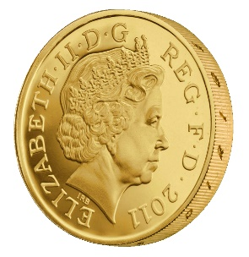












Identification Game (${Ident}_{A,Π}^{}\left(n\right)$)
Public Key: pk
$$Again$$
$${Trans}_{sk}\left(.\right)$$
$$Again$$
…
$${Trans}_{sk}\left(.\right)$$
$$I$$
$${r←Ω}_{pk}$$
$$Again$$
$${Trans}_{sk}\left(.\right)$$
(pk,sk) = Gen(.)
$$s$$
$${Ident}_{A,Π}^{}\left(n\right)=\left\{\begin{aligned}1 if V\left(pk,r,s\right)=I \\ 0 otherwise \end{aligned}\right.$$
$$∀PPT A ∃μ (negligible) s.t Pr\left[{Ident}_{A,Π}^{}\left(n\right)=1\right]≤μ(n)$$

Slide 11
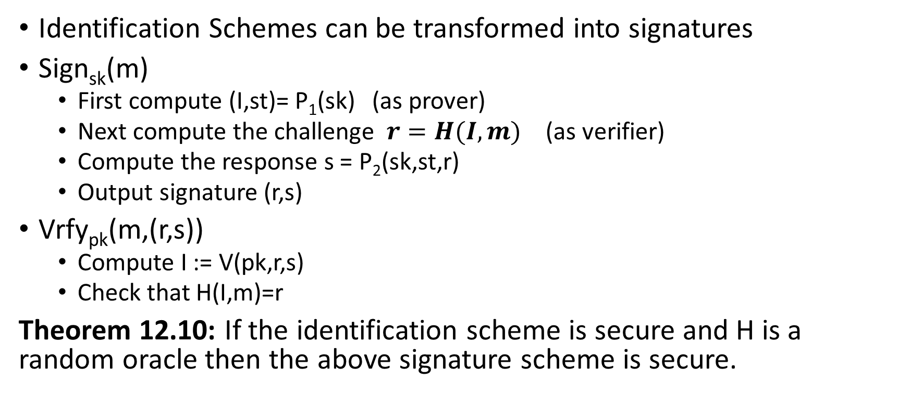
Fiat-Shamir Transform
Identification Schemes can be transformed into signatures
Sign_{sk}(m)
  First compute (I,st)= P₁(sk) (as prover)
  Next compute the challenge $r=H(I,m)$ (as verifier)
  Compute the response s = P₂(sk,st,r)
  Output signature (r,s)
Vrfy_{pk}(m,(r,s))
  Compute I := V(pk,r,s)
  Check that H(I,m)=r
Theorem 12.10: If the identification scheme is secure and H is a random oracle then the above signature scheme is secure.

Slide 12
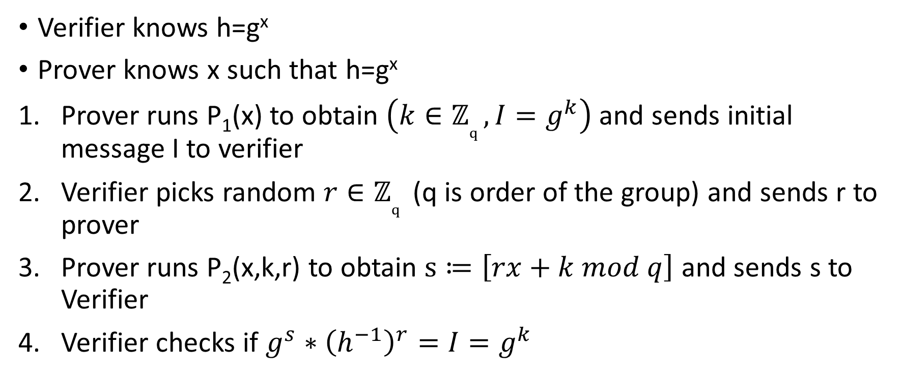
Schnorr Identification Scheme
Verifier knows h=g^{x}
Prover knows x such that h=g^{x}
Prover runs P₁(x) to obtain $\left({k∈ℤ}_{q}^{},I=g^{k}\right)$and sends initial message I to verifier
Verifier picks random ${r∈ℤ}_{q}^{}$ (q is order of the group) and sends r to prover
Prover runs P₂(x,k,r) to obtain $s≔\left[rx+k mod q\right]$ and sends s to Verifier
Verifier checks if $g^{s}∗{\left(h^{−1}\right)}^{r}=I=g^{k}$

Slide 13
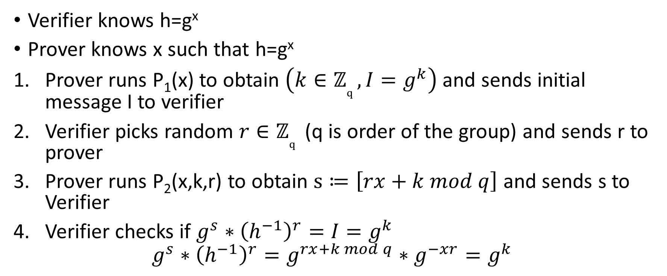
Schnorr Identification Scheme
Verifier knows h=g^{x}
Prover knows x such that h=g^{x}
Prover runs P₁(x) to obtain $\left({k∈ℤ}_{q}^{},I=g^{k}\right)$and sends initial message I to verifier
Verifier picks random ${r∈ℤ}_{q}^{}$ (q is order of the group) and sends r to prover
Prover runs P₂(x,k,r) to obtain $s≔\left[rx+k mod q\right]$ and sends s to Verifier
Verifier checks if $g^{s}∗{\left(h^{−1}\right)}^{r}=I=g^{k}$
$$g^{s}∗{\left(h^{−1}\right)}^{r}=g^{rx+k mod q}∗g^{−xr}=g^{k}$$

Slide 14
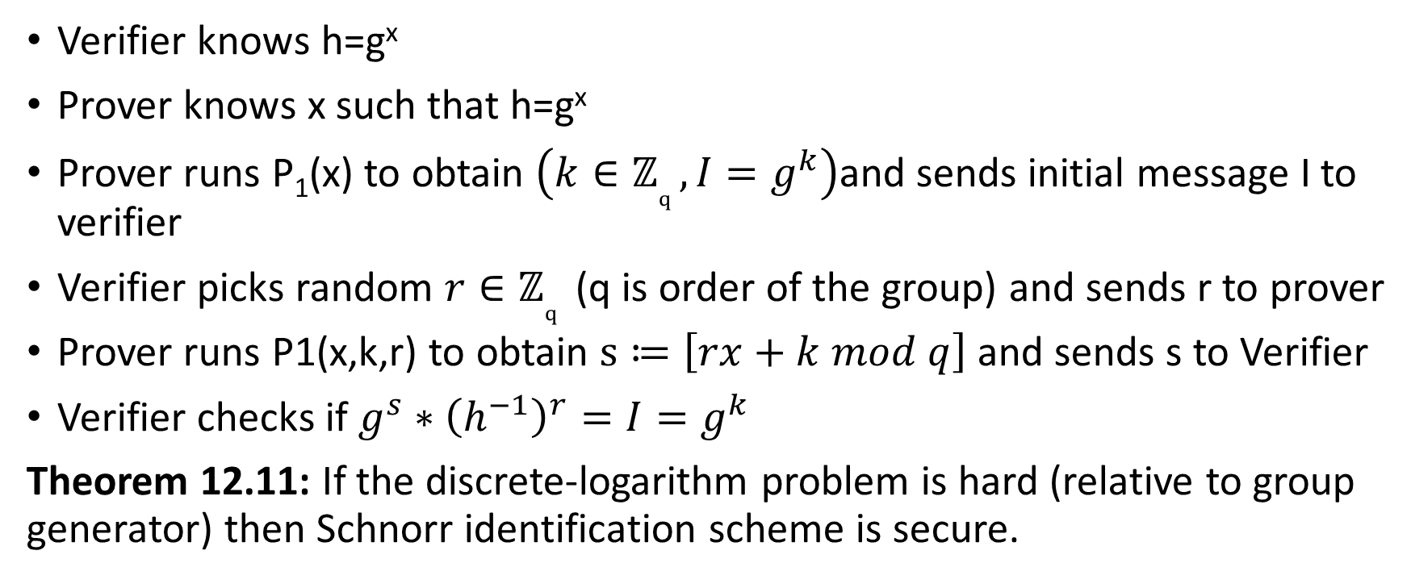
Schnorr Identification Scheme
Verifier knows h=g^{x}
Prover knows x such that h=g^{x}
Prover runs P₁(x) to obtain $\left({k∈ℤ}_{q}^{},I=g^{k}\right)$and sends initial message I to verifier
Verifier picks random ${r∈ℤ}_{q}^{}$ (q is order of the group) and sends r to prover
Prover runs P1(x,k,r) to obtain $s≔\left[rx+k mod q\right]$ and sends s to Verifier
Verifier checks if $g^{s}∗{\left(h^{−1}\right)}^{r}=I=g^{k}$
Theorem 12.11: If the discrete-logarithm problem is hard (relative to group generator) then Schnorr identification scheme is secure.

Slide 15
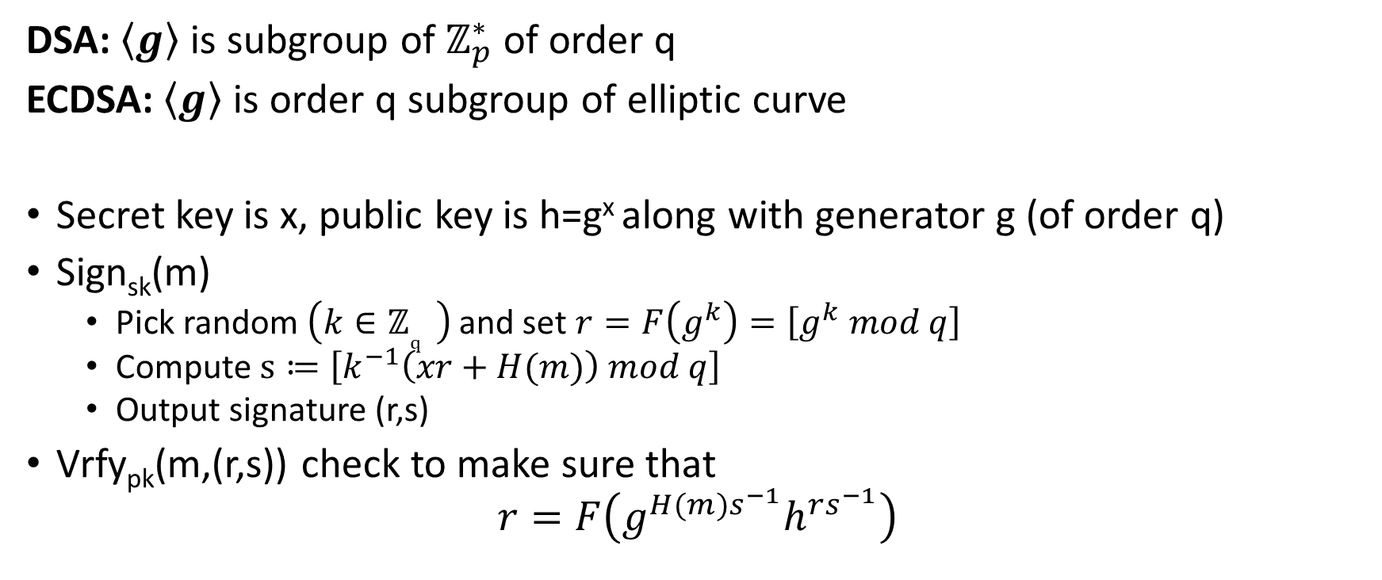
Digital Signature Algorithm (DSA)
DSA: $\left\langle g\right\rangle$ is subgroup of $ℤ_{p}^{∗}$ of order q
ECDSA: $\left\langle g\right\rangle$ is order q subgroup of elliptic curve
Secret key is x, public key is h=g^{x} along with generator g (of order q)
Sign_{sk}(m)
  Pick random $\left({k∈ℤ}_{q}^{} \right)$ and set $r=F\left(g^{k}\right)=\left[g^{k} mod q\right]$
  Compute $s≔\left[k^{−1}\left(xr+H(m)\right) mod q\right]$
  Output signature (r,s)
Vrfy_{pk}(m,(r,s)) check to make sure that
$$r=F\left(g^{H(m)s^{−1}}h^{rs^{−1}}\right)$$
Notes:
$$F\left(g^{H(m)s^{−1}}h^{rs^{−1}}\right)$$
$$=F\left(g^{H\left(m\right)k\left(xr+H(m)−1\right)}g^{xrk\left(xr+H(m)−1\right)}\right)$$
$$=F\left(g^{(H\left(m\right)+xr)k\left(xr+H(m)−1\right)}\right)$$
$$=F\left(g^{k}\right)=r$$

Slide 16
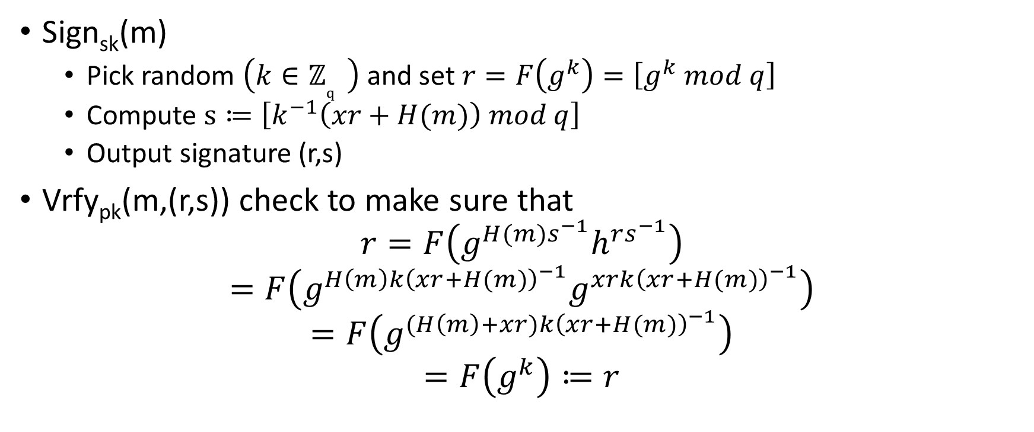
Digital Signature Algorithm (DSA)
Sign_{sk}(m)
  Pick random $\left({k∈ℤ}_{q}^{} \right)$ and set $r=F\left(g^{k}\right)=\left[g^{k} mod q\right]$
  Compute $s≔\left[k^{−1}\left(xr+H(m)\right) mod q\right]$
  Output signature (r,s)
Vrfy_{pk}(m,(r,s)) check to make sure that
$$r=F\left(g^{H(m)s^{−1}}h^{rs^{−1}}\right)$$
$$=F\left(g^{H\left(m\right)k{\left(xr+H(m)\right)}^{−1}}g^{xrk{\left(xr+H(m)\right)}^{−1}}\right)$$
$$=F\left(g^{(H\left(m\right)+xr)k{\left(xr+H(m)\right)}^{−1}}\right)$$
$$=F\left(g^{k}\right)≔r$$

Slide 17
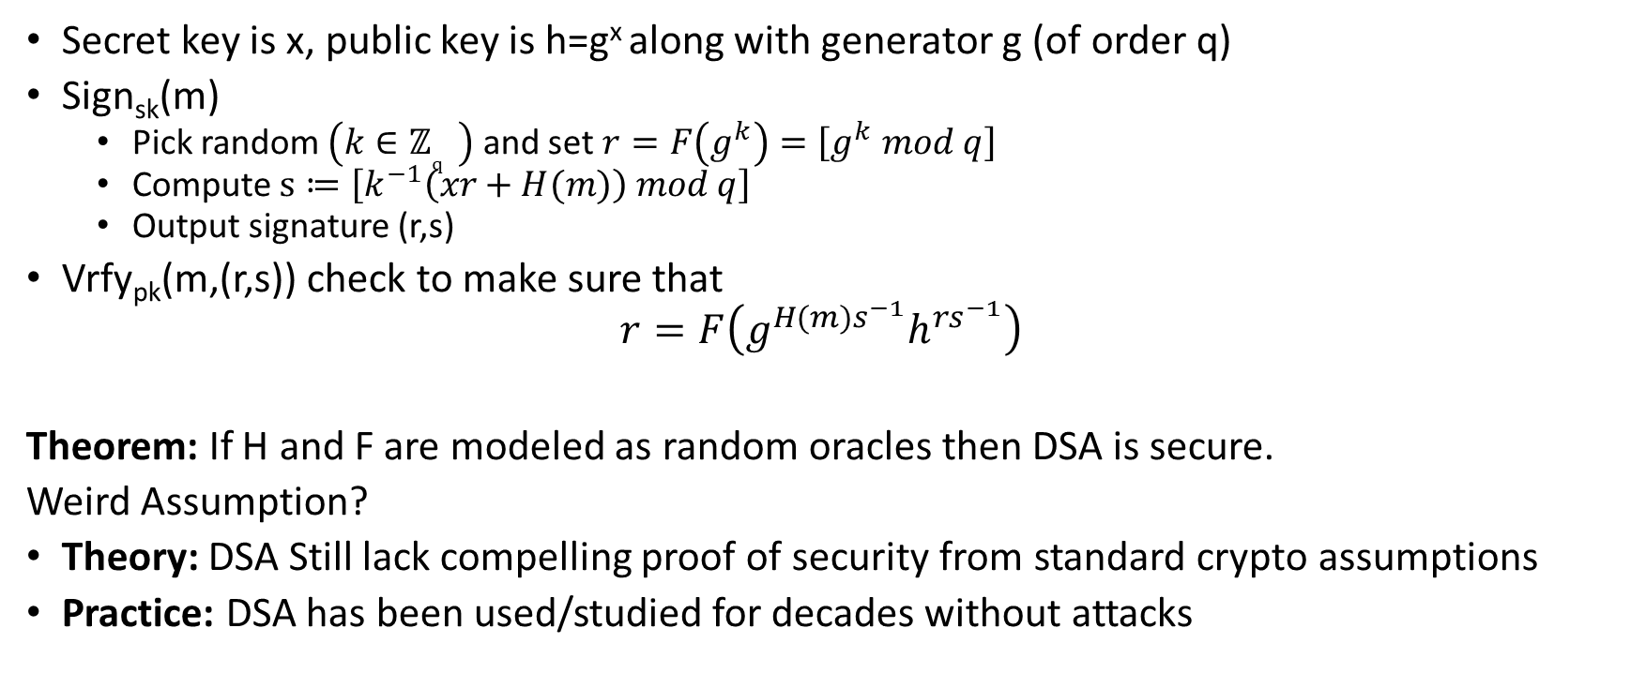
Digital Signature Algorithm (DSA)
Secret key is x, public key is h=g^{x} along with generator g (of order q)
Sign_{sk}(m)
  Pick random $\left({k∈ℤ}_{q}^{} \right)$ and set $r=F\left(g^{k}\right)=\left[g^{k} mod q\right]$
  Compute $s≔\left[k^{−1}\left(xr+H(m)\right) mod q\right]$
  Output signature (r,s)
Vrfy_{pk}(m,(r,s)) check to make sure that
$$r=F\left(g^{H(m)s^{−1}}h^{rs^{−1}}\right)$$
Theorem: If H and F are modeled as random oracles then DSA is secure.
Weird Assumption?
Theory: DSA Still lack compelling proof of security from standard crypto assumptions
Practice: DSA has been used/studied for decades without attacks
Notes:
$$F\left(g^{H(m)s^{−1}}h^{rs^{−1}}\right)$$
$$=F\left(g^{H\left(m\right)k\left(xr+H(m)−1\right)}g^{xrk\left(xr+H(m)−1\right)}\right)$$
$$=F\left(g^{(H\left(m\right)+xr)k\left(xr+H(m)−1\right)}\right)$$
$$=F\left(g^{k}\right)=r$$

Slide 18
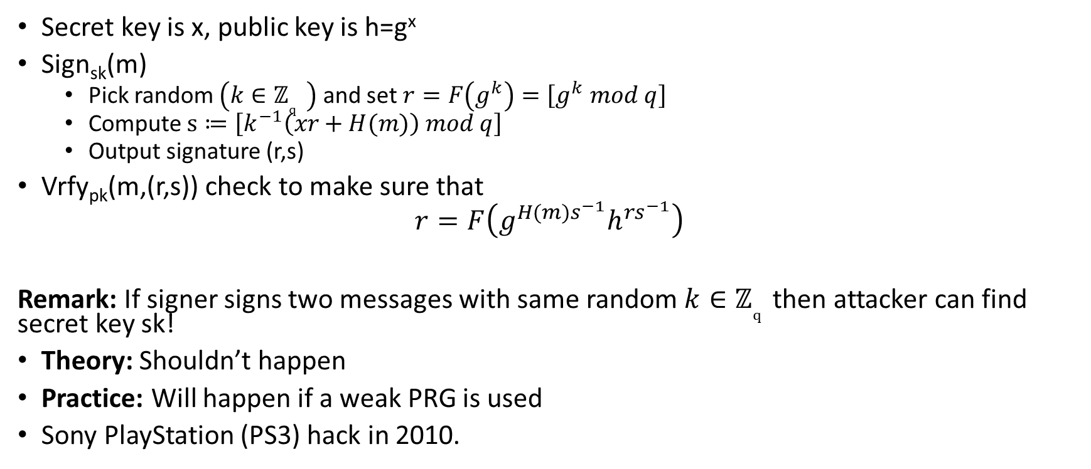
Digital Signature Algorithm (DSA)
Secret key is x, public key is h=g^{x}
Sign_{sk}(m)
  Pick random $\left({k∈ℤ}_{q}^{} \right)$ and set $r=F\left(g^{k}\right)=\left[g^{k} mod q\right]$
  Compute $s≔\left[k^{−1}\left(xr+H(m)\right) mod q\right]$
  Output signature (r,s)
Vrfy_{pk}(m,(r,s)) check to make sure that
$$r=F\left(g^{H(m)s^{−1}}h^{rs^{−1}}\right)$$
Remark: If signer signs two messages with same random ${k∈ℤ}_{q}^{}$then attacker can find secret key sk!
Theory: Shouldn’t happen
Practice: Will happen if a weak PRG is used
Sony PlayStation (PS3) hack in 2010.
Notes:
$$s1≔\left[k^{−1}\left(xr+H(m1)\right) mod q\right]$$
$$s2≔\left[k^{−1}\left(xr+H(m2)\right) mod q\right]$$
$$s1−s2=\left[k^{−1}\left(H\left(m1\right)−H(m2)\right) mod q\right]$$
$$Solve for k$$

Slide 19
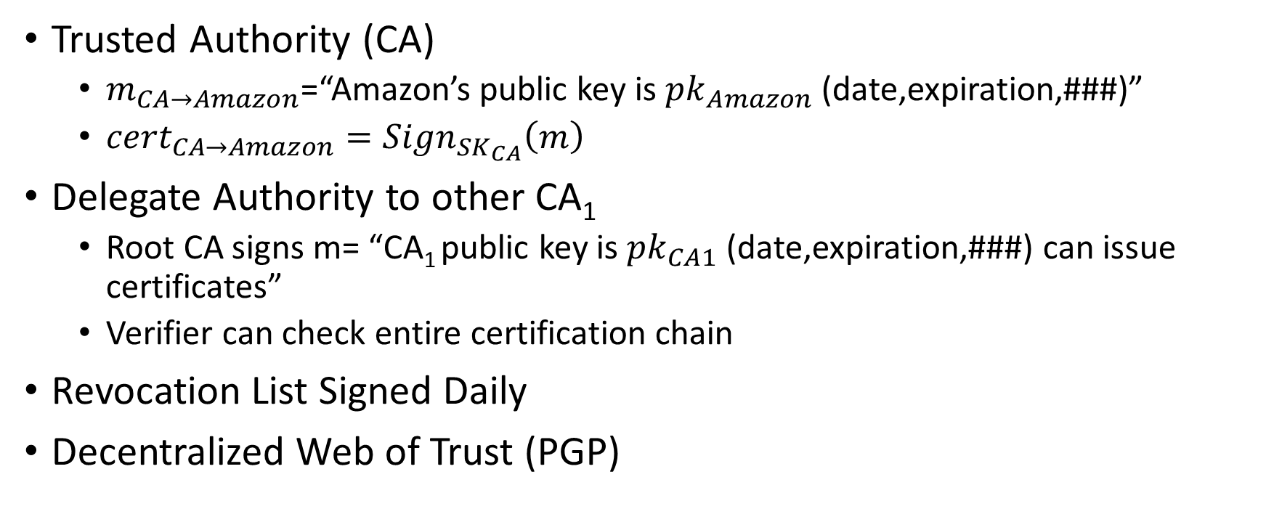
Certificate Authority
Trusted Authority (CA)
  $m_{CA→Amazon}$=“Amazon’s public key is ${pk}_{Amazon}$ (date,expiration,###)”
  ${cert}_{CA→Amazon}={Sign}_{{SK}_{CA}}\left(m\right)$
Delegate Authority to other CA₁
  Root CA signs m= “CA₁ public key is ${pk}_{CA1}$ (date,expiration,###) can issue certificates”
  Verifier can check entire certification chain
Revocation List Signed Daily
Decentralized Web of Trust (PGP)

Slide 20




Secure Multiparty Computation
z
H(x,y,z)
x
y
F(x,y,z)
G(x,y,z)
Bob only learns G(x,y,z)
Alice only learns F(x,y,z)
Mickey only learns H(x,y,z)
Cryptography: What if we don’t have a trusted third party?

Slide 21
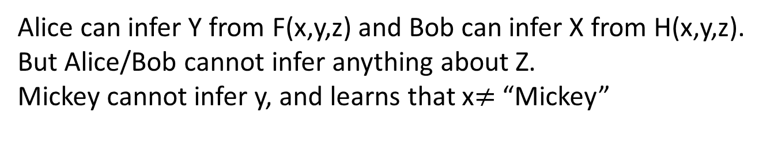
Secure Multiparty Computation (Crushes)
Z=“Alice”
H(x,y,z)=“no match”
x=“Bob”
F(x,y,z)=“match Bob”
Y=“Alice”
G(x,y,z)=“match Alice”
Bob only learns G(x,y,z)
Alice only learns F(x,y,z)
Mickey only learns H(x,y,z)
Alice can infer Y from F(x,y,z) and Bob can infer X from H(x,y,z).
But Alice/Bob cannot infer anything about Z.
Mickey cannot infer y, and learns that x$≠$ “Mickey”

Slide 22
Secure Multiparty Computation (Crushes)
Key Point: The output H(x,y,z) may leak info about inputs. Thus, we cannot prevent Mickey from learning anything about x,y but Mickey should not learn anything else besides H(x,y,z)!
Z=“Alice”
H(x,y,z)=“no match”
x=“Bob”
F(x,y,z)=“match Bob”
Y=“Alice”
G(x,y,z)=“match Alice”
Bob only learns G(x,y,z)
Alice only learns F(x,y,z)
Mickey only learns H(x,y,z)
Though Question: How can we formalize this property?
Alice can infer Y from F(x,y,z) and Bob can infer X from H(x,y,z).
But Alice/Bob cannot infer anything about Z.
Mickey cannot infer y, and learns that x$≠$ “Mickey”

Slide 23
Adversary Models
Semi-Honest (“honest, but curious”)
  All parties follow protocol instructions, but…
  dishonest parties may be curious to violate privacy of others when possible
Fully Malicious Model
  Adversarial Parties may deviate from the protocol arbitrarily
    Quit unexpectedly
    Send different messages
  It is much harder to achieve security in the fully malicious model
Convert Secure Semi-Honest Protocol into Secure Protocol in Fully Malicious Mode?
  Tool: Zero-Knowledge Proofs

Slide 24
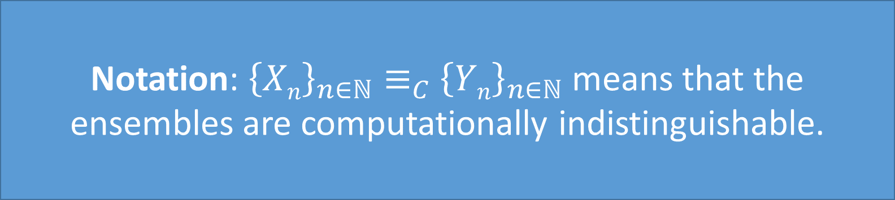

Computational Indistinguishability
Definition: We say that an ensemble of distributions ${\left\{Xn\right\}}_{n∈ℕ}$ and ${\left\{Yn\right\}}_{n∈ℕ}$ are computationally indistinguishable if for all PPT distinguishers D, there is a negligible function negl(n), such that we have
$${Adv}_{D,n}=\left|{Pr}_{s←\text{X}ℓ}\left[D\left(s\right)=1\right]−{Pr}_{s←Yℓ}\left[D\left(s\right)=1\right]\right|≤negl(n)$$
Notation: ${\left\{Xn\right\}}_{n∈ℕ}≡_{C}$ ${\left\{Yn\right\}}_{n∈ℕ}$ means that the ensembles are computationally indistinguishable.

Slide 25
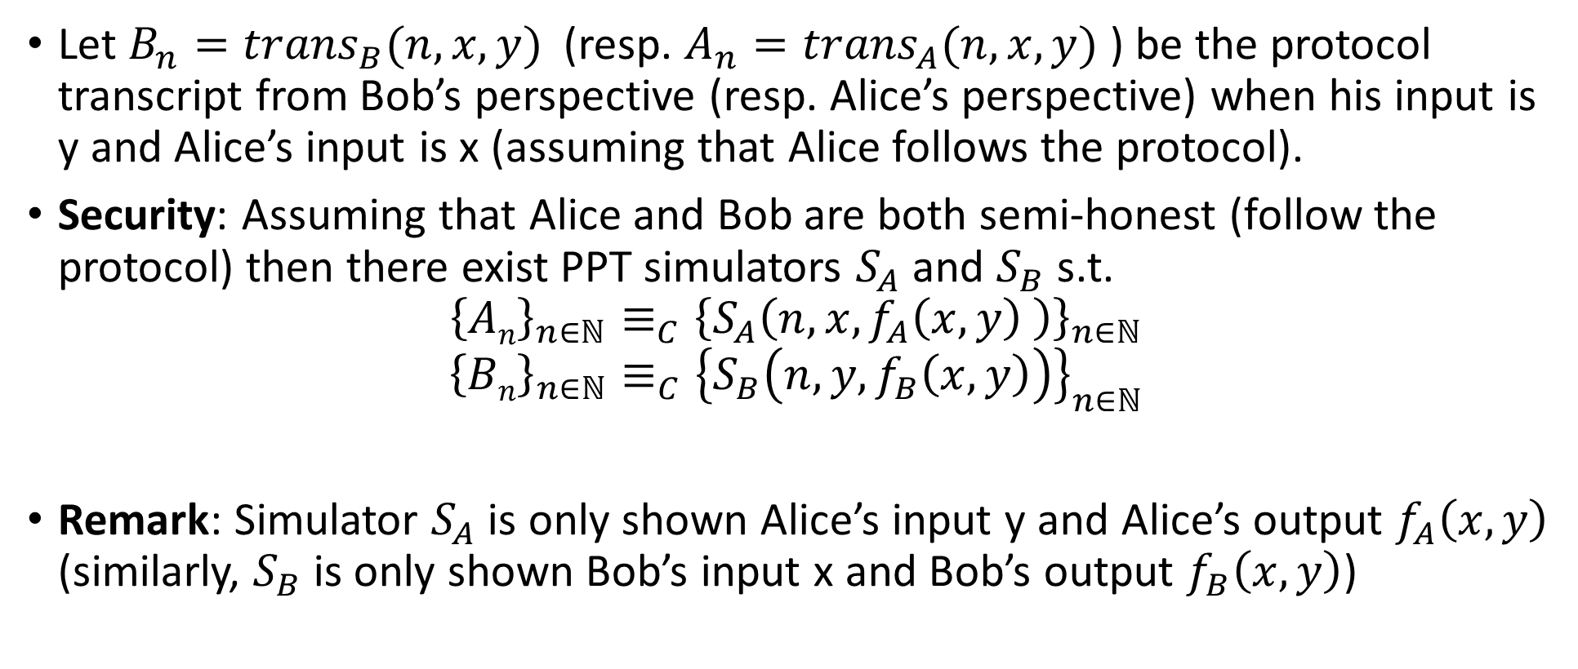
Security (Semi-Honest Model)
Let $B_{n}={trans}_{B}(n,x,y)$ (resp. $A_{n}={trans}_{A}(n,x,y)$ ) be the protocol transcript from Bob’s perspective (resp. Alice’s perspective) when his input is y and Alice’s input is x (assuming that Alice follows the protocol).
Security: Assuming that Alice and Bob are both semi-honest (follow the protocol) then there exist PPT simulators $S_{A}$ and $S_{B}$ s.t.
$${\left\{An\right\}}_{n∈ℕ}≡_{C}{\left\{S_{A}\left(n,x,f_{A}\left(x,y\right) \right)\right\}}_{n∈ℕ}$$
$${\left\{Bn\right\}}_{n∈ℕ}≡_{C}{\left\{S_{B}\left(n,y,f_{B}\left(x,y\right)\right)\right\}}_{n∈ℕ}$$
Remark: Simulator $S_{A}$ is only shown Alice’s input y and Alice’s output $f_{A}\left(x,y\right)$ (similarly, $S_{B}$ is only shown Bob’s input x and Bob’s output $f_{B}\left(x,y\right)$)

Slide 26
Oblivious Transfer (OT)
1 out of 2 OT
  Alice has two messages m₀ and m₁
  At the end of the protocol
    Bob gets exactly one of m₀ and m₁
    Alice does not know which one
Oblivious Transfer with a Trusted Third Party
m₀
b
1 out of 2 OT
m₁
m_{b}

Slide 27




Bellare-Micali 1-out-of-2-OT protocol
Oblivious Transfer without a Trusted Third Party
    g is a generator for a prime order group G_{q} in which CDH problem is hard
m₀
c
b
m₁
$$z0,z1$$
  $$C_{0}=\left[g^{r_{0}},H\left(z_{0}^{r_{0}}\right)⊕m_{0}\right]$$
  $$C_{1}=\left[g^{r_{1}},H\left(z_{1}^{r_{1}}\right)⊕m_{1}\right]$$
c ←_{R} G_{q}
k ←_{R} Z_{q}
$z_{b}=g^{k},$ $z_{1−b}=cg^{−k}$
Bob can decrypt C_{b}
$$z_{b}^{r_{b}}=g^{kr_{b}}$$

Slide 28

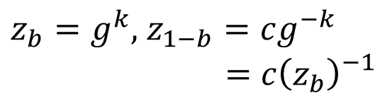
Bellare-Micali 1-out-of-2-OT protocol
Oblivious Transfer without a Trusted Third Party
    g is a generator for a prime order group G_{q} in which CDH is Hard
m₀
c
b
m₁
$$z0,z1$$
  $$C_{0}=\left[g^{r_{0}},H\left(z_{0}^{r_{0}}\right)⊕m_{0}\right]$$
  $$C_{1}=\left[g^{r_{1}},H\left(z_{1}^{r_{1}}\right)⊕m_{1}\right]$$
c ←_{R} G_{q}
k ←_{R} Z_{q}
Alice must check that
$$z_{1}=c{\left(z_{0}\right)}_{}^{−1}$$
$z_{b}=g^{k},$ $z_{1−b}=cg^{−k}$
$$=c{\left(z_{b}\right)}_{}^{−1}$$
Bob can decrypt C_{b}
$$z_{b}^{r_{b}}=g^{kr_{b}}$$

Slide 29

Bellare-Micali 1-out-of-2-OT protocol
Alice does not learn b because
$z_{1}=c{\left(z_{0}\right)}_{}^{−1}$ and
$z_{0}=c{\left(z_{1}\right)}_{}^{−1}$ and
$z_{1}$, $z_{0}$ are distributed uniformly at random subject to these condition.
This is an information theoretic guarantee!
Oblivious Transfer without a Trusted Third Party
    g is a generator for a prime order group G_{q} in which Discrete Log Problem is Hard
m₀
c
b
m₁
$$z0,z1$$
  $$C_{0}=\left[g^{r_{0}},H\left(z_{0}^{r_{0}}\right)⊕m_{0}\right]$$
  $$C_{1}=\left[g^{r_{1}},H\left(z_{1}^{r_{1}}\right)⊕m_{1}\right]$$
c ←_{R} G_{q}
k ←_{R} Z_{q}
Alice must check that
$$z_{1}=c{\left(z_{0}\right)}_{}^{−1}$$
$z_{b}=g^{k},$ $z_{1−b}=cg^{−k}$
$$=c{\left(z_{b}\right)}_{}^{−1}$$
Bob can decrypt C_{b}
$$z_{b}^{r_{b}}=g^{kr_{b}}$$

Slide 30

Bellare-Micali 1-out-of-2-OT protocol
Bob cannot decrypt C_{1-b}
Unless he queries random oracle at
$c^{r_{1−b}}g^{−kr_{1−b}}$
Given this value we can obtain $c^{r_{1−b}}$
Thus, we can break CDH assumption
given random ${c=g}^{m}$ and $g^{r_{1−b}}$ it is hard to find${ c}^{r_{1−b}}=g^{{mr}_{1−b}}$
Oblivious Transfer without a Trusted Third Party
    g is a generator for a prime order group G_{q} in which Discrete Log Problem is Hard
m₀
c
b
m₁
$$z0,z1$$
  $$C_{0}=\left[g^{r_{0}},H\left(z_{0}^{r_{0}}\right)⊕m_{0}\right]$$
  $$C_{1}=\left[g^{r_{1}},H\left(z_{1}^{r_{1}}\right)⊕m_{1}\right]$$
c ←_{R} G_{q}
k ←_{R} Z_{q}
Alice must check that
$$z_{1}=c{\left(z_{0}\right)}_{}^{−1}$$
$z_{b}=g^{k},$ $z_{1−b}=cg^{−k}$
$$=c{\left(z_{b}\right)}_{}^{−1}$$
Bob can decrypt C_{b}
$$z_{b}^{r_{b}}=g^{kr_{b}}$$

Slide 31
Yao’s Protocol
CS 380S
Vitaly Shmatikov

Slide 32
Yao’s Protocol
Compute any function securely
  … in the semi-honest model
First, convert the function into a boolean circuit
AND
AND
NOT
Alice’s inputs
Bob’s inputs
AND
OR
OR
z
z
x
y
z
x
y
z
AND
0
0
0
OR
0
0
0
Truth table:
0
1
0
Truth table:
0
1
1
x
y
1
0
0
x
y
1
0
1
1
1
1
1
1
1

Slide 33
AND
AND
NOT
Alice’s inputs
Bob’s inputs
AND
OR
OR
Overview:
Alice prepares “garbled” version C’ of C
Sends “encrypted” form x’ of her input x
Allows Bob to obtain “encrypted” form y’ of his input y via OT
Bob can compute from C’,x’,y’ the “encryption” z’ of z=C(x,y)
Bob sends z’ to Alice and she decrypts and reveals to him z
Crucial properties:
Bob never sees Alice’s input x in unencrypted form.
Bob can obtain encryption of y without Alice learning y.
Neither party learns intermediate values.
Remains secure even if parties try to cheat.

Slide 34
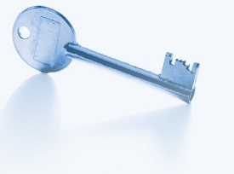

Intuition
c
AND
a
b

Slide 35

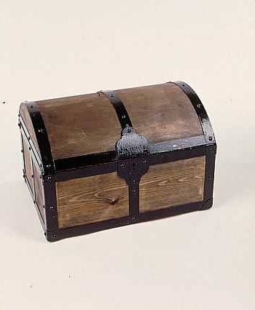



Intuition
a
b
a
b
c
a
b
AND
a
b
b
a
b
a

Slide 36
1: Pick Random Keys For Each Wire
Next, evaluate one gate securely
  Later, generalize to the entire circuit
Alice picks two random keys for each wire
  One key corresponds to “0”, the other to “1”
  6 keys in total for a gate with 2 input wires
k_{0z}, k_{1z}
z
AND
Alice
x
y
Bob
k_{0x}, k_{1x}
k_{0y}, k_{1y}

Slide 37
2: Encrypt Truth Table
Alice encrypts each row of the truth table by encrypting the output-wire key with the corresponding pair of input-wire keys
z
k_{0z}, k_{1z}
AND
Alice
x
y
Bob
k_{0x}, k_{1x}
k_{0y}, k_{1y}
E_{k0x}(E_{k0y}(k_{0z}))
x
y
z
E_{k0x}(E_{k1y}(k_{0z}))
0
0
0
Encrypted truth table:
Original truth table:
0
1
0
E_{k1x}(E_{k0y}(k_{0z}))
1
0
0
1
1
1
E_{k1x}(E_{k1y}(k_{1z}))

Slide 38
3: Send Garbled Truth Table
Alice randomly permutes (“garbles”) encrypted truth table and sends it to Bob
Does not know which row of garbled table corresponds to which row of original table
z
k_{0z}, k_{1z}
AND
Alice
x
y
Bob
k_{0x}, k_{1x}
k_{0y}, k_{1y}
E_{k1x}(E_{k0y}(k_{0z}))
E_{k0x}(E_{k0y}(k_{0z}))
E_{k0x}(E_{k1y}(k_{0z}))
E_{k0x}(E_{k1y}(k_{0z}))
Garbled truth table:
E_{k1x}(E_{k0y}(k_{0z}))
E_{k1x}(E_{k1y}(k_{1z}))
E_{k1x}(E_{k1y}(k_{1z}))
E_{k0x}(E_{k0y}(k_{0z}))

Slide 39
4: Send Keys For Alice’s Inputs
Alice sends the key corresponding to her input bit
  Keys are random, so Bob does not learn what this bit is
k_{0z}, k_{1z}
z
Learns K_{b’x} where b’ is Alice’s input bit, but not b’ (why?)
AND
Alice
x
y
Bob
k_{0x}, k_{1x}
If Alice’s bit is 1, she
simply sends k_{1x} to Bob;
if 0, she sends k_{0x}
k_{0y}, k_{1y}
E_{k1x}(E_{k0y}(k_{0z}))
Garbled truth table:
E_{k0x}(E_{k1y}(k_{0z}))
E_{k1x}(E_{k1y}(k_{1z}))
E_{k0x}(E_{k0y}(k_{0z}))

Slide 40
5: Use OT on Keys for Bob’s Input
Alice and Bob run oblivious transfer protocol
  Alice’s input is the two keys corresponding to Bob’s wire
  Bob’s input into OT is simply his 1-bit input on that wire
z
Knows K_{b’x} where b’ is Alice’s input bit and K_{by} where b is his own input bit
k_{0z}, k_{1z}
AND
Alice
x
y
Bob
k_{0x}, k_{1x}
Run oblivious transfer
Alice’s input: k_{0y}, k_{1y}
Bob’s input: his bit b
Bob learns k_{by}
What does Alice learn?
k_{0y}, k_{1y}
E_{k1x}(E_{k0y}(k_{0z}))
Garbled truth table:
E_{k0x}(E_{k1y}(k_{0z}))
E_{k1x}(E_{k1y}(k_{1z}))
E_{k0x}(E_{k0y}(k_{0z}))

Slide 41
6: Evaluate Garbled Gate
Using the two keys that he learned, Bob decrypts exactly one of the output-wire keys
  Bob does not learn if this key corresponds to 0 or 1
    Why is this important?
z
Knows K_{b’x} where b’ is Alice’s input bit and K_{by} where b is his own input bit
k_{0z}, k_{1z}
AND
Alice
x
y
Bob
k_{0x}, k_{1x}
Suppose b’=0, b=1
k_{0y}, k_{1y}
E_{k1x}(E_{k0y}(k_{0z}))
E_{k0x}(E_{k1y}(k_{0z}))
This is the only row
Bob can decrypt.
He learns K_{0z}
Garbled truth table:
E_{k1x}(E_{k1y}(k_{1z}))
E_{k0x}(E_{k0y}(k_{0z}))

Slide 42
7: Evaluate Entire Circuit
In this way, Bob evaluates entire garbled circuit
  For each wire in the circuit, Bob learns only one key
  It corresponds to 0 or 1 (Bob does not know which)
    Therefore, Bob does not learn intermediate values (why?)
Bob tells Alice the key for the final output wire and she tells him if it corresponds to 0 or 1
  Bob does not tell her intermediate wire keys (why?)
AND
AND
NOT
Alice’s inputs
Bob’s inputs
AND
OR
OR

Slide 43
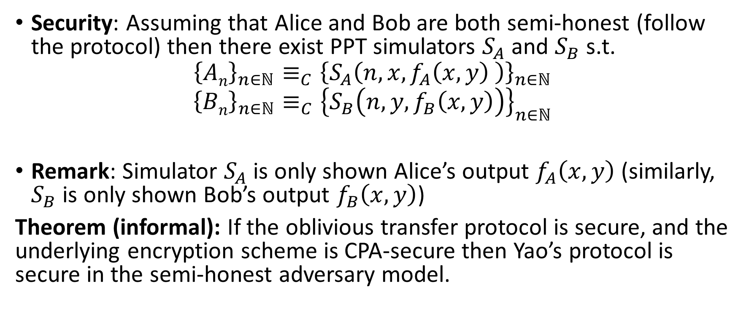
Security (Semi-Honest Model)
Security: Assuming that Alice and Bob are both semi-honest (follow the protocol) then there exist PPT simulators $S_{A}$ and $S_{B}$ s.t.
$${\left\{An\right\}}_{n∈ℕ}≡_{C}{\left\{S_{A}\left(n,x,f_{A}\left(x,y\right) \right)\right\}}_{n∈ℕ}$$
$${\left\{Bn\right\}}_{n∈ℕ}≡_{C}{\left\{S_{B}\left(n,y,f_{B}\left(x,y\right)\right)\right\}}_{n∈ℕ}$$
Remark: Simulator $S_{A}$ is only shown Alice’s output $f_{A}\left(x,y\right)$ (similarly, $S_{B}$ is only shown Bob’s output $f_{B}\left(x,y\right)$)
Theorem (informal): If the oblivious transfer protocol is secure, and the underlying encryption scheme is CPA-secure then Yao’s protocol is secure in the semi-honest adversary model.

Slide 44
Brief Discussion of Yao’s Protocol
Function must be converted into a circuit
  For many functions, circuit will be huge
If m gates in the circuit and n inputs from Bob, then need 4m encryptions and n oblivious transfers
  Oblivious transfers for all inputs can be done in parallel
Yao’s construction gives a constant-round protocol for secure computation of any function in the semi-honest model
  Number of rounds does not depend on the number of inputs or the size of the circuit!

Slide 45
Fully Malicious Security?
Alice could initially garble the wrong circuit C(x,y)=y.
Given output of C(x,y) Alice can still send Bob the output f(x,y).
Can Bob detect/prevent this?
Fix: Assume Alice and Bob have both committed to their input: c_{A}=com(xlr_{A}) and c_{B}=com(ylr_{B}).
  Alice and Bob can use zero-knowledge proofs to convince other party that they are behaving honestly.
  Example: After sending a message A Alice proves that the message she just sent is the same message an honest party would have sent with input x s.t. c_{A}=com(xlr_{A})
  Here we assume that Alice and Bob have both committed to correct inputs (Bob might use y which does not represent his real vote etc… but this is not a problem we can address with cryptography)

Slide 46
Fully Malicious Security
Assume Alice and Bob have both committed to their input: c_{A}=com(xlr_{A}) and c_{B}=com(ylr_{B}).
  Here we assume that Alice and Bob have both committed to correct inputs (Bob might use y which does not represent his real vote etc… but this is not a problem we can address with cryptography)
  Alice has c_{B} and can unlock c_{A}
  Bob has c_{A} and can unlock c_{B}
Alice sets C_{f} = GarbleCircuit(f,r).
  Alice sends to Bob.
  Alice convinces Bob that C_{f} = GarbleCircuit(f,r) for some r (using a zero-knowledge proof)
For each original oblivious transfer if Alice’s inputs were originally x₀,x₁
  Alice and Bob run OT with y₀,y₁ where y_{i}=Enc_{K}(x_{i})
  Bob uses a zero-knowledge proof to convince Alice that he received the correct y_{i} (e.g. matching his previous commitment c_{B})
  Alice sends K to Bob who decrypts y_{i} to obtain x_{i}

