Slide 1
Course Business
Homework 3
Due: Tuesday, October 31st at the beginning of class
Professor Blocki is travelling, but will be back on Thursday
Remaining Office Hours before Deadline:
Professor Blocki: Friday @ 10:30 AM
TA Duc Le: Wed @ 10AM
TA Duc Le: Mon @ 10AM

Slide 2
Cryptography CS 555
Week 10:
RSA
Attacks on Plain RSA
Discrete Log/DDH
Readings: Katz and Lindell Chapter 8.2-8.3,11.5.1
Fall 2017

Slide 3
CS 555: Week 10: Topic 1 Finding Prime Numbers, RSA

Slide 4
Recap
Number Theory Basics
Polynomial Time Operations on Integers
Addition/Subtraction/Multiplication/Division
Exponentiation Modulo N
GCD
Find Modular Inverse of${ x∈ℤ}_{N}^{∗}$
$φ\left(N\right)=\left|ℤ_{N}^{∗}\right|$
Special Case: $φ\left(pq\right)=\left(p−1\right)\left(q−1\right)$ for distinct primes p and q
Key Property: For each ${g∈ℤ}_{N}^{∗}$ and integer $x∈ℕ$ we have
$$\left[g^{x}mod N\right]=\left[g^{[x mod φ\left(N\right)]}mod N\right]$$

Slide 5
RSA Key-Generation
KeyGeneration(1^{n})
Step 1: Pick two random n-bit primes p and q
Step 2: Let N=pq, $φ\left(N\right)=(p−1)(q−1)$
Step 3: …
Question: How do we accomplish step one?

Slide 6
Bertrand’s Postulate
Theorem 8.32. For any n > 1 the fraction of n-bit integers that are prime is at least $1/{3n}$.
GenerateRandomPrime(1^{n})
For i=1 to 3n²:
p’← {0,1}^{n-1}
p← $1\left\|p′\right.$
if isPrime(p) then
return p
return fail
Can we do this in polynomial time?

Slide 7
Bertrand’s Postulate
Theorem 8.32. For any n > 1 the fraction of n-bit integers that are prime is at least $1/{3n}$.
GenerateRandomPrime(1^{n})
For i=1 to 3n²:
p’← {0,1}^{n-1}
p← $1\left\|p′\right.$
if isPrime(p) then
return p
return fail
Assume for now that we can run isPrime(p). What are the odds that the algorithm fails?
On each iteration the probability that p is not a prime is $\left(1−\frac{1}{3n}\right)$
We fail if we pick a non-prime in all 3n² iterations. The probability of failure is at most
$${\left(1−\frac{1}{3n}\right)}^{3n^{2}}={\left({\left(1−\frac{1}{3n}\right)}^{3n}\right)}^{n}≤e^{−n}$$

Slide 8
isPrime(p): Miller-Rabin Test
We can check for primality of p in polynomial time in $\left\|p\right\|$.
Theory: Deterministic algorithm to test for primality.
See breakthrough paper “Primes is in P”
Practice: Miller-Rabin Test (randomized algorithm)
Guarantee 1: If p is prime then the test outputs YES
Guarantee 2: If p is not prime then the test outputs NO except with negligible probability.
https://www.cse.iitk.ac.in/users/manindra/algebra/primality_v6.pdf

Slide 9
The “Almost” Miller-Rabin Test
Input: Integer N and parameter 1^{t}
Output: “prime” or “composite”
for i=1 to t:
a ← {1,…,N-1}
if $a^{N−1} ≠1 mod N$ then return “composite”
Return “prime”
Claim: If N is prime then algorithm always outputs “prime”
Proof: For any $a∈\text{\{1,…,}\text{N}\text{−1\}}$ we have $a^{N−1}=a^{φ\left(N\right)}=1 mod N$

Slide 10
The “Almost” Miller-Rabin Test
Need a bit of extra work to handle Carmichael numbers (see textbook).
Input: Integer N and parameter 1^{t}
Output: “prime” or “composite”
for i=1 to t:
a ← {1,…,N-1}
if $a^{N−1} ≠1 mod N$ then return “composite”
Return “prime”
Fact: If N is composite and not a Carmichael number then the algorithm outputs “composite” with probability
$$1−2^{−t}$$

Slide 11
Back to RSA Key-Generation
KeyGeneration(1^{n})
Step 1: Pick two random n-bit primes p and q
Step 2: Let N=pq, $φ\left(N\right)=(p−1)(q−1)$
Step 3: Pick e > 1 such that gcd(e, $φ\left(N\right)$)=1
Step 4: Set d=[e⁻¹ mod $φ\left(N\right)$] (secret key)
Return: N, e, d
How do we find d?
Answer: Use extended gcd algorithm to find e⁻¹mod $φ\left(N\right)$.

Slide 12
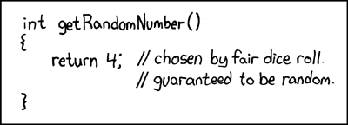
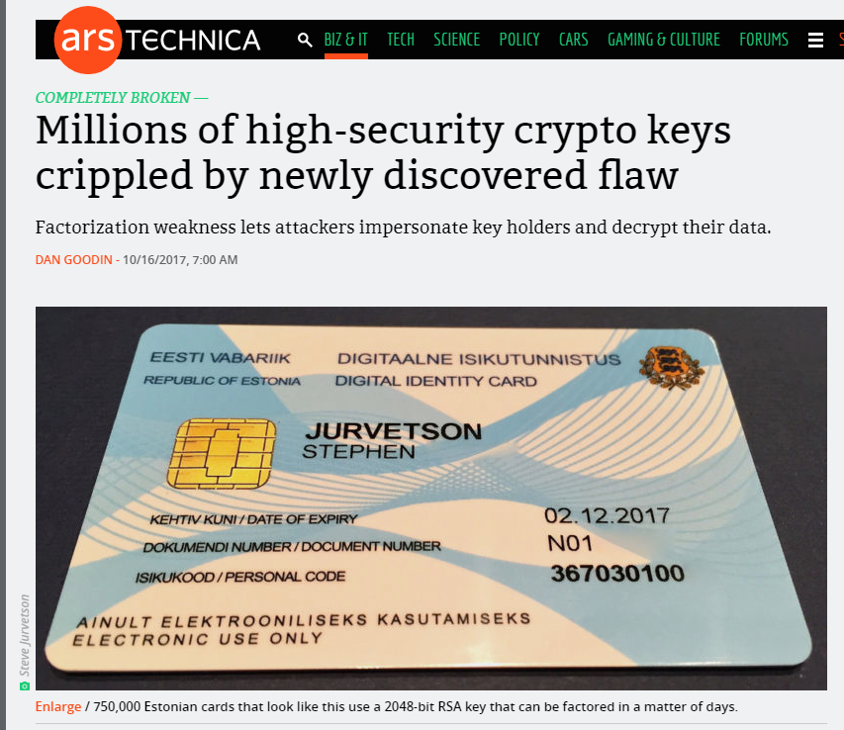
Be Careful Where You Get Your “Random Bits!”
RSA Keys Generated with weak PRG
Implementation Flaw
Unfortunately Commonplace
Resulting Keys are Vulnerable
Sophisticated Attack
Coppersmith’s Method
The Return of Coppersmith's Attack: Practical Factorization of Widely Used RSA Moduli (CCS 2017)

Slide 13
(Plain) RSA Encryption
Public Key: PK=(N,e)
Message $m∈ℤ_{N}^{}$
$$\text{Enc}\text{PK}\text{(}\text{m}\text{)}= \left[m^{e}\operatorname{mod}{N}\right]$$
Remark: Encryption is efficient if we use the power mod algorithm.

Slide 14
(Plain) RSA Decryption
Secret Key: SK=(N,d)
Ciphertext $c∈ℤ_{N}^{}$
$$\text{D}\text{e}\text{c}\text{S}\text{K}\text{(}\text{c}\text{)}= \left[c^{d}\operatorname{mod}{N}\right]$$
Remark 1: Decryption is efficient if we use the power mod algorithm.
Remark 2: Suppose that $m∈ ℤ_{N}^{∗}$ and let c=$\text{Enc}\text{PK}\text{(}\text{m}\text{)}= \left[m^{e}\operatorname{mod}{N}\right]$
$$\text{De}\text{c}\text{SK}\text{(}\text{c}\text{)}= \left[{\left(m^{e}\right)}^{d}\operatorname{mod}{N}\right]= \left[m^{ed}\operatorname{mod}{N}\right]$$
$$= \left[m^{[ed mod φ\left(N\right)]}\operatorname{mod}{N}\right]$$
$$= \left[m1\operatorname{mod}{N}\right]=m$$

Slide 15
RSA Decryption
Secret Key: SK=(N,d)
Ciphertext $c∈ℤ_{N}^{}$
$$\text{D}\text{e}\text{c}\text{S}\text{K}\text{(}\text{c}\text{)}= \left[c^{d}\operatorname{mod}{N}\right]$$
Remark 1: Decryption is efficient if we use the power mod algorithm.
Remark 2: Suppose that $m∈ ℤ_{N}^{∗}$ and let c=$\text{Enc}\text{PK}\text{(}\text{m}\text{)}= \left[m^{e}\operatorname{mod}{N}\right]$ then
$$\text{De}\text{c}\text{SK}\text{(}\text{c}\text{)}= m$$
Remark 3: Even if $m∈ℤ_{N}^{}− ℤ_{N}^{∗}$ and let c=$\text{Enc}\text{PK}\text{(}\text{m}\text{)}= \left[m^{e}\operatorname{mod}{N}\right]$ then
$$\text{De}\text{c}\text{SK}\text{(}\text{c}\text{)}= m$$
Use Chinese Remainder Theorem to show this

Slide 16
Plain RSA (Summary)
Public Key (pk): N = pq, e such that $GCD\left(e,φ\left(N\right)\right)=1$
$φ\left(N\right)=\left(p−1\right)\left(q−1\right)$ for distinct primes p and q
Secret Key (sk): N, d such that ed=1 mod $φ\left(N\right)$
Encrypt(pk=(N,e),m) = $m^{e} mod N$
Decrypt(sk=(N,d),c) = $c^{d} mod N$
$Decryption Works because$
$$\left[c^{d}mod N\right]=\left[m^{ed}mod N\right]=\left[m^{[ed mod φ\left(N\right)]}mod N\right]=\left[m mod N\right]$$

Slide 17
Factoring Assumption
Let GenModulus(1^{n}) be a randomized algorithm that outputs (N=pq,p,q) where p and q are n-bit primes (except with negligible probability negl(n)).
Experiment FACTOR_{A,n}
(N=pq,p,q) ← GenModulus(1^{n})
Attacker A is given N as input
Attacker A outputs p’ > 1 and q’ > 1
Attacker A wins if N=p’q’.

Slide 18
Factoring Assumption
Necessary for security of RSA.
Not known to be sufficient.
Experiment FACTOR_{A,n}
(N=pq,p,q) ← GenModulus(1^{n})
Attacker A is given N as input
Attacker A outputs p’ > 1 and q’ > 1
Attacker A wins ($\text{FACTOR}\text{A}\text{,}\text{n}=1$) if and only if N=p’q’.
$$∀PPT A ∃μ (negligible) s.t Pr\left[\text{FACTOR}\text{A}\text{,}\text{n}=1\right]≤μ(n)$$

Slide 19
RSA-Assumption
RSA-Experiment: RSA-INV_{A,n}
Run KeyGeneration(1^{n}) to obtain (N,e,d)
Pick uniform $y∈ ℤ_{N}^{∗}$
Attacker A is given N, e, y and outputs $x∈ ℤ_{N}^{∗}$
Attacker wins (RSA-INV_{A,n}=1) if $x^{e}=y mod N$
$$∀PPT A ∃μ (negligible) s.t Pr\left[\text{RSA}\text{−}\text{INVA}\text{,}\text{n} =1\right]≤μ(n)$$

Slide 20
RSA-Assumption
RSA-Experiment: RSA-INV_{A,n}
Run KeyGeneration(1^{n}) to obtain (N,e,d)
Pick uniform $y∈ ℤ_{N}^{∗}$
Attacker A is given N, e, y and outputs $x∈ ℤ_{N}^{∗}$
Attacker wins (RSA-INV_{A,n}=1) if $x^{e}=y mod N$
$$∀PPT A ∃μ (negligible) s.t Pr\left[\text{RSA}\text{−}\text{INVA}\text{,}\text{n}=1\right]≤μ(n)$$
Plain RSA Encryption behaves like a one-way function
Attacker cannot invert encryption of random message

Slide 21
Discussion of RSA-Assumption
Plain RSA Encryption behaves like a one-way-function
Decryption key is a “trapdoor” which allows us to invert the OWF
RSA-Assumption ➔ OWFs exist

Slide 22
Recap
Plain RSA
Public Key (pk): N = pq, e such that $GCD\left(e,φ\left(N\right)\right)=1$
$φ\left(N\right)=\left(p−1\right)\left(q−1\right)$ for distinct primes p and q
Secret Key (sk): N, d such that ed=1 mod $φ\left(N\right)$
Encrypt(pk=(N,e),m) = $m^{e} mod N$
Decrypt(sk=(N,d),c) = $c^{d} mod N$
$Decryption Works because$
$$\left[c^{d}mod N\right]=\left[m^{ed}mod N\right]=\left[m^{[ed mod φ\left(N\right)]}mod N\right]=\left[m mod N\right]$$

Slide 23
Mathematica Demo
https://www.cs.purdue.edu/homes/jblocki/courses/555_Spring17/slides/Lecture24Demo.nb
Note: Online version of mathematica available at https://sandbox.open.wolframcloud.com (reduced functionality, but can be used to solve homework bonus problems)

Slide 24
(Toy) RSA Implementation in Mathematica
(* Random Seed 123456 is not secure, but it allows us to repeat the experiment *)
SeedRandom[123456]
(* Step 1: Generate primes for an RSA key *)
p = RandomPrime[{10^1000, 10^1050}];
q = RandomPrime[{10^1000, 10^1050}];
NN = p q; (*Symbol N is protected in mathematica *)
phi = (p - 1) (q - 1);
https://www.cs.purdue.edu/homes/jblocki/courses/555_Spring17/slides/Lecture24Demo.nb

Slide 25
(Toy) RSA Implementation in Mathematica
(* Step 1.A: Find e *)
GCD[phi,7]
Output: 7
(* GCD[phi,7] is not 1, so he have to try a different value of e *)
GCD[phi,3]
Output: 1
(* We can set e=3 *)
e=3;
https://www.cs.purdue.edu/homes/jblocki/courses/555_Spring17/slides/Lecture24Demo.nb

Slide 26
(Toy) RSA Implementation in Mathematica
(* Step 1.B find d s.t. ed = 1 mod N by using the extended GCD algorithm *)
(* Mathematica is clever enough to do this automatically *)
Solve[e x == 1, Modulus->phi]
Output:
{{x->36469680590663028301700626132883867272718728905205088...
…………………………………………………………………………………………………………
394069421778610209425624440980084481398131}}
(* We can now set d = x *)
d=364696805…. 8131;

Slide 27
(Toy) RSA Implementation in Mathematica
(* Double Check 1 = [ed mod $φ\left(N\right)]$ *)
Mod [e d, (p-1)(q-1)]
Output: 1
(* Encrypt the message 200, c= m^e mod N *)
m = 200;
PowerMod[m,e,NN]
Output: 8 000 000

Slide 28
(Toy) RSA Implementation in Mathematica
(* Encrypt the message 200, c= m^e mod N *)
m = 200;
PowerMod[m,e,NN]
Output: 8 000 000
(* Hm...That doesn't seem too secure *)
CubeRoot[PowerMod[m,e,NN]]
Output: 200
(* Moral: if $m^{e}<N$then Plain RSA does not hide the message m. *)

Slide 29
RSA Implementation in Mathematica
(* Encrypt a larger message, c= m^e mod N *)
SeedRandom[1234567];
m2= RandomInteger[{10^1500,10^1501}];
c=PowerMod[m2,e,NN]
Output: 405215834903772786……… 388068292685976133
(* Does it Decrypt Properly? *)
PowerMod[c,d, NN]-m2
Output: 0
(* Yes! *)

Slide 30
CS 555: Week 10: Topic 2 Attacks on Plain RSA

Slide 31
(Plain) RSA Discussion
We have not introduced security models like CPA-Security or CCA-security for Public Key Cryptosystems
However, notice that (Plain) RSA Encryption is stateless and deterministic.
→Plain RSA is not secure against chosen-plaintext attacks
As we will see Plain RSA is also highly vulnerable to chosen-ciphertext attacks

Slide 32
(Plain) RSA Discussion
However, notice that (Plain) RSA Encryption is stateless and deterministic.
→Plain RSA is not secure against chosen-plaintext attacks
Remark: In a public key setting the attacker who knows the public key always has access to an encryption oracle
Encrypted messages with low entropy are particularly vulnerable to brute-force attacks
Example: If $m<B$ then attacker can recover $m$ from $c={Enc}_{pk}\left(m\right)$after at most $B$ queries to encryption oracle (using public key)

Slide 33
Chosen Ciphertext Attack on Plain RSA
Attacker intercepts ciphertext $c=\left[m^{e}\operatorname{mod}{N}\right]$
Attacker generates ciphertext c’ for secret message 2m as follows
$\text{c}\text{’}=\left[\left(c2^{e}\right)\operatorname{mod}{N}\right]$
$=\left[\left(m^{e}2^{e}\right)\operatorname{mod}{N}\right]$
$=\left[{\left(2m\right)}^{e}\operatorname{mod}{N}\right]$
Attacker asks for decryption of $\left[c2^{e}\operatorname{mod}{N}\right]$ and receives 2m.
Divide by two to recover message
Above Example: Shows plain RSA is highly vulnerable to ciphertext-tampering attacks

Slide 34
More Weaknesses: Plain RSA with small e
(Small Messages) If m^{e} < N then we can decrypt c = m^{e} mod N directly e.g., m=c^{(1/e)}
(Partially Known Messages) If an attacker knows first 1-(1/e) bits of secret message $m=m_{1}\left\|??\right.$ then he can recover m given
$$Encrypt(pk,m)=m^{e}mod N$$
Theorem[Coppersmith]: If p(x) is a polynomial of degree e then in polynomial time (in log(N), e) we can find all m such that p(m) = 0 mod N and |m|<N^{(1/e)}

Slide 35
More Weaknesses: Plain RSA with small e
Theorem[Coppersmith]: If p(x) is a polynomial of degree e then in polynomial time (in log(N), e) we can find all m such that p(m) = 0 mod N and |m|<N^{(1/e)}
Example: e = 3, $m=m1\left\|m2\right.$ and attacker knows $m1\left(2k bits\right)$ and $c={\left(m1\left\|m2\right.\right)}^{e}mod N$, but not $m2\left(k bits\right)$
$$p\left(x\right)={\left(2^{k}m1+x\right)}^{3}−c$$
Polynomial has a small root mod N at x= $m2$ and coppersmith’s method will find it!
D. Coppersmith (1996). "Finding a Small Root of a Univariate Modular Equation".

Slide 36
More Weaknesses: Plain RSA with small e
Theorem[Coppersmith]: Can also find small roots of bivariate polynomial $p\left(x_{1},x_{2}\right)$
Similar Approach used to factor weak RSA secret keys N=q₁q₂
Weak PRG → Can guess many of the bits of prime factors
Obtain $\tilde{q_{1}}≈q_{1}$ and $\tilde{q_{2}}≈q_{2}$
Coppersmith Attack: Define polynomial p(.,.) as follows
$$p\left(x_{1},x_{2}\right)=\left(x_{1}+\tilde{q_{1}}\right)\left(x_{2}+\tilde{q_{2}}\right)−N$$
Small Roots of $p\left(x_{1},x_{2}\right)$: $x_{1}=q_{1}−\tilde{q_{1}}$ and $x_{2}=q_{2}−\tilde{q_{2}}$
D. Coppersmith (1996). "Finding a Small Root of a Bivariate Integer Equation; Factoring with high bits known"

Slide 37
The Return of Coppersmith's Attack: Practical Factorization of Widely Used RSA Moduli (CCS 2017)

Slide 38
RSA-Assumption
RSA-Experiment: RSA-INV_{A,n}
Run KeyGeneration(1^{n}) to obtain (N,e,d)
Pick uniform $y∈ ℤ_{N}^{∗}$
Attacker A is given N, e, y and outputs $x∈ ℤ_{N}^{∗}$
Attacker wins (RSA-INV_{A,n}=1) if $x^{e}=y mod N$
$$∀PPT A ∃μ (negligible) s.t Pr\left[\text{RSA}\text{−}\text{INVA}\text{,}\text{n} =1\right]≤μ(n)$$

Slide 39
(Plain) RSA Discussion
However, notice that (Plain) RSA Encryption is stateless and deterministic.
→Plain RSA is not secure against chosen-plaintext attacks
In a public key setting the attacker does have access to an encryption oracle
Encrypted messages with low entropy are vulnerable to a brute-force attack.

Slide 40
Fixes for Plain RSA
Approach 1: RSA-OAEP
Incorporates random nonce r
CCA-Secure (in random oracle model)
Approach 2: Use RSA to exchange symmetric key for Authenticated Encryption scheme (e.g., AES)
Key Encapsulation Mechanism (KEM)
More details in future lectures…stay tuned!
For now we will focus on attacks on Plain RSA

Slide 41
Chinese Remainder Theorem
Theorem: Let N = pq (where gcd(p,q)=1) be given and let ${f:ℤ}_{N}^{}→ℤp×ℤq$ be defined as follows
$$f\left(x\right)=\left([x mod p],[x mod q]\right)$$
then
f is a bijective mapping (invertible)
f and its inverse$f^{−1}:ℤp×ℤq→ℤ_{N}^{}$ can be computed efficiently
$f\left(x+y\right)=f\left(x\right)+f(y)$
The restriction of f to $ℤ_{N}^{∗}$ yields a bijective mapping to $ℤ_{p}^{∗}×ℤ_{q}^{∗}$
For inputs ${x,y∈ℤ}_{N}^{∗}$ we have $f\left(x\right)f\left(y\right)=f\left(xy\right)$

Slide 42
Chinese Remainder Theorem
Application of CRT: Faster computation
Example: Compute [11⁵³ mod 15]
f(11)=([-1 mod 3],[1 mod 5])
f(11⁵³) =([(-1)⁵³ mod 3],[1⁵³ mod 5])= (-1,1)
$f^{−1}$(-1,1)=11
Thus, 11=[11⁵³ mod 15]

Slide 43
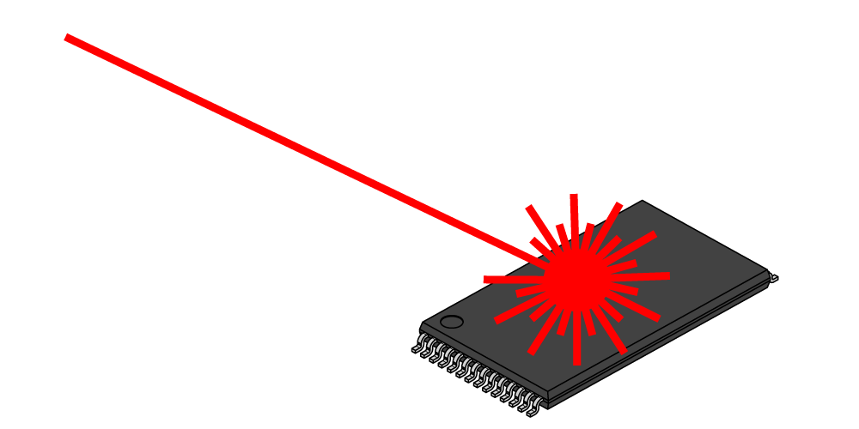
A Side Channel Attack on RSA with CRT
Suppose that decryption is done via Chinese Remainder Theorem for speed.
$${Dec}_{sk}^{}\left(c\right)=c^{d} mod N↔\left(c^{d} mod p,c^{d} mod q\right)$$
Attacker has physical access to smartcard
Can mess up computation of $c^{d} mod p$
Response is $R↔\left(r,c^{d} mod q\right)$
$R−m↔\left(r−m mod p,0 mod q\right)$
GCD(R-m,N)=q

Slide 44
Recovering Encrypted Message faster than Brute-Force
Claim: Let m < 2^{n} be a secret message. For some constant $α=\frac{1}{2}+ε.$ We can recover m in in time ${T=2}^{αn}$ with high probability.
For r=1,…,T
let $xr=\left[cr^{−e}mod N\right]$, where $r^{−e}={\left(r^{−1}\right)}^{e}mod N$
Sort $L={\left\{\left(r,x_{r}\right)\right\}}_{r=1}^{T}$ (by the x_{r} values)
For s=1,…,T
if $\left[s^{e}mod N\right]=x_{r}$for some r then
return $\left[rs mod N\right]$

Slide 45
Recovering Encrypted Message faster than Brute-Force
For r=1,…,T
let $xr=\left[cr^{−e}mod N\right]$, where $r^{−e}={\left(r^{−1}\right)}^{e}mod N$
Sort $L={\left\{\left(r,x_{r}\right)\right\}}_{r=1}^{T}$ (by the x_{r} values)
For s=1,…,T
if $\left[s^{e}mod N\right]=x_{r}$ for some r then
return $\left[rs mod N\right]$
Analysis: $\left[rs mod N\right]=\left[r\left(s^{e}\right)d mod N\right]=\left[r\left(xr\right)d mod N\right]$
$$=\left[r\left(cr^{−e}\right)d mod N\right]=\left[rr^{−ed}\left(c\right)d mod N\right]$$
$$=\left[rr^{−1}m mod N\right]=m$$

Slide 46
Recovering Encrypted Message faster than Brute-Force
For r=1,…,T
let $xr=\left[cr^{−e}mod N\right]$, where $r^{−e}={\left(r^{−1}\right)}^{e}mod N$
Sort $L={\left\{\left(r,x_{r}\right)\right\}}_{r=1}^{T}$ (by the x_{r} values)
For s=1,…,T
if $\left[s^{e}mod N\right]=x_{r}$ for some r then
return $\left[rs mod N\right]$
Fact: some constant $α=\frac{1}{2}+ε$ setting ${T=2}^{αn}$ with high probability we will find a pair s and x_{r} with $\left[s^{e}mod N\right]=xr$.

Slide 47
Recovering Encrypted Message faster than Brute-Force
Claim: Let m < 2^{n} be a secret message. For some constant $α=\frac{1}{2}+ε.$ We can recover m in in time ${T=2}^{αn}$ with high probability.
Roughly $\sqrt{B}$ steps to find a secret message m < B

Slide 48
CS 555: Week 10: Topic 3 Discrete Log + DDH Assumption

Slide 49
(Recap) Finite Groups
Definition: A (finite) group is a (finite) set $𝔾$with a binary operation $∘$ (over G) for which we have
(Closure:) For all $g,h∈𝔾$ we have $g∘h∈𝔾$
(Identity:) There is an element $e∈𝔾$ such that for all $g∈𝔾$ we have
$$g∘e=g=e∘g$$
(Inverses:) For each element $g∈𝔾$ we can find $h∈𝔾$ such that $g∘h=e$. We say that h is the inverse of g.
(Associativity: ) For all $g1,g2,g3∈𝔾$ we have
$$\left(g1∘g2\right)∘g3=g1∘\left(g2∘g3\right)$$
We say that the group is abelian if
(Commutativity:) For all $g,h∈𝔾$ we have $g∘h=$ $h∘g$

Slide 50
Finite Abelian Groups (Examples)
Example 1: $ℤ_{N}^{}$ when $∘$ denotes addition modulo N
Identity: 0, since 0 $∘$x =[0+x mod N] = [x mod N].
Inverse of x? Set x⁻¹=N-x so that [x⁻¹+x mod N] = [N-x+x mod N] = 0.
Example 2: $ℤ_{N}^{∗}$ when $∘$ denotes multiplication modulo N
Identity: 1, since 1$∘$x =[1(x) mod N] = [x mod N].
Inverse of x? Run extended GCD to obtain integers a and b such that
$$ax+bN=\gcd\left(x,N\right)=1$$
Observe that: x⁻¹ = a. Why?

Slide 51
Cyclic Group
Let $𝔾 be a group with order m=\left|𝔾\right|$with a binary operation $∘$ (over G) and let $g∈𝔾$ be given consider the set
$$\left\langle g\right\rangle =\left\{g0,g1,g2,…\right\}$$
Fact: $\left\langle g\right\rangle$ defines a subgroup of $𝔾.$
Identity: $g0$
Closure: $gi∘gj=g^{i+j}∈\left\langle g\right\rangle$
g is called a “generator” of the subgroup.
Fact: Let $r=\left|\left\langle g\right\rangle \right|$ then $g^{i }=gj$ if and only if $i=j mod r$. Also m is divisible by r.

Slide 52
Finite Abelian Groups (Examples)
Fact: Let p be a prime then $ℤ_{p}^{∗}$ is a cyclic group of order p-1.
Note: Number of generators g s.t. of $\left\langle g\right\rangle =ℤ_{p}^{∗}$ is $φ\left(p−1\right)$
Example (non-generator): p=7, g=2
<2>={1,2,4}
Example (generator): p=7, g=5
<2>={1,5,4,6,2,3}

Slide 53
Discrete Log Experiment DLog_{A,G}(n)
Run G(1^{n}) to obtain a cyclic group $𝔾$ of order q (with $\left\|q\right\|=n$) and a generator g such that $<g>=𝔾$.
Select$h∈𝔾$ uniformly at random.
Attacker A is given $𝔾$, q, g, h and outputs integer x.
Attacker wins (DLog_{A,G}(n)=1) if and only if g^{x}=h.
We say that the discrete log problem is hard relative to generator G if
$$∀PPT A ∃μ (negligible) s.t Pr\left[\text{DLog}\text{A}\text{,}\text{n} =1\right]≤μ(n)$$

Slide 54
Diffie-Hellman Problems
Computational Diffie-Hellman Problem (CDH)
Attacker is given $h1=g^{x_{1}}∈𝔾$ and $h2=g^{x_{2}}∈𝔾.$
Attackers goal is to find${ g}^{x_{1}x_{2}}={\left(h1\right)}^{x_{2}}={\left(h2\right)}^{x_{1}}$
CDH Assumption: For all PPT A there is a negligible function negl upper bounding the probability that A succeeds with probability at most negl(n).
Decisional Diffie-Hellman Problem (DDH)
L$et z0={ g}^{x_{1}x_{2}}$ and let $z1={ g}^{r}$, where x₁,x₂ and r are random
Attacker is given $g^{x_{1}}$, $g^{x_{2}}$ and $zb$ (for a random bit b)
Attackers goal is to guess b
DDH Assumption: For all PPT A there is a negligible function negl such that A succeeds with probability at most ½ + negl(n).

Slide 55
Secure key-agreement with DDH
Alice publishes ${ g}^{xA}$ and Bob publishes ${ g}^{xB}$
Alice and Bob can both compute ${K_{A,B}=g}^{xB xA}$ but to Eve this key is indistinguishable from a random group element (by DDH)
Remark: Protocol is vulnerable to Man-In-The-Middle Attacks if Bob cannot validate ${ g}^{xA}$.

Slide 56
Can we find a cyclic group where DDH holds?
Example 1: $ℤ_{p}^{∗}$ where p is a random n-bit prime.
CDH is believed to be hard
DDH is *not* hard (Exercise 13.15)
Theorem: $Let$p=rq+1 be a random n-bit prime where q is a large $λ$-bit prime then the set of r^{th} residues modulo p is a cyclic subgroup of order q. Then $𝔾_{r}=\left\{[h^{r}mod p] | {h∈ℤ}_{p}^{∗}\right\}$is a cyclic subgroup of $ℤ_{p}^{∗}$ of order q.
Remark 1: DDH is believed to hold for such a group
Remark 2: It is easy to generate uniformly random elements of $𝔾_{r}$
Remark 3: Any element (besides 1) is a generator of $𝔾_{r}$

Slide 57
Can we find a cyclic group where DDH holds?
Theorem: $Let$p=rq+1 be a random n-bit prime where q is a large $λ$-bit prime then the set of rth residues modulo p is a cyclic subgroup of order q. Then $𝔾_{r}=\left\{[h^{r}mod p] | {h∈ℤ}_{p}^{∗}\right\}$is a cyclic subgroup of $ℤ_{p}^{∗}$ of order q.
Closure: $hrgr={\left(hg\right)}^{r}$
Inverse of $hr$ is ${\left(h^{−1}\right)}^{r}∈𝔾_{r}$
Size ${\left(hr\right)}^{x}=h^{[rx mod rq]}={{\left(hr\right)}^{x}=h}^{r[x mod q]}={\left(hr\right)}^{[x mod q]}mod p$
Remark: Two known attacks on Discrete Log Problem for $𝔾_{r}$(Section 9.2).
First runs in time $O\left(\sqrt{q}\right)=O\left(2^{λ/2}\right)$
Second runs in time $2^{O\left(\sqrt[3]{n}{\left(\log{n}\right)}^{2/3}\right)}$

Slide 58
Can we find a cyclic group where DDH holds?
Remark: Two known attacks (Section 9.2).
First runs in time $O\left(\sqrt{q}\right)=O\left(2^{λ/2}\right)$
Second runs in time $2^{O\left(\sqrt[3]{n}{\left(\log{n}\right)}^{2/3}\right)},$where n is bit length of p
Goal: Set $λ$ and n to balance attacks
$$λ=O\left(\sqrt[3]{n}{\left(\log{n}\right)}^{2/3}\right)$$
How to sample p=rq+1?
First sample a random $λ$-bit prime q and
Repeatedly check if rq+1 is prime for a random n- $λ$ bit value r

Slide 59
Can we find a cyclic group where DDH holds?
Elliptic Curves Example: Let p be a prime (p > 3) and let A, B be constants. Consider the equation
$$y2=x3+Ax+B mod p$$
And let
$$E\left(ℤ_{p}^{}\right)=\left\{\left(x,y\right)∈ℤ_{p}^{2} | y2=x3+Ax+B mod p \right\}∪\left\{𝒪\right\}$$
Note: $𝒪$ is defined to be an additive identity $\left(x,y\right)+𝒪=\left(x,y\right)$
W$hat is \left(x1,y1\right)+\left(x2,y2\right)?$

Slide 60
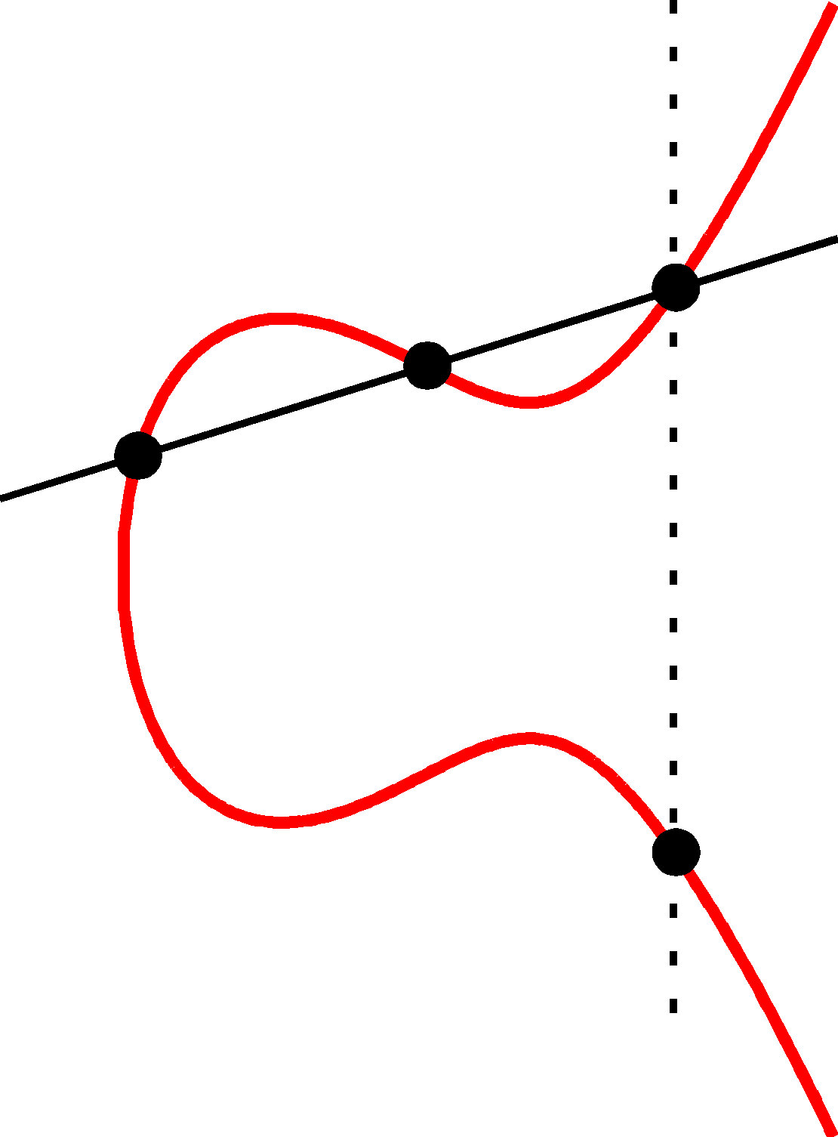
Elliptic Curve Example
$$\left(x2,y2\right)$$
(x₃,y₃)
The line passing through $\left(x1,y1\right)$ and $\left(x2,y2\right)$ has the equation
$$y=m\left(x−x1\right)+y1 mod P$$
Where the slope
$$m=\left[\frac{y1−y2}{x1−x2} mod p\right]$$
$$\left(x1,y1\right)$$
(x₃,-y₃)=$\left(x1,y1\right)+\left(x2,y2\right)$

Slide 61
Elliptic Curve Example
$$\left(x2,y2\right)$$
(x₃,y₃)
$$\left(x1,y1\right)$$
Formally, let
$$m=\left[\frac{y1−y2}{x1−x2} mod p\right]$$
Be the slope. Then the line passing through $\left(x1,y1\right)$ and $\left(x2,y2\right)$ has the equation
$$y=m\left(x−x1\right)+y1 mod P$$
$$\left(m\left(x−x1\right)+y1\right)2=x3+Ax+B mod p$$
(x₃,-y₃)=$\left(x1,y1\right)+\left(x2,y2\right)$
$$x3=[m2−x1−x2 mod p]$$
$$y3=[m\left(x3−x1\right)+y1 mod p]$$

Slide 62
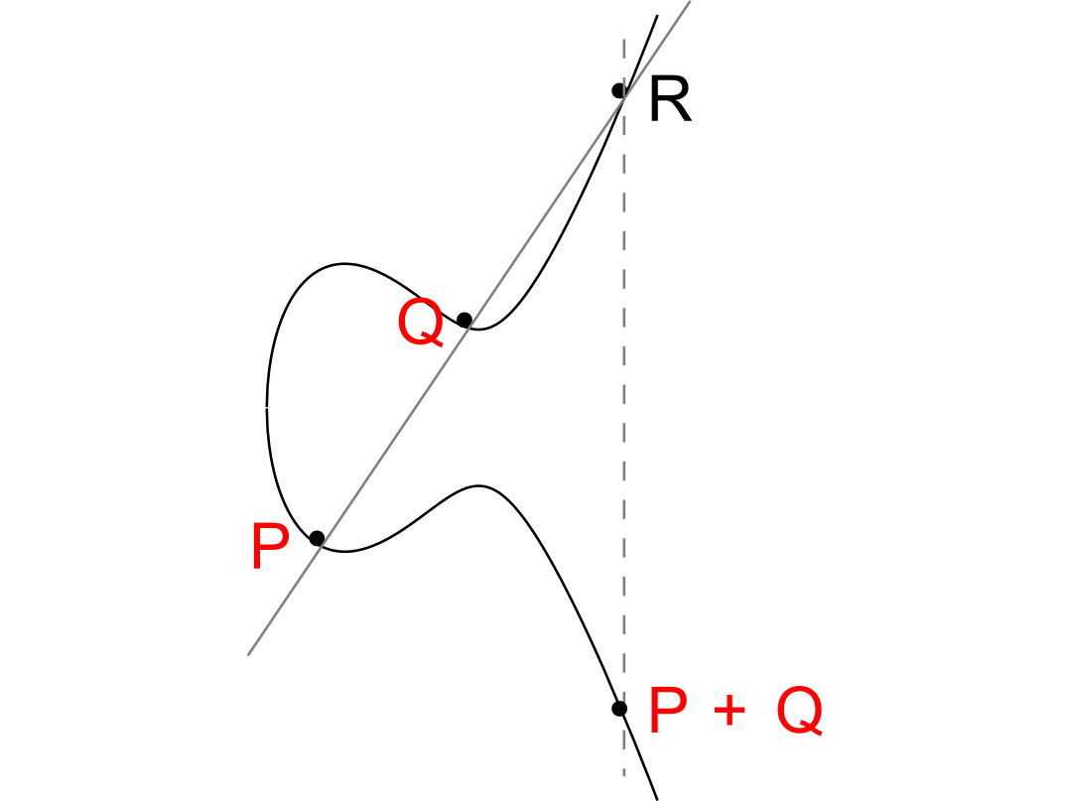

Slide 63
Elliptic Curve Example
No third point R on the elliptic curve.
P+Q = 0

Slide 64
Can we find a cyclic group where DDH holds?
Elliptic Curves Example: Let p be a prime (p > 3) and let A, B be constants. Consider the equation
$$y2=x3+Ax+B mod p$$
And let
$$E\left(ℤ_{p}^{}\right)=\left\{\left(x,y\right)∈ℤ_{p}^{2} | y2=x3+Ax+B mod p \right\}∪\left\{𝒪\right\}$$
Fact: $E\left(ℤ_{p}^{}\right)$ defines an abelian group
For appropriate curves the DDH assumption is believed to hold
If you make up your own curve there is a good chance it is broken…
NIST has a list of recommendations

