Slide 1
Cryptography
CS 555
Week 1:
Course Overview & What is Cryptography
Historical Ciphers (& How to Break Them)
Perfect Secrecy
Readings: Katz and Lindell Chapter 1-2 + Appendix A.3 (background)
Fall 2017

Slide 2
Topic 1: Course Overview & What is Cryptography

Slide 3
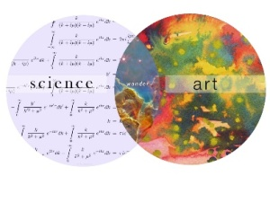
What is Cryptography?
“the art of writing or solving codes” – Concise Oxford English Dictionary

Slide 4
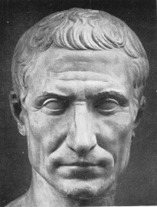
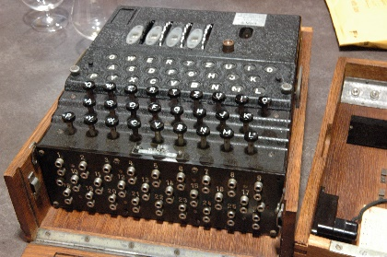
What is Cryptography?
“the art of writing or solving codes” – Concise Oxford English Dictionary
“The study of mathematical techniques for securing digital information, systems and distributed computation against adversarial attacks.”
-- Intro to Modern Cryptography
Late 20th century
Art
Science

Slide 5
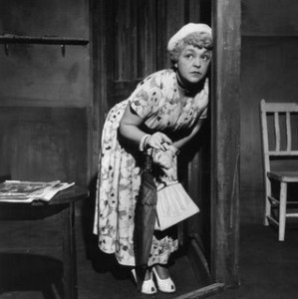
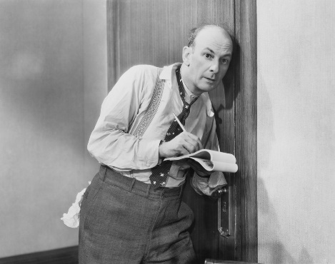
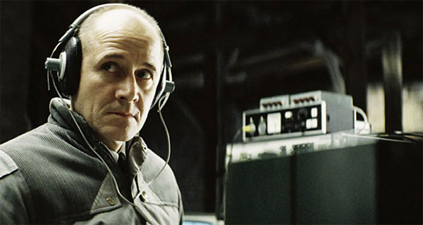
What Does It Mean to “Secure Information”
Confidentiality (Security/Privacy)
  Only intended recipient can see the communication

Slide 6




What Does It Mean to “Secure Information”
Confidentiality (Security/Privacy)
  Only intended recipient can see the communication
Integrity (Authenticity)
  The message was actually sent by the alleged sender
I love you Alice… - Bob
We need to break up -Bob
Alice
Bob

Slide 7
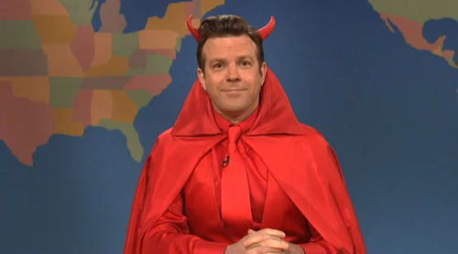

Two Attacker Models
Passive Attacker
  Attacker can eavesdrop
  Protection Requires?
    Confidentiality
Active Attacker
  Has full control over communication channel
  Protection Requires?
    Confidentiality & Integrity

Slide 8

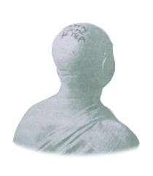
Steganography vs Cryptography
Steganography
  Goal: Hide existence of a message
    Invisible Ink, Tattoo Underneath Hair, …
  Assumption: Method is secret
Notes:
Herodotus, an entertaining but less than reliable Greek historian, reports a more ingenious method. Histaeus, ruler of Miletus, wanted to send a message to his friend Aristagorus, urging revolt against the Persians. Histaeus shaved the head of his most trusted slave, then tattooed a message on the slave's scalp. After the hair grew back, the slave was sent to Aristagorus with the message safely hidden.
Later in Herodotus' histories, the Spartans received word that Xerxes was preparing to invade Greece. Their informant, Demeratus, was a Greek in exile in Persia. Fearing discovery, Demeratus wrote his message on the wood backing of a wax tablet. He then hid the message underneath a fresh layer of wax. The apparently blank tablet sailed easily past sentries on the road.
A more subtle method, nearly as old, is to use invisible ink. Described as early as the first century AD, invisible inks were commonly used for serious communications until WWII. The simplest are organic compounds, such as lemon juice, milk, or urine, all of which turn dark when held over a flame. In 1641, Bishop John Wilkins suggested onion juice, alum, ammonia salts, and for glow-in-the dark writing the "distilled Juice of Glowworms." Modern invisible inks fluoresce under ultraviolet light and are used as anti-counterfeit devices. For example, "VOID" is printed on checks and other official documents in an ink that appears under the strong ultraviolet light used for photocopies.
A modern area that is related to both is information hiding or covert channels. Embed messages in places not intended for storing information. They can use cryptographic approaches to ensure secrecy, and do not rely only on secrecy of method.

Slide 9
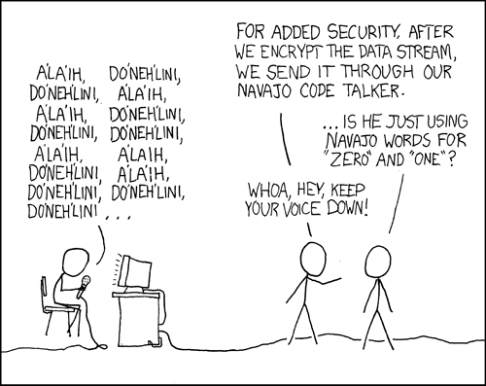
Steganography vs Cryptography
Steganography
  Goal: Hide existence of a message
    Invisible Ink, Tattoo Underneath Hair, …
  Assumption: Method is secret
Cryptography
  Goal: Hide the meaning of a message
  Depends only on secrecy of a (short) key
  Kerckhoff’s Principle: Cipher method should
  not be required to be secret.
Notes:
Herodotus, an entertaining but less than reliable Greek historian, reports a more ingenious method. Histaeus, ruler of Miletus, wanted to send a message to his friend Aristagorus, urging revolt against the Persians. Histaeus shaved the head of his most trusted slave, then tattooed a message on the slave's scalp. After the hair grew back, the slave was sent to Aristagorus with the message safely hidden.
Later in Herodotus' histories, the Spartans received word that Xerxes was preparing to invade Greece. Their informant, Demeratus, was a Greek in exile in Persia. Fearing discovery, Demeratus wrote his message on the wood backing of a wax tablet. He then hid the message underneath a fresh layer of wax. The apparently blank tablet sailed easily past sentries on the road.
A more subtle method, nearly as old, is to use invisible ink. Described as early as the first century AD, invisible inks were commonly used for serious communications until WWII. The simplest are organic compounds, such as lemon juice, milk, or urine, all of which turn dark when held over a flame. In 1641, Bishop John Wilkins suggested onion juice, alum, ammonia salts, and for glow-in-the dark writing the "distilled Juice of Glowworms." Modern invisible inks fluoresce under ultraviolet light and are used as anti-counterfeit devices. For example, "VOID" is printed on checks and other official documents in an ink that appears under the strong ultraviolet light used for photocopies.
A modern area that is related to both is information hiding or covert channels. Embed messages in places not intended for storing information. They can use cryptographic approaches to ensure secrecy, and do not rely only on secrecy of method.

Slide 10
Symmetric Key Encryption
What cryptography has historically been all about (Pre 1970)
Two parties (sender and receiver) share secret key
Sender uses key to encrypt (“scramble”) the message before transmission
Receiver uses the key to decrypt (“unscramble”) and recover the original message

Slide 11
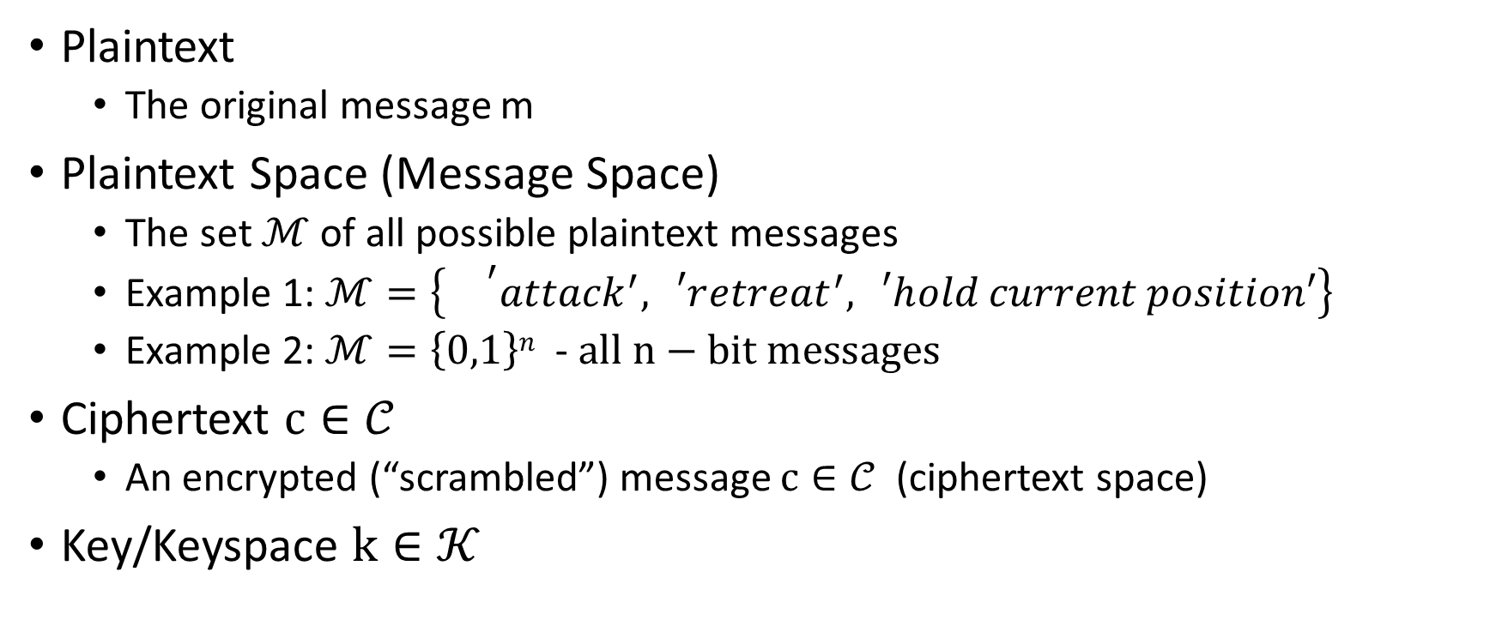
Encryption: Basic Terminology
Plaintext
  The original message m
Plaintext Space (Message Space)
  The set $ℳ$ of all possible plaintext messages
  Example 1: $ℳ=\left\{{}^{′}attack^{′},{}_{}^{′}retreat^{′},{}_{}^{′}hold current position′\right\}$
  Example 2: $ℳ=\left\{0,1\right\}n$ - $all n−bit messages$
Ciphertext $c∈𝒞$
  An encrypted (“scrambled”) message $c∈𝒞$ (ciphertext space)
Key/Keyspace $k∈𝒦$

Slide 12
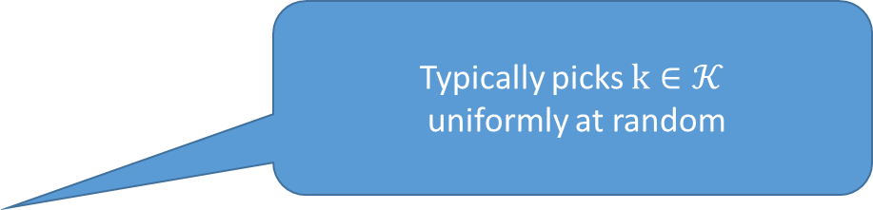
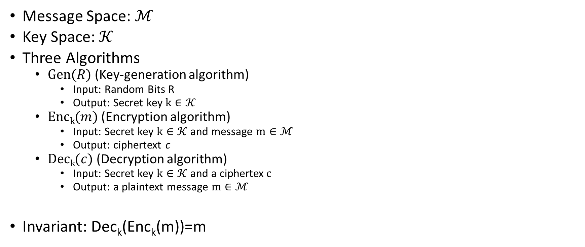
Private Key Encryption Syntax
    Typically picks $k∈𝒦$
uniformly at random
Message Space: $ℳ$
Key Space: $𝒦$
Three Algorithms
  $\operatorname{Gen}{(R)}$ (Key-generation algorithm)
    Input: Random Bits R
    Output: Secret key $k∈𝒦$
  $\operatorname{Enck}{(m)}$ (Encryption algorithm)
    Input: Secret key $k∈𝒦$ and message $m∈ℳ$
    Output: ciphertext c
  $\operatorname{Deck}{(c)}$ (Decryption algorithm)
    Input: Secret key $k∈𝒦$ and a ciphertex$c$
    Output: a plaintext message $m∈ℳ$
Invariant: Dec_{k}(Enc_{k}(m))=m
    Trusted Parties (e.g., Alice and Bob) must run Gen in advance to obtain secret k.
    Assumption: Adversary does not get to see output of Gen

Slide 13
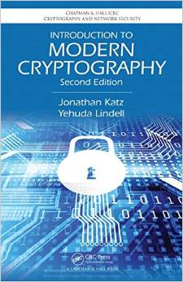
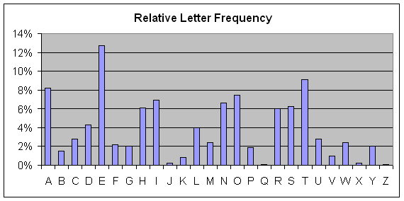

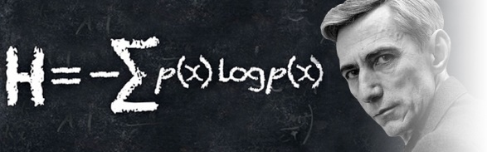
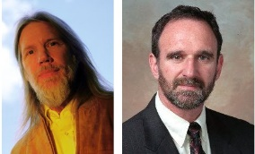
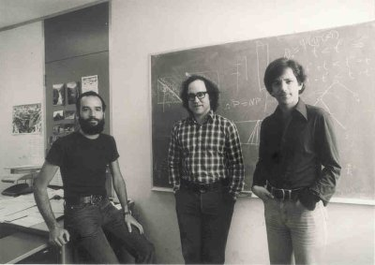
Cryptography History
2500+ years
Ongoing battle
  Codemakers and codebreakers
Formalization of Modern Crypto (1976+)
Caesar Shift Cipher (50 BC)
Shannon Entropy/Perfect Secrecy
(~1950)
1970s
Cipher Machines (1900s)
Frequency Analysis
Public Key Crypto/RSA

Slide 14



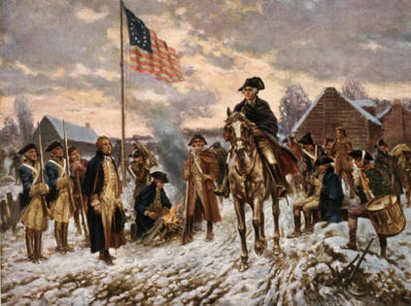

Who Uses Cryptography
Traditionally: Militias
Modern Times: Everyone!
Caesar Shift Cipher (50 BC)
Revolutionary War
Modern Crypto

Slide 15
Course Goals
Understand the mathematics underlying cryptographic algorithms and protocols
Understand the power (and limitations) of common cryptographic tools
Understand the formal approach to security in modern cryptography

Slide 16
Course Background
Some probability
Algorithms and complexity
General Mathematical Maturity
  Understand what is (is not) a proper definition
  Know how to write a proof

Slide 17
Topic 2: Historical Ciphers (& How to Break Them)

Slide 18
Symmetric Key Encryption
What cryptography has historically been all about (Pre 1970)
Two parties (sender and receiver) share secret key
Sender uses key to encrypt (“scramble”) the message before transmission
Receiver uses the key to decrypt (“unscramble”) and recover the original message

Slide 19
Encryption: Basic Terminology
Plaintext
  The original message m
Plaintext Space (Message Space)
  The set $ℳ$ of all possible plaintext messages
  Example 1: $ℳ=\left\{{}^{′}attack^{′},{}_{}^{′}retreat^{′},{}_{}^{′}hold current position′\right\}$
  Example 2: $ℳ=\left\{0,1\right\}n$ - $all n−bit messages$
Ciphertext $c∈𝒞$
  An encrypted (“scrambled”) message $c∈𝒞$ (ciphertext space)
Key/Keyspace $k∈𝒦$

Slide 20
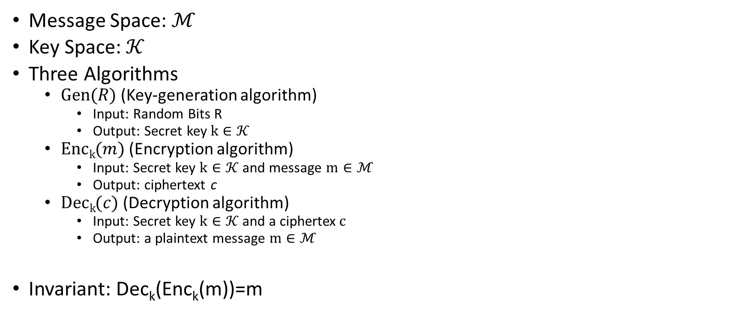
Private Key Encryption Syntax
    Typically picks $k∈𝒦$
uniformly at random
Message Space: $ℳ$
Key Space: $𝒦$
Three Algorithms
  $\operatorname{Gen}{(R)}$ (Key-generation algorithm)
    Input: Random Bits R
    Output: Secret key $k∈𝒦$
  $\operatorname{Enck}{(m)}$ (Encryption algorithm)
    Input: Secret key $k∈𝒦$ and message $m∈ℳ$
    Output: ciphertext c
  $\operatorname{Deck}{(c)}$ (Decryption algorithm)
    Input: Secret key $k∈𝒦$ and a ciphertex$c$
    Output: a plaintext message $m∈ℳ$
Invariant: Dec_{k}(Enc_{k}(m))=m
    Trusted Parties (e.g., Alice and Bob) must run Gen in advance to obtain secret k.
    Assumption: Adversary does not get to see output of Gen

Slide 21
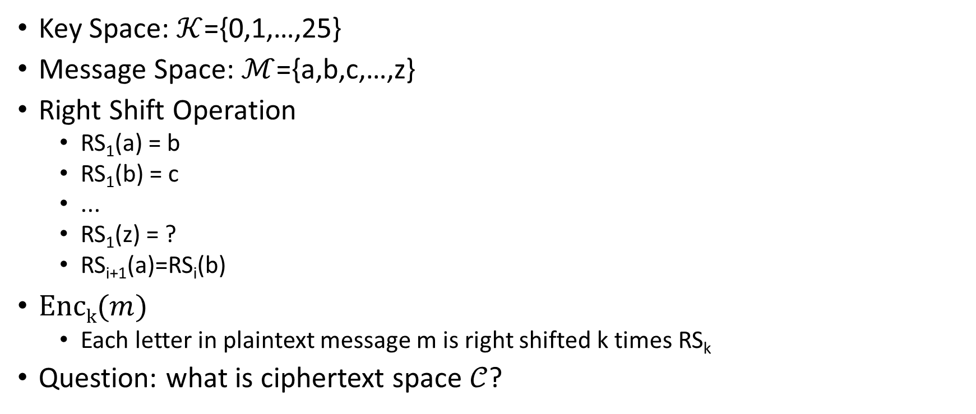
Shift Cipher
Key Space: $𝒦$={0,1,…,25}
Message Space: $ℳ$={a,b,c,…,z}
Right Shift Operation
  RS₁(a) = b
  RS₁(b) = c
  ...
  RS₁(z) = ?
  RS_{i+1}(a)=RS_{i}(b)
$\operatorname{Enck}{(m)}$
  Each letter in plaintext message m is right shifted k times RS_{k}
Question: what is ciphertext space $𝒞$?

Slide 22
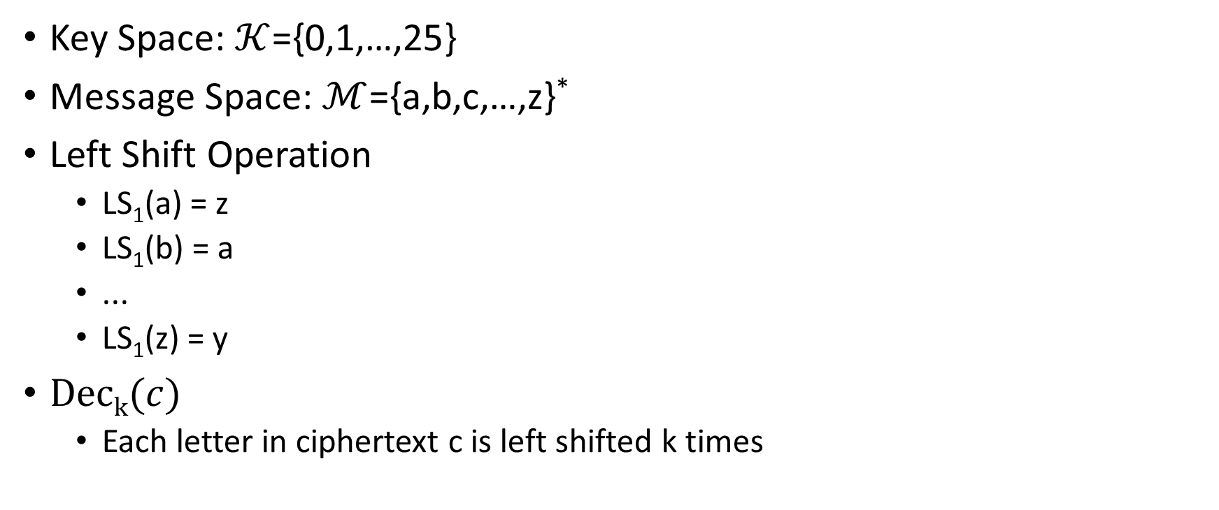
Shift Cipher
Key Space: $𝒦$={0,1,…,25}
Message Space: $ℳ$={a,b,c,…,z}*
Left Shift Operation
  LS₁(a) = z
  LS₁(b) = a
  ...
  LS₁(z) = y
$\operatorname{Deck}{(c)}$
  Each letter in ciphertext c is left shifted k times

Slide 23
Caesar Cipher
Three shall be the number of thy shifting and the number of thy shifting shall be three. Four shalt thou not shift, neither shift thou two, excepting that thou then proceed to three. Five is right out…..
Caesar adopted the shift cipher with secret key k=3

Slide 24
Caesar Cipher (Example)
BEGINTHEATTACKNOW
→
EHJLQWKHDWWDFNQRZ
Caesar adopted the shift cipher with secret key k=3

Slide 25
Caesar Cipher (Example)
BEGINTHEATTACKNOW
→
EHJLQWKHDWWDFNQRZ
Immediate Issue: anyone who knows method can decrypt
(since k=3 is fixed)

Slide 26
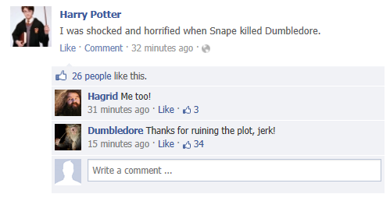
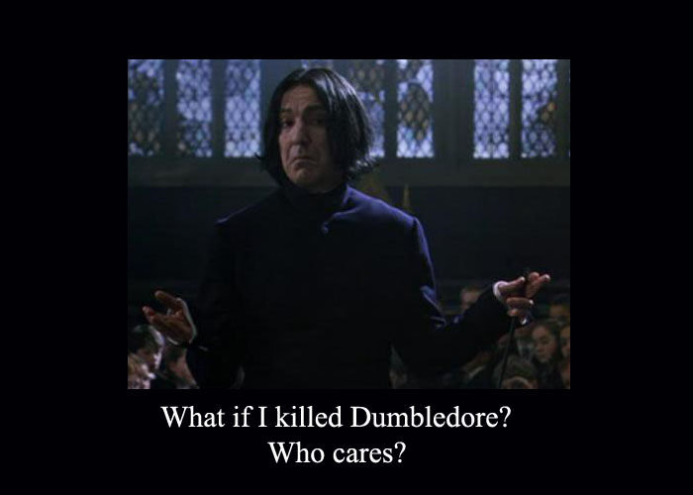
Modern Application: Avoid Spoilers (ROT13)

Slide 27
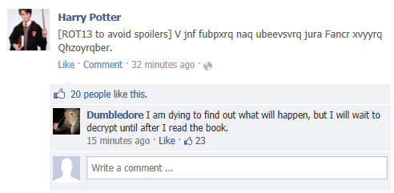
Modern Application: Avoid Spoilers (ROT13)

Slide 28
Shift Cipher: Brute Force Attack
Ciphertext: “lwxrw ztn sd ndj iwxcz xh gxvwi?”
  k=1 → m = “mxysx auo te oek jxyda yi hywxj?”
  k=2 → m=“nyzty bvp uf pfl kyzeb zj izxyk?”
  k=3 → m=“ozauz cwq vg qgm lzafc ak jayzl?”
  k=4 → m = “pabva dxr wh rhn mabgd bl kbzam?”
  k=5 → m=“qbcwb eys xi sio nbche cm lcabn?”
  k=6 → m=“rcdxc fzt yj tjp ocdif dn mdbco?”

Slide 29
Shift Cipher: Brute Force Attack
Ciphertext: “lwxrw ztn sd ndj iwxcz xh gxvwi?”
  …
  k=7 → m=“sdeyd gau zk ukq pdejg eo necdp?”
  k=8 → m=“tefze hbv al vlr qefkh fp ofdeq?”
  k=9 → m = “ufgaf icw bm wms rfgli gq pgefr?”
  k=10 → m=“vghbg jdx cn xnt sghmj hr qhfgs?”
  k=11→ m= “which key do you think is right?”
  k=12→ m= “xijdi lfz ep zpv uijol jt sjhiu?”

Slide 30
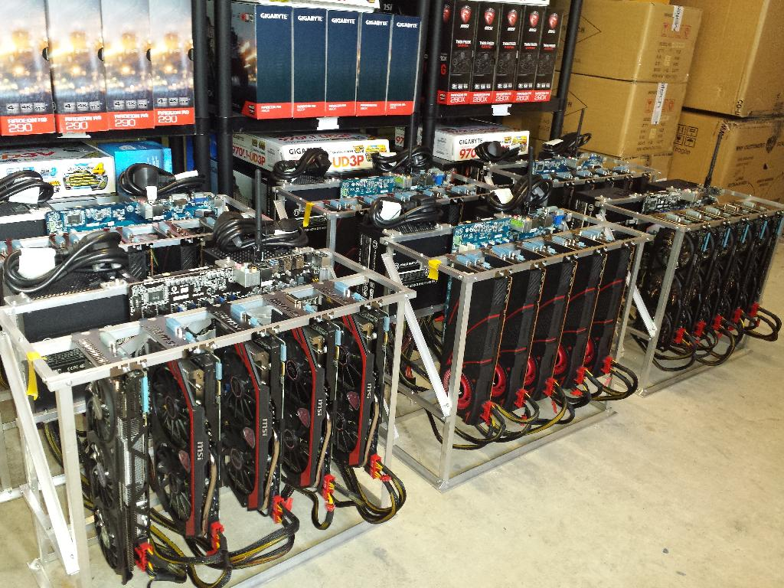
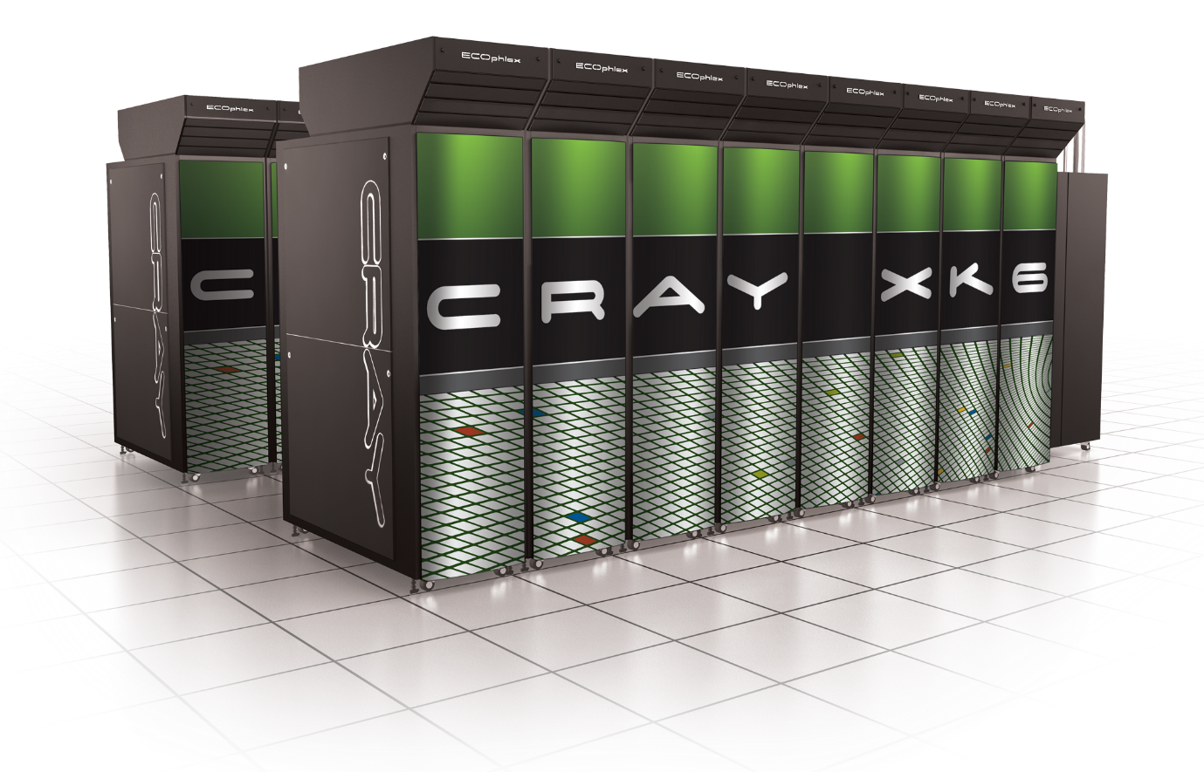
Sufficient Key Space Principle
“Any secure encryption scheme must have a key space that is sufficiently large to make an exhaustive search attack infeasible.”
Notes:
Attackers can user supercomputer, GPUs, Application Specific Integrated Circtuits etc… to speed up brute-force attacks. Key space should have size at least 2^70….probably larger to provide long term security against well funded attackers…

Slide 31
Sufficient Key Space Principle
“Any secure encryption scheme must have a key space that is sufficiently large to make an exhaustive search attack infeasible.”
Question 1: How big is big enough? Complicated question….
Question 2: If the key space is large is the encryption scheme necessarily secure?

Slide 32
Substitution Cipher
Secret key K is permutation of the alphabet
  Example:
    A B C D E F G H I J K L M N O P Q R S T U V W X Y Z
    X E U A D N B K V M R O C Q F S Y H W G L Z I J P T
Encryption: apply permutation K to each letter in message
  TELLHIMABOUTME → GDOOKVCXEFLGCD
Decryption: reverse the permutation

Slide 33
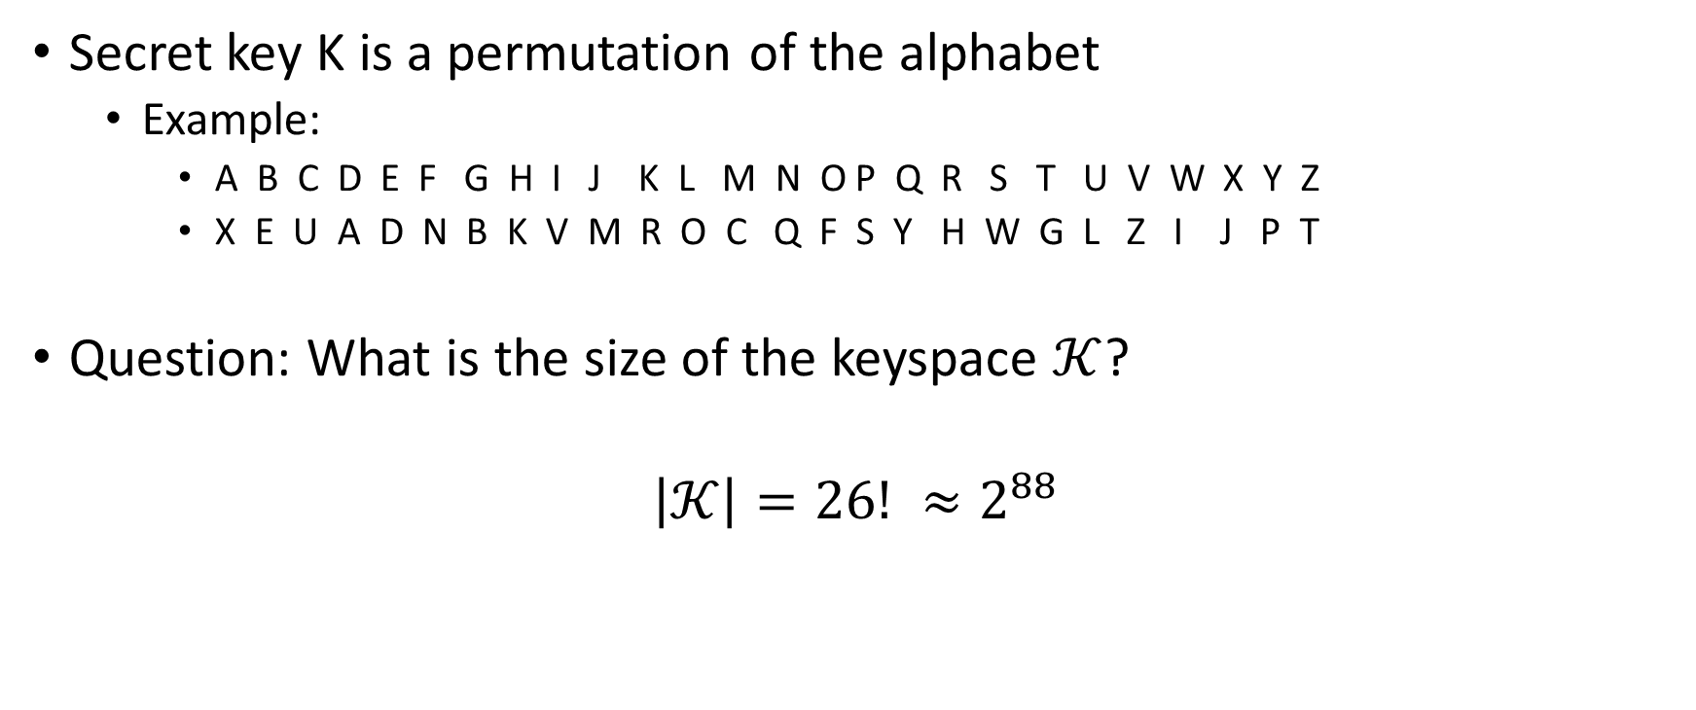
Substitution Cipher
Secret key K is a permutation of the alphabet
  Example:
    A B C D E F G H I J K L M N O P Q R S T U V W X Y Z
    X E U A D N B K V M R O C Q F S Y H W G L Z I J P T
Question: What is the size of the keyspace $𝒦$?
$$\left|𝒦\right|=26! ≈2^{88}$$

Slide 34
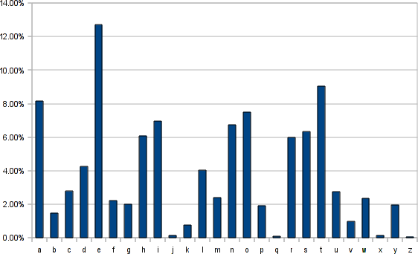
Frequency Analysis
Observation 1: If e is mapped to d then every appearance of e in the plaintext results in the appearance of a d in the ciphertext
Observation 2: Some letters occur much more frequently in English.
Observation 3: Texts consisting of a few sentences tend to have a distribution close to average.
Step 1: Find letter in ciphertext that occurs with
frequency > 11%. This letter is probably e…

Slide 35
Vigenere Cipher
Generalizes Shift Cipher
K=k₁,…,k_{t}
Enc_{K}(m)
  Shift first letter right k₁ times
  Shift second letter right k₂ times
  …
  Shift t^{th} letter right k_{t} times
  Shift t+1st letter right k₁ times
  …
Question: Size of key-space?
Answer: 26^{t} (brute force may not be useful)

Slide 36
Vigenere Cipher
Still vulnerable to frequency analysis
Good guess: Select K=k₁,…,k_{t} to maximize number of e’s in resulting ciphertext
  See Katz and Lindell 1.3 for even more sophisticated heuristics.
Works if the initial message m is long enough
Vigenere is perfectly secure if the message m is at most t letters long.

Slide 37
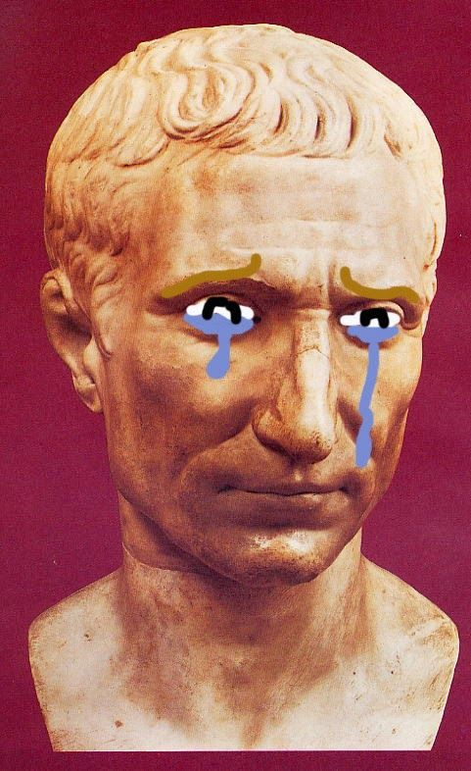
Conclusions
Designing secure ciphers is hard
Vigenere remained “unbroken” for a long time
Complex schemes are not secure
All historical ciphers have fallen

Slide 38
Topic 3: Perfect Secrecy + One-Time-Pads

Slide 39
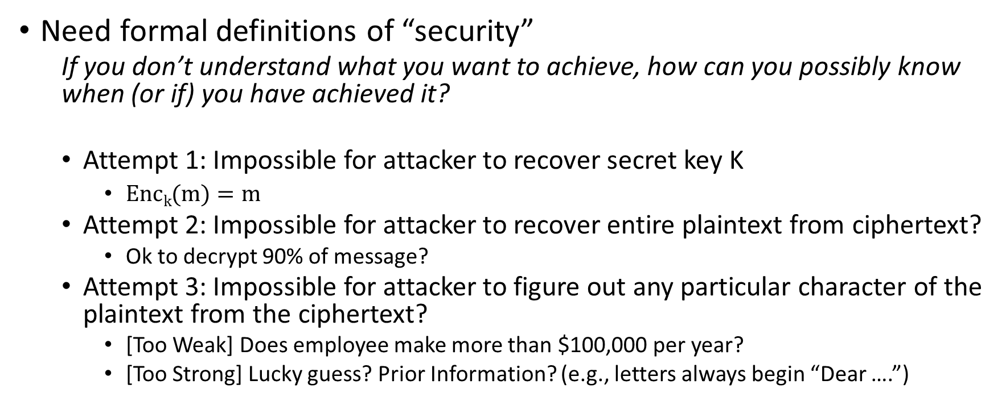
Principles of Modern Cryptography
Need formal definitions of “security”
  If you don’t understand what you want to achieve, how can you possibly know when (or if) you have achieved it?
  Attempt 1: Impossible for attacker to recover secret key K
    $\operatorname{Enck}{(m)}=m$
  Attempt 2: Impossible for attacker to recover entire plaintext from ciphertext?
    Ok to decrypt 90% of message?
  Attempt 3: Impossible for attacker to figure out any particular character of the plaintext from the ciphertext?
    [Too Weak] Does employee make more than $100,000 per year?
    [Too Strong] Lucky guess? Prior Information? (e.g., letters always begin “Dear ….”)

Slide 40
Principles of Modern Cryptography
Need formal definitions of “security”
  If you don’t understand what you want to achieve, how can you possibly know when (or if) you have achieved it?
  Final Attempt: Regardless of information an attacker already has, a ciphertext should leak no additional information about the underlying plaintext.
    This is the “right” approach
    Still need to formalize mathematically
Security definition includes goal and threat-model

Slide 41
Principles of Modern Cryptography
Proofs of Security are critical
  Iron-clad guarantee that attacker will not succeed (relative to definition/assumptions)
Experience: intuition is often misleading in cryptography
  An “intuitively secure” scheme may actually be badly broken.
Before deploying in the real world
  Consider definition/assumptions in security definition
  Does the threat model capture the attackers true abilities?

Slide 42
Perfect Secrecy Intuition
  Regardless of information an attacker already has, a ciphertext should leak no additional information about the underlying plaintext.
We will formalize this intuition
  And show how to achieve it

Slide 43
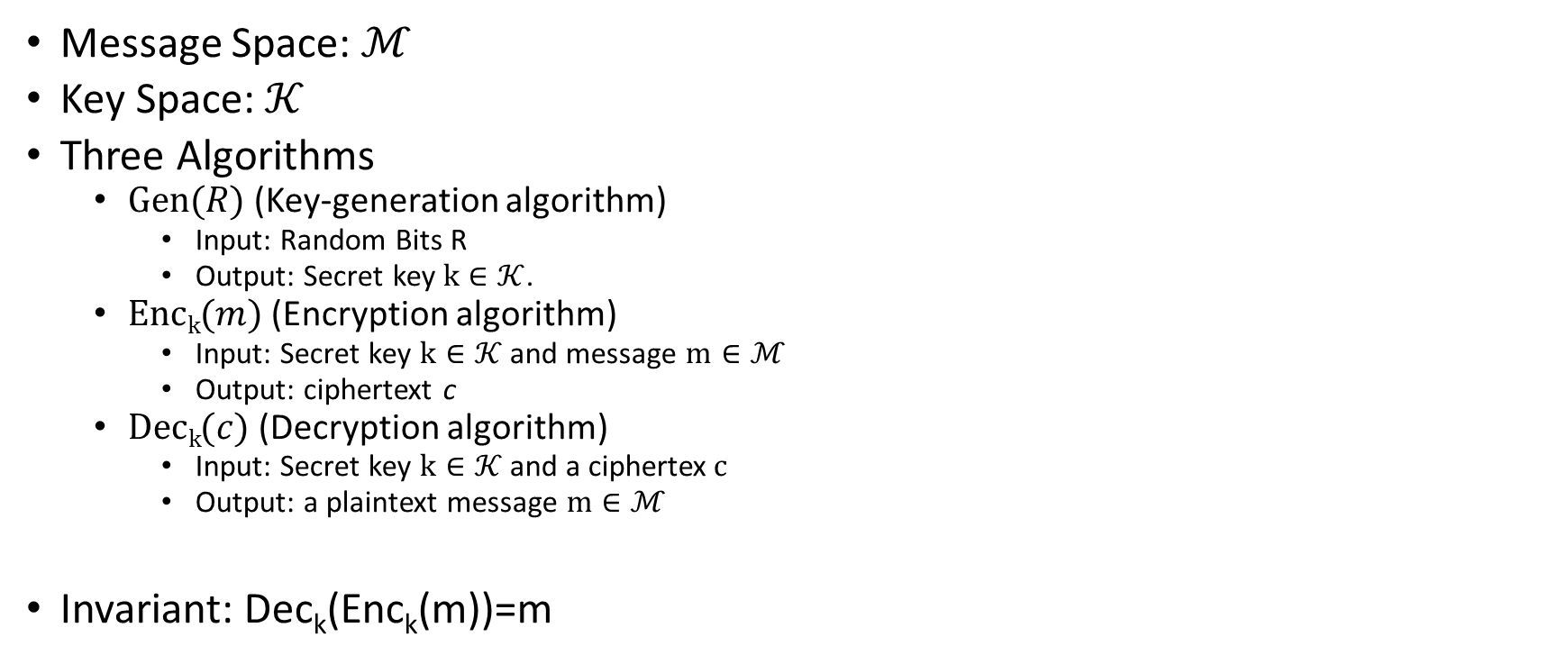
Private Key Encryption Syntax
    Typically picks $k∈𝒦$
uniformly at random
Message Space: $ℳ$
Key Space: $𝒦$
Three Algorithms
  $\operatorname{Gen}{(R)}$ (Key-generation algorithm)
    Input: Random Bits R
    Output: Secret key $k∈𝒦$.
  $\operatorname{Enck}{(m)}$ (Encryption algorithm)
    Input: Secret key $k∈𝒦$ and message $m∈ℳ$
    Output: ciphertext c
  $\operatorname{Deck}{(c)}$ (Decryption algorithm)
    Input: Secret key $k∈𝒦$ and a ciphertex$c$
    Output: a plaintext message $m∈ℳ$
Invariant: Dec_{k}(Enc_{k}(m))=m
    Trusted Parties (e.g., Alice and Bob) must run Gen in advance to obtain secret k.
    Assumption: Adversary does not get to see output of Gen

Slide 44
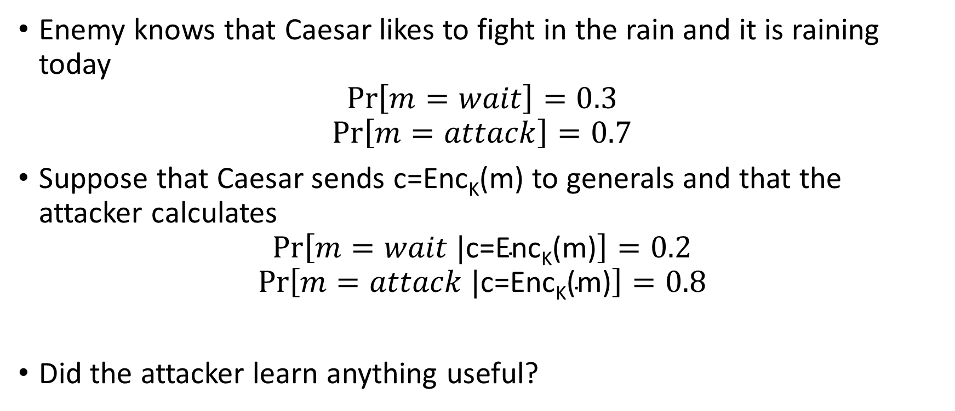
An Example
Enemy knows that Caesar likes to fight in the rain and it is raining today
$$Pr\left[m=wait\right]=0.3$$
$$Pr\left[m=attack\right]=0.7$$
Suppose that Caesar sends c=Enc_{K}(m) to generals and that the attacker calculates
$$Pr\left[m=wait |\text{c}\text{=}\text{EncK}\text{(}\text{m}\text{)}\right]=0.2$$
$$Pr\left[m=attack |\text{c}\text{=}\text{EncK}\text{(}\text{m}\text{)}\right]=0.8$$
Did the attacker learn anything useful?

Slide 45
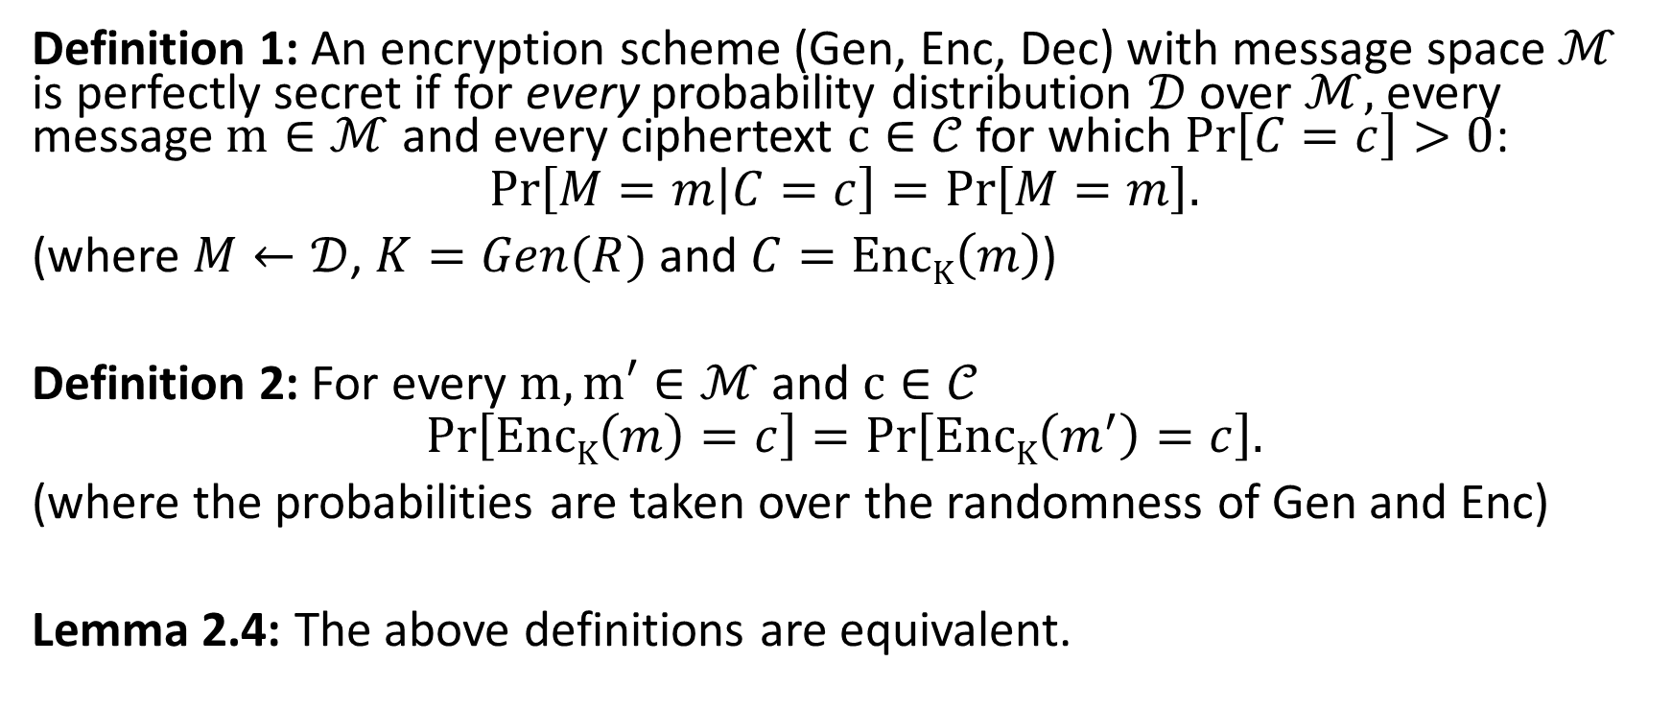
Perfect Secrecy
Definition 1: An encryption scheme (Gen, Enc, Dec) with message space $ℳ$ is perfectly secret if for every probability distribution $𝒟$ over $ℳ,$every message $m∈ℳ$ and every ciphertext $c∈𝒞$ for which $Pr\left[C=c\right]>0$:
$$Pr\left[M=m\left|C=c\right.\right]=Pr\left[M=m\right].$$
(where $M←𝒟$, $K=Gen(R)$ and $C=EncK\left(m\right)$)
Definition 2: For every $m,m′∈ℳ$ and $c∈𝒞$
$$Pr\left[EncK\left(m\right)=c\right]=Pr\left[EncK\left(m^{′}\right)=c\right].$$
(where the probabilities are taken over the randomness of Gen and Enc)
Lemma 2.4: The above definitions are equivalent.
Notes:
Proof: Suppose first that (Gen,Enc,Dec) does not satisfy definition 2. Then there exists $m,m′∈ℳ$ and $c∈𝒞$ such that
$$Pr\left[EncK\left(m\right)=c\right]≠Pr\left[EncK\left(m^{′}\right)=c\right] (1).$$
Now suppose for contradiction that Definition 1 holds and define the distribution $𝒟$ such that Pr[M=m]=1/2=Pr[M=m’] when $M←𝒟$. By definition 1 we have $Pr\left[M=m\left|C=c\right.\right]=Pr\left[M=m\left|EncK\left(m\right)=c\right.\right]=\text{Pr}\text{[}\text{M}\text{=}\text{m}\text{]}=\frac{1}{2}=Pr\left[M=m′\left|EncK\left(m′\right)=c\right.\right].$ Notice that by Bayes Theorem we have
$$\frac{1}{2}=Pr\left[M=m\left|EncK\left(m\right)=c\right.\right]=\frac{Pr\left[C=c\left|M=m\right.\right]\text{Pr}\text{[}\text{M}\text{=}\text{m}\text{]}}{\text{Pr}\text{[}\text{C}\text{=}\text{c}\text{]}}=\frac{Pr\left[C=c\left|M=m\right.\right]}{2\text{Pr}\text{[}\text{C}\text{=}\text{c}\text{]}}(2)$$
And similarly
$$\frac{1}{2}=Pr\left[M=m′\left|EncK\left(m′\right)=c\right.\right]=\frac{Pr\left[C=c\left|M=m′\right.\right]}{2\text{Pr}\text{[}\text{C}\text{=}\text{c}\text{]}} (3)$$
It follows that
$$Pr\left[C=c\left|M=m′\right.\right]=Pr\left[C=c\left|M=m\right.\right] (4)$$
We now observe that
$$Pr\left[C=c\left|M=m\right.\right]=Pr\left[EncK\left(m\right)=c\left|M=m\right.\right]=Pr\left[EncK\left(m\right)=c\right] (5)$$
Where the first inequality follows by definition of C and the second follows because we condition on the event that M=m.
From (4) + (5) we reach the conclusion that
$$Pr\left[EncK\left(m\right)=c\right]=Pr\left[EncK\left(m^{′}\right)=c\right]$$
In contradiction of our assumption (1). See textbook for other direction of proof.

Slide 46
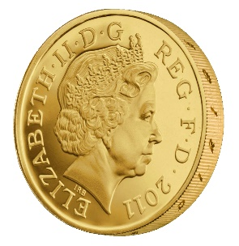

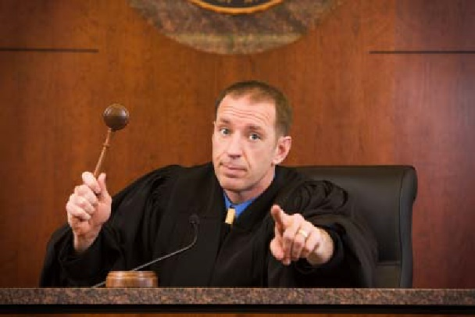



Another Equivalent Definition (Game)
m₀, m₁
Random bit b
K = Gen(.)
c = Enc_{K}(m_{b})
c
b’
$$∀\begin{matrix} & \\ & \\ & \end{matrix} Pr\left[\begin{matrix} & \\ & \end{matrix} Guesses b^{′}=b\right]=\frac{1}{2}$$
Notes:
Suppose we have m,m’,c’ s.t. Pr[EncK(m)= c’] > Pr[EncK(m’)=c’] then adversary can select m0= m, m1=m’. If the ciphertext challenge c=c’ then the adversary outputs guess b’ = 1. Otherwise, the adversary outputs random guess b’.

Slide 47
Another Equivalent Definition (Game)
m₀, m₁
Random bit b
K = Gen(.)
c = Enc_{K}(m_{b})
c
b’
Suppose we have m,m’,c’ s.t. Pr[Enc_{K}(m)= c’] > Pr[Enc_{K}(m’)=c’] then the adversary can win the game w.p > ½. How?
What else do we need to establish to prove that the definitions are equivalent?
Notes:
Suppose we have m,m’,c’ s.t. Pr[EncK(m)= c’] > Pr[EncK(m’)=c’] then adversary can select m0= m, m1=m’. If the ciphertext challenge c=c’ then the adversary outputs guess b’ = 1. Otherwise, the adversary outputs random guess b’. Let Wins
Denote the event that the attacker wins the game.
Pr[Wins|c!=c’] = 1/2
Pr[Wins|c=c’] = Pr[b=1|c=c’] = Pr[b=1 and c=c’]/Pr[c=c’] = (1/2)Pr[Enck(m1)=c’]/Pr[c=c’]
Pr[Wins|c=c’] *Pr[c=c’] = (1/2) Pr[Enck(m1)]
Pr[Wins] = Pr[Wins|c!=c’]*Pr[c!=c’] + Pr[c=c’]*Pr[Wins|c=c’] = (½)*Pr[c!=c’]+(½) Pr[Enck(m1)] = (½) (1-½ * Pr[Enck(m0)=c’]-½ Pr[Enck(m1)=c’]) ’]+(½) Pr[Enck(m1)] = ½ – ¼ Pr[Enck(m0)=c’] + ¼ Pr[Enck(m1)=c’] > ½
The above derivation only establishes one direction of the proof.
Suppose now that for all m,m’, c’ we have Pr[Enc_{K}(m)= c’] > Pr[Enc_{K}(m’)=c’] . Now we need to argue that the adversary cannot win the game with probability > ½. How to argue? Let m0,m1 denote the messages played in round 1, and let c be the challenge cipher text sent in round 2. Note that Pr[Enc_{K}(m₀)= c’] > Pr[Enc_{K}(m₁)=c’] (by definition) so we have
Pr[b=1 | c] = Pr[b and c]/Pr[c] = (1/2) Pr[Enc_{K}(m₁)=c]/ Pr[c] = (1/2) Pr[Enc_{K}(m₀)=c]/ Pr[c] = Pr[b=0|c]
Note that Pr[b=1 | c] +Pr[b=0|c] =1. Thus, Pr[b=0|c] = ½ and Pr[b=1|c] = ½ so whatever bit b’ the attacker guesses after seeing c he will win with probability ½.
QED.

Slide 48

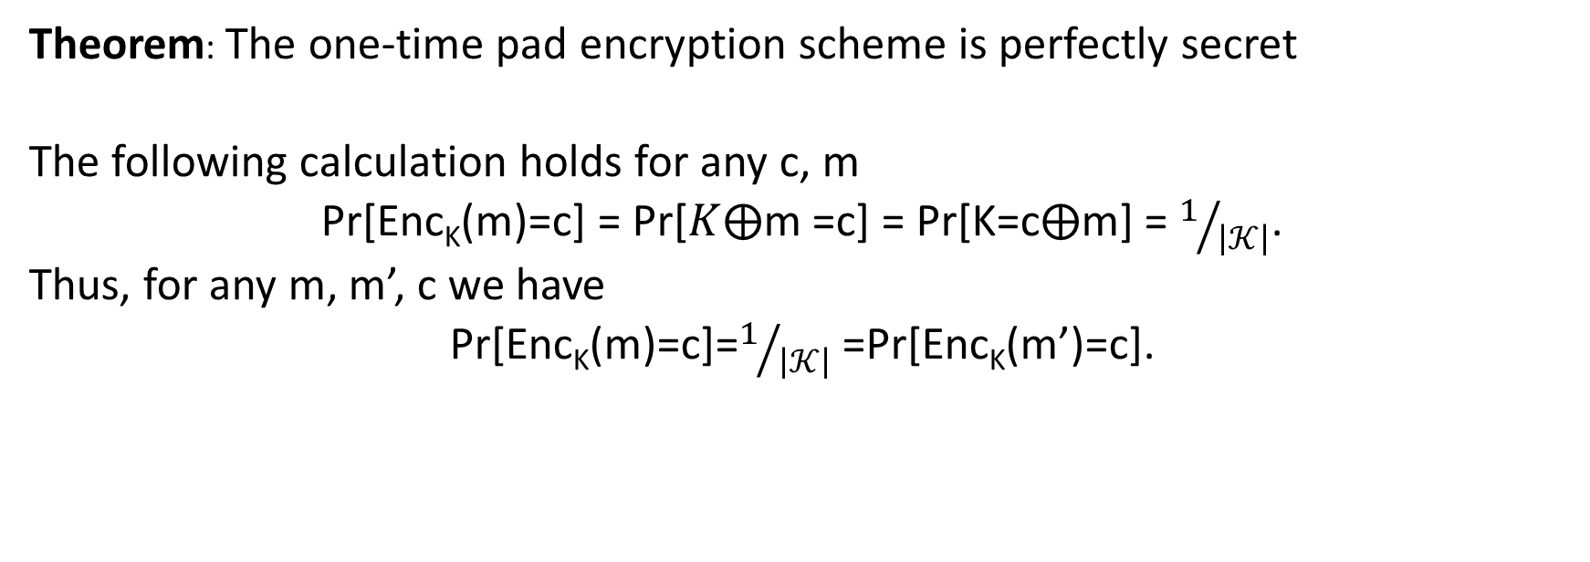


One Time Pad [Vernam 1917]
$${Enc}_{K}\left(m\right)=K⨁m$$
$${Dec}_{K}\left(c\right)=K⨁c$$
$Example=1011⨁$0011 = ???
Theorem: The one-time pad encryption scheme is perfectly secret
The following calculation holds for any c, m
Pr[Enc_{K}(m)=c] = Pr[$K⨁$m =c] = Pr[K=c$⨁$m] = $1/{\left|𝒦\right|}$.
Thus, for any m, m’, c we have
Pr[Enc_{K}(m)=c]=$1/{\left|𝒦\right|}$ =Pr[Enc_{K}(m’)=c].
Notes:
The following calculation holds for any c, m’ Pr[C=c|M=m’] = Pr[Enc_{K}(m’)=c] = Pr[$K⨁$m’ =c] = Pr[K=c$⨁$m’] = $1/{\left|𝒦\right|}$

Slide 49
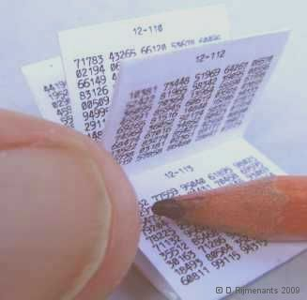
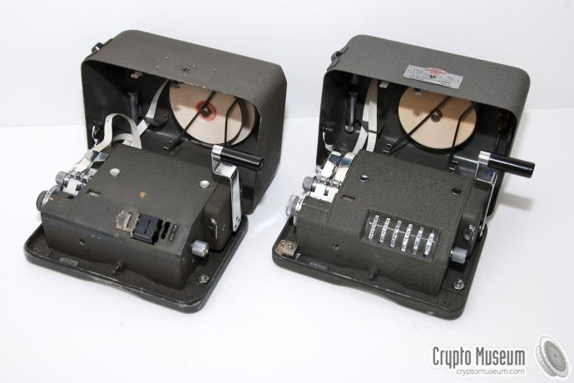
One Time Pad [Vernam 1917]
$${Enc}_{K}\left(m\right)=K⨁m$$
$${Dec}_{K}\left(c\right)=K⨁c$$
$Example=1011⨁$0011 = ???
Notes:
Examples

Slide 50
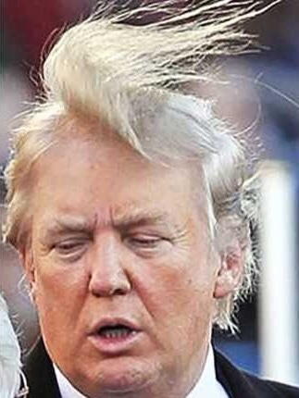

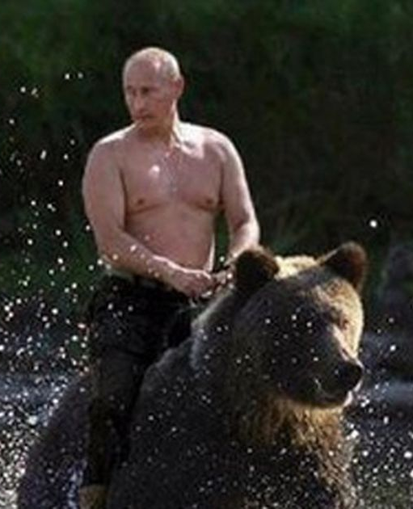
One Time Pad

Slide 51

Perfect Secrecy Limitations
    Theorem: If (Gen,Enc,Dec) is a perfectly secret encryption scheme then
    $$\left|𝒦\right|≥\left|ℳ\right|$$
Notes:
Proof: Suppose for contradiction that $\left|𝒦\right|<\left|ℳ\right|$. Given a ciphertext c let $ℳ\left(c\right)=\left\{m\left|m={Dec}_{k}\left(c\right)\right. for some key k ∈𝒦\right\}$. Trivially $\left|ℳ\left(c\right)\right|≤\left|𝒦\right|<\left|ℳ\right|$. This implies that there is some message$m∈ℳ\backslash ℳ\left(c\right)$ so that
$$Pr\left[M=m\left|C=c\right.\right]=0≠Pr\left[M=m\right].$$

Slide 52

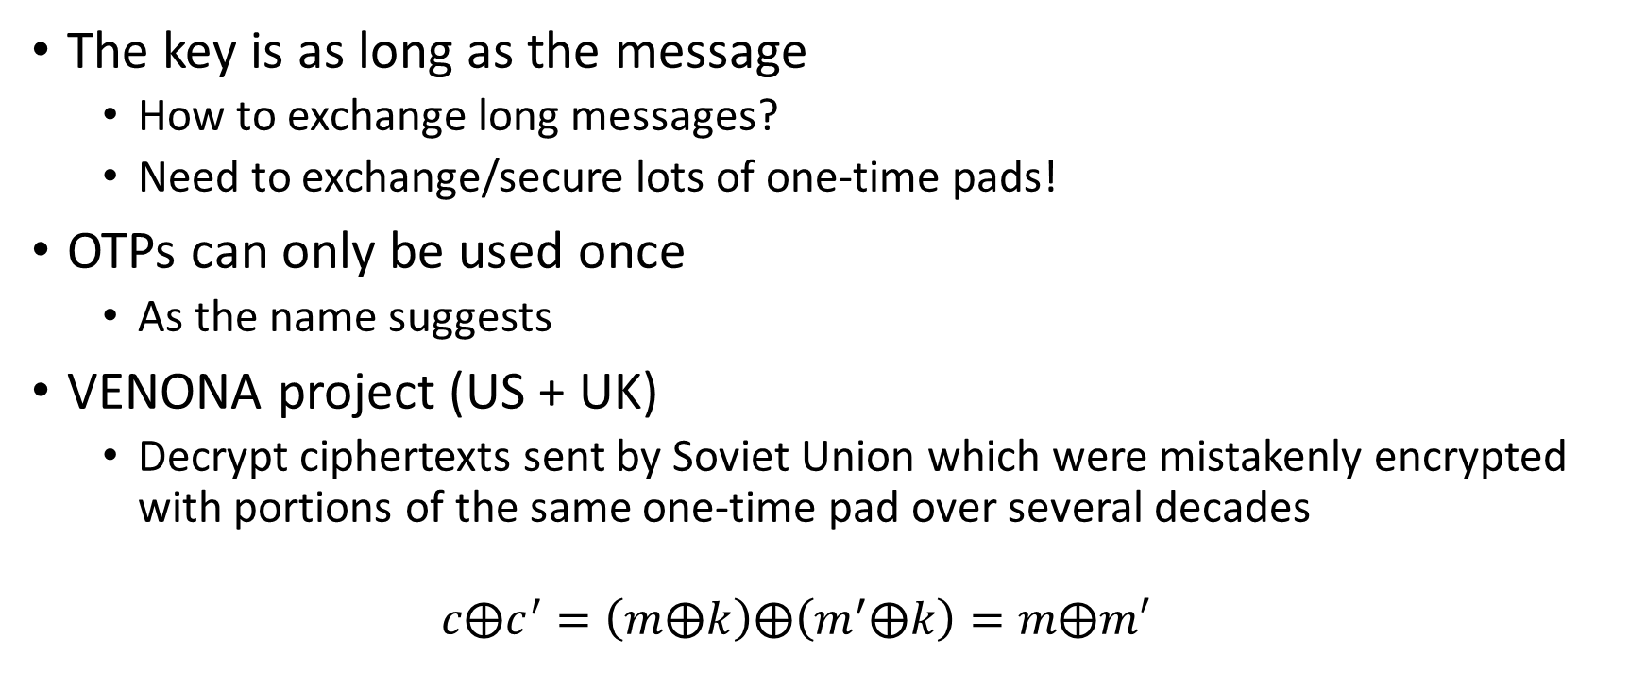
One Time Pad Limitations
The key is as long as the message
  How to exchange long messages?
  Need to exchange/secure lots of one-time pads!
OTPs can only be used once
  As the name suggests
VENONA project (US + UK)
  Decrypt ciphertexts sent by Soviet Union which were mistakenly encrypted with portions of the same one-time pad over several decades
  $$c⨁c^{′}=\left(m⨁k\right)⨁\left(m^{′}⨁k\right)=m⨁m′$$
Notes:
Other Limitations?
Integrity

Slide 53
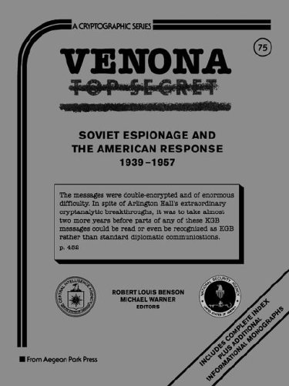

VENONA project

Slide 54
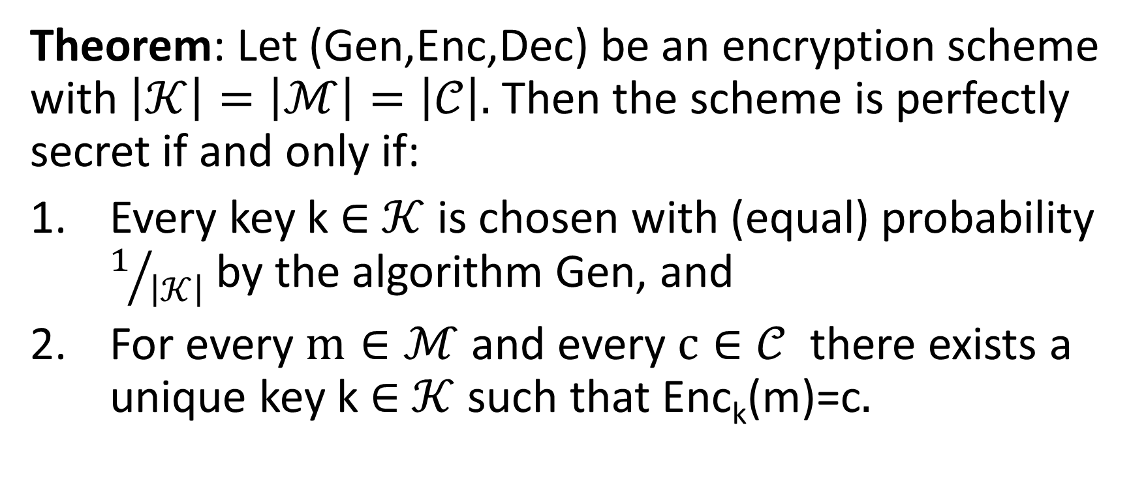
Shannon’s Theorem
    Theorem: Let (Gen,Enc,Dec) be an encryption scheme with $\left|𝒦\right|=\left|ℳ\right|=\left|𝒞\right|.$Then the scheme is perfectly secret if and only if:
    Every key k $∈$ $𝒦$ is chosen with (equal) probability $1/{\left|𝒦\right|}$ by the algorithm Gen, and
    For every $m∈ℳ$ and every $c∈𝒞$ there exists a unique key k $∈$ $𝒦$such that Enc_{k}(m)=c$.$

Slide 55
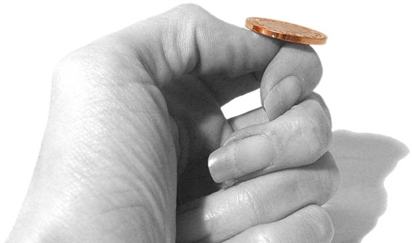
An Important Remark on Randomness
In our analysis we have made (and will
continue to make) a key assumption:
We have access to true “randomness”
to generate a secret key K
Example: K = one time pad
Independent Random Bits
  Unbiased Coin flips
  Radioactive decay?

Slide 56
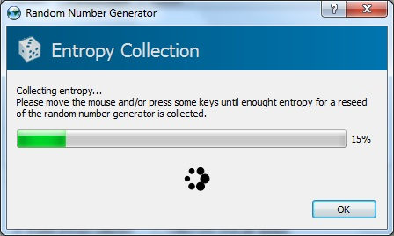
In Practice
Hard to flip thousands/millions of coins
Mouse-movements/keys
  Uniform bits?
  Independent bits?
Use Randomness Extractors
  As long as input has high entropy, we can extract (almost) uniform/independent bits
  Hot research topic in theory

Slide 57
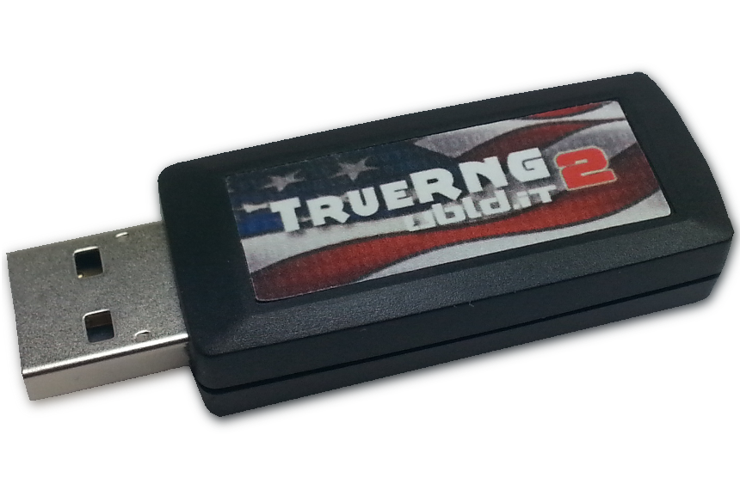
In Practice
Hard to flip thousands/millions of coins
Mouse-movements/keys
Customized Randomness Chip?

Slide 58
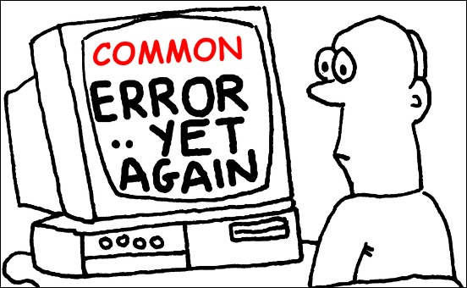
Caveat: Don’t do this!
Rand() in C stdlib.h is no good for cryptographic applications
Source of many real
world flaws

Slide 59
Coming Up in Week 2…
Computational Security
Pseudorandomness + Stream Ciphers
Chosen Plaintext Attacks and CPA Security
Week 2 Reading: Katz and Lindell 3.1-3.4

