Slide 1
Have you completed the Pre-Workshop Survey?
Pre-Perception: [consult authors if desired]

Slide 2
Generative AI (GenAI) + Content Generation Workshop
Ethan Dickey and Andres Bejarano
All framework and framework-related ideas must be shared with credit to our paper:
E. Dickey and A. Bejarano, "GAIDE: A Framework for Using Generative AI to Assist in Course Content Development," 2024 IEEE Frontiers in Education Conference (FIE), Washington, DC, USA, 2024, pp. 1-9, doi: 10.1109/FIE61694.2024.10893132.
Notes:
Framework:
no opinions
(4m) justify framework -** reduced content generation time (anecdotal)
structured experience easier than on your own
get experience to evaluate
(<=10m) cover framework (<= 5 slides (not including summary one at end))
(40m) hands on generation: choose your own topic, medium difficulty to see variety
(20m) 2 groups present
5m present
5m questions
(10m) discuss

Slide 3
Outline
What/Why GenAI?
How can we use it? Framework etc.
Activity: using it to either:
Create the TA orientation session
Create a homework/test for a particular topic
Share results (big groups only a few)
Notes:
By the end of this workshop, you should be able to…
Explain how to effectively prompt generative AI tools like ChatGPT to generate high-quality course content.
Generate sample course content by applying prompting strategies with a generative AI tool.
Judge the quality, accuracy, and appropriateness of generative AI-created course content.

Slide 4
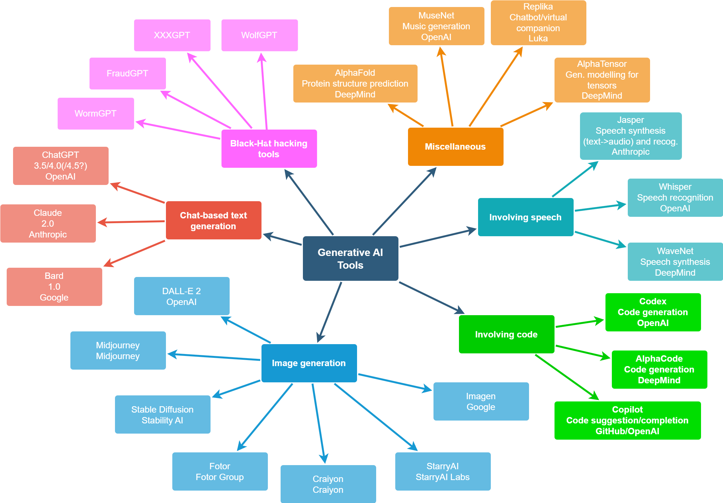
What is GenAI?
Last updated: Aug 2023
Notes:
(1.5m) Generative AI refers to AI systems that can generate new content and data versus just analyzing existing information. The most common type we see today are large language models like GPT, which can generate human-like text based on the patterns in the massive datasets they are trained on.
This is as of December 2023.

Slide 5
Why Use AI for Content Generation?
Notes:
(5m) We’ll argue first why you should be interested in it, then discuss some of the benefits as they related to content generation.

Slide 6
Generative AI (GenAI) Tools Are Here to Stay
Usage has proved exceedingly hard to detect
Harder than normal plagiarism
Novelty for students
Ease of access
Real-world applications
Thus, we (educators) must understand how these tools fit into academic settings.
Notes:
(1.5m)
There are a variety of reasons these tools are here to stay in the academic environment. Among them, from the students’ perspective, etc.
Student-driven motivation
Moreso than regular cheating activities, due to the creative element GenAI introduces
One of the best ways to understand how they fit is to try and use them.

Slide 7
Benefits of GenAI for Content Creation
(some) Abilities:
Producing high volumes of content very quickly
Ideation and brainstorming new content ideas
Iteratively refining responses based on feedback, much like a human.
(some) Benefits:
Faster course development (with proper training)
Increased content flexibility (styles and levels)
Enables frequent content updates
Personalized content at scale
Lower content costs (if specialists are used)
Content experimentation support
Automation of repetitive tasks
Notes:
(1.5m)
Beyond simply understanding how they fit, there are a large variety of things GenAI can help the instructional team with. On the content generation side, we have abilities like…

Slide 8
How do we best use GenAI for content generation?
Notes:
(10m) Learning Objective: Explain how to effectively prompt generative AI tools like ChatGPT to generate high-quality course content.

Slide 9
GAIDE: Generative AI for Instructional Development and Education
Get learning objectives
(LOs)
Set goals (offline)
Set up the context
“To provide meaningful, engaging, and fresh content for students in CS251”

Slide 10
Context and Learning Objectives
Context: how to act, content topic, previous knowledge, relevant student demographics (e.g., academic year)
LOs: make a specific, measurable request for learning objectives and tell it to use professional language for them.
“Act as an instructor of Computer Science in a university. The current topic we are covering is Binary Search Trees. Students know discrete math, basic programming, pointers, primitive data structures, and runtime algorithm analysis. Students are in their second year of studies. Give me five learning objectives for the current topic. Use Bloom's revised taxonomy verbs for the objectives.”
“Act as a [insert top-level expert in the field you are using GenAI for, with more qualifications or titles if necessary]. The topic we are covering is [topic(s)]. Students know [insert any relevant skills students have]. Students are in their [year] year of studies. Give me [choose 5-10] learning objectives for the current topic. Use Bloom’s revised taxonomy of verbs for the objectives.”
Notes:
(2m) Emphasize the purpose of each underlined thing.

Slide 11
Important note
Don’t expect it to be perfect all the time, that’s not what it’s built for. If you ask for 5-10 things, only expect 2-4 of them to be good.
Select 2-4 learning objectives to create your course content over that you feel are reasonable for the targeted student skill level and context.
Notes:
(30s)

Slide 12
GAIDE: Generative AI for Instructional Development and Education
Get learning objectives
(LOs)
Set goals (offline)
Set up the context
Dive into particular course content
Lecture-Style
Problem Creation
“To provide meaningful, engaging, and fresh content for students in CS251”
How to act, previous knowledge, context, expected student skill level (measured by year in program)
Specific, measurable request for learning objectives (using Bloom’s taxonomy)
Lecture-Style
Start with an outline
Iteratively
refine result
as a whole
Problem Creation
Start with a list of potential problems from specific LOs
Use technical language

Slide 13
Content-Specific Steps: Lecture-Type: Iteratively refine as a whole
Request an outline based on the selected LOs
Iteratively refine based on your preferences. Some considerations:
Lecture length
Outside work for you (prep and post-lecture work)
Outside work for the students
Specific subtopics
In-class activities
Once satisfied, inform the GenAI that you are diving into specific parts of the outline
Contextual integrity: context bleeding and loss of focus
Notes:
(2m)
How long do you have for the lecture?
Do you want to do work outside the lecture (i.e., grading, etc.)?
Are there pre-/post-lecture activities?
Are there any subtopics you want to be sure to hit?
Are there any specific activities (quizzes, group work, etc.) that you want to do?
For some of these things it might be good to let GenAI brainstorm and change up your regular routine.
This is a good time to remind you not to expect it to be perfect. It may get the whole outline perfect, or it may only have a couple good ideas for sections. Either way, it is something you can work with to either (a) refine whatever you don’t like or (b) incorporate what you do like into your lecture draft.
- Once you are satisfied the outline accurately represents your general attitude towards and goals for the lecture, dive into specific parts of the outline in the same way that we will for problem sets.

Slide 14
Content-Specific Steps: Problem Creation: Iteratively refine as a whole
Request a specific number of problems based on the selected LOs
If it presents no usable ideas, request refinement based on what you are looking for. Some considerations:
Answer style
Depth (what level of Bloom’s Revised Taxonomy or Webb’s Depth of Knowledge do you want, or what range?)
Theme
Give examples
Converse with it as you would a content development TA, describing what you want.
Choose the best/most relevant problems and request more like them.
Notes:
(2m)
Answer style (MC, short answer, etc.)
Depth (what level of Bloom’s Revised Taxonomy or Webb’s Depth of Knowledge do you want, or what range?)
Theme (creativity is a strong suit of GenAI)
It may be necessary to give an example of what you are looking for, at least briefly.

Slide 15
GAIDE: Generative AI for Instructional Development and Education
Get learning objectives
(LOs)
Set goals (offline)
Set up the context
Dive into particular course content
Lecture-Style
Problem Creation
“To provide meaningful, engaging, and fresh content for students in CS251”
How to act, previous knowledge, context, expected student skill level (measured by year in program)
Specific, measurable request for learning objectives (using Bloom’s taxonomy)
Repetitively
wrong?
Start a new chat and tell it where you were (context, LOs, outline, specific location, etc.)
Start with an outline
Iteratively
refine result
as a whole
Iteratively
refine small
pieces, one
at a time
Occasionally remind it of your goals and the context
Lecture-Style
Problem Creation
Start with a list of potential problems from specific LOs
“Rewrite them to be more engaging and relevant for collegiate computer science students at X University.”
Use technical language
Done
“Act as an instructor of Computer Science in a university. Please answer these questions in a brief way.”
Notes:
(3m) Dive into each step of the outline, or each problem, one by one and really flesh out the details. In a part of the lecture, ask it to outline a script for you, or give you important talking points. Refine the pieces individually that you don’t like, then have it piece the script back together from all of its different parts.
In problems, choose one or two similar problems and ask it for more of those, if you like them. Then, dive into a particular problem. Have it reword the problem, dress it up in a story, or make it harder based on whatever direction you want to take the problem. Then, ask it for answers, a rubric, and whatever else would be useful for you. Use the same process we’ve been discussing over and over and over again. While this may seem tedious to repeat, it is something you must do anyways, and GenAI can greatly shorten the amount of time this already-tedious process takes.
- Sometimes it can give insight into undergraduate thinking and common pitfalls if you ask it to answer the question as an undergraduate (thus telling you if the problem needs to be refined more).
In the transition between small pieces, be careful that it remembers where you want to go with the course content. You can ask it to repeat the LO/section/problem for verification.
Last two things: firstly, don’t forget to ask for more than you need when generating fresh content so that you get a subset you are satisfied with. Secondly, don’t forget to give it feedback as if it were a human.

Slide 16
Pair Up for Hands-On Experience: Prompting for Content
Target: Medium-Difficulty Course Content (Lecture or Problem Creation)
https://oai.azure.com/
Notes:
(should be 15m in)
(20m)
Learning Objective: Generate sample course content by applying prompting strategies with a generative AI tool.
Display complete framework here
We’ll start the orientation week session working together, then split it into 3 parts. After 20 minutes of this, we’ll come back together and each of you will show what you’ve done (keep a separate document with a draft of your plans).

Slide 17
GAIDE: Generative AI for Instructional Development and Education
Get learning objectives
(LOs)
Set goals (offline)
Set up the context
Dive into particular course content
Lecture-Style
Problem Creation
“To provide meaningful, engaging, and fresh content for students in CS251”
How to act, previous knowledge, context, expected student skill level (measured by year in program)
Specific, measurable request for learning objectives (using Bloom’s taxonomy)
Repetitively
wrong?
Start a new chat and tell it where you were (context, LOs, outline, specific location, etc.)
Start with an outline
Iteratively
refine result
as a whole
Iteratively
refine small
pieces, one
at a time
Occasionally remind it of your goals and the context
Lecture-Style
Problem Creation
Start with a list of potential problems from specific LOs
“Rewrite them to be more engaging and relevant for collegiate computer science students at X University.”
Use technical language
Done
“Act as an instructor of Computer Science in a university. Please answer these questions in a brief way.”
Notes:
(20m – copied from prev. slide)

Slide 18
Presentation and Review of Generated Content
Notes:
(10-15m)

Slide 19
Thanks for coming!
Post-Workshop Surveys (will be emailed):
Post-Perception: [consult authors if desired] Workshop Evaluation: [consult authors if desired]
Notes:
(5-10m)
Feedback, discussion, etc.

