Slide 1
CS536: Data Communication &
Computer Networks
Chunyi Peng
Fall 2023
Notes:
Syllabus

Slide 2
Agenda
CS536 Syllabus and basic course info https://www.cs.purdue.edu/homes/chunyi/teaching/cs536-fall23/cs536-fall23.html
Chapter 1

Slide 3
About Me
Chunyi Peng (https://www.cs.purdue.edu/homes/chunyi/)
  2013, PhD, UCLA
  2013 – 2017, Assistant Prof, Ohio State University
  2017 – 2020, Assistant Prof, Purdue University
  2020 – Present: Associate Professor
Research Areas:
  Mobile networks (5G/6G): AI for Network
  5G/IoT security
  Mobile edge computing (mainly for drones and robots)
Office Hour: 11:00AM - 12:00PM Tue, LWSN 2142E

Slide 4
About Three TAs
Contact us: cs536-ta@cs.purdue.edu
  Junpeng Guo
  Chen Peng
  Shilong Lei
PSOs and Office Hours
  No PSOs in the first week
    Tue 1:30p - 2:20p, ONLINE, Shilong Lei
    Wed 11:30a - 12:20p, HAAS G050 , Chen Peng
    Friday 9:30a - 10:20a, HAAS G050 , Junpeng Guo
  PSOs are optional but encouraged for homework, labs and exams
  Campuswire used for Q&A online
  Check your PSO schedule and contact us if you have concerns on attending PSOs

Slide 5
About You
Attendee Survey: https://forms.gle/1PBHc4eGbq2zvemNA
Your information
Why do you take this course?
What are your expectations with CS536?
What you know about computer networks (any prior experience)?
What else do you want to share about CS536?
…
Any other questions or concerns?
Notes:
Name
Department: CS or others?
PhD, MS, Undergrad (senior/junior)?
Research areas/interestes if applicable

Slide 6
In-Class Survey
Your department: CS and non-CS
Your program: PhD/MS/Bachelor
Why do you take this course?
  To meet my core course requirement
  Interest (no need to meet a core course requirement)
What is the minimal grade you need and expect?
  A/A+ A- B+ B N/A

Slide 7
How much do you know about CS536?
Internet
TCP/IP
Application
transport
network
link
physical
Congestion
Control
End Hosts
Routing
Access Network
Core Network

Slide 8
BGP
SDN
MAC
Handover
WiFi 7
5G
DASH
ARP
LEO
Edge Computing
Serverless Computing
Notes:
Serverless computing

Slide 9
What is your C programming level?
Never/rarely used
< 3 times (< 200 lines) used in my courses
> 3 times or >500 lines used in my courses
Often used (beyond my course projects)

Slide 10
Why this survey?
Be interactive
Your feedback will be used to tune how to teach CS536 Scope: balance between Part I and Part II
  Difficulty levels: from basic to advanced
  Assignments: labs and homework
  Quizzes and exams
Your feedback are welcome anytime

Slide 11
What is the course about?
Internet

Slide 12








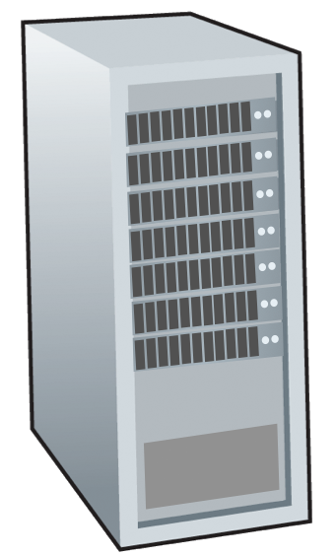



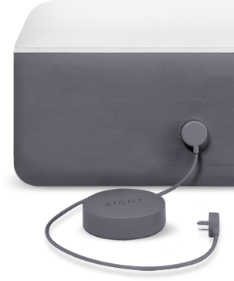
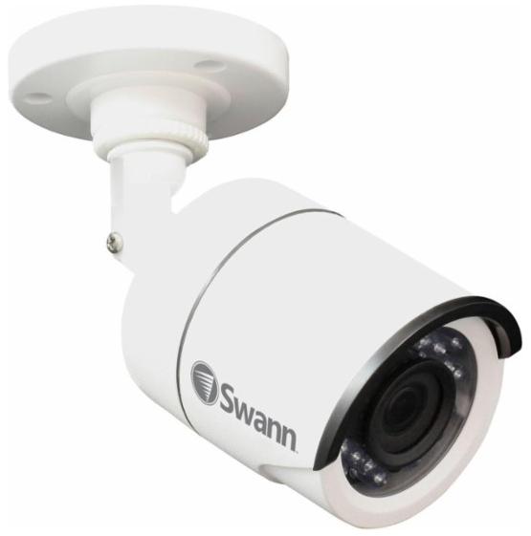
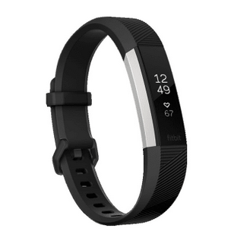
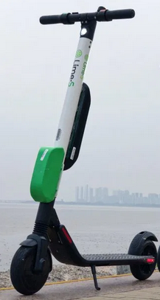





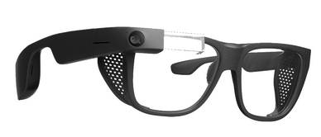
What is the course about?
Billions of connected computing devices (end systems/hosts)
Internet

Slide 13
What is the course about?
Billions of connected computing devices (end systems/hosts)
Core network
(Internet backbone)
Access networks
(heterogenous)

Slide 14
What is the course about?
Part I: Basic topics (Internet in the Past)
  A focus on TCP/IP protocols
  Understand principles, concepts and main protocols
  Develop basic network programming skills
Part II: Advanced topics (Internet today and in the future)
  A focus on wireless and mobile networks
  Topics: Internet of Things, AI for Net, edge computing …
Notes:
How does it work?

Slide 15

Textbook
James F. Kurose & Keith W. Ross, “Computer Networking: A Top Down Approach,” 8th edition,
Online lecture notes
Additional readings

Slide 16
Topics (tentative)
Part I: Basic topics (Internet in the Past)
  Chapter 1 – Chapter 6
  Application → Transport → Networking → Link (Ethernet)
Part II: Advanced topics (Internet today and in the future)
Chapter 7, Chapter 8 and additional materials
Wireless → Security → IoT, Edge computing
Notes:
How does it work?

Slide 17
Grading Policy
Syllabus: https://www.cs.purdue.edu/homes/chunyi/teaching/cs536-fall23/cs536-fall23.html
Exam 1: 23%
Exam 2: 23%
Pop-up Quiz: 4% (top-4 out of 5 counted)
Homework: 15%
Programming labs: 20%
Final Project: 15%

Slide 18
More Details
3 late days
5 Quizzes (top-4 counted)
Exam-1: in-class (16:30 PM – 17:45PM on Thur Oct 5)
Exam-2: in-class (16:30 PM – 17:45PM on Thur Nov 30)
5-6 homework assignments
Programming labs in C (individual)
Final course project: a team up to THREE students; project topics released soon (much harder than any lab).

Slide 19

Another Perspective
Easy to learn the basic; Hard to excel
 | Homework | Programming Labs | Final Project
 | 15% | 20% | 15%
Difficulty | Easy | Medium | Hard
Credit-per-Hour
 | Part I: basic | Part II: advanced
Effort | 60 – 70% | 30 – 40%
Credit | > 80% | < 20%
Notes:
Two mechanisms
Basic/Easy parts with higher weights
Be curved

Slide 20
Any Questions?
Please sign in Campuswire & Gradescope
    https://campuswire.com/c/G6F1FC7BA
    https://www.gradescope.com/courses/558671
Please finish attendee survey
    https://forms.gle/1PBHc4eGbq2zvemNA
Contact me right away if you have concerns/questions
Contact TAs and me: cs536-ta@cs.purdue.edu

