Slide 1
Tutorial on
MobileInsight @ Hackathon’18
This is particularly reorganized and greatly enhanced for online distribution!
Workspace is at http://www.cs.purdue.edu/homes/chunyi/hackathon18-workspace
Chunyi Peng
Purdue University
Nokia Skypark, Budapest
Hackathon, co-Located with SIGCOMM’18
August 25, 2018

Slide 2
Outline
Introduction
Background & MobileInsight overview
  Cellular network protocols
  Data relevant to latency
Hackathon projects
  Sample source codes

Slide 3
Introduction
Please introduce yourself
Name
Affiliation
Research interests & projects
Expectations
One hobby or fun fact

Slide 4
About Me
Name: Chunyi Peng
Affiliation: assistant Prof, CS@Purdue University
  2013/08~2017/08, Assistant professor @Ohio State
  2009/09~2013/06, PhD @ UCLA
Research interests & projects
  Innovating 5G/4G network access: performance & reliability & security
  Project: Mobile network intelligence (networking, data, AI, PL)
Expectation (Mission)
  Towards an open and growing community on mobile networking system research
One hobby or fun fact
  Hiking/camping; Highest footprint so far: around 17,300 ft (5300m) in Mount Everest
Notes:
Introduce myself

Slide 5
About You
Please introduce yourself
Name
Affiliation
Research interests & projects
Expectations
One hobby or fun fact

Slide 6
Our Team
Last Name alphabetically
Quentin De Coninck, University of Clouvain, Belgium
Dr. Maryam Hafeez, University of Huddersfield, UK (remote)
Dr. Syed Ali Raza Zaidi, University of Leeds, UK (remote)
Ensar Zeljkovic, University of Antwerp, Belgium
Notes:
quentin.deconinck@uclouvain.be;
ensar.zeljkovic@uantwerpen.be;
s.a.zaidi@leeds.ac.uk;
m.hafeez@hud.ac.uk;
Dr. Syed Ali Raza Zaidi, University of Leeds
Ensar Zeljkovic, University of Antwerp

Slide 7
Before We Start
MobileInsight
  http://www.mobileinsight.net
Android app on rooted phones
  Use phones provided by my lab
  Or install it on your phones if rooted (V3.3)
    http://www.mobileinsight.net/download.html
Developers (next, if interested)
  Setup (~ 30 minutes)

Slide 8
Install Dev Environment (Optional)
Install all-in-one VM package (for developers only)
  http://mobileinsight.net/mi-dev-vm.html
  Install Virtualbox and Vagrant;
  Download the MobileInsight’s vagrant script (https://github.com/mobile-insight/mobileinsight-dev)
  Create a folder and install it (~ 30 minutes)
    > cd MI_FOLDER
    > vagrant destroy # Run it only if you have installed VM before
    > vagrant up
    > vagrant ssh
Install from source codes (github)
  https://github.com/mobile-insight
  Repo: mobile, core, libs, python-for-android
Note: source codes in /home/vagrant/mi-dev
Notes:
Before we move ahead, for those who are interested in development, I would suggest you install

Slide 9
Three Projects @ Hackathon’18
Project 1 (easy): Collect L1/L2 information from MI and extract PHY-layer information (bandwidth, radio resource blocks, modulation, etc.) and MAC-layer information (retransmission, sequence etc.) and other options of your interests
Project 2 (easy): Visualize the L1/L2 analytics in project 1 on the desktop. Monitor their changes over time and under special events (e.g., handoff); Display basic statistics (percentiles over sliding windows) and perform anomaly detection.
Project 3 (advanced): Extract the L1/L2 network latency out of above information. Compare with higher-layer latency analysis using tcpdump (RTT in TCP) and build a full-stack latency analyzer (optional).

Slide 10
The Team’s Pick
Project 1 (easy): Collect L1/L2 information from MI and extract PHY-layer information (bandwidth, radio resource blocks, modulation, etc.) and MAC-layer information (retransmission, sequence etc.) and other options of your interests
Project 2 (easy): Visualize the L1/L2 analytics in project 1 on the desktop. Monitor their changes over time and under special events (e.g., handoff); Display basic statistics (percentiles over sliding windows) and perform anomaly detection.
Project 3 (advanced): Extract the L1/L2 network latency out of above information. Compare with higher-layer latency analysis using tcpdump (RTT in TCP) and build a full-stack latency analyzer (optional).

Slide 11
Brief
Background &
MobileInsight Tutorial
Reference

Slide 12
Why MobileInsight?

Slide 13

Background: Cellular Network Architecture
User Equipment (UE)
LTE Network Infrastructure
Internet Host

Slide 14
Background: Protocol Stack
App
App
TCP
TCP
IP
IP
Link
Link
PHY
PHY
end-to-end
data-plane
Access network
cellular-specific L1/L2
data-plane & control-plane (signaling)
unfortunately “closed”

Slide 15
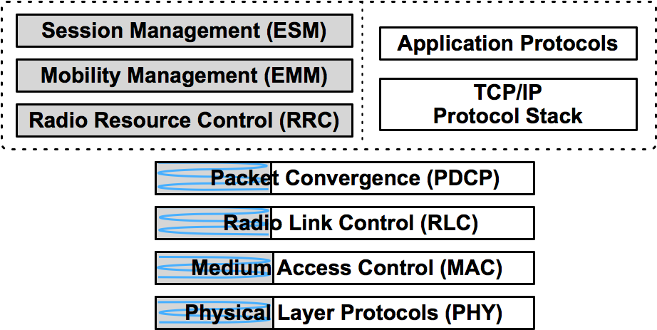
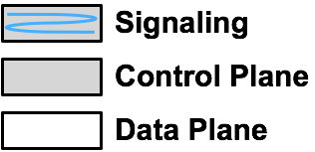
Cellular-Specific Protocol Stack
Link
Link
PHY
PHY
Notes:
More complex functions on both control and data plane
Operations are distributed across layers

Slide 16
Rich Information … but NO Access
Operator: no open access (NDA)
Device: in chipset, no exposure
X
Link
Link
PHY
PHY
Notes:
More complex functions on both control and data plane
Operations are distributed across layers

Slide 17
MobileInsight: Open Up Access on Mobile
extract msgs btw device & network
leverage standard protocols & common operations
enable data monitor & analysis (side-channel)
X
Link
Link
PHY
PHY
✔
Notes:
More complex functions on both control and data plane
Operations are distributed across layers

Slide 18
Why MobileInsight?
Break long-standing research barriers and open up amble opportunities

Slide 19
MobileInsight: Current Status
http://mobileinsight.net/
Open source, open datasets
Latest release (v3.3, 12/2017)
  Download by 130+ companies and universities
  10+ projects & starts-up
    Several top publications at SIGCOMM, MobiCom, MobiSys, SIGMETRICS, IMC, CoNext, TMC, …
Android
App
Join us early & pick low-hanging fruits!
Map of
download + view
Notes:
low-hanging fruit

Slide 20
How to Use MobileInsight?

Slide 21
A Data Flow View
Cellular Network
Domain Knowledge
Hardware
Software
/dev/diag
Raw
data
Stream
(vendor-specific)
monitor
Parsed
data
Stream
(standard)
analyzer
Extracted
info
(of your interests)
Msg
stream in the air
August 2018
MobileInsight@Hackathon'18, © Chunyi Peng
Notes:
low-hanging fruit

Slide 22
Your Task Atop MobileInsight
Your Task
Develop your own analyzer given
Built-in analyzers
Sample codes
Cellular Network
Domain Knowledge
Hardware
Software
/dev/diag
Raw
data
Stream
(vendor-specific)
monitor
Parsed
data
Stream
(standard)
analyzer
Extracted
info
(of your interests)
Msg
stream in the air
August 2018
MobileInsight@Hackathon'18, © Chunyi Peng
Notes:
low-hanging fruit

Slide 23
Go Back to Hackathon Project #3
Project 1 (easy): Collect L1/L2 information from MI and extract PHY-layer information (bandwidth, radio resource blocks, modulation, etc.) and MAC-layer information (retransmission, sequence etc.) and other options of your interests
Project 2 (easy): Visualize the L1/L2 analytics in project 1 on the desktop. Monitor their changes over time and under special events (e.g., handoff); Display basic statistics (percentiles over sliding windows) and perform anomaly detection.
Project 3 (advanced): Extract the L1/L2 network latency out of above information. Compare with higher-layer latency analysis using tcpdump (RTT in TCP) and build a full-stack latency analyzer (optional).

Slide 24
Warm up via Project #1
Step 1: installation and first run MobileInsight-Mobile
  Video tutorial on first-job-with MobileInsight (next)

Slide 25


Slide 26
Steps for Project #1
Step 1: installation and first run MobileInsight-Mobile
Step 2: configure NetLogger and run
  >Setting>NetLogger, LTE PHY, LTE Control/Data, Read config
  > run NetLogger
Step 3: View logs at the phone
  >Log Browser, open logs
Step 4: load logs to desktop
  > adb pull /sdcard/mobileinsight/log/ ./

Slide 27
Steps for Project #1
Step 5: parse logs offline (MobileInsight-Core)
  python mobile_insight_gui.py, open files
  Or revise \examples\*.py to parse messages of our interests
Step6: extract messages of our interests
  Require knowledge on cellular network protocols
    Hardest part (mastering domain knowledge takes time)
    List relevant messages
    PHY-layer information (bandwidth, radio resource blocks, modulation, etc.)
    MAC-layer information (retransmission, sequence etc.)
    Refer to tutorial on cellular network protocols

Slide 28
Project #3: Offline L1/L2 Latency Analysis
Step 1: run MI-Android app, collect and load data to desktop
Step 2 (optional): use GUI to locate messages of interests and learn what can be used to infer latency
Step 3: write codes to extract information, following the sample code
Step 4: analyze the traces collected to obtain latency results offline
Step 5 (optional): test under various exp settings (apps, carriers, RATs) and see how latency varies

Slide 29
Background on Latency Analysis

Slide 30

Use Web Browsing as an Example
www.youtube.com
Loading…
Notes:
Weblatency: (cross-layer)
http://milab.cs.purdue.edu/taskrounds/75289190-df2c-4b0a-a30a-fd97c239ed05

Slide 31
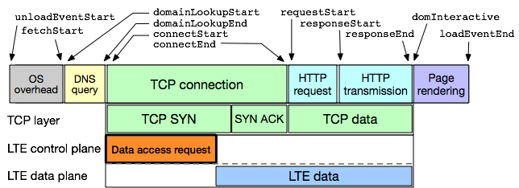
Full-Stack Latency Analysis
Enabled by MobileInsight [ICCCN’18]
✔
[ICCCN'18] Yuan et. al, A Machine Learning Based Approach to Mobile Network Analysis. (courtesy from Yuan’s slide)
Notes:
Weblatency: (cross-layer)
http://milab.cs.purdue.edu/taskrounds/75289190-df2c-4b0a-a30a-fd97c239ed05

Slide 32
Time Alignment at Three levels
Notes:
Time alignment: three levels: app, tcpdump, mobileinsight
Breakdown Along Message Flow

Slide 33
Particularly over Cellular Networks
Control-plane latency
  Radio connectivity setup
Data-plane transmission
  PDCP
  RLC
  MAC
  PHY
  radio
  control

Slide 34
Data-Plane Latency Below IP
PDCP (Packet Data Convergence Protocol) – header compression, radio encryption
RLC(Radio Link Control) – Ready packets to be transferred over the air interface
MAC (Medium Access Control) – Multiplexing, QoS
PHY (Physical) – preamble, sync, modulation and coding scheme, …
Notes:
Packet Data Convergence Protocol (PDCP) – header compression, radio encryption
Radio Link Control (RLC) – Readies packets to be transferred over the air interface
Medium Access Control (MAC) – Multiplexing, QoS
Physical (PHY) – preamble, sync, modulation and coding scheme, …

Slide 35
Messages Supported by MI (v3.3)
Note: Msgs by MI are not exhaustive.
PDCP
"LTE_PDCP_DL_Config"
"LTE_PDCP_UL_Config"
"LTE_PDCP_UL_Data_PDU"
"LTE_PDCP_DL_Ctrl_PDU"
"LTE_PDCP_UL_Ctrl_PDU"
"LTE_PDCP_DL_Cipher_Data_PDU"
"LTE_PDCP_UL_Cipher_Data_PDU"
"LTE_PDCP_DL_Stats"
"LTE_PDCP_UL_Stats"
"LTE_PDCP_DL_SRB_Integrity_Data_PDU"
"LTE_PDCP_UL_SRB_Integrity_Data_PDU"
Tip: understand better and faster by reading both 3GPP TS*.* + real logs
Notes:
"CDMA_Paging_Channel_Message"
"1xEV_Connection_Attempt"
"1xEV_Connection_Release"
"1xEV_Signaling_Control_Channel_Broadcast"
"1xEV_Connected_State_Search_Info"
"Srch_TNG_1x_Searcher_Dump"
"1xEV_Rx_Partial_MultiRLP_Packet"
"_1xEVDO_Multi_Carrier_Pilot_Sets"
"HDR_Pilot_Sets"
"WCDMA_Search_Cell_Reselection_Rank"
"WCDMA_RRC_States"
"WCDMA_RRC_Serv_Cell_Info"
"WCDMA_RRC_OTA_Packet"
"UMTS_NAS_GMM_State"
"UMTS_NAS_MM_State"
"UMTS_NAS_MM_REG_State"
"UMTS_NAS_OTA_Packet"
"LTE_RRC_OTA_Packet"
"LTE_RRC_MIB_Packet"
"LTE_RRC_MIB_Message_Log_Packet"
"LTE_RRC_Serv_Cell_Info"
"LTE_NAS_ESM_OTA_Incoming_Packet"
"LTE_NAS_ESM_OTA_Outgoing_Packet"
"LTE_NAS_EMM_OTA_Incoming_Packet"
"LTE_NAS_EMM_OTA_Outgoing_Packet"
"LTE_NAS_EMM_State"
"LTE_NAS_ESM_State"
"LTE_PDCP_DL_Config"
"LTE_PDCP_UL_Config"
"LTE_PDCP_UL_Data_PDU"
"LTE_PDCP_DL_Ctrl_PDU"
"LTE_PDCP_UL_Ctrl_PDU"
"LTE_PDCP_DL_Cipher_Data_PDU"
"LTE_PDCP_UL_Cipher_Data_PDU"
"LTE_PDCP_DL_Stats"
"LTE_PDCP_UL_Stats"
"LTE_PDCP_DL_SRB_Integrity_Data_PDU"
"LTE_PDCP_UL_SRB_Integrity_Data_PDU"
"LTE_MAC_Configuration"
"LTE_MAC_Rach_Trigger"
"LTE_MAC_Rach_Attempt"
"LTE_MAC_UL_Transport_Block"
"LTE_MAC_DL_Transport_Block"
"LTE_MAC_UL_Buffer_Status_Internal"
"LTE_MAC_UL_Tx_Statistics"
"LTE_RLC_UL_Config_Log_Packet"
"LTE_RLC_DL_Config_Log_Packet"
"LTE_RLC_UL_AM_All_PDU"
"LTE_RLC_DL_AM_All_PDU"
"LTE_RLC_UL_Stats"
"LTE_RLC_DL_Stats"
"LTE_PHY_PUCCH_Power_Control"
"LTE_PHY_PUSCH_Power_Control"
"LTE_PHY_PDCCH_PHICH_Indication_Report"
"LTE_PHY_PDSCH_Stat_Indication"
"LTE_PHY_Connected_Mode_Intra_Freq_Meas"
"LTE_PHY_Inter_RAT_CDMA_Measurement"
"LTE_PHY_Inter_RAT_Measurement"
"LTE_PHY_Inter_RAT_Measurement"
"LTE_PHY_RLM_Report"
"LTE_PHY_System_Scan_Results"
"LTE_PHY_Idle_Neighbor_Cell_Meas"
"LTE_PHY_Serv_Cell_Measurement"
"LTE_PHY_Connected_Mode_Neighbor_Measurement"
"LTE_RRC_CDRX_Events_Info"
"LTE_PHY_BPLMN_Cell_Request"
"LTE_PHY_BPLMN_Cell_Confirm"
"LTE_PHY_Serving_Cell_COM_Loop"
"LTE_PHY_PDSCH_Packet"
"LTE_PHY_PDCCH_Decoding_Result"
"LTE_PHY_PDSCH_Decoding_Result"
"LTE_PHY_PUSCH_Tx_Report"
"LTE_PHY_PUCCH_Tx_Report"
"LTE_PHY_PUCCH_CSF"
"LTE_PHY_PUSCH_CSF"
"GSM_Surround_Cell_BA_List"
"GSM_RR_Cell_Reselection_Parameters"
"GSM_RR_Cell_Information"
"GSM_RR_Cell_Reselection_Meas"
"GSM_RR_Signaling_Message"
"GSM_DSDS_RR_Cell_Reselection_Parameters"
"GSM_DSDS_RR_Cell_Information"
"GSM_DSDS_RR_Signaling_Message"
"Modem_debug_message"

Slide 36
Messages Supported by MI (v3.3)
PDCP
RLC
"LTE_RLC_UL_Config_Log_Packet"
"LTE_RLC_DL_Config_Log_Packet"
"LTE_RLC_UL_AM_All_PDU"
"LTE_RLC_DL_AM_All_PDU"
"LTE_RLC_UL_Stats"
"LTE_RLC_DL_Stats"

Slide 37
Messages Supported by MI (v3.3)
PDCP
RLC
MAC
"LTE_MAC_Configuration"
"LTE_MAC_Rach_Trigger"
"LTE_MAC_Rach_Attempt"
"LTE_MAC_UL_Transport_Block"
"LTE_MAC_DL_Transport_Block"
"LTE_MAC_UL_Buffer_Status_Internal"
"LTE_MAC_UL_Tx_Statistics"

Slide 38
Messages Supported by MI (v3.3)
PDCP
RLC
MAC
PHY
"LTE_PHY_Idle_Neighbor_Cell_Meas"
"LTE_PHY_Serv_Cell_Measurement"
"LTE_PHY_Serving_Cell_COM_Loop"
"LTE_PHY_PDSCH_Packet"
"LTE_PHY_PDCCH_Decoding_Result"
"LTE_PHY_PDSCH_Decoding_Result"
"LTE_PHY_PUSCH_Tx_Report"
"LTE_PHY_PUCCH_Tx_Report"
"LTE_PHY_Connected_Mode_Intra_Freq_Meas"
"LTE_PHY_Inter_RAT_CDMA_Measurement"
"LTE_PHY_Inter_RAT_Measurement"
"LTE_PHY_Inter_RAT_Measurement"
"LTE_PHY_PDCCH_PHICH_Indication_Report"
"LTE_PHY_Connected_Mode_Neighbor_Meas”
“LTE_PHY_PUCCH_Power_Control"
"LTE_PHY_PUSCH_Power_Control”
"LTE_PHY_PDSCH_Stat_Indication”
"LTE_PHY_PUCCH_CSF"
"LTE_PHY_PUSCH_CSF"
"LTE_PHY_RLM_Report"
"LTE_PHY_System_Scan_Results”
"LTE_PHY_BPLMN_Cell_Request"
"LTE_PHY_BPLMN_Cell_Confirm"
Notes:
"CDMA_Paging_Channel_Message"
"1xEV_Connection_Attempt"
"1xEV_Connection_Release"
"1xEV_Signaling_Control_Channel_Broadcast"
"1xEV_Connected_State_Search_Info"
"Srch_TNG_1x_Searcher_Dump"
"1xEV_Rx_Partial_MultiRLP_Packet"
"_1xEVDO_Multi_Carrier_Pilot_Sets"
"HDR_Pilot_Sets"
"WCDMA_Search_Cell_Reselection_Rank"
"WCDMA_RRC_States"
"WCDMA_RRC_Serv_Cell_Info"
"WCDMA_RRC_OTA_Packet"
"UMTS_NAS_GMM_State"
"UMTS_NAS_MM_State"
"UMTS_NAS_MM_REG_State"
"UMTS_NAS_OTA_Packet"
"LTE_RRC_OTA_Packet"
"LTE_RRC_MIB_Packet"
"LTE_RRC_MIB_Message_Log_Packet"
"LTE_RRC_Serv_Cell_Info"
"LTE_NAS_ESM_OTA_Incoming_Packet"
"LTE_NAS_ESM_OTA_Outgoing_Packet"
"LTE_NAS_EMM_OTA_Incoming_Packet"
"LTE_NAS_EMM_OTA_Outgoing_Packet"
"LTE_NAS_EMM_State"
"LTE_NAS_ESM_State"
"LTE_PDCP_DL_Config"
"LTE_PDCP_UL_Config"
"LTE_PDCP_UL_Data_PDU"
"LTE_PDCP_DL_Ctrl_PDU"
"LTE_PDCP_UL_Ctrl_PDU"
"LTE_PDCP_DL_Cipher_Data_PDU"
"LTE_PDCP_UL_Cipher_Data_PDU"
"LTE_PDCP_DL_Stats"
"LTE_PDCP_UL_Stats"
"LTE_PDCP_DL_SRB_Integrity_Data_PDU"
"LTE_PDCP_UL_SRB_Integrity_Data_PDU"
"LTE_MAC_Configuration"
"LTE_MAC_Rach_Trigger"
"LTE_MAC_Rach_Attempt"
"LTE_MAC_UL_Transport_Block"
"LTE_MAC_DL_Transport_Block"
"LTE_MAC_UL_Buffer_Status_Internal"
"LTE_MAC_UL_Tx_Statistics"
"LTE_RLC_UL_Config_Log_Packet"
"LTE_RLC_DL_Config_Log_Packet"
"LTE_RLC_UL_AM_All_PDU"
"LTE_RLC_DL_AM_All_PDU"
"LTE_RLC_UL_Stats"
"LTE_RLC_DL_Stats"
"LTE_PHY_PUCCH_Power_Control"
"LTE_PHY_PUSCH_Power_Control"
"LTE_PHY_PDCCH_PHICH_Indication_Report"
"LTE_PHY_PDSCH_Stat_Indication"
"LTE_PHY_Connected_Mode_Intra_Freq_Meas"
"LTE_PHY_Inter_RAT_CDMA_Measurement"
"LTE_PHY_Inter_RAT_Measurement"
"LTE_PHY_Inter_RAT_Measurement"
"LTE_PHY_RLM_Report"
"LTE_PHY_System_Scan_Results"
"LTE_PHY_Idle_Neighbor_Cell_Meas"
"LTE_PHY_Serv_Cell_Measurement"
"LTE_PHY_Connected_Mode_Neighbor_Measurement"
"LTE_RRC_CDRX_Events_Info"
"LTE_PHY_BPLMN_Cell_Request"
"LTE_PHY_BPLMN_Cell_Confirm"
"LTE_PHY_Serving_Cell_COM_Loop"
"LTE_PHY_PDSCH_Packet"
"LTE_PHY_PDCCH_Decoding_Result"
"LTE_PHY_PDSCH_Decoding_Result"
"LTE_PHY_PUSCH_Tx_Report"
"LTE_PHY_PUCCH_Tx_Report"
"LTE_PHY_PUCCH_CSF"
"LTE_PHY_PUSCH_CSF"
"GSM_Surround_Cell_BA_List"
"GSM_RR_Cell_Reselection_Parameters"
"GSM_RR_Cell_Information"
"GSM_RR_Cell_Reselection_Meas"
"GSM_RR_Signaling_Message"
"GSM_DSDS_RR_Cell_Reselection_Parameters"
"GSM_DSDS_RR_Cell_Information"
"GSM_DSDS_RR_Signaling_Message"
"Modem_debug_message"

Slide 39
How to Understand Them?
Message formats mostly regulated in 3GPP technical specifications
  Skipped here (refer to online protocol tutorials)
First-hand practice (see the above demo)
  Use MI on Android to collect logs (NetLogger)
  Use MI on Android to view logs (Log Browser)
    Or use a GUI tool (MI-Core) on Desktop to view logs

Slide 40
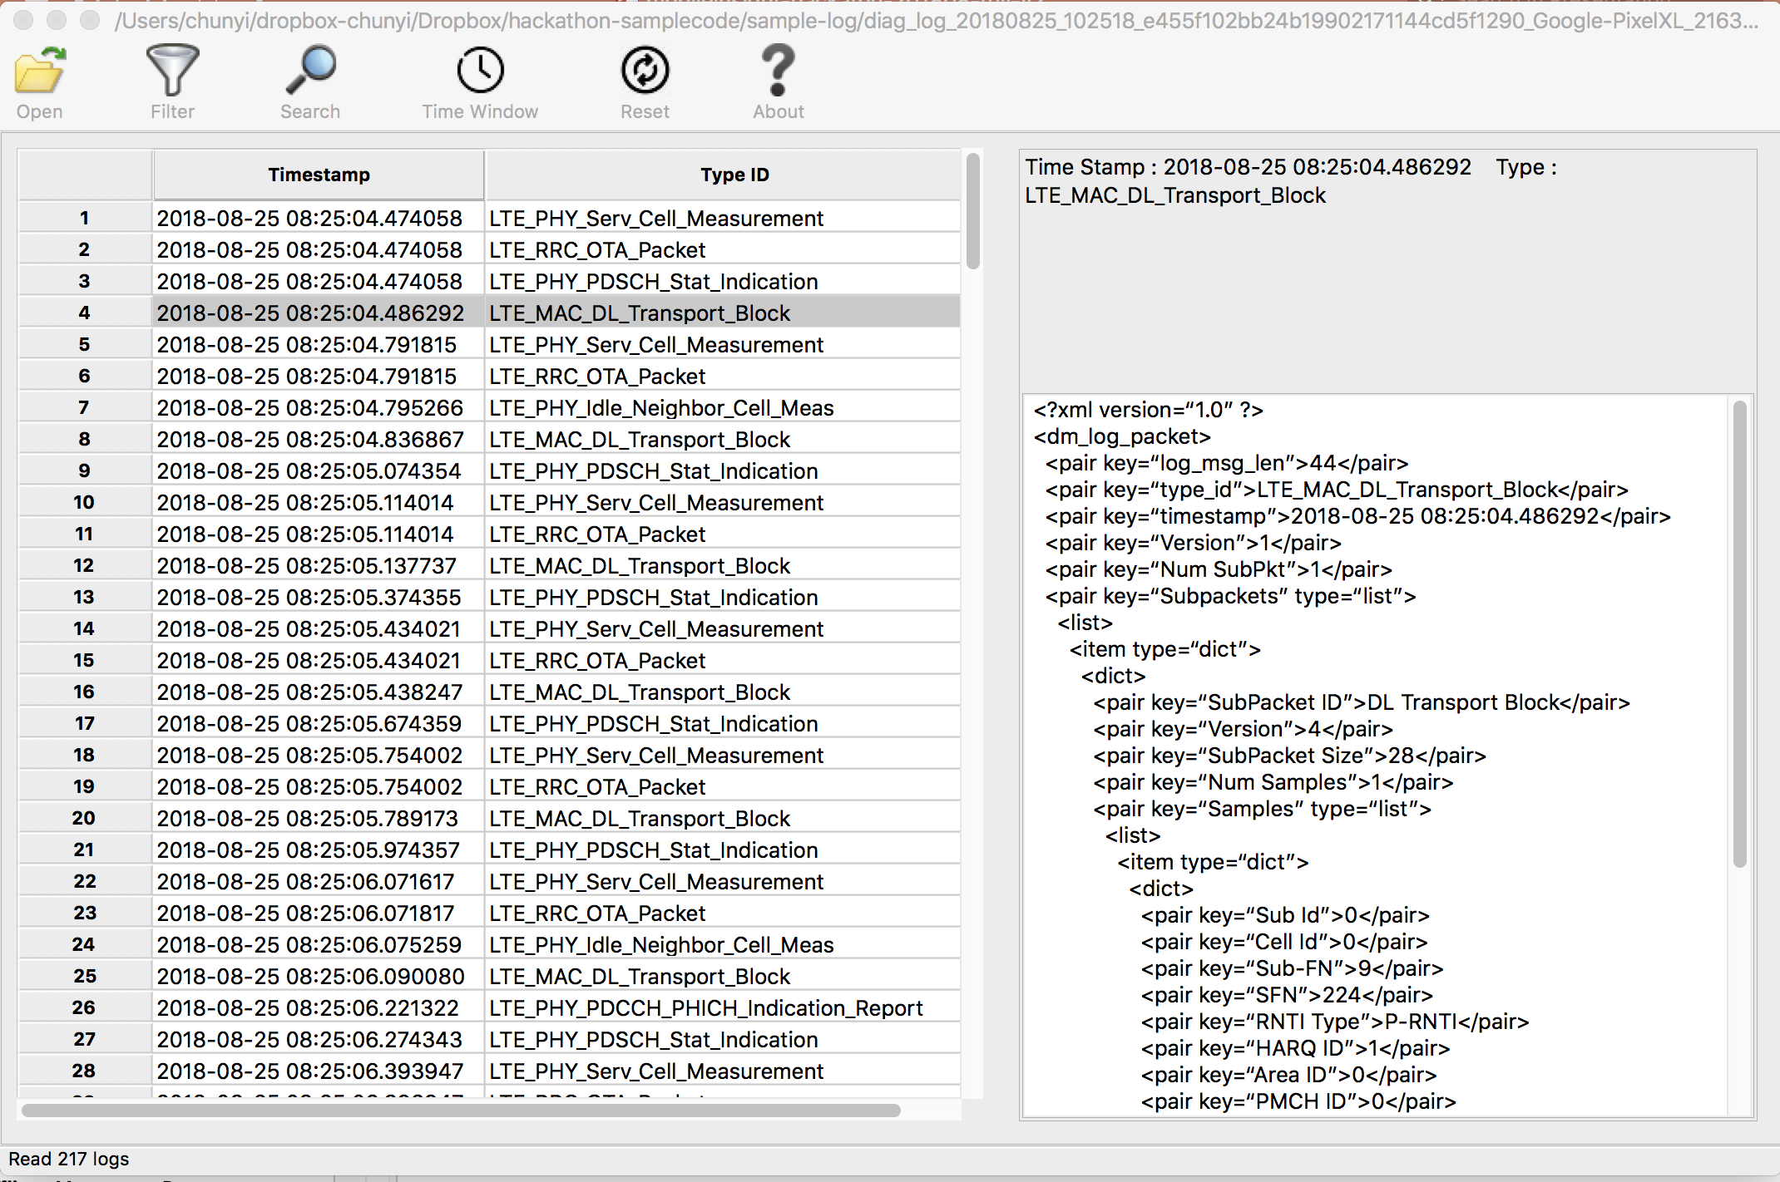
Sample Logs
\sample-log\diag_log_20180825_102518_e455f102bb24b19902171144cd5f1290_Google-PixelXL_21630.mi2log

Slide 41
How Do We Really Achieve It?
Thanks to sample codes from the MobileInsight Team

Slide 42
Offline Message Parser
\sample-codes\...\example_pdcp.py
  Extensible to any message supported by MI
Run it yourself
  python example_pdcp.py offline_log_example.mi2log
Notes:
> python example_pdcp.py offline_log_example.mi2log > offline_log_example.txt
[INFO] [OfflineReplayer]: Enable LTE_PDCP_DL_Cipher_Data_PDU[INFO] [OfflineReplayer]: Enable LTE_PDCP_UL_Cipher_Data_PDU[INFO] [OfflineReplayer]: STARTED: 1535161099.9[INFO] [OfflineReplayer]: Loading offline_log_example.mi2log[INFO] [OfflineReplayer]: Loading: 1535161099.9[INFO] [OfflineReplayer]: Decoding_inter: 0.000120878219604[INFO] [OfflineReplayer]: sending_inter: 0.0120270252228[INFO] [OfflineReplayer]: Offline replay is completed.

Slide 43
One Sample (For Your Reference)
<?xml version="1.0" ?>
<dm_log_packet>
<pair key="log_msg_len">72</pair>
<pair key="type_id">LTE_PDCP_UL_Cipher_Data_PDU</pair>
<pair key="timestamp">2016-03-23 21:55:49.366944</pair>
<pair key="Version">1</pair>
<pair key="Num Subpkts">1</pair>
<pair key="Subpackets" type="list">
<list>
<item type="dict">
<dict>
<pair key="Subpacket ID">195</pair>
...
<pair key="Num PDUs">1</pair>
<pair key="PDCPUL CIPH DATA" type="list">
<list>
<item type="dict">
<dict>
<pair key="Cfg Idx">33</pair>
<pair key="Mode">AM</pair>
<pair key="SN Length">5 bit</pair>
<pair key="Bearer ID">0</pair>
<pair key="Valid PDU">Yes</pair>
<pair key="PDU Size">132</pair>
<pair key="Logged Bytes">3</pair>
<pair key="Sub FN">6</pair>
<pair key="Sys FN">574</pair>
<pair key="SN">0</pair>
</dict>
...
</dm_log_packet>
…

Slide 44
Latency Analyzers
Sample codes: \sample-codes\weblatency\
  Actually used for WebLatency task in MI-LAB
  What messages are used?
    ul_lat_alyzr.py
      source.enable_log("LTE_RRC_OTA_Packet") source.enable_log("LTE_NAS_EMM_OTA_Outgoing_Packet") source.enable_log("LTE_PDCP_UL_Cipher_Data_PDU") source.enable_log("LTE_RLC_UL_AM_All_PDU")
    ul_mac_lat_alyzr.py
      source.enable_log("LTE_MAC_UL_Buffer_Status_Internal")
  How to calculate latency?
    State-dependent (multiple messages involved)
    check wait_delay → self.mapped_pdcp_rlc[] → …
    check __get_time_inter …
    read sample codes and traceback

Slide 45
Accomplishment @ Hackathon’18
Project #3: Extract PDCP latency not all
  Start from a scratch (no prior MI dev experience)
    two remote members (via Skype conference calls)
  10:30AM-18:30AM (1hr tutorial, 2-2.5hr code study, 1.5-2hr dev+debug, 0.5hr break, 0.5hr slide)
  Incomplete but functionality demonstrated
https://github.com/qdeconinck/hackathon-2018-mobileinsight

Slide 46
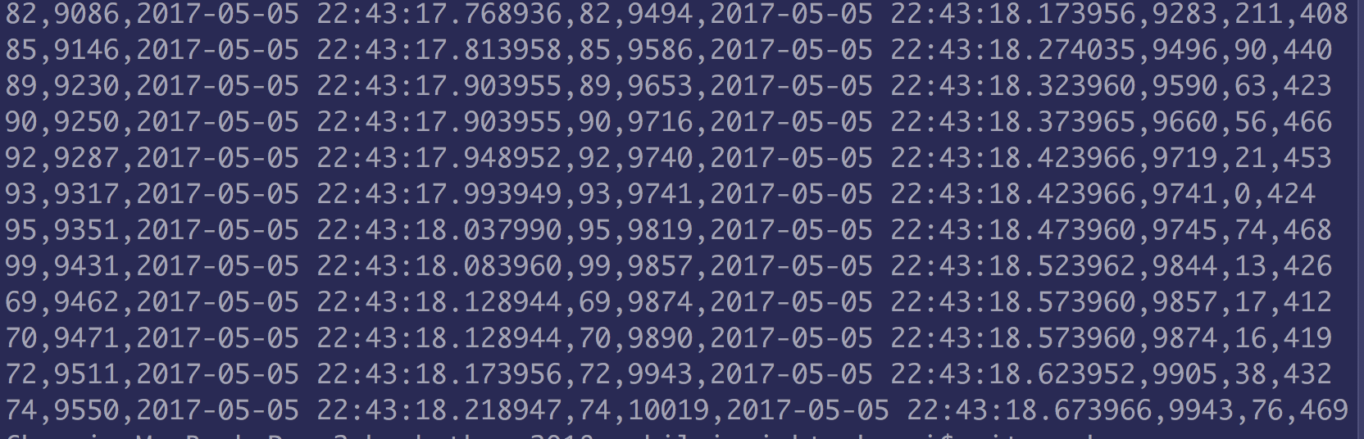
Live Demo
PDCP
E2E

Slide 47
PDCP vs. End-to-End Latency
Source: sample.mi2log
Not all results presented
ms
(source from Hackathon’s presentation slide)

Slide 48
PDCP vs. End-to-End Latency
Source: sample.mi2log
Not all results presented
Observation:
Data transmission time (determined bandwidth) is NOT
main source of latency in most case.
ms
Mobile Insight:
Increasing bandwidth will not reduce latency proportionally.
Efforts in other aspects are warranted!
(source from Hackathon’s presentation slide)

Slide 49
Takeaways
Demonstration of unexplored possibilities exposed by MobileInsight
Easy to learn and develop (despite the barrier on cellular network domain knowledge)
Still at the tip of the iceberg
  More on performance, efficiency, reliability, security, …
  Check recent results using MobileInsight (via citations)
Build our (mainly academic) community on mobile networking research
Code & data: http://www.cs.purdue.edu/homes/chunyi/hackathon18-workspace
Github: https://github.com/qdeconinck/hackathon-2018-mobileinsight

Slide 50
Acknowledgement
MobileInsight Dev Team
http://mobileinsight.net
https://github.com/mobile-insight
Technical support: support@mobileinsight.net
Prof. Songwu Lu (UCLA)
Yuanjie Li (UCLA)
Zengwen Yuan (UCLA)
Haotian Deng (Purdue)
Jiayao Li (Peking Univ, UCLA)
…
Plus 15+ developers
MobileInsight Users and Contributors
30+ volunteering participators across the world (>450GB data)
Sample codes from
\examples_pdcp: Haotian Deng (Purdue)
\weblatency: Zengwen Yuan (UCLA)
\test_offline_latency: Zhaowei Tan (UCLA)

Slide 51
This Page is intentionally blank

Slide 52
More Resources and References
More source codes and recent studies on latency
[ICCCN'18] Yuan et. al, A Machine Learning Based Approach to Mobile Network Analysis
  Full-stack web latency analysis: App/TCP + cellular (control + data)
One real example
using chrome
main source of latency

Slide 53
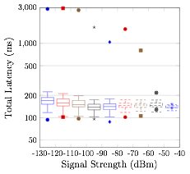
More Resources and References
More source codes and recent studies on latency
  [ICCCN'18]: measurement of radio access latency (radio + control)
77-2956 ms in 500K samples in the US
  Varies among different mobile carriers
  Insensitive to varying radio link quality
[Mobicom'17], Li et. al, A Control-Plane Perspective on Reducing Data Access Latency in LTE Networks
A new solution to reduce radio access latency via control-plane redesign (DPCM)

Slide 54
More Resources and References
More source codes and recent studies on latency
  [ICCCN'18]: measurement of radio access latency (radio + control)
DPCM solution in [Mobicom'17] Li et. al, A Control-Plane Perspective on Reducing Data Access Latency in LTE Networks
77-2956 ms in 500K samples in the US
  Varies among different mobile carriers
  Insensitive to varying radio link quality

Slide 55
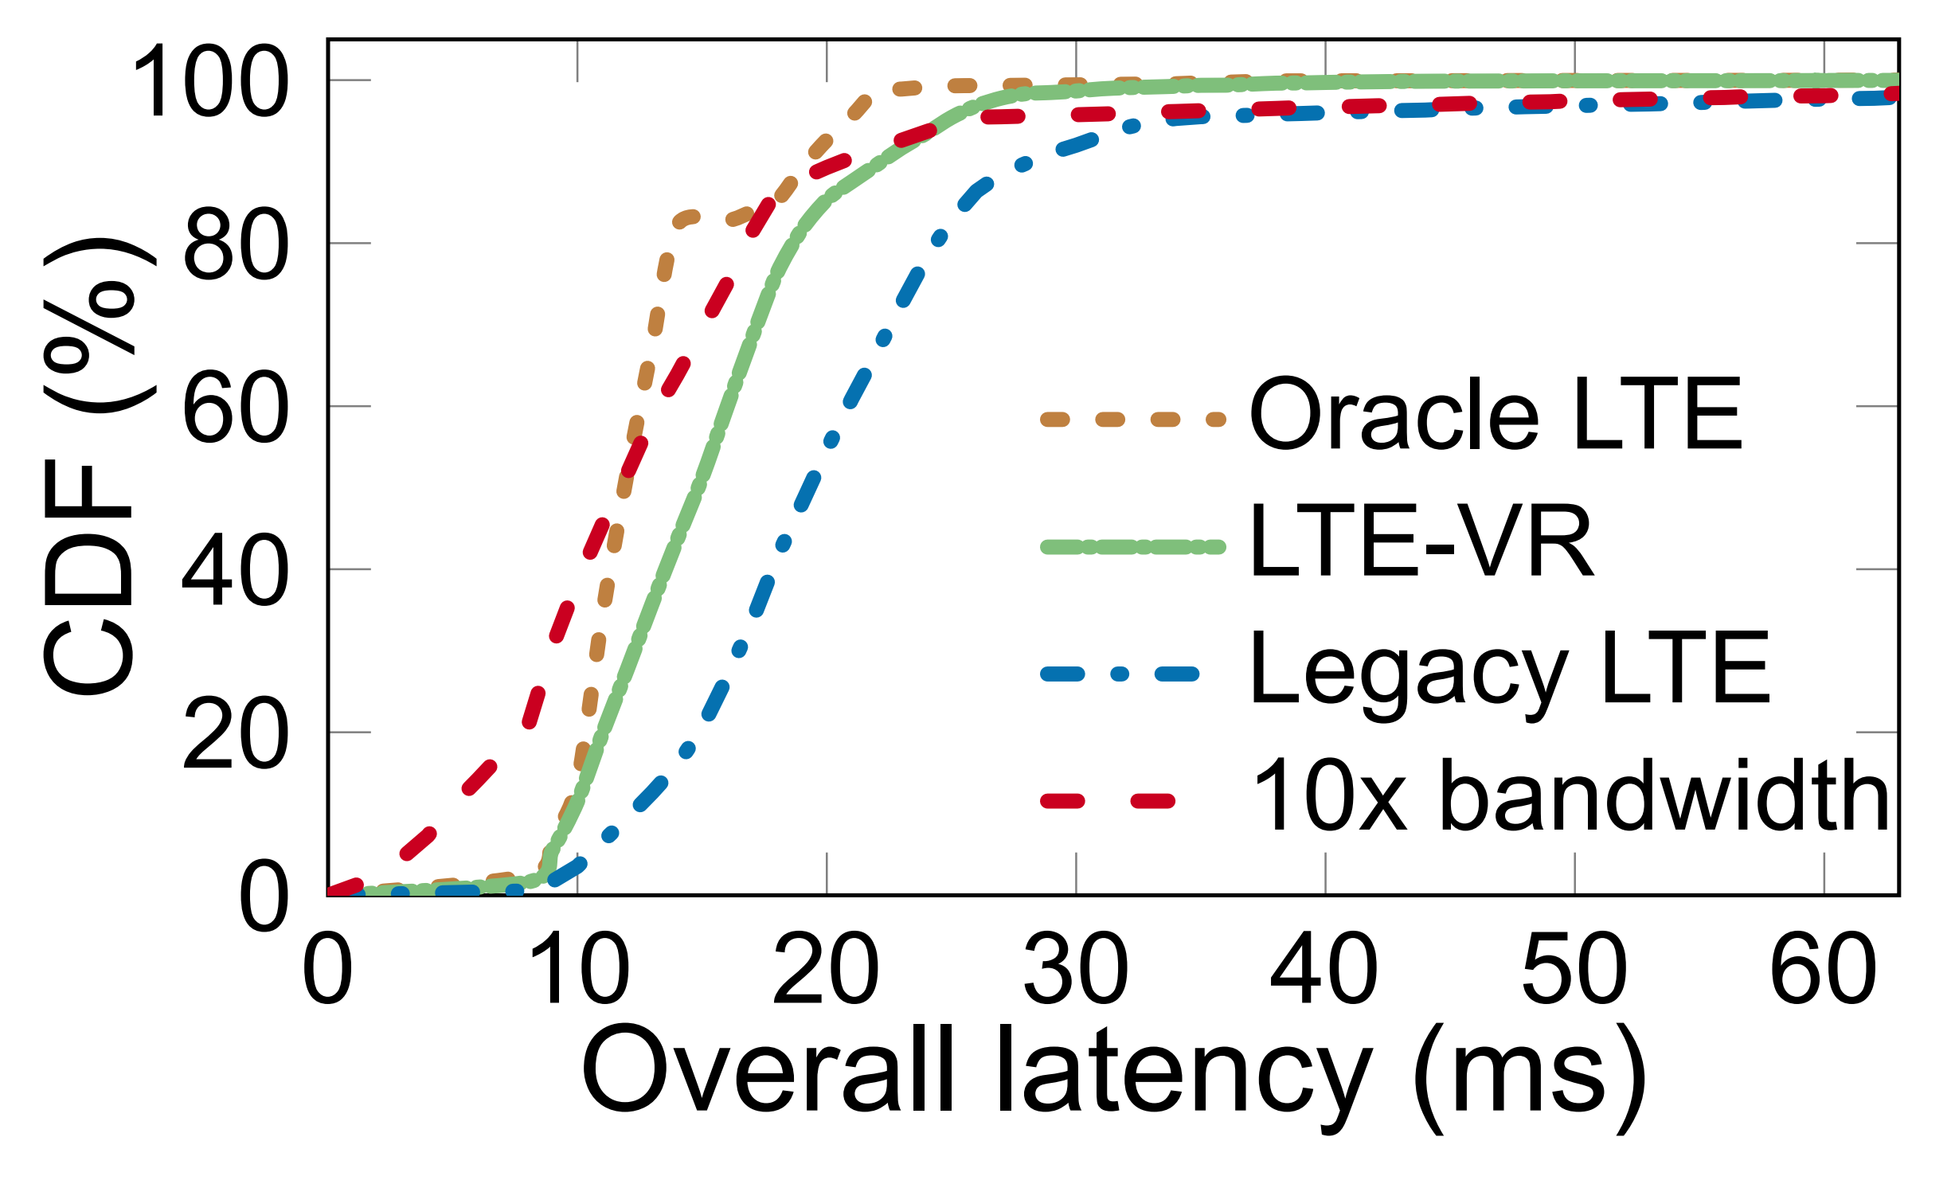
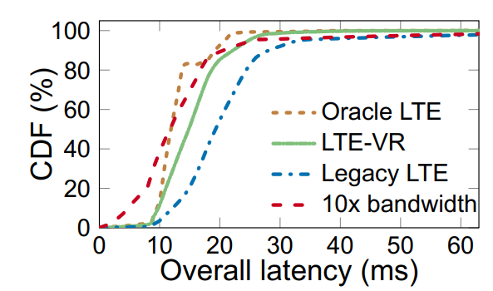
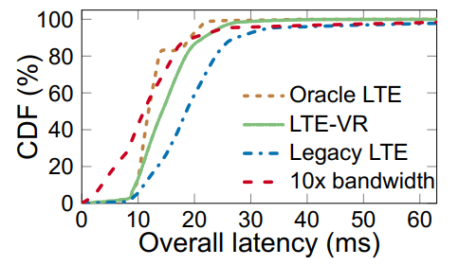
More Resources and References
More source codes and recent studies on latency
[SIGMETRICS'18] Tan et. al, supporting Mobile VR in LTE Networks: How Close AreWe?
  L1/L2 latency analysis
  Public dataset and source codes for mobile VR latency analysis
    http://metro.cs.ucla.edu/mobileVR.html
  Sample codes for data collected by MobileInsight
    \sample-codes\test_offline_latency
LTE-VR (their solution) meets delay tolerance with 95% probability
Reduce latency outlier frames by 3.7x
Comparable to 10x bandwidth expansion
(Courtesy from Tan’s SIGMETRICS’18 slide)
a) Overall latency CDF – APP1
b) Overall latency CDF – APP2
Notes:
https://ucla.app.box.com/s/cwd6yt8tg5orhbltckkvho9s73crk74d

Slide 56
Another MobileInsight Tutorial
Globecom’17: more research-centric
  Empower research ”impossible” (with a focus on network verification)
  http://http//www.cs.purdue.edu/homes/chunyi/talks/globecom17-tutorial-mobileinsight-public.pdf
Notes:
Default analyzer (as your samples)

Slide 57
Built-In Analyzers
Analyze r | Descrip tion | Standar ds/Refere nce
lte_mac_analyzer .py | 4G MAC protocol analyzer | TS36.321
lte_meas urement_ analyzer. py | Reports 4G-RRC measureme nt results | TS36.331
lte_nas_analyzer .py | 4G EMM/ESM protocol analyzer | TS24.301
lte_pdcp _analyze r.py | 4G PDCP protocol analyzer | TS36.323
lte_phy_analyzer .py | 4G PHY layer (LL1) analyzer | TS36.213, TS36.211
lte_rlc_analyzer .py | 4G RLC protocol analyzer | TS36.322
lte_rrc_analyzer .py | 4G RRC protocol analyzer | TS36.331
umts_nas _analyze r.py | 3G MM/GMM/SM /CM protocol analyzer | TS24.008
mobility_mngt.py | 4G handoff decision logic inference | TS36.304, TS36.331, MobileIns ight paper [Mobicom’ 16]
wcdma_rr c_analyz er.py | 3G-RRC protocol analyzer | TS25.331
Notes:
Default analyzer (as your samples)

