Slide 1
InFrame++: Achieve Simultaneous Screen-Human Viewing and Hidden Screen-Camera Communication
Anran Wang¹, Zhuoran Li², Chunyi Peng², Guobin Shen³, Gan Fang², Bing Zeng⁴
¹
²
³
⁴
Notes:
Hello, everyone…
This presentation is to show our InFrame Plus Plus project, which aim to …
+background color
+

Slide 2
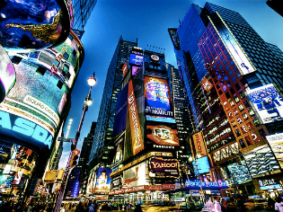
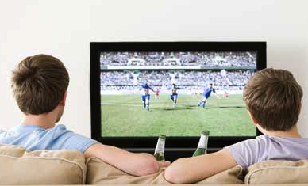
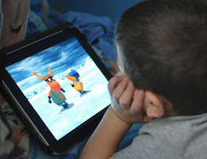
Digital Display: Primary Info Source to human
Browsing Ad
Watching movies
Watch football games
Read articles,
Play games
….
Notes:
We enjoy our viewing experience thanks to the ubiquitous digital screens and our naked eyes
Vision is the primary source

Slide 3
Ohio Stadium
411 Woody Hayes Dr, Columbus, OH 43210
(614) 292-6330
Spatial compromise
Notes:
Let us start with one real experience.
When we watch a video or ad, we sometimes want to get more information at the same time.
For example, this is a nice building. Where is it? What is the story about it?
One approach: display side-information. Yes. It is ugly and also contains little information.
Another improvement
================= Script ends ===========
Moreover, we also need video-related meta-data as well.
For example, when we watch an advertisement, we are looking for the contacts and potential coupons from the store.
However, if we want to realize it,
We have to make spatial compromise,
Or temporal compromise
Ugly!
Complex!
Left: Replaced by a video,
Right: replace wechat by temporal
+1 slide: expected results, state of the art
Two types of information are competing the limited space.

Slide 4
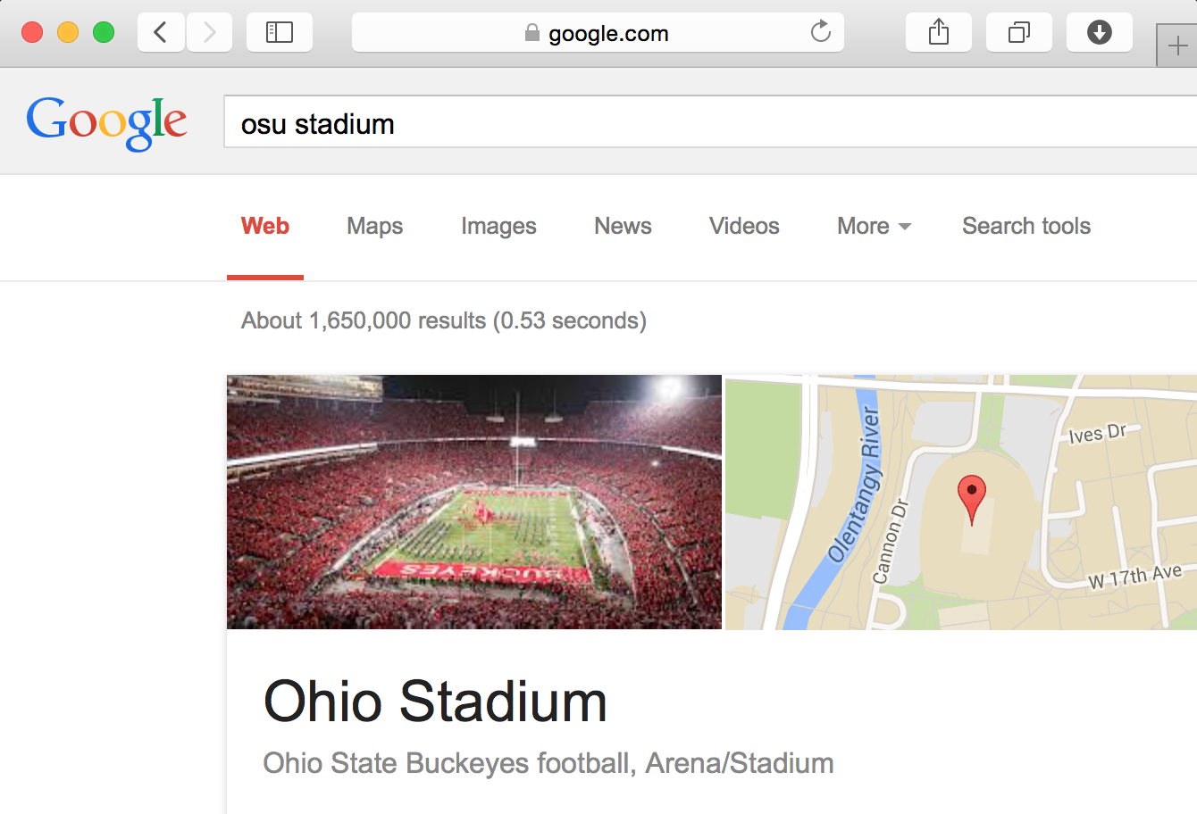
Temporal compromise
Notes:
Let us start with one real experience.
When we watch a video or ad, we sometimes want to get more information at the same time.
For example, this is a nice building. Where is it? What is the story about it?
One approach: display side-information. Yes. It is ugly and also contains little information.
Another improvement
================= Script ends ===========
Moreover, we also need video-related meta-data as well.
For example, when we watch an advertisement, we are looking for the contacts and potential coupons from the store.
However, if we want to realize it,
We have to make spatial compromise,
Or temporal compromise
Ugly!
Complex!
Left: Replaced by a video,
Right: replace wechat by temporal
+1 slide: expected results, state of the art
Two types of information are competing the limited space.

Slide 5
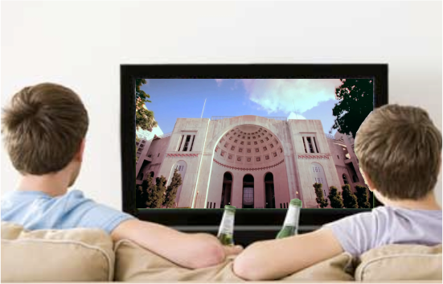
Can we AChIEVE both simultaneously?
What our eyes see:
What our cameras (devices) see:
Ohio Stadium, also known as The Horseshoe, is an American football stadium in The Ohio State University (OSU).
411 Woody Hayes Dr, Columbus, OH 43210
(614) 292-6330
Full-screen normal viewing
Accompanying data communication, but imperceptible
Notes:
Maybe our smart devices can help us reading the invisible contents from the display
This need us to realize
1…
2…
Image #2: + 1 smart device on image
Echo
Till now: 3min

Slide 6
Yes! InFrame++ Can! (NOTE: replaced by real capture effects)

Slide 7
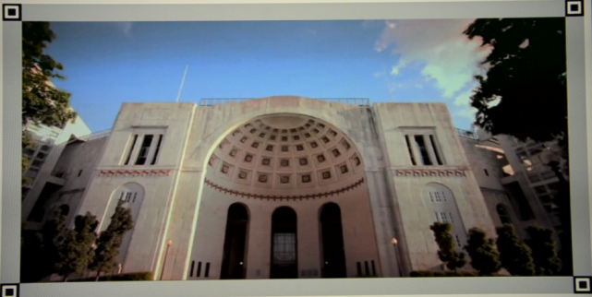
InFrame++: Dual Mode Communication
Screen-to-eye (primary):
Ohio Stadium,
is a football stadium
at Ohio State Univ….
0110110….
Screen-to-camera (secondary)
Notes:
Now we briefly describe the overview of InFrame++
First we want to design a dual mode display
Which enables screen to eye communication, we want intact human viewing exp.
And what’s more, screen to camera communication, we want high speed and high reliability.
Of course, the tension emerges
And introduce two challenges to InFrame++
One is..
The second is…
Line color: consistent!
Font color also consistent
Keywords rather than sentences

Slide 8
InFrame++: Dual Mode Communication
Screen-to-eye (primary):
Goal#1
Intact viewing
Impairment-free
Challenge #1
How to Embed data without impairing viewing?
Tension! How to ???
Goal#2
good data performance
as possible
Challenge #2
How to boost throughput and reliability with primary video as interference?
Screen-to-camera (secondary)
Notes:
Now we briefly describe the overview of InFrame++
First we want to design a dual mode display
Which enables screen to eye communication, we want intact human viewing exp.
And what’s more, screen to camera communication, we want high speed and high reliability.
Of course, the tension emerges
And introduce two challenges to InFrame++
One is..
The second is…
Line color: consistent!
Font color also consistent
Keywords rather than sentences

Slide 9
InFrame++: Dual Mode Communication
Screen-to-eye (primary):
Goal#1
Intact viewing
Impairment-free
Challenge #1
How to Embed data without impairing viewing?
Goal#2
good data performance
as possible
Challenge #2
How to boost throughput and reliability with primary video as interference?
Screen-to-camera (secondary)
Notes:
Now we briefly describe the overview of InFrame++
First we want to design a dual mode display
Which enables screen to eye communication, we want intact human viewing exp.
And what’s more, screen to camera communication, we want high speed and high reliability.
Of course, the tension emerges
And introduce two challenges to InFrame++
One is..
The second is…
Line color: consistent!
Font color also consistent
Keywords rather than sentences

Slide 10
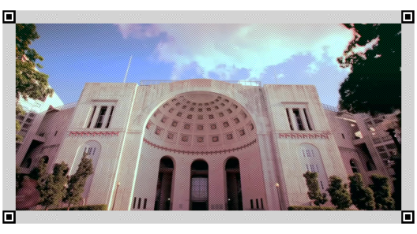
Embedded Patterns INDEED exists.
But invisible to eyes during video viewing
Notes:
Let us freeze the video and zoom in this static frame.
> pattern indeed exists.
> Click (but invisible to human eyes during video viewing, why?....)
Anran: please select an area and zoom in 16x

Slide 11
Leveraging Perception Gap
Human Vision System
Screen to Camera
Temporal resolution: Low-pass filter (40-50Hz)
Almost imperceptible if faster > 50Hz
Modern Screen: high fresh rate ( 120FPS, or 240FPS)
Cameras: rolling-shutter (snapshot captured)
What if we play Complementary “DATA”
at high frequency (120FPS)?
Notes:
We leverage the perception gaps between human vision system and morden cameras.
======================
Cameras nowadays equipped with every smartphones are of high resolution and frame rate, and are still developing
So are the displays. We can see cheap 120 frame per second full-HD LCD on the market now
Moreover, cameras take snapshots, and the shutter time can be as short as one by hundreds second
Meanwhile, the human vision system is quite stable. Our eyes have fixed temporal resolution and spatial resolution,
And most importantly, our eyes perceive lights following the low-pass filter mechanisms.
We searched lots of academic papers in human vision systems and this mechanism of human eyes are widely regarded

Slide 12
V + D
+D
V
Complementary
Pixel
Complementary Pattern
Complementary
Frame
Pixel
- D
V - D

Slide 13
V+D
V-D
V+D
V-D
V+D
V-D
V+D
V-D

Slide 14
They Are Complementary Frames
V + D
+D
V
Pixel
Complementary Pixel
Complementary Frame
Complementary Pattern
Detail Patterns
- D
V - D
V-D
V-D
V+D
V-D
Inframe++ will play the video with complementary frames.

Slide 15
They Are Complementary Frames
V + D
+D
V
Pixel
Complementary Pixel
Complementary Frame
Complementary Pattern
Detail Patterns
- D
V - D
V-D
V+D
V-D
V+D
V-D
Inframe++ will play the video with complementary frames.

Slide 16
V-D
V+D
V-D
V+D
V-D
V+D
V-D
We play it at high frame rate (120 FPS)
V-D
V+D
Screen Show
V-D
V+D
V-D
V+D
V-D
Our eyes are like a filter (40-50HZ)
Eyes See
V
V+D
V- D
V
V
V
V
V

Slide 17
Complementary pixels
+ ==========
V_{p} V_{p*} V
The colors satisfy V_{p} + V_{p*} = 2V in RGB domain.
High frequency,
Low-pass filter
Input
Output
Simulation by an electronic low-pass filter.
Notes:
One of the basic concepts of InFrame++ is the complementary pixels.
If we keep our eyes on two different colors alternating in a rather high frequency,
We will only see the average
This is proven under a simulation by an electronic low-pass filter.

Slide 18
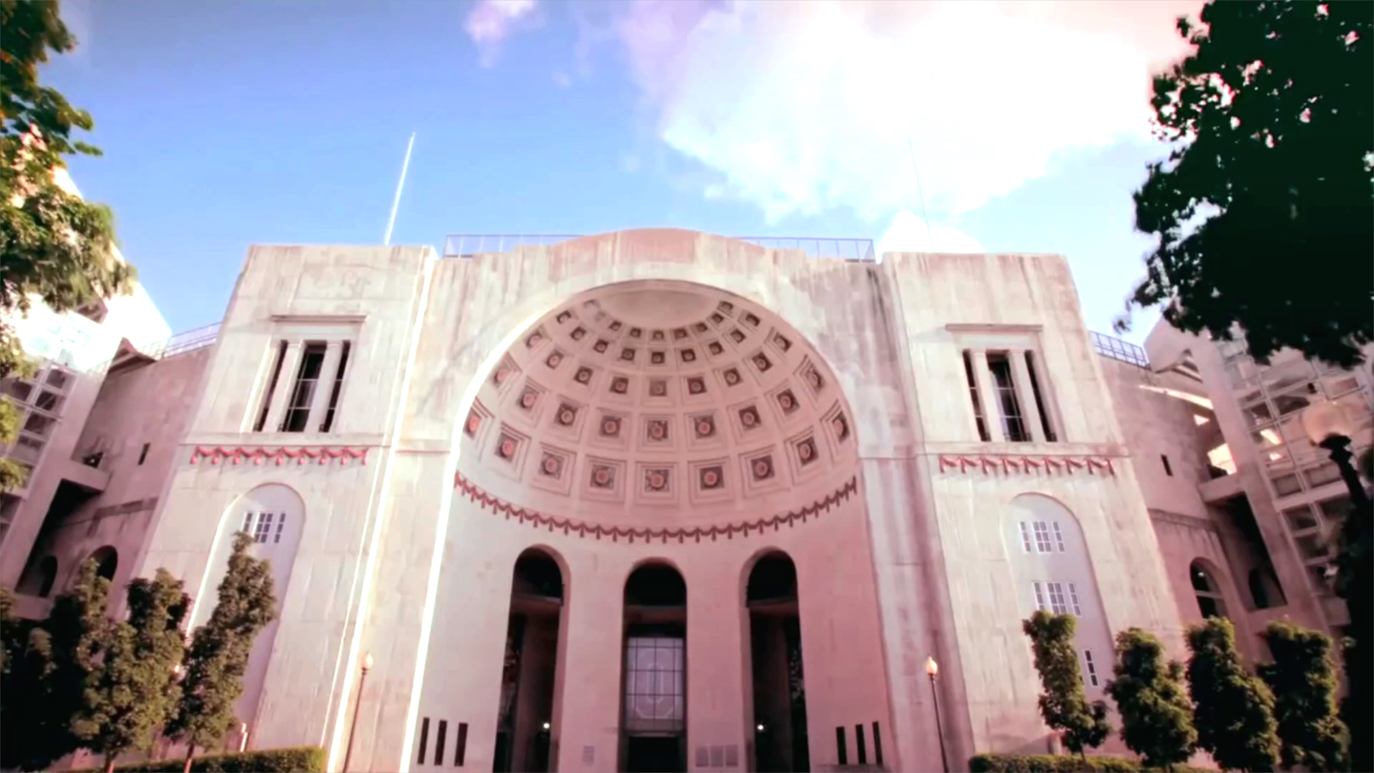
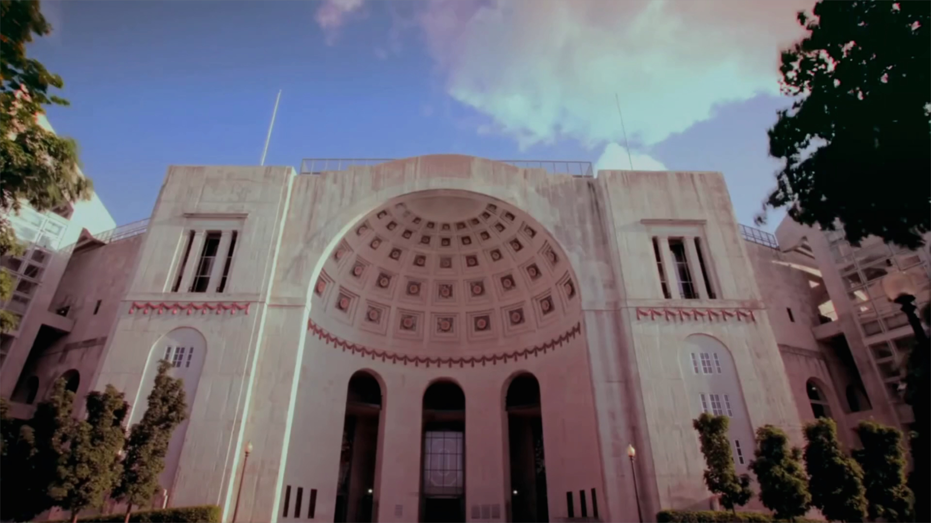
Temporal Patterns
Frame 2i
Frame 2i+1
Temporal complementary frames (TCF)
Cameras take snapshots, shutter speed: 1/200s
Low-pass filter
(cut-off: 40-50Hz)
Luminance
Luminance
V1 + D1
V2 + D2
…
V1 − D1
V2− D2
…
V1
V2
…
Time
Time
(Vi: original video frames, Di: embedded data frames)
Notes:
Based on this, we design the temporal patterns of InFrame++
Each even video frames will be multiplexed by a positive data frame.
Each odd …
If the frequency reaches a threshold, we will only see the average, the original videos.
The camera, oppositely, capture snapshots, which includes both video frames and data frames

Slide 19
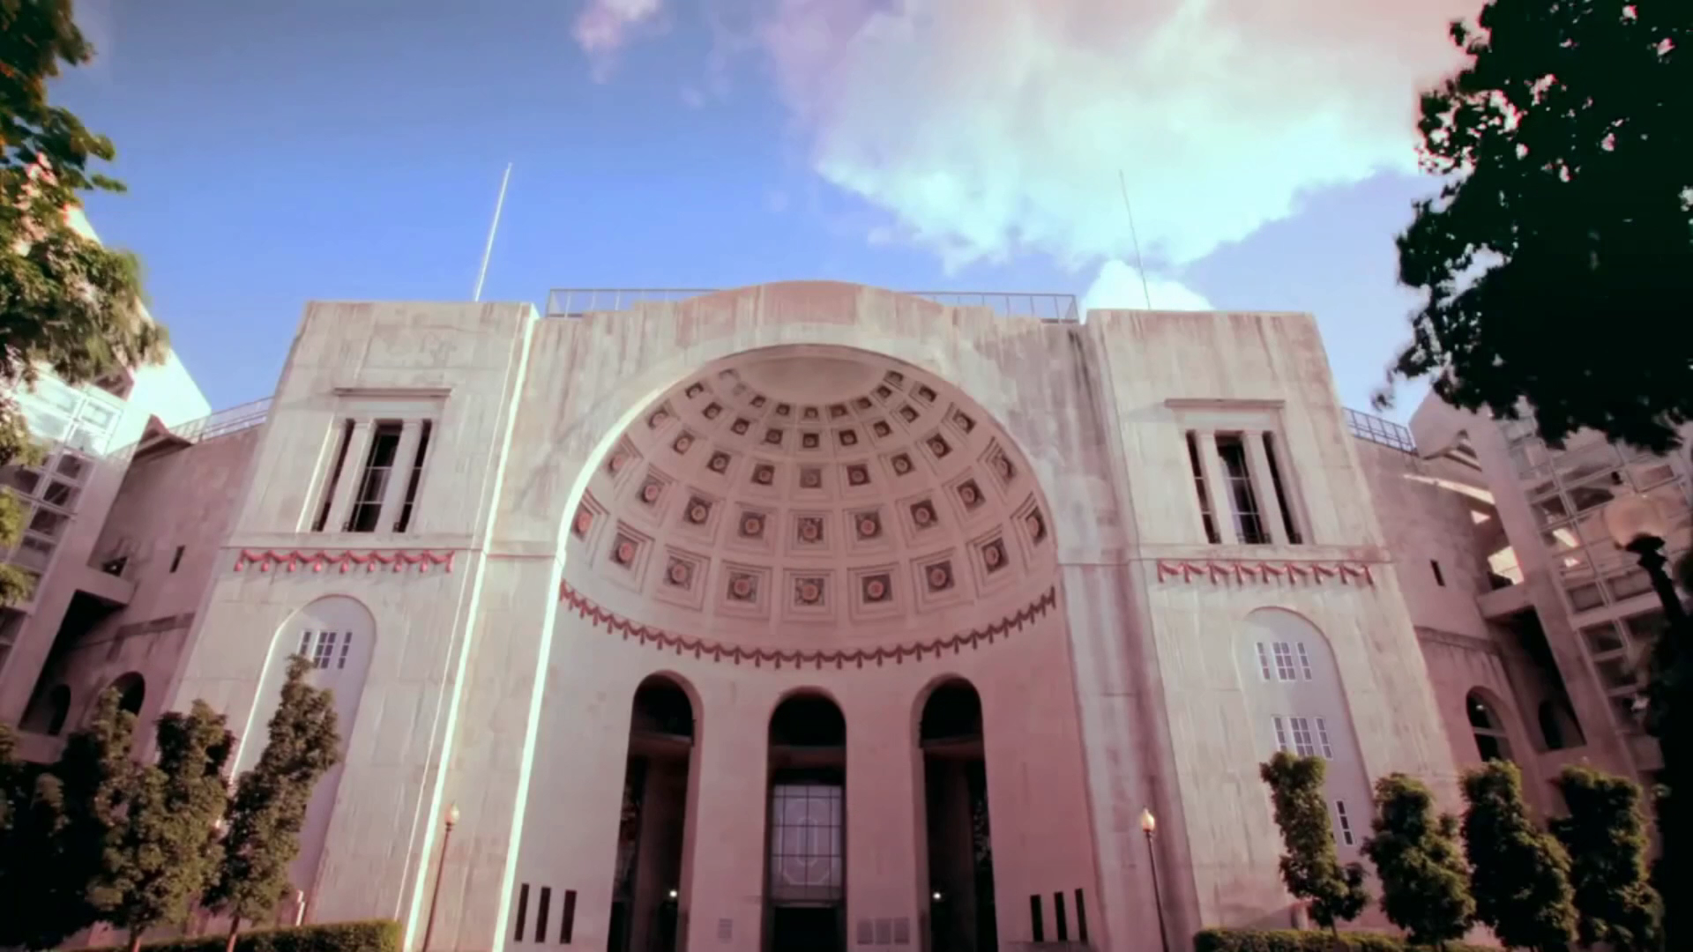
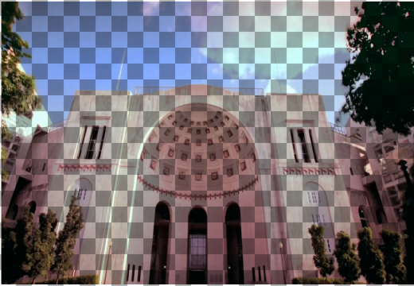
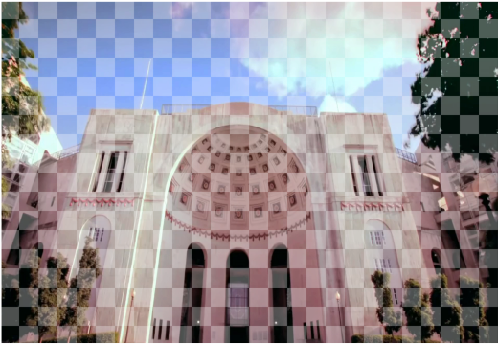
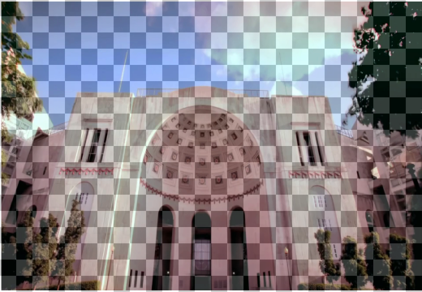
Spatial Patterns
Chessboard patterns
If the cells are extremely small, we can only see the original video.
Spatial-temporal Complementary Frame (STCF)
Not spatial complementary
Spatial complementary
(average D=0 both spatially and temporally)
Notes:
We also want to leverage the spatial perception gap as well.
Firstly, if we multiplex a chessboard pattern on a picture, the more dense, the more invisible. This is exactly the dithering mechanism used by most printers
Based on that, we design spatial-temporal complementary frames, short as STCF

Slide 20
(Here’s a video to show STCF)

Slide 21
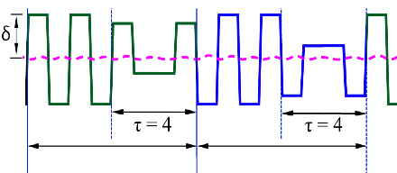
Time-variant Data Frames
Introduce time-variant amplitudes to encode data? Flickers!
Smoothing Transitional Frames
Half the raised Cosine waveform
Di=1
Di+1=-1
τ: The number of transitional frames
Spectrum leakage!
Simulation using an electronic low-pass filter
Notes:
Title: Data changes
+introducing tau

Slide 22
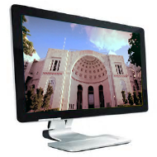
InFrame++: Dual Mode Communication
Screen-eye (primary):
Challenge 1: How to Embed data without impairing viewing?
Screen-eye (primary):
Goal: Intact human viewing experience
Impairment-free, interference-free
Screen-camera (secondary):
Goal: High throughput and moderate error rate
Detectable patterns, high SNR
Screen-camera (secondary):
Challenge 2: How to improve the throughput and reliability?
Notes:
Now we briefly describe the overview of InFrame++
First we want to design a dual mode display
Which enables screen to eye communication, we want intact human viewing exp.
And what’s more, screen to camera communication, we want high speed and high reliability.
Of course, the tension emerges
And introduce two challenges to InFrame++
One is..
The second is…
Line color: consistent!
Font color also consistent
Keywords rather than sentences

Slide 23
Screen-camera (secondary):
Challenge 2: How to improve the throughput and reliability?

Slide 24
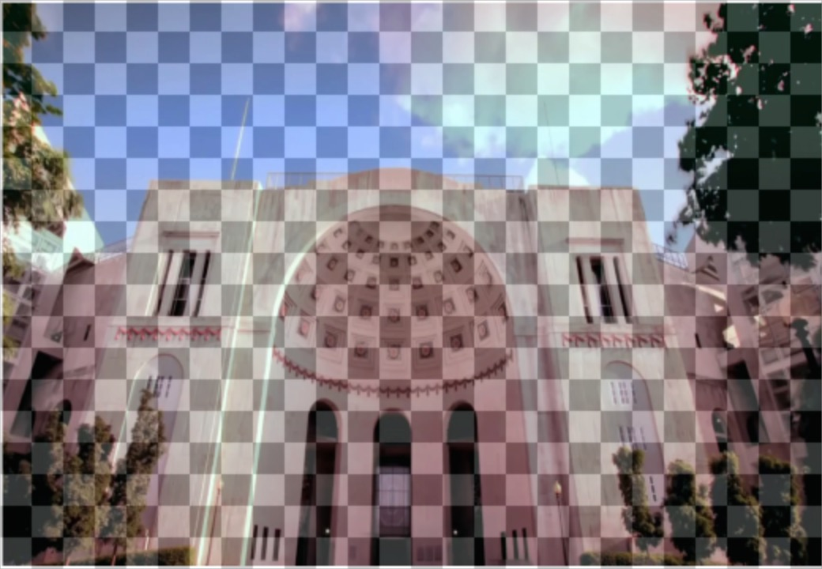
How to encode and decode the pattern?
Challenge: difference from traditional VLC approaches
Primary video as interference, SNR is too low!
What we encode
What we capture
Traditional VLC approach
Notes:
Challenge: diff. from VLC
Compared with traditional VLC
+a plot

Slide 25
CDMA-like Modulation
Cell-Block-Segment-Frame structure
How a Block encodes data?
Code Division Multiple Access (CDMA)
Pixel
Cell
Block
Frame
Segment
x
> 0
x
≈ 0
Invisibility
Locating errors
Interference and noises
x
or
≈ 0
Notes:
Slow!
Left:rec. right: codes (0,1)

Slide 26
CDMA-like Modulation
Average=0
Contiguous 1 or -1 cannot be too long
Unique subject to circular shifts
Unique subject to reverse operation
Maximum Hamming distance (2^{2n−1})
Four valid codes used in InFrame++.
Hamming Distance: 8
Notes:
Use Bullet rather than sentences

Slide 27
CDMA-like Demodulation
Cross-correlation: codes and captured patterns
Locating errors cancellation: for all shifts within a certain range, choose the maximum cross-correlation results
Offset with maximum result
x
Original location
Notes:
shorten

Slide 28
General VLC problems
Border Design and Error Resilience

Slide 29
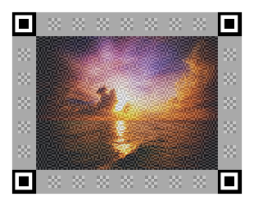
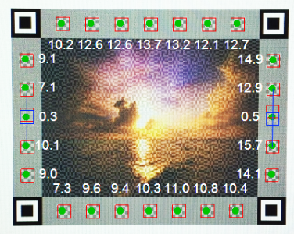
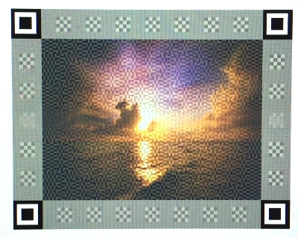
Robust Block Localization
Rolling Shutter!
What camera captures
What we see
What display shows
(Locators, Borders and Blocks are enlarged for clearer visual)

Slide 30
Error Resilience
Visual Guard
The Blocks at borders are erroneous, so we leave them blank.
Channel Reference Blocks
We put known patterns at known places to estimate the BER.
Error detection and coding
In our demo: LDPC Code per Segment and across Segment (BER: up to 7% -> 0)

Slide 31
Implementation
Sender:
Written in C# and HLSL
Direct-Compute using GPU
120FPS Real-time rendering
Offline receiver:
Written in C#
Multithreading
4-5 frames per second
Online receiver for Android:
Written in C++ (using Android NDK)
Multithreading
3-4 frames per second
Experimental Settings
Eizo FG2421 24’ LCD
1080p, 120FPS
Lumia 1020, Galax S5 and Note 3
1080p, 30FPS
60cm distance as default
Sunset video source as default

Slide 32
User Study Results – STCF
Flicker perception:
Severe flickers
Moderate flickers
No flicker
60 FPS (30Hz) TCF
Artifacts:
Much
Some
None
80 FPS (40Hz) TCF
120FPS TCF
120 FPS STCF
120FPS STCF
Amplitude δ: 10 20 30 40 50
Amplitude δ: 10 20 30 40 50
Notes:
Smoothing transition frames: after this slide

Slide 33
User Study – Cell Size & Watching Distance
Flicker perception:
Severe flickers
Moderate flickers
No flicker
Flicker perception:
Severe flickers
Moderate flickers
No flicker
TCF
Cell size = 7*7
STCF
Cell size = 3*3
Cell size c: 1*1 3*3 5*5 7:7 9*9
Distance (cm): 40 60 100 150 200
Notes:
Eval: after tech.

Slide 34
User Study – Smoothing & Video Sources
Flicker perception:
Severe flickers
Moderate flickers
No flicker
Flicker Perception:
Moderate flickers
No flicker
STCF, δ = 20
STCF, δ = 50
TCF, δ = 50
δ = 50 (TCF)
δ = 50 (TCF)
δ = 20 (TCF)
δ = 20 (STCF)
Transition count (τ): 0 2 4 6 8 10 12
Video sources: Gray Football Golf Beach Sunset
(All under 120 FPS (60Hz))

Slide 35
Evaluation – Throughput vs BER
Throughput (kbps)
300
200
100
0
Throughput (kbps)
200
150
100
50
Bit-error rate (%)
15
10
5
0
Data frame rate: 10 12 15 20
Amplitude (δ): 20 30 40
Throughput (kbps)
200
150
100
50
0
Bit-error rate (%)
40
30
20
10
0
Block Size (px): 6*6 12*12 12*12 24*24 24*24
Bit per block: 1 2 1 3 2

Slide 36
Evaluation – Throughput vs BER
Throughput (kbps)
200
150
100
50
Throughput (kbps)
200
150
100
50
Distance (cm): 40 60 100 150 200
Video sources: Gray Football Golf Beach Sunset
(12*12 pixels/block, 2 bits/block, δ = 20, 10 data frames/second)
Much better performance compared with our previous work InFrame!

Slide 37
Evaluation – Encoding & Decoding Speed
 | PC1 (i5, Radeon HD8490) | PC2 (Xeon e5, AMD FirePro V3900) | Macbook Pro (i5, Iris integrated card)
Pure color | 136FPS | 242FPS | 250FPS
720p video | 131FPS | 235FPS | 185FPS
Encoding Performance
 | PC1 | PC2 | Galaxy S5 (C++) | Requirement (10FPS)
Single Thread | 981ms | 908.7ms | - | 100ms
Multiple Thread | 269ms | 202.7ms | 444ms
Decoding Performance

Slide 38
Summary
Simultaneous Screen-Human Viewing and Hidden Screen-Camera Communication
Utilizing the perception gaps between human eyes and cameras
One channel, two views.
Techniques to achieve InFrame++
Spatial-temporal Complementary Frames and Smoothing Transitional Frames
CDMA-like Modulation and Demodulation
robust Block localization and error resilience
Much higher throughput and much lower BER compared with our previous work.

Slide 39
Future Work
More detailed frame design to optimize locating performance with less distraction
Explore the expanding capability discrepancy between users and devices
Real-world application

Slide 40
Thanks

