Slide 1
CS 40800 These slides were created by Kevin Schenk, BS in Computer Science, Purdue University, 2012.
Scrum

Slide 2
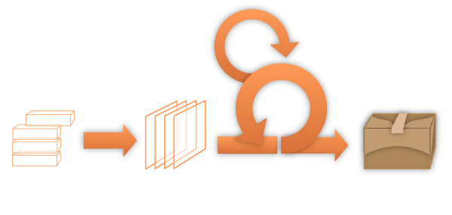
Scrum Framework
Roles
Product Owner
Scrum Master
Events
Sprint
Sprint Planning
Artifacts
Product Backlog
Sprint Backlog
Development Team
Sprint Review
Daily Scrum
Sprint Retrospective
Project Charter
Burn down chart

Slide 3
Scrum Framework
Roles
Product Owner
Scrum Master
Events
Sprint
Sprint Planning
Artifacts
Product Backlog
Sprint Backlog
Development Team
Sprint Review
Daily Scrum
Sprint Retrospective

Slide 4
Product Owner
Defines the features of the product
Decides on release date and content
Prioritizes features according to market value
Adjusts features and priority every iteration, as needed
Accepts or rejects work results

Slide 5
Scrum Master
Represents management to the project
Responsible for enacting Scrum values and practices
Removes impediments
Ensures that the team is fully functional
Enables close cooperation across all roles and functions
Shields the team from external interferences

Slide 6
Development Team
Members are cross-functional, with all of the skills as a team necessary to create a product
Programmers, user interface designers, testers, business analysts, etc.
Members have no titles other than “Developer”, regardless of the work being performed by the person
Members may have specialized skills and areas of focus, but accountability belongs to the team as a whole
Teams do not contain sub-teams dedicated to particular domains like testing or business analysis.
Optimal team size: 4-6 members

Slide 7
Scrum Framework
Roles
Product Owner
Scrum Master
Events
Sprint
Sprint Planning
Artifacts
Product Backlog
Sprint Backlog
Development Team
Sprint Review
Daily Scrum
Sprint Retrospective

Slide 8
Sprint
Considered the “heart” of Scrum
A sprint is a time-box of one month or less (usually between 2-4 weeks) during which a “Done,” useable, and potentially-releasable product increment is created.
Sprints have consistent durations throughout a development effort.
A new Sprint starts immediately after the conclusion of the previous Sprint.
During the Sprint:
No changes are made that will affect the Sprint Goal
Development Team composition remains constant
Software Quality attributes do not change
Scope may be clarified and re-negotiated between the Product Owner and Development Team as more is learned

Slide 9
Sprint Planning Meeting
A Sprint Planning Meeting is a meeting where the work to be performed in the sprint is planned.
Usually time-boxed to eight hours for a one-month sprint. For shorter sprints, the event is proportionately shorter.
There are two parts to the meeting:
What will be delivered in this Sprint?
How will the work get done?

Slide 10
What will be delivered in this sprint?
The Product Owner presents to the Development Team an ordered list of all items needed to be completed.
The entire Scrum Team collaborates on understanding the work to be done in the Sprint.
Other items evaluated before making a decision:
Product Backlog
The latest product Increment (or Iteration)
Projected capacity of the Development Team for the upcoming Sprint
Past performance of the Development Team
A Sprint Goal, or an objective that will be met within the Sprint, is defined during this meeting.

Slide 11
How will the work get done?
The Development Team decides how it will build this functionality into a “Done” product Increment during the Sprint
The Product Backlog items selected for this Sprint plus the plan for delivering them is called the Sprint Backlog.
The Development Team self-organizes the Sprint Backlog by estimating the time it will take to complete each item and assigning tasks to individual team members

Slide 12
Daily Scrum Meeting
The Daily Scrum (or “Stand-up Meeting”) is a 15-minute time-boxed event for the Development Team to synchronize activities and create a plan for the next 24 hours.
The Daily Scrum is held at the same time and place each day to reduce complexity.
Each team member answers three questions:
What has been accomplished since the last meeting?
What will be done before the next meeting?
What obstacles are in the way?

Slide 13
Daily Scrum Advantages
Improves communication among team members
Eliminates the need for other meetings
Identifies and removes impediments to development
Highlights and promotes quick decision-making
Improves the Development Team’s level of project knowledge.

Slide 14
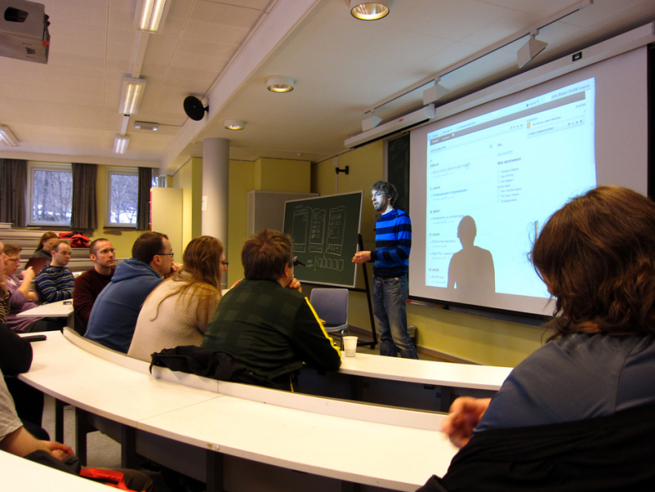
Sprint Review Meeting
The Sprint Review Meeting is the time when the Development Team presents what it accomplished during the sprint
Takes the form of a demo of new features or concrete progress
Informal and requires little prep time
The entire team participates

Slide 15
Sprint Retrospective Meeting
The Sprint Retrospective is an opportunity for the Scrum Team to reflect and create a plan for improvements to be enacted during the next Sprint.
The purpose:
Think about how the last Sprint went with regards to people, relationships, process, and tools
Identify the major items that went well and potential improvements
Create a plan for implementing improvements to the way the Scrum Team does its work
All team members have the opportunity to answer:
What went well during the last sprint?
What didn’t go well during the last sprint?
How should the team improve for the next sprint?

Slide 16
Scrum Framework
Roles
Product Owner
Scrum Master
Events
Sprint
Sprint Planning
Artifacts
Product Backlog
Sprint Backlog
Development Team
Sprint Review
Daily Scrum
Sprint Retrospective
Project Charter
Burn down chart

Slide 17
Project Charter
Problem Statement: Short and succinct (one or two sentences)
Project Objectives: What the project will achieve
Stakeholders: Persons who will be actively involved with the project (e.g. project sponsor, types of users, etc.)
Project Deliverables: The major results or services that will be produced, what are the specific things the software will do

Slide 18
Product Backlog
The Product Backlog is an ordered list of everything that might be needed in the product and is the single source of Requirements for any changes to be made to the product.
The Product Owner is responsible for the Product Backlog, including its content, availability, and ordering.
A Product Backlog is never complete.
Lists all features, functions, requirements, enhancements, and fixes that constitute the changes to be made to the product in future releases.

Slide 19
Product Backlog Sample
Backlog Item | Estimate
As a guest, I want to make a reservation. | 3
As a guest, I want to cancel a reservation. | 5
As a guest, I want to change the dates of a reservation. | 3
As an admin, I want to change the availability of dates at my hotel. | 8
As a developer, I want to improve exception handling. | 8
Backlog items are usually in the form of:
As a ______, I want to ________ (so that I can _______).
Product Backlog items are sometimes called “user stories”

Slide 20
Sprint Backlog
In a Sprint Backlog, the Development Team selects items from the product backlog they can commit to completing in a given sprint.
The team then identifies tasks to complete these and each is estimated (how many hours to complete).
Program the Back-End (8 hours)
As a travel planner, I would like to see the reviews of each hotel.
Program the Front-End (4 hours)
Write Test Cases (4 hours)
Make Database Changes (2 hours)
Update Dependent Pages (3 hours)
User Story
Sprint Backlog Items

Slide 21
Managing the Sprint Backlog
Individuals sign up for work of their own choosing
Work is never assigned
Estimated work remaining is updated daily
Any team member can add to, delete from, or modify the sprint backlog
Work for the sprint emerges
If work is unclear, define a sprint backlog item with a larger amount of time and break it down later
Update work remaining as more becomes known

Slide 22
Sprint Backlog Sample
Backlog Tasks | Mon | Tue | Wed | Thur | Fri
Program the Back-End | 3 | 4 | 1
Program the Front-End |  |  | 2 | 2
Write Test Cases | 3 |  | 1
Make Database Changes |  | 2
Update Dependent Pages |  |  |  |  | 3

Slide 23
Scrum Framework for CS 40800
Roles
Product Owner
Scrum Master
Events
Sprint
Sprint Planning
Artifacts
Product Backlog
Sprint Backlog
Development Team
Sprint Review
Daily Scrum
Sprint Retrospective
Project Charter
Burn down chart

Slide 24
Product Owner
TEAM
Defines the features of the product
Decides on release date and content
Prioritizes features according to market value
Adjusts features and priority every iteration, as needed
PROJECT COORDINATOR
Accepts or rejects work results

Slide 25
Scrum Master
TEAM LEADER
Represents management to the project
Responsible for enacting Scrum values and practices
Removes impediments
Ensures that the team is fully functional
Enables close cooperation across all roles and functions
Shields the team from external interferences

Slide 26
Sprints
Develop a Project Charter (What the software will do) by Friday, September 5
Develop a Product Backlog (Requirements Document) and Test Plan by Friday, September 12
Sprint 1 -- Friday, September 12 – Friday, September 26
Sprint 2 -- Friday, September 26 – Friday, October 10

Slide 27
Sprint Planning Meetings
Have your Sprint 1 Planning Meeting (1-2 hours long) by Friday, September 12
Have your Sprint 2 Planning Meeting (1-2 hours long) by Friday, September 26

Slide 28
Daily Scrum Meeting
During your two 2-week Sprints have a "Daily Scrum" 2-3 times per week at the same time and place

Slide 29
Sprint Review Meeting
The Sprint 1 Review Meeting (with your Project Coordinator) will be the week of Mon-Fri, Sep 22-26
The Sprint 2 Review Meeting (with your Project Coordinator) will be the week of Mon-Fri, Oct 6-10

