Slide 1
CS18000: Problem Solving and Object-Oriented Programming
Concurrency
(revised 10/16/23)

Slide 2
Video 1 History of Concurrency, Java Threads

Slide 3
Concurrent Programming and Synchronization
Threads

Slide 4
Time Slicing
In early days -- one program ran at a time
Along came windowed operating systems
Giving illusion of multiple programs running at a time
Email tool, web browser, text editor
1 second = 1000 milliseconds
Time slicing -- running each program a few hundred milliseconds
Humans are so slow that it appeared that all programs were running simultaneously

Slide 5
Mobile Devices
Illusion worked well as programs became more and more complex
Simply make the CPU run faster
Along came mobile devices -- laptops and phones
Run on batteries
As the CPU runs faster, battery runs down quicker and gets very hot

Slide 6
Multiple Cores
How about putting 2 or more CPUs (cores) on same chip?
If run 2 cores at half speed, same as 1 core at full speed
Slower cores consume less battery and generate less heat
Now most laptops and phones have 4 or more cores
If you have 4 apps running, they may actually be running simultaneously
But, what if you have more than 4
Time slicing is alive and well -- some apps are in a queue waiting to get a core

Slide 7
Threads
Multiple cores can even be used to speed up one program
A program can have more than one part (thread) running simultaneously
What if a database is spread over 3 files?
Run 3 threads on 3 cores ... each looking for the same item
Program runs (approximately) 3 times faster

Slide 8
Sequential vs. Concurrent
Sequential:
A single “thread of execution” weaves its way through your program
A single PC (“program counter”) identifies the current instruction being executed
Concurrent:
Multiple “threads of execution” are running simultaneously through your program
Multiple PCs are active, one for each thread

Slide 9
Java Threads
Thread class with run() method
import java.lang.*;
Allows creation and manipulation of threads
Thread t = new Thread();
Three important methods:
t.start(): start the thread referenced by t
t.join(): “join with” (wait for) the running thread t
t.run(): called by start() in a different thread
Note: Your code does not call run() directly; instead, the start() method calls run() as part of the new thread sequence

Slide 10
Example: MainThread
public class MainThread {
public static void main(String[] args) {
Thread t = Thread.currentThread();
System.out.printf("main thread = %s\n", t);
System.out.printf("going to sleep...\n");
try {
Thread.sleep(5000);
} catch (InterruptedException e) {
e.printStackTrace();
}
System.out.printf("ah, that was nice\n");
System.out.printf("letting someone else run\n");
Thread.yield();
System.out.printf("back\n");
}
}

Slide 11
How to Create Threads
Create a class that implements the Runnable interface
public class MyTask implements Runnable {
public void run() { … }
}
Thread t = new Thread(new MyTask());

Slide 12
Example: MyTask
public class MyTask implements Runnable {
public static void main(String[] args) {
MyTask m = new MyTask();
Thread t = new Thread(m);
t.start();
}
public void run() {
System.out.printf("now in %s\n", Thread.currentThread());
}
}

Slide 13
Video 2 Task and Domain Decomposition

Slide 14
Concurrent Programming and Synchronization
Runnables

Slide 15
Using Concurrent Processing
How do you break down a large problem into pieces?
Need to decompose the problem into pieces
Two approaches to decomposition
By the tasks to be done
By the data to be processed

Slide 16
Task Decomposition
Split task into multiple subtasks
Each subtask runs different code
Each subtask runs on its own core (processor)
Primary benefit: responsiveness
GUI is one task
Background computation a different task
GUI has its own core, so is always responsive

Slide 17
Domain Decomposition
Domain:
Input examined by the problem
Divide domain into pieces (subdomains)
Each subtask runs the
same code but
on different input
Each subdomain is given to a task running on a different core
Primary benefit: raw speed

Slide 18
Examples: Task Decomposition
Updating the screen of a video game
One task processes player moves
One task updates the display
Two tasks communicate as necessary
Can a student register for a class?
One task determines if student has pre-reqs
One task decides if student has class at same time
One task determines if a seat is available in class
Combine results when each task is done

Slide 19
Task Decomposition Example: Video Game Updates

Slide 20
Examples: Domain Decomposition
Factoring a large number
Trial divide up to square root of number
Assign blocks of trial divisors to separate tasks
First task to divide with 0 remainder stops process
Finding words in a word search puzzle
Divide word list into subsets
Assign each subset to a separate task
Tasks search the puzzle grid, recording hits

Slide 21
Domain Decomposition Example: Matrix Multiplication
Using domain decomposition to compute the matrix product A x B.
The top half is computed on Core 1 and the bottom half on Core 2.

Slide 22
Task Decomposition
public class Model implements Runnable {
// This run method keeps track of where the characters are, what
// direction they are moving and at what speed
public void run() {…}
}
public class View implements Runnable {
// This run method updates the GUI showing where each character is
// right now
public void run() {…}
}

Slide 23
Task Decomposition
public class Game {
public static void main(String[] args) {
// Thread data keeps track of where the characters are, what direction they
// are moving and at what speed
Thread data = new Thread(new Model (…));
// Thread gui updates the GUI showing each character
Thread gui = new Thread(new View (…));
// Start the data thread. It will receive information from the GUI about use
// of controls, mouse clicks, etc.
data.start();
// Start the gui thread. It will receive information from Model class methods
// about where the characters are, what direction they are moving and at what
// speed
gui.start();
…
}
}

Slide 24
Video 1 Synchronization Using join()

Slide 25
Concurrent Programming and Synchronization
Synchronization

Slide 26
Unpredictability in Thread Execution
Thread execution may be interrupted
“Time slicing” of threads (and processes) prevents one thread from “hogging” the CPU
Higher priority activities may interrupt the thread: e.g., I/O
Multiple threads do not always proceed at the same rate
Coordination of multiple threads a challenge
Java provides low-level and high-level tools to deal with synchronization of threads

Slide 27
Example: Interleave (1)
public class Interleave implements Runnable {
private char c;
public Interleave(char c) {
this.c = c;
}
public void run() {
for (int i = 0; i < 100; i++) {
System.out.printf("%c", c);
for (int j = 0; j < 1000; j++)
Math.hypot(i, j);
}
System.out.printf("%c", Character.toUpperCase(c));
}
// ... continued on next slide ...

Slide 28
Example: Interleave (2)
// ... continued from previous slide ...
public static void main(String[] args) {
while (true) {
Thread t1 = new Thread(new Interleave('a'));
Thread t2 = new Thread(new Interleave('b'));
t1.start();
t2.start();
try {
t1.join();
t2.join();
} catch (InterruptedException e) { …. }
System.out.println();
}
}
}

Slide 29
Join: Wait for a Thread to Finish
A simple kind of synchronization
For Thread t:
t.join();
Blocks the “current thread”—the one that called t.join()—until Thread t completes (returns from run())
join() may throw an InterruptedException, so generally is in try-catch clause

Slide 30
Join using Try-Catch Clause
try {
t.join();
} catch (InterruptedException e) {
e.printStackTrace(); // example
};

Slide 31
Search for a Student using Threads
public class FindStudent implements Runnable {
private static Student stu = null; // stu will be returned
private static boolean found = false; // haven’t found stu yet
private static int student; // who we are looking for
private Fileserver fileserver; // where to look
private Student maybe = null; // maybe this is the one
public FindStudent (Fileserver f) {fileserver=f;};
public Student search (int student) throws
StudentNotFoundException {
this.student = student;
Thread t1 = new Thread (new FindStudent (fileserver1));
Thread t2 = new Thread (new FindStudent (fileserver2));
Thread t3 = new Thread (new FindStudent (fileserver3));

Slide 32
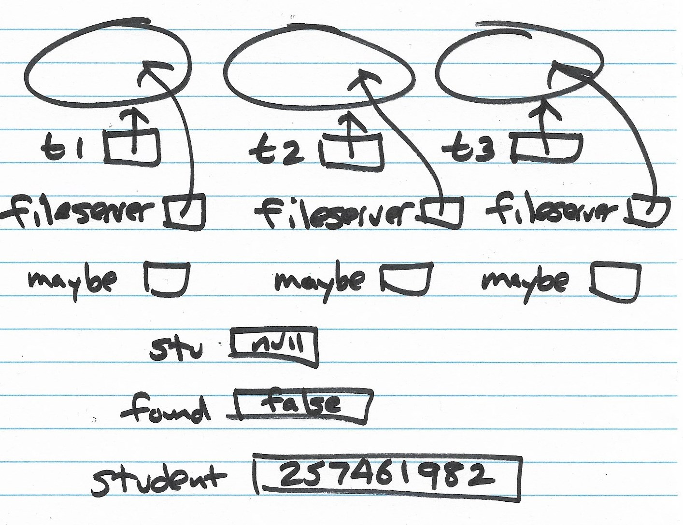

Slide 33
Search for a Student using Threads
t1.start();
t2.start();
t3.start();
try {
t1.join();
t2.join();
t3.join();
} catch (InterruptedException e) { …. }
if (found)
return stu;
else
throw new StudentNotFoundException
(Integer.toString(student));
}

Slide 34
Search for a Student using Threads
public void run() {
while (more to read on fileserver) {
if (found) return;
// read the next Student object, maybe points to it
…
if (maybe.getID() == student) {
stu = maybe;
found = true;
}
}

Slide 35
Video 2 Race Conditions

Slide 36
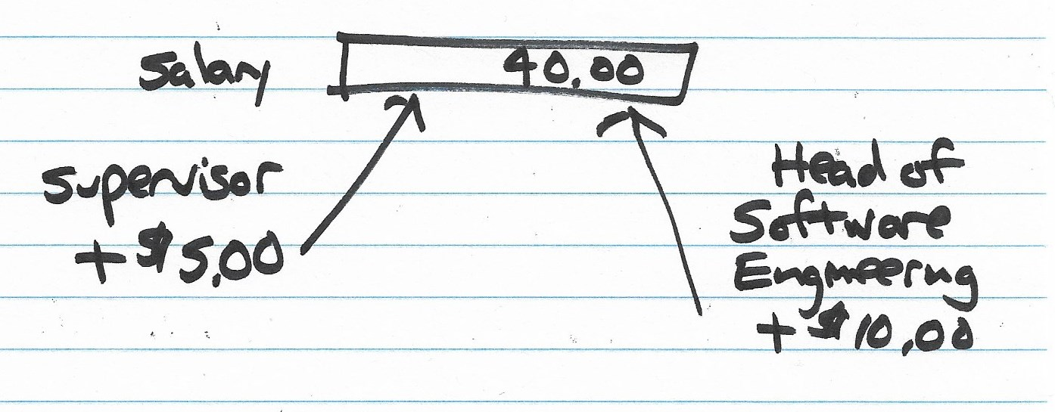

Slide 37
Synchronization Problem: Race Condition
As threads “race” through execution, their instructions are interleaved at the nanosecond level
Byte codes within a thread always executed in relative order, as expected
Byte codes between threads not executed in predictable absolute order
Causes problems when accessing and updating shared data

Slide 38
Example: RaceCondition (1)
public class RaceCondition implements Runnable {
private static int counter;
public static void main(String[] args) {
counter = 0;
Thread t1 = new Thread(new RaceCondition());
Thread t2 = new Thread(new RaceCondition());
t1.start();
t2.start();
try {
t1.join();
t2.join();
} catch (InterruptedException e) { e.printStackTrace(); }
System.out.printf("counter = %d\n", counter);
}
// ... run() method on next slide ...
}

Slide 39
Example: RaceCondition (2)
public void run() {
for (int i = 0; i < 10000; i++) {
counter++;
}
}

Slide 40
Two Threads Updating a Counter
Thread 1
int t1 = counter;
t1 = t1 + 1;
counter = t1;
Thread 2
int t2 = counter;
t2 = t2 + 1;
counter = t2;

Slide 41
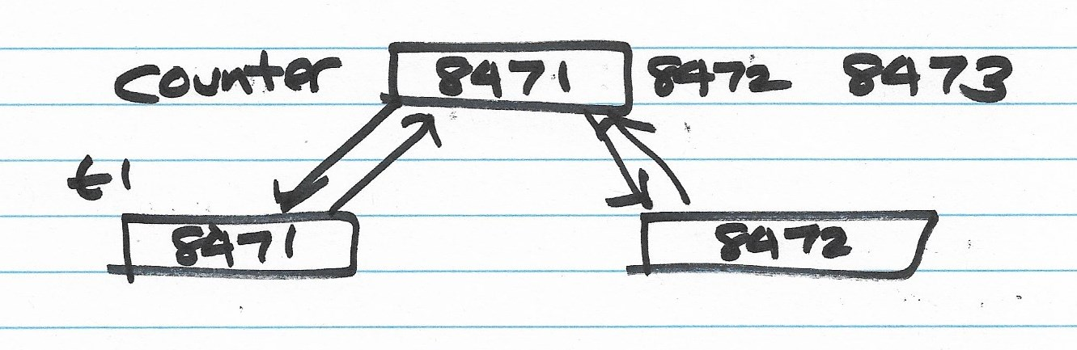

Slide 42
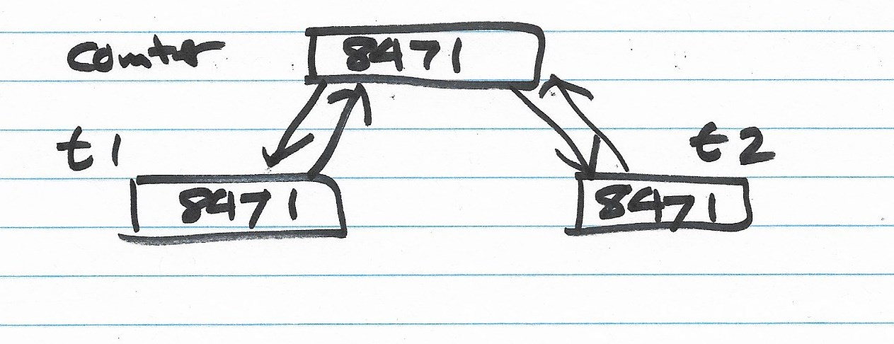

Slide 43
Solution: Synchronize Threads
Java keyword “synchronized”
Allows two or more threads to use a common object to avoid race conditions
Syntax:
synchronized (object) {
statements; // modify shared data here
}
Among all threads synchronizing using the same object, only one thread can be “inside” the block of statements at a time

Slide 44
Example: NoRaceCondition (1)
public class NoRaceCondition implements Runnable {
private static int counter = 0;
private static Object gateKeeper = new Object();
public static void main(String[] args) {
Thread t1 = new Thread(new NoRaceCondition());
Thread t2 = new Thread(new NoRaceCondition());
t1.start();
t2.start();
try {
t1.join();
t2.join();
} catch (InterruptedException e) { e.printStackTrace(); }
System.out.printf("counter = %d\n", counter);
}
public void run() {
for (int i = 0; i < 10000; i++) {
synchronized (gateKeeper) { counter++; }
}
}
}

Slide 45
Shared Memory Architecture
Two paradigms for supporting concurrent or parallel processing
Message Passing: processes
Messages sent between separate processes
Generally, one process per program
May run on different physical computers
Shared Memory: threads
Single program
All threads share the same memory space
This approach is what we are using in Java

Slide 46
Thread States
A Java thread goes through several states in its lifetime:
New thread: created but not yet started
Runnable: started and available to be run
Not Runnable: sleeping, waiting for i/o, etc.
Terminated: returned from the run() method
t.sleep(n) puts the current thread to sleep for n milliseconds; allows other threads to run
t.yield() “gives up” the CPU, letting another thread run

Slide 47
Thread States

Slide 48
t1.start();
t2.start();
t3.start();
t4.start();
t5.start();
try {
t1.join();
t2.join();
t3.join();
t4.join();
t5.join();
} catch (InterruptedException e) { …. }

