Slide 1
CS18000: Problem Solving and Object-Oriented Programming
Simple GUIs

Slide 2
Video 1
JOptionPane Class

Slide 3
Simple Graphical User Interfaces
Dialogs

Slide 4
Text-Based Interface vs. GUI
Text-Based Interface
  Program prompts user for data
  User enters data via keyboard
  Output in a “terminal window”
  Old days: the terminal was the window
GUI (Graphical User Interface)
  Window displays set of “controls” or “widgets”
  User interacts with controls
  Program responds to user “events” with actions

Slide 5
Dialog Concepts
Prerequisite: application must be running on JVM with window system configured
Java dialogs are “modal”
  Application code (your program) “blocks” waiting for user response
  Similar to using Scanner to read from keyboard
Java GUI components adapt to “Look and Feel” of local system

Slide 6
JOptionPane Class
Java workhorse for modal dialogs
Part of Java GUI package: “Swing”
import javax.swing.JOptionPane;
Several static methods for typical use cases…
  showMessageDialog
  showInputDialog
  showConfirmDialog
  showOptionDialog

Slide 7
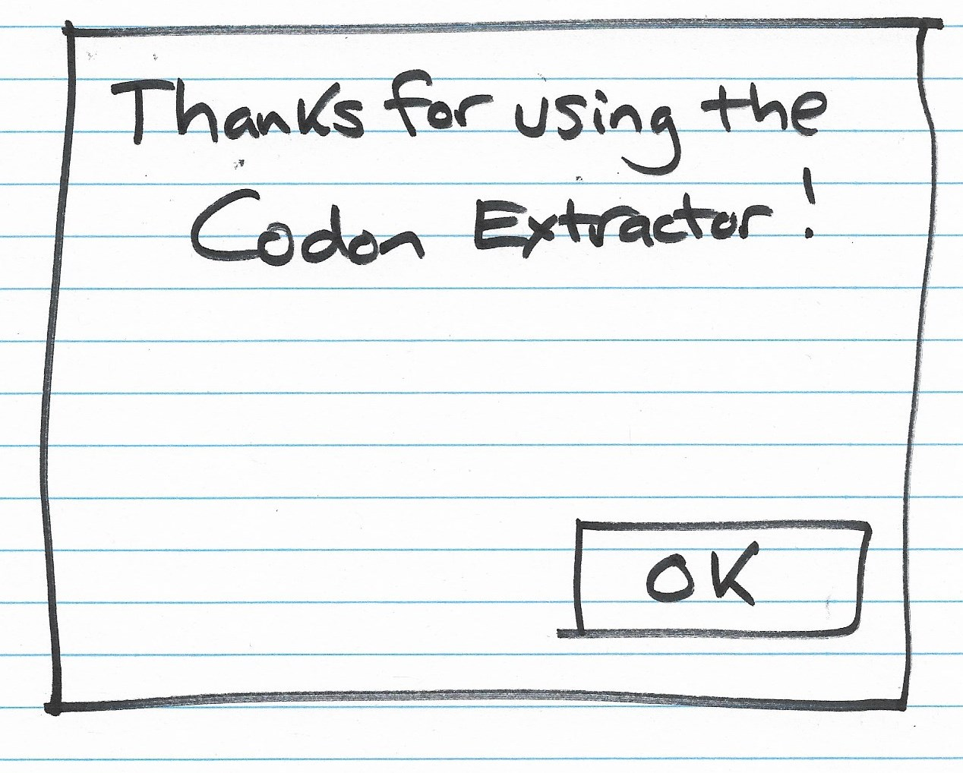

Slide 8
JOptionPane Class
Common arguments…
  Location where dialog pops up (null is center screen)
  Message to be included in dialog box (may be string or icon or html)
  Message type (used for “look and feel” and helpful icon)
  Option type (what buttons should be included by default)
  Options (e.g., array of Strings for button names)
  Icon to replace default icon of message type
  Title string to be used in window heading
  Initial value (a default value for certain option types)
Many arguments can be omitted for default values

Slide 9
Message Type Parameter
Message Type selects icon to display
Look and Feel dependent
Possible values
  JOptionPane.PLAIN_MESSAGE (-1)
  JOptionPane.ERROR_MESSAGE (0)
  JOptionPane.INFORMATION_MESSAGE (1)
  JOptionPane.WARNING_MESSAGE (2)
  JOptionPane.QUESTION_MESSAGE (3)

Slide 10
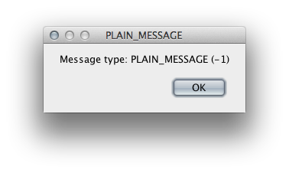
JOptionPane.PLAIN_MESSAGE

Slide 11
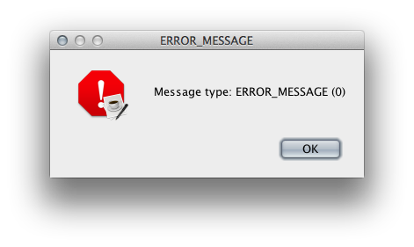
JOptionPane.ERROR_MESSAGE

Slide 12
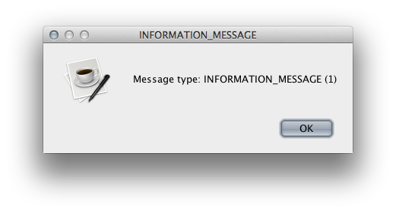
JOptionPane.INFORMATION_MESSAGE

Slide 13
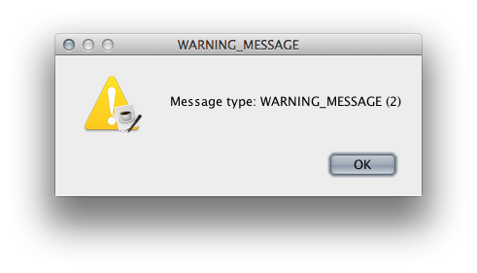
JOptionPane.WARNING_MESSAGE

Slide 14
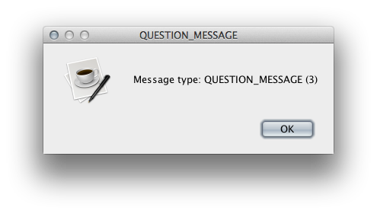
JOptionPane.QUESTION_MESSAGE

Slide 15
Video 2
JOptionPane Methods

Slide 16
showMessageDialog
Simplest dialog
At minimum, displays message to user
Can include other parameters to affect appearance
Only one of these methods with a void return value—it is a do-only method

Slide 18
showConfirmDialog
Asks the user to confirm an action
Default options: “Yes”, “No”, “Cancel”
Returns int value indicating which button user selected
Various button combinations available…
  “Yes” or “No”
  “OK” or “Cancel”
  Or user configurable with list of Strings

Slide 19
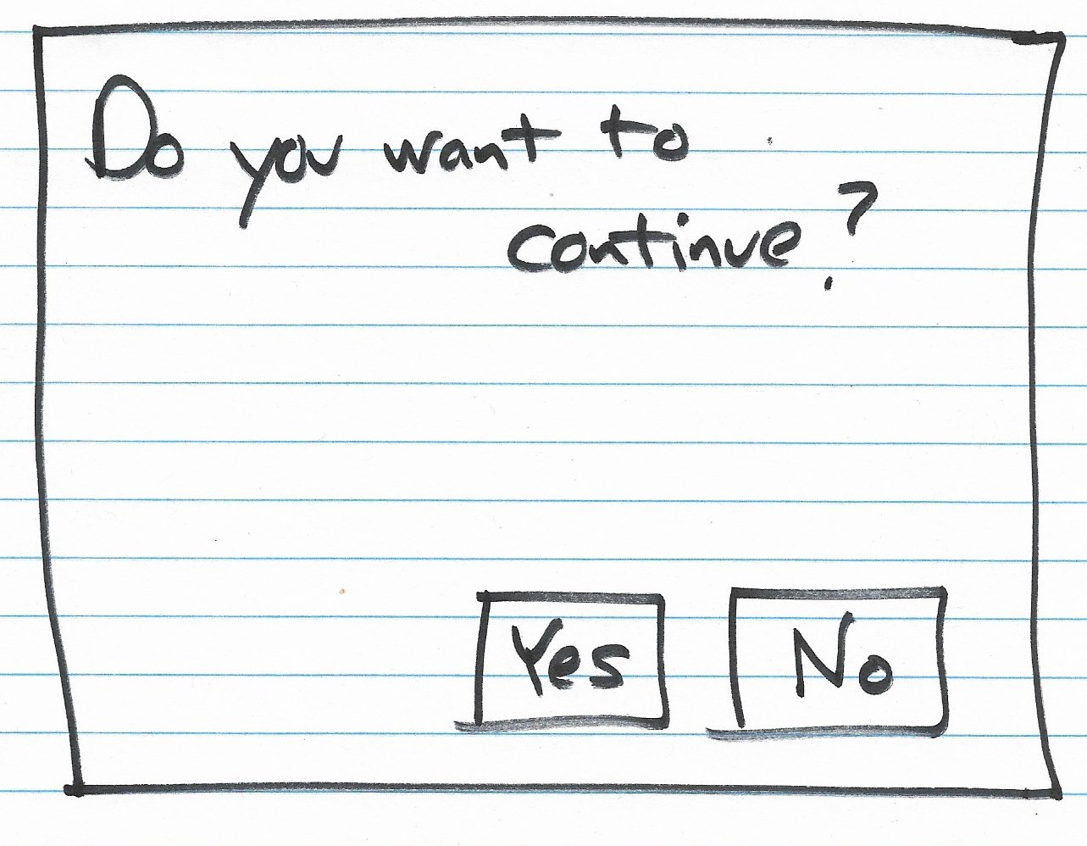

Slide 20
Values with showConfirmDialog
Parameter option types...
  JOptionPane.YES_NO_OPTION
  JOptionPane.YES_NO_CANCEL_OPTION
  JOptionPane.OK_CANCEL_OPTION
Returns one of…
  JOptionPane.YES_OPTION (0) (same as OK_OPTION)
  JOptionPane.NO_OPTION (1)
  JOptionPane.CANCEL_OPTION (2)
  JOptionPane.CLOSED_OPTION (-1)

Slide 21
showInputDialog
Asks the user for some input
Returns String value
Input may be…
  Freely typed text
  Selected from drop-down box or list
Allows simplified arguments
To create a drop-down box or list…
  Provide array of Strings and default value
  Must cast return value to String

Slide 22
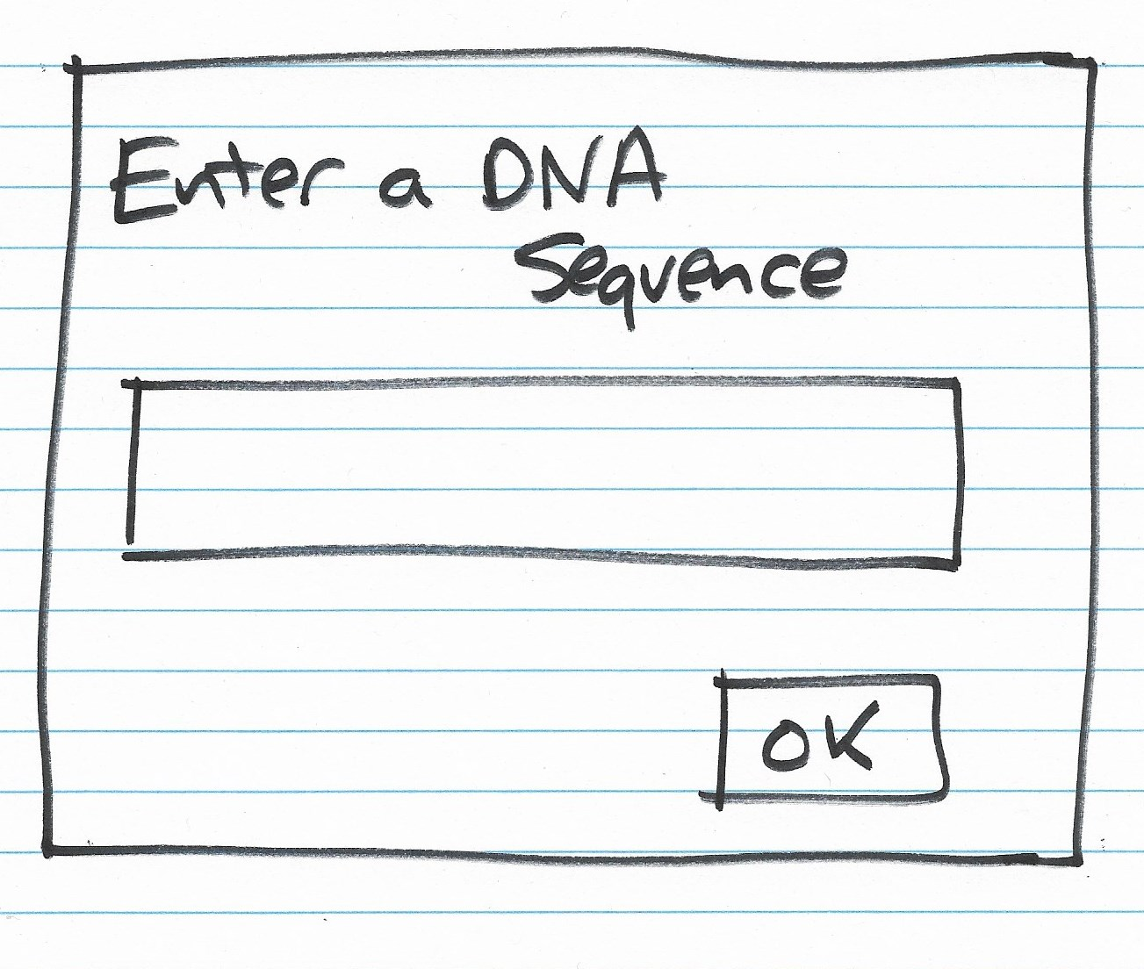

Slide 23
showOptionDialog
Generalized version: configurable buttons
Returns index of button selected
Way too many parameters…
  Component parentComponent
  Object message
  String title
  int optionType
  int messageType
  Icon icon
  Object[] options
  Object initialValue

Slide 24
Dialog Demo Code
Available here: http://bit.ly/WeYeZC

Slide 25
Video 3
CodonExtractor Example

Slide 26
Simple Graphical User Interfaces
GUI Examples

Slide 27
Problem: CodonExtractor
Write a program that reads a DNA sequence from the user and displays the codons in it
Definitions:
  DNA sequence: sequence of chars in ACGT
  Codon: sequence of three chars in DNA sequence
Algorithm:
  Prompt user for DNA, check for valid input
  Break DNA into 3-character chunks, display
  Repeat until user indicates done

Slide 28
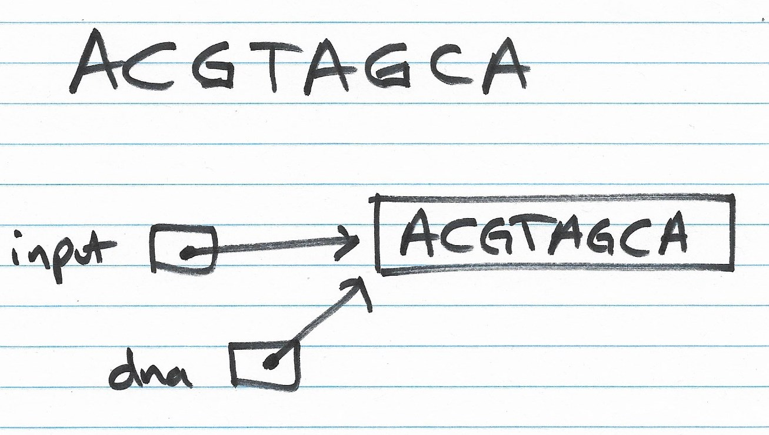

Slide 29
CodonExtractor: main Method
int continueProgram;
do {
// Read DNAsequence
String input = JOptionPane.showInputDialog("Enter a DNA sequence");
input = input.toUpperCase(); // Make upper case
String message = "Do you want to continue?";
if (isValid(input)) // Check for validity
displayCodons(input); // Find and display codons
else
message = "Invalid DNA Sequence.\n" + message;
continueProgram = JOptionPane.showConfirmDialog(null, message,
"Alert",
JOptionPane.YES_NO_OPTION);
} while (continueProgram == JOptionPane.YES_OPTION);
JOptionPane.showMessageDialog(null, "Thanks for using the Codon Extractor!");

Slide 30
CodonExtractor: isValid
public static boolean isValid(String dna) {
String validBases = "ACGT";
for (int i = 0; i < dna.length(); i++) {
char base = dna.charAt(i);
if (validBases.indexOf(base) == -1)
return false; //base not in "ACGT"
}
return true;
}

Slide 31
CodonExtractor: displayCodons
public static void displayCodons(String dna) {
String message = "";
// Get as many complete codons as possible
for (int i = 0; i < dna.length() - 2; i += 3)
message += "\n" + dna.substring(i, i + 3);
// 1-2 bases might be left over
int remaining = dna.length() % 3;
if (remaining == 1)
message += "\n"+ dna.substring(dna.length() - 1,
dna.length()) + "**";
else if (remaining == 2)
message += "\n"+ dna.substring(dna.length() - 2,
dna.length()) + "*";
message = "dna length: " + dna.length() + "\n\nCodons: " + message;
JOptionPane.showMessageDialog(null, message,
"Codons in DNA",
JOptionPane.INFORMATION_MESSAGE);
}

Slide 32
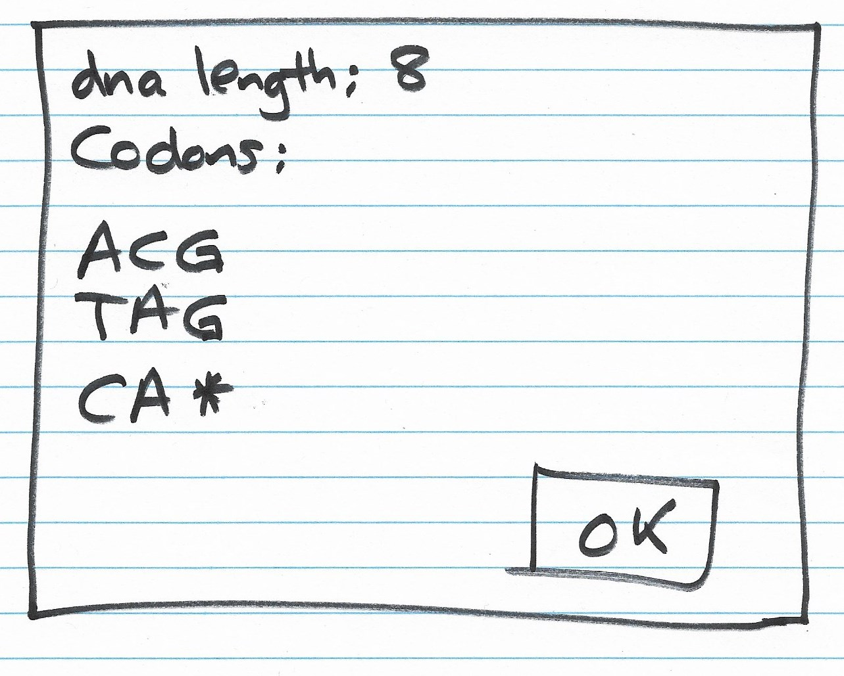

Slide 33
Video 4
JFileChooser

Slide 34
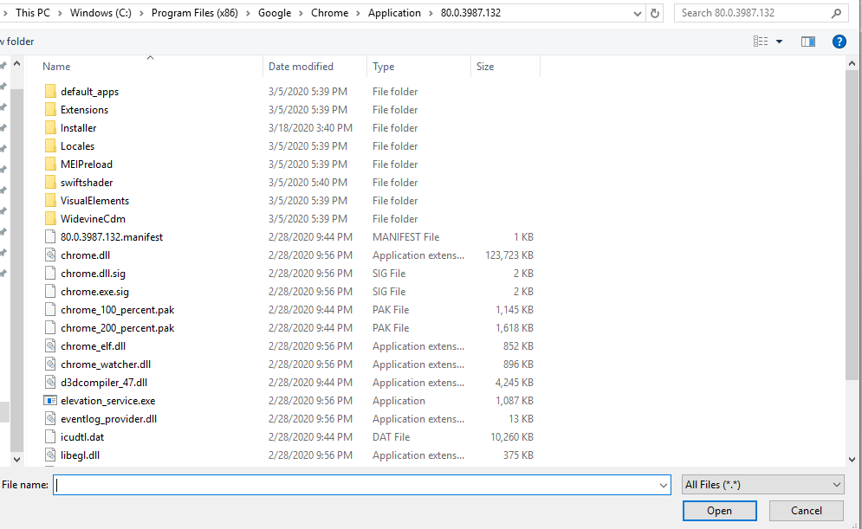

Slide 35
Problem: Prompting for a File Name
JFileChooser (javax.swing.JFileChooser)
Use new to create an object
Set title bar with setDialogTitle(title)
Show with showOpenDialog(null)
Return value is an int: 0 open, 1 cancel
Get the File selected with getSelectedFile()
File object describes the name and location of (the path to) the file

Slide 36
Solution: Prompting for a File Name
import java.io.File;
import javax.swing.JFileChooser;
public class FileChooser {
public static void main(String[] args) {
JFileChooser fc = new JFileChooser();
fc.setDialogTitle("Choose Important File");
int val = fc.showOpenDialog(null);
System.out.println(val);
File f = fc.getSelectedFile();
System.out.println(f);
}
}

Slide 37
Projects and Exam 2
Project 3 due 6 pm Mon Mar 25
  On Sat Mar 9 an update was made to the Project 3 RunLocalTest.java file to correct for an error in the expected output. You will need to copy the new RunLocalTest.java file from the starter code folder on Vocareum.
Project 4 launches Mon Mar 25, due Mon Apr 8. There is NO Project 5.
Team Project released at 6 pm Mon Mar 18. Team rosters are posted on Brightspace. If you are NOT placed on a team, contact your lab's Lead TA.
Exam 2 covers through Concurrency, 6 pm Mon Mar 25 - 6 pm Tue Mar 26.

