Slide 1
CS18000: Problem Solving and Object-Oriented Programming
Selection
(revised 11/24/23)

Slide 2
Video 1
The if statement

Slide 3
Selection
Booleans, Relations, and Selection Statements

Slide 4
Sequential Execution
By default, a list of statements…
  Statement 1;
  Statement 2;
  …
  Statement N;
…is executed in order, one after another
…unless there is an error (“exception”), all statements are executed
We say, “Control flows sequentially.”

Slide 5
Control Structures
Language features (syntax) that affect the flow of control in a program
Default control flow is sequential
Control flow jumps to methods, then returns
Various keywords introduce changes to the default flow
  if
  switch
  while
  for

Slide 6
The if Statement
if (boolean-expression)
  then-statement;
next-statement;
if (boolean-expression)
  then-statement;
else
  else-statement;
next-statement;

Slide 7
Decision Making
If it is a weekday and I’m not on vacation, then I will get up early
If there is a basketball game on and Purdue is playing, I’ll cheer for Purdue, otherwise if IU is playing, I’ll cheer for their opponent

Slide 8
Primitive Type: boolean (Review)
Set of two elements { true, false }
Set of operations
  Logical: && (and), || (or), ^ (xor), and ! (not)
  Testing in various Java statements (e.g., if)
Created by comparison operators
  x < y, x <= y, x == y, x != y, x > y, x >= y
  And result of logical operators (above)
  Note: == and != also work with reference types, but only compare references (addresses) not the values

Slide 9
Comparing Strings
== does not work in the way you might expect
Strings are objects
== between objects only compares the references (addresses) of the objects
Two different String objects with the exact same characters will compare == false (since their objects are stored in different locations)
if (s1.equals(s2))
then-statement;

Slide 10
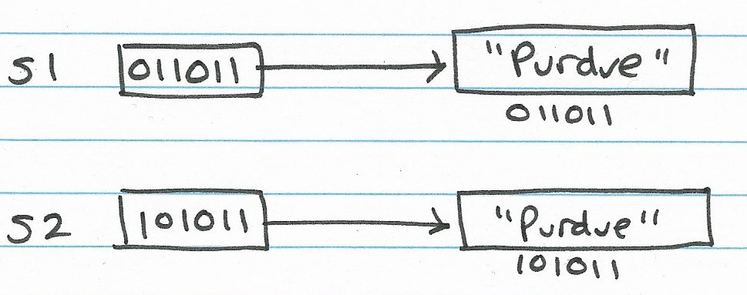
Comparing Strings

Slide 11
Abstracting Conditions
If it is a weekday and I’m not on vacation, then I will get up early
  if (isWeekday && !onVacation)
  getUpEarly();
If there is a basketball game on and Purdue is playing, I’ll cheer for Purdue, otherwise if IU is playing, I’ll cheer for their opponent
  if (gameOn(basketball) && playing(purdue))
  cheerFor(purdue);
  else if (gameOn(basketball) && playing(iu))
  cheerFor(opponent(iu));

Slide 12
Video 2
Examples using if statements

Slide 13
Problem: SecretWord
Write a program that reads a word from the user and prints a message if it matches a “secret word” in the program.

Slide 14
Solution: SecretWord
import java.util.Scanner;
public class SecretWord {
final static String SECRET = “awesome";
public static void main(String[] args) {
Scanner in = new Scanner(System.in);
String word = in.next();
if (word.equals(SECRET))
System.out.printf(
"You have said the secret word: '%s'\n",
SECRET);
}
}

Slide 15
Problem: Absolute Value
Write a program that illustrates how to convert the value in a variable x to the absolute value using an if statement

Slide 16
Solution: Absolute Value
import java.util.Scanner;
public class AbsVal {
public static void main(String[] args) {
Scanner in = new Scanner(System.in);
int x = in.nextInt();
System.out.printf("BEFORE: x = %d\n", x);
if (x < 0)
x = -x;
System.out.printf("AFTER: x = %d\n", x);
}
}

Slide 17
Solution: Absolute Value
x = 37
BEFORE: x = 37
AFTER: x = 37
x = -41
BEFORE: x = -41
AFTER: x = 41

Slide 18
Problem: DaisyDriveIn
If you work more than 20 hours at the Daisy Drive-in, they pay you $16/hour for first 20 hours plus $20/hour for all hours above 20. Otherwise, they pay you $14/hour
Write a method…
  double computePay(double hours)
that returns the correct pay

Slide 19
Solution: DaisyDriveIn
public class DaisyDriveIn {
double computePay(double hours) {
if (hours > 20)
return 16.00 * 20 + (hours - 20) * 20.00;
else
return hours * 14.00;
}
public static void main(String[] args) {
DaisyDriveIn d = new DaisyDriveIn();
double pay;
pay = d.computePay(20); // pay should be 280
pay = d.computePay(21); // pay should be 340
pay = d.computePay(9.5); // pay should be 133
pay = d.computePay(9.1); //pay should be 127.40
}
}

Slide 20
Video 3
More complex if statements

Slide 21
More Selection Statements
A few more if-else examples
switch statement

Slide 22
Boolean Operations
A | B | A || B | A && B | A ^ B
True | True | True | True | False
True | False | True | False | True
False | True | True | False | True
False | False | False | False | False

Slide 23
Problem: Median
Write a method…
double median(double a, double b, double c)
This example illustrates cascading if-else-if statements

Slide 24
Solution: Median
double median(double x, double y, double z) {
if (x <= y && y <= z || z <= y && y <= x)
return y;
else if (y <= x && x <= z || z <= x && x <= y)
return x;
else if (x <= z && z <= y || y <= z && z <= x)
return z;
else
return 0;
}

Slide 25
Solution: Median
x = 12 y = 14 z = 27
median is y
x = 14 y = 27 z = 12
median is x
x = 24 y = 15 z = 18
median is z

Slide 26
Basic Forms of the “if” Statement
if (boolean-expression)
  statement-if-true;
if (boolean-expression)
  statement-if-true;
else
  statement-if-false;

Slide 27
Blocks and Braces
Use braces ({}) to group a sequence of statements into a single unit
Already seen with method bodies and other examples
Also can be use for control structures

Slide 28
Block Forms of the “if” Statement
if (boolean-expression) {
  list-of-statements-if-true;
}
if (boolean-expression) {
  list-of-statements-if-true;
} else {
  list-of-statements-if-false;
}

Slide 29
Video 1
Examples using complex if statements

Slide 30
Problem: Swapper
Write a program that, given two values in variables x and y, ensures that y is not less than x (swap them if necessary)

Slide 31
Solution: Swapper
    import java.util.Scanner;
    public class Swapper {
    public static void main(String[] args) {
    Scanner in = new Scanner(System.in);
    int x = in.nextInt();
    int y = in.nextInt();
    System.out.printf("BEFORE: x = %d, y = %d\n", x, y);
    if (y < x) {
    int t = x;
    x = y;
    y = t;
    }
    System.out.printf("AFTER: x = %d, y = %d\n", x, y);
    }
    }

Slide 32
Solution: Swapper
    x = 36 y = 52
    BEFORE: x = 36, y = 52
    AFTER: x = 36, y = 52
    x = 63 y = 18
    BEFORE: x = 63, y = 18
    t = 63 x = 18 y = 63
    AFTER: x = 18, y = 63

Slide 33
Problem: Quadratic
Write a method…
void printRoots(double a, double b, double c)
that finds and prints the roots of a quadratic equation (including imaginary roots)
ax² + bx + c = 0
2x² - 9x + 4 = 0
a=2 b=-9 c=4
d = 81-32 = 49
x1=4.0 x2=0.5

Slide 34
Solution: Quadratic
// Reference: http://www.1728.org/quadratc.htm
public class Quadratic {
void printRoots(double a, double b, double c) {
double d = b * b - 4 * a * c;
if (d < 0) {
double x = -b/(2*a), xi = Math.sqrt(-d)/(2*a);
System.out.printf("%.2f+%.2fi and %.2f-%.2fi are imaginary roots of %.2fx^2 + %.2fx + %.2f\n",
x, xi, x, xi, a, b, c);
} else {
double x1 = (-b + Math.sqrt(d))/ (2 * a);
double x2 = (-b - Math.sqrt(d))/ (2 * a);
System.out.printf("%.2f and %.2f are real roots of %.2fx^2 + %.2fx + %.2f\n",
x1, x2, a, b, c);
}
}
public static void main(String[] args) {
Quadratic q = new Quadratic();
q.printRoots(3, 4, 5);
q.printRoots(2, 4, -30);
q.printRoots(12, 5, 3);
}
}

Slide 35
Problem: FileExtensions
Write a method…
String findExtension(String filename)
that finds the extension in String filename.
Example illustrates short-circuit evaluation

Slide 36
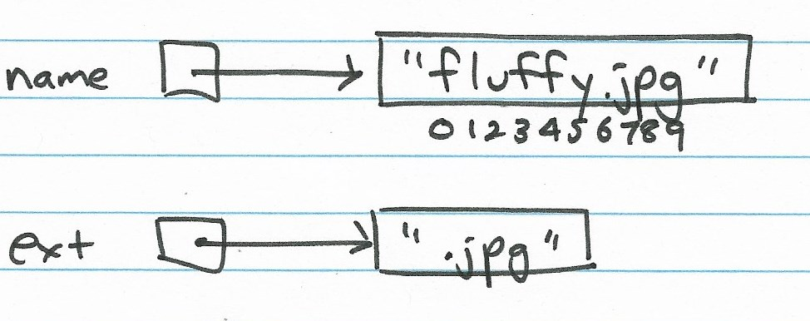
Problem: FileExtensions
String name = new String (“fluffy.jpg”);
String ext = findExtension (name);
substring [begin, end)
[0.0,100.0) starts at 0.0 and goes up to but does not include 100.0
[6,10) is 6, 7, 8, 9

Slide 37
FileExtensions (Version 1)
String findExtension(String fname) {
int dot;
if (fname == null)
return "";
dot = fname.indexOf('.');
if (dot == -1)
return "";
String extension = fname.substring(dot, fname.length());
return extension;
}

Slide 38
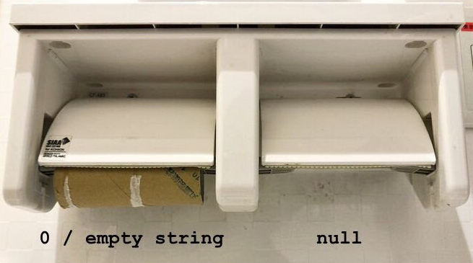
Strings, Empty Strings, Null Pointers
String fname = new String ("fluffy.jpg");
fname points to the object that contains the string "fluffy.jpg"
String fname = new String ("");
fname points to the object that contains the string "" (empty string)
String fname = null;
fname does not point to a string. It is a null pointer.

Slide 39
FileExtensions (Version 2)
String findExtension(String fname) {
int dot;
if (fname == null || fname.indexOf('.') == -1)
return "";
dot = fname.indexOf('.');
String extension = fname.substring(dot, fname.length());
return extension;
}

Slide 40
Short-Circuit Evaluation
The Boolean operators && (and) and || (or) abandon evaluation if the result is determined with certainty, e.g., no matter what “whatever” is
  true || (whatever) -> must be true
  false && (whatever) -> must be false
In these cases, “whatever” is not evaluated
Common use:
  p != null && p.isImportant()
  Second expression would cause null pointer exception if p were null

Slide 41
Video 2
Special cases with if statements

Slide 42
Dangling Else Problem
  if (familyVisiting)
  if (isWarmOut)
  goToPark();
  else
  hangoutWithFriends();
The else clause goes with the most recent if, not as formatted above
  if (familyVisiting)
  if (isWarmOut)
  goToPark();
  else
  hangoutWithFriends();
Use braces to disambiguate

Slide 43
Problem: ChangeBack
Comparing real valued quantities for equality
You gave the waiter a $10 bill
  double paid = 10.00;
The check was $9.10
  double check = 9.10;
The waiter gave you 90 cents back
  double change = 0.90;
Is it correct?
  (paid – check) == change

Slide 44
Solution: ChangeBack
public class ChangeBack {
double computeChange(double check, double paid) {
return paid - check;
}
public static void main(String[] args) {
ChangeBack c = new ChangeBack();
double change;
change = c.computeChange(8, 10); // 2.00
change = c.computeChange(9.10, 10); // 0.90
}
}

Slide 45
Comparing Real Values
Since real numbers represented with double and float are imprecise…
Comparisons may fail when they shouldn’t
Common trick:
  Replace…
  if (x == y)
  By…
  if (Math.abs(x – y) < epsilon)
  For some small value, epsilon
if (Math.abs(c.computeChange(9.10, 10) – 0.90) < 0.001) {…}

Slide 46
Ternary Assignment Operator
A common situation is to assign one of two alternative values depending on a condition
    if (a < b)
minVal = a;
else
minVal = b;
We can use the following equivalent statement
minVal = (a < b)? a : b;

Slide 47
Video 3
Switch statement

Slide 48
Problem: Days
Write a method that returns the number of days in a given month from a given year
int daysInMonth(int month, int year)

Slide 49
Solution 1: Days
int daysInMonth1(int month, int year) {
if (month == 1) // January
return 31;
else if (month == 2) {
LeapYear ly = new LeapYear();
if (ly.isLeapYear(year))
return 29;
else
return 28;
}
else if (month == 3)
return 31;
else if (month == 4)
return 30;
else if (month == 5)
return 31;
else if (month == 6)
return 30;
else if (month == 7)
return 31;
else if (month == 8)
return 31;
else if (month == 9)
return 30;
else if (month == 10)
return 31;
else if (month == 11)
return 30;
else if (month == 12)
return 31;
return -1;
}

Slide 50
Solution 2: Days
int daysInMonth2 (int month, int year) {
switch (month) {
case 1: case 3: case 5: case 7: case 8: case 10: case 12:
return 31;
case 4: case 6: case 9: case 11:
return 30;
case 2:
LeapYear ly = new LeapYear();
if (ly.isLeapYear(year))
return 29;
else
return 28;
}
return -1;
}

Slide 51
Solution 2: Days (arrow case labels)
int daysInMonth2 (int month, int year) {
switch (month) {
case 1, 3, 5, 7, 8, 10, 12 -> {
return 31;
}
case 4, 6, 9, 11 -> { // right hand side of the arrow has to be
// an expression or block
return 30;
}
case 2 -> {
LeapYear ly = new LeapYear();
if (ly.isLeapYear(year))
return 29;
else
return 28;
}
}
return -1;
}

Slide 52
Solution 2: Days (switch expressions, arrow case labels, yield statements)
int daysInMonth2 (int month, int year) {
int numberOfDays;
numberOfDays = switch (month) {
case 1, 3, 5, 7, 8, 10, 12 -> 31; // can just put value here
case 4, 6, 9, 11 -> 30; // and here
case 2 -> { // in a block must use “yield”
LeapYear ly = new LeapYear();
if (ly.isLeapYear(year))
yield 29;
else
yield 28;
}
default -> -1:
}; // switch expression form has to end in a semicolon
return numberOfDays;
}

Slide 53
Problem: what stuff
Write a method that returns a string saying what stuff students are given based on their year in college:
Seniors (4) and Juniors (3) get a new backpack
Sophomores (2) get a new coat
Freshmen (1) get new gloves and a new coat
String whatStuff (int yearInCollege)

Slide 54
Solution: what stuff
String whatStuff (int yearInCollege) {
String stuff = “You will be given ”;
switch (yearInCollege) {
case 1:
stuff = stuff + “new gloves “;
case 2:
stuff = stuff + “new coat“;
break;
case 3: case 4:
stuff = stuff + “new backpack“;
break;
default:
stuff = stuff + “nothing“;
break;
}
return stuff;
}

Slide 55
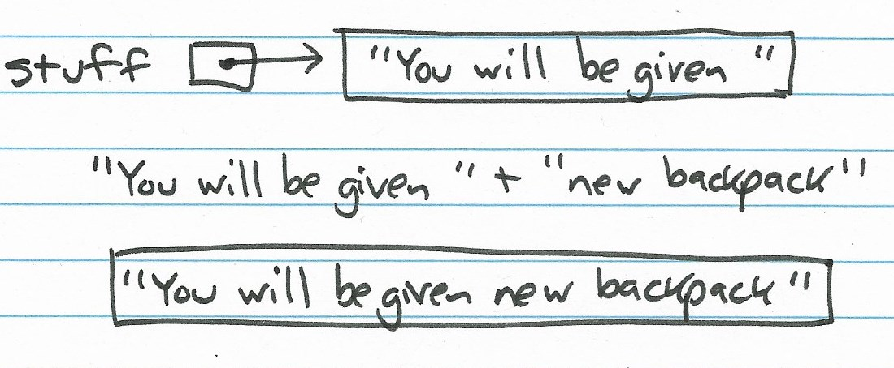
Solution: what stuff

Slide 56
Switch can use Strings
String whatStuff (String yearInCollege) {
String stuff = “You will be given ”;
switch (yearInCollege) {
case “Freshman”:
stuff = stuff + “new gloves “;
case “Sophomore”:
stuff = stuff + “new coat“;
break;
case “Junior”: case “Senior”:
stuff = stuff + “new backpack“;
break;
default:
stuff = stuff + “nothing“;
break;
}
return stuff;
}

