Slide 1
CS18000: Problem Solving and Object-Oriented Programming
Primitive Types and Strings

Slide 2
Video 1 Data Types

Slide 3
Numbers and Mathematical Operators
Types
Primitive Types

Slide 4
Values, Variables, and Literals
Programs (and CPUs) work with values
Values are represented in programs by literals and stored in variables
Literals
3, -23, 4.5, 0.23, 3E8, 6.02e+23
"Hello there", 'A', true, false
Variables
x, y, a, b, helloMessage, wheel, robot, r1, w27
Use letters, digits, and "_" (start with letter)
Identify a location in memory

Slide 5
Types
Variables and literals have types
Examples
int
double
String
Type is a formal definition
Set of values
Set of operations on those values

Slide 6
Example Java Type: int
Set of values: subset of the integers
Stored in 4 consecutive bytes: 32 bits
Range: -2,147,483,648 to 2,147,483,647
Literals: 23, 45, -19, 0
Variables declared with “int” reserved word
Set of operations: standard mathematical
+, -, *, /
% (mod) remainder 17%3=2

Slide 7
Type Categories in Java
Primitive Types
Built-in to language
boolean, byte, short, int, long, float, double, char
Occupy enough bits/bytes to store value
Reference Types
Can be defined by the user
Hold a “reference” (pointer) to an object

Slide 8
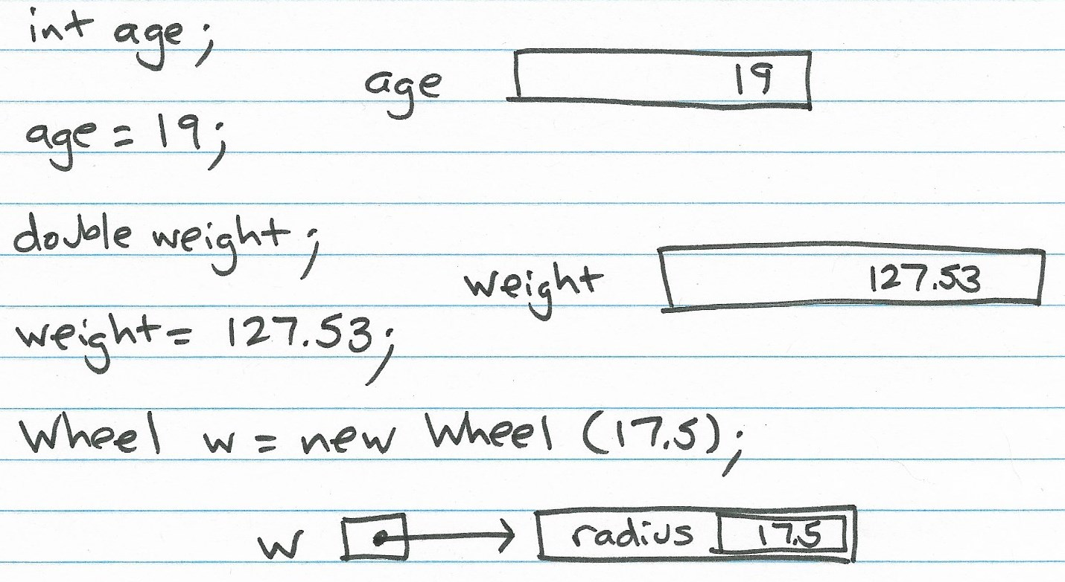
Primitive and Reference Types

Slide 9
Example Reference Type: String
Set of values:
Sequences of characters
Length 0 to 2,147,483,647
Set of operations:
concat() (also + operator)
toUpperCase()
length()
substring()
Plus many others

Slide 10
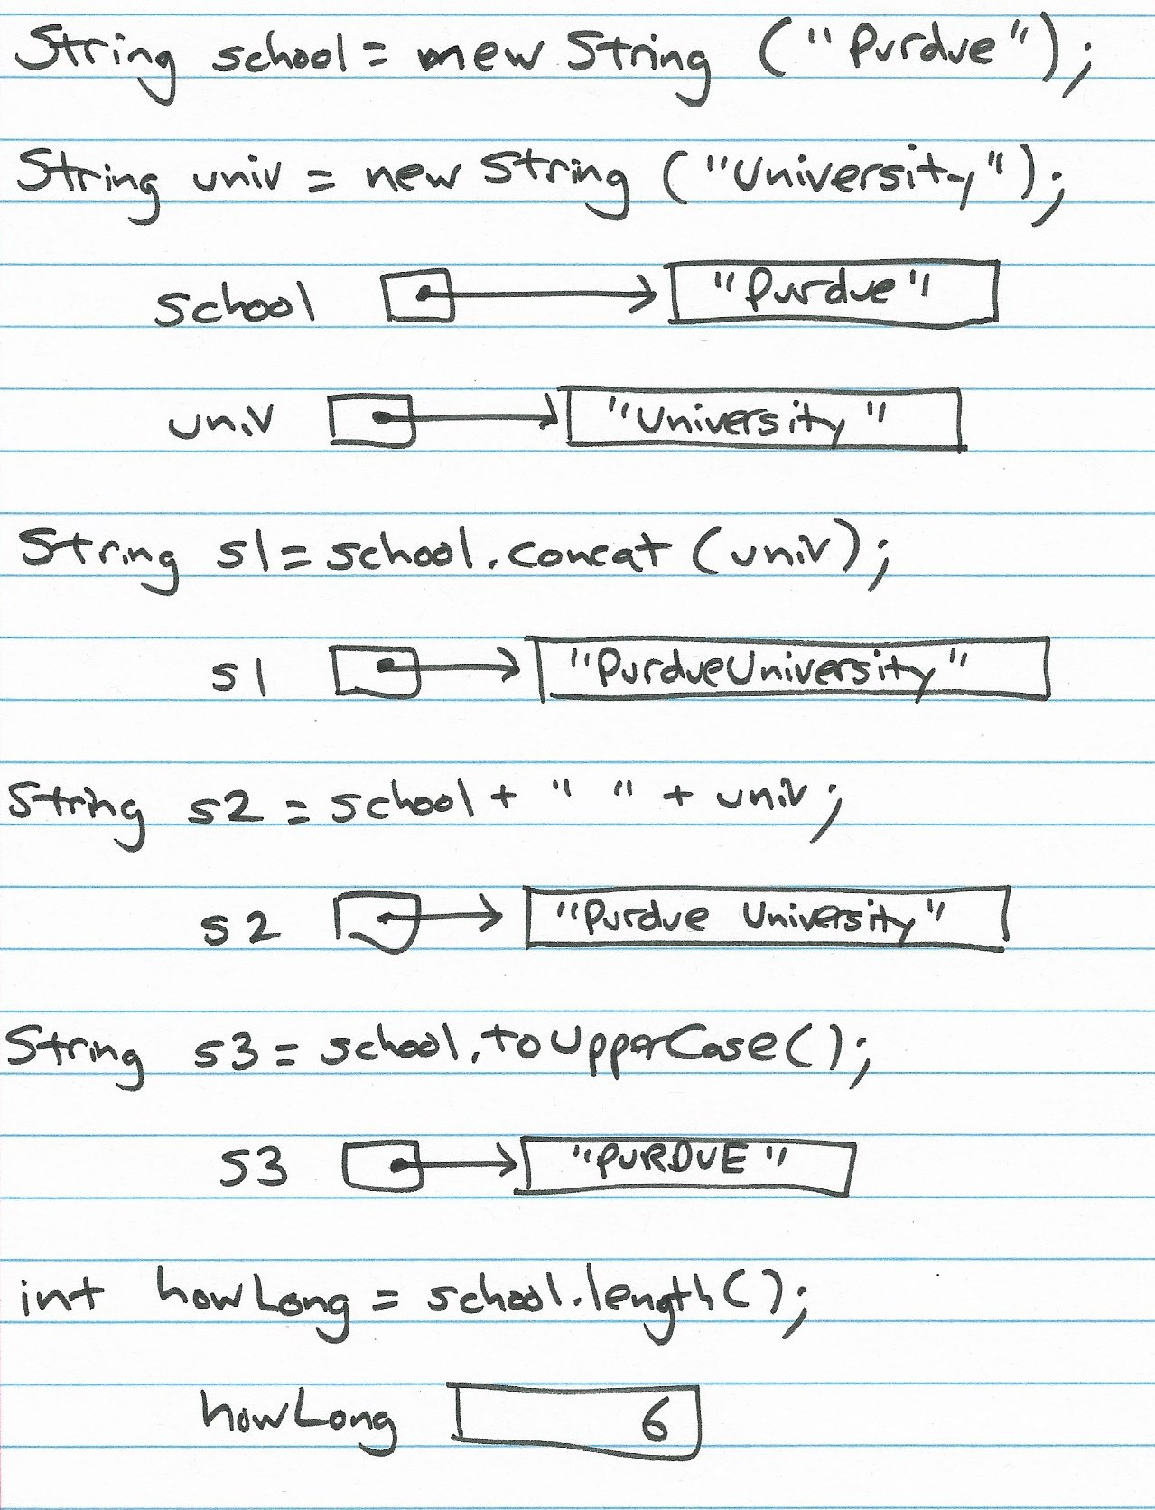
Example Reference Type: String

Slide 11
Wheel Class
public class Wheel {
double radius;
Wheel(double radius) {
this.radius = radius;
}
double getCircumference() {
return 2 * Math.PI * radius;
}
double getArea() {
return Math.PI * radius * radius;
}
double getRadius() {
return radius;
}
}

Slide 12
Example Reference Type: Wheel
Set of values:
Limited by memory only
A new one created for each “new Wheel(…)”
Same or different radius
Set of operations
getArea()
getCircumference()
getRadius()

Slide 13
Variables and Literals
Variable
Memory location where something can be stored
Contents of the location can change: vary
Literal
A value that cannot change
Can be stored in a variable
Examples: 42, 3.14159, "hello", and 'X'

Slide 14
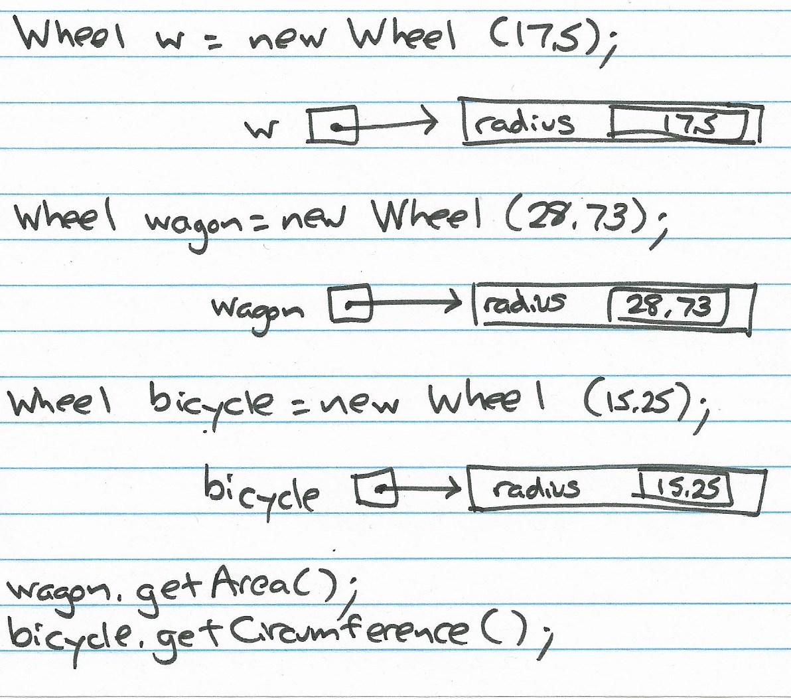
Variables and Literals

Slide 15
Declarations
In Java, variables must be declared and given a type
Java compiler does two things with this information
Arranges for space to be allocated for the variable to store a value
Ensures that only valid (type-defined) operations can be performed on this variable

Slide 16
Video 2 Primitive Types

Slide 17
Primitive Types
Integer and Real Number Types

Slide 18
Integer Types in Java
All represent subsets of the integers
Differ in how many bits used to store the value (and, so, how many values)
byte: 8 bits (-128 to 127)
short: 16 bits (-32,768 to 32,767)
int: 32 bits (-2,147,483,648 to 2,147,483,647)
long: 64 bits (18 digits)
Most popular: int

Slide 19
Operations on Integer Types
Usual mathematical: +, -, *, /, and % (mod)
Important note:
Divide operation is “integer divide”
Result is an integer, even if it “should” be a fraction
Called “truncation”
Examples:
10 / 5 is 2
13 / 4 is 3
3 / 2 is 1
1 / 2 is 0

Slide 20
Real Number Types in Java
Represent subsets of the real numbers
Two types, differing in number of bits used
float: 32 bits (aka “single precision”)
double: 64 bits (aka “double precision”)
Most popular: double

Slide 21
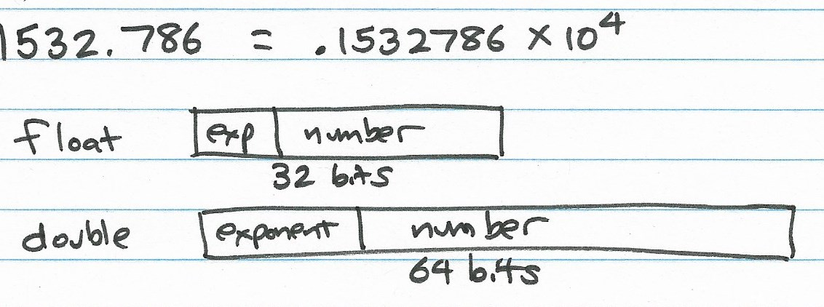
Real Number Types in Java

Slide 22
Operations on Real Types
Usual mathematical: +, -, *, /
The Math class includes many others (some also applicable to integers):
Math.pow(base, exponent)
Math.log10(number)
Trig functions, logs, etc.
See http://docs.oracle.com/javase/6/docs/api/java/lang/Math.html

Slide 23
Declaring Variables: Syntax
Various possibilities supported…
int x; // declare only
int x = 5; // and initialize
int x, y; // two at once
int x = 5, y = 10;
Best practice guidelines…
Declare only one variable per line
Include a comment describing its purpose
int mass; // mass of the particle

Slide 24
Expressions
Expressions built by combining
variables (x, y) and literals (3, 27) with
operators (+, -)
Usual mathematical precedence
Multiplication and division first
Addition and subtraction second
(see chart on next slide)
x = b + c * d - a / b / d; … same as…
x = ((b + (c * d)) - ((a / b) / d));

Slide 25
Precedence (Highest to Lowest)
Category | Operator
Unary | +expr -expr
Multiplicative | * / %
Additive | + -
Shift | << >> >>>
Bitwise operators | & then ^ then |
Logical operators | && then ||
Assignment | =
Complete list: http://docs.oracle.com/javase/tutorial/java/nutsandbolts/operators.html

Slide 26
Video 1 Type Promotion and Characters

Slide 27
You are much smarter than a computer
A computer cannot do this….
3 + 5.0

Slide 28
Type Promotion
Mixing value types in expressions is allowable
Values are “promoted” when it makes sense (no data is lost)
short to int, float to double
integers to reals (e.g., int to double)
Examples:
3 + 5.0 evaluated as 3.0 + 5.0 -> 8.0
1 / 2.0 evaluated as 1.0 / 2.0 -> 0.5
Promotion is a form of casting…

Slide 29
Casting
Cast: convert from a value of one type to a value of another type
Upcast: from “narrower” to “wider” (more bits)
short -> int
float -> double
int -> double
Downcast: from “wider” to “narrower” (fewer bits)
int -> short
double -> float
double -> int

Slide 30
Casting Rules
Upcasting is fine
Nothing lost
Java handles automatically (“promotes”)
double x = 1 / 2.0; // x is assigned 0.5
Downcasting is dangerous
Precision is lost
Java prevents by default
Programmer must override with cast operator

Slide 31
Cast Operator
Tells Java compiler…
“Trust me; the expression can be converted to the indicated type”
Put type name in parentheses before expression
Example:
int x;
double y = 12.0;
x = y; // “loss of precision” error
x = (int) y; // allowable
x = (int) (y / 3.0); // also allowable

Slide 32
Constructors and Fields
Constructor
A special method in a class that is used to “construct” an object when it is being created
Called by the “new” operator
new Wheel(15) invokes the Wheel(double radius) method
Fields (instance or member variables)
Variables located inside the class definition that become part of the object
Often “initialized” by the constructor using “this”
this.radius = radius

Slide 33
Primitive Type: char
Set of possible characters, symbols that make up a String
Encoded as number: e.g., ‘A’ is 65, ‘B’ is 66, ‘C’ is 67, etc.
Java uses 16 bits to store each character (65536)
Historical growth…
Initially ASCII standard of 128 characters
Extended to Latin-1 character set of 256 characters
Now at Unicode character set of 65536 characters

Slide 34
Set of char Values
ASCII subset
Character codes 0-127 (7 bits)
Include English alphabet (upper and lower), numbers, punctuation, special characters
Latin-1 extension
Added character codes 128-255 (8 bits)
Include non-English (Romanized) characters and punctuation (dipthongs, accents, circumflexes, etc.)
Unicode 1 extension
Added character codes 256-65535 (16 bits)
Includes non-Romanized alphabetic characters from Cyrillic, Hebrew, Arabic, Chinese, Japanese, etc.

Slide 35
char Literals
A single character surrounded by single quotes, for example
‘A’, ‘a’, ‘x’, ‘0’, ‘3’
‘!’, ‘,’, ‘”’, ‘&’
A special “escape sequence” surrounded by single quotes, for example
‘\t’ (tab)
‘\n’ (newline)
‘\’’ (single quote)
‘\\’ (backslash)
‘\uxxxx’ (char hexadecimal xxxx in Unicode set)

Slide 36
Set of char Operations
Treated as (upcast to) String for printing and concatenation
System.out.println(‘A’) -> prints A
“Hello” + ‘!’ -> “Hello!”
Treated as integer for arithmetic operations
‘a’ + 0 -> 97
‘z’ – ‘a’ -> 25
Many more operations implemented by methods in class Character

Slide 37
Useful Character Methods
Character.isDigit(char value)
Character.isLetter(char value)
Character.isLetterOrDigit(char value)
Character.isLowerCase(char value)
Character.isUpperCase(char value)
Character.isWhiteSpace(char value)
Character.toLowerCase(char value)
Character.toUpperCase(char value)

Slide 38
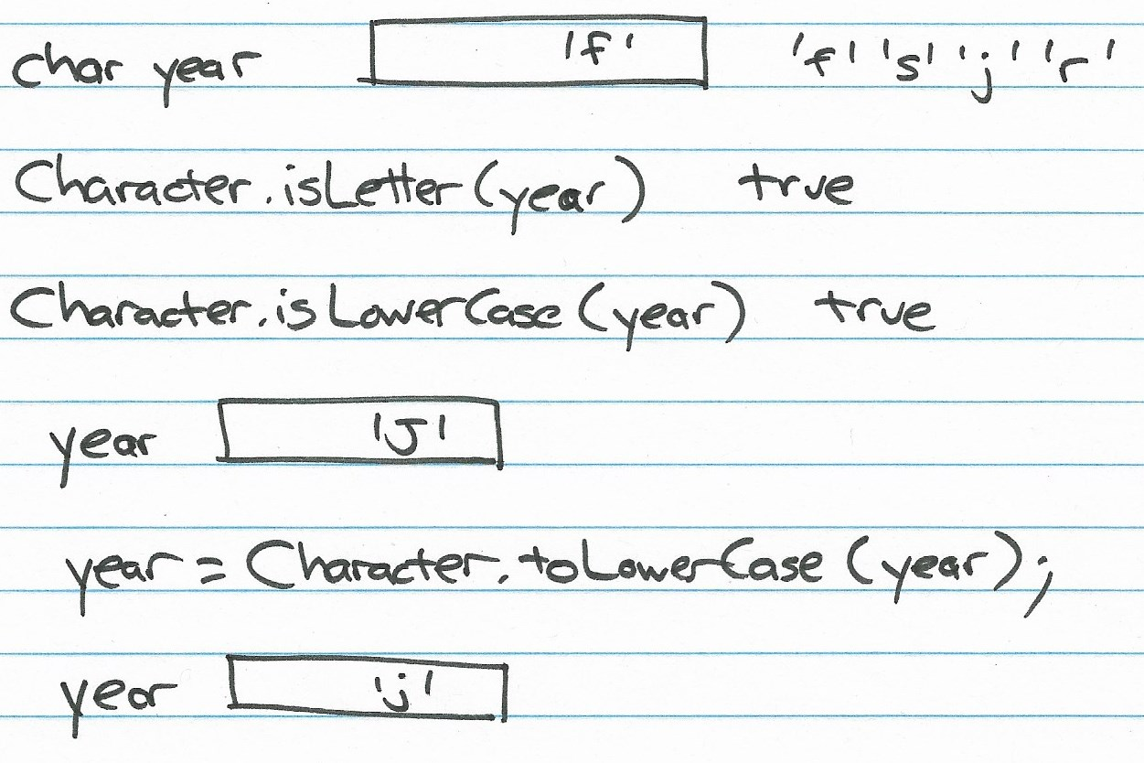
Useful Character Methods

Slide 39
Primitive Type: boolean
Set of two elements { true, false }
Set of operations
Logical: && (and), || (or), ^ (xor), and ! (not)
Testing in various Java statements (e.g., if)
Created by comparison operators
x < y, x <= y, x == y, x != y, x > y, x >= y
And result of logical operators (above)
Note: == and != also work with reference types, but only compare references (addresses) not the values

Slide 40
Video 2 Reference Types and Strings

Slide 41
Reference Types
Unlike primitive types:
Are extensible: can be created by the programmer
Variable declaration creates space for reference to object, not the object itself
Defined with a class declaration
Set of values: created with the new operator
Set of operations: defined and implemented by the methods in the class

Slide 42
Declarations and Reference Types
The declaration of a variable of a reference type allocates space only for the reference, not for the object to which it refers
If the variable is a field of an object, and you say...
Wheel w;
... w will contain the "null pointer" (pointer to nothing). Then, if later you say...
w.getRadius();
... this will result in a “null pointer exception”
If the variable is a local variable in a method, and you say...
Wheel w;
... the Java compiler will refuse to compile it and make you have an actual reference...
Wheel w = new Wheel (17.5);
Wheel w = null;
... will also compile, but can easily lead to a “null pointer exception”

Slide 43
Important Reference Type: String
Java class String is built in
No need to import
Language supports String literals (“hello”)
Because String is a class…
Instances (e.g., literals) are objects
Can create with new operator
String greeting = new String (“Hello”);
String variables hold references to objects

Slide 44
Local Variable Type Inference
Wheel w = new Wheel (15.75);
String school = new String ("Purdue");
repeat the class name Wheel and String
Java allows a shortened form using var
var w = new Wheel (15.75);
var school = new String ("Purdue");
These are equivalent to the declarations above

Slide 45
Operations on Strings
Concatenation (+) built-in to Java
Lots of operations defined as methods in the String class
Strings are immutable: no operation on a String object changes the value of that object

Slide 46
Comparing Strings
== does not work in the way you might expect
Strings are objects
s1 == s2
== between objects only compares the references (addresses) of the objects
Two different String objects with the exact same characters will compare == false (since their objects are stored in different locations)
Use String equals method: s1.equals(s2)

Slide 47
Formatting Strings
Template (“format”) string includes regular characters and “escape” sequences:
%s: string
%d: integer (byte, short, int, long)
%f: float, including double
System.out.printf(“%s! %d or %f”, “Hi”, 42, 3.14159);
prints Hi! 42 or 3.14159
Width specification allowed
%10s: pad string on left to make it 10 characters
%-10s: pad string on right to make it 10 characters
%12d: pad integer on left to make it 12 characters
%10.3f: format number with 3 decimals; total width 10
%.2f: format with 2 decimals; whatever width needed
Full details in Javadocs Formatter

Slide 48
The final Keyword
final is a modifier used in variable declarations
Prevents the variable from being changed
Example 1
final int SIZE = 100;
SIZE = 50; // not allowed by Java
Example 2
Math.PI = 3.1; // also not allowed

Slide 49
Wrapper Classes and Useful Methods
Byte
Short
Integer
Long
Float
Double
Character
Boolean

Slide 50
String to Numeric Value
Convert (parse) a String to a numeric value
Available for all numeric wrapper classes, but two most useful ones are…
Integer.parseInt("4000")
Double.parseDouble(" 66.23457")
Watch for NumberFormatException

Slide 51
Minimum and Maximum Values
Integer.MAX_VALUE
Integer.MIN_VALUE
Double.MAX_VALUE
Double.MIN_VALUE
See text or Java references for other values

Slide 52
College Cost Calculator (1)
import java.util.Scanner;
public class CollegeCosts {
public static void main(String[] args) {
Scanner in;
// Input variables...
String firstName, lastName;
double semesterTuition, monthlyRent, monthlyFood;
double annualInterest;
int years;
// Computed variables...
double yearlyCost, fourYearCost, monthlyInterest;
double monthlyPayment, totalLoanCost;

Slide 53
College Cost Calculator (2)
System.out.printf("Welcome to the College Cost Calculator!\n");
in = new Scanner(System.in);
// Prompt for input values...
System.out.printf("Enter your first name: ");
firstName = in.next();
System.out.printf("Enter your last name: ");
lastName = in.next();
System.out.printf("Enter tuition per semester: $");
semesterTuition = in.nextDouble();
System.out.printf("Enter rent per month: $");
monthlyRent = in.nextDouble();
System.out.printf("Enter food cost per month: $");
monthlyFood = in.nextDouble();

Slide 54
College Cost Calculator (3)
System.out.printf("Annual interest rate: ");
annualInterest = in.nextDouble();
System.out.printf("Years to pay back your loan: ");
years = in.nextInt();
// Compute results...
yearlyCost = semesterTuition * 2.0 +
(monthlyRent + monthlyFood) * 12.0;
fourYearCost = yearlyCost * 4.0;
monthlyInterest = annualInterest / 12.0;
monthlyPayment = fourYearCost * monthlyInterest /
(1.0 - Math.pow(1.0 + monthlyInterest, -years * 12.0));
totalLoanCost = monthlyPayment * 12.0 * years;

Slide 55
College Cost Calculator (4)
// Print results...
System.out.printf("\n");
System.out.printf("College costs for %s %s\n",
firstName, lastName);
System.out.printf("*********************************\n");
System.out.printf("Yearly cost: $%10.2f\n",
yearlyCost);
System.out.printf("Four year cost: $%10.2f\n",
fourYearCost);
System.out.printf("Monthly loan payment: $%10.2f\n",
monthlyPayment);
System.out.printf("Total loan cost: $%10.2f\n",
totalLoanCost );
}
}

