Slide 1
CS18000: Problem Solving and Object-Oriented Programming
File I/O and Exception Handling
(revised 11/24/23)

Slide 2
Video 1 Basics of File I/O

Slide 3
External Communication
File I/O

Slide 4
Persistence of File Storage
RAM comes and goes
Programs crash
Systems reboot
Files last (well … comparatively speaking…)
Programs save data to files to
recover from program crashes and system reboots
provide as input to other programs
File I/O operations extend naturally to communication between programs

Slide 5
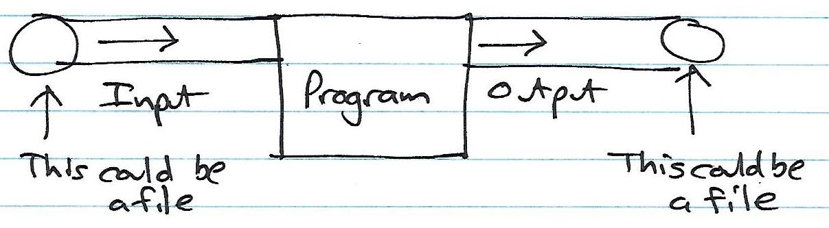
Input and Output “Pipes”

Slide 6
Files and Java
Java is (or tries to be) platform independent
Provides abstractions for files and file systems
File class
But, file name is operating system (OS) dependent
And, file directory conventions are OS-dependent (e.g., path name of user home directory)
So, there are limits to OS independence
Three layers of abstraction in Java for file I/O
Ultimately, all data stored as a stream of bytes
or bits

Slide 7
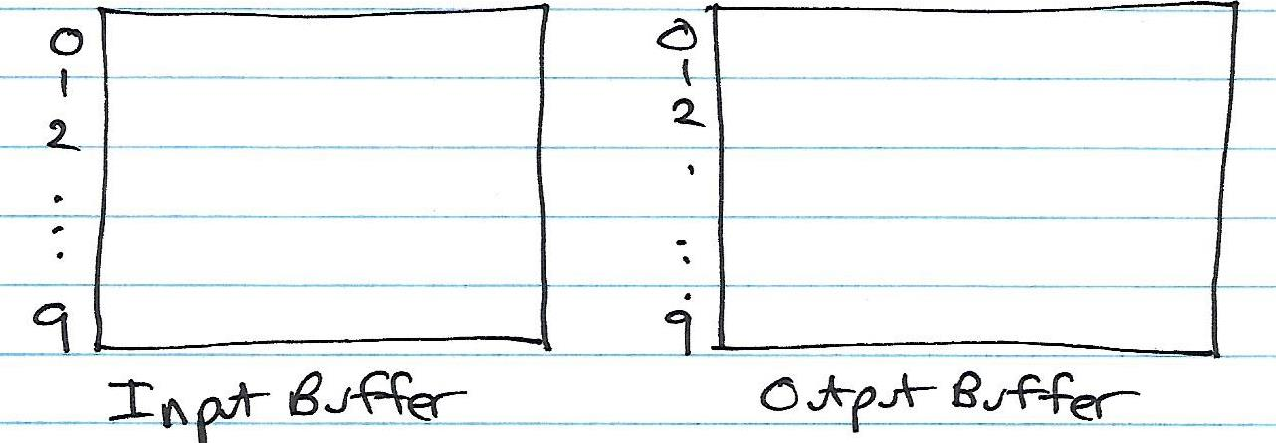
The Implementation of Buffering

Slide 8
The Importance of Buffering
Without buffering, each read or write may generate physical disk access
Can be extremely slow for large volumes of data
Buffering has OS create internal array
OS reads “more than needed” on input, keeps rest for next call to read method
OS doesn’t send output “right away” to disk drive, waits a while in case another write comes along
Important to close file (or flush buffers) when done

Slide 9
Generic File Operations (1)
Open:
Files must be opened before they can be used
Open method indicates “for reading”, “for writing”, or “both”
May also indicate “append” mode
Allows operating system to establish “buffers” and other state information about the file being read or written
Read
Transfers data from the file (or input stream) to the user process
Specific method signatures indicate the type of data being transferred (byte, int, String, Tree, etc.)
Write
Transfers data from the user process to the file (or output stream)
Specific method signatures indicate the type of data being transferred (byte, int, String, Tree, etc.)

Slide 10
Generic File Operations (2)
File position
Sets the “current input position” to a specific byte address in the file
Can be used to skip over data in the file; or back up to read data again
Can be used to “rewind” the file to start reading from the beginning again
Close
Ensures that any “queued data” is “flushed” from the operating system buffers
Frees any operating system resources being dedicated to managing the file

Slide 11
Video 2 Low-Level, High-Level, and Object I/O

Slide 12
File I/O Layers in Java
Low-Level
“Raw” data transfer: byte-oriented
Classes: FileOutputStream, FileInputStream
High-Level
Java primitive types
Classes: DataOutputStream, DataInputStream
Object I/O
Java object types
Classes: ObjectOutputStream, ObjectInputStream
Ultimately, all data stored as a sequence of bytes

Slide 13
Example: Low-Level I/O
import java.io.*;
public class LowLevelIO {
public static void main(String[] args) throws IOException {
File f = new File("lowlevel");
FileOutputStream fos = new FileOutputStream(f);
fos.write(42);
fos.close();
FileInputStream fis = new FileInputStream(f);
int i = fis.read();
System.out.printf("Read %d\n", i);
fis.close();
}
}

Slide 14
Example: High-Level I/O
import java.io.*;
public class HighLevelIO {
public static void main(String[] args) throws IOException {
File f = new File("highlevel");
FileOutputStream fos = new FileOutputStream(f);
DataOutputStream dos = new DataOutputStream(fos);
dos.writeInt(1000);
dos.close();
FileInputStream fis = new FileInputStream(f);
DataInputStream dis = new DataInputStream(fis);
int i = dis.readInt();
System.out.printf("Read %d\n", i);
dis.close();
}
}
dos builds on fos
dis builds on fis

Slide 15
Tricky Bits
You must keep track of what you’re doing!
Data values must be read in the same order in which they were written
write int, long, long, boolean, double, float, char
read int, long, long, boolean, double, float, char
If you try to read an int, but a double is next in the stream, you’ll get garbage

Slide 16
Example: (1)
import java.io.*;
public class ObjectIO {
public static void main(String[] args) throws Exception {
File f = new File("object");
FileOutputStream fos = new FileOutputStream(f);
ObjectOutputStream oos = new ObjectOutputStream(fos);
Tree tree1 = new Tree(42, "elm");
oos.writeObject(tree1); // write the object out
oos.close();
FileInputStream fis = new FileInputStream(f);
ObjectInputStream ois = new ObjectInputStream(fis);
Tree tree2 = (Tree) ois.readObject(); // read the object back
ois.close();
System.out.printf("tree1 = %s\n", tree1);
System.out.printf("tree2 = %s\n", tree2);
}
}
oos builds on fos
ois builds on fis

Slide 17
Example: Object I/O (2)
class Tree implements Serializable {
double circumference;
String species;
Tree(double circumference, String species) {
this.circumference = circumference;
this.species = species;
}
public String toString() {
return String.format("%x: circumference = %d, species = %s",
hashCode(), circumference, species);
}
}

Slide 18
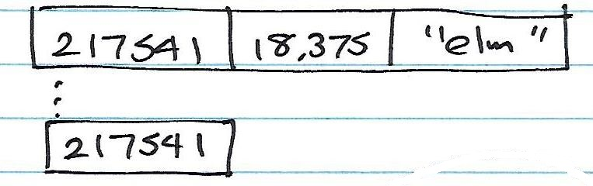
Serializable

Slide 19
Video 3 Text I/O

Slide 20
File Content Types
Can consider file contents in two categories
Text (e.g., *.java, *.txt)
Store human-readable, character data
Mostly platform independent (except EOL)
Binary (e.g., *.class, *.exe)
Not (generally) human readable
Store any kind of data
Requires specific programs to “make sense” of it

Slide 21
Writing and Reading Text
Java handles translation from internal primitive format to human-readable text
Writing
Class: PrintWriter (favored, more platform independent)
Class: PrintStream for System.out (but out of favor)
Reading
Classes: FileReader and BufferedReader
Also, Scanner
Note: BufferedReader is more efficient than Scanner (only important for high volumes of I/O)

Slide 22
Example: TextIO (1)
import java.io.*;
public class TextIO {
public static void main(String[] args) throws IOException {
File f = new File("textio.txt");
// open FileOutputStream in append mode (true)
FileOutputStream fos = new FileOutputStream(f, true);
// use PrintWriter--similar to PrintStream (like System.out)...
PrintWriter pw = new PrintWriter(fos);
pw.println("our old friend");
pw.close();
// continued...

Slide 23
Example: TextIO (2)
// ... continued
// read what we just wrote...
FileReader fr = new FileReader(f);
BufferedReader bfr = new BufferedReader(fr);
while (true) {
String s = bfr.readLine();
if (s == null)
break;
System.out.println(s);
}
bfr.close();
}
}

Slide 24
Video 1 Introduction to Exceptions

Slide 25
Exceptions
try-catch
throw

Slide 26
Handling Error Situations
public class Summer {
public static void main(String[] args) {
Scanner in = new Scanner(System.in);
int number; // number that is input
int sum = 0; // sum of values
int c = 0; // how many values read
double average; // average value
while (in.hasNextInt()) {
number = in.nextInt();
c = c + 1;
sum = sum + number;
}
if (c > 0) {
average = sum / c;
System.out.printf("%d values, sum %d, average %f", c, sum, average);
} else
System.out.printf(“no values, no sum, no average");
}
}

Slide 27
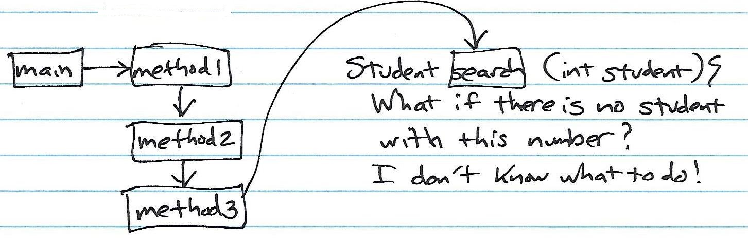
What to do when an error occurs?

Slide 28
What to do when an error occurs?
Old style: return an “error code”
Caller must check on each call
Did the method return an error?
Requires a special value to indicate error
Example:
indexOf() method used to retrieve index position at which a particular character appears in a string
If specified character is not found, indexOf() returns -1
Programmer must check for -1

Slide 29
Java Approach: Exceptions
Write code without worrying about checking for errors
When an error is detected, an exception is “thrown”…
Java system stops execution of the current method
Searches for an “exception handler” to deal with the problem
Search begins in the current method and continues to
caller -> caller’s caller -> caller’s caller’s caller ->
…-> main -> …

Slide 30
The Call Stack
Currently executing method
method4
method3
Each method “frame” on the “stack” contains storage for the parameters and local variables of the method
method2
Methods waiting for called method to complete
method1
main

Slide 31
Searching for a Handler
Exception occurs here
method4
method3
Java searches for an exception handler starting with the current method, then caller, caller’s caller, etc.
Each method can either “catch” the exception or “throw” it on to its caller
method2
method1
main

Slide 32
Video 2 The Exception Class

Slide 33
Catching an Exception: Basic Syntax
Basic syntax of the try-catch statement…
try {
statements-that-might-throw-exception;
} catch (Exception e) {
statements-to-recover-from-exception;
}
Note: “Exception” is a class name, not a reserved word; e is an object reference.
try clause
catch clause

Slide 34
Passing the Buck: Throws
A method can declare that it throws an exception without catching it…
public void doit(int x) throws Exception {
statements-that-might-throw-an-exception;
}
Note: “throws” is a keyword, “Exception” is a class name
New syntax
No try-catch needed!

Slide 35
Exception Class
Exceptions are objects
The exception object is an instance of
class Exception, or
a subclass of Exception
Created using new (just like any object)
Two useful methods…
e.getMessage() get the associated text message
e.printStackTrace() prints the current call stack

Slide 36
Exception Class Hierarchy
Exception
IOException
YourException
FileNotFoundException
RuntimeException
ArithmeticException
NullPointerException
IndexOutOfBoundsException

Slide 37
Checked vs. Unchecked Exceptions
The RuntimeException class and its subclasses are “unchecked” exceptions:
Generally indicate program or JVM error (null pointer, arithmetic, invalid array index, etc.)
Typically: no recovery is possible; program crashes
All other Exceptions are “checked”
Generally indicate “user” error (e.g., file not found)
Must check for them (try-catch or throws)
Typically: recoverable (e.g., prompt user again)

Slide 38
EOF: Unchecked Exception
import java.util.Scanner;
public class EOF {
public static void main(String[] args) {
FileReader fr = new FileReader(f);
Scanner s = new Scanner(fr);
while (true) {
String word = s.next();
System.out.println(word);
}
}
}
Throws NoSuchElementException at end of file

Slide 39
EOF: Catching NoSuchElement
import java.util.Scanner;
import java.util.NoSuchElementException;
public class EOF {
public static void main(String[] args) {
FileReader fr = new FileReader(f);
Scanner s = new Scanner(fr);
while (true) {
try {
String word = s.next();
System.out.println(word);
} catch (NoSuchElementException e) {
System.out.printf("NoSuchElementException: %s\n”,e.getMessage());
break;
}
}
}
}

Slide 40
Scanner: Catching FileNotFound
import java.util.Scanner;
import java.io.File;
import java.io.FileNotFoundException;
public class LineCounter {
public static void main(String[] args) {
File f = new File(args[0]);
try {
FileReader fr = new FileReader(f);
Scanner s = new Scanner(fr);
int c = 0;
while (s.hasNextLine()) {
s.nextLine();
c++;
}
System.out.printf("read %d lines from file %s\n", c, f);
} catch (FileNotFoundException e) {
System.out.printf("Exception: %s\n", e.getMessage());
}
}
}

Slide 41
Video 3 Advanced Exception Handling

Slide 42
Making Your Own Exception Class
public class StudentNotFoundException extends Exception {
public StudentNotFoundException (String message) {
super (message);
}
}
public class FindStudent {
public Student search (int student) throws
StudentNotFoundException {
if (...) {
throw new StudentNotFoundException
(Integer.toString(student));
}
}
}

Slide 43
Typical Exception Handling Situation
try {
…
method1(…);
…
} catch (StudentNotFoundException e) {
statements-to-recover;
}

Slide 44
Catching Multiple Exceptions
It is possible to catch multiple exceptions from one try
Catches must be ordered from lowest subclass to highest superclass
try {
… statements-that-may-throw-exceptions;
} catch (StudentNotFoundException e) {
// code to handle student not found
} catch (NullPointerException e) {
// code to handle null pointer
} catch (Exception e) {
// code to handle all other exceptions
}

Slide 45
Finally Clause
Finally, if present, a “finally” clause is executed after all other try/catch statements
The finally clause is guaranteed to execute, even if earlier clause returns
try {
… statements-that-may-throw-exceptions;
} catch (StudentNotFoundException e) {
// code to handle student not found
…
} finally {
// code to clean things up
}

Slide 46
try-with-resources statement
Instead of a finally block to ensure that a resource is closed you can use a try-with-resources statement
A resource is an object that must be closed after the program is finished with it

Slide 47
try-with-resources statement
static String readFirstLineFromFile(String path) throws IOException {
try (BufferedReader br =
new BufferedReader(new FileReader(path))) {
return br.readLine();
}
catch (StudentNotFoundException e) {
// code to handle other exceptions
}
}

Slide 48
try-with-resources statement
Resource declared in the try-with-resources statement is a BufferedReader
BufferedReader br must be closed after the program is finished with it
BufferedReader br will be closed regardless of whether the try statement completes normally or abruptly

