Slide 1
CS18000: Problem Solving and Object-Oriented Programming
Arrays

Slide 2
Video 1
Introduction to Arrays

Slide 3
Arrays
Concepts
Syntax
Examples

Slide 4
Lots of Temperatures
Three temperatures:
double tempAM, tempNoon, tempPM;
24 temperatures:
double temp1AM, temp2AM, ... tempNoon, temp1PM, ... tempMidnight;
Mathematicians have solved this problem
Subscripted variables
temp₁, temp₂, ... temp₂₄
Java uses
double[] temp = new double [24];
which creates temp[0], temp[1], ..., temp[23]

Slide 5
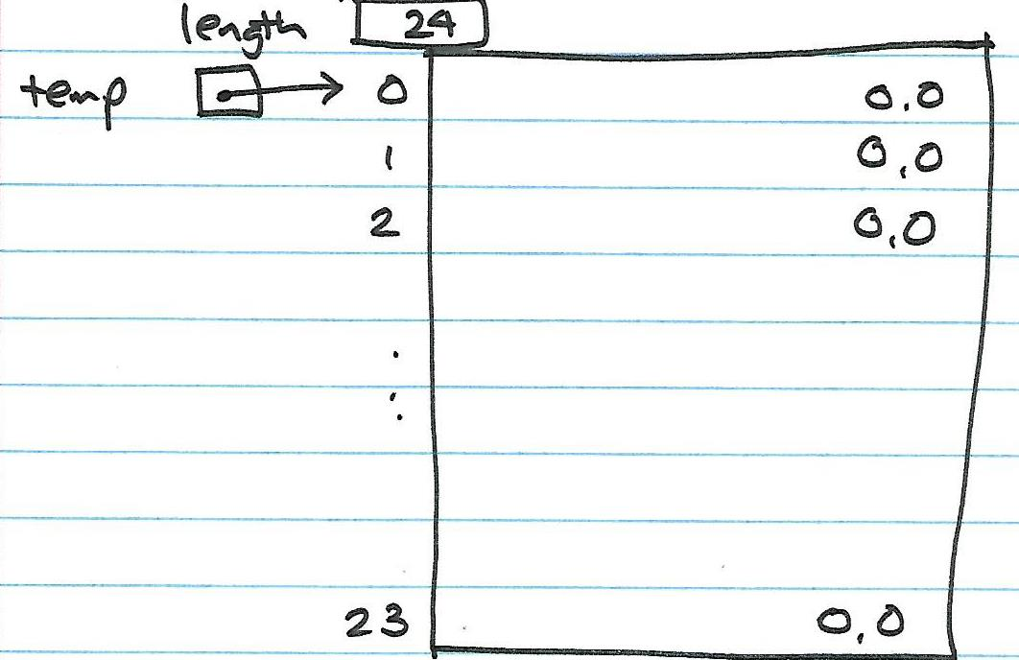
Lots of Temperatures

Slide 6
Our Next Advance
Single variables holding single values is not enough
Need…
  Ways to deal with data in bulk
  Treat a collection of values as single unit
Also known as “data structures” and “aggregate data types”
Arrays are just one example

Slide 7
Data Structure Characteristics
Contents: types of the values
  heterogeneous data values, or
  homogeneous data values
Size: number of data values it contains
  static (fixed size)
  dynamic (can grow or shrink)
Element access: how efficiently can different elements be inserted, deleted, or changed?
  Sequential access
  Random access

Slide 8
Arrays
An array is a list of values
A kind of “container object” in Java
In Java, arrays are
  homogeneous
  static
  random access
  reference types
Analogy: a String is like an array of characters

Slide 9
Video 2
Using Arrays

Slide 10
A Familiar Example
public static void main(String[] args) { }
The parameter to main is an array of Strings
Array args initialized from the space-separated “words” on the command line
>java Calculate add 5 17.25
This will work just like…
String[] args = new String [3];
args[0]: first argument
args[1]: second argument
args[i]: i^{th} argument
args.length == number of arguments

Slide 11
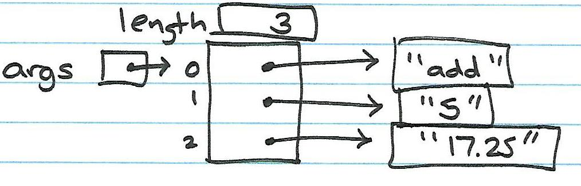
A Familiar Example

Slide 12
An Example of the Familiar
public class Calculate {
public static void main(String[] args) {
for (int i = 0; i < args.length; i++)
System.out.printf(
"args[%d] = %s\n", i, args[i]);
}
}

Slide 13
Declaring an Array Variable
Example:
  String[] args
In general:
  type_name [ ] variable_name
type_name: any primitive or reference type
variable_name: a standard Java identifier

Slide 14
Creating an Array Object
Example:
  new String[10]
In general:
  new type_name[size]
type_name: any primitive or reference type
size: an int-valued expression
  String[] students = new String[10];
or
  var students = new String[10];

Slide 15
Accessing an Array Element
Example:
  args[0] or args[i]
In general:
  array_object_reference [ int_value ]
array_object_reference: an expression (e.g., variable) that references an array object
int_value: an expression that yields an int

Slide 16
Array Picture
int[] list = new int[5];
assign
int[5]
0
declare
list
0
create
0
list[3]
0
0
reference

Slide 17
Video 3
WordList Array Example

Slide 18
Problem: WordList
Create a WordList class that reads words from a file into an array
Create a computeHistogram method in WordList that computes the number of words of each length in the WordList
Need to
  Declare array variables for the main word list and to hold the histogram counts
  Choose suitable maximum lengths and allocate

Slide 19
Step 1: WordList
Create WordList class
What information (fields) should be stored in a WordList object?
  words: an array containing the words
  size: the number of actual words in the array
How should the object be initialized?
  Constructor takes a Scanner object
  Allocates “big” array
  Reads words from Scanner and stores in array

Slide 20
Step 2: WordList
Create a main method for testing
Create a Scanner object with String of words
Create a WordList object
Print
  Number of words found
  List of words

Slide 21
Step 3: Create Histogram
Add method “int[] computeHistogram()”
Allocate an array of ints to store the histogram
How big? Pick a number
Loop through all the words in the list
  Get the length of the word
  Update the histogram counter of that length
Return the histogram array
In main: call, then print results

Slide 22
Solution: WordList (1)
import java.util.Scanner;
public class WordList {
final static int MAXWORDS = 300000; //Problem we will discuss later!
final static int MAXHIST = 50;
private String[] words;
private int size;
public WordList(Scanner in) {
words = new String[MAXWORDS];
size = 0;
while (in.hasNext()) {
words[size++] = in.next();
}
}

Slide 23
Solution: WordList (2)
public int getSize() {
return size;
}
public int[] computeHistogram() {
var histogram = new int[MAXHIST];
for (int i = 0; i < size; i++)
histogram[words[i].length()]++;
return histogram;
}
}

Slide 24
Solution: WordList (3)
public static void main(String[] args) {
Scanner scan = new Scanner(System.in);
WordList w = new WordList(scan);
System.out.printf("read %d words\n", w.getSize());
int[] wordLengths = w.computeHistogram();
for (int i = 1; i < MAXHIST; i++)
if (wordLengths[i] > 0)
System.out.printf("%2d: %5d\n", i, wordLengths[i]);
}
}

Slide 25
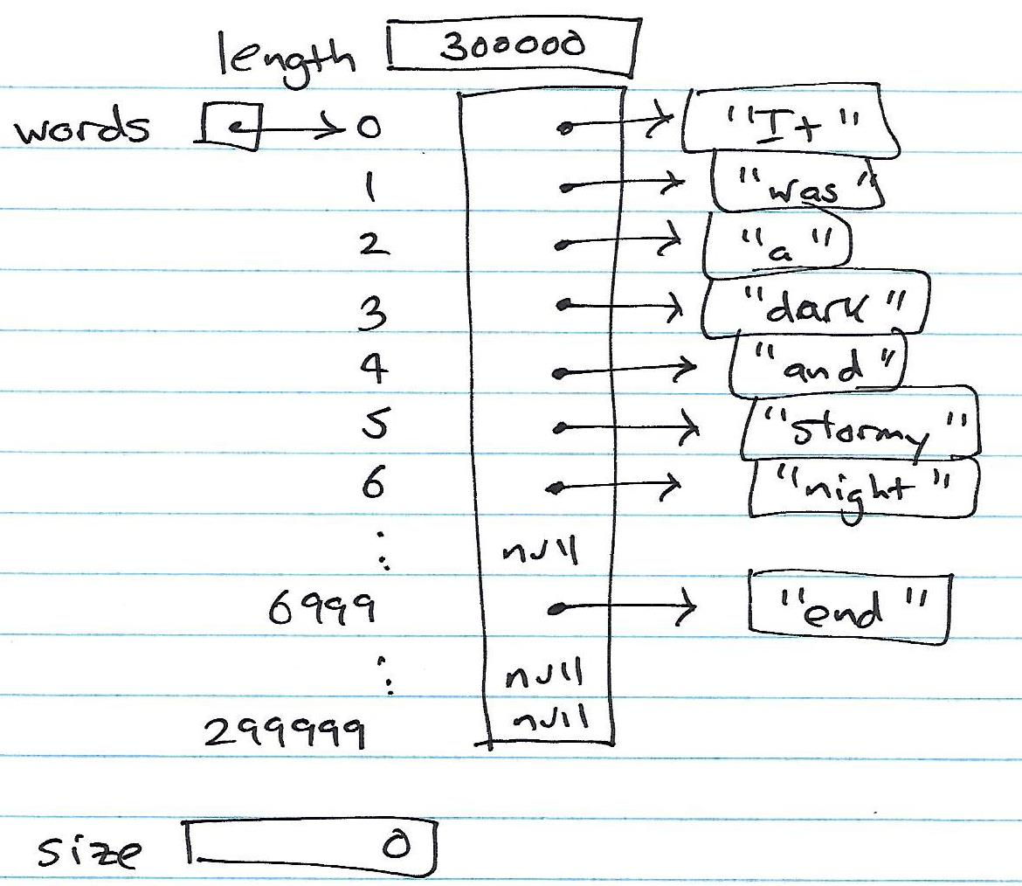
Solution: WordList

Slide 26
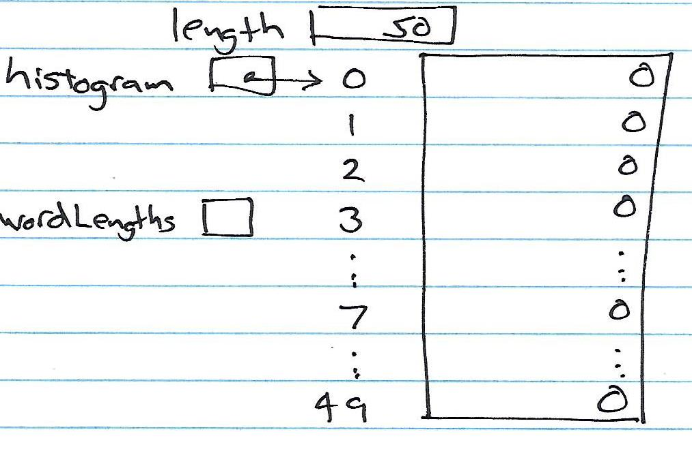
Solution: WordList

Slide 27
Video 4
TreeTracker Array Example

Slide 28
Array Initialization
Default: elements initialized with type-specific default
  Integer types: 0
  Real types: 0.0
  Reference types: null
Compile-time array initialization possible
Example:
  char[] vowels = { 'a', 'e', 'i', 'o', 'u' };
In general:
  array_declaration = { v₁, v₂, … v_{n} };
  int[] days = {31,28,31,30,31,30,31,31,30,31,30,31};
Note: Initialization must be done in conjunction with (at time of) declaration

Slide 29
Problem: TreeTracker
The National Forest Service needs our help…
Create a TreeTracker class that creates random Tree objects (for testing)
  Generate random species and circumferences
  Store them in an array and print out using the describe method
Illustrates: array initialization, pseudo-random numbers, length field in arrays

Slide 30
Tree class
public class Tree {
private int serial;
private double circumference;
private String species;
public Tree(int serial, double circumference, String species) {
this.serial = serial;
this.circumference = circumference;
this.species = species;
}
public String describe() {
return String.format("Tree number %d has a circumference of %.2f and is of species %s.", serial, circumference, species);
}
public double getDiameter() {
return circumference / Math.PI;
}
public double getCircumference() {
return circumference;
}
}

Slide 31
Random Class
A Random Class object can be used to generate a random number
You must...
import java.util.Random;
...and declare a Random object...
Random r = new Random();
r.nextDouble() returns a value in the range [0.0-1.0) (same as Math.random())
r.nextInt(int n) returns a value in the range [0-n)
r.nextInt() returns any possible integer positive or negative number

Slide 32
Solution: TreeTracker
import java.util.Random;
public class TreeTracker {
final static int NUMTREES = 100;
public static void main(String[] args) {
Random r = new Random();
String[] species = { "pine", "elm", "spruce", "oak", "walnut" };
var trees = new Tree[NUMTREES];
for (int i = 0; i < trees.length; i++) {
String specie = species[r.nextInt(species.length)];
trees[i] = new Tree(i, r.nextDouble()*100, specie);
}
for (int i = 0; i < trees.length; i++)
System.out.println(trees[i].describe());
}
}

Slide 33
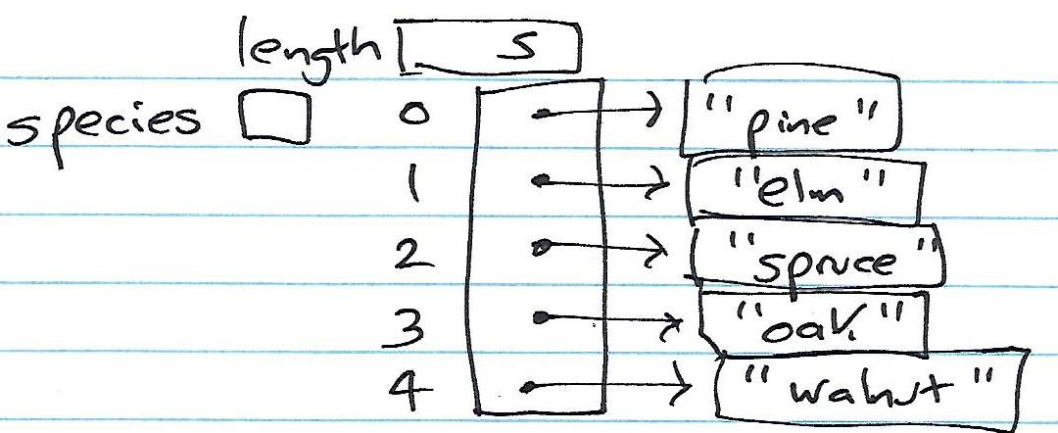
Solution: TreeTracker

Slide 34
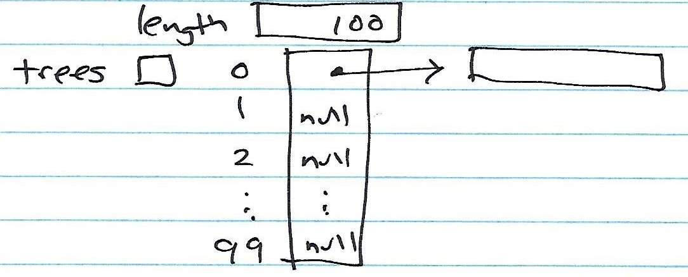
Solution: TreeTracker

Slide 35
Video 1
Two-dimensional arrays, for-each loops, varargs

Slide 36
Array Elements Can Be Other Arrays!
  int[][] matrix = new int[5][10];
Creates a 2D matrix with 5 rows and 10 columns
  { { 0, 0, 0, 0, 0, 0, 0, 0, 0, 0 },
  { 0, 0, 0, 0, 0, 0, 0, 0, 0, 0 },
  { 0, 0, 0, 0, 0, 0, 0, 0, 0, 0 },
  { 0, 0, 0, 0, 0, 0, 0, 0, 0, 0 },
  { 0, 0, 0, 0, 0, 0, 0, 0, 0, 0 } }
Elements of matrix[i] are arrays of (10) ints.

Slide 37
A Java 5x10 Matrix
matrix[i][j]
0
1
2
3
4
5
6
7
8
9
0
0
0
0
0
0
0
0
0
0
0
1
0
0
0
0
0
0
0
0
0
0
2
0
0
0
0
0
0
0
0
0
0
3
0
0
0
0
0
0
0
0
0
0
4
0
0
0
0
0
0
0
0
0
0
matrix.length is 5
matrix[i].length is 10 (for all i in this example)

Slide 38
Quirks
There is no requirement in Java that all rows of a 2-D matrix have the same number of elements (“columns”)
Allows “ragged right” arrays (aka “jagged right”)
Useful for saving storage

Slide 39
Declaring a Ragged Array
int[][] matrix = new int [5][];
matrix[0] = new int [7];
matrix[1] = new int [10];
matrix[2] = new int [4];
matrix[3] = new int [6];
matrix[4] = new int [9];

Slide 40
Problem: Sum Matrix
Compute the sum of a 2D array…
int computeSum() {
int sum = 0;
for (int i = 0; i < matrix.length; i++)
for (int j = 0; j < matrix[i].length; j++)
sum += matrix[i][j];
return sum;
}
Note: This solution works even for ragged arrays.

Slide 41
The for-each Loop
Designed for use with arrays (and, more importantly, other data structures to come)
Allows simplified iteration through an array
  int[] bloodPressure = new int [500];
  int sum = 0;
  for (i=0; i<bloodPressure.length; i++)
  sum += bloodPressure[i];
  for (int value : bloodPressure)
  sum += value;
Limitation: only read-access to each element

Slide 42
Generic Classes
An advanced topic to be covered more fully later
Basic idea: A generic class is one that can be parameterized with another class
ArrayList<E> is parameterized with class (or type) E. It can only “hold” elements that are references to objects of class E
E must be a reference type; primitive types are not supported

Slide 43
ArrayList Class
A class provided in the java.util package
Dynamic array: automatically grows to accommodate new items
Works with any type of object, but you must specify the type when the ArrayList object is created (just like a Java array)
Example
  ArrayList<String> list = new ArrayList<String>();
  Creates an empty array of String objects
  String[] list = new String[10];

Slide 44
ArrayList Class
ArrayList<String> list = new ArrayList<String>();
is correct and complete, but we can use Local Variable Type Inference
var list = new ArrayList<String>();
or the second argument can be inferred
ArrayList<String> list = new ArrayList<>();

Slide 45
ArrayList Class
Unlike Java arrays, ArrayList does not work with primitive types, only reference types
Can’t say “ArrayList<int> list”
Fortunately, Java provides special “wrapper” classes for each primitive type
Can say “ArrayList<Integer> list”
Java handles the conversion between wrapper class and corresponding primitive type

Slide 46
Useful ArrayList Methods
add(e) – adds e to end of list
add(i, e) – adds e at index i (0-based), pushing others down
contains(e) – returns true if e is in the list
get(i) – returns the value at index i
remove(e) – removes e from the list
set(i, e) – adds e at index i, replacing what was there
size() – returns the current size of the list

Slide 47
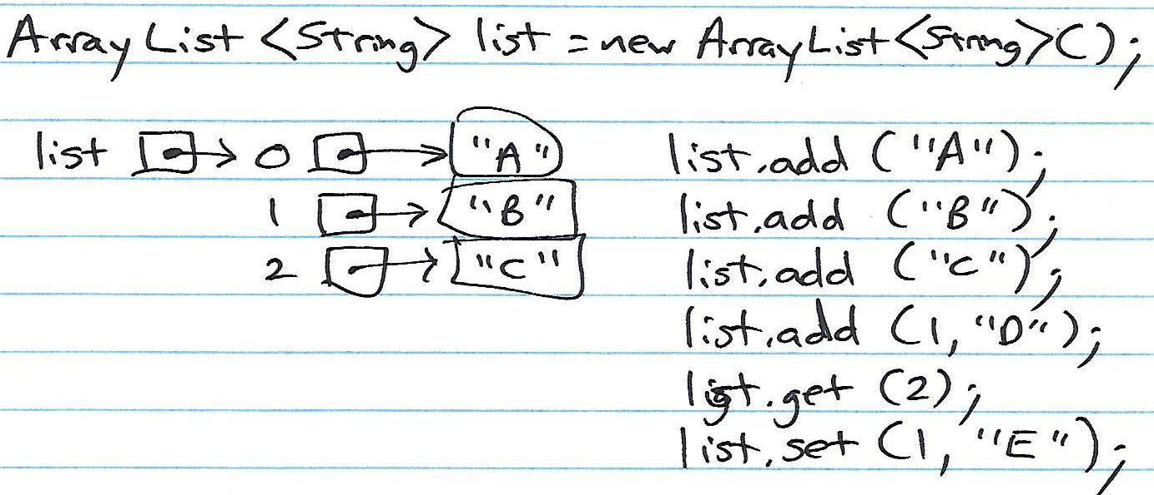
Useful ArrayList Methods

Slide 48
When Should You Use an ArrayList?
You CAN use an ArrayList any time in place of an array. ArrayLists can do everything an array can ... and more.
You SHOULD use an ArrayList
When you have no idea how many items will be in the array
When you want to take advantage of add(i,e) which adds e at index i and pushes everything else down

Slide 49
WordList Using ArrayList (1)
import java.util.Scanner;
public class WordList {
final static int MAXHIST = 50;
private ArrayList<String> words = new ArrayList<String>();
public WordList(Scanner in) {
while (in.hasNext()) {
words.add(in.next());
}
}

Slide 50
WordList Using ArrayList (2)
public int getSize() {
return words.size();
}
public int[] computeHistogram() {
var histogram = new int[MAXHIST];
for (int i = 0; i < words.size(); i++)
histogram[words.get(i).length()]++;
return histogram;
}
}

Slide 51
Example: ArrayListDemo
import java.util.ArrayList;
import java.util.Scanner;
public class ArrayListDemo {
public static void main(String[] args) {
var list = new ArrayList<String>();
Scanner in = new Scanner(System.in);
while (in.hasNextLine()) {
String s = in.nextLine();
list.add(s);
}
System.out.printf("read %d lines\n", list.size());
for (int i = 0; i < list.size(); i++) {
System.out.printf("%s\n", list.get(i));
}
}
}

Slide 52
TreeList Class
import java.util.ArrayList;
public class TreeList {
public static void main(String[] args) {
var forest = new ArrayList<Tree>();
while (Math.random() < 0.9) {
Tree t = new Tree(Math.random() * 100);
System.out.printf("tree has radius %.3f\n", t.getRadius());
forest.add(t);
}
System.out.printf("created %d trees\n", Tree.getNumberOfTrees());
System.out.printf("list has %d trees:\n", forest.size());
for (Tree t : forest)
System.out.printf("tree with radius %.3f\n", t.getRadius());
}
}

Slide 53
Arrays Class
Useful utility methods for dealing with arrays
import java.util.Arrays;
Work with arrays of many types (not just int and double)
Arrays.binarySearch(int[] array, int value)
Arrays.copyOf(double[] array, int length)
Arrays.copyOfRange(double[] array, int from, int to)
Arrays.equals(int[] array1, int[] array2)
Arrays.fill(double[] array, double value)
Arrays.sort(int[] array)
Arrays.toString(double[] array)

Slide 54
Generalizations
A method can take an array as parameter
  int computeSum(int[] a)
  public static void main(String[] args)
A method can return an array as return value
  int[] sortIntegers(int[] a)
  int[] computeHistogram()
An array of type T[], has elements of type T

Slide 55
varargs
varargs is short for variable-length arguments
method that takes a variable number of arguments is a varargs method
A variable-length argument is specified by three periods(...)
public static void func (int ... a)
{
// method body
}
tells the compiler that func() can be called with zero or more arguments
a is implicitly declared as an array of type int[]

Slide 56
varargs
public static void main (String[] args)
{
func (100); // sends array {100}
func (1, 2, 3, 4); // sends array {1,2,3,4}
func (); // sends array {}
}
varargs has been used and these arguments should be stored in the int array referred to by a
a.length can be used to find the length of the array
A method can have variable length parameters with other parameters too, but the varargs parameter should be last in the parameter list of the method declaration
int nums (int a, float b, double ... c)

Slide 57
Problem: Model Playing Cards
Create a class that models a deck of playing cards
Features needed:
  Draw cards at random from the deck
  Shuffle
  Convert card representation to suit and value string

Slide 58
Representing Cards
Represent suits as ints 0-3
  H, S, D, C
  0, 1, 2, 3
Represent card values as ints 0-12
  A, 2, 3, 4, 5, 6, 7, 8, 9, T, J, Q, K
  0, 1, 2, 3, 4, 5, 6, 7, 8, 9, 10, 11, 12
Represent a card in a single int as
  suit * 13 + value
  Each card is a value in the range 0-51 (inclusive)
  suit is (card / 13); value is (card % 13)

Slide 59
Representing Cards
six of diamonds
suit = 2
value = 5
suit * 13 + value = 31
What card is 31?
suit is (card / 13) = 2 (diamonds)
value is (card % 13) = 5 (six)

Slide 60
Representing a Deck of Cards
Use an int array with 52 locations
Locations are (initially) values 0-51
That is: deck[i] == i for all i
Thus, deck is initially
  Sorted by suits then by value
  All cards are available to be drawn
To draw a card
  Choose card at random from available cards
  Swap chosen card with last card in deck
  Reduce available cards by 1
To shuffle
  Set available cards to 52

Slide 61
Initial Deck Representation
int[]
0
0
(AH)
1
1
(2H)
deck
2
2
(3H)
3
3
(4H)
size
4
4
(5H)
52
5
(6H)
5
.
.
.
.
.
.
.
.
.
51
51
(KC)

Slide 62
Drawing a Card at Random
int[]
0
0
(AH)
1
1
(2H)
deck
2
2
(3H)
3
3
(4H)
size
4
4
(5H)
52
5
(6H)
5
.
.
.
.
.
.
.
.
.
r.nextInt(size) -> 5
Swap card 5 (6H) and 51 (KC)
Decrement size by 1
51
51
(KC)

Slide 63
Drawing a Card at Random
int[]
0
0
(AH)
1
1
(2H)
deck
2
2
(3H)
3
3
(4H)
size
4
4
(5H)
51
5
(KC)
51
.
.
.
.
.
.
.
.
.
r.nextInt(size) -> 5
Swap card 5 (6H) and 51 (KC)
Decrement size by 1
51
5
(6H)

Slide 64
Solution: DeckOfCards
See code at http://bit.ly/XXwLsK

Slide 65
Uses of 2D Arrays
Representing
  A grid-based game, like tic-tac-toe or chess
  A set of distances between pairs of cities
  Matrices in linear algebra
  Other tabular data
Generalizable to additional dimensions
  double[][][][] spaceTime = new double[100][100][100][100];
Note: Above requires 100,000,000 storage locations

Slide 66
Video 2
ArrayLists

Slide 67
Video 3
Playing Cards Array Example

