Slide 1
CS18000: Problem Solving and Object-Oriented Programming
Methods and Classes

Slide 2
Video 1
Static and Non-Static Fields

Slide 3
Methods and Classes
Defining Methods
Parameters
Return Values

Slide 4
Java Class
Java class includes…
  Fields: attributes of an object or the class
  Methods: operations on an object or the class
Within certain limitations:
Fields are accessible to methods of the class
Fields and methods may be static or non-static
  When static, fields and methods are “of the class”
  When non-static, fields and methods are “of the object”

Slide 5
Static and Non-Static Fields
Static field:
  One memory location shared by all objects of the class
  Same value shared by all methods
  What is this good for?
Non-static field:
  Each instance of the class (object) has its own memory location for the field
  Different value (in general) in each object

Slide 6
Java Terminology: Variables
Instance variables: non-static fields in a class declaration
Class variables: static fields in a class declaration
Local variables: variables in method or block
Parameters: variables in a method declaration
Source: http://docs.oracle.com/javase/tutorial/java/nutsandbolts/variables.html

Slide 7
Problem: Counter
Create a class with static and non-static counters
Create objects
Increment the counters
Print values before and after

Slide 8
Solution 1: Counter
public class Counter {
int x;
static int y;
public static void main(String[] args) {
Counter alice = new Counter();
Counter bob = new Counter();
alice.x = 10; alice.y = 42;
bob.x = 50; bob.y = 99;
System.out.println(alice.x); System.out.println(alice.y);
System.out.println(bob.x); System.out.println(bob.y);
alice.y++;
System.out.println(alice.y); System.out.println(bob.y);
Counter.y++;
System.out.println(alice.y); System.out.println(bob.y);
}
}

Slide 9
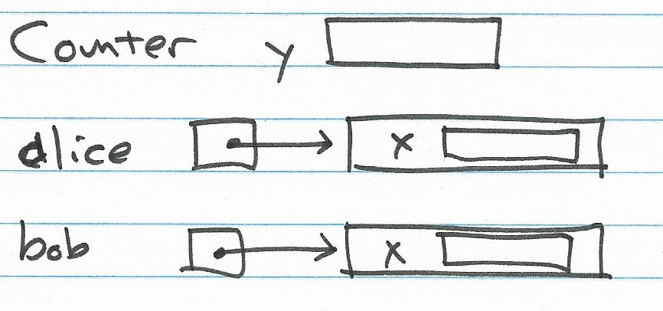
Solution 1: Counter

Slide 10
Video 2
Methods

Slide 11
Methods
Method: a parameterized block of code that may return a value
Every method exists inside some class
Useful for…
  Reusability: Reduce redundancy in code
  Readability: Identify logical operation by name (abstraction)
  Modularity: software developers can code and test independently

Slide 12
Basic Method Syntax
return_type methodName(param_list) {
statements;
return_if_needed;
}
return_type: type of value to be returned (void if no return value)
param_list: list of parameters expected by method (includes types and local name, can be empty)

Slide 13
Parameters and Arguments
Parameters allow a method to work on different data values
Parameter: a variable local to a method
Argument: an expression that is passed to the corresponding parameter at time of method call
Argument values are copied into parameter variables
Argument values to a method must match the number and types of parameters of the method
int calc (double x, int y) {… return z;}
sum = calc (r,s);

Slide 14
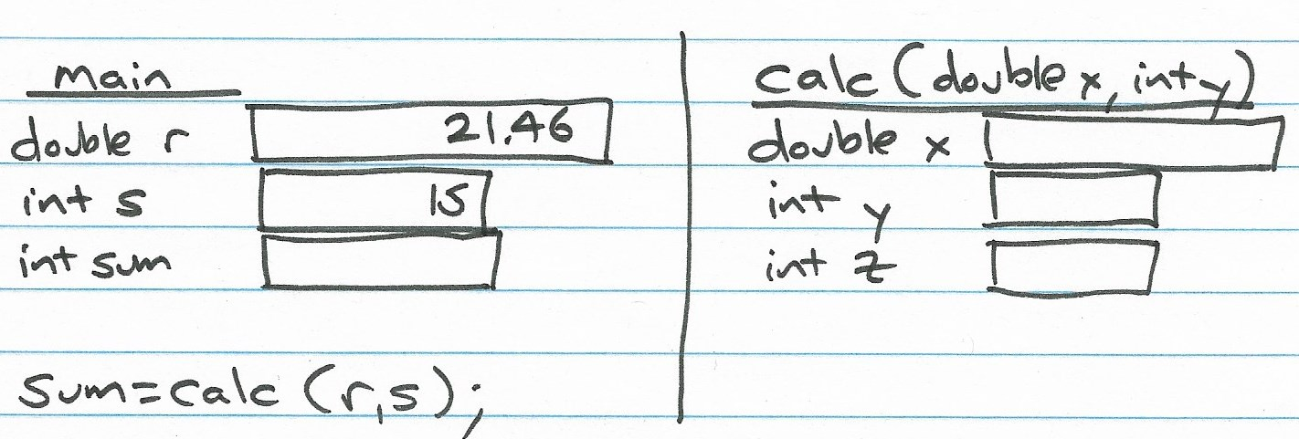
Parameters and Arguments

Slide 15
Flow of Control for Method Calls
Before call: argument values at calling site are copied to parameter variables in called method
Then…
  The calling method is “suspended”
  The called method begins at the top of the method body and runs to completion (return statement or the end)
  The calling method continues where it left off
After call: Return value from called method becomes value returned to calling site

Slide 16
Parameters: Call by Value
Parameter variables are distinct from variables passed in as arguments
  void changer(int x) {
  x = 12;
  }
  …
  int y = 5;
  changer(y);
  System.out.println(y); // prints 5

Slide 17
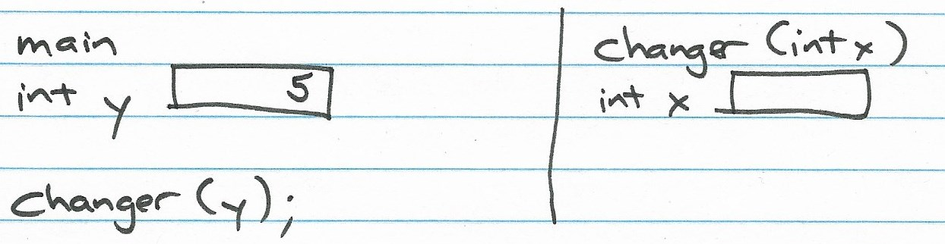
Parameters: Call by Value

Slide 18
Solution 2: Counter
public class Counter {
int x;
static int y = 42;
Counter(int x) {
this.x = x;
}
public static void main(String[] args) {
Counter alice = new Counter(100);
Counter jimmy = new Counter(500);
System.out.printf("%s: x = %d, y = %d\n", "alice", alice.x, alice.y);
System.out.printf("%s: x = %d, y = %d\n", "jimmy", jimmy.x, jimmy.y);
alice.x++;
alice.y++;
jimmy.x++;
jimmy.y++;
System.out.printf("%s: x = %d, y = %d\n", "alice", alice.x, alice.y);
System.out.printf("%s: x = %d, y = %d\n", "jimmy", jimmy.x, jimmy.y);
}
}

Slide 19
Solution 3: Counter
public class Counter {
// [fields and constructor omitted]
static void display(String name, Counter c) {
System.out.printf("%s: x = %d, y = %d\n", name, c.x, c.y);
}
public static void main(String[] args) {
Counter alice = new Counter(100);
Counter jimmy = new Counter(500);
display("alice", alice);
display("jimmy", jimmy);
alice.x++;
alice.y++;
jimmy.x++;
jimmy.y++;
display("alice", alice);
display("jimmy", jimmy);
}
}

Slide 20
Video 3
Scope of Variables

Slide 21
Static and Non-Static Methods
Static method:
  May only access static fields and call other static methods in the class
  Can be called using class name: Math.pow(2,5)
Non-static method:
  May also access non-static fields associated with the particular object
  Must be associated with an object in some way in order to be called, e.g., t3.describe()
  If no object specified, “this” implied: describe() is same as this.describe()

Slide 22
Extended Method Syntax
[static] return_type methodName(param_list) {
statements;
return_if_needed;
}
static: method is a static method
Not static: method is an “instance method” (AKA “object method”)

Slide 23
Constructors
Counter c1 = new Counter(500);
Not exactly a method, but very similar
Callable using “new” operator
May take parameters
May access all fields of class (including static)
Main task: Initialize the object being allocated
Does not explicitly return a value…
…but the new operator that started it returns a reference to the newly created object

Slide 24
Scope of Variables
Scope: where in the code the variable is usable
Basic rule: A variable is usable from the point of declaration to the end of the enclosing block
Special cases…
  Parameters: accessible within the method body
  For loop variable: accessible within heading and body

Slide 25
Example: Scope1a
public class Scope1 {
int x;
void one(int x) { // OK: hides field x
// int x; // cannot have in same scope as parameter
}
void two() {
int x = 10; // OK: hides field x
while (true) {
// int x; // error: same scope as x above
}
}
}

Slide 26
Example: Scope1b
public class Scope1 {
public static void main(String[] args) {
{ // independent block 1
int x = 12;
}
{ // independent block 2
int x = 15;
}
for (int i = 0; i < 10; i++) // i is available in header and body
System.out.println(i);
// System.out.println(i); // i is now "out of scope"
}

Slide 27
Limitations Because of Scope Rules
Cannot have two variables with same name active in same scope (compiler gives a syntax error)
Exception:
  parameters and local variables can “shadow” (hide) fields with the same name
  Use this.field to access hidden field
You’ve seen this used in many constructors

Slide 28
Example: Scope2
public class Scope2 {
int x;
String name;
Scope2(int x, String aName) {
this.x = x; // common style to initialize a field
name = aName; // alternative style that doesn't require 'this'
}
void doit() {
int x = 10; // OK: hides field x
this.x = x; // allows access to hidden field x
}
public static void main(String[] args) {
Scope2 sc1 = new Scope2(12, "Fred");
Scope2 sc2 = new Scope2(25, "Ralph");
}
}

Slide 29
What is this anyway?
Java reserved word…
…cannot have a variable named “this”
Used only within a non-static method or constructor
It is a reference to the “current object”
Used to access any field or method (member) of the current object

Slide 30
Video 1
Designing a Class

Slide 31
When designing a class… (1)
Non-static fields are the attributes of the objects of the class
  Wheel diameter
  Tree circumference
  Puzzle matrix
Static fields are shared by all objects of the class
  Constants
  Totals or other variables that accumulate across all objects

Slide 32
When designing a class… (2)
Non-static methods operate on the attributes of the class (think: “do an action on/with object”)
  computeDiameter
  computeSolution
Static methods operate on static variables or use no non-local variables at all
  readPuzzle, readWords, computeSqrt
  Utility methods: process parameters, return value
  main method of a program

Slide 33
Problem: Modeling Trees
Individual trees have a circumference
Collectively, a number of trees (Tree objects) have been created (with new)

Slide 34
Solution: Modeling Trees
public class Tree {
double circumference;
static int numberOfTrees = 0;
Tree(double circumference) {
this.circumference = circumference;
numberOfTrees = numberOfTrees + 1;
}
double getRadius() {
return circumference / (2 * Math.PI);
}
static int getNumberOfTrees() {
return numberOfTrees;
}
}

Slide 35
Problem: Making Trees
Write a program to create a number of trees
Print how many trees were created
Could use a counter in the method(s) that create a new Tree…
… but using a Tree static variable keeps the bookkeeping centralized without having to insert the same code in all places that create a Tree
Math.random() returns a number from [0.0 to 1.0)

Slide 36
Solution: Tracking the Trees
public class TreeMaker {
public static void main(String[] args) {
while (Math.random() < 0.9) {
Tree t = new Tree(Math.random() * 100);
System.out.printf("tree has radius %.3f\n",
t.getRadius());
}
System.out.printf("created %d trees\n",
Tree.getNumberOfTrees());
}
}

Slide 37
Video 2
Extent, Passing References, Overloading

Slide 38
Methods and Classes
Extent, Passing References, Overloading
Encapsulation
Accessors and Mutators

Slide 39
Extent (vs. Scope)
Scope: Where a variable is “visible”
Extent: How long a value is kept (its “lifetime”)
Variable: lifetime same as scope
  When block left, value of variable is lost
  So, initializers are re-done on block entry
  while (…) { int i = 0; i++; System.out.println(i); }
Object: lifetime lasts until it is no longer accessible (e.g., no variables reference it)

Slide 40
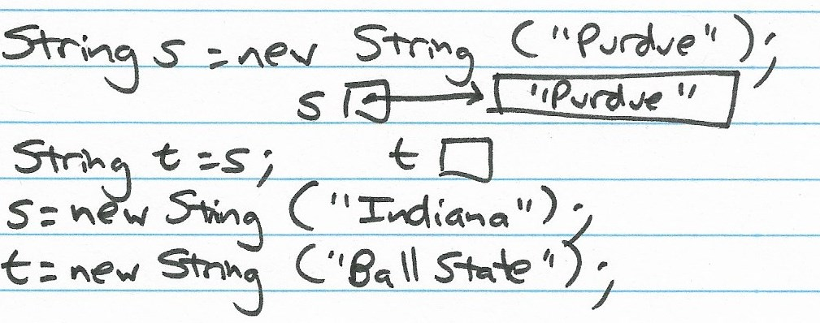
Extent (vs. Scope)

Slide 41
Passing References by Value
Reminder: parameter passing is “by value”
Passing an object reference by value means…
  The “value” is the reference to (address of) the object
  The called method cannot modify the variable where the reference is stored
  But, it can modify the object it references

Slide 42
Example: Reference by Value
public class Danger {
static void modify(Wheel wagon) {
wagon.radius = 22.6; // modifies object referenced by wagon
}
public static void main(String[] args) {
Wheel w = new Wheel (17.5);
System.out.println(w.getRadius());
modify(w);
System.out.println(w.getRadius());
}
}

Slide 43
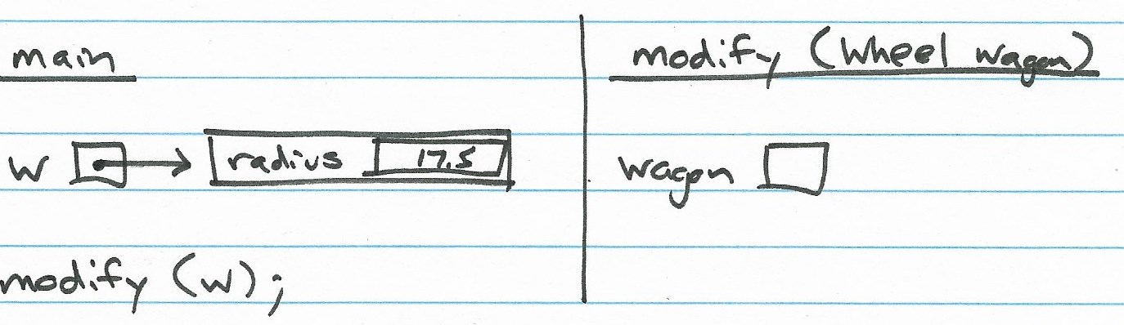
Example: Reference by Value

Slide 44
Overloading Constructors and Methods (1)
Term signature refers to the name and parameter types of a method or constructor
double getPayment (int months, double interestRate)
Each constructor and method in a class must have a unique signature
Same names are OK, but parameter types must be different
double getPayment (int years)
double getPayment ()
double getPayment (int owner, String address)

Slide 45
Overloading Constructors and Methods (2)
Java matches argument types with parameter types to choose the right constructor or method to invoke
Called overloading: we’re overloading the meaning of the method name
Many built-in classes use constructor and method overloading (see println in http://docs.oracle.com/javase/6/docs/api/java/io/PrintStream.html)

Slide 46
Example: Improving isPalindrome
public class Palindrome {
static boolean isPalindrome(String s) {
if (s == null || s.length() <= 1)
return true;
while (s.length() > 1) {
char first = s.charAt(0);
char last = s.charAt(s.length() - 1);
if (first != last)
return false;
s = s.substring(1, s.length() - 1);
}
return true;
}
static boolean isPalindrome(int x) {
return isPalindrome(Integer.toString(x));
}
}

Slide 47
Video 3 this() in Constructors

Slide 48
Special Trick: this() in Constructor
Use this(…) to invoke one constructor from another
Must be first line in current constructor
Java matches argument types to determine which constructor to call
Other constructor returns to calling constructor

Slide 49
Example: PurdueStudent (1)
public class PurdueStudent {
boolean hasName;
String name;
int puid;
// constructor with int...
PurdueStudent(int puid) {
this.puid = puid;
hasName = false;
}
// constructor with String and int...
PurdueStudent(String name, int puid) {
this(puid);
this.name = name;
hasName = true;
}
// [see next slide…]
}

Slide 50
Example: PurdueStudent (2)
public class PurdueStudent {
// [see previous slide…]
void printStudent() {
if (hasName)
System.out.println(name + ": " + puid);
else
System.out.println("(no name): " + puid);
}
public static void main(String[] args) {
// call int-only constructor...
PurdueStudent p1 = new PurdueStudent(1010337138);
// call String-int constructor...
PurdueStudent p2 = new PurdueStudent("Drake", 1123441245);
p1.printStudent();
p2.printStudent();
}
}

Slide 51
Example: Overloader
public class Overloader {
int calc (double x, int y) {
...
return z;}
// valid overload, 3 parameters
int calc (double x, int y, int z) {
...
return z;}
// valid overload, 1 parameter
double calc (double x) {
...
return q;}
// valid overload, 2 parameters, different types
int calc (double x, String s) {
...
return z;}
// INVALID overload, return type is not part of the signature
double calc (double a, int b) {
...
return q;}
}
}

Slide 52
Video 4
Encapsulation

Slide 53
Encapsulation
Java supports team work through encapsulation
A form of information hiding or “need to know”
Encapsulation serves two purposes
  Hides implementation details from other programmers, allowing the author to make changes without affecting other programmers
  Prevents other programmers from modifying certain fields or calling certain methods that might leave the object in an inconsistent or unexpected state

Slide 54
Java Access Modifiers
Can apply to members: fields and methods
Modifiers control access to members from methods in other classes
This list is from least to most restrictive:
Keyword | Restriction
public | None (any other method can access)
protected | Only methods in the class, subclasses, or in classes in the same package can access
[none] | Only methods in the class or in classes in the same package can access (called “package private”)
private | Only methods in the class can access

Slide 55
Conventional Wisdom
Make methods public
  Allows anyone to use them
  They should be written defensively to “protect” the object internal state (i.e., attribute fields)
Make fields private
  Keeps them safe from unexpected changes
  Only your methods can modify them
Constants (“final” fields) can be made public since they can’t be changed anyway

Slide 56
Accessor and Mutator Methods
With fields being private, all access to them from outside the class is via methods
There is no special Java syntax, just naming convention:
  Accessor: “get…” access (read) field in an object
  Mutator: “set…” mutate (change) field in an object
Accessor methods allow read-only access
Mutator methods allow “controlled” change

Slide 57
Better Wheel Class
public class Wheel {
private double radius;
public Wheel(double radius) {
this.radius = radius;
}
public double getCircumference() {
return 2 * Math.PI * radius;
}
public double getArea() {
return Math.PI * radius * radius;
}
public double getRadius() {
return radius;
}
public void setRadius(double r) {
if (r>0 && r<=1000)
radius=r;
}
}

Slide 58
Using Accessor and Mutator Methods
public class Transportation {
public static void main(String[] args) {
Wheel w = new Wheel (17.5);
double circ = w.getCircumference();
double rad = w.radius; // not allowed
double rad = w.getRadius();
w.radius = 15.4; // not allowed
w.setRadius(15.4);
}
}

