Slide 1
Protecting and Securing PLM and Supply Chain Data
Students: Rohit Ranchal and Gen Nishida
PI: Bharat Bhargava ( bbshail@purdue.edu)
PLM Center of Excellence and CERIAS
Computer Sciences
Purdue University
http://www.cs.purdue.edu/homes/rranchal/plm.html

Slide 2
Outline
Project Summary
Motivation
Background
Problem: Information Flow in Supply Chain
  Impacts and Challenges
Related Work
Proposed Approach for Security in Supply chain
  Approach 1: Active Bundle Scheme
  Approach 2: End to End Auditing
Future Plans
Privacy Preserving Identity Exchange

Slide 3
Project Summary/Accomplishments
Proposal
  Protecting and Securing Supply Chain Data throughout its Lifecycle
  Publications (http://www.cs.purdue.edu/homes/rranchal/plm.html)
  Protecting PLM Data throughout their lifecycle (Qshine 2013)
  Secure Information Sharing in Digital Supply Chains (IEEE IACC 2013)
  Poster in CERIAS annual symposium
Prototype
  Active Bundle prototype based on Mobile Agents
  Active Bundle prototype based on JAR file
  Active Bundle prototype improvements using Key splitting and Distributed Hash Tables
  End to End Security software
Proposal submitted to ABB on Information Sharing Security and Visibility in Supply Chain Collaboration
Proposal in progress for submission to NSF

Slide 4

Motivation
Boeing Supply Chain for

Slide 5
Background: Modern Enterprises
Globally distributed operations e.g. Boeing, Cummins, Dow Agro Sciences, Rolls-Royce, GM
Focus on core competencies and outsource auxiliary tasks to partner organizations
Rely on Supply Chain to collaborate with partners in transforming raw materials into products
Use PLM Information Systems to manage the information flow that facilitates the movement of physical product related entities in the supply chain
PLM systems continuously receive, process and share dynamic supply chain information (sensitive data)
  Commercial information shared with advisors and lawyers
  Personally identifiable information about customers and employees
  Intellectual property shared with partners

Slide 6
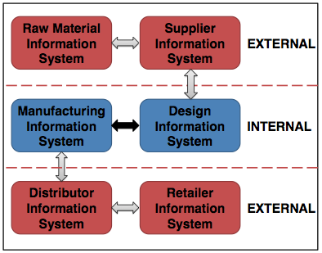
Background: Supply Chain Interaction
Information Flow in Supply Chain

Slide 7
Information Flow in Supply Chain
Globally distributed supply chain processes
Information not confined to a single domain but distributed among and controlled by multiple partners
Outsourcing of shared information by partner organizations
No way to track the information access and usage in external domain (organization has no control over the processes in external domain)
Intermediate steps of information flow might expose information to hostile threats
Unauthorized disclosure and data leakage of information shared among partners across multiple domains
Violations and malicious activities in a trusted domain remain undetected

Slide 8
Impact of Security Threats
Leakage of sensitive information - list of customers, product design secrets, pricing, etc. to competitors, malicious entities, government institutions or attackers
  High financial and losses
  Damage to the reputation of organization and its partners
  Criminal activities leading to delay in manufacturing and delivery
  Impact on National Security

Slide 9
Challenges for Supply Chain Security
Lack of mechanisms to communicate information owner’s policies to the protection frameworks of the partners
Lack of information sharing standards for protecting data in distributed supply chains
  Custom security requirements and controls applied by partners
  Incompatibility and reduced ability to ensure policy enforcement leaves security gaps
Disparate, evolving and changing Information security standards to satisfy changing business models, regulatory and geographical law requirements

Slide 10
Related Work
Generalized approach to protect shared data
  Secure data e.g. using encryption
  Define Policies for data sharing and usage e.g. access control policies
  Setup Policy enforcement mechanism to enforce policies on data
Classification of available solutions
  Policy Enforcement at the Sender
  Policy Enforcement in the middle
  Policy Enforcement at the Receiver

Slide 11
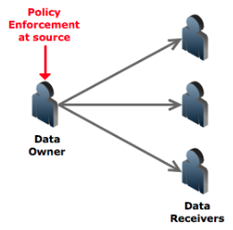
Related Work
Policy enforcement at owner
Traditional approach – uses encryption for protection (interactive protocols) e.g. Servers
A lot of exchange of messages
Source can become bottleneck
Problem if source becomes unavailable
Digibox [5] – uses multiple keys

Slide 12
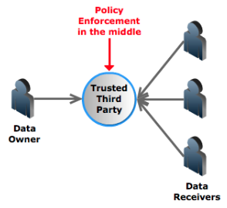
Related Work
Policy enforcement in the middle
Trusted Third Party – e.g. pub/sub
Single point of trust and failure
Information aggregation - caches and stores data
Can sell data to interested parties
Data disclosure during Subpoenas
Prone to hacking attacks and insider abuse
Casassa Mont et al [9] – uses time vault service

Slide 13
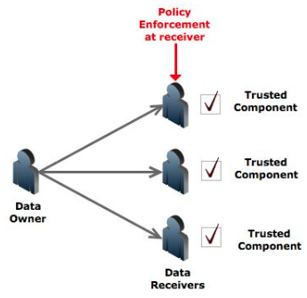
Related Work
Policy enforcement at receiver
Requires a Trusted component
Eg – Digital Rights Management solutions, Document-sharing solutions - Adobe, Microsoft etc
Distribution issues of Trusted component
Restricted to known/trusted hosts
Montero et al [6] – uses sticky policies

Slide 14
Proposed Approach
Existing approaches that rely on the use of standards, service level agreements, and legal contracts are insufficient
Propose an end-to-end approach for protecting shared data in digital supply chains
  Self-protecting data centric approach for policy based controlled data dissemination
  Security auditing of business processes that compose supply chains
  Enables tracking the information flows of shared data
  Detecting malicious interactions and compromised business processes of partners
  Tracks the data flow and actions upon them and enables auditing, detecting and reporting policy violations

Slide 15
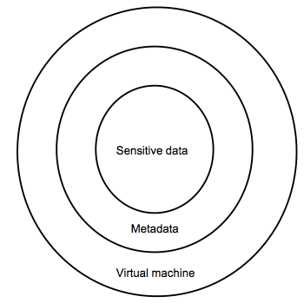
Approach 1: Self-Protecting Data
Active bundle (AB) [12, 13]
    Encapsulation mechanism for protecting data
    Includes metadata for controlled dissemination
    Includes Virtual Machine
      Policy enforcement mechanism
      Protection mechanism
Active Bundle Operations
    Self-Integrity check
    Filtering
      Selective dissemination based on policies
    Apoptosis
      Self-destructs AB completely

Slide 16
What is Active Bundle
An active bundle is a container with a payload of sensitive data, metadata (including, among others, privacy policies), and a virtual machine (VM) specific to the active bundle. We show that data, encapsulated
within active bundles can protect their own confidentiality. ABs protect privacy of sensitive data through:
assuring enforcement of data privacy policy by the VM from the active bundle that includes the data;
relying on host trustworthiness to activate protection mechanisms when data are tampered with; and
recording all data-related activities by the VM.
AB scheme ensures (1) encrypting sensitive data and storing decryption keys at a TTP; (2) signing data to ensure their integrity; (3) activating apoptosis when a host receiving the bundle is not allowed to access any portion of active bundle’s data due to its sufficient trust level; (4) decrypting data, checking integrity of data and simulating enforcement of privacy policies when the receiving host is allowed to access a portion or all data; (5) collecting audit information and storing it by the Audit Service Agent on a TTP.

Slide 17
AB Implementation
    AB based on Mobile Agent Framework Jade
      AB sent as a Mobile Agent
      Mobile Agent is a software object able to perform computations on visited hosts, transport itself from one host to another, and interact with and use capabilities of visited hosts
      Java sensitive data, metadata for policies and code for the VM of active bundle
      Trusted Third Party for crypto keys, trust and audit
    AB based on a JAR file
      AB sent as a JAR file
      Java archive (JAR) file represents the nested structure of active bundles.
      Java code as VM of the active bundle
      Privacy policy file as Metadata
      Sensitive data as a document (PDF file)

Slide 18
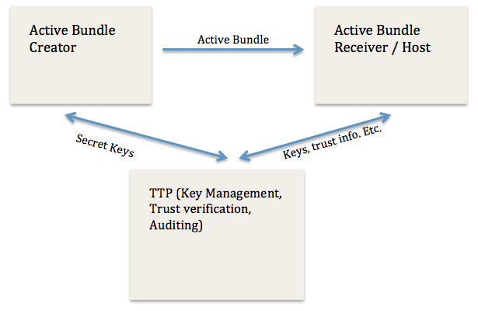
AB based on TTP [13]

Slide 19













AB based on TTP [13]
AB information disclosure
Active Bundle Destination
User Application
Active Bundle
Active Bundle Creator
Active
Bundle (AB)
Security Services
Agent (SSA)
Audit Services
Agent (ASA)
Directory
Facilitator
Trust Evaluation
Agent (TEA)
Active Bundle Coordinator
Active Bundle Services

Slide 20
Enabling AB

Slide 21
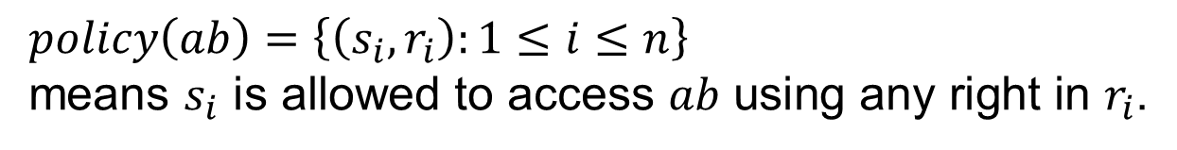
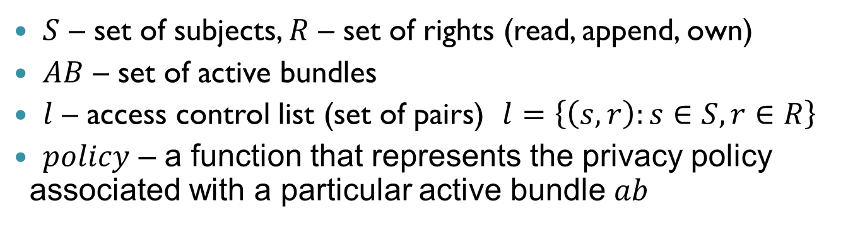
AB Formal Access Control Model
  $S$ – set of subjects, $R$ – set of rights (read, append, own)
  $AB$ – set of active bundles
  $l$ – access control list (set of pairs) $l=\left\{\left(s,r\right):s∈S, r∈R\right\}$
  $policy$ – a function that represents the privacy policy associated with a particular active bundle $ab$
$policy\left(ab\right)=\left\{\left(s_{i},r_{i}\right):1≤i≤n\right\}$
means $s_{i} \text{is} \text{allowed} \text{to} \text{access} ab \text{using} \text{any} \text{right} \text{in} r_{i}$.

Slide 22







AB Updates
  Supply Chain entities in the information flow receive AB and update its information
  Scenario – 1: Send update request to owner
Distributor
Retailer
Sensitive data
Information addition
Sensitive data

Slide 23
Problems with updating an AB
    Advantage
      Simple
      The owner can control every update
    Disadvantage
      The update request may be rejected or partially rejected by the owner
      The new privacy policy for the updated AB is created by the owner which may conflict with the updater’s policy
      The updater may not want the original owner to know the appended data
      The owner may get a lot of requests for updates

Slide 24











AB Update Solution
Nested Structure
An active bundle autonomously grows into a bigger active bundle including both the original active bundle and the appended information with new metadata and virtual machine
$${AB}_{P}$$
$$a, b$$
$$a, b$$
Sensitive data
$$x, y$$
Sensitive data
$${MD}_{P}$$
Appended
information
$${MD}_{P}$$
$${VM}_{P}$$
$${VM}_{P}$$
$${MD}_{D}$$
$${VM}_{D}$$

Slide 25
Experiments
File Size
Creation Time
[MB]
Updates
[sec]
Updates

Slide 26
AB Update Solution
      Advantage
    Any entity with the permission to append information can append and specify the new privacy policy for the appended information
    Existing policies are still effective on the existing data and new policies are only enforced on the appended data and the existing data
    The nested structure of an active bundle naturally represents the history of updates
      Disadvantage
    AB’s size grows linearly with every update
    The new policies may be more restrictive than the original policies which may restrict access to the original data
    Possible Solution: VMs of Nested ABs are redundant. A single common VM can serve all Nested ABs

Slide 27
Improving the AB Implementation
Improve the AB implementation by making it less dependent on TTP
Provide a mechanism for policy based selective dissemination
Use a policy language to define policies
Providing resilience against malicious hosts
Application specific development and experimentation

Slide 28
Improving AB Implementation
Provide selective dissemination
  Organize data in AB into separate items
  Encrypt each item with a different key
Decrease dependence on TTP
  Use Shamir’s threshold secret sharing technique [16] to split each of the decryption keys into N shares
  Set a threshold t such that t shares are required for key reconstruction
  Store the key shares in a distributed hash table (DHT) built on top of P2P system (Vuze) [26]
  Each share is stored at a random node

Slide 29
Implementation
The implementation consists of an Active Bundle “Creator” that creates an Active Bundle. The key used to encrypt the data is split into shares and the shares are stored in the DHT. Then, the creator passes the cipher text, the seed of PRNG, and the number of shares needed to generate the original encryption key. The receiver then retrieves the key shares to generate the original key and decrypt the cipher text.

Slide 30
Split the data and create new keys
Distributed Key Management Infrastructure makes the key management infrastructure more resilient and secure. One idea is to release the data in parts, with each part being more fine grained than the previous. The active bundle receiver has to interpret the contents of the data in a correct manner and send it back to the creator to get the next part. A correct interpretation would indicate that the person was authorized to view it. A wrong interpretation leads to either denial or receiving diluted data.

Slide 31
Experiences and Implementation Details
Experiences and Implementation Details
We implemented the new architecture in Java. For the DHT we used Bamboo DHT nodes [3]. Bamboo DHT was developed in UC Berkeley and has the Pastry DHT as its underlying protocol.

Slide 32
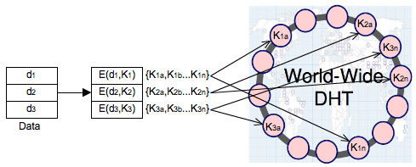
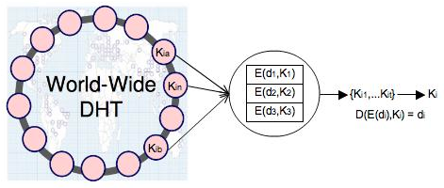
DHT scheme for AB
AB Key distribution
AB Key reconstruction

Slide 33
Advantages of using DHT
Distributed Key Management Infrastructure – more resilient and secure
Huge scale - millions of geographically distributed nodes
Decentralized – individually owned nodes with no single point of trust
Load reduction and Asynchronous communication – no synchronization issues
Hard to deduce all the shares (at least t)
Hard to compromise all the nodes that store the shares
User-specified Active Bundle Time To Live (TTL)
Use periodic splitting to protect against dynamic adversaries

Slide 34
Measurement
We ran the DHT nodes as processes on a local machine. The Active Bundle Creator and Receiver ran as processes on the same machine. Since, the DHT is a new addition to the AB architecture we decided to measure the delay in storing (put) and retrieving (get) values from the DHT. We ran 20, 25 and 30 DHT nodes. We used 10 key shares. The following are the average put and get times.

Slide 35
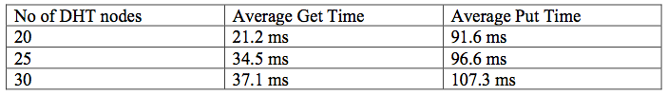
Improvement in DHT
DHT Implementation
  Setup based on open source Bamboo DHT [18]
  Uses the Pastry DHT as its underlying protocol
DHT loses key shares over time
  Nodes crash or leave
  Need to republish the shares for availability
  Use a hybrid DHT (combination of reliable* DHT and public DHT) [26]
  Average time to store and retrieve values from DHT using 10 key shares

Slide 36
AB Policies
Extend the AB approach with a formal language for specifying policies
Need efficient policy negotiation mechanism
OASIS eXtensible Access Control Markup Language (XACML) [17]
Role Based Access Control (RBAC) [18]

Slide 37
Protection against Malicious Hosts
Use TPM [7] to ensure that host is not already compromised
Perform code obfuscation – hide data and real program code within a scrambled code
Intertwine code and data together – hide data within the code to make it incomprehensible
Use of polymorphic code [25] – code changes itself each time it runs but its semantics don't change
Can store the control flow information in random DHT nodes

Slide 38
Active Bundles Capabilities
Capabilities
Controlled and Selective Dissemination: Control the dissemination and selectively share the data based on the policies
Quantifiable and Contextual Data Dissemination: Track the amount of data disclosed to a particular host and decide to further disclose or deny data requests
Dynamic Metadata Adjustment: Update the policies based on a context, host, history of interactions, trust level etc.

Slide 39
Active Bundles Advantages
Do not require hosts to have a policy enforcement engine or a trusted component
Doesn’t rely on a dedicated TTP
No trusted destination host assumption – works on unknown hosts
Decentralized Distributed Asynchronous communication

Slide 40
Approach 2: End to End Auditing
Trust Broker
  Trusted third party responsible for maintaining end-to-end auditing in information flow chain
  Maintains a list of certified business processes that use the Taint Analysis Module and ensure their compliance with the required security controls
  Manages end-to-end client/process-invocation session
Taint Analysis
  Low level layer that monitors the interactions of business processes (at runtime)
  Inspects the data exchanges (information flow) and reports policy violations

Slide 41
Trust Broker
Certifies business processes upon certification by an external trusted authority
  Certification assures that the business process allows tracking of information flow and ensures secure messaging
Maintains an end-to-end session of business processes’ interactions
  Collects and audits the activities of the business processes of the collaborating partners
  Logs warnings of illegal interactions and informs the client process about the detected violation

Slide 42
Taint Analysis
Independent of processes
  No need to change the processes or access the source code of processes
  Interception of process execution (Process remains transparent)
  Uses program instrumentation to gain control upon the occurrence of certain events
Two possible deployment options
  Only in Trusted Domains
    Detection of insider attacks
    Detection of compromised processes
    Detection of outbound interactions
  In Public Domains
    Enforcing service composition policies

Slide 43
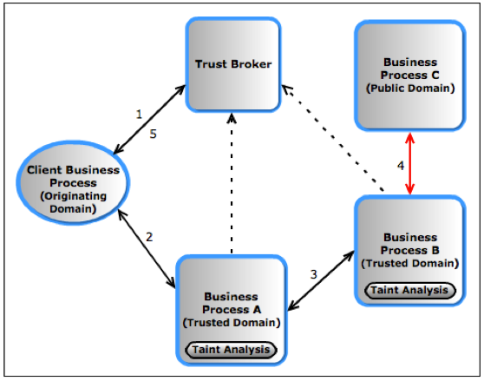
Secure Supply Chain Interaction using the Approach

Slide 44
Information Flow using the Approach
Client Business Process decides sharing information with a Trusted Business Process A and requests a session in the Trust Broker (TB) to keep track of this interaction’s activities for end-to-end information flow
Client Business Process shares information with Trusted Business Process A
Trusted Business Process A uses this information and shares it with Trusted Business Process B. During this exchange, the Taint Analysis (TA) module intercepts the communications and reports any illegal external interaction to the TB
Trusted Business Process B shares data with (possibly untrusted) Public Business Process C. TA detects the interaction and reports the activity to TB
TB informs the Client Business Process about the activity of Trusted Business process B

Slide 45
Capabilities of the Approach
Controlled information sharing
Information flow tracking
Monitoring information usage and detecting illegal sharing
No interference between the security mechanisms and supply chain operations
Scalable and reliable to be used for large supply chains
Reporting unauthorized information usage and disclosure by entities while in transit between the partners

Slide 46
Future Plans
Extend the AB prototype with the proposed enhancements
  How variations in splitting affects the performance of the system (Average Refresh time for shares)
  Effect of using multiple DHTs on the performance
Adapt the scheme for an application specific scenario of PLM/Supply Chain
Performance evaluation of the scheme under varying network conditions
  Compare the size of an active bundle with data size in other approaches
  Compare the time of the AB scheme with other approaches
Notes:
We have previously proposed the use of active bundles for identity management in the cloud [26, 27] and secure data sharing in a peer-to-peer network of AVs [28] which enables selective data disclosure based on the trustworthiness of the platform. Initially, we presented Smart Home systems as a motivation. In the future, we plan to adapt AB approach and develop experiments for protecting confidentiality of data in such applications. Further we plan to measure performance of AB scheme in different deployments setups. We will compare the size of an active bundle with data size in other approaches and will also measure how the number of created active bundles affects performance of the whole system.

Slide 47
Ongoing Research
The security mechanisms should not interfere with the supply chain operations. They should be scalable and reliable in order to support large supply chains.
Algorithms for privacy preserving and secure data dissemination in various scenarios including data from UAV’s to command and control in Air Force research laboratory. We have already developed a prototype for end to end security in large system that uses web services for data flow. It included identity management, taint analysis, and dealing with untrusted services.

Slide 48
Deliverables
Deliverables to be provided to IAB members:
System design and architecture, prototype implementation, measurements and results
from experiments, project report.

Slide 49
Privacy Preservation of Identities in an Information Flow Chain using Approach 1 (Active Bundle Scheme)
Related Publications
Protection of Identity Information in Cloud Computing without Trusted Third Party. R. Ranchal, B. Bhargava, L.B. Othmane, L. Lilien, A. Kim, M. Kang, In Proceedings of IEEE SRDS 2010.
An Entity-Centric Approach for Privacy and Identity Management in Cloud Computing. P. Angin, B. Bhargava, R. Ranchal, N. Singh, L. Lilien, L.B. Othmane, In Proceedings of IEEE SRDS 2010.

Slide 50






Identity Management using AB
User initiating request
Name
E-mail
Password
Billing Address
Shipping Address
Credit Card
Name
Billing Address
Credit Card
Name
E-mail
Password
Billing Address
Shipping Address
Credit Card
Name
E-mail
Shipping Address
Name
E-mail
Shipping Address

Slide 51
Identity Management using AB
User on Amazon Cloud
Name
E-mail
Password
Billing Address
Shipping Address
Credit Card
Name
Billing Address
Credit Card
Name
E-mail
Password
Billing Address
Shipping Address
Credit Card
Name
E-mail
Shipping Address
Name
E-mail
Shipping Address

Slide 52
Identity Management (IDM)
IDM in traditional application-centric IDM model
  Each service keeps track of identifying information of its users.
Existing IDM Systems
  Microsoft Windows CardSpace [W. A. Alrodhan]
  OpenID [http://openid.net]
  PRIME [S. F. Hubner, Karlstad Univ]
These systems require a trusted third party and do not work on an untrusted host.
If Trusted Third Party is compromised, all the identifying information of the users is also compromised leading to serious problems like Identity Theft.

Slide 53
IDM in Supply Chain
Information chain introduces several issues to IDM
  Collusion between entities in chain
    Users have multiple accounts associated with multiple entities in the chain.
    Sharing sensitive identity information between entities can lead to undesirable mapping of the identities to the user.
  Lack of trust
    Hosts in the chain can be unknown/untrusted
    Use of Trusted Third Party is not an option
  Loss of control
    Outsourcing of request and information
IDM needs to be user-centric

Slide 54
Goals of Proposed User-Centric IDM
Authenticate without disclosing identifying information
Ability to securely interact with an entity while on an untrusted host (VM on the cloud)
Minimal disclosure and minimized risk of disclosure during communication between user and chain entities
Independence of Trusted Third Party

Slide 55
Active Bundle Scheme
  Metadata:
    Access control policies
    Data integrity checks
    Dissemination policies
    Life duration
    ID of a trust server
    ID of a security server
    App-dependent information
    …
E(Name)
E(E-mail)
E(Password)
E(Shipping Address)
E(Billing Address)
E(Credit Card)
…
  Sensitive Data:
    Identity Information
    ...
  Virtual Machine (algorithm):
    Interprets metadata
    Checks active bundle integrity
    Enforces access and dissemination control policies
    …
* E( ) - Encrypted Information

Slide 56
Anonymous Identification
  Use of Zero-knowledge proofing for user authentication without disclosing its identifier.
User initiating request
ZKP Interactive Protocol
User Request for service
Function f and number k
E-mail
Password
f_{k}(E-mail, Password) = R
E-mail
Password
Authenticated

Slide 57
Verification of Encrypted Data
  Verification without disclosing unencrypted identity data.
  Use ZKP or predicates over encrypted data
Predicate Request*
E-mail
Password
E(Name)
E(Shipping Address)
E(Billing Address)
E(Credit Card)
E(Name)
E(E-mail)
E(Password)
E(Shipping Address)
E(Billing Address)
E(Credit Card)
…
  *Age Verification Request
  *Credit Card Verification Request

Slide 58
Verification of Encrypted Data
  To become independent of a trusted third party
    Multiple nodes hold shares of the secret key
    Minimize the risk
Predicate Reply*
Name
Billing Address
Credit Card
K’₁
K’₂
K’₃
K’_{n}
DHT
  *Age Verified
  *Credit Card Verified

Slide 59
Selective Disclosure
  User Policies in the Active Bundle dictate dissemination
Selective disclosure*
E-mail
E(Name)
E(Password)
E(Shipping Address)
E(Billing Address)
E(Credit Card)
…
*e-bay shares the AB with the seller

Slide 60
Selective Disclosure
Selective disclosure*
Name
E(E-mail)
E(Password)
Shipping Address
E(Billing Address)
E(Credit Card)
…
*e-bay seller shares the AB with the shipping company
*AB selectively discloses the information with shipping company based on the policies

Slide 61
Selective Disclosure
Selective disclosure
Name
Shipping Address
  Fed-Ex can now send the package to the user

Slide 62
Identity Management using AB
User on Amazon Cloud
E-mail
Password
Name
Billing Address
Credit Card
Name
E-mail
Password
Billing Address
Shipping Address
Credit Card
E-mail
Name
Shipping Address

Slide 63
Characteristics and Advantages
Ability to use Identity data on untrusted hosts
  Self Integrity Check
  Integrity compromised- apoptosis
  Selectively disclose data
Establishes the trust of users in IDM
  Through putting the user in control of who has his data and how it is used
Independent of Third Party
  Prevents correlation attacks
Minimal disclosure to the SP
  SP receives only necessary information.

Slide 64
References
R. Shirey, “Internet Security Glossary, Version 2,” The Internet Engineering Task Force (IETF), RFC4949, August 2007. Online at http://tools.ietf.org/html/rfc4949
“iPad Mini Heist: $1.5 Million Stash Of Apple Devices Reportedly Stolen From JFK Airport,” Nov. 2012, online at: http://www.huffingtonpost.com/2012/11/15/ipad-mini-heist-million- stolen-jfk-airport_n_2137799.html
“Hackers attack Foxconn for the laughs,” Feb. 2012, online at: http://www.macworld.com/article/1165298/foxconn_reportedly_hacked _by_group_critical_of_working_conditions.html
H. Livingston, T. Telesco, L. Gardner, R. Loeslein, E. Zelinski, and W. Pumford, “Counterfeit Parts Safeguards and Reporting – U.S. Government and Industry Collaboration to Combat the Threat,” Defense Standardization Journal, pp.9-16, Jan/Mar 2010.
“Verizon 2012 Data Breach Investigations Report,” http://www.verizonbusiness.com/resources/reports/rp_data-breach- investigations-report-2012_en_xg.pdf?CMP=DMC- SMB_Z_ZZ_ZZ_Z_TV_N_Z037
World Economic Forum, “New Models for Addressing Supply Chain and Transport Risk,” 2011.
Insider Threat Center at Cert, “Examining Insider Threat Risk at the US Citizenship and Immigration Services,” Dec. 2010, online at: http://www.dhs.gov/xoig/assets/mgmtrpts/OIG_11-33_Jan11.pdf
N. Browne, M. de Crespigny, J. Reavis, K. Roemer, and R. Samani, “Business Assurance for the 21st Century: Navigating the Information Assurance landscape,” white paper, Information Security Forum, 2011.

Slide 65
References
B. Fabian, and O. Günther, “Security Challenges of the EPCglobal Network,” Communications of the ACM, v.52 n.7, July 2009.
M. Swanson, N. Bartol, and R. Moorthy, “Piloting Supply Chain Risk Management Practices for Federal Information Systems,” Draft NISTIR 7622. NIST, 2010.
M. Atallah, H. Elmongui, V. Deshpande, and L. Schwarz, "Secure supply-chain protocols," in IEEE International Conference on E- Commerce, pp. 293-302, 2003.
R. Ranchal, and B. Bhargava, “Protecting PLM data throughout their lifecycle,” in 9th International Conference on Heterogeneous Networking for Quality, Reliability, Security and Robustness (Qshine), 2013.
M. Azarmi, B. Bhargava, P. Angin, R. Ranchal, N. Ahmed, A. Sinclair, M. Linderman, and L. ben Othmane, “An End-to-End Security Auditing Approach for Service Oriented Architecture,” In 31st IEEE Symposium on Reliable Distributed Systems (SRDS), 2012.
G. Kiczales, J. Lamping, A. Mendhekar, C. Maeda, C. Lopes, J. Loingtier, and J. Irwin, “Aspect-oriented programming,” European Conference on Object-Oriented Programming (ECOOP’97), pp. 220– 242, 1997.
L. Othmane, and L. Lilien, “Protecting Privacy in Sensitive Data Dissemination with Active Bundles,” In The 7th Annual Conference on Privacy, Security and Trust, Saint John, NB, Canada, 2009.
L. ben Othmane, “Active bundles for protecting confidentiality of sensitive data throughout their lifecycle,” Theses, Western Michigan University Kalamazoo, MI, USA, December 2010.

Slide 66
References
Sean Rhea, Brighten Godfrey, Brad Karp, John Kubiatowicz, Sylvia Ratnasamy, Scott Shenker, Ion Stoica, and Harlan Yu.OpenDHT: A Public DHT Service and Its
Uses. Proceedings of ACM SIGCOMM 2005, August 2005.
Boeing Supply Chain. http://supply-chain-data-mgmt.blogspot.in/2012/10/the-size-of-boeings-supply.html
GM Supply Chain. http://www.nsf.gov/about/history/nsf0050/manufacturing/supply.htm
Honda Sully Chain. http://www.scribd.com/doc/29977840/Supply-Chain-Management-Principles-and-Practices-at-Honda
Rolls-Royce Supply Chain. http://www.rolls-royce.com/Images/SO_Supply%20Chain%20Management_tcm92-24001.pdf
Cummins Supply Chain. http://supplier.cummins.com/wps/portal/SupplierPortal/SupplierHome/StandardsAndProcesses/SupplyChain
Boeing Supply Chain. http://supply-chain-data-mgmt.blogspot.com/2012/10/the-size-of-boeings-supply.html
Boing Images of Supply Chain. https://www.google.com/search?q=supply+chain+management+boeing+787&client=firefox-a&hs=g9X&rls=org.mozilla:en-US:official&tbm=isch&tbo=u&source=univ&sa=X&ei=AEK7Udq4EMmgqwHU44CoCA&ved=0CF8QsAQ&biw=1280&bih=630

