Slide 1
Measures of Readiness/Success in Cyber Warfare and Network Reliability/Security
Bharat Bhargava
Purdue University
bbshail@purdue.edu

Slide 2
Collaborators
Benny Cheng
Louis Joseph
Iris Kaneshiro

Slide 3
Focus of Research
Identify measures for cyber operations and warfare readiness
Effects of reliability considering failures and attacks on readiness and mission assurance
Identify attacks on computer networks and how to deal with them
How to build adaptable system that can degrade gracefully, increase maintainability, and deal with adversity
How to deal with vulnerabilities and threats
How to test for effects of failures on cyber systems such as ship network and missile network
Plan to deal with permanent/intermittent failures and attacks (coordinated, incognito, persistent) or frauds

Slide 4
Quality of Service (QoS) Parameters
Service level Agreements (SLA)
Timeliness, Accuracy, and Precision ( TAP) of information flow
Connectivity, Latency, Loss of messages, Packet delivery ratio in network
Access control violation, Mistaken identity, Loss of privacy, Leakage of data
Service availability to shipboard users, Volume of user requests satisfied, Availability of individual services, Impact of these service on various missions
User-perceived service availability, Number of users who lose service
Types, Duration, Timing, Extent, Severity of Cyber Attacks that can be defended
Capability for Adaptability, Cost and benefits of dynamic reconfiguration
Analytical, Simulation, Emulation and Real execution comparisons on QoS parameters
Under what situations, what is the loss of reliability, availability ,and readiness and impact on ship
Capability for automatic and comprehensive defense and attacks
Operation preparedness and evaluation tools

Slide 8
Parameters of Interest
Number or percentage of good nodes
Number of percentage bad nodes
Number of active bad nodes
Number of idle bad nodes
Number of evicted ( bypassed) bad nodes
Random attacker, Persistent attacker, insidious attacker
Per node IDS-Probabilities of ( false positive and false negative)

Slide 9
Parameters of Interest
Randon attack probability by a random attacker
Attack probability
Impairment rate for an attacker to cause severe functional impairement

Slide 10
Measures and Effects
System minimum compliance threshold
Minimum threshold set by the system for a persistent attack
Compliance degree of a bad node, good node, arbitrary node

Slide 11
Security Failure Conditions
If one third or more of the nodes are compromised, then the system fails. The reason is that consensus is no more possible.
Compromised node performing active attack without being impacted can impair the functionality and cause the system to fail.
Impairment failure is modeled by defining an impairment-failure attack period by a compromised node beyond which the system cannot sustain the damage.

Slide 12
Byzantine failure
This is defined as a failure whose actions can not be predicted. The failure disappears suddenly, reappears and behaves in multiple modes. So nothing can be believed about the data and consensus is not possible

Slide 13
Behavior of Attacks
Source of attack ( Is it from a specific country whose capabilities are known and understood?). Is it from an internal source or external? Do we know the communication channel that the attacker is using? Do we know what communication characteristics are needed for the attacker to reach our critical infrastructure?

Slide 14
Types of Attack
Malware Distribution: Hackers with malicious intent can exploit your email client by distributing malware through email messages. The malware includes viruses, worms, rootkits, Trojans, keyloggers, spyware, and adware, to name a few types. The malware is distributed via an email attachment or sometimes by simply opening an email message. More often than not, the mail message is disguised as a message from someone you know when in reality; it is sent by the hacker.
Phishing Attack: A phishing attack is generally not hazardous to the inner workings of your PC however; it is designed to trick you into revealing your personal information, passwords, or bank account information. For example, if you use PayPal, the phisher sends you a message that looks like it came from PayPal. The message requests you to verify your account information with PayPal to continue using your account. The message proceeds to tell you that if you do not verify the information your account will be closed. Someone that is unaware of phishing scams easily gets tricked into revealing their account information. These types of messages are set up to look like the real deal.
Spam Attack: Spam is unsolicited email or "junk" mail that you receive in your Inbox. Spam generally contains advertisements but it can also contain malicious files. When you click on spam, the files are downloaded into your email client and into your PC. The same thing can happen if you reply to spam in an attempt to get removed from the list.

Slide 15
Types of Attacks
Denial of Service Attack: A denial of service attack occurs when the hacker sends multitudes of email messages to your email client in an effort to block you from using your email client or crashing your computer altogether. In the case of an organization, a denial of service attack on email can crash an entire network and prevent the users from responding to legitimate traffic.
Eavesdropping - This is the process of listening in or overhearing parts of a conversation. It also includes attackers listening in on your network traffic. Its generally a passive attack, for example, a coworker may overhear your dinner plans because your speaker phone is set too loud. The opportunity to overhear a conversation is coupled with the carelessness of the parties in the conversation.
Snooping - This is when someone looks through your files in the hopes of finding something interesting whether it is electronic or on paper. In the case of physical snooping people might inspect your dumpster, recycling bins, or even your file cabinets; they can look under your keyboard for post-It-notes, or look for scraps of paper tracked to your bulletin board. Computer snooping on the other hand, involves someone searching through your electronic files trying to find something interesting.
Interception - This can be either an active or passive process. In a networked environment, a passive interception might involve someone who routinely monitors network traffic. Active interception might include putting a computer system between sender and receiver to capture information as it is sent. From the perspective of interception, this process is covert. The last thing a person on an intercept mission wants is to be discovered. Intercept missions can occur for years without the knowledge of the intercept parties.

Slide 16
Types of Attacks
Modification Attacks - This involves the deletion, insertion, or alteration of information in an unauthorized manner that is intended to appear genuine to the user. These attacks can be very hard to detect. The motivation of this type of attack may be to plant information, change grades in a class, alter credit card records, or something similar. Website defacements are a common form of modification attacks.
Repudiation Attacks - This makes data or information to appear to be invalid or misleading (Which can even be worse). For example, someone might access your email server and inflammatory information to others under the guise of one of your top managers. This information might prove embarrassing to your company and possibly do irreparable harm. This type of attack is fairly easy to accomplish because most email systems don't check outbound email for validity. Repudiation attacks like modification attacks usually begin as access attacks.

Slide 17
Types of Attacks
Denial-of-service Attacks - They prevent access to resources by users by users authorized to use those resources. An attacker may try to bring down an e-commerce website to prevent or deny usage by legitimate customers. DoS attacks are common on the internet, where they have hit large companies such as Amazon, Microsoft, and AT&T. These attacks are often widely publicized in the media. Several types of attacks can occur in this category. These attacks can deny access to information, applications, systems, or communications. A DoS attack on a system crashes the operation system (a simple reboot may restore the server to normal operation). A common DoS attack is to open as many TCP sessions as possible; This type of attack is called TCP SYN flood DoS attack. Two of the most common are the ping of death and the buffer overflow attack. The ping of death operates by sending Internet control message protocol (ICMP) packets that are larger than the system can handle. Buffer overflow attacks attempt to put more data into the buffer than it can handle. Code red, slapper and slammer are attacks that took advantage of buffer overflows, sPing is an example of ping of death.

Slide 18
Types of Attacks
Distributed Denial-of-service Attacks - This is similar to a DoS attack. This type of attack amplifies the concepts of DoS attacks by using multiple computer systems to conduct the attack against a single organization. These attacks exploit the inherent weaknesses of dedicated networks such as DSL and Cable. These permanently attached systems have little, if any, protection. The attacker can load an attack program onto dozens or even hundreds of computer systems that use DSL or Cable modems. The attack program lies dormant on these computers until they get attack signal from the master computer. This signal triggers these systems which launch an attack simultaneously on the target network or system.
Back door Attacks - This can have two different meanings, the original term back door referred to troubleshooting and developer hooks into systems. During the development of a complicated operating system or application, programmers add back doors or maintenance hooks. These back doors allow them to examine operations inside the code while the program is running. The second type of back door refers to gaining access to a network and inserting a program or utility that creates an entrance for an attacker. The program may allow a certain user to log in without a password or gain administrative privileges. A number of tools exist to create a back door attack such as, Back Orifice (Which has been updated to work with windows server 2003 as well as erlier versions), Subseven,NetBus, and NetDevil. There are many more. Fortunately, most anti-virus software will recognize these attacks.

Slide 19
Types of Attacks
Spoofing Attacks - This is an attempt by someone or something to masquerade as someone else. This type of attack is usually considered as an access attack. The most popular spoofing attacks today are IP spoofing and DNS spoofing. The goal of IP spoofing is to make the data look like it came from a trusted host when it really didn't. With DNS spoofing, The DNS server is given information about a name server that it thinks is legitimate when it isn't. This can send users to a website other than the one they wanted to go to.
Man-in-the-Middle Attacks - This can be fairly sophisticated, This type of attack is also an access attack, but it can be used as the starting point of a modification attack. This involves placing a piece of software between a server and the user that neither the server administrators nor the user are aware of. This software intercepts data and then send the information to the server as if nothing is wrong. The server responds back to the software, thinking it's communicating with the legitimate client. The attacking software continues sending information to the server and so forth.
Replay Attacks - These are becoming quite common, This occur when information is captured over a network. Replay attacks are used for access or modification attacks. In a distributed environment, logon and password information is sent over the network between the client and the authentication system. The attacker can capture this information and replay it later. This can also occur security certificates from systems such as kerberos: The attacker resubmits the certificate, hoping to be validated by the authentication system, and circumvent any time sensitivity.

Slide 20
Types of Attacks
Collusive attacks- Multiple attacks from multiple sources collaborate ( intentionally or unintentionally) to increase damage at faster pace ( speed)

Slide 21
Extent of Attack
Is the attack causing the mission to fail?
Is the attack causing only superficial ( at the periphery of the network at non critical nodes)
Is the attack penetrating the system and moving close to critical components?
Is the attack affecting multiple routes ( paths) in the network?

Slide 22
Duration of Attack
Is it a one time attack that disappears ( goes away in a short period of time)?
Is it a persistent attack that stays in system unless removed or dealt with ?
Does it cause other attacks to succeed (through cascade) and thus has a long term effect?
Does it escape detection time period?

Slide 23
Network Reliability
Network reliability refers to the reliability of the overall network to provide communication in the event of failure of a component or components in the network
The term fault-tolerant is used to refer to how reliable a particular component (element) of a network is (e.g., a switch or a router).
The term fault-tolerant network, on the other hand, refers to how resilient the network is against the failure of a component.

Slide 24
Network Reliability Considerations
Communication network reliability depends on the sustainability of both hardware and software. A variety of network failures, lasting from a few seconds to days depending on the failure, is possible.
Traditionally, such failures were primarily from hardware malfunctions that result in downtime (or “outage period") of a network element (a node or a link). Thus, the emphasis has been on the element-level network availability and, in turn, the determination of overall network availability.
However, other types of major outages have received much attention in recent years. Such incidents include accidental fire, fiber cable cut, natural disasters, and malicious cyber attack (both hardware and software).
These major failures need more than what is traditionally addressed through network availability.

Slide 25
Dealing with failure or attack
Failures can drop a significant number of existing network connections.
The network is required to have the ability to detect a fault/misbehaving link/node and isolate/bypass it.
The network must reconnect or reroute the packets through a slow/longer or less trusted or secured route.
The network may not have enough capacity and capability to handle such a major simultaneous “reconnect" phase. Security officer may need to stop communication manually or agree to support degraded or partial services.
Redundancy and adaptability underlies all approaches

Slide 26
Adaptability and Dynamic Reconfiguration
The challenge in adaptability is to configure set of components that conform to the security policy requirements. A dynamically reconfigured system composition is based on changes in the context with respect to timeliness and accuracy of information as well as the type, duration, extent of attacks and the complexity of the threat environment. Configurability needs rules that allow applications and customers to set priorities, risk tolerance, and monitoring requirements.

Slide 27
Secure Service Orchestration
Since there are multiple services in every service category, we face a new challenge of selecting the most secure service orchestration out of the available components.
This problem gets more challenging, as we require meeting multiple criteria such as security, availability, and cost of a service, etc. These criteria are derived from the requirements of a service client as specified through SLA (service-level agreement) and security assurance.
There are multiple routes with different SLA guarantees to be able to meet the requirements of clients. We investigate the problem of secure composition by formulating and formalizing it as a variation of famous Knapsack Problem [MT90]. We developed the efficient algorithms to find (near)-optimal solutions to this problem.

Slide 28
Dynamic Compositions of Components
The goal of secure network composition is to maximize the resiliency and security of the system based on selecting the best individual components, while meeting the constraints (security and SLA requirements).
Using the service monitor, we maintain the latest values for the QoS parameters of the components.
Once there is a change in the QoS of a service, we evaluate the alternative orchestrations to find the most secure composition.
If the new service composition is different from the current deployment, one of a few components could be replaced with other services in the same categories to maximize the overall security.
While switching the services, we will take advantage of VMware software called Vsphere. The optimal selection of components is NP-complete.

Slide 29
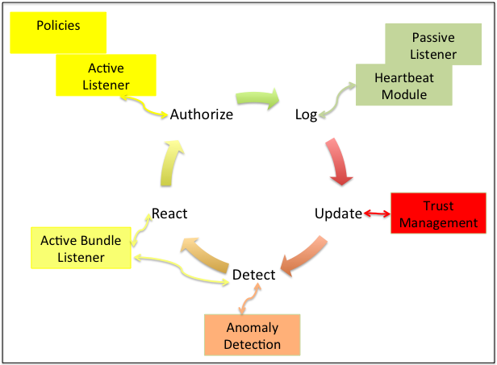
End to End Monitoring

Slide 30
Finding the Shortest Route
Dijkstra's Algorithm: A common example of a graph-based pathfinding algorithm is Dijkstra's algorithm. This algorithm begins with a start node and an "open set" of candidate nodes. At each step, the node in the open set with the lowest distance from the start is examined. The node is marked "closed", and all nodes adjacent to it are added to the open set if they have not already been examined. This process repeats until a path to the destination has been found. Since the lowest distance nodes are examined first, the first time the destination is found, the path to it will be the shortest path.
One must additionally consider congestion of routes, currency of information at each node selected in the path, trustworthiness of paths. AODV is one such protocol used by Manets.

Slide 31
Active Bundle Scheme
  Metadata:
    Access control policies
    Data integrity checks
    Dissemination policies
    Life duration
    ID of a trust server
    ID of a security server
    App-dependent information
    …
E(Name)
E(E-mail)
E(Password)
E(Shipping Address)
E(Billing Address)
E(Credit Card)
…
  Sensitive Data:
    Identity Information
    ...
  Virtual Machine (algorithm):
    Interprets metadata
    Checks active bundle integrity
    Enforces access and dissemination control policies
    …
* E( ) - Encrypted Information
Notes:
Encrypted sensitive data
Metadata the access control policies
VM which enforces these policies

Slide 32
Resiliency and Adaptability
We achieve resiliency of a system through switching failed or compromised services to more reliable versions. It requires the transfer of the state of the current service to a new virtual machine, or Cloud.
The ideas for building alternates services that are more resilient and trustworthy has been studied by us over the years and our laboratory built the RAID ( Reliable, Adaptable, Distributed) system based on these ideas. The goal is to provide non-stop operations in the presence of failures or attacks by dynamically configuring the system as the context and urgency of client’s requirements.

Slide 33
Detecting Service Violation in Internet
Problem statement
Detecting service violation in networks is the procedure of identifying the misbehaviors of users or operations that do not adhere to network protocols.

Slide 34
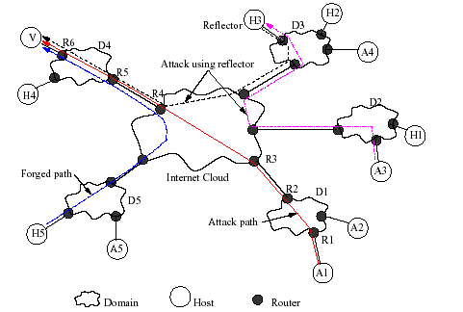
Topology Used (Internet)
Victim, V
A3 uses reflector H3 to attack V
H5
A1 spoofs H5’s address to attack V

Slide 35
Detecting DoS Attacks in Internet
*SPIE: Source Path Isolation Engine

Slide 36
Research Directions
  Observe misbehavior flows through service level agreement (SLA) violation detection
  Core-based loss
  Stripe based probing
  Overlay based monitoring

Slide 37
Approach
Develop low overhead and scalable monitoring techniques to detect service violations, bandwidth theft, and attacks. The monitor alerts against possible DoS attacks in early stage
Policy enforcement and controlling the suspected flows are needed to maintain confidence in the security and QoS of networks

Slide 38
Methods
Network tomography
  Stripe based probing is used to infer individual link loss from edge-to-edge measurements
  Overlay network is used to identify congested links by measuring loss of edge-to-edge paths
Transport layer flow characteristics are used to protect critical packets of a flow
Edge-to-edge mechanism is used to detect and control unresponsive flows

Slide 39
Monitoring Network Domains
Idea:
  Excessive traffic changes internal characteristics inside a domain (high delay & loss, low throughput)
  Monitor network domain for unusual patterns
  If traffic is aggregating towards a domain (same IP prefix), probably an attack is coming
Measure delay, link loss, and throughput achieved by user inside a network domain
Monitoring by periodic polling or deploying agents in high speed core routers put non-trivial overhead on them

Slide 40
Overlay-based Monitoring
Problem statement
  Given topology of a network domain, identify which links are congested
Solutions: Simple and Advanced methods
  Monitor the network for link delay
  If delay^{i} > Threshold^{i}_{delay} for path i, then probe the network for loss
  If loss^{j} > Threshold^{j}_{loss} for any link j, then probe the network for throughput
  If BW^{k} > Threshold^{k}_{BW}, flow k is violating service agreements by taking excess resources. Upon detection, we control the flows.

Slide 41
Probing: Simple Method
Congested link
(a) Topology
(b) Overlay
(c) internal links
Each peer probes both of its neighbors
Detect congested link in both directions

Slide 42
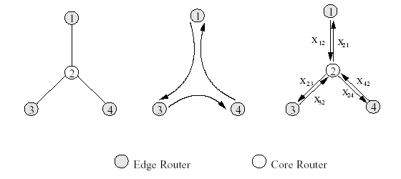
An Example
Perform one round peer-to-peer probing in counter-clockwise direction
Each boolean variable X_{ij} represents the congestion status of link i → j
For each probe P, we have an equation P_{i,j} = X_{i,k}+ … + X_{l,j}

Slide 43
Experiments: Evaluation methodology
Simulation using ns-2
Two topologies
  C-C links, 20 Mbps
  E-C links, 10 Mbps
Parameters
  Number of flows order of thousands
  Change life time of flows
  Simulate attacks by varying traffic intensities and injecting traffic from multiple entry points
Output Parameters
  delay, loss ratio, throughput
Congested link
Topology 1
Notes:
We evaluate our monitoring scheme with ns-2, which is a de facto simulator to conduct research on networking
We use two topologies. The topologies and their parameters are taken from reference work.
We vary the number of flows, life time of flows during simulation. An attack is simulated by injecting traffic from multiple entry points.

Slide 44
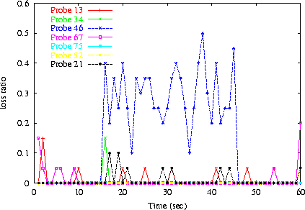
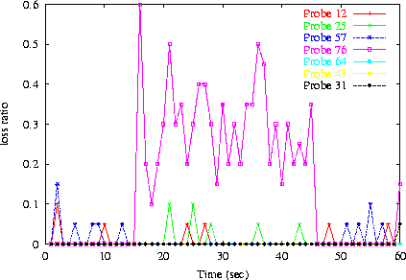
Identified Congested Links
Loss Ratio
Loss Ratio
Time (sec)
Time (sec)
(a) Counter clockwise probing
(b) Clockwise probing
Probe46 in graph (a) and Probe76 in graph (b) observe high losses, which means link C4 → E6 is congested.

Slide 45
False Positive (theoretical analysis)
The simple method does not correctly label all links
The unsolved “good” links are considered bad hence false positive happens
Need to refine the solution → Advanced Method

Slide 46
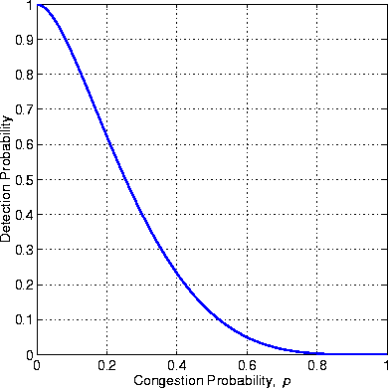
Performance: Simple Method
Theorem 2. Let p be the probability of a link being congested in any arbitrary overlay network. The simple method determines the status of any link of the topology with probability at least 2(1-p)⁴-(1-p)⁷+p(1-p)¹²
Detection Probability
Frac of actual congested links

Slide 47
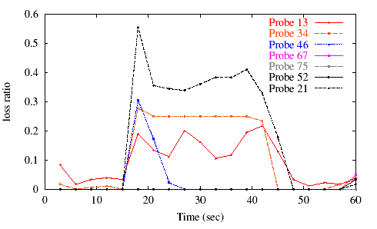
Identifying Links: Advanced Method
Loss Ratio
Time (sec)
Link E2 → C2, C1 → C3, C3 → C4, and C4 → E6 are congested. Simple method identifies all except E2 → C2. Advanced method finds probe E5→E1 to identify status of E2 → C2.

Slide 48
Analyzing Advanced Method
Lemma 2. For an arbitrary overlay network with n edge routers, on the average a link lies on b = edge-to-edge paths
Lemma 3. For an arbitrary overlay network with n edge routers, the average length of all edge-to-edge paths is d =
Theorem 3. Let p be the probability of a link being congested. The advanced method can detect the status of a link with probability at least (1-(1-(1-p)^{d})^{b})

Slide 49
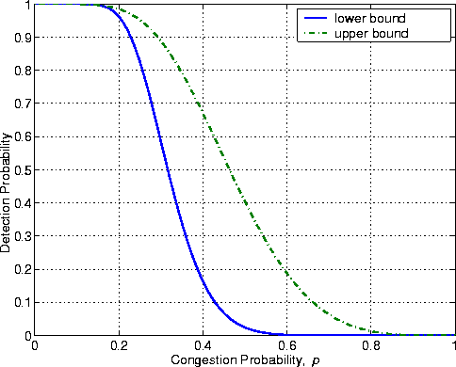
Bounds on Advanced Method
Graph shows lower and upper bounds
When congestion is ≤ 20%, links are identified with O(n) probes with probability ≥ 0.98
Does not help if ≥ 60% links are congested
Detection Probability
Frac of actual congested links
Advanced method uses output of simple method and topology to find a probe that can be used to identify status of an unsolved link in simple method

Slide 50
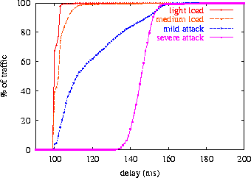
Experiments: Delay Measurements
% of traffic
Delay (ms)
Cumulative distribution function (cdf)
Attack changes delay pattern in a network domain
We need to know the delay pattern when there is not attack

Slide 51
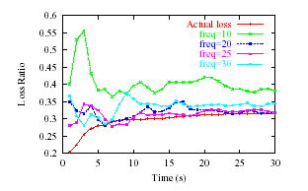
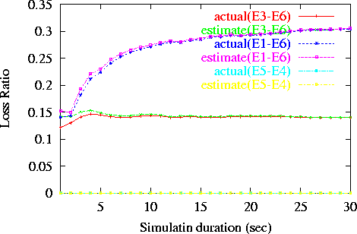
Experiments: Loss measurements
Loss Ratio
Loss Ratio
Time (sec)
Time (sec)
(b) Stripe-based
(a) Core-assisted
Core-based measurement is more precise than stripe-based, however, it has high overhead

Slide 52
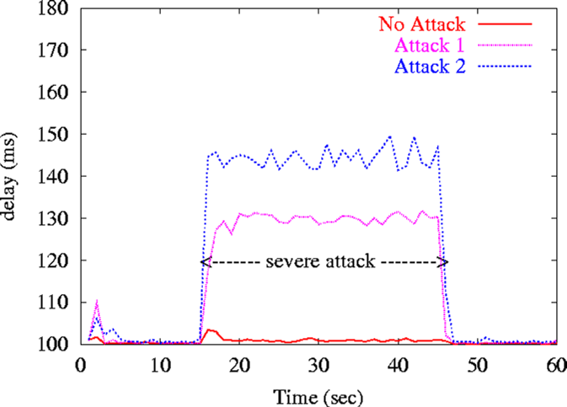
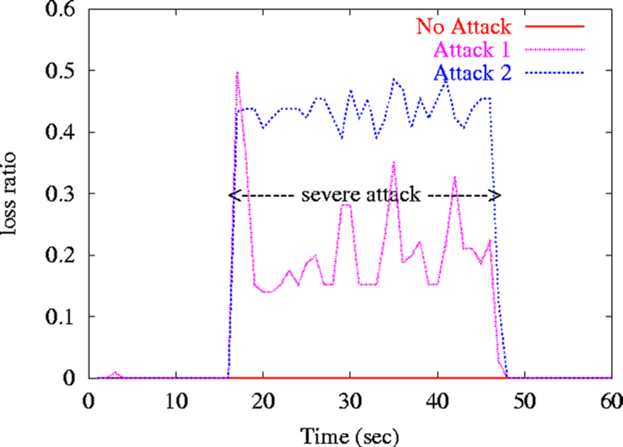
Attack Scenarios
Delay (ms)
Loss Ratio
Time (sec)
Time (sec)
(a) Changing delay pattern due to attack
(b) Changing loss pattern due to attack
Attack 1 violates SLA and causes 15-30% of packet loss
Attack 2 causes more than 35% of packet loss

Slide 53
Detecting DoS Attacks
If many flows aggregate towards a downstream domain, it might be a DoS attack on the domain
Analyze flows at exit routers of the congested links to identify misbehaving flows
Activate filters to control the suspected flows
Flow association with ingress routers
  Egress routers can backtrack paths, and confirm entry points of suspected flows

Slide 54
Overhead comparison
Communication overhead in KB
Processing overhead (CPU cycle)
Percentage of misbehaving flow
Percentage of misbehaving flow
(a) Processing overhead
(b) Communication overhead
Core has relative low processing overhead
Overlay scheme has an edge over other two schemes

Slide 55
Observations
Stripe-based Monitoring
  Stripe-based probing can monitor DiffServ networks only from the edges
  It takes 10 sec to converge the inferred loss ratio to actual loss ratio with ≥ 90% accuracy
  10-15 delay probes and 20-25 loss probes per second are sufficient for monitoring
  Probe is a 3-packet stripe
    3 shows good correlation, 4 does not add much
Notes:
I have one slide on this, I will skip the details

Slide 56
Observations (Cont’d)
Overlay-based Monitoring
  Congestion status of individual links can be inferred from edge-to-edge measurements
  When the network is ≤ 20% congested
    Status of a link is identified with probability ≥ 0.98
    Requires O(n) probes, where n is the number of edge routers
  Worst case is O(n²), whereas stripe-based requires O(n³) probes to achieve same functionality

Slide 57
Observations (Cont’d)
Analyze existing techniques to defeat DoS attacks
  Marking has less overhead than Filtering, however, it is only a forensic method
  Monitoring might have less processing overhead than marking or filtering, however, monitoring injects packets and others do not
  Monitoring can alert against DoS attacks in early stage

Slide 58
Observations (Cont’d)
Traffic Conditioner
  Using small state table, we can design scalable traffic conditioner
  It can protect critical packets of a flow to improve application QoS (delay, throughput, response time, …)
  Both Round trip time (RTT) & Retransmission time-out (RTO) are necessary to avoid RTT-bias among flows

Slide 59
Observations (Cont’d)
Flow Control
  Network tomography is used to design edge-to-edge mechanism to detect & control unresponsive flows
  QoS of adaptive flows improves significantly with flow control mechanism

Slide 60
Conclusion on Monitoring
Elegant way to use probability in inferring loss. 3-packets stripe shows good correlation
Monitoring network can detect service violation and bandwidth theft using measurements
Monitoring can detect DoS attacks in early stage. Filter can be used to stop the attacks
Overlay-based monitoring requires only O(n) probing with a very high probability, where n is the number of edge routers
Overlay-based monitoring has very low communication and processing overhead
Stripe-based inference is useful to annotate a topology tree with loss, delay, and bandwidth.

Slide 61
Research Motivation
Two kinds of attacks target Ad Hoc network
  External attacks:
    MAC Layer jam
    Traffic analysis
  Internal attacks:
    Compromised host sending false routing information
    Fake authentication and authorization
    Traffic flooding

Slide 62
Attacks on routing in mobile ad hoc networks
Attacks on routing
Active attacks
Passive attacks
Routing procedure
Flood network
Packet silent discard
Routing information hiding
False reply
Wormhole attacks
Route request
Route broken message

Slide 63
Collaborative Attacks
Informal definition:
“Collaborative attacks (CA) occur when more than one attacker or running process synchronize their actions to disturb a target network”

Slide 64
Collaborative Attacks (cont’d)
Forms of collaborative attacks
  Multiple attacks occur when a system is disturbed by more than one attacker
  Attacks in quick sequences is another way to perpetrate CA by launching sequential disruptions in short intervals
  Attacks may concentrate on a group of nodes or spread to different group of nodes just for confusing the detection/prevention system in place
  Attacks may be long-lived or short-lived
  Attacks on routing

Slide 65
Collaborative Attacks (cont’d)
From a low-level technical point of view, attacks can be categorized into:
  Attacks that may overshadow (cover) each other
  Attacks that may diminish the effects of others
  Attacks that interfere with each other
  Attacks that may expose other attacks
  Attacks that may be launched in sequence
  Attacks that may target different areas of the network
  Attacks that are just below the threshold of detection but persist in large numbers

Slide 66
Examples of Attacks that can Collaborate
Denial-of-Messages (DoM) attacks
Blackhole attacks
Wormhole attacks
Replication attacks
Sybil attacks
Rushing attacks
Malicious flooding
We are investigating the interactions among these forms of attacks
Example of probably
incompatible attacks:
Wormhole attacks need fast connections, but DoM attacks reduce bandwidth!

Slide 67
Examples of Attacks that can Collaborate (cont’d)
Denial-of-Messages (DoM) attacks
  Malicious nodes may prevent other honest ones from receiving broadcast messages by interfering with their radio
Blackhole attacks
  A node transmits a malicious broadcast informing that it has the shortest and most current path to the destination aiming to intercept messages
Wormhole attacks
  An attacker records packets (or bits) at one location in the network, tunnels them to another location, and retransmits them into the network at that location

Slide 68
Examples of Attacks that can Collaborate (cont’d)
Replication attacks
  Adversaries can insert additional replicated hostile nodes into the network after obtaining some secret information from the captured nodes or by infiltration. Sybil attack is one form of replicated attacks
Sybil attacks
  A malicious user obtains multiple fake identities and pretends to be multiple, distinct nodes in the system. This way the malicious nodes can control the decisions of the system, especially if the decision process involves voting or any other type of collaboration

Slide 69
Examples of Attacks that can Collaborate (cont’d)
Rushing attacks
  An attacker disseminates a malicious control messages fast enough to block legitimate messages that arrive later (uses the fact that only the first message received by a node is used preventing loops)
Malicious flooding
  A bad node floods the network or a specific target node with data or control messages

Slide 70
Modeling Collaborative Attacks
Attack graph
  A general model technique used in assessing security vulnerabilities of a system and all possible sequences of exploits an intruder can take to achieve a specific goal
  We are currently working on a modeling for collaborative graph attacks to identify not only sequence of exploits but also concurrent and collaborative exploits. This leads to our Causal Model

Slide 71
Causal model
Purposes:
Identify all attacks events that occur during the launch of individual and collaborative attacks
Establish a partial order (or causal relationship) among all attack events and produce a “causal attack graph”
Verify the security properties of the causal attack graph using model checking techniques.
  Specifically, verify a sequence of events that lets the security checker proceeds from initial state to the goal state

Slide 72
Causal model (cont’d)
Identify the set of events that are critical to perform the attacks.
  Specifically, investigate how to find a minimum set of events that, once removed, would disable the attacks
Determine whether the occurrences of some event/state transitions are based on message transmission or collaboration
  Based on this, one can infer the degree of collaboration and temporal ordering in the system

Slide 73
Causal model (cont’d)
A collaborative attack X can be modeled as a set of attacks {Xi} such that Xi is the local attack launched by attacker n
Each local attack Xi is modeled by a FSM (finite state machine) and has independent state and event specifications, such as preconditions, postconditions, and state transition rules
In simple distributed attacks such as Distributed Denial-of-Service Attacks, the FSMs of each local attack can be the same. However, in sophisticated collaborative attacks, FSMs of local attacks are not necessarily homogeneous
Each local attack Xi can be formally defined as:
<Sn, En, Mn, Ln>
  Sn denotes a set of states in the local attack, En denotes a set of events in the local attack, Mn denotes a set of communication messages, and Ln denotes a set of local operations on Mn.

Slide 74
Causal model (cont’d)
In collaborative attacks, events in attacks occur in certain sequences. A sequence of attack events may cause more damage to the system than others
There are certain relationships among the events and we model the relationships by causal rules.
Definition of causal rules
  A causal rule U consists of
  <P, Q, A>
  P and Q are events
  A is one of the causal relationships (->, →, - →>)

Slide 75
Route Discovery in AODV (An Example)
D
S1
S3
S2
S4
S
Route to the source
Route to the destination

Slide 76
Attacks on AODV
Route request flooding
  query non-existing host (RREQ will flood throughout the network)
False distance vector
  reply “one hop to destination” to every request and select a large enough sequence number
False destination sequence number
  select a large number (even beat the reply from the real destination)
Wormhole attacks
  tunnel route request through wormhole and attract the data traffic to the wormhole
Coordinated attacks
  The malicious hosts establish trust to frame other hosts, or conduct attacks alternatively to avoid being identified

Slide 77
False Destination Sequence Attack
Sequence number 5
RREQ(D, 3)
RREP(D, 4)
S3
S4
D
RREQ(D, 3)
RREQ(D, 3)
S
S1
RREQ(D, 3)
RREP(D, 20)
S2
M
Packets from S to D are sinking at M.

Slide 78
During Route Rediscovery, False Destination Sequence Number Attack Is Detected, S needs to find D again.
Node movement breaks the path from S to M (trigger route rediscovery).
(1). S broadcasts a request that carries the old sequence + 1 = 21
D
(2) D receives the RREQ. Local sequence is 5, but the sequence in RREQ is 21. D detects the false desti-nation sequence number attack.
S3
RREQ(D, 21)
S
S1
S2
M
S4
Propagation of RREQ

Slide 79
Blackhole attack detection: Reverse Labeling Restriction (RLR)
Every host maintains a blacklist to record suspicious hosts who gave wrong route related information
Blacklists are updated after an attack is detected
The destination host will broadcast an INVALID packet with its signature when it finds that the system is under attack on sequence. The packet carries the host’s identification, current sequence, new sequence, and its own blacklist
Every host receiving this packet will examine its route entry to the destination host. The previous host that provides the false route will be added into this host’s blacklist

Slide 80
RLR (cont’d)
Detecting false destination sequence attack by destination host during route rediscovery
During Route Rediscovery, False Destination Sequence Number Attack is Detected, S needs to find D again
Node movement breaks the path from S to M (trigger route rediscovery)
(1). S broadcasts a request that carries the old sequence + 1 = 21
D
(2) D receives the RREQ. Local sequence is 5, but the sequence in RREQ is 21. D detects the false destination sequence number attack.
S3
RREQ(D, 21)
S
S1
S2
M
S4
Propagation of RREQ

Slide 81
RLR (cont’d)
Correct destination sequence number is broadcasted. Blacklist at each host in the path is determined
BL {}
S3
D
INVALID ( D, 5, 21, BL{}, Signature )
BL {}
S4
S
S1
BL {S2}
BL {S1}
M
S2
BL {}
BL {M}
S4
BL {}

Slide 82
RLR (cont’d)
Malicious site is in blacklists of multiple destination hosts
D1
D2
S4
[M]
[M]
S3
M
D3
D4
[M]
[M]
S1
S2
M attacks 4 routes (S1-D1, S2-D2, S3-D3, and S4-D4). When the first two false routes are detected, D3 and D4 add M into their blacklists. When later D3 and D4 become victim destinations, they will broadcast their blacklists, and every host will get two votes that M is malicious host

Slide 83
RLR (cont’d)
Update Blacklist by Broadcasted Packets from Destinations under Attack
  Next hop on the false route will be put into local blacklist, and a counter increases. The time duration that the host stays in blacklist increases exponentially to the counter value
  When timer expires, the suspicious host will be released from the blacklist and routing information from it will be accepted

Slide 84
RLR: Deal With Hosts in Blacklist
Packets from hosts in blacklist
  Route request: If the request is from suspicious hosts, ignore it
  Route reply: If the previous hop is suspicious and the query destination is not the previous hop, the reply will be ignored
  Route error: Will be processed as usual. RERR will activate re-discovery, which will help to detect attacks on destination sequence
  Broadcast of INVALID packet: If the sender is suspicious, the packet will be processed but the blacklist will be ignored

Slide 85
Attacks of Malicious Hosts on RLR
Attack 1: Malicious host M sends false INVALID packet
  Because the INVALID packets are signed, it cannot send the packets in other hosts’ name
  M sends INVALID in its own name
    If the reported sequence number is greater than the real sequence number, every host ignores this attack
    If the reported sequence number is less than the real sequence number, RLR will converge at the malicious host. M is included in blacklist of more hosts. M accelerated the intruder identification directing towards M

Slide 86
Attacks on RLR (cont’d)
Attack 2: Malicious host M frames other innocent hosts by sending false blacklist
  If the malicious host has been identified, the blacklist will be updated
  If the malicious host has not been identified, this operation can only make the threshold lower. If the threshold is selected properly, it will not impact the identification results
  Combining trust can further limit the impact of this attack

Slide 87
Attacks on RLR (cont’d)
Attack 3: Malicious host M only sends false destination sequence about some special host
  The special host will detect the attack and send INVALID packets
  Other hosts can establish new routes to the destination by receiving the INVALID packets

Slide 88
Two Attacks in Collaboration: blackhole & replication
The RLR scheme cannot detect the two attacks working simultaneously
The malicious node M relies on the replicated neighboring nodes to avoid the blacklist
D1
D2
S4
[M]
[M]
S3
M
D3
D4
[M]
[M]
Replicated nodes
Regular nodes
S1
S2

Slide 89
Wormhole Attacks defense
A pair of attackers can form a tunnel, fabricating a false scenario that a short path between sender and receiver exists, and so packets go through a wormhole path being either compromised or dropped
In many routing protocols, mobile nodes depend on the neighbor discovery procedure to construct the local network topology
Wormhole attacks can harm some routing protocols by inducing a node to believe that a further away node is its neighbor

Slide 90
Wormhole Attacks: proposed defense mechanism
This is a preliminary mechanism to classify wormhole attacks in its various forms
It takes a more generic approach than previous work in the sense that it is end-to-end and does not rely on trust among neighbors
It assumes trust between sender and receiver only to detect wormhole attacks on a multi-hop route
Geographic information is used to detect anomalies in neighbor relation and node movements

Slide 91
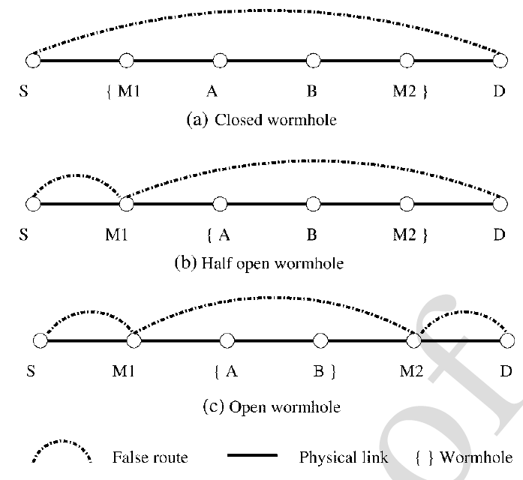
Wormhole Attacks: proposed defense mechanism (cont’d)
The e2e mechanism can detect:
  Closed wormhole
  Half open wormhole
  Open wormhole

Slide 92
Wormhole Attacks: proposed defense mechanism (cont’d)
The approach requires considerable computation and storage power as periodical wormhole detection packets are transmitted and the response are used to compute nodes position, velocity etc
Because of that, an additional scheme called COTA is proposed to manage the detection information. It records and compares only a part of the <time, position> pairs
Using a suitable relaxation, COTA has the same detection capability as the end-to-end mechanism

Slide 93
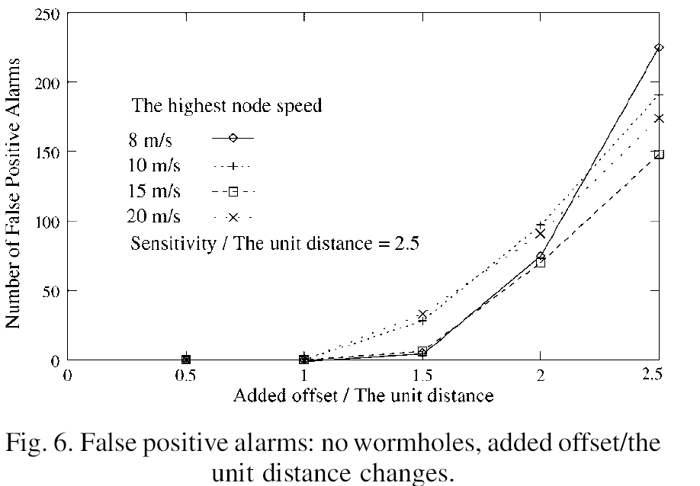
Wormhole Attacks: proposed defense mechanism (cont’d)
Simulation evaluations: false positive with no attack

Slide 94
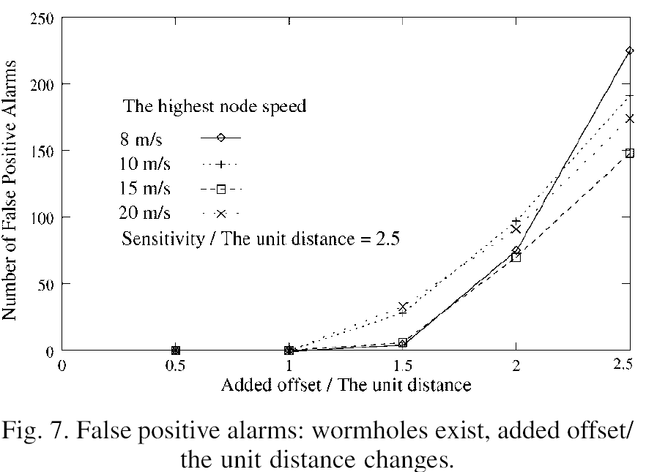
Wormhole Attacks: proposed defense mechanism (cont’d)
Simulation evaluations: false positive with attack

Slide 95
Sybil Attack Detection
A Hierarchical Architecture for Sybil Attack Detection
The Sybil attack is a harmful threat to sensor networks
  Sybil attack can disrupt multi-path routing protocols by using a single node to present multiple identities for the multiple paths
  Existing approaches are not oriented toward energy

Slide 96
Sybil Attack Detection: Proposed Method
Use identity certificates to defend against Sybil attacks
Each node is assigned some unique information by the setup server
The server then creates an identity certificate for each level-0 node binding this node’s identity to the assigned unique information
The group leader creates an identity certificate for its group member (level-1 node)
To securely demonstrate its identity, a node first presents its identity certificate, then it proves that it possesses the associated unique information

