Slide 1
Monitoring-Based System for E2E Security Auditing and Enforcement in Trusted and Untrusted SOA

Slide 2
Problem Domain: Typical SOA Scenario
Service B
Potentially
malicious
Trust Domain
PII
PII
Service A
Service C
PII
Service D
Service Level
Agreements /
Security Policies
Enforced
PII: Personally identifying information
Services may outsource part of their functionality to other services
There is no control over the sharing of PII and service invocations outside
the trust domain

Slide 3
Problem Statement
A new threat landscape (large attack surface)
Diverse security administration domains
Security across organizational boundaries
Any service may outsource part of its functionality to other services
Chain of service invocations
Service consumer only interacts only with the first service in the invocation chain
Businesses place a lot of trust in their partners (trust is not transitive!)
Consumer has no knowledge of or control over the invoked services in the invocation chain
Some of these services may be untrusted for the consumer
User cannot specify the service invocation policies
Violations and malicious activities in a trusted service domain remain undetected
External services are not verified or validated dynamically (uninformed selection of services by user)
Malicious activity may cause service disruptions

Slide 4
Benefits of Proposed Research
This research proposes a novel method of dealing with security problems in SOA:
Monitoring all interactions among services in the enterprise
Provides increased awareness of security violations
Proactive treatment of potentially malicious service invocations
Leads to increased security
Detection and prevention of service interaction anomalies
Illegal service interactions
Privacy preservation in service interactions
Data leakage
Dynamic trust management of services in an enterprise
Enables timely detection of potentially compromised services
Agile and resilient defense mechanisms
Ability to adapt in the presence of anomalies
The proposed service monitoring and auditing framework provides easy integration of any service topology, trust management method and authorization policy into a SOA system
To enable global enforcement of security requirements in various runtime environments (including clouds)
The proposed service monitoring techniques allow for easy detection of bottlenecks in an enterprise SOA
Leading to increased performance

Slide 5
State of the Art
Runtime auditing:
Finite state automata to validate predefined interaction constraints [LJ06]
Checking behavioral correctness of web service conversations [SG09]
Reporting and monitoring functional requirements and QoS for BPEL processes [BG10]
→ technology-dependent solutions
Information flow control: Controlling leakage of data by sending/validating certificates in whole service invocation chain [SL10] → inefficient, assumes service are semi-trusted
AOP: Aspect-oriented extensions to WS-BPEL used to intercept execution of activities interacting with outside world [WH08] → do not address security policy enforcement, are not generic
Cloud and SOA auditing: Filtering and reasoning over audit trails to manifest potential security vulnerabilities based on compliance with established standards [XG12] → compliance with standards does not imply security, needs strong support from cloud provider
WS* standards and standard security protocols (HTTPS): point-to-point security (not end-to-end)

Slide 6
End-to-End Security Policy-Auditing and Enforcement in Service-Oriented Architecture
System Architecture
Service Monitor
Service 1
request
Instrumentation
Passive
Passive Listener
Passive Monitoring Algorithms
Active
Active Listener
Interaction Authorization Algorithms
Trust Algorithms
response
request
request
(if authorized)
Trust Algorithms
Trust Algorithms
Service 2
Policies
All service interactions instrumented to go through passive or active listening
Passive instrumentation logs interactions in the Service Monitor database
Active instrumentation disallows invocations violating domain policies
Trust values of services updated based on their invocations of other services

Slide 7
Methodology
A novel service invocation monitoring and control mechanism
Passive monitoring for service feedback
Active monitoring for service interaction authorization
A trust management system that manages dynamic trust of services
Pluggable trust management algorithms that can be turned on/off at the system level
A policy subsystem for policy definition, monitoring, and enforcement
Pluggable service interaction authorization policies
Management console to experiment with service interactions and evaluate different service topologies

Slide 8
Results Overview
Low overhead of service instrumentation
Experiments with:
Baseline (no monitoring)
Passive monitoring
Active monitoring
Implementation of different pluggable trust algorithms demonstrating protection capability of system under different conditions
Moving average trust
SORT (a Self-Organizing Trust Model for P2P Systems)
Simulation of attacks showing system resilience
DoS attack
Insider attack
Prototype capable of handling different interaction authorization policies

Slide 9
Active Service Monitoring Response Time Experiment Results
 | Baseline | Passive | Active
Run 1 | 10.11 | 11.48 | 24.35
Run 2 | 10.09 | 10.77 | 15.62
Run 3 | 10.20 | 10.13 | 13.65
Run 4 | 10.83 | 9.34 | 13.56
Run 5 | 9.52 | 10.92 | 13.57
LAN-based setup
Testing based on Apache bench
50 concurrent requests per run
Negligible overhead in Passive Monitoring
Small overhead in Active Monitoring with 2 enabled policies
Insignificant increase in overhead with more policies

Slide 10
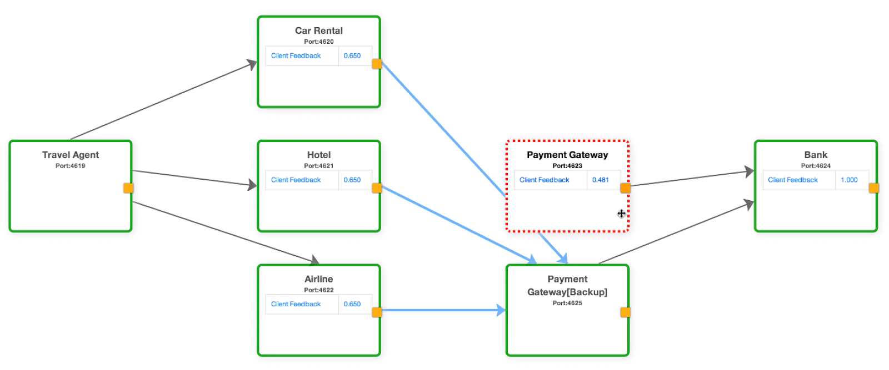
DoS attack
Attack creation: Simulated attack by introducing a delay in request processing
at the service
Attack detection: Client feedback trust algorithm deployed causes service trust
value to decrease with weak feedback from clients due to increased delay
Remedial action: Redirect requests to backup service

Slide 11
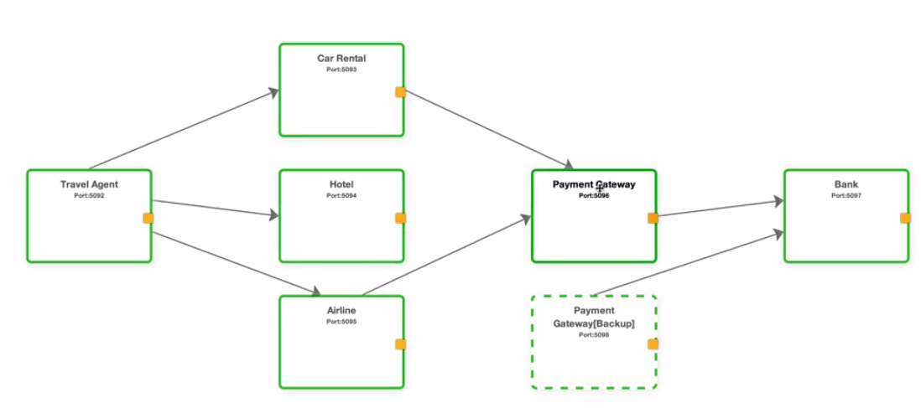
Insider attack
Attack creation: Simulate insider to change transport protocol from HTTPS to HTTP
Attack detection: Interaction authorization algorithm enforcing use of secure
protocols
Remedial action: Block request and interrupt service operation

Slide 12
Impact
The conducted research provides a novel method of dealing with security problems in SOA. The main advantages of the solution are as follows:
Monitors all interactions among services in the enterprise
Provides increased awareness of security violations
Proactive treatment of potentially malicious service invocations
Dynamic trust management of services in an enterprise
Enables timely detection of potentially compromised services
Detection of bottlenecks in an enterprise SOA to improve performance
Easy integration of any service topology, trust management algorithms and authorization policy into a SOA system
Provides a platform to experiment with different service topologies and policies along with different perspectives of service trust evaluation

Slide 13
Demonstration
Source code: https://code.google.com/p/end-to-end-soa/
Demo videos:
http://youtu.be/eJTT075rWQM : Typical SOA topology for online travel agent with examples for enabling trust modules/interaction authorization modules (4:00 min)
http://youtu.be/cbwfB0u9gfc: Mitigation of insider attack on the hotel service (2:21 min)
http://youtu.be/cEzy6frCX34: Use of XACML-based interaction authorization module to evaluate contents of a request and take actions (2:48 min)

Slide 14
Monitoring-Based System for E2E Security Auditing and Enforcement in Trusted and Untrusted SOA
Focus:
Security auditing and enforcement in trusted and untrusted environments (cloud)
Data Privacy
End-to-end privacy protection of data disseminated in a chain of service invocations
Identity Management in trusted and untrusted environments
Agile Defense Management
Service monitoring
Anomaly detection
Automated situational awareness
Resiliency and adaptability to failures and attacks
Efficient dynamic service reconfiguration

Slide 15
Technical Approach Overview
Service Monitor
Active Bundle
Service 1
request
Instrumentation
Passive
Passive Listener
Passive Monitoring Algorithms
Active
Interaction Authorization Algorithms
Active Listener
request
(if authorized)
Active Bundle Listener
response
request
Service 2
Heartbeat & Inflow Listener
Policies
Dynamic Service Composition
reconfiguration
Anomaly Detection
Trust Management

Slide 16
Proposed Solution Components
Policies
Passive Listener
Active
Listener
Active Bundle
Listener
Heartbeat Module
Log
Detect
React
Authorize
Analyze
Trust Management
Agile Defense
Resiliency & Adaptability
Anomaly Detection

Slide 17
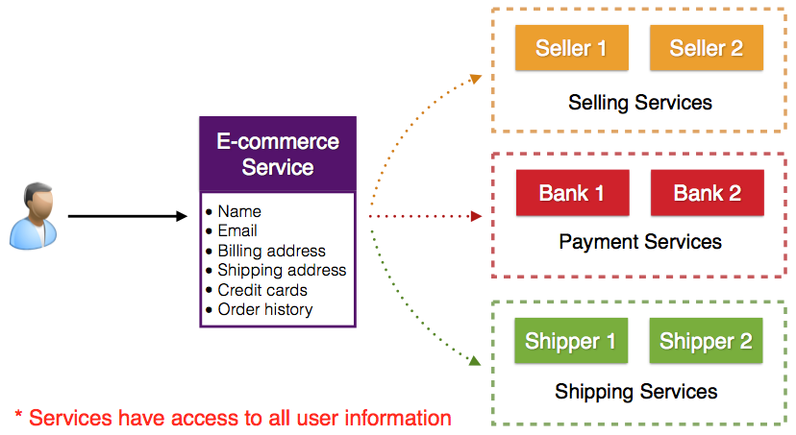
Data Privacy
PII Sharing in SOA
Services have access to all user information

Slide 18
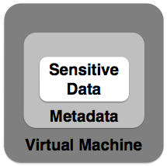
Active Bundles for Data Privacy
Message security mechanisms (HTTPS, WS-Security standards) are not sufficient
Provide point to point security
Unable to provide protection in remote domains
Active Bundles
Data-centric approach
Encapsulation mechanism for protecting data
Includes metadata (policies) used for controlled dissemination
Access control policies
Life duration
Includes Virtual Machine (VM)
Policy enforcement mechanism
Protection mechanism
Active Bundle operations
Self-Integrity check
Filtering
Selective dissemination based on policies

Slide 19
Active Bundle Features
Data-centric approach
Self-monitoring ability
Policy based access control
Ability to control interactions
Selective data dissemination
Context-aware dissemination
Minimal disclosure
Interaction visibility
Ability to operate in unknown (untrusted) environment

Slide 20
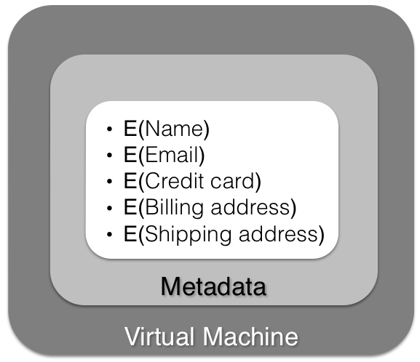
User Request using Active Bundles
Active Bundle
order request
+
Credit Card request
Active Bundle
E-commerce Service
Payment Gateway Service
payment request
+
Credit Card authorization
request
Active Bundle
Credit Card Authority Service

Slide 21
Active Bundle Message Exchange
Service Domain
AB
AB Interceptor
Service

Slide 22
Active Bundle Extraction and Execution
Service Domain
Service
AB Interceptor
Message
AB Process
AB

Slide 23
Active Bundle-Service Interaction
Service Domain
Service
AB Interceptor
Message
AB Process
auth_challenge()
auth_response()
get_value()
AB

Slide 24
Active Bundles in SOA
Trust Domain
Service B
AB
AB
Service A
Service C
AB
Service D
AB
ABs expose an API to services:
getSLA()
authenticateChallenge()
authenticateResponse(token, signedToken, serviceCert)
getValue(sessionKey, dataKey)
AB API implemented using Apache Thrift
AB is included in the message (REST/SOAP header)

Slide 25
Active Bundle Interaction with Service Monitor
Active bundle logs state information with service monitor for each interaction:
Authentication decisions
Security policy evaluation results
Self-integrity check results
Information provided by active bundle is used by service monitor to:
Evaluate trust for services with which active bundle interacted (dynamic trust management)
Detect malicious service behavior (anomaly detection)

Slide 26
Active Bundle Security Challenges
Data Security: Service interacting with AB may become anomalous
Mitigation approaches:
Use predicates over encrypted data and multi-party computing for authentication, authorization and identity management with AB
Use threshold secret sharing scheme: Organize AB into separate items, assign encryption key and encrypt respective item using that key so that each service can access only items it’s authorized for
Use distributed hash tables (DHT) to store keys (to make practical attacks on key shares near-impossible)
Execution Security: Service may alter AB code
Mitigation approaches:
Code obfuscation
Polymorphic encryption code
Placement of guard code to check for tampering [AN13]

Slide 27
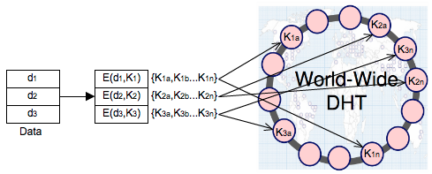
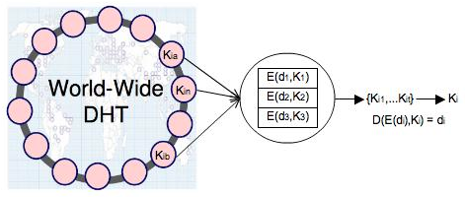
DHT scheme for Active Bundles

Slide 28
Using DHT with Active Bundles
Advantages:
Huge scale - millions of geographically distributed nodes
Decentralized – individually owned nodes with no single point of trust
Load reduction and Asynchronous communication – no synchronization issues
Hard to deduce all the shares (at least t)
Hard to compromise all the nodes that store the shares
Use continuous splitting to protect against dynamic adversaries (Zhou et al [30])
Improving DHT scheme:
DHT loses key shares over time (nodes crash or leave)
Republish the shares for availability
Use a hybrid DHT (combination of reliable* DHT (openDHT in planet lab) and public DHT)
Split K into K’ and K’’
Split K’ into n shares and store in reliable DHT
Split K’’ into n shares and store in public DHT

Slide 29
Identity Management with Active Bundles
Goals:
Authenticate without disclosing identifying information
Ability to securely use a service while on an untrusted host (VM on the cloud)
Minimal disclosure and minimized risk of disclosure during communication between user and service provider
Independence of Trusted Third Party

Slide 30
ID Management with AB: Anonymous Identification
Use of Zero-knowledge proofing for user authentication without disclosing its identifier.
User on Amazon Cloud
ZKP Interactive Protocol
User Request for service
Function f and number k
E-mail
Password
f_{k}(E-mail, Password) = R
E-mail
Password
Authenticated

Slide 31
ID Management with AB: Verification of Encrypted Data
Verification without disclosing unencrypted identity data.
Use ZKP or predicates over encrypted data
Predicate Request*
E-mail
Password
E(Name)
E(Shipping Address)
E(Billing Address)
E(Credit Card)
E(Name)
E(E-mail)
E(Password)
E(Shipping Address)
E(Billing Address)
E(Credit Card)
…
*Age Verification Request
*Credit Card Verification Request

Slide 32
ID Management with AB: Selective Disclosure
User Policies in the Active Bundle dictate dissemination
Selective disclosure*
E-mail
E(Name)
E(Password)
E(Shipping Address)
E(Billing Address)
E(Credit Card)
…
*e-bay shares the AB with the seller

Slide 33
Agile Defense Management
Ability to reconfigure system service orchestrations to respond to anomalous service behavior
Swiftly self-adapt to changes in context
Automated situational awareness
Ability to enforce proactive and reactive response policies to achieve system security goals
Continuous system availability even under attacks
Two components:
Anomaly detection
Remedial action (resiliency and adaptability)

Slide 34
Agile Defense
Reacting
All actions are successful
Reaction actions are selected
Normal
Anomalous
A service anomaly is detected
All actions are successful
Recovery actions are selected
Recovery
System agility states

Slide 35
Anomaly Detection
Types of anomalies:
Service behavior under abnormal conditions (service failures)
Data usage anomalies (non-compliance with requester’s data usage policies)
Service interaction anomalies (unauthorized interactions)
Insecure communication
External attacks
DDoS
Injection attacks
Internal attacks
Service misconfiguration, e.g., exposing internal services to public
Service misbehavior, e.g., anomalous external service communication

Slide 36
Anomaly Detection Process
Develop anomaly signatures
Analyze data continuously collected by service monitor:
Service interaction data
Identify malicious service behavior
Incoming request data
Identify internal/external attacks
Service health data
Identify threats such as DDoS attacks
AB interaction logs
Unauthorized data interactions, AB integrity violations

Slide 37
Resiliency and Adaptability
Show resiliency against: data/service/authentication failures
Adapt to changes in context [BB90] [BR89]
Ability to remotely enforce security policies
Using active bundles
Ability to securely interact with services in untrusted domains
Using active bundles
Dynamic system reconfiguration
Dynamic service composition
Dynamically switching failed or compromised services to more reliable versions
Service replication in cloud
Dynamic trust evaluation
Elastic auto-scaling
Moving target defense

Slide 38
Determining Service Reliability
Reliability of services can vary a lot in highly-dynamic environments
Depending on the urgency of service requests, reliability may be traded off for performance
Acceptability of a service for a specific service request: Meeting the minimum performance, accuracy and service composition requirements (QoS)
Continuous acceptance testing can be used for up-to-date service reliability information to be logged by the trust management module
Service A
Acceptance
Test
Service/Test input/
Acceptance test
result
Trust
Manager
Acceptance
test input
Service
output

Slide 39
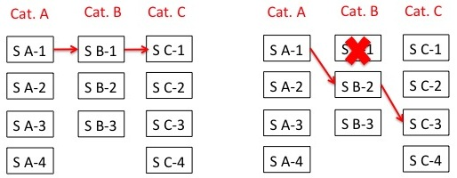
Dynamic Service Reconfiguration
An SOA service orchestration is composed of a series of services that interact with each other based on a service interaction graph
One of the multiple services in each service category can be selected for specific service functionality
Challenge: Configuring set of services that conform to QoS and security policy requirements
Dynamically reconfigured service composition is based on changes in the context with respect to timeliness and accuracy of information as well as the type, duration, extent of attacks and the complexity of the environment

Slide 40
Dynamic Service Composition and Reconfiguration Approach
Goal: Maximize resiliency and trustworthiness of system by selecting the best individual services, while meeting security and SLA requirements
Service monitor maintains up-to-date trust and QoS values for services
Dynamic service composition/reconfiguration module will use information from service monitor database to find the most secure service composition given performance constraints → NP-hard problem

Slide 41
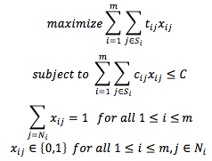
Dynamic Service Composition and Reconfiguration Approach
Formulate secure service composition as a variation of the Knapsack Problem:
We have developed heuristics-based algorithms to find near-optimal solutions to the problem

Slide 42
Dynamically Switching to More Reliable Services
In case of service failure or detection of an anomalous runtime environment (under attack), services will need to be switched to more reliable versions dynamically
Two approaches:
Service replication in cloud: Have multiple replicas of the same service at different locations → resiliency against service failure
Live service migration to different runtime environment:
To achieve live service migration, we plan to take advantage of VMWare’s VSphere software
Vsphere enables live migration of virtual machines between servers with no disruption of service

Slide 43
Moving Target Defense
Static service domains/configurations are more prone to attacks than dynamic ones
Advanced persistent threats (APTs) take advantage of static environments over a long period of time
Periodic changes in service environment increases resiliency against attacks
Approach:
Periodically update service compositions
Periodically update service configuration
Periodically move services to different locations

Slide 44
Proposed Experiments
Simulation of denial of service and distributed denial of service attacks
Use the BackTrack tool to launch attacks against individual services and the service monitor
Simulation of replay attacks
Intercept active bundles to tamper with their code and retransmit to destination
Simulation of system policy violations
Introduce non-compliant services in various service compositions and for different types of policies including trust-based policies, data usage policies, data communication requirements etc.
Simulation of attacks against data privacy
Test active bundle mechanism by simulating violation of client’s data sharing policies by services

Slide 45
Proposed Experiments (cont.)
Performance of service invocations with vs. without active/passive monitoring
Response time
CPU usage
Memory usage
Stress tests to evaluate scalability of service monitor
Cloud experiments:
On industry standard platforms including Amazon EC2
Replication of services in the cloud
Using different types of machine instances, operating systems and software packages
Testing the effects of the auto-scaling capability in the case of high service demands

Slide 46
Success Criteria
Resilience against service attacks
Detection of system policy violations
Resilience against data privacy violations
Runtime performance of service monitor
Service monitor scalability
Effectiveness of dynamic service composition algorithm
Successful deployment of monitoring framework on different platforms including industry-standard cloud infrastructures

Slide 47
References
[AN13] P. Angin, “Autonomous Agent-Based Mobile-Cloud Computing,” Ph.D. Thesis, Purdue University, Dec. 2013.
[BB90] B. Bhargava, S. Browne. ``Adaptable recovery Using Dynamic Quorum Assignments,” in Proceedings of the Sixteenth International Conference on Very Large Data Bases (VLDB), Brisbane, Australia, August 1990.
[BR89] B. Bhargava and J. Riedl. ``A Formal Model for Adaptable Systems for Transaction Processing,” IEEE Transactions on Knowledge and Data Engineering, Vol. 4, No. 1, 1989, pp. 433-449.
[BG10] L Baresi, S Guinea, O Nano, “Comprehensive Monitoring of BPEL Processes,” Proc. IEEE Internet Computing Conference, vol. 14(3), June 2010, pp. 50-57.
[LJ06] Z. Li, Y. Jin, and J. Han “A Runtime Monitoring and Validation Framework for Web Service Interactions,” Proc. Australian Software Engineering Conference, Sydney, Australia, Apr. 2006, pp. 70–79.
[SG09] J. Simmonds, Y. Gan, M. Chechik, S. Nejati, B. O'Farrell, E. Litani, J. Waterhouse, “Runtime Monitoring of Web Service Conversations,” IEEE Transactions on Service Computing, vol. 2(3), , 2009, pp. 223-244.
[SL10] W. She, I. Yen, B. Thuraisingham, “Enhancing Security Modeling for Web Services Using Delegation and Pass-On,” Int. J. Web Service Res. vol. 7(1): 1-21 (2010).
[WH08] G. Wu, J. Wei, T. Huang, “Flexible Pattern Monitoring for WS-BPEL Through Stateful Aspect Extension,” Proc. IEEE International Conference on Web Services (ICWS '08), Sept. 2008, Beijing, China, pp. 577 – 584.
[XG12] R Xie, R Gamble, “A Tiered Strategy for Auditing in the Cloud,” Proc. IEEE 5th International Conference on Cloud Computing (CLOUD), June 2012, Honolulu, HI, pp. 945-946.

