Slide 1
End-to-End Security in Data Dissemination
Bharat Bhargava
CERIAS and CS Department
Purdue University
www.cs.purdue.edu/homes/bb

Slide 2
What needs to be done
Protect the Data
Protect the Communication
Protect the Identity of sender and requester
Evaluate Trust, Privacy Policies, Privacy Metrics, Deploy Apoptosis, Filtering

Slide 3
Research Topics
Privacy is needed to protect source of information, the destination of information, the route of information transmission of dissemination and the information content itself
Trusted Router and Protection Against Collaborative Attacks. Identify malicious activity and collusion.
Can we protect disseminated data? Active Bundle approach for controlled dissemination or apoptosis. Managed Information Object in Cross-Domain Information Exchange.
Privacy of Sender and Requester in Data Sharing.

Slide 5





Evaporation Implemented as
Controlled Data Distortion
Distorted data reveal less, protects privacy
Examples:
  accurate data more and more distorted data
  250 N. Salisbury Street
  West Lafayette, IN
  250 N. Salisbury Street
  West Lafayette, IN
  [home address]
  765-123-4567
  [home phone]
  Salisbury Street
  West Lafayette, IN
  250 N. University Street
  West Lafayette, IN
  [office address]
  765-987-6543
  [office phone]
  somewhere in
  West Lafayette, IN
  P.O. Box 1234
  West Lafayette, IN
  [P.O. box]
  765-987-4321
  [office fax]

Slide 6
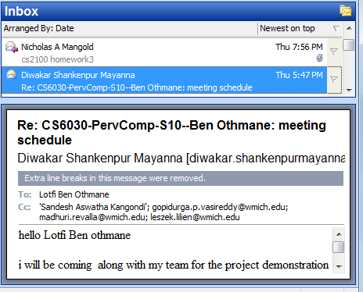
Another Example of Controlled Data Dissemination
Example: Imagine you send an email and the following will be enforced:
    Receiver can read it
    Receiver can not copy it
    Receiver can not change it
    Receiver can forward it only to destinations allowed by the owner (originator) or a guardian (owner’s delegate)
    Receiver can access it only if authorized by the owner/guardian
6

Slide 7
Introduction
Privacy is fundamental to trusted collaboration and interactions to protect against malicious users and fraudulent activities.

Slide 8



Distance Metrics for Trust
Examples of one-dimensional distance metrics
  Distance ~ business type
  Distance ~ distrust level: more trusted entities are “closer”
Multi-dimensional distance metrics
  Security/reliability as one of the dimensions
Insurance Company C
Bank I -Original Guardian
Used Car Dealer 1
    If a bank is the original guardian, then:
    -- any other bank is “closer” than any insurance company
    -- any insurance company is “closer” than any used car dealer
2
5
Used Car Dealer 3
2
5
Insurance Company A
1
1
5
2
Used Car Dealer 2
Bank II
Bank III
Insurance Company B

Slide 9
IDEAS
Basis for idea: The semantic of information changes with time, context, and interpretation by humans
Ideas for privacy:
Replication and Equivalence and Similarity
Aggregation and Generalization
Exaggeration and Mutilation
Anonymity and Crowds
Access Permissions, Authentication, Views

Slide 10
IDEAS
B. Basis for Idea: The exact address may only be known in the neighborhood of a peer
Idea for Privacy:
Request is forwarded towards an approximate direction and position
Granularity of location can be changed
Remove association between the content of the information and the identity of the source of information
Somebody may know the source while others may know the content but not both
Timely position reports are needed to keep a node traceable but this leads to the disclosure of the trajectory of node movement
Enhanced algorithm(AO2P) can use the position of an abstract reference point instead of the position of destination
Anonymity as a measure of privacy can be based on probability of matching a position of a node to its id and the number of nodes in a particular area representing a position
Use trusted proxies to protect privacy

Slide 11
IDEAS
C. Basis for idea: Some people or sites can be trusted more than others due to evidence, credibility , past interactions and recommendations
Ideas for privacy:
Develop measures of trust and privacy
Trade privacy for trust
Offer private information in increments over a period of time

Slide 12
IDEAS
D. Basis for idea: It is hard to specify the policies for privacy preservation in a legal, precise, and correct manner. It is even harder to enforce the privacy policies
Ideas for privacy:
Develop languages to specify policies
Bundle data with policy constraints
Use obligations and penalties
Specify when, who, and how many times the private information can be disseminated
Use Apoptosis to destroy private information
,

Slide 13
Privacy Metrics
Anonymity set size metrics
Entropy-based metrics

Slide 14
A. Anonymity Set Size Metrics
The larger set of indistinguishable entities, the lower probability of identifying any one of them
  Can use to ”anonymize” a selected private attribute value within the domain of its all possible values
“Hiding in a crowd”
“Less” anonymous (1/4)
“More” anonymous (1/n)

Slide 15
Anonymity Set
Anonymity set A
A = {(s₁, p₁), (s₂, p₂), …, (s_{n}, p_{n})}
  s_{i}: subject i who might access private data
  or: i-th possible value for a private data attribute
  p_{i}: probability that s_{i} accessed private data
  or: probability that the attribute assumes the i-th possible value

Slide 16
Effective Anonymity Set Size
Effective anonymity set size is
  Maximum value of L is |A| iff all p_{i’}’s are equal to 1/|A|
  L below maximum when distribution is skewed
    skewed when p_{i’}’s have different values
Deficiency:
L does not consider violator’s learning behavior

Slide 17
B. Entropy-based Metrics
Entropy measures the randomness, or uncertainty, in private data
When a violator gains more information, entropy decreases
Metric: Compare the current entropy value with its maximum value
  The difference shows how much information has been leaked

Slide 18
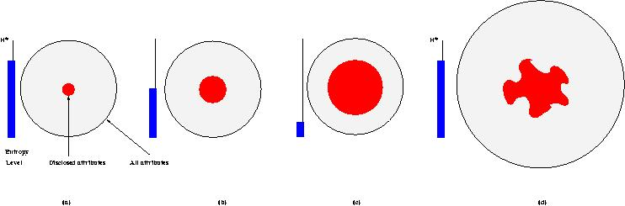
Dynamics of Entropy
Decrease of system entropy with attribute disclosures (capturing dynamics)
  When entropy reaches a threshold (b), data evaporation can be invoked to increase entropy by controlled data distortions
  When entropy drops to a very low level (c), apoptosis can be triggered to destroy private data
  Entropy increases (d) if the set of attributes grows or the disclosed attributes become less valuable – e.g., obsolete or more data now available
H*
Entropy
Level
Disclosed attributes
All
attributes
(a)
(b)
(c)
(d)

Slide 19
Quantifying Privacy Loss
Privacy loss D(A,t) at time t, when a subset of attribute values A might have been disclosed:
  H*(A) – the maximum entropy
    Computed when probability distribution of p_{i}’s is uniform
  H(A,t) is entropy at time t
  w_{j} – weights capturing relative privacy “value” of attributes

Slide 20
Using Entropy in Data Dissemination
Specify two thresholds for D
  For triggering evaporation
  For triggering apoptosis
When private data is exchanged
  Entropy is recomputed and compared to the thresholds
  Evaporation or apoptosis may be invoked to enforce privacy

Slide 21
Entropy: Example
Consider a private phone number: (a₁a₂a₃) a₄a₅ a₆ – a₇a₈a₉ a₁₀
Each digit is stored as a value of a separate attribute
Assume:
  Range of values for each attribute is [0—9]
  All attributes are equally important, i.e., w_{j} = 1
The maximum entropy – when violator has no information about the value of each attribute:
  Violator assigns a uniform probability distribution to values of each attribute
    e.g., a₁= i with probability of 0.10 for each i in [0—9]

Slide 22
Entropy: Example – cont.
Suppose that after time t, violator can figure out the state of the phone number, which may allow him to learn the three leftmost digits
Entropy at time t is given by:
  Attributes a₁, a₂, a₃ contribute 0 to the entropy value because violator knows their correct values

Slide 23
Trusted Router and Protection Against Collaborative Attacks
Characterizing collaborative/coordinated attacks
Types of collaborative attacks
Identifying Malicious activity
Identifying Collaborative Attack

Slide 24
Collaborative Attacks
Informal definition:
“Collaborative attacks (CA) occur when more than one attacker or running process synchronize their actions to disturb a target network”

Slide 25
Collaborative Attacks (cont’d)
Forms of collaborative attacks
  Multiple attacks occur when a system is disturbed by more than one attacker
  Attacks in quick sequences is another way to perpetrate CA by launching sequential disruptions in short intervals
  Attacks may concentrate on a group of nodes or spread to different group of nodes just for confusing the detection/prevention system in place
  Attacks may be long-lived or short-lived
  Attacks on routing

Slide 26
Collaborative Attacks (cont’d)
Open issues
  Comprehensive understanding of the coordination among attacks and/or the collaboration among various attackers
  Characterization and Modeling of CAs
  Intrusion Detection Systems (IDS) capable of correlating CAs
  Coordinated prevention/defense mechanisms

Slide 27
Collaborative Attacks (cont’d)
From a low-level technical point of view, attacks can be categorized into:
  Attacks that may overshadow (cover) each other
  Attacks that may diminish the effects of others
  Attacks that interfere with each other
  Attacks that may expose other attacks
  Attacks that may be launched in sequence
  Attacks that may target different areas of the network
  Attacks that are just below the threshold of detection but persist in large numbers

Slide 28
Examples of Attacks that can Collaborate
Denial-of-Messages (DoM) attacks
Blackhole attacks
Wormhole attacks
Replication attacks
Sybil attacks
Rushing attacks
Malicious flooding
We are investigating the interactions among these forms of attacks
Example of probably
incompatible attacks:
Wormhole attacks need fast connections, but DoM attacks reduce bandwidth!

Slide 29
Current Proposed Solutions
Blackhole attack detection
  Reverse Labeling Restriction (RLR)
Wormhole Attacks: defense mechanism
  E2E detector and Cell-based Open Tunnel Avoidance (COTA)
Sybil Attack detection
  Light-weight method based on hierarchical architecture
Modeling Collaborative Attacks using Causal Model

Slide 30
Blackhole attack detection: Reverse Labeling Restriction (RLR)
Every host maintains a blacklist to record suspicious hosts who gave wrong route related information
Blacklists are updated after an attack is detected
The destination host will broadcast an INVALID packet with its signature when it finds that the system is under attack on sequence. The packet carries the host’s identification, current sequence, new sequence, and its own blacklist
Every host receiving this packet will examine its route entry to the destination host. The previous host that provides the false route will be added into this host’s blacklist

Slide 31
RLR (cont’d)
Detecting false destination sequence attack by destination host during route rediscovery
During Route Rediscovery, False Destination Sequence Number Attack is Detected, S needs to find D again
Node movement breaks the path from S to M (trigger route rediscovery)
(1). S broadcasts a request that carries the old sequence + 1 = 21
D
(2) D receives the RREQ. Local sequence is 5, but the sequence in RREQ is 21. D detects the false destination sequence number attack.
S3
RREQ(D, 21)
S
S1
S2
M
S4
Propagation of RREQ

Slide 32
RLR (cont’d)
Correct destination sequence number is broadcasted. Blacklist at each host in the path is determined
BL {}
S3
D
INVALID ( D, 5, 21, BL{}, Signature )
BL {}
S4
S
S1
BL {S2}
BL {S1}
M
S2
BL {}
BL {M}
S4
BL {}

Slide 33
RLR (cont’d)
Malicious site is in blacklists of multiple destination hosts
D1
D2
S4
[M]
[M]
S3
M
D3
D4
[M]
[M]
S1
S2
M attacks 4 routes (S1-D1, S2-D2, S3-D3, and S4-D4). When the first two false routes are detected, D3 and D4 add M into their blacklists. When later D3 and D4 become victim destinations, they will broadcast their blacklists, and every host will get two votes that M is malicious host

Slide 34
Two Attacks in Collaboration: blackhole & replication
The RLR scheme cannot detect the two attacks working simultaneously
The malicious node M relies on the replicated neighboring nodes to avoid the blacklist
D1
D2
S4
[M]
[M]
S3
M
D3
D4
[M]
[M]
Replicated nodes
Regular nodes
S1
S2

Slide 35
Defending against Collaborative Packet Drop Attacks on Router

Slide 36
Problem Statement
Packet drop attacks put severe threats to Ad Hoc network performance and safety
Directly impact the parameters such as packet delivery ratio
Will impact security mechanisms such as distributed node behavior monitoring
Different approaches have been proposed
  Vulnerable to collaborative attacks
  Have strong assumptions of the nodes

Slide 37
Problem Statement
Many research efforts focus on individual attackers
The effectiveness of detection methods will be weakened under collaborative attacks
  E.g., in “watchdog”, multiple malicious nodes can provide fake evidences to support each other’s innocence
  In wormhole and Sybil attacks, malicious nodes may share keys to hide their real identities

Slide 38
Problem Statement
We focus on collaborative packet drop attacks. Why?
Secure and robust data delivery is a top priority for many applications
The proposed approach can be achieved as a reactive method: reduce overhead during normal operations
Can be applied in parallel to secure routing

Slide 39
Related Work
Detecting packet drop attacks
Audit based approaches
  Whether or not the next hop forward the packets
  Use both first hand and second hand evidences
  Problems:
    Energy consumption of eavesdropping
    Can be cheated by directional antenna
    Authenticity of the evidence
Incentive based approaches
  Nuggets and credits
Multi-hop acknowledgement

Slide 40
Related Work
Collaborative attacks and detection
Classification of the collaborative attacks
Collusion attack model on secure routing protocols
Collaborative attacks on key management in MANET
Detection mechanisms:
    Collaborative IDS systems
    Ideas from immune systems
    Byzantine behavior based detection

Slide 41
REAct system and Vulnerability
REAct system:
Proposed by researchers in Arizona, ACM WiSec 2009
Random audit based detector of packet drop
A reactive approach: will be activated only when something bad happens
Assumptions:
  At least two node disjoint paths b/w any pair of nodes
  Know the identity of the intermediate nodes
  Pair-wise keys b/w the source and the intermediate nodes

Slide 42
REAct system and Vulnerability
Working procedure of REAct
Destination detects the drop in packet arriving rate and notifies the source
Source randomly selects an intermediate node and asks it to generate a behavioral proof of the received packets
Intermediate node constructs a bloom filter using these packets
Source compares the bloom filter to its own value
  If match: the attacker is after the intermediate node
  Otherwise, it is before the intermediate node
Repeat the procedure until the bad link is located

Slide 43
REAct system and vulnerability
Example of REAct: the source selects n4 to be the first audited node. n4 generates the correct bloom filter, so the attacker is between n4 and D.

Slide 44
Collaborative attacks on REAct
n1 and n4 are collusive attackers. n1 discards the packets but delivers the bloom filter to n4. Now the source will think that the attacker is between n4 and D.
Why REAct is vulnerable to this attack: the source can verify the bloom filter, but not the generator of the filter.

Slide 45
Proposed approach
Assumptions:
Source shares a different secret key and a different random number with every intermediate node
All nodes in the network agree on a hash function h()
There are multiple attackers in the network
  They share their secret keys and random numbers
  Attackers have their own communication channel
  An attacker can impersonate other attackers

Slide 46
Proposed approach
Hash based approach:
Every node will add a fingerprint into the packet
S1 sends out the packet to n1:
S → n1: (S, D, data packet, random number t0)
Node n1 will combine the received packet and its random number r1 to calculate the new fingerprint:
t1 = h( r1 || S || D || data packet || t0 || r1 )
n1 → n2: (S, D, data packet, t1 )
The audited node will generate the bloom filter based on the data packets and the fingerprints
The source will generate its own bloom filter and compare it to the value of the audited node

Slide 47
Proposed approach
Why our approach is safe
The node behavioral proofs in our proposed approach contain information from both the data packets and the intermediate nodes.
Theorem 1. If node ni correctly generates the value ti, then all innocent nodes in the path before ni (including ni) must have correctly received the data packet selected by S.

Slide 48
Proposed approach
Why this approach is safe
The ordered hash calculations guarantee that any update, insertion, and deletion operations to the sequence of forwarding nodes will be detected.
Therefore, we have:
  if the behavioral proof passes the test of S, the suspicious set will be reduced to {ni, ni+1, ---, D}
  if the behavioral proof fails the test of S, the suspicious set will be reduced to {S, n1, ---, ni}

Slide 49
Discussion
Indistinguishable audit packets
  The malicious node should not tell the difference between the data packets and audited packets
  The source will attach a random number to every data packet
Reducing computation overhead
  A hash function needs 20 machine cycles to process one byte
  We can choose a part of the bytes in the packet to generate the fingerprint. In this way, we can balance the overhead and the detection capability.

Slide 50
Discussion
Security of the proposed approach
  The hash function is easy to compute: very hard to conduct DoS attacks on our approach
  It is hard for attackers to generate fake fingerprint: they have to have a non-negligible advantage in breaking the hash function
The attackers will adjust their behavior to avoid detection
  The source may choose multiple nodes to be audited at the same time
  The source should adopt a random pattern to determine the audited nodes

Slide 51
Dealing with Collaborative Attacks
Earlier approach is vulnerable to collaborative attacks
Propose a new mechanism for nodes to generate behavioral proofs
  Hash based packet commitment
  Contain both contents of the packets and information of the forwarding paths
  Introduce limited computation and communication overhead
Extensions:
  Investigate other collaborative attacks
  Integrate our detection method with secure routing protocols

Slide 52
Can we protect disseminated data?
  Data dissemination is the process of forwarding sensitive data from any guardian to other guardians
    A guardian is an entity (either human or not) that accesses data or disseminates them.
    The owner loses control of her data when it is disseminated
    Send Data encapsulated with policies for Access Control
    Trust level of requester determines the Content of Data Disclosure
    Monitor Obligation Compliance of requester

Slide 53
Problem Statement
Research Problem
  How to securely share sensitive data, control its dissemination, minimize unnecessary disclosure and protect them throughout their lifecycle?
Research Goal
  Propose a solution to control data disclosure and minimize the risk of unauthorized disclosure
Notes:
In trusted environment, data + metadata helps route right information to right destination
But in untrusted enviroment, on unknown (may be malicious) hosts, how to ensure policy enforcement, no policy enforcer
The case of unknown recipient
Proposed Solution
Data are shared based on policies and can protect themselves from unauthorized accesses

Slide 54
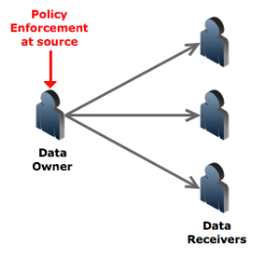
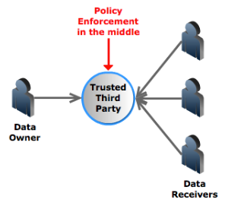
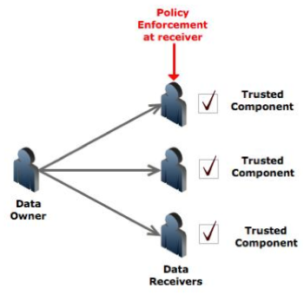
Current Solutions for Data Dissemination
Requires owner
availability
Single point of
failure
Requires presence
of a trusted
component on host
Traditional approaches:
Data are considered passive entities unable to protect themselves
Require another active and trusted entity to protect them – a trusted processor, a trusted memory module, a trusted application or a trusted third party

Slide 55
Active Bundle Approach
Active bundle (AB)
  An encapsulating mechanism protecting data carried within it
  Includes sensitive data
  Includes metadata used for managing the privacy
  Includes Virtual Machine (VM)
    performing a set of operations
    protecting data privacy
  VM is dependent on the data and metadata
    Unlike client applications, it is independent of the application that uses the data
AB is used to provide data privacy protection
55

Slide 56
Active Bundle Scheme
  Metadata:
    Access control policies
    Data integrity checks
    Dissemination policies
    Life duration
    ID of a trust server
    ID of a security server
    App-dependent information
    …
E(Name)
E(E-mail)
E(Password)
E(Shipping Address)
E(Billing Address)
E(Credit Card)
…
  Sensitive Data:
    Identity Information
    ...
  Virtual Machine (algorithm):
    Interprets metadata
    Checks active bundle integrity
    Enforces access and dissemination control policies
    …
* E( ) - Encrypted Information

Slide 57
Active Bundle Operations
Privacy policy enforcement
  Enforces privacy policies included in metadata of the data
Self-Integrity check
  Using a hash function
Evaporation
  Evaporates (a part of) sensitive data when threatened with disclosure
Apoptosis
  Self-destruction of AB’s sensitive data and metadata
57

Slide 58
Components of Active Bundle
Identity data: Data used during authentication, getting service, using service (i.e. SSN, Date of Birth).
Disclosure policy: A set of rules for choosing Identity data from a set of identities in IDM Wallet.
Disclosure history: Used for logging and auditing purposes.
Negotiation policy: This is Anonymous Identification, based on the Zero Knowledge Proofing.
Virtual Machine: Code for protecting data on untrusted hosts. It enforces the disclosure policies.

Slide 59
Enabling AB
Notes:
For initialization the owner of sensitive data constructs an AB by putting together data, metadata, and adding a virtual machine. After this stage, the AB becomes an active entity, since it has its own virtual machine.
For building an AB:
The AB gets two pairs of public/private keys from a Security Service Agent (SSA) (which is a trusted third party), where the first pair of keys is used for encrypting the AB and the second pair of keys is used for signing/verifying the signature of sensitive data included in the AB. The reason for having two key pairs is to prevent attackers from modifying AB’s sensitive data and signing it again with the public key of the data owner.
The AB sends a request to SSA asking it to record the AB’s security information. The AB’s identity data includes its name, a decryption key, and the trust level that a host must satisfy to use the AB. The goal is to keep the decryption keys and other auxiliary data for ABs in a trusted location. The decryption keys are given only to hosts that are eligible to access the AB.
The AB computes a hash value for sensitive data and signs them using the signature key. The signature certifies that sensitive data is from its owner.
The AB encrypts sensitive data using the encryption key.
After arriving at the destination host, the AB enables itself. The steps of the enabling algorithm seen in this figure are as follows:
Step 1: AB sends a request to SSA asking for the security information on AB and the host’s trust level.
Step 2: AB checks if the host’s trust level is lower than the minimal trust level required for AB access. If so, the AB apoptosizes (i.e. completely destroys itself), otherwise, it executes Step 4.
Step 4: AB checks integrity of its sensitive data. It computes the hash value for sensitive data and it verifies the AB’s signed hash value by comparing it to the computed hash value. If verification fails, AB apoptosizes (Step 5); otherwise, the AB decrypts the data (Step 6).
Step 7: AB enforces its privacy policies.
Step 8: AB provides the output to the host.
Step 9: AB sends audit information to an Audit Services Agent. This information includes AB’s name, the host’s identity, and the name of the event being audited (“the move to the host”).

Slide 60
TTP-based Implementation of Active Bundle Approach
Can use Trusted Third Party (TTP) to enable dissemination of ABs
The role of TTP is:
  Generate and store cryptographic keys for Abs
  Trust management of requestors
  Authorize hosts wishing to access ABs
  Provide the cryptographic keys to ABs so that ABs can deliver contents to their authorized hosts

Slide 61
TTP-based Implementation of Active Bundle Approach—Cont.
Tools used to develop the prototype
  Programming language Java 1.6.01
  Development environment Eclipse 3.5.2
  Cryptographic libraries: Java cryptographic libraries
    Java Cryptography Architecture (JCA)
    Java Cryptography Extension (JCE)
  JADE
    A software framework that provides basic MA middleware functionalities

Slide 62
Improvements in the AB Scheme
Policy-based selective dissemination
Decrease dependence on Trusted Third Party (TTP)
Resilience against malicious receivers

Slide 63
Improving the AB Scheme
Policy-based selective dissemination
  Organize data in AB into separate items
  Encrypt each item with a separate key
  Specify XACML based access policies for authorization for an item or a set of items

Slide 64
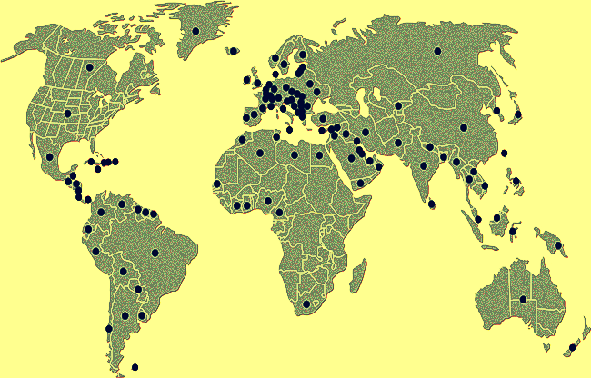
Improving the AB Scheme
Decreasing dependence on TTP
  Use Shamir’s threshold secret sharing technique
    Split decryption keys into n shares
    Set a threshold t such that t (<n) shares are required for key reconstruction
  Use a public Distributed Hash Table (DHT) to store key shares at random nodes
K2
K1
K: {k1, k2, k3,…, kn}
Kn
K3
AB key distribution
K2
K1
Kn
{k1, k2,…, kt}: K
K3
AB key reconstruction

Slide 65
Advantages of using DHT
  Decentralized storage with no single point of trust
  Huge scale with millions of geographically distributed nodes
    Hard to deduce key shares
    Difficult to compromise nodes that store key shares
  Refresh key shares periodically
    Ensures availability when nodes crash or leave
    Protects against attacks

Slide 66
Improving the AB Scheme
Protection Against Malicious Hosts
  Use TPM (trusted platform module) to ensure that host is not already compromised
  Intertwine code and data together – hide data within the code to make it incomprehensible
  Use polymorphic code – code changes itself each time it runs but its semantics don't change
  Can store the control flow information in random DHT nodes
  Perform code obfuscation - hide data and real program code within a scrambled code
Notes:
Make it harder for the malicious host or the attacker
TPM is a security hardware component. It can facilitate numerous important capabilities, such as authentication, hardware-based encryption, digital signing, secure key storage, and attestation of software installed on hardware. For encryption and signing, TPM uses keys stored in a protected hardware storage [7]. TPM enables building trustworthy computing relationships. For instance, it can be used to prevent tampering software from exploiting the chain of trust [8]. For building a chain of trust, TPM evaluates a hash function for the host’s BIOS, and compares this hash value to a value stored by the TPM. If both values are equal, then the BIOS can be trusted (else, it can not). If the BIOS is trustworthy, it can in turn be used to determine trustworthiness of the operating system (OS) loader. If the OS loader is trustworthy, it can in turn be used to determine trustworthiness of the OS [8].
Genetic algos – mutation/crossover
This technique can be used to hide the code and protect its execution. The main code is encrypted and a decryption function is added to the code. When the code executes, the decryption function reads the main encrypted code and decrypts it before executing it in turn. To gain polymorphic behavior, the encryptor/decryptor function pair are mutated with each copy of the code. This allows different versions of same code while all function the same semantically. Such techniques make it difficult for the malicious host to recognize the VM algorithm and code because it constantly mutates by rewriting the unencrypted decryption engine (and the resulting encrypted payload) each time it runs.
The idea is to use program obfuscation to develop means to scramble code so that it still works, but provably cannot be reverse engineered [22]. A code obfuscator is a tool, which repeatedly applies semantics-preserving code transformations to a program [23]. The obfuscator tries to make a program as incomprehensible as possible in order to protect it from being reverse-engineered or to protect a secret stored in the program from being discovered. Typically, code obfuscating transformations use the following operations: fold/flatten (turn a d- dimensional construct into d+1 or d-1 dimensional ones), split/merge (turn a compound construct into two constructs or merge two constructs into one), box/unbox (add or remove a layer of abstraction), ref/deref (add or remove a level of indirection), reorder (swap two adjacent constructs), and rename (assign a new name to a labeled construct). While obfuscation makes a program more difficult to analyze, it comes at a cost: The obfuscated programs usually have greater complexity than their original, optimized counterparts, which causes worse performance. Therefore, the best practice for providing code confidentiality would be to use obfuscation sparingly, only in parts of a program, which include content that must be protected against leakage. Another obfuscation approach is based on using non- decomposable concurrent programming techniques. We propose searching for efficient algorithms able to add “foolproof” dependencies among two (or more) component programs (the original and padding programs) via branching statements. Although the active bundle scheme ensures initial code integrity, it does not offer a mechanism to protect against dynamic changes in the code during execution. Code obfuscation makes it harder for attackers to modify code in a way to achieve malicious goals. Therefore we consider the obfuscation approach for protecting program privacy. Several open-source Java obfuscation tools such as JObfuscator [24] are available, which can be used to obfuscate the AB code.
Memory curtaining extends common memory protection techniques to provide full isolation of sensitive areas of memory—for example, locations containing cryptographic keys. Even the operating system does not have full access to curtained memory. The exact implementation details are vendor specific; Intel's Trusted Execution Technology (TXT) already offers this feature.

Slide 67
Active Bundle Features
Controlled and Selective Dissemination: Control the dissemination and selectively share the data based on the policies
Quantifiable Data Dissemination: Track the amount of data disclosed to a particular host and decide to further disclose or deny data requests
Contextual Dissemination: Context-aware dissemination
Dynamic Metadata Adjustment: Update the policies based on a context, host, history of interactions, trust level etc.
Do not require hosts to have a policy enforcement engine or a trusted component
Doesn’t rely on a TTP
No trusted destination host assumption – works on unknown hosts

Slide 68
Advantages of the Active Bundle Approach
    Ensure protection mechanisms are available for ABs when needed
    No need for a client application to enforce policies associated with the received data
    No need to trust the client application
      The VM is provided by the data owner
    Reduced severity of the risk of code tampering
      VM is dependent on data and input; e.g., encrypt a set of instructions of VM such that the decryption key is a valid input.
      Attacker who accesses one AB does not learn how to access other ABs

Slide 69
Active Bundle Applications
Identity Management in SOA
Mobile-Cloud Pedestrian Crossing Guide Application for the Blind
A Trust-based Approach for Secure Data Dissemination in a Mobile Peer-to-Peer Network of UAVs

Slide 70
A. Identity Management (IDM) Service-Oriented Architecture (SOA)
IDM in traditional application-centric IDM model
  Each application keeps trace of identities of the entities it uses.
IDM in SOA
  Entities have multiple accounts associated with a single or multiple service providers (SPs).
  Sharing sensitive identity information along with associated attributes of the same entity across services can lead to mapping of the identities to the entity.

Slide 71
Goals of IDM
Authenticate without disclosing data (Unencrypted data)
Use service on untrusted hosts (hosts not owned by user)
Minimal disclosure and minimize risk of disclosure during communication between user and service provider (Man in the Middle, Side Channel and Correlation Attacks)
Independence of Trusted Third Party

Slide 72


Anonymous Identification
  Use of Zero-knowledge proofing for user authentication without disclosing its identifier.
User VM on Amazon Cloud
ZKP Interactive Protocol
User Request for service
Function f and number k
E-mail
Password
f_{k}(E-mail, Password) = R
E-mail
Password
Authenticated R is correct

Slide 73










Interaction using Active Bundle
AB information disclosure
Active Bundle Destination
User Application
Active Bundle
Active Bundle Creator
Active
Bundle (AB)
Key Management
Security Services
Agent (SSA)
Trust Evaluation
Agent (TEA)
Active Bundle Services

Slide 74


Predicate over Encrypted Data
  Verification without disclosing unencrypted identity data.
Predicate Request*
E-mail
Password
E(Name)
E(Shipping Address)
E(Billing Address)
E(Credit Card)
E(Name)
E(Billing Address)
E(Credit Card)
  *Credit Card Verification Request

Slide 75
Multi-Party Computation
  To become independent of a trusted third party
    Multiple Services hold shares of the secret key
    Minimize the risk
Predicate Request
E(Name)
E(Billing Address)
E(Credit Card)
K’₁
K’₂
K’₃
K’_{n}
Key Management Services
  * Decryption of information is handled by the Key Management services

Slide 76
Multi-Party Computation
  Credit Card Verified
Predicate Reply*
Name
Billing Address
Credit Card
K’₁
K’₂
K’₃
K’_{n}
Key Management Services

Slide 77

Selective Disclosure
  User Policies in the Active Bundle dictate dissemination
Selective disclosure*
E-mail
Password
E(Name)
E(Shipping Address)
E(Billing Address)
E(Credit Card)
E-mail
E(Name)
E(Shipping Address)
*e-bay shares the encrypted information based on the user policy

Slide 78

Selective Disclosure
Selective disclosure*
E-mail
E(Name)
E(Shipping Address)
E(Name)
E(Shipping Address)
*e-bay seller shares the encrypted information based on the user policy

Slide 79
Selective Disclosure
Selective disclosure
E-mail
E(Name)
E(Shipping Address)
Name
Shipping Address
  Decryption handled by Multi-Party Computing as in the previous slides

Slide 80

Selective Disclosure
Selective disclosure
E-mail
E(Name)
E(Shipping Address)
Name
Shipping Address
  Fed-Ex can now send the package to the user

Slide 81

Identity revealed to Vendors
User on Amazon Cloud
E-mail
Password
Name
Billing Address
Credit Card
Name
E-mail
Password
Billing Address
Shipping Address
Credit Card
E-mail
Name
Shipping Address

Slide 82
Advantage of AB for IDM
Ability to use Identity data on untrusted hosts
  Self Integrity Check against Corruption of AB content
  Compromised AB leads to apoptosis
Establishes the trust of users in Requesters
  Through putting the user in control of who has her data and how it is disseminated
Independent of Third Party
  Minimizes identity correlation attacks
Minimal disclosure to the requester.

Slide 83
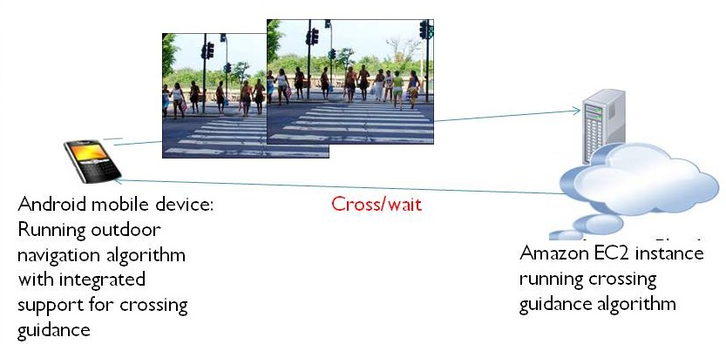
B. Mobile-Cloud Pedestrian Crossing Guide for the Blind
Bundle the image, position, and destination as well as the computation in an active bundle; send the AB to the cloud service
Process the code and return the AB to the mobile
Ensure data are protected; e.g., removed from the cloud when processing finishes.
Notes:
One problem we picked within this domain was helping blind people cross at street intersections. The Mobile-Cloud computing solution we propose for this problem has the simple system architecture we see on this slide. The two main components are the Android device with integrated GPS receiver and compass, and the cloud server, which is responsible for processing the image frames received from the mobile device.
The proposed crossing guidance system works as follows:
The Android Application captures the GPS signal and communicates with the Google Maps Server, to determine the current location of the blind user.
Once the application detects that the blind user is at an urban intersection, it triggers the phone camera to take a picture, and send the picture to the Server running on the Amazon EC2 Cloud.
The server then does the image processing, applying the Pedestrian Signal Detection algorithm, and returns the result about whether it is safe for the blind user to cross the intersection.
If the result is positive, the Android Application notifies the blind user to cross the intersection with speech feedback.

Slide 84
C. A Trust-based Approach for Secure Data Dissemination in a Mobile Peer-to-Peer Network of UAVs
Mobile peer-to-peer networks of unmanned aerial vehicles (UAVs) have become significant in collaborative tasks including military missions and search and rescue operations
Data communication (over shared media) between the nodes in a UAV network makes the disseminated data prone to interception by malicious parties, which could cause serious harm for the designated mission of the network
A scheme for secure dissemination of data between UAV nodes is needed

Slide 85



Proposed Data Protection Scheme
Trust Evaluation Server
Producer
Consumer
Application
Security Server
Filtered Data
Data Protection
Mechanism (Active Bundle)
Identity Management
1.Data producer UAV (publisher) invokes its data sharing application
Middleware
2.The application gets the desired data from the data folder and bundles it along with the policy for data protection in the protection structure proposed (active bundle)
Data Folder
Services provided by
Trusted Third Parties
3.The active bundle consults trusted third party services to determine the trust level of the destination UAV(consumer)
4.The active bundle filters its data based on the trust level of the consumer and the matching of policies between the producer and consumer and presents the filtered data to the consumer.

Slide 86
Dynamic Trust Calculation
The trust calculation component works like a reputation system, where the trustworthiness of a node is evaluated based on various dynamic parameters
Trust parameters vary with the scenario in which the UAVs communicate, and have different weights
Computed trust value is used to determine whether it is safe to share the data and the degree of filtering to apply on the data before sharing
Trust value T for a particular UAV u at time t also depends on previous interactions with that UAV and is calculated using the below formula, where α determines how important previous interactions are and P is the trust value determined by the dynamic parameters
T_{u}(t) = α ∙ T_{u}(t-1) + (1- α) ∙ P

Slide 87
Trust Evaluation
Trust level for the destination UAV (data consumer) can be evaluated and verified by a Trusted Third Party and can be based on different parameters such as:
Location: USA, Middle East, Iraq, etc
Security Clearance Level: Top-secret, Secret, Confidential, Unclassified
Bandwidth: High Bandwidth, Low Bandwidth
History of Obligations: Satisfactory, Unsatisfactory
Distance: Not necessarily based on metric distance, i.e. more trusted entities are closer
Authentication Level: Fully authenticated, Partially authenticated, Not authenticated
Context: Emergency, Disaster, Normal etc.

Slide 88



Example of Data Filtering
EPHI (Electronic Private Health Information):
Stored in a relational database, data filtering for different data consumers performed through SQL queries run in the Active Bundle VM
a. Data consumer verified as doctor at the hospital can get all patient data
b. Hospital Receptionist gets filtered data
c. Insurance company gets only the minimal required data

Slide 89
Image Data Filtering Techniques
Low Dynamic Range Rendering: This method applies the reverse of high dynamic range rendering on an image to degrade image quality and hide details.
Pattern Recognition and Blurring: This method involves recognition of specific patterns in the image to black out those high sensitivity areas.
Data Equivalence Techniques: Image can be transformed such that the information content of the image remains the same while the fine grain details change (such as replacing the model number of an aircraft with another model’s).

Slide 90
Data Dissemination Models
Direct Link: UAVs discover each other through broadcast of ALIVE messages and initiate data transfer without involvement of third-party nodes.
Publish-Subscribe: This model requires a third-party (ground controller) called the information broker (IB) to mediate data dissemination between UAVs. The publisher node registers an active bundle with the IB and subscriber receives data from IB after evaluation of its trustworthiness by the IB.

Slide 91
Simulation
Fig.a. UAV Network. Data transfer is initiated from UAV₃ to UAV_{1.} Available bandwidths are displayed on the lines connecting pairs of AVs.
Fig.b. Policy of data sharing is at the top, original data in the middle and the virtual machine status at the bottom. Policy is based on the trust level of the AV: If above 2.5, original data is shared; if below 2.5 but above 2.3, minimal filtering is applied; if between 2.3 and 2.0 greater filtering is applied and if below the threshold of 2.0, no data is shared, in which case the active bundle destroys itself.

Slide 92
Simulation (cont.)
Fig.c. The trust level of the receiver AV is calculated as 2.09, which is higher than the threshold trust level, but not high enough to share the original data.
Fig.d. Data transformed by the virtual machine according to the policy and the transformed data shared with the receiver node. The data shared provides a narrower view of the environment than the original image.

Slide 93
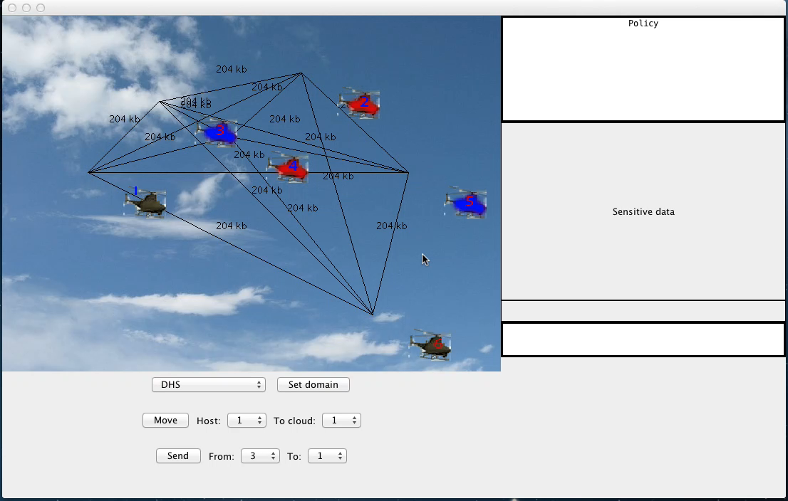
Simulation

Slide 96
Privacy of Sender and Requester in Peer-to-peer Data Sharing
Privacy in peer-to-peer systems is different from the anonymity problem
Preserve privacy of requester
A mechanism is needed to remove the association between the identity of the requester and the data needed

Slide 97
Proposed solution
A mechanism is proposed that allows the peers to acquire data through trusted proxies to preserve privacy of requester
  The data request is handled through the peer’s proxies
  The proxy can become a supplier later and mask the original requester

Slide 98
Related work
Trust in privacy preservation
  Authorization based on evidence and trust, [Bhargava and Zhong, DaWaK’02]
  Developing pervasive trust [Lilien, CGW’03]
Hiding the subject in a crowd
  K-anonymity [Sweeney, UFKS’02]
  Broadcast and multicast [Scarlata et al, INCP’01]

Slide 99
Related work (2)
Fixed servers and proxies
  Publius [Waldman et al, USENIX’00]
Building a multi-hop path to hide the real source and destination
  FreeNet [Clarke et al, IC’02]
  Crowds [Reiter and Rubin, ACM TISS’98]
  Onion routing [Goldschlag et al, ACM Commu.’99]

Slide 100
Related work (3)
[Sherwood et al, IEEE SSP’02]
  provides sender-receiver anonymity by transmitting packets to a broadcast group
Herbivore [Goel et al, Cornell Univ Tech Report’03]
  Provides provable anonymity in peer-to-peer communication systems by adopting dining cryptographer networks

Slide 101
Privacy measurement
A tuple <requester ID, data handle, data content> is defined to describe a data acquirement.
For each element, “0” means that the peer knows nothing, while “1” means that it knows everything.
A state in which the requester’s privacy is compromised can be represented as a vector <1, 1, y>, (y Є [0,1]) from which one can link the ID of the requester to the data that it is interested in.

Slide 102
Privacy measurement (2)
For example, line k represents the states that the requester’s privacy is compromised.

Slide 103
Mitigating collusion
An operation “*” is defined as:
This operation describes the revealed information after a collusion of two peers when each peer knows a part of the “secret”.
The number of collusions required to compromise the secret can be used to evaluate the achieved privacy

Slide 104
Trust based privacy preservation scheme
The requester asks one proxy to look up the data on its behalf. Once the supplier is located, the proxy will get the data and deliver it to the requester
  Advantage: other peers, including the supplier, do not know the real requester
  Disadvantage: The privacy solely depends on the trustworthiness and reliability of the proxy

Slide 105
Trust based scheme – Improvement 1
To avoid specifying the data handle in plain text, the requester calculates the hash code and only reveals a part of it to the proxy.
The proxy sends it to possible suppliers.
Receiving the partial hash code, the supplier compares it to the hash codes of the data handles that it holds. Depending on the revealed part, multiple matches may be found.
The suppliers then construct a bloom filter based on the remaining parts of the matched hash codes and send it back. They also send back their public key certificates.

Slide 106
Trust based scheme – Improvement 1
Examining the filters, the requester can eliminate some candidate suppliers and finds some who may have the data.
It then encrypts the full data handle and a data transfer key with the public key.
The supplier sends the data back using through the proxy
Advantages:
  It is difficult to infer the data handle through the partial hash code
  The proxy alone cannot compromise the privacy
  Through adjusting the revealed hash code, the allowable error of the bloom filter can be determined

Slide 107
Data transfer procedure after improvement 1
Requester Proxy of Supplier
Requester
R: requester S: supplier
Step 1, 2: R sends out the partial hash code of the data handle
Step 3, 4: S sends the bloom filter of the handles and the public key certificates
Step 5, 6: R sends the data handle and encrypted by the public key
Step 7, 8: S sends the required data encrypted by

Slide 108
Trust based scheme – Improvement 2
The above scheme does not protect the privacy of the supplier
To address this problem, the supplier can respond to a request via its own proxy

Slide 109
Trust based scheme – Improvement 2
Requester Proxy of Proxy of Supplier
Requester Supplier

Slide 110
Trustworthiness of peers
The trust value of a proxy is assessed based on its behaviors and other peers’ recommendations
Using Kalman filtering, the trust model can be built as a multivariate, time-varying state vector

Slide 111
Experimental platform - TERA
Trust enhanced role mapping (TERM) server assigns roles to users based on
  Uncertain & subjective evidences
  Dynamic trust
Reputation server
  Dynamic trust information repository
  Evaluate reputation from trust information by using algorithms specified by TERM server

Slide 112
Trust enhanced role assignment architecture (TERA)

Slide 114
Examples of Attacks that can Collaborate (cont’d)
Denial-of-Messages (DoM) attacks
  Malicious nodes may prevent other honest ones from receiving broadcast messages by interfering with their radio
Blackhole attacks
  A node transmits a malicious broadcast informing that it has the shortest and most current path to the destination aiming to intercept messages
Wormhole attacks
  An attacker records packets (or bits) at one location in the network, tunnels them to another location, and retransmits them into the network at that location

Slide 115
Examples of Attacks that can Collaborate (cont’d)
Replication attacks
  Adversaries can insert additional replicated hostile nodes into the network after obtaining some secret information from the captured nodes or by infiltration. Sybil attack is one form of replicated attacks
Sybil attacks
  A malicious user obtains multiple fake identities and pretends to be multiple, distinct nodes in the system. This way the malicious nodes can control the decisions of the system, especially if the decision process involves voting or any other type of collaboration

Slide 116
Examples of Attacks that can Collaborate (cont’d)
Rushing attacks
  An attacker disseminates a malicious control messages fast enough to block legitimate messages that arrive later (uses the fact that only the first message received by a node is used preventing loops)
Malicious flooding
  A bad node floods the network or a specific target node with data or control messages

Slide 117
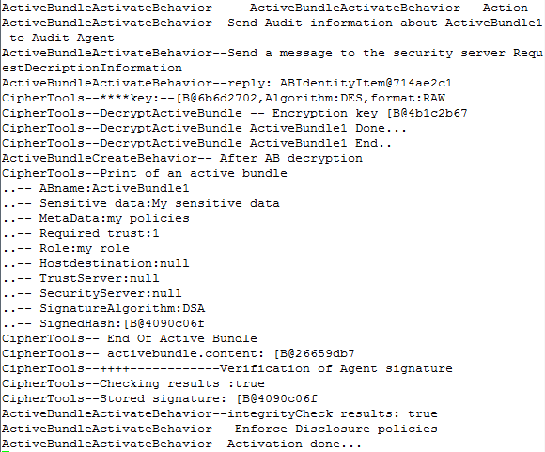
TTP-based Implementation of Active Bundle Approach—Cont.
Log for AB Destination

Slide 118
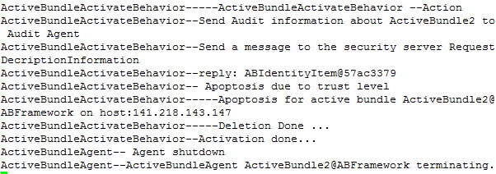
TTP-based Implementation of Active Bundle Approach—Cont.
Log for AB Destination

Slide 119
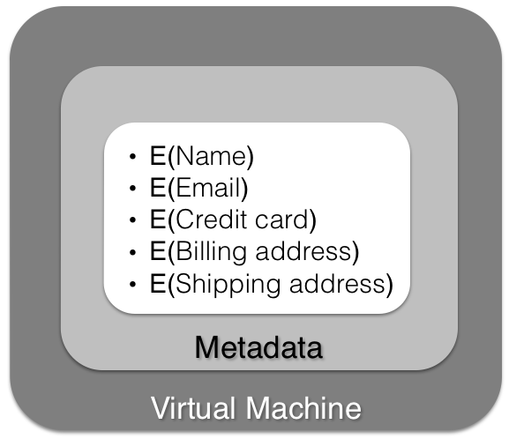
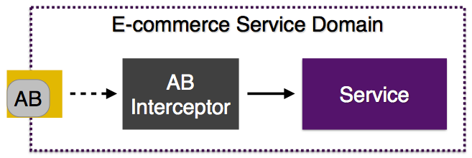
Using AB for IDM in SOA
Step 1
AB Creation
Step 2
AB exchange in the SOAP/REST message

Slide 120
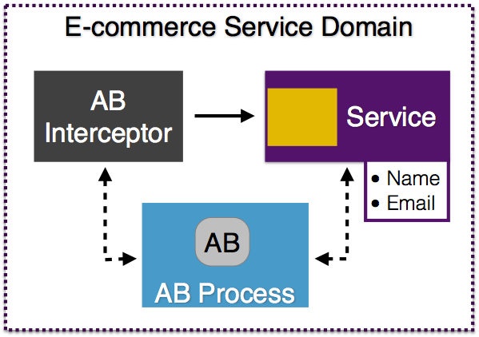
AB-Service Interaction
Step 3
AB extracted
from the
message and
executed

Slide 121
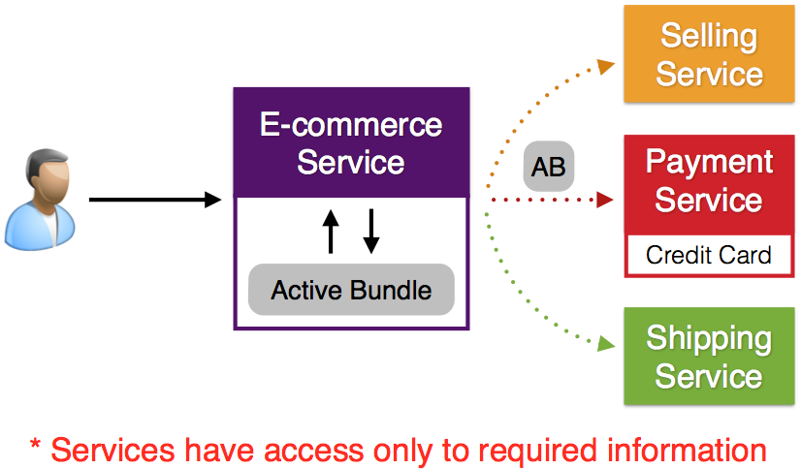
AB-Service Interaction
Services have access only to required information

Slide 122
Usage Scenario
An entity requests a service from an SP (e.g., a website).
SP informs the entity, user must authenticate and provide its identity information (if required).
IDM Wallet uses its policy and determines what claims it should issue given the proof supplied by the claimant and the policy requirements of the SP.
IDM Wallet runs an interactive protocol based on Anonymous Identification with the SP for authentication.
If further required by SP, IDM Wallet creates an AB token and forwards it to the SP. SP then uses its technical policy to decide whether to recognize (authenticate) the user and provides the service.

