Slide 1

Intelligent Autonomous Systems based on Data Analytics and Machine Learning
Bharat Bhargava
Purdue University
17 April 2018
Acknowledgement: This research is supported by NGC Research Consortium.

Slide 2
  Intelligent Autonomous Systems
  According to Wes Bush, CEO of NGC, Autonomous Systems¹ should be
  Able to perform complex tasks without or with limited ongoing connection to humans.
  Cognitive enough to act without a human’s judgment lapses or execution inadequacies.
  Intelligent Autonomous Systems (IAS) are characterized as highly Cognitive, effective in Knowledge Discovery, Reflexive, and Trusted,
¹Wes Bush, Sept. 6, 2016. “The Exciting Future of Autonomous Systems” at KSU
2

Slide 3
Motivation from NGC – A Holistic Approach
  Autonomous systems should not only learn at the network level but they should learn about their environment.
  Autonomous systems should be able to be trained with
  Meta-data, limited data, incomplete data, and unknown (new) data
  Dynamic and unpredictable environment
  We discussed these ideas with Jason Kobes and Paul Conoval.
3

Slide 4
Collaboration with NGC IRADs
  IAS implementations contribute to the following IRADs with machine learning and data analytics to enhance autonomy in smart cyber systems.
    Adaptive Real-Time Detection and Examination Network IRAD
    Automated Mission Planning for Autonomous Systems IRAD
    Distributed Data Processing IRAD
    Enterprise Information Management System and Analytics IRAD
    Information Analytics IRAD
    Rapid Autonomy Prototype Implementation & Demonstration IRAD
    Reliability Analysis Data System IRAD
    Smart Autonomy IRAD
    Cyber Resilient DevOps IRAD
4

Slide 5
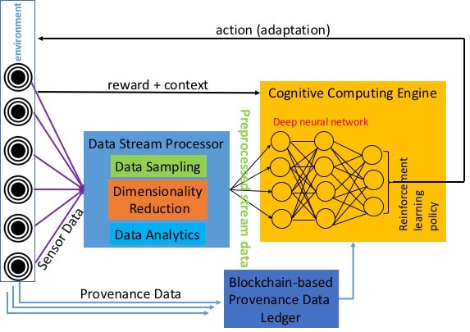
Comprehensive IAS Architecture
Adaptive action
Anomaly Detection
5

Slide 6
Implementation of Components of IAS
  Cognitive Autonomy & Knowledge Discovery:
  Monitors and records system’s activities (Data provenance and sequence of system calls)
  Conducts privacy-preserving aggregated analytics on provenance data.
  Utilizes Deep learning based anomaly detection by analyzing sequence of system calls.
  Reflexivity:
  Adaptive actions are performed through graceful degradations without disrupting the ongoing critical processes by incremental learning.
  Trust:
  Uses blockchain for storing provenance data for trust.
6

Slide 7
Demo Description
  There are three components that are demonstrated.
  Demo 1 (Cognitive Autonomy/Knowledge Discovery):
  System is monitored and its interactions with client services are recorded as provenance data.
  Privacy-preserving aggregated data analytics are performed on the provenance data.
  Sensitive data is perturbed with random noise and the noise is removed at the end to obtain aggregated result, protecting the privacy of individual entities.
  A Deep Learning based anomaly detection is implemented to protect against code-hijacking attacks.
7

Slide 8
Demo Description
  Demo 2 (Reflexivity):
  Under anomalous operating contexts or attacks, the replicas in the replacement scheme based on Combinatorial balanced designs take over the processing from primary module.
  Replicas are updated with system states periodically (Update interval is determined through Bayesian inference of system’s operating context).
  Unused replicas are used for other processes simultaneously, which makes the system faster and fault-tolerant.
8

Slide 9
Demo Description
  Demo 3 (Trust):
  A scheme that guarantees the integrity of provenance data is implemented.
  Capacity to verify every transaction in IAS.
9

Slide 10
Demo Video Presentation
10

Slide 11
Implementation and Deliverables
Reflexivity prototype for combinatorial replica scheme:
Source code: Node.js implementation, Bayesian model, simulation software developed for combinatorial design, and Data used for simulation. Link: https://goo.gl/M4rXCN
The prototype is built with FAYE framework (https://faye.jcoglan.com/node.html) with Node.js.
Replica updates are done through a combinatorial design simulator (https://goo.gl/pgVHdk).
Deep Learning based anomaly detection prototype: In progress.
Blockhub prototype for secure blockchain-based data distribution:
Source code: https://github.com/Denis-Ulybysh/Waxedprune2018
codebase is taken from open-source “Marbles” project https://github.com/IBM-Blockchain/marbles/tree/v4.0
Documentation: Demo video and User manual for running the prototype.
11

Slide 12
Publications
https://www.cs.purdue.edu/homes/bb/#research
https://www.cs.purdue.edu/homes/bb/#colloquia
M. Villarreal-Vasquez, B. Bhargava, P. Angin, N. Ahmed, D. Goodwin, K. Brin and J. Kobes. “An MTD-based Self-Adaptive Resilience Approach for Cloud Systems.” IEEE CLOUD 2017.
M. Villarreal-Vasquez, B. Bhargava and P. Angin. “Adaptable Safety and Security in V2X Systems.” IEEE ICIOT 2017.
Ulybyshev, B. Bhargava, M. Villarreal-Vasquez, D. Steiner, L. Li, J. Kobes, H. Halpin, R. Ranchal, A. Alsalem "Privacy - Preserving Data Dissemination in Untrusted Cloud", IEEE CLOUD, 2017
G. Mani, B. Bhargava, B. Shivakumar, J. Kobes "Incremental Learning Through Graceful Degradations in Autonomous Systems", IEEE ICCC, June 2018 (In Submission).
G. Mani, B. Bhargava, P. Angin, M. Villarreal-Vasquez, D. Ulybyshev, J. Kobes "Machine Learning Models to Enhance the Science of Cognitive Autonomy", IEEE ICCC, June 2018 (In Submission)
G. Mani, B. Bhargava” Scalable Learning Through Error-correcting Codes based Clustering in Autonomous Systems", IEEE ICCC, June 2018 (In Submission)
G. Mani, D. Ulybyshev, B. Bhargava, J. Kobes, P. Goyal"Autonomous Aggregate Data Analytics in Untrusted Cloud", IEEE ICCC, June 2018 (In Submission).
G. Mani, B. Bhargava. "Graceful Degradation in Autonomous Systems Based on Combinatorial Learning Model". (In Submission).
D. Ulybyshev, M. Villarreal-Vasquez, B. Bhargava, G. Mani, S. Seaberg, P. Conoval, D. Steiner, J. Kobes "Blockhub: Blockchain-based Software Development System for Untrusted Environments", IEEE CLOUD 2018, (In Submission).
D. Ulybyshev, B. Bhargava, A. Alsalem "Secure Data Exchange and Data Leakage Detection in Untrusted Cloud", ICACCT 2018 (Accepted, in-press).
12

Slide 13
Reflexivity
A Solution Based on Graceful Degradation
13

Slide 14
Comprehensive Architecture of IAS
Reflexivity
Adaptive action
Anomaly Detection
14

Slide 15
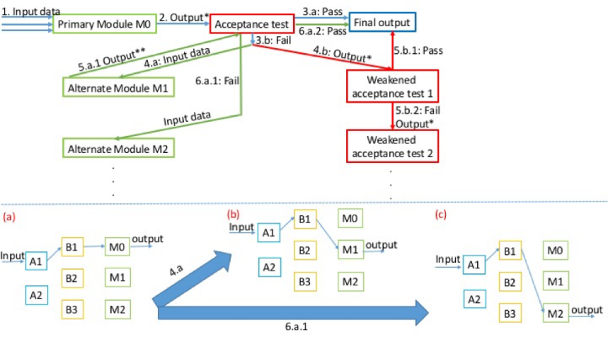
Generic Model of Dynamic Adaptation
15

Slide 16
Solved Problem
Given a smart cyber system operating in a distributed computing environment, it should be able to:
  Replace anomalous/underperforming modules
  Swiftly adapt to changes in context
  Achieve continuous availability even under attacks and failures⁴.
⁴Thomas E. Vice, Corporate VP of NGC. Sep. 06, 2016. “"Future of Advanced
Trusted Cognitive Autonomous Systems,” at Purdue University
16

Slide 17
Graceful Degradations:
Combinatorial Replica Replacement Scheme
Replica replacement by Combinatorial Balanced-blocks:
N systems (S1…S7) are split into M subset blocks (DAB1…DAB7) of size R (3 : S1, S5, S7). Each system appears in C blocks (3 out of M). Each system pair appears in ∆ blocks (only 1). We implemented (N, M, R, C, ∆) = (7, 7, 3, 3, 1). Example on next slide.
Each distributed block contains a subset of systems and their replicas that are mathematically distributed and connected, providing balanced resource usage.
The replicas periodically receive updates from their primary modules. Update interval is set based on Bayesian inference.
Replicas can be used to perform other tasks in parallel while primary module is functioning properly.
17

Slide 18
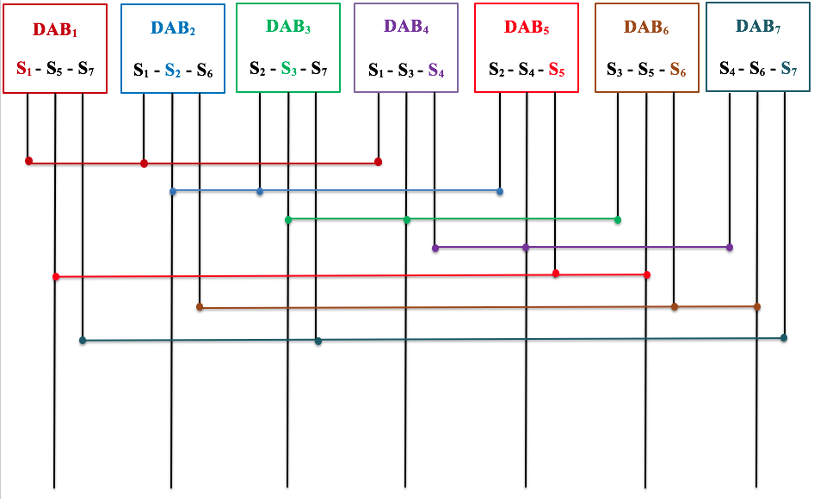
(7, 7, 3, 3, 1)-configuration
DAB: Distributed Autonomous Block
18

Slide 19
Measurements for Various Process Completions
Process Type | Process Name | Speed Up Due to Combinatorial Replica Scheme (Compared to regular sequential design)
P1 | FIBSEARCH | 1.3
P2 | DOUBLE MULT | 1.4
P3 | FIBB | 1.5
P4 | SEARCH | 1.8
P5 | COPY | 1.8
P6 | SCALAR | 2
P7 | SUM | 2.1
P8 | PRINT | 3
P9 | MOVEMENT | 3.1
19

Slide 20
Measurements for Various Process Completions
Number of state migrations
Process Types
20

Slide 21
Cognitive Autonomy / Knowledge Discovery
A Deep Learning Based Anomaly Detection Solution
21

Slide 22
Comprehensive Architecture of IAS
Cognitive Autonomy and Knowledge Discovery
Adaptive action
Anomaly Detection
22

Slide 23
Problem Statement
Programs store Return Addresses (control flow) along with data in the stack.
Control-hijacking attacks execute arbitrary code on the target IAS program by hijacking its control flow.
A Deep Learning (DL) based anomaly detection technique has been developed to protect IAS programs against these attacks
Stack Frame
Local
Variables
EBP
Return
Address
Parameters
23

Slide 24
Problem Statement
Programs store Return Addresses (control flow) along with data in the stack.
Control-hijacking attacks execute arbitrary code on the target IAS program by hijacking its control flow.
A Deep Learning (DL) based anomaly detection technique has been developed to protect IAS programs against these attacks
Data overrides
Return Address
Stack Frame
Local
Variables
EBP
Return
Address
Parameters
23

Slide 25
Research Approach
An event e_{i} is defined defined as a function call (system or library call) in the execution trace of a program.
Use Deep Learning to answer the binary classification problem of given a sequence of function calls (or system events) e₁e₂e₃…e_{k} whether or not the sequence should occur?
24

Slide 26
Research Approach
An event e_{i} is defined defined as a function call (system or library call) in the execution trace of a program.
Use Deep Learning to answer the binary classification problem of given a sequence of function calls (or system events) e₁e₂e₃…e_{k} whether or not the sequence should occur?
System Events
Given this sequence at time t-1
24

Slide 27
Research Approach
An event e_{i} is defined defined as a function call (system or library call) in the execution trace of a program.
Use Deep Learning to answer the binary classification problem of given a sequence of function calls (or system events) e₁e₂e₃…e_{k} whether or not the sequence should occur?
System Events
Given this sequence at time t-1
At time t, should this sequence occur?
24

Slide 28
Types of attacks and mitigation
Attacks:
Code injection: Malicious instruction sequences are executed using injected codes in the data portion of the stack. Examples: buffer overflow and buffer specified injection
Code reuse: Malicious instruction sequences are executed without injecting external code. Examples: Return-oriented programming and memory disclosure.
Mitigation:
Control Flow Integrity (CFI) is required.
Deep Learning is used to guarantee Control Flow Integrity (CFI) as the model detects non-conforming sequences of execution traces in run time.
25

Slide 29
Deep Learning Based Anomaly Detection
For a given program, a code coverage is conducted to obtain all the possible execution traces.
An event e_{i} is defined defined as a function call (system or library call) in the execution trace of a program.
Each possible system event (function calls) is uniquely identified as they will form the vocabulary of system events.
The Deep Learning model (neural network) is trained with the obtained sequences of events.
The model is based on Recurrent Neural Networks: Long-Short Term Memory (LSTM) and Gated Recurrent Units (GRU.)
26

Slide 30
Deep Learning Based Anomaly Detection
After training, given a sequence of events as input, the neural network produces as output an array of probabilities, one for each of the possible events in the system.
At any time t each possible event (system call or library call) in the system is assigned a probability estimated with respect to the sequences of events observed until time t-1.
At classification time t, the decision is made with respect to a pre-defined threshold of the top-k most likely events.
27

Slide 31
Deep Learning Based Anomaly Detection
Set of all system events
Neural Network
28

Slide 32
Deep Learning Based Anomaly Detection
Sequence of system events at time t-1
Set of all system events
Neural Network
28

Slide 33
Deep Learning Based Anomaly Detection
Sequence of system events at time t-1
Set of all system events
New event
at time t
Neural Network
28

Slide 34
Deep Learning Based Anomaly Detection
Sequence of system events at time t-1
Set of all system events
New event
at time t
Neural Network
Input
28

Slide 35
Deep Learning Based Anomaly Detection
Sequence of system events at time t-1
Set of all system events
New event
at time t
Neural Network
Input
Output
[p1, p2, p3, p4, p5, p6, p7]
Probabilities of
possible events
28

Slide 36
Deep Learning Based Anomaly Detection
Sequence of system events at time t-1
Set of all system events
New event
at time t
Neural Network
Input
Output
[p1, p2, p3, p4, p5, p6, p7]
Probabilities of
possible events
At time t, the new event is classified as normal if its probability is in the top-k
probabilities; anomalous otherwise
28

Slide 37
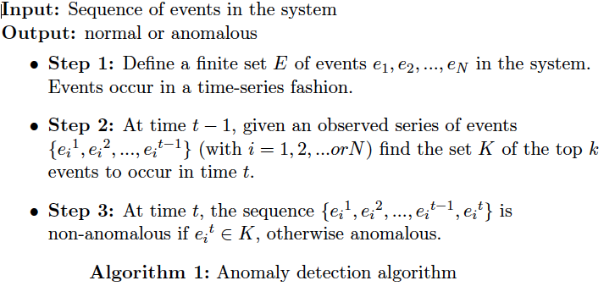
Deep Learning Based Anomaly Detection
29

Slide 38
Trust
A Solution Based on Blockchain
30

Slide 39
Comprehensive Architecture of IAS
Trust
Adaptive action
Anomaly Detection
31

Slide 40
Problem Statement
Provide trust (integrity, confidentiality, verifiability) to provenance data in IAS
  Interactions between services are logged
  Log records can not be corrupted
Provide trust for network participants in IAS
  Ensure data confidentiality
  Ensure data integrity
Provide privacy-preserving data exchange in IAS
32

Slide 41
Blockchain Technology Deployment
Fine-grained role-based and attribute-based access control with data leakage detection capabilities is provided by integration with ‘WAXEDPRUNE’
Performance improvements:
  Depth-robust graphs (in collaboration with Prof. Blocki, Purdue) to store blockchain for faster transaction verification: no need to verify all the links in the chain
33

Slide 42
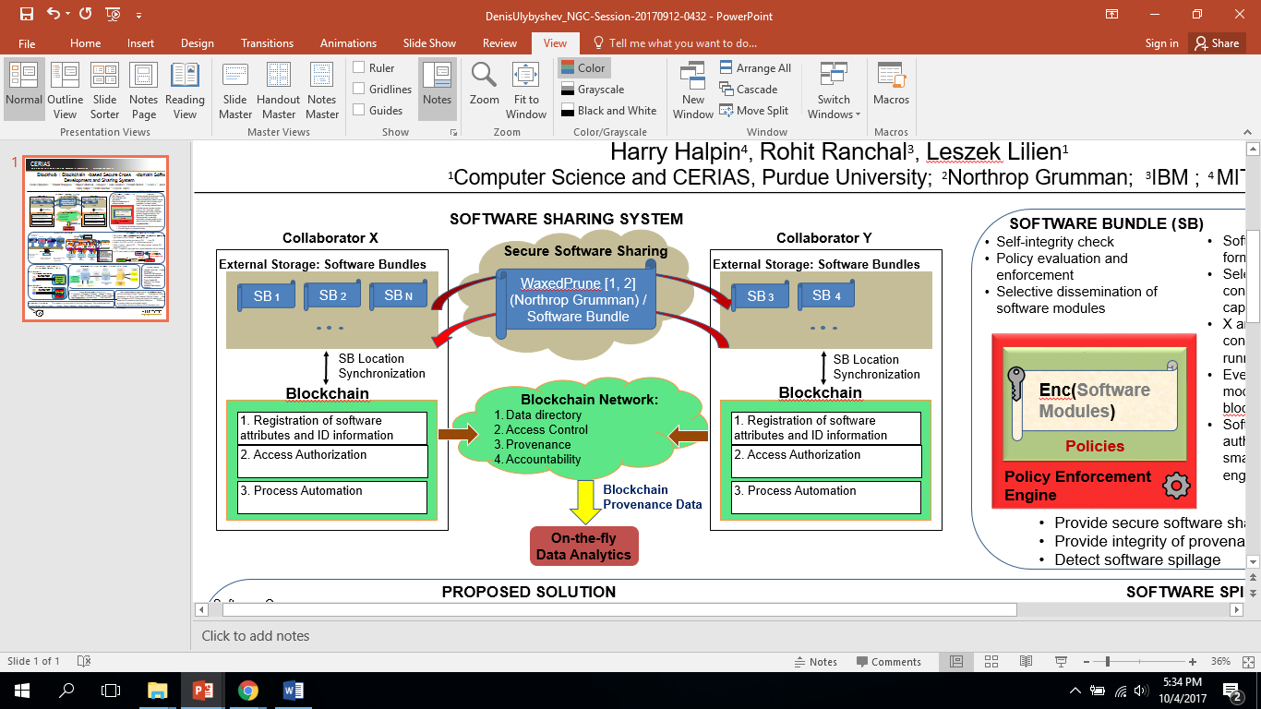
Blockhub: blockchain-platform for IAS
34

Slide 43
Future Work
Failure Recovery (proposed by Steve Seaberg, NGC)
  Need to maintain consistency in mobile environment with intermittent connectivity
  Need quantification of performance parameters after a varying period of connectivity breakdown
  Need to determine how much bandwidth and resources are needed to make network nodes consistent (or current)
35

Slide 44
Thank you!!!
36

