Slide 1
Northrop Grumman Cybersecurity Research Consortium (NGCRC) Spring 2015 Symposium
Monitoring-based System for E2E Security Auditing and Enforcement in Trusted and Untrusted SOA
29/30 April 2015
PI: Prof. Bharat Bhargava
Purdue University
Technical Champions: Dr. Sunil Lingayat, Dr. Jason C. Kobes

Slide 2
Project Participants
Prof. Bharat Bhargava
Dr. Pelin Angin
Rohit Ranchal, PhD student
Denis Ulybyshev, PhD student
Prof. Leszek Lilien
Dr. Lotfi ben Othmane

Slide 3
Problem Statement
Trust Domain
Service B
Service A
Service C
Service D
SOA: Loosely coupled independent services are composed to accomplish tasks
Involves interactions of trusted and untrusted services
No client control on the chain of service invocations
Problems:
Attackers can gain control of a number of services, modify a service or get access to in-transit messages
Client does not have ability to specify service interaction policies
Violations, malicious activities and failures in a trusted service domain may remain undetected
Services are not verified or validated dynamically (uninformed selection of services)
Malicious activity may cause service disruptions

Slide 4
Problem Statement
Trust Domain
Service B
Service A
Service C
Service D
There is need for novel techniques to
Monitor service activity
Discover and report service misbehavior
Ensure security and privacy of data in SOA and clouds.
If a service is compromised or misbehaves, the service monitor should
Discover malicious activity
Provide feedback
Take remedial actions
Adapt according to changes in context.

Slide 5
Benefits
We propose a novel method of dealing with security problems in SOA:
Monitoring all interactions among services in a domain
Provides increased awareness of security violations
Proactive treatment of potentially malicious service invocations
Leads to increased security
Dynamic trust management of services in a domain
Enables timely detection of potentially compromised services
Agile and resilient defense mechanisms
Ability to adapt in the presence of anomalies
Dynamic reconfiguration of service compositions
Privacy preservation in service interactions
Prevention of data leakage
The monitoring-based security solution:
Provides enforcement of security policies in addition to auditing capability
Offers a proactive security solution by detecting anomalies across individual service interactions and at the domain level
Ensures uninterrupted service even under attacks and failures
Provides a transparent mechanism for service monitoring that can be used in standard web service frameworks

Slide 6
Technical Approach Overview
Service Monitor
Active Bundle
Service 1
request
Instrumentation
Passive
Passive Listener
Passive Monitoring Algorithms
Active
Interaction Authorization Algorithms
Active Listener
request
(if authorized)
Active Bundle State Listener
response
request
Service 2
Heartbeat & Inflow Listener
Policies
Dynamic Service Composition
reconfiguration
Anomaly Detection
Trust Management
Service monitor intercepts all client-service/service-service interactions.
The approach aims to provide a unified security architecture for SOA and cloud by integrating components for:
Service trust management
Interaction authorization between different services
Anomaly detection based on service behavior
Dynamic service composition
Secure data dissemination using active bundles

Slide 7
Solution Components
Policies
Passive Listener
Active
Listener
Active Bundle
Listener
Heartbeat Module
Log
Detect
React
Authorize
Analyze
Trust Management
Agile Defense
Resiliency & Adaptability
Agile Defense
Anomaly Detection

Slide 8
Agile Defense
Goals:
Replace anomalous services with reliable versions
Reconfigure service orchestrations in response to anomalous service behavior
Swiftly adapt to changes in context
Ensure continuous availability even under attacks and failures
Components:
Monitor service status and determine action
Update service health status in case of significant deviations from normal behavior
Create service backup in case of suspicion of anomaly
Re-deploy service in case of complete failure
Dynamic service reconfiguration based on changes in context
Adapt priorities (e.g. response time vs. level of detail/accuracy)
Adapt constraints (e.g. trust levels of all services > T for critical mission)
Dynamically replace failed services in composition with healthy ones to avoid complete restart of business process
Controlled sharing of data
Determine data dissemination based on the requirements and authorization level of the subscriber
Limit data disclosure based on trust level of subscriber
Control dissemination based on changes in context (e.g. emergency, attack, etc.)

Slide 9
Distributed Service Monitoring for Cross-domain Anomaly Detection and Adaptability
*: service request data
*: summary service health data
S4
*
M_{B}
*
S5
S1
S6
*
Domain B
*
*
S2
M_{C}
*
S7
M_{A}
*
*
S3
*
S9
Domain A
Domain C
*
*
S10
*
S11
*
*
M_{D}
*
M_{E}
*
S12
Domain D
Central Monitor
Domain E
Each monitor M_{X} tracks all requests in its domain, gathering response time, heartbeat data, response status, authorization/authentication failures, and reports summary to central monitor.
Distributed monitoring allows for collection, analysis and reaction to dynamic cyber events, preventing propagation of threats within or outside the domain of anomalous service.

Slide 10
Anomaly Detection Approach
Statistical analysis of multivariate time-series data collected by service monitors to detect significant deviations from normal behavior
Adjusts service threat levels based on duration, extent & type of anomalies
Correlation of time-series data from multiple services allows for detection of bigger threats (affecting the whole domain, collaborative attacks etc.)
Ability to detect zero-day attacks as opposed to signature-based models
Diagnosis: Anomaly affecting S1
Response: Replace S1
Diagnosis: Anomaly affecting whole domain
Response: Re-deploy all services in different domain /switch to backup versions in different domain

Slide 11
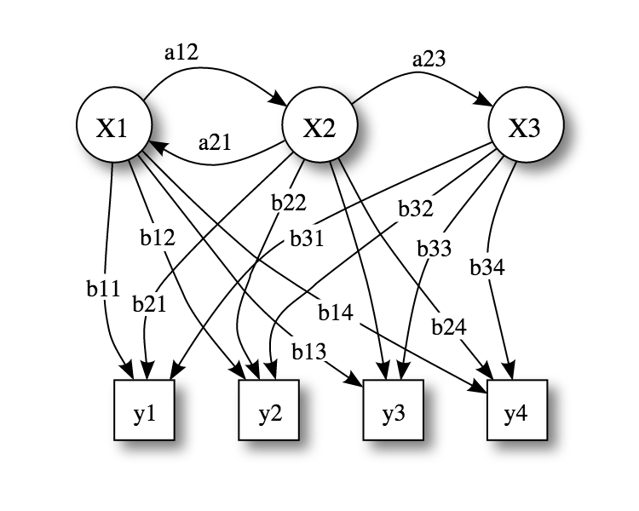
Hidden Markov Models (HMM) for Anomaly Detection
HMM: Simplest dynamic Bayesian network model
Consists of states X and an observation sequence (output tokens) Y, whose probability of occurrence depends on the state
States hidden, but outputs of each state observed
Sequence of observations related to each other
Task: Given model’s parameters and sequence of observations, compute distribution over the hidden states of the last variable in the sequence
a_{ij}: State transition probabilities, b_{ij}: Output probabilities
X_{i}: States (normal, attack, high load, failure etc.)
y_{i}: Observations ({low response time, high response time, normal response time},
{high CPU usage, no CPU usage, normal CPU usage}…)
Train HMM with service operation data under normal conditions (to detect anomalies)
Merge with measure of distance between different sets of time-series data to assess
significance of deviation from normal

Slide 12
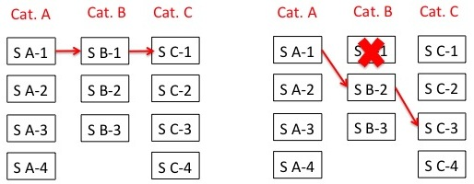
Dynamic Service Composition Reconfiguration
An SOA service orchestration is composed of a series of services that interact with each other based on a service interaction graph
One of the multiple services in each service category can be selected for specific service functionality,
E.g. category: weather, services: weather.com, Yahoo weather, accuweather
Challenge: Configuring set of services to comply with SLA and security policy requirements
Dynamic service composition reconfiguration is based on
Changes in context
Type, duration, extent of attacks and failures

Slide 13
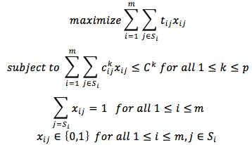
Dynamic Service Composition Approach
This problem is an instance of the multiple-choice multiply-constrained knapsack problem (MMKP):
t_{ij:} utility of service j in category i
x_{ij}: indicator for participation in a service composition (of service j in category i)
c_{ij}^{k}: value of service j in category i for constraint category k
C^{k}: threshold value for constraint category k
S_{i}: set of services in category i p: number of constraints m: number of service categories
MMKP is NP-hard, therefore we use a greedy heuristic-based approach to find near-optimal solutions

Slide 14
Dynamic Service Composition Experiments
Dynamic service composition overhead is especially important in time-critical settings
Measure response time overhead of dynamic service composition for:
(1)Different number of service categories in a composition (2)Different number of services to choose from for each category
Setting: Central service monitor on Amazon EC2 m3.medium instance (1 vCPU, 3.75 GB memory)
Composition time dominated by the database access time and not affected significantly by the number of possible services in a category or the number of service categories involved in the composition.
Composition overhead reasonable for most settings.
Composition involving varying number
of service categories, with 3 possible
services for each category
Composition involving 3 service categories, with varying number of
services for each category

Slide 15
Data Privacy in SOA
Data (D) = {d₁,.., d_{n}}
D
TRUSTED
DOMAIN
Point-to-Point authentication is
unable to protect data dissemination in unknown domains
Service 1 may not want to disclose its service composition to the user
D
SERVICE 1
d₁
D
SERVICE 2
d₂
Secure channel but
no policy communication,
evaluation, enforcement
Unauthorized
data disclosure resulting in undetected user privacy violation
Opaque data sharing by Service 1 to services in
unknown domain
D
D
SERVICE 4
d₄
SERVICE 3
d₃
UNKNOWN
DOMAIN

Slide 16
Research Tasks
Develop a policy-based distributed data dissemination framework to:
Ensure each authorized subscriber service only accesses the data for which it is authorized
Prohibit data dissemination to an unauthorized subscriber service
Demonstrate compatibility of solution with existing service infrastructure (e.g. RESTful services)
Demonstrate applications (such as Electronic Healthcare Records, UAVs) for controlled cross-domain information exchange under various anomalies and attacks

Slide 17
Proposed Solution
Data item (d_{i}) = <k_{i}, v_{i}>
Policies (P) = {p₁,.., p_{m}}
Ciphertext (C) = {c₁,.., c_{n}}
Function set (F)
USER
D, P, C, F
if (host == authorized)
F(k_{i}, P, C) = d_{i}
P, C, F
SERVICE 1
K₁, P, C, F
P, C, F
SERVICE 2
K₂ , P, C, F
P, C, F
P, C, F
SERVICE 4
K₄ , P, C, F
SERVICE 3
K₃, P, C, F

Slide 18
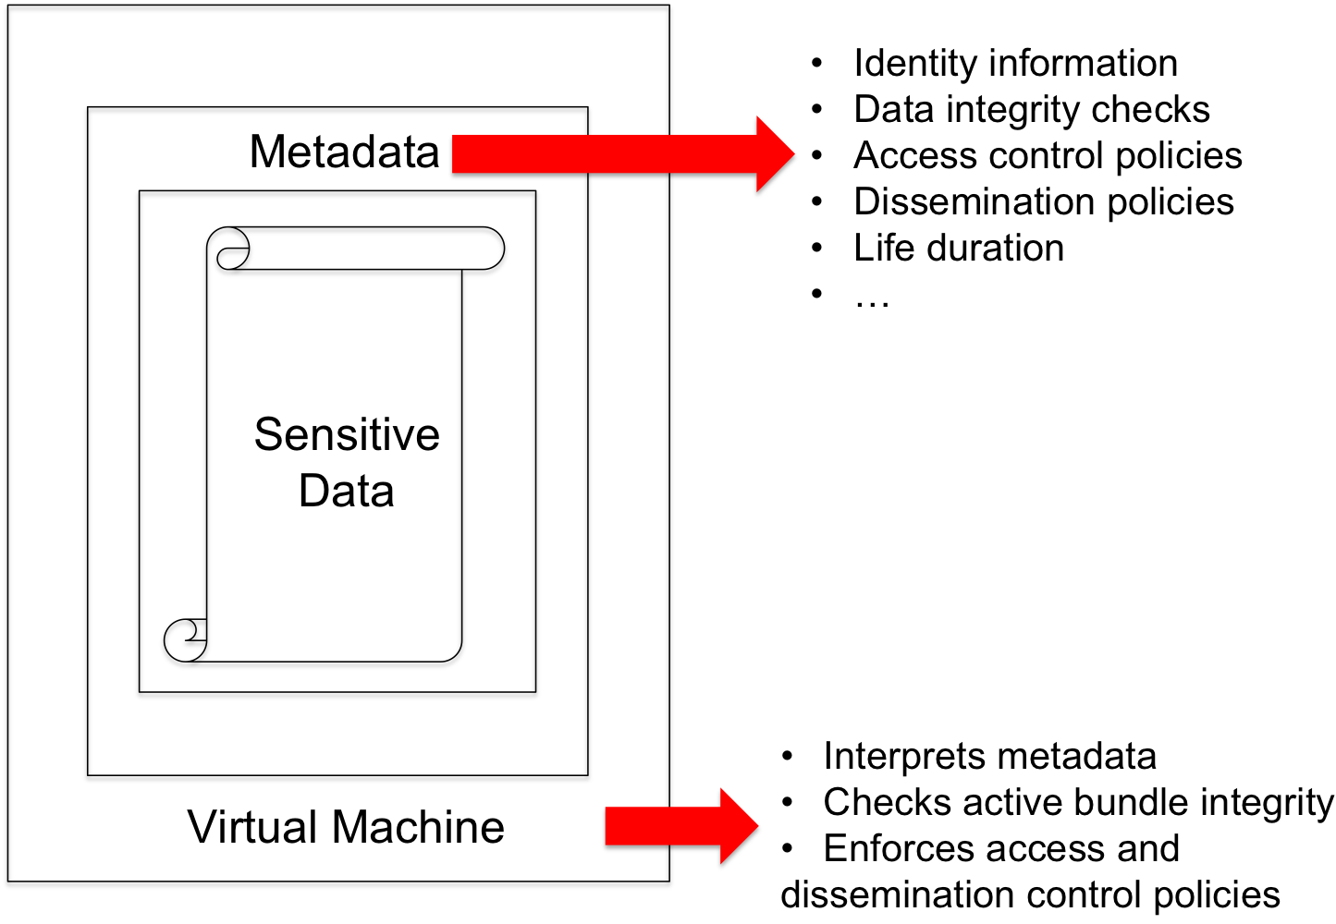
Proposed Framework
Practical implementation of function F, policy P, and ciphertext C
Active Bundle approach for
secure data dissemination
Active Bundle (AB)
Self-protecting data encapsulation
mechanism
Provides secure cross-domain
information exchange
Sensitive data (encrypted)
Metadata
Access control and operational
policies
Virtual Machine
Protection mechanism (self-integrity check)
Policy evaluation, enforcement and data dissemination

Slide 19
Framework Components
Host authentication can be based on
Password, Certificate, Biometric, PKI
Host request authorization is based on policy evaluation
Supports different access control models such as Attribute/Role-based
Key management methods
Key inclusion (prone to attacks)
Key management service (use of trusted third party for key storage and distribution)
Dynamic key derivation based on the unique information generated in AB execution control flow steps only if the service is authenticated and authorized
Tamper Resistance
Correct data dissemination depends on the correct execution of AB control flow steps
Verifies the integrity of the execution steps to ensure there is no difference from the original code (using secure one-way hash function)
Derives keys based on digests of AB execution steps and their resources
Any modification of AB changes the digest resulting in incorrect key derivation
Notes:
Flow-chart for tamper resistance

Slide 20
Cross-Domain Data Dissemination
UAV 1
Infrared imagery
Location coordinates
UAV 2
Multispectral imagery
Location coordinates
UAV 3
Command
& Control
Time period
Deployed personnel
Target locations
Intelligence reports
Mission expenses
Deployed weapons
Casualties
Press Release
Top Secret
Secret
Confidential
Unclassified

Slide 21
Cross-Domain Data Dissemination
UAV 1
Infrared imagery
Location coordinates
UAV 2
Multispectral imagery
Location coordinates
UAV 3
Time period
Deployed personnel
Target locations
Intelligence reports
Mission expenses
Deployed weapons
Casualties
Press Release
Command
& Control
Time period
Deployed personnel
Target locations
Intelligence reports
Mission expenses
Deployed weapons
Casualties
Press Release
Top Secret
Secret
Confidential
Unclassified
Target locations
Intelligence reports
Mission expenses
Deployed weapons
Press Release
Mission expenses
Press Release
Press Release

Slide 22
Attack Resilience
Attacks on AB
Man-in-the-middle: during AB transfer or interaction between AB and service
Tamper attack on code or policies of AB
Repudiation attack
Trusting the AB and its execution
Digital signatures to validate the authenticity and integrity of AB
Containerized execution of AB (e.g. using Docker containers)
Cloud-based execution
Protecting AB against malicious receivers
Tamper resistant code (code integrity checks)
Correct secret key generation only in case of correct execution
Cloud-based execution (third party code execution vs third party data broker)

Slide 23
Experimental Setup
Measurements
Experiment 1: Growth in AB size with increasing number of policies
Experiment 2: Growth in AB and Service interaction time with increasing number of policies
Experiment 3: Tamper Resistance overhead in AB execution
Variations
AB versions
ABx – XACML-based policies and WSO2 Balana-based policy evaluation
ABxt – ABx with tamper resistance capabilities
ABc – JSON-based policies and JAVA-based policy evaluation
ABct – ABc with tamper resistance capabilities
Number of AB policies
Environment
Amazon EC2 C3 Large and XLarge instances
Data collection
5 runs of each experiment repeated
100 requests per run

Slide 24
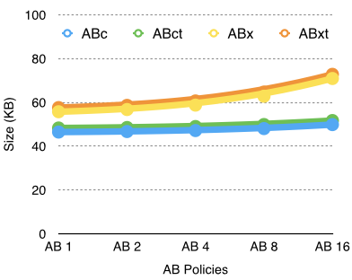
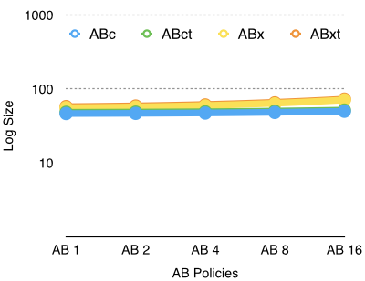
Experiment 1: AB Size vs Number of policies
Observations
Linear growth in AB size with increase in number of policies for all versions
Tamper resistance adds a slight overhead to AB size (< 2 KB)
79% reduction in policy size (0.79 KB) with JSON-based policies
Additional reduction of 8.5 KB with Java-based policy engine

Slide 25
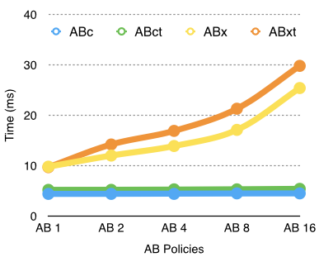
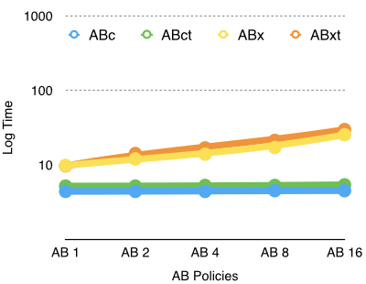
Experiment 2: AB-Service Interaction Time vs Number of policies
growth in interaction time with
Observations
Linear growth in interaction time with increase in policies for ABx and ABxt
Use of XACML-based policies and external library (WSO2 Balana) for policy evaluation
Evaluation of XACML policies involve the traversal of XML policy and request trees
Constant growth in interaction time with increase in policies for ABc and ABct
Use of JSON-based policies and Java code for policy evaluation
Highly optimized Java code evaluation

Slide 26
Deliverables
Prototype implementation of proposed monitoring framework:
Local (domain-level) Service Monitor (implemented using Apache Axis2 valves for interception, MySQL database for logging)
Central Monitor (implemented as Web service on Amazon EC2)
Anomaly Detection Module
Dynamic Service Composition Module (algorithm) (enables integration with business process composition using dynamic partner links in BPEL)
Active Bundle Module
AB implementation as an executable JAR file
AB API implementation using Apache Thrift RPC framework
Policy specification in XACML/JSON and evaluation using WSO2 Balana
Documentation:
Source code
Deployment and user manual
Report on performance and security testing of solution

Slide 27
Demonstration
Agile Defense
Detection of failures and attacks
Service composition reconfiguration based on context changes
Data Privacy
Policy-based selective data dissemination
Context-based controlled data dissemination

Slide 28
Impact
Comprehensive security auditing and enforcement architecture for SOA
Continuous monitoring of SLA and policy compliance
Swift detection of failures and attacks in the system
Efficient mechanism to dynamically reconfigure service composition based on the system context/state (failed, attacked, compromised) and resiliency requirements
Resilient architecture to ensure continuous service availability under failures and attacks
Privacy-preserving data sharing approach for client-to-service and service-to-service interactions
Compatibility of solution with industry standard SOA frameworks

Slide 29
Future Work
Refining anomaly detection process with best service health parameters (to improve runtime performance and maximize accuracy)
Extend Active Bundle implementation to exchange state information with Service Monitor
Protecting AB execution against control flow hijacks
Experiments:
DoS and DDoS attacks on services
Tampering attacks on services (code injection etc.)
Man in the middle attacks (using an intercepted active bundle)
Attacks against data privacy (trying to bypass active bundle protection mechanism)
Tampering attacks on active bundle’s policies and code
Service performance evaluation with/without monitoring (CPU and memory usage)
Central service monitor scalability evaluation with stress tests
Service failures (evaluation of speed of detection by service monitor)
Performance evaluation of dynamic service composition algorithm for different service compositions (different number of service categories/services in composition)
Cloud experiments: Framework scalability on industry standard cloud platforms (e.g. Amazon EC2)
Integration with NGC projects:
Cyber 2.0 IRAD (resiliency) (with Dr. Sunil Lingayat)
Complex Organization and Decision Analytics (CO&DA) (with Dr. Jason C. Kobes)
BluVector (machine-learning based anomaly detection in enterprises)

Slide 30
Presentations and Publications
“Policy-based Distributed Data Dissemination,” R. Ranchal, D. Ulybyshev, P. Angin, and B. Bhargava.
“Consumer-Oriented Privacy-Preserving Access Control for Electronic Health Records in the Cloud,” R. Fernando, R. Ranchal, L. Othmane, and B. Bhargava.
“An End-to-End Security Auditing Approach for Service Oriented Architecture,” M. Azarmi, B. Bhargava, P. Angin, R. Ranchal, N. Ahmed, A. Sinclair, M. Linderman, and L. ben Othmane.
“Privacy-Preserving Identity Claims with Complex Service Provider Policies,” R. Fernando, and B. Bhargava.
“SORT: A self- organizing trust model for peer-to-peer systems,” A. Can, and B. Bhargava.
“A Trust-based Approach for Secure Data Dissemination in a Mobile Peer-to-Peer Network of AVs,” B. Bhargava, P. Angin, R. Ranchal, R. Sivakumar, A. Sinclair, and M. Linderman.
“Protection of Identity Information in Cloud Computing without Trusted Third Party,” R. Ranchal, B. Bhargava, L. ben Othmane, M. Linderman, M. Kang, A. Kim, and L. Lilien.

Slide 32
Back-up Slides

Slide 33
Potential End-to-End Scenario using 3 NGCRC Projects (concept by Dr. Steiner, NGC)
High security
assurance in SOA
User Machine
Service Selection based on trust level of user
User
(1)
Secure Browser
(2)
Authenticate to browser (trusted e.g. CAC or untrusted e.g. PIN) Request data processing
Untrusted Service Data Processing
Trusted Service Encrypted Data Processing
(3)
 | NGCRC Projects | Univ.
(1) | Secure Hardware Tokens and Key Storage in the Browser | MIT
(2) | End to End Security Policy Auditing and Enforcement in Service Oriented Architecture | Purdue
(3) | Ensuring Privacy in Cloud-based Data Analysis | Purdue
Untrusted Cloud
Untrusted Cloud
Data (potentially corrupted)
Encrypted Data
Notes:
The figure below is based on the vision of Dr. Donald Steiner. It shows the different aspects addressed by the three NGCRC projects in the end-to-end scenario. Our main contribution in this figure is to develop a SOA framework that is secure, adaptable and resilient to attacks and failures. Our work compliments the work done by the other two NGCRC projects. The research work in Project 1 on secure browser can be used to securely access the service directory and select trustworthy services. Furthermore it can be used to securely send requests to the selected SOA composition. Failures and attacks are inevitable in services but the SOA Service Monitor needs to handle failures and attacks and ensure service availability even in their presence. We are building an agile monitoring framework that has the ability to adapt based on the context. For instance, in case of attacks and failures, it can start secondary services to ensure system availabilty. These secondary services may be located in cloud. In order to ensure security while using untrusted cloud platforms, the research in Project 3 can be leveraged.

Slide 34
Dynamic Service Composition Algorithm
//Input: A set of m service categories S_{i}, each with a set of concrete services.
//Output: A set of services, one in each category, with near-optimal utility based on context.
sort services in every category in descending order of utility
for i: 1..m
x_{i1} = 1 // select the highest utility service for the initial composition
if
return current composition //solution satisfies constraints
else
while solution not feasible
//downgrade using the service with biggest aggregate saving in constraints
for each category i
for each service j in i
calculate aggregate saving of service in category i of the current composition with j
find service j with maximum aggregate saving
find service with max aggregate saving across all categories, include in the composition
return composition

Slide 35
Adaptability Cost and Benefit Consideration
Benefits:
Increased availability of services (measured by up-time and throughput)
Increased performance by obviating the need to restart invocations of service compositions with failed/attacked services (measured by total response time)
Increased security and flexibility in service composition based on priorities and constraints in a specific environment (measured by success of avoiding attacks)
Costs:
Dynamic service composition time cost
Cost to maintain central service monitor
Service response delay due to monitoring
Increased resource usage in service domain
Overhead of re-deploying service in same/different domain

