Slide 1

Countering Adversarial AI/ML and Threat Recognition with Deep Learning
Topic Area: Cybersecurity
Purdue University
April 29, 2020
PI: Bharat Bhargava
NGC Champions: James MacDonald, Paul Conoval, Justin King, Jason Kobes

Slide 2
Collaboration with NGCRC
Researchers:
Bharat Bhargava
Miguel Villarreal-Vasquez
Ganapathy Mani
Pelin Angin
Leszek Lilien
Mayank Kejriwal
NGC Champions:
James MacDonald
Paul Conoval
Justin King
Jason Kobes
Institutions:
Purdue University
Northrop Grumman Corporation
ISI/USC

Slide 3
Collaboration With NGCRC
NGC IRADs:
Reliability Analysis Data System IRAD
Smart Autonomy IRAD
Cyber Resiliency DevOps IRAD
MINT Enterprise Analytics IRAD
Third-party funding proposals:
Office of Naval Research: Vulnerability detection and mitigation.
Sandia Research Lab: Hardening Space Systems and MTD.
MITRE: Innovation program on privacy preserving dissemination of cyber threat intelligence and analytics.
NASA/JPL: Seed funding for predicting attacks in adversarial ML.
DARPA: Generating Novelty in Open-world Multi-agent Environments (GNOME) (with Dr. James MacDonald and ISI/USC)
  https://www.darpa.mil/program/science-of-artificial-intelligence-and-learning-for-open-world-novelty
IARPA: TrojanAI (with Dr. Justin King)
  https://www.iarpa.gov/index.php/research-programs/trojai/trojai-proposers-day

Slide 4
Publications
https://www.cs.purdue.edu/homes/bb/#recentpub
  M. Villarreal-Vasquez, B. Bhargava, J. MacDonald. “ConFoc: Content-Focus Protection Against Trojan Attacks on Neural Networks.” Submitted to ACM CCS 2020. CERIAS Symposium Best Poster Award.
  M. Villarreal-Vasquez, G. Modelo-Howard, B. Bhargava, S. Dube, J. MacDonald. “LSTM-based Anomaly Detection In High Dimensional Sequential Data.” Submitted to IEEE Transactions on Dependable and Secure Computing 2020.
  D. Ulybyshev, M. Villarreal-Vasquez, B. Bhargava, G. Mani, S. Seaberg, P. Conoval, R. Pike, J. Kobes "Blockhub: Blockchain-based Software Development System for Untrusted Environments", IEEE CLOUD 2018. 2nd Place CERIAS Symposium Poster Award.
  G. Mani, B. Bhargava, J. MacDonald, J. Kobes, J. King. “DeCrypto Profiler: Deep Learning-Based Cryptojacking Detection using System Telemetry”. In submission process to 3rd IEEE International Conference on Artificial Intelligence and Knowledge Engineering (AIKE) 2020.
  G. Mani, B. Bhargava, J. MacDonald, J. Kobes, J. King. “CodePro: A Deep Learning-Based Model for Behavior Profiling in Cyber Systems”, In submission process to 1st IEEE International Conference on Autonomic Computing and Self-Organizing Systems (ACSOS) 2020.
  G. Mani, B. Bhargava, J. MacDonald, J. Kobes, J. King. “Trusted Classification with Semantic Factors Under Poisoning Attacks in Autonomous Cyber systems”, In submission process to International Journal of Semantic Computing (IJSC) 2020.

Slide 5
Proposed Research Project
Cyber Attacks
Trojan Attacks | Manipulate Training Data (TD) Training-time Attack: TD is poisoned by input with triggers
Adversarial Sample Attacks | Manipulate Inference Inference-time Attack: Use SGD to generate adv. samples
Evasive Attacks | Hide intent / remain undetected Mimic benign behavior
Adversarial Application Cyber Behavior | Identifying attack intent Adversarial cyber behavior

Slide 6
Proposed Research Project
Content-Focus (ConFoc) | Model hardening technique to increase the robustness against adversarial ML attacks.
Cyber Attacks
Proposed Solutions
ConFoc + Explainable AI | Threat explanation and assessment. Explain ML model behavior.
Attack Intent Determination | Deep learning-based prediction of attack intent through RNN.
Adversarial Cyber Behavior Profiling | Ensemble learning and BLSTM are used for profiling. Multimodal MTD-style approach.
ML Trust Explainability | Explainable ML model to enable human-in-the-loop for adaptive decision making.
Threat Assessment with Immutability | LSTM-based evasive threat assessment and detection using immutable system counters.

Slide 7
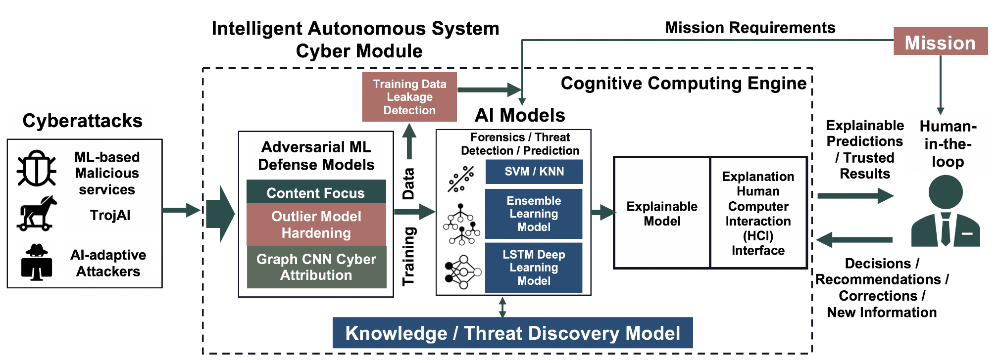
Graphical Illustration of Solution
Adversarial ML
Countering Module
Attack Prediction Engine
Threat Recognition and Assessment
Countering Adversarial ML
Threat Recognition

Slide 8
Countering Adversarial ML & Threat Recognition: Implemented Solutions
Countering Adversarial ML
Threat Recognition
Content-focus (ConFoc) Defensive Models to Counter Trojan Attacks. Slides 13 – 21.
ConFoc + Explainable AI to Counter Both Trojan and Adversarial Sample Attacks. Slides 22 – 26.
Trusted Classification With Semantic Factors Under Poisoning Attacks. Slides 27 – 29.
Identifying evasion attack intent using Deep Learning – Recurrent Neural Networks (RNNs).
Slides 35 – 45.
Threat Recognition Using Performance Counters Data. Slides 46 – 52.
Code as Natural Language: Threat Recognition Using Instruction Sequences. Slides 53 – 56.

Slide 9
  Countering Adversarial ML (Slides 9-30)

Slide 10



Problem Statement
Inputs
Training
Label: Stop Sign
Predicted
Classes
Label: Speed Limit
Neural Network
Testing
Correct!
Pedestrian Crossing
Label: Pedestrian Crossing
Correct!
Stop Sign
Label: Speed Limit
Incorrect!
Speed Limit
Correct!
Caused because of this trigger in the case of Trojan Attacks or specific variation to pixels using SGD in the case of Adversarial Sample Attacks.

Slide 11
Problem Statement
Adversarial Sample Attacks
Type: Inference-time attack.
Strategy: Crafting adversarial samples that cause misclassification.
Objective: Detriment performance of classifier (increase misclassification rate)
Applicability: Modifications are not effective in all inputs. Any input X must be uniquely crafted to achieve an specific behavior.
Real-world scenario: Adversary needs to modify each sample with unperceivable changes before conducting the attack. Difficult to achieve.
Trojan or Backdoor Attacks
Type: Training-time attack.
Strategy: Poisoning or re-training.
Objective: Misclassification in a controlled manner. Benign inputs are classified as expected, while inputs with trigger are misclassified.
Applicability: Modifications are effective in any input. Any input X with trigger t will be misclassified as chosen by the adversary.
Real-world scenario: Adversaries can feed the model with an adversarial sample (e.g. a road stop sign with a sticker). Easier to achieve.
Proposed solutions counter both attacks (from discussion with Paul Conoval of NGC)

Slide 12
Problem Statement
Two threats against Neural Networks are Adversarial Sample and Trojan attacks.
Assumptions and execution process are different in these two attacks.
Adversarial Sample attacks require manipulating inputs at testing time before them being classified by NN models.
  Gradient descent techniques are carefully applied to inputs to add variations on them that lead to misclassification.
  An inference-time attack
Trojan attacks, instead, manipulate the training process only.
  No manipulation of inputs at testing time is required.
  Testing inputs with triggers activate the misbehavior.
  A training-time attack
We propose an Explainable AI based technique to detect adversarial inputs of both attacks (an extension of our Content-Focus approach).
We are working with Prof. Christ Clifton on adversarial ML threat assessment and with Dr. Lalana Kagal on Explainable AI for cybersecurity.

Slide 13
  Content-focus (ConFoc) Defensive Models to Counter
  Trojan Attacks (Slides 13-21)

Slide 14





Proposed Solution: ConFoc
Based on the concept of Image Style Transfer: Image features can be separated in content and style¹.
The style b of any image b can be passed to the input image x to form the styed image x_{b} . Styled image X_{b} gets the content from x (x_{c} ).
Observation: The only characteristic in common between x, x_{c}, and x_{b} is the content of x (x_{c} ) itself.
S
S
S
Input x
Content of x ( x_{c} )
Styled x ( x_{b} )
S
Style base (b)
Style (b_{S} )
S

Slide 15

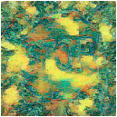



Proposed Solution: ConFoc
Given an input x (and its content x_{c}) and N style bases we generate N styled images.
Intuition: Models trained with these samples will focus on content only. Using different styles increases randomness (Jason Kobes and Paul Conoval from NGC).
Style Base (b)
Input x
Content of x ( x_{c} )
_{s}
Styled Input (x_{b} )

Slide 16
Proposed Solution: ConFoc
Defenders have access to a small healing set.
Healed models focus on content. At testing time, either original or transformed (styled version) inputs are securely classified by the healed models.
Image style transfer is applied to generate multiple styled version from each sample in the healing set.
Trojaned models are fine-tuned with the generated samples.

Slide 17
Evaluation Setup
Evaluation metrics:
  Accuracy with benign data: Rate of classification to the true class with benign samples. Need to be high for the model to be functional.
  Accuracy with adversarial data: Rate of classification to the true class with adversarial samples. Need to be high as well. If low, adversaries can still execute an untargeted attack (misclassification to a random class).
  Attack success rate (ASR): A threat assessment metric where the percentage of adversarial samples classified to the target class. It measures how well triggers in adversarial samples activate the intended misbehavior.
We aim to have high accuracy (with both benign and adversarial data) and low ASR.
A novelty generated from this research: Some of the prior works achieve high accuracy with benign data but low accuracy with adversarial data.

Slide 18
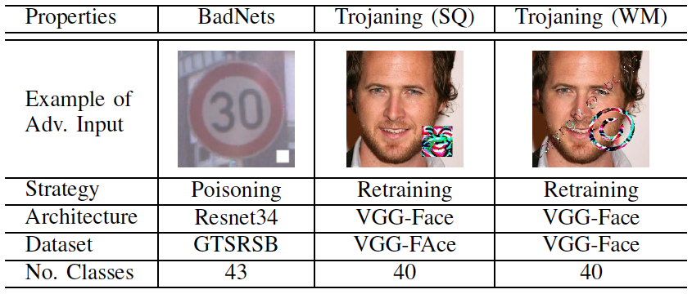
Evaluation Setup
Evaluated against two variants of trojan attacks, each executed with a variety of triggers.
Two versions of the testing sets: original and transformed (styled) samples.
The table below presents a summary of the evaluated attacks.

Slide 19
Evaluation Setup
BadNets
Type: Training-time attack.
Strategy: Data Poisoning.
Objective: Make models recognize triggers to belong to a target class.
Changes on Models:
Trojaning Attack
Type: Training-time attack.
Strategy: Re-training.
Objective: Make models recognize triggers to belong to a target class.
Changes on Models:
Parameters of all the layers are modified
Parameters of the last layers are modified
Model Layers
Model Layers
ConFoc is effective against both attacks, while others agaist Trojaning Attacks only.

Slide 20
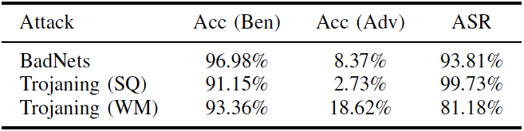
Experimental Results and Findings
RQ. How well does ConFoc perform compared to the state-of-the-art and what overhead it imposes at testing?
Initial Metrics of Trojaned Models (Before Applying Any Defensive Method)
Now the model hardening methods are applied… See next slides

Slide 21
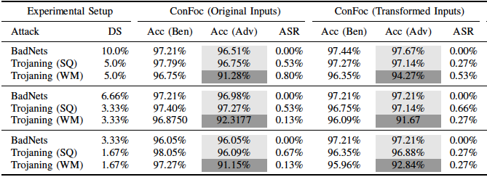
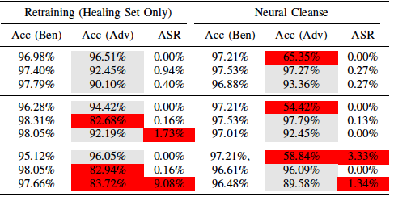
Experimental Results and Findings
RQ. How well does ConFoc perform compared to the state-of-the-art and what overhead it imposes at testing?
Metrics of Corrected Models Applying ConFoc and Other State-of-the-Art Methods
BadNets attack modifies the parameters of all the layers. One epoch of training is not enough to remove the trojan. Notice that the method does work against Trojaning Attacks as only the last layers of the model are modified during the insertion of the trojan at training time.
Accuracy with adversarial data (some < 90.0%)
Lowest values in this accuracy due to the violation of condition C3.
Either accuracy with adversarial data < 90.0% or ASR > 1%.
Findings: ConFoc outperforms the state-of-the-art method regardless the size of the healing set, without imposing any overhead when original inputs are used in the evaluation.

Slide 22
  ConFoc + Explainable AI to Counter Both Trojan and Adversarial Sample Attacks (Slides 22-26)

Slide 23
Proposed Solution: ConFoc + ExplainableAI
Creation of Content-Focus Model M_{C} (Suggestion by: Neta Ezer)
Input x
Styled Image Generator
Styled Input (x_{b} )
_{s}
G_{SI}
1
Model M_{H}
2
3
Model M_{O}
Content Neuron Extraction
Get styled version from original image
Feed healed model with styled images and extract features (i.e. neurons) in each layer.
Feed original model with the original image and extract features (i.e. neurons) in each layer.
Extract from each model layer the neurons that keep high similarity. Use them to create a content-focus model (M_{C}) by strengthening the values of content neurons and weakening the values of non-content neurons
Content Neurons for each layer in Model (Used to create model M_{C} )
4

Slide 24
Proposed Solution: ConFoc + ExplainableAI
Adversarial Input Detection with Original and Content-Focus Models (Illustration)
Input X
Y_{O}
Adversarial Input
Model M_{O}
No
1
Y_{O} == Y_{C} ?
2
Y_{C}
Model M_{C}
Yes
Benign
Input
Adversarial Input Detection Steps
At testing time, given an input X the classification is made by both the original model M_{O} and the content-focus model M_{C}.
The input is considered adversarial in case of mismatch; benign otherwise.

Slide 25
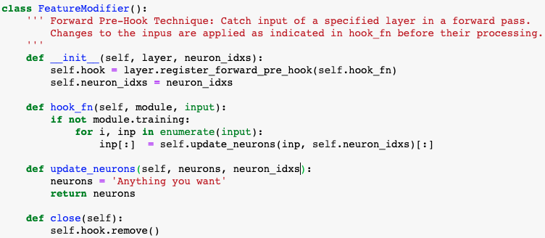
Experimental Results and Findings
We are able to modify activations on-the-fly:
Model Layers
Output based on content neurons.
Strengthen content-related neurons, while weaken others.

Slide 26
Experimental Results and Findings
Unexpected Results:
  Separating content-related neurons from style-related ones is a difficult task.
  Selecting content-related neurons by comparing the difference in the activations does not suffice.
We need new experiments:
  Answer whether or not content and style related neurons can be separated.
  If so, do extra research to find the best method to separate them.

Slide 27
  Trusted Classification with Semantic Factors Under Poisoning Attacks (Slides 27-29)

Slide 28


Proposed Solution: Semantic Factors
Data: We collect two types of system data (numeric and text),
  Performance Counters: Provide information as to how well the operating system or an application, service, or driver is performing. 68 unique counters and 245 feature values.
  Instruction Sequences: Assembly instructions of each process running on the cyber system extracted from memory addresses.
Label
Training Data
P1
0.026 | 0.160 | 0.094 | 0.110 | 0.191 | 0.001
P2
INT3 | XOR | JZ | AND | LEA | AND
BLSTM, LSTM
KNN, RF
Explainable Features.
Human-in-the-loop influence in feature selection.
Suggestion by: Dr. Neta Ezer
Freq. (%)
P1
0.026 | 0.160 | 0.094 | 0.110 | 0.191 | 0.001
P1
0 | 0.160 | 0 | 0.110 | 0.191 | 0
Features that are important to make a prediction.
P2
INT3 | XOR | JZ | AND | LEA | AND
P1
0 | 0.160 | 0 | 0.110 | 0.191 | 0
P2
P2
0 | XOR | 0 | AND | 0 | AND
0 | XOR | 0 | AND | 0 | AND

Slide 29
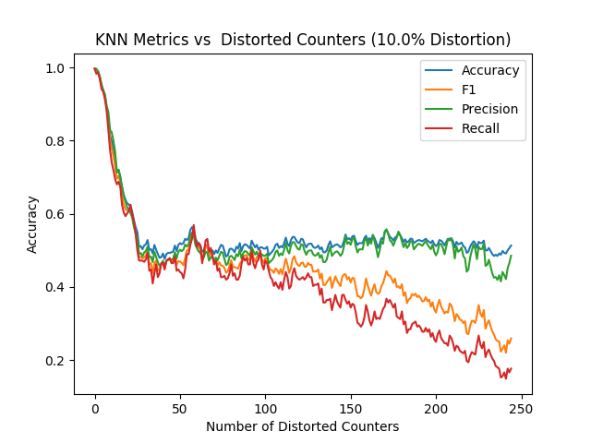
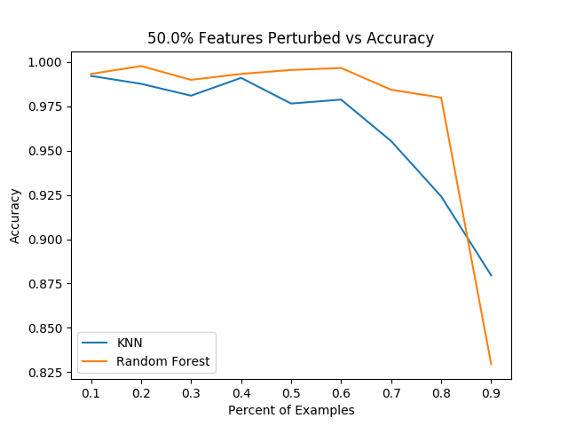
Experimental Results and Findings
Performance evaluation through experiments include (1) threat assessment, (2) results after mitigation, and (3) results under attack.
Experiment 1: What is the Acc. & F1 of Poisoned Model after Semantic Factors Extraction?
Experiment 2: What is the Acc. Of light-weight ML Models in the presence of poisonous data?
Result: Poisoned Model’s Accuracy goes down.
Result: Accuracy stays high even with the large amount of poisoned training samples.
Experiment 3: What is the performance of Of Deep Learning Models in the presence of poisonous data?
Model | Accuracy | Precision | Recall | F1
BILSTM | 0.97 | 0.93 | 0.94 | 0.94
LSTM | 0.98 | 0.88 | 0.87 | 0.87
Result: Accuracy stays high even with the large amount of poisoned training samples.

Slide 30
Research Innovations and Deliverables
Software tool:
  Prototype evaluated with a various of applications and are generic.
Demo Video:
  Brief introduction to the solutions and an illustration of their operations.
  Link: https://www.cs.purdue.edu/homes/bb/#demos
Main research contributions:
  AI model generation using observations from known adversarial AI behaviors.
  Analyzing the feature space learned by DNNs and identifying that they have both content and style. Trojans can be countered by making models focus on content.
  Increasing the model resiliency against poisoning attacks using Semantic Factors in text and numerical training data.
  Built a system to determine cyber-attack on a system, perform threat assessment, infer the intent, and impact to the mission or organizational goal.
  Developed a tool to classify cyber security incidents by “impact” in the and make inferences as to the intent of that specific impact.
  Proposed relevant mitigation and future defense strategies to prevent attacks of the same type in the future.
  Contributed to Explainability of ML/AI in the decision-making process.

Slide 31
Countering Adversarial ML & Threat Recognition: Implemented Solutions
Countering Adversarial ML
Threat Recognition
Content-focus (ConFoc) Defensive Models to Counter Trojan Attacks. Slides 13 – 21.
ConFoc + Explainable AI to Counter Both Trojan and Adversarial Sample Attacks. Slides 22 – 26.
Trusted Classification With Semantic Factors Under Poisoning Attacks. Slides 27 – 29.
Identifying evasion attack intent using Deep Learning – Recurrent Neural Networks (RNNs).
Slides 35 – 45.
Threat Recognition Using Performance Counters Data. Slides 46 – 52.
Code as Natural Language: Threat Recognition Using Instruction Sequences. Slides 53 – 56.

Slide 32
  Threat Recognition: Determination of Cyber Attack Intent and Impact (Slides 32-57)

Slide 33







Problem Statement
Security Company
Customer Company
Security
Agent
Customer Company
Customer Company
High volume of high dimensional data available.
Solutions able to process these amount of data and find relationships among security events are required.
There is a need for not only detecting unexpected events, but also predicting the next steps of ongoing attacks.
Security
Agent
Security
Agent
Centralized ML Algorithms

Slide 34
Problem Statement
New generations of evasion attack techniques allow adversaries to conduct attacks consisting of malicious event sequences, which can be crafted to avoid detection.
Some examples are multistage advanced persistent threats and mimicry-based attacks, which are conducted by executing malicious sequences of events organized at a specific order chosen by adversaries so as to be unrecognizable.
These attack sequences can be composed by legitimate events only without requiring any already-recognized malicious event in it.
This increasing sophistication in evasion attacks demands precise system behavior modeling for not only to detect malicious activity as it happens, but also to predict the specific steps that will be taken by adversaries when performing an attack.

Slide 35
  Identifying evasion attack intent using Deep Learning – Recurrent Neural Networks (Slides 35-45)

Slide 36
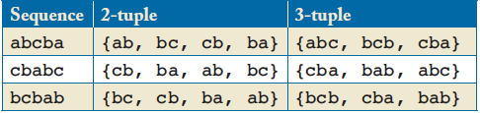
Why LSTM-based models?
Order-aware Recognition Problem: Refers to incapacity of distinguishing sequences after certain length.
Different ordered sequences abcba, cbabc and bcbab produce the same set of 2-tuple adjacent events.
Clearly, methods able to analyze sequences of length 2 or less can not discern among these three different ordered sequences. Obvious if we consider the set of 3-tuple adjacent events.
N-gram and N-order HMM based approaches can distinguish among sequences of length less than or equal N. Due to limitations on their algorithms N is usually small.
Same 2-tuple adjacent events
Different 3-tuple adjacent events
Traditional solutions are not efficient as the length of sequence grows
Given 3 different sequences

Slide 37
Proposed Solution: LADOHD
Data collected from multiple agents running in customer companies.
Collected data is filtered out to include events of interest only.
LSTM-based model trained with sequences of selected events.

Slide 38
Proposed Solution: LADOHD
LSTM based prediction model
Sequence of events until t-1
Set of all possible events
Neural Network
Input
Output
[p1, p2, p3, p4, p5, p6, p7]
Probabilities of possible events
Events with the highest probabilities are candidates for the next event in the sequence. If an event with low probability appears at time t, the event is considered anomalous.
The output can be used for both: prediction of the next event and anomaly detection.

Slide 39
Proposed Solution: LADOHD
Leverage recent advances in the area of deep learning (specifically LSTM-based models) to develop systems able to learn from past system events to predict specific events that will occur in the future.
  The main idea is obtaining the baseline of security event activities to predict future steps in an attack using information collected from multiple security agents running in different companies.
  Employ the same method to predict the next event and detect anomalies.
Benefits of the approach:
  The solution provides much more precise predictive information compared to existing techniques, allowing companies to deploy truly proactive countermeasures based on the predicted information.
  Allow predicting which particular CVE will be the next step in a multi-step attack against a server (target), or determining the potential severity of an attack by only looking at its early steps.
  Full explanation of the strengths and limitations of LSTMs solving the order-aware recognition problem

Slide 40
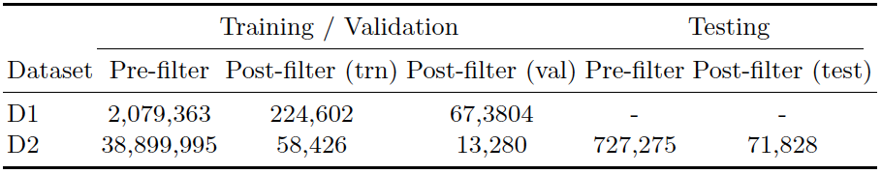
Evaluation Setup
Two datasets provided by a renown security company:
Number of events in sequences before and after filtering them out

Slide 41
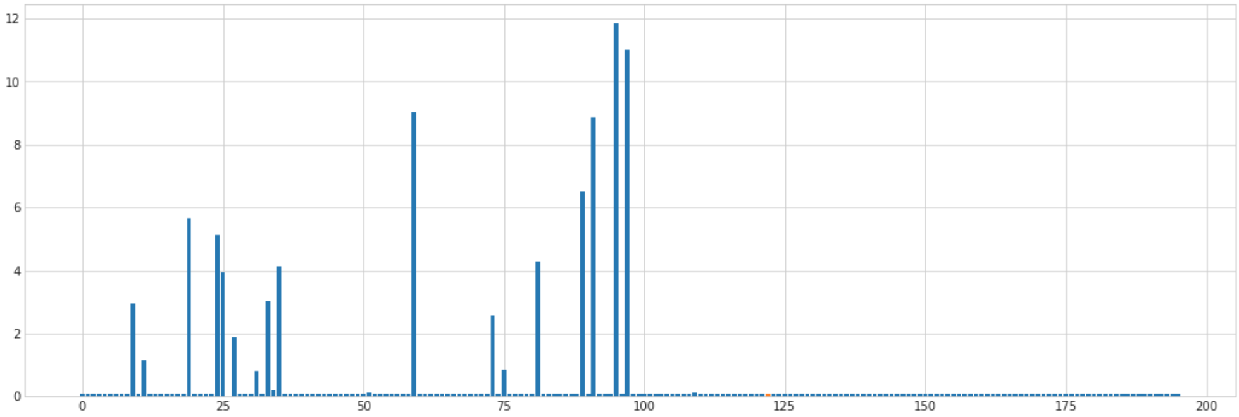
Experimental Results and Findings
RQ1. How to effectively discriminate between events of low and high probabilities from the output array of the models without manually fixing a threshold?
Output of Model at Time t-1
High probable events
Anomaly Detection at Time t
20/196 events above the natural threshold; the rest is considered anomalous
Event Prediction at Time t
Event with the highest probability (a.k.a. prediction certatinty).
Findings: There is a natural separation between high and low probable events in the output of LSTM-based models. The length of the previous sequence affect the probability (certainty) of the predicted event (most likely event), but it does not impair the accuracy of the model.

Slide 42
Experimental Results and Findings
RQ2. How much accurate are LSTM-based models with respect to other solutions such as HMM in the prediction of the next event in sequences of variable length?
Prediction on Training Sequence
Prediction on Testing Sequence
Findings: LSTM-based models have a better capacity than HMM-based models to predict the next event, given a previous subsequence. This suggests that LSTM-based models rank better the set of possible events in each timestep of a sequence than HMM-based models, which favor their capacity to detect low probable events in runtime (i.e., detection of anomalies).

Slide 43
Experimental Results and Findings
RQ3. What impact does the length of the previous sequences have over the detection? Is the detection of anomalies given the observation of a short sequence as good as the detection made given an observation of a long sequence?
Effect of Long-Term Dependencies in the Detection of Anomalies

Slide 44
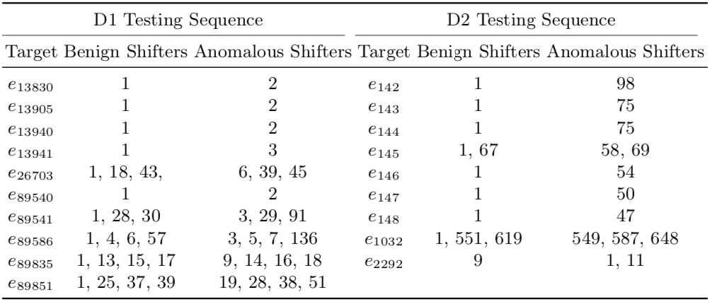
Experimental Results and Findings
RQ3. What impact does the length of the previous sequences have over the detection? Is the detection of anomalies given the observation of a short sequence as good as the detection made given an observation of a long sequence?
Effect of Long-Term Dependencies in the Detection of Anomalies

Slide 45
Experimental Results and Findings
RQ3. What impact does the length of the previous sequences have over the detection? Is the detection of anomalies given the observation of a short sequence as good as the detection made given an observation of a long sequence?
Findings: The same event might be classified differently depending on the length of the previous subsequence. Hence, keeping the internal states (cell state and hidden state) of the model while predicting allows detecting anomalies based on long-range relationships of events.

Slide 46
  Threat Recognition Using Performance
  Counters Data (Slides 46-52)

Slide 47












Threat Model
Malware: Unauthorized mining of Cryptocurrencies. It takes a long time and special computing equipment such as GPU and ASIC!
Malware can take away resources from processes
in mission-critical autonomous systems.
Unauthorized
Bitcoin
Crypto
Mining Pool
List of Hashes to find Bitcoins
Difficult to Detect
They may use less CPU power
Mimic benign software’s (e.g. 7zip) bitwise and encryption operations
Thursday, July 02, 2020

Slide 48
Research Approach
Detection
Trigger
Sampling
Normalize
Model
Selection
Application Profiling
High CPU
Usages
Anomalous
Outputs
Untraceable Process
Executions
Fixed/
Random
Sampling
Sample Perf Counters
PERF
Counters
Provide
Contextual
Data
Normalize
with Min-Max
Feature
Scaling
Selective
PERF
Counters
KNN and RF
Long Short-
Term Memory
Networks
Is it malicious or benign?
Any specific
attack?
Operational Context Data

Slide 49
Model Selection Framework
Data is Ready: Cryptomining (XMRig, Monero, etc.) Context labeled as Malicious and Compression (7zip, winzip, etc.) labeled as benign.
Experiment 1
Supervised Labeling with Local Database
Online Detection
With Fuzzy Logic
Experiment 2
Processed Data
Feature Selection: Top k Counters
Light-weight ML Models
(kNN, RF)
Experiment 3
Automatic
Feature Selection
Deep Neural Nets
(LSTM)

Slide 50
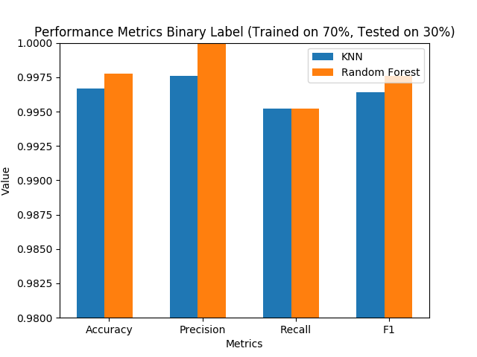
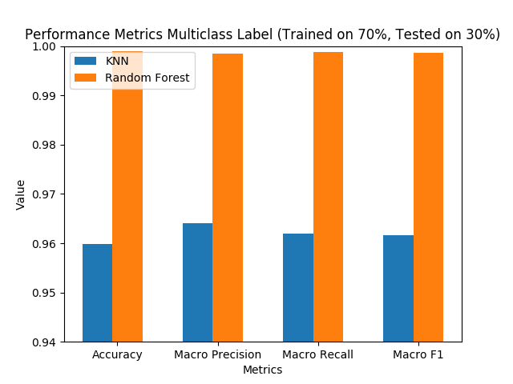
Experimental Results and Findings
Experiment 1: Given the PERF counter data, what is performance of Random Forest and K Nearest Neighbor Models?
Result: High Accuracy, Precision, Recall, and F1

Slide 51
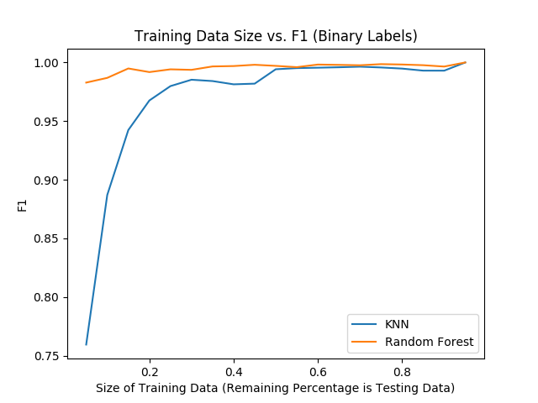
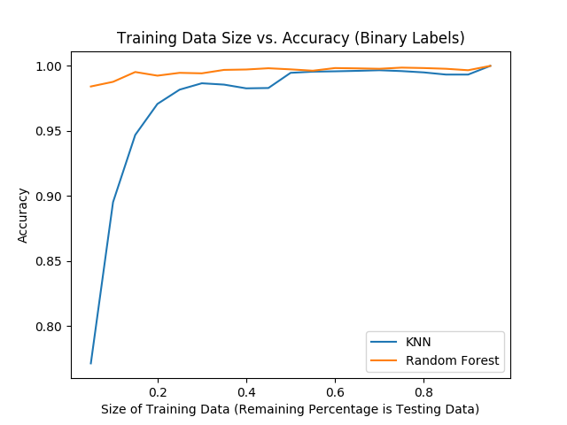
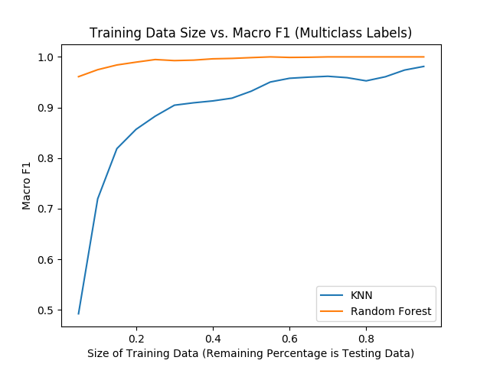
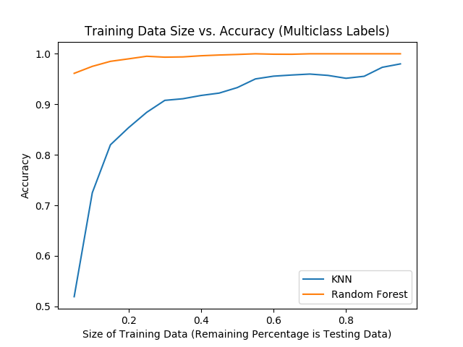
Experimental Results and Findings
Experiment 2: What is the training size that is needed for effective prediction?
Binary Classification
Multi-Class Classification
Result: Only needed considerably small amount of data for learning

Slide 52
Experimental Results and Findings
Experiment 3: Given the optimized hyperparameters how does the LSTM model perform with 10-fold validation?
Metrics | Values
Accuracy | 99.5%
Precision | 98.2%
Recall | 96.9%
F1 Score | 0.97
False Positives | 2%
False Negatives | 0.7%
Result: High Accuracy, Precision, Recall, and F1

Slide 53
  Code as Natural Language: Threat Recognition Using Instruction Sequences (Slides 53-56)

Slide 54
Research Approach
Idea: Take advantage of immutable actions of attackers such as instructions execution in memory. Threat Model: Cryptojacking.
Data
Collection
Tools
Sampling
Frequently Occurring Signatures
Word2Vec
Application Profiling
Linux Memory Extractor
(LiME)
Intel Extreme Tuning Utility
(Intel® XTU) Driver
Fixed/variable
Sampling
Sample
Memory
Addresses
Find Hotspot Memory
Addresses
Extract Ins. & Memory
bytes
Unigram,
Bigram,
n-gram
features
Apply
Word2Vec for
n-gram
Vectors
Bidirectional
LSTM
(BLSTM) on
instruction
Sequences
Is it malicious or benign?
Any specific
malware?

Slide 55

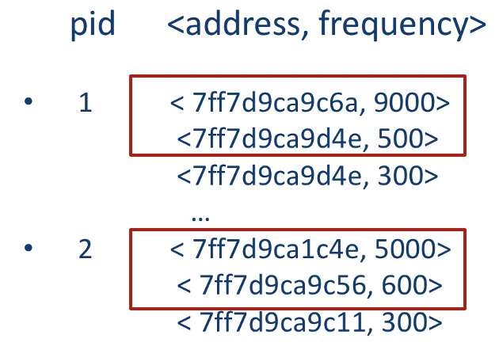
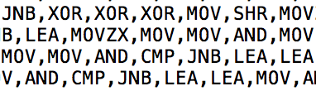
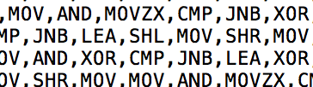
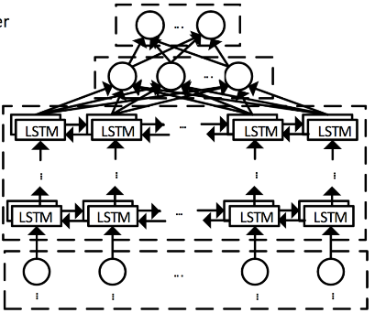
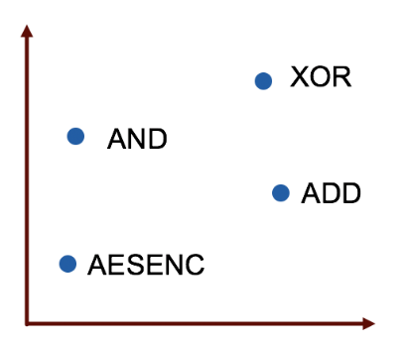
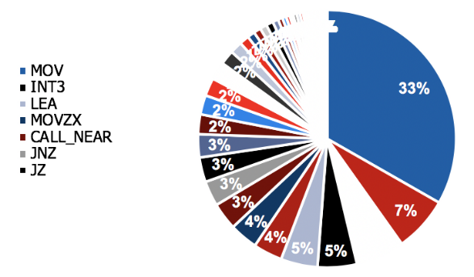

BLSTM-based Adversarial Profiling
Memory
*
Pid: 1
Pid: 2
Sampling:
Snapshot of Memory Frame and Last Branch Record (LBR) Addresses
Select top n% of addresses
Extract Instructions from Addresses
Remove Noise: Computing Language Processing
Hyperdimensional
Space
BLSTM
Instruction Vectors
Word2Vec
* Process ID, Address and number of times the instructions in that address location were executed

Slide 56
Experimental Results and Findings
Data: We used 5 different sets of data.
  Instructions from Trap Frame with Fixed (TFF) & Variable (TFV) Sampling, LBR with Fixed (LBRF) & Variable (LBRV) Sampling, and LBR + Trap Frame (LBR-TF).
Experiment 1: Given the consolidated data, optimized hyperparameters, and 10—fold cross validation, what is the performance of BLSTM?
Experiment 2: Given the individual datasets from LBR and Trap Frame with variable and fixed sampling, optimized hyperparameters, and 10—fold cross validation, what is the performance of BiLSTM?
Metrics | Values
Accuracy | 93%
Precision | 91%
Recall | 94%
F1 Score | 0.92
False Positive Rate | 0.08%
False Negative Rate | 0.06%
Dataset | Accuracy | FPR | FNR | F1
LBRF | 91% | 1.9% | 0.4% | 0.94
LBRV | 90% | 20% | 0.6% | 0.93
TFF | 94% | 0.8% | 0.3% | 0.95
TFV | 93% | 0.5% | 11% | 0.90
Future: Collaborating with Prof. Chris Brinton on application of LDA for large set of Computing Language data.
Result: Any dataset will provide high F1 Score and Accuracy

Slide 57
Research Innovations and Deliverables
Software tool:
  Prototype evaluated with a variety of datasets and prediction of next steps in ongoing attacks.
Demo Video:
  Brief introduction to the solutions and an illustration of their operations.
  Link: https://www.cs.purdue.edu/homes/bb/#demos.
Main research contributions:
  Developed malicious Event data aggregation and correlation to classify threat assessment and determine impact of events.
  Our methods can accomplish Advanced persistent threat discovery, forensic analysis, prevention, and recovery.
  We introduce a novel approach to processing computing languages and leveraged immutable actions by adversaries to build high accuracy model.
  Proposed solutions for malicious AI/ML activity detection with identification of potential impact of events and understanding of attack targets and methods used.
  Characterized new and novel attacks against AI/ML and other decision algorithms including test infrastructure for evaluating implementation robustness to attack.
  Proposed Threat analysis schemes that determine if an attack occurred and the details of the attack like: potential damage, attack methods, and identification of attack actions.
  Developed techniques/approaches for defending against adversarial inputs and manipulation of AI/ML and other decision algorithms.

