Slide 1
Blockhub: Blockchain-Based
Software Development System for Untrusted Environments
Denis Ulybyshev, Miguel Villarreal-Vasquez, Bharat Bhargava, Ganapathy Mani, Steve Seaberg, Paul Conoval, Robert Pike, Jason Kobes

Slide 2
Outline
Problem Statement
Motivation
Core Design
  3.1. Software Bundle
  3.2. Blockhub Architecture
Evaluation
Conclusions
Future Work
2

Slide 3
Problem Statement
Design a framework for cross-domain secure software development that provides:
  Fine-grained role- and attribute-based access control
  Integrity of provenance data
    Interactions between services are logged
    Log records can not be corrupted
  Data/software confidentiality and integrity
  Data/software spillage detection
3

Slide 4
Blockchain Overview
Blockchain is a file shared by network participants
This file stores logs (transactions) organized in blocks
Each new block is linked to the previous one
Any log record in the Blockchain can be cryptographically verified any time in the future
Different types of logs: Transaction Logs, Pieces of Code (Smart Contracts / Chaincodes)
Transactions can not be repudiated
4

Slide 5
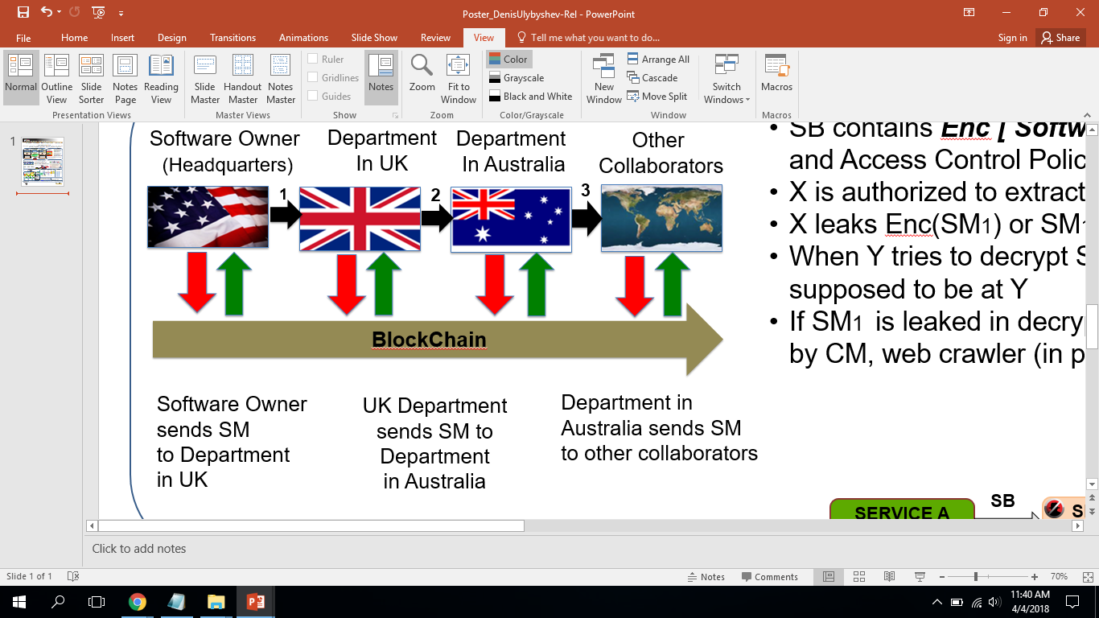
Motivation: secure platform for software development
  Provide secure cross-domain exchange of Data / Software Modules (SMs), enabling software tracking and auditing
5

Slide 6
Core Design
  Software Bundle (SB) contains:
Sensitive data:
  Encrypted data items or software modules
Access Control Policies:
  Manage SB interaction with services and hosts
  Metadata describes SB
Policy Enforcement Engine
Enforces policies specified in SB
Provides tamper-resistance of SB [4]
6

Slide 7
Core Design
  Ideas
Extend Active Bundle [1], [2], [3] concept to store software modules (source code/ binary executables), in addition to data
Record provenance data to investigate software spillages
Use blockchain-based technology to guarantee integrity of provenance data for system with multiple untrusted writers
Every software access/ transfer/ update is registered in a blockchain network and recorded in the public ledger
Every software access/ transfer/ update is non-repudiatable and can be verified any time in the future
7

Slide 8

Attribute-Based and Role-Based Software Dissemination
Source Code
ACCESSIBLE CODE
Browser’s Crypto Level: High
Authentication Method: Fingerprint
Client’s device: Desktop
Source network: Corporate Intranet
Role: Team Leader
AUTHENTICATED
CLIENT
AUTHENTICATED
CLIENT
Browser’s Crypto Level: Low
Authentication Method: Password
Client’s device: Mobile
Source network: Unknown
Role: Junior Developer
Source Code
INACCESSIBLE CODE 1
ACCESSIBLE CODE
INACCESSIBLE CODE 2
8

Slide 9

Software Bundle
Key is not stored inside SB [4]
Separate symmetric key is used for each separate data subset
Tamper-resistance is guaranteed
Aggregation{di}
(Execution info;
Digest(SB Modules);
Resources)
Key Derivation
Module
Ki
DECki (di)
di
Aggregation{di} ( Tampered (
Execution info;
Digest(SB Modules);
Resources) )
wrong di
Key Derivation
Module
K’i
DECk’i (di)
9

Slide 10
Blockhub: Core Design
Integrate WAXEDPRUNE [7] project into blockchain-based framework to provide additional features:
  role-based access control
  detection/prevention of data/software spillages made by insiders
  attribute-based access control, attributes include:
    (c1) trust level of network nodes
    (c2) context (e.g. normal vs. emergency)
    (c3) authentication method (e.g. password-based vs. fingerprint)
    (c4) cryptographic capabilities of network node
10

Slide 11
Blockchub: blockchain-based platform
BlockHub can be used for:
1. Tracking and control of software components that are shared across multiple security domains.
2. Automating the export auditing and tracking processes.
3. Cross-domain dissemination of encrypted software modules using role- and attribute-based access control.
4. Licensing provenance of deployed software components.
5. Enabling software supply chain that is tamper resistant.
6. Software spillage remediation.
11

Slide 12
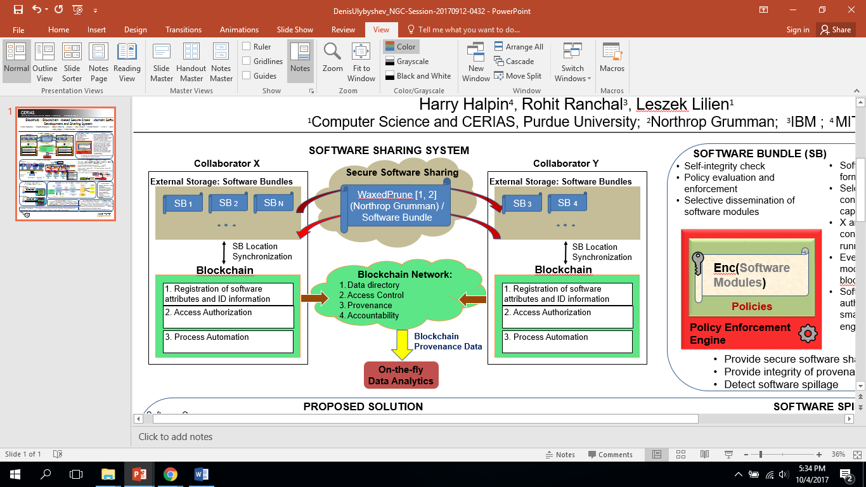

Blockchub Architecture
12

Slide 13
Blockchub Architecture
X and Y share software via smart contracts running in blockchain network
Every request is logged in the blockchain’s distributed ledger
Software stored in form of Software Bundles (SB)
Software is transferred if authorization has been granted by both smart contract (first) and policy enforcement engine of the corresponding SB
Any transaction, i.e. software access/update can be verified any time in the future
13

Slide 14
Experiment
Objectives: (1) Test verifiability of the data/software exchange transactions in blockchain-based framework; (2) measure performance overhead.
Input: 3 web services (in NodeJS-based framework) which exchange sample data/software modules.
Output parameters: (1) verifiable transaction records (provenance data); (2) Transaction latency.
Experimental setup: (1) data/software request goes through IBM Hyperledger Fabric 1.0.x blockchain network [5] (codebase taken from [7] ). (2) if permitted by smart contracts, request evaluated by Policy Enforcement Engine of SB (WaxedPrune project [7] )
14

Slide 15
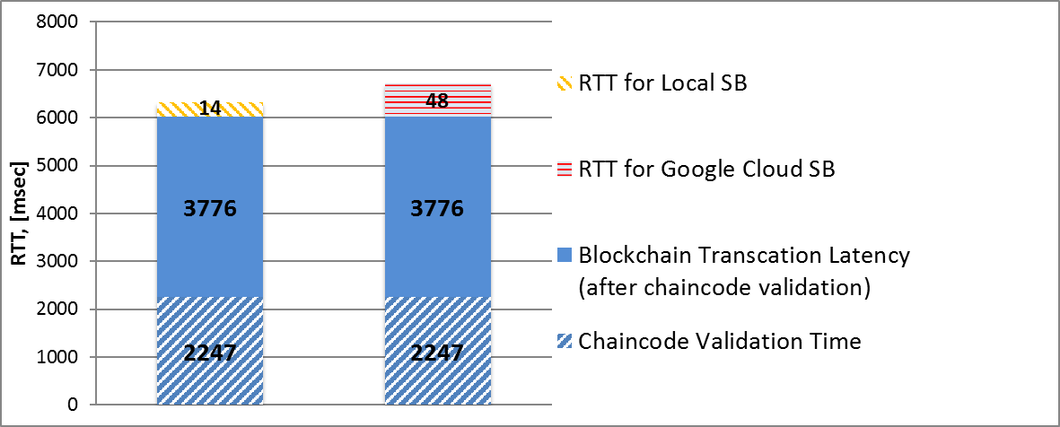
Blockchub Evaluation
Experimental Setup: IBM Hyperledger Fabric ver 1.0.x [5], “Marbles” open-source project [6]
15

Slide 16
Conclusions
Blockchain-based framework “Blockhub” can be used for secure collaborative cross-domain software development
Blockhub supports:
  Role-based and attribute-based access control
  Data/software spillage detection
  Confidentiality and integrity of data and software modules
  Integrity of provenance data
Overall Performance needs to be improved
Overhead, imposed by Waxedprune, does not exceed 0.8%
16

Slide 17
Future Work
Performance:
(a) Transaction latency in IBM Hyperledger Fabric
blockchain platform (ver 1.0.x) is about 6 seconds
(b) Overhead on log verification phase when the chain is
large (a great amount of blocks) => verifiers have to
compute many hash functions
Solution:
  Modify transaction verification process at “Endorsers”
  Explore other blockchain-based platforms
  Implement basic blockchain-based functionality from the scratch without using existing platforms
17

Slide 18
Future Work
Failure Recovery
  Need to maintain consistency in mobile environment with intermittent connectivity
  Need quantification of performance parameters after a varying period of connectivity breakdown
  Need to determine how much bandwidth and resources are needed to make network nodes consistent (or current)
18

Slide 19
References
[1] L. Ben Othmane and L. Lilien, “Protecting privacy in sensitive data dissemination with active bundles,” 7-th Annual Conf. on Privacy, Security and Trust (PST 2009), Saint John, New Brunswick, Canada, Aug. 2009, pp. 202-213
[2] L. Lilien and B. Bhargava, ”A scheme for privacy-preserving data dissemination,” IEEE Trans. on Systems, Man and Cybernetics, Part A: Systems and Humans, vol. 36(3), May 2006, pp. 503-506.
[3] L. B. Othmane, “Active bundles for protecting confidentiality of sensitive data throughout their lifecycle,” PhD thesis, Western Michigan University, 2010.
[4] R. Ranchal, “Cross-domain data dissemination and policy enforcement,” PhD Thesis, Purdue University, Jun. 2015
[5] “IBM Blockchain 101: Quick-start guide for developers,” 2016. Available: https://www.ibm.com/developerworks/cloud/library/cl-ibm-blockchain-101-quick-start-guide-for-developers-bluemix-trs/index.html, accessed: May 2018
[6] “Marbles Demo,” Available: https://github.com/IBM-Blockchain/marbles, accessed: May 2018
[7] D. Ulybyshev, B. Bhargava, M. Villarreal-Vasquez, D. Steiner, L. Li, J. Kobes, H. Halpin, R. Ranchal, A. Oqab-Alsalem, “Privacy-Preserving Data Dissemination in Untrusted Cloud”, IEEE CLOUD 2017, pp. 770- 773.
19

