Slide 1
Northrop Grumman Cybersecurity Research Consortium (NGCRC)
Intelligent Autonomous Systems based on Data Analytics and Machine Learning
19 April 2018
Bharat Bhargava
Purdue University
Technical Champions: Jason Kobes, Jeffrey Ciocco, Will Chambers, Miguel Ochoa, Steve Seaberg, Peter Meloy, Paul Conoval, Jessica Trombley-Owens, Robert Pike, Brock Bose, Sam Shekar, Roderick Son
1

Slide 2
Intelligent Autonomous Systems
According to Wes Bush, CEO of NGC, Autonomous Systems¹ should be
Able to perform complex tasks without or with limited ongoing connection to humans.
Cognitive enough to act without a human’s judgment lapses or execution inadequacies.
Intelligent Autonomous Systems (IAS) are characterized as highly Cognitive, effective in Knowledge Discovery, Reflexive, and Trusted,
¹Wes Bush, Sept. 6, 2016. “The Exciting Future of Autonomous Systems” at KSU
2

Slide 3
Implemented Components of IAS
Cognitive Autonomy & Knowledge Discovery:
Monitor and record system’s activities (Data provenance and sequence of system calls)
Perform advanced analytics on provenance data, discover new patterns, and make predictions.
Deep learning based anomaly detection by analyzing sequence of system calls.
Reflexivity:
Adapt to meet the mission objectives without disrupting the ongoing critical processes by incremental learning.
Trust:
Provide consensus, verifiability, and integrity by using blockchain for storing provenance data.
3

Slide 4
Observations & Data from Experiments
Demo 1 (Cognitive Autonomy / Knowledge Discovery):
Analytics over trusted provenance data to understand the current status of the system and take actions based on the result.
Performing aggregate analytics with data perturbation to protect the privacy of individual entities in IAS network.
4

Slide 5
Observations & Data from Experiments
Demo 2 (Reflexivity):
Under anomalous operating contexts or attacks, the replica replacement design based on Combinatorial balanced incomplete modules, can take over the processing from primary module.
Replicas are updated with system states periodically (Update interval is determined through Bayesian inference of system’s operating context).
Unused replicas are used for other processes, which makes the system to be faster and fault-tolerant.
5

Slide 6
Observations & Data from Experiments
Demo 3 (Trust):
Scheme which guarantees integrity of provenance data is implemented
Capability to verify every transaction in IAS
6

Slide 7
Reflexivity
Graceful Degradation Based on Machine Learning
7

Slide 8
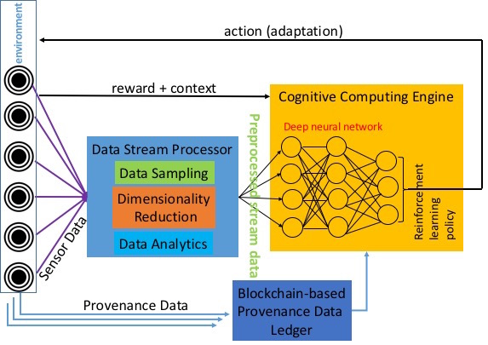
Comprehensive Architecture of IAS
Anomaly Detection
8

Slide 9
Comprehensive Architecture of IAS
Reflexivity
Anomaly Detection
8

Slide 10
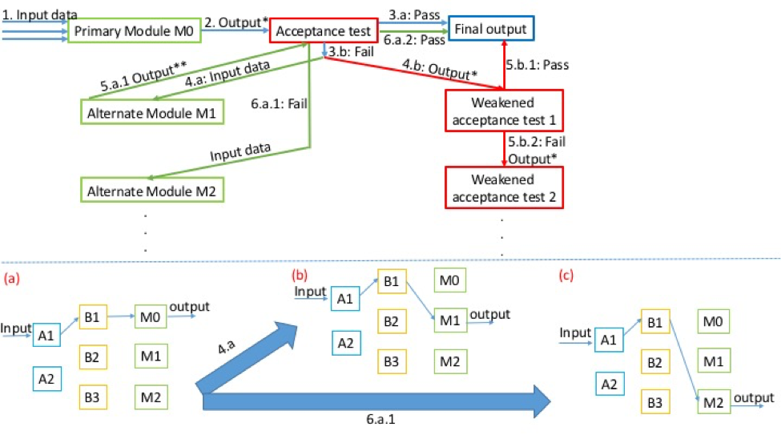
Generic Model of Dynamic Adaptation
9

Slide 11
Problem Statement
Given a smart cyber system operating in a distributed computing environment, it should be able to:
Replace anomalous/underperforming modules
Swiftly adapt to changes in context
Achieve continuous availability even under attacks and failures⁴.
⁴Thomas E. Vice, Corporate VP of NGC. Sep. 06, 2016. “"Future of Advanced
Trusted Cognitive Autonomous Systems,” at Purdue University
10

Slide 12
Reflexivity Workflow
IAS
Unknown / anomalous
data item is
detected
Data Analysis
for
Knowledge Discovery
Learning
Model for Prediction
Action A_{t}
Update to Model (U_{t+1})
Incremental Learning Model
Graceful Degradations (GD)
Progressive Enhancements (PE)
PE
GD
Progressive Acceptance
(increase participation of data object progressively)
Weakened Acceptance
(operate at lower capacity) / Replace Primary Module
(with replicas)
11

Slide 13
Reflexivity Workflow: Graceful
Degradations
IAS
Unknown / anomalous
data item is
detected
Data Analysis
for
Knowledge Discovery
Learning
Model for Prediction
Action A_{t}
Update to Model (U_{t+1})
Incremental Learning Model
Graceful Degradations (GD)
Progressive Enhancements (PE)
PE
GD
Progressive Acceptance
(increase participation of data object progressively)
Weakened Acceptance
(operate at lower capacity) / Replace Primary Module
(with replicas)
12

Slide 14
Graceful Degradations:
Replica Replacement Technique
Replica replacement by Combinatorial Balanced-block Designs:
Combinatorial Structure is a subset satisfying certain conditions.
Each block contains systems and their replicas that are mathematically distributed.
The systems and their replicas in the distributed blocks are strategically connected to receive updates from primary modules.
Resources are mathematically balanced, enabling scalable designs for the systems.
13

Slide 15
Combinatorial Balanced-block Structure
It is distributed environment with
A set Z consisting N systems
M distributed blocks consisting of
Subset of N system of size of R
Each system in set N appears exactly in C subsets
Each pair in N systems appears exactly in ∆ subsets.
14

Slide 16
Combinatorial Balanced-block Structure:
Our implementation
It is distributed environment with
A set Z consisting 7 systems
M = 7 distributed blocks consisting of
Subset of Z of size of R = 3
Each system in Z appears exactly in C = 3 subsets (3 replicas)
Each pair in Z appears exactly in ∆ = 1 subsets.
15

Slide 17
(7, 7, 3, 3, 1)-configuration
7 systems {S₁, S₂, S₃, S₄, S₅, S₆, S₇}
7 Distributed Autonomous Blocks (DABs) each with 3-system subset
DAB₁ = {S₁, S₅, S₇}, DAB₂ = {S₁, S₂, S₆},
DAB₃ = {S₂, S₃, S₇}, DAB₄ = {S₁, S₃, S₄},
DAB₅ = {S₂, S₄, S₅}, DAB₆ = {S₃, S₅, S₆},
DAB₇ = {S₄, S₆, S₇}.
16

Slide 18
(7, 7, 3, 3, 1)-configuration
7 systems {S₁, S₂, S₃, S₄, S₅, S₆, S₇}
7 Distributed Autonomous Blocks (DABs) each with 3-system subset
Each system appears in 3 DABs (Say, S₆)
DAB₁ = {S₁, S₅, S₇}, DAB₂ = {S₁, S₂, S₆},
DAB₃ = {S₂, S₃, S₇}, DAB₄ = {S₁, S₃, S₄},
DAB₅ = {S₂, S₄, S₅}, DAB₆ = {S₃, S₅, S₆},
DAB₇ = {S₄, S₆, S₇}.
17

Slide 19
(7, 7, 3, 3, 1)-configuration
7 systems {S₁, S₂, S₃, S₄, S₅, S₆, S₇}
7 Distributed Autonomous Blocks (DABs) each with 3-system subset
Each system appears in 3 DABs
Each pair of systems appear in 1 DAB (Say, S₁ and S₅)
DAB₁ = {S₁, S₅, S₇}, DAB₂ = {S₁, S₂, S₆},
DAB₃ = {S₂, S₃, S₇}, DAB₄ = {S₁, S₃, S₄},
DAB₅ = {S₂, S₄, S₅}, DAB₆ = {S₃, S₅, S₆},
DAB₇ = {S₄, S₆, S₇}.
18

Slide 20
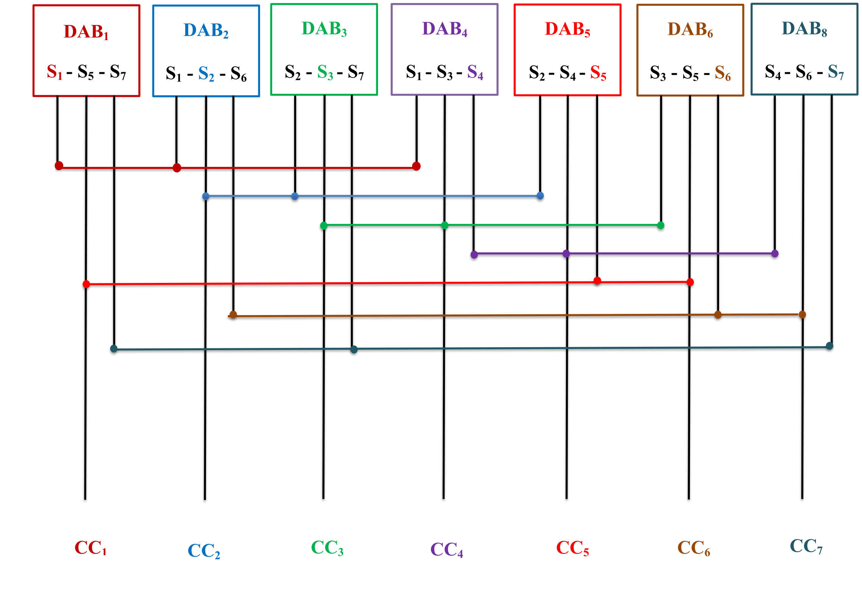
(7, 7, 3, 3, 1)-configuration
19

Slide 21
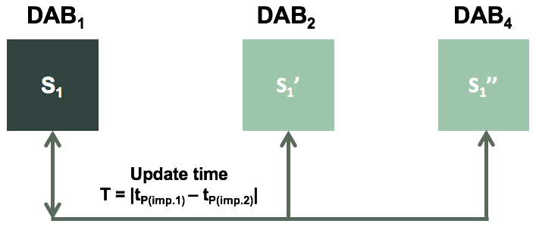
(7,7,3,3,1)-configuration’s Functionality
Each primary module periodically updates its replicas in corresponding distributed block connected by communication links (CC).
Update the interval dynamically through learning models with Bayesian learning by continuously updating the prior.
20

Slide 22
(7,7,3,3,1)-configuration’s Functionality
Update time is defined as
P_{I}(importance (I) | operational context (C)) = $\frac{P \left(C | I\right)P\left(I\right)}{P(C)}$
Update interval T = | t¹_{P(I)} – t²_{P(I)} |
When any system in any primary module’s DAB acts in anomalous fashion, that system can be
Replaced with one of the replicas that can be selected in round robin fashion.
Anomalous module will be set for self-healing or repair by external source
21

Slide 23
Our Implementation and Deliverables
The prototype is built with FAYE framework¹ with Node.js.
It is a server-client framework where servers act as primary modules and clients as replicated system.
Replica updates are done through a combinatorial design simulator².
Combinatorial simulator is loaded with finite processes to compare the updates and processing time compared to a regular or sequential processing.
22
¹https://faye.jcoglan.com/node.html ²https://goo.gl/pgVHdk

Slide 24
Our Implementation and Deliverables
Deliverables:
Autonomous replica replacement prototype
Source code: Node.js implementation, Bayesian model, simulation software developed for combinatorial design, and Data used for simulation. Link: https://goo.gl/M4rXCN
Documentation: Demo video and User manual for running the prototype.
23

Slide 25
Results of Measurements
Number of Updates
(Required for a finite process completion)
Processes
24

Slide 26
Results of Measurements
Process | Speed Up of Replica Scheme (Compared to regular sequential design)
FIBSEARCH | 1.3
DOUBLE MULT | 1.4
FIBB | 1.5
SEARCH | 1.8
COPY | 1.8
SCALAR | 2
SUM | 2.1
PRINT | 3
MOVEMENT | 3.1
25

Slide 27
Advantage of the Design
Since block sizes are equal the efficiency of the system is balanced.
It provides a stable and reliable system [1].
The design provides scalability with thousands of systems with simplistic communication links.
The design is scalable since the number of replicas can be decreased depending on the failure rate of the whole system. (Note: Replicas are C – 1).
No. of Replicas ∝ $\frac{1}{Number of Systems \left(N\right)| (Failure Rate < C)}$
26

Slide 28
Advantage of the Design
Updates to the replicas happen independently and simultaneously without interfering with others
Replicas can aid other functionalities with their updates.
All the systems in the DAB are connected which aid a faster communication.
For example, if S3 needs an update from S1 and S4, it can instantly communicate with them since they are in DB 4. This type of instant communication can aid parallel progressing of any process.
27

Slide 29
Combinatorial Balanced-block Structure:
Other possibilities
There are other configurations such as
M = 7, 13, 21, 31, 55, 73, 91, 132
N = 7, 13, 21, 31, 55, 73, 91, 132
C = 3, 4, 5, 6, 8, 9, 10, 12
R = 3, 4, 5, 6, 8, 9, 10, 12
∆ = 1, 1, 1, 1, 1, 1, 1, 1
28

Slide 30
Benefits to NGC IRADs and Customers
The recovery and replica replacement mechanism contributes towards self-healing: Automated Enterprise Monitoring and Recovery (AEMR) IRAD.
Distributed, simultaneous, and independent communication contributes to Distributed Data Processing IRAD.
29

Slide 31
Trust
Blockhub: A Blockchain-Based
Distribution of Datasets in IAS
30

Slide 32
Comprehensive Architecture of IAS
Anomaly Detection
31

Slide 33
Comprehensive Architecture of IAS
Trust
Anomaly Detection
31

Slide 34
Problem Statement
Provide trust (integrity, confidentiality, verifiability) to provenance data in IAS
Interactions between services are logged
Log records can not be corrupted
Provide trust for network participants in IAS
(a) ensure data confidentiality
(b) ensure data integrity
Provide privacy-preserving data exchange in IAS
32

Slide 35
Blockchain technology deployment challenges
Performance:
(a) Transaction latency on IBM Hyperledger Fabric blockchain
platform (ver 1.0.x) is greater than 6 seconds
(b) Performance overhead on log verification phase when the
chain has large in size (a great amount of blocks) =>
verifiers have to compute too many hash functions
Solution:
modify transaction verification process at “Endorsers”
Use depth-robust graphs to store blockchain (in collaboration with Prof. Blocki, Purdue) which can validate transaction without checking every block in the chain
33

Slide 36
Blockchain technology deployment challenges
Fine-grained role- and attribute-based access control with data leakage detection capabilities
Solution:
Integrate WAXEDPRUNE project into blockchain-based
framework to provide:
(a) role-based access control
(b) detection/prevention of data leakages made by insiders
(c) attribute-based access control, with attributes including:
(c1) trust level of network nodes
(c2) context (e.g. normal vs. emergency)
(c3) authentication method (e.g. password-based vs. fingerprint)
(c4) cryptographic capabilities of network node
34

Slide 37
Blockchain technology deployment challenges
Failure Recovery (proposed by Steve Seaberg, NGC)
Need to maintain consistency in mobile environment with intermittent connectivity
Need quantification of performance parameters after a varying period of connectivity breakdown
Need to determine how much bandwidth and resources are needed to make network nodes consistent (or current)
35

Slide 38
Blockchain technology deployment challenges
Access Control (Read): revoked access to data in a blockchain can be bypassed as follows:
Attacker holding a copy of a blockchain can use a modified client to just ignore the revocation block
Attacker can replay old blocks against an empty blockchain and stop before revocation block is appended
36

Slide 39
Blockchain technology deployment challenges
Provide secure User Interface to create Smart Contracts (Chaincodes)
Idea proposed by Ashish Kundu (IBM)
GO language is currently used to write chaincode
How to make chaincode writing easier for the user and reduce attack surface
37

Slide 40
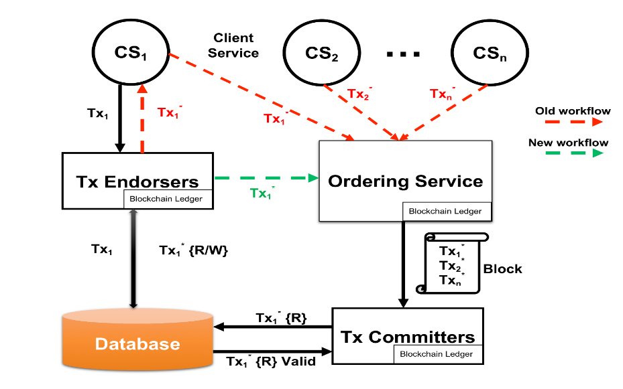
Solution for Permissioned Systems
38

Slide 41
Research Approach
Idea: protect against dDOS attacks when invalid transactions flood the network and don’t let valid transactions to be processed
Remove client service’s communication with the ordering service and extra-communications with Endorsers
Endorsers directly send validated transaction to the Ordering Service
Ordering Service delivers transaction to the Committers
39

Slide 42
Blockhub: blockchain-platform for IAS
Blockchain-based Software Distribution
(WAXEDPRUNE extension)
Blockchain-based technology ensures integrity of provenance data
BlockHub provides secure cross-domain software distribution
40

Slide 43
Blockhub: blockchain-platform for IAS
BlockHub can be used for: (proposed by Robert Pike, NGC)
1. Tracking and control of software components that are shared across multiple security domains.
2. Automating the export auditing and tracking processes.
3. Cross-domain dissemination of encrypted software modules using role- and attribute-based access control.
4. Licensing provenance of deployed software components.
5. Enabling software supply chain that is tamper resistant.
6. Software spillage remediation.
41

Slide 44
Blockhub: blockchain-platform for IAS
42

Slide 45
Blockhub Architecture
X and Y share software via smart contracts running in blockchain network
Every request is logged in the blockchain’s distributed ledger
Software stored in form of Software Bundles (SB) that contain:
- Encrypted Software Modules (source code or executables)
- Access Control Policies
- Policy Enforcement Engine (Virtual Machine)
Software is transferred if authorization has been granted by both smart contract and policy enforcement engine of the SB
Any transaction, i.e. software access/update can be verified any time in the future
Storing blockchain in form of depth-robust graph (proposed by Prof. Blocki, Purdue Univ.) reduces transaction validation time
There is one depth-robust graph per SB and it gets updated each time a transaction occurs
43

Slide 46
Evaluation
44

Slide 47
Implementation and Deliverables
Deliverables:
‘Blockhub’ prototype for secure blockchain-based data
distribution
Source code: https://github.com/Denis-Ulybysh/Waxedprune2018 * codebase is taken from open-source “Marbles” project https://github.com/IBM-Blockchain/marbles/tree/v4.0
Demo video
45

Slide 48
Cognitive Autonomy / Knowledge Discovery
A Deep Learning Based Anomaly Detection Solution
45

Slide 49
Comprehensive Architecture of IAS
Anomaly Detection
46

Slide 50
Comprehensive Architecture of IAS
Cognitive Autonomy and Knowledge Discovery
Anomaly Detection
46

Slide 51
Problem Statement
Intelligent Autonomous Systems (IAS) adapt to meet the mission objectives without disrupting the ongoing critical processes by incremental learning (reflexivity).
Programs store Return Addresses (control flow) along with data in the stack.
Control-hijacking attacks execute arbitrary code on the target IAS program by hijacking its control flow.
Stack Frame
Local
Variables
EBP
Return
Address
Parameters
47

Slide 52
Problem Statement
Intelligent Autonomous Systems (IAS) adapt to meet the mission objectives without disrupting the ongoing critical processes by incremental learning (reflexivity).
Programs store Return Addresses (control flow) along with data in the stack.
Control-hijacking attacks execute arbitrary code on the target IAS program by hijacking its control flow.
Data overrides
Return Address
Stack Frame
Local
Variables
EBP
Return
Address
Parameters
47

Slide 53
Problem Statement
Advanced modern exploits characterize by their sophistication in stealthy attacks.
Code-reuse attacks such as return-oriented programming (ROP) and memory disclosures allow attackers executing malicious instruction sequences on victim systems without injecting external code.
Control Flow Integrity (CFI) is required.
Research Question: Can we developed a Deep Learning based anomaly detection technique that probabilistically models program control flows for behavioral reasoning and system monitoring?
48

Slide 54
Research Approach
An event e_{i} is defined defined as a function call (system or library call) in the execution trace of a program.
Use Deep Learning to answer the binary classification problem of given a sequence of function calls (or system events) e₁e₂e₃…e_{k} whether or not the sequence should occur?
49

Slide 55
Research Approach
An event e_{i} is defined defined as a function call (system or library call) in the execution trace of a program.
Use Deep Learning to answer the binary classification problem of given a sequence of function calls (or system events) e₁e₂e₃…e_{k} whether or not the sequence should occur?
System Events
Given this sequence at time t-1
49

Slide 56
Research Approach
An event e_{i} is defined defined as a function call (system or library call) in the execution trace of a program.
Use Deep Learning to answer the binary classification problem of given a sequence of function calls (or system events) e₁e₂e₃…e_{k} whether or not the sequence should occur?
System Events
Given this sequence at time t-1
At time t, should this sequence occur?
49

Slide 57
Deep Learning against code reuse attacks
The eternal war
Attack
Code Injection (e.g., Buffer Overflow)
Defense
WX (e.g., Windows DEP)
Attack
Code Reuse (e.g., ROP)
Defense
Attack
Defense
ASLR and variants
Memory Disclosure (JIT-ROP): Enables Code Reuse
Code Re-Randomization
Deep Learning based Anomaly Detection
Invalid and abnormal control flow of a program:
Code Injection
Code Reuse
Memory Disclosure
Can be caused by:
Human error (e.g., unauthorized use or operation of the program
Software flaws (e.g., buffer overflow vulnerabilities)
Attacks by remote attackers
Malicious insiders (e.g., through drive-by downloads)
50

Slide 58
Deep Learning against code reuse attacks
The eternal war: DL against code reuse attacks
Attack
Code Injection (e.g., Buffer Overflow)
Defense
WX (e.g., Windows DEP)
Attack
Code Reuse (e.g., ROP)
Defense
Attack
Defense
ASLR and variants
Memory Disclosure (JIT-ROP): Enables Code Reuse
Code Re-Randomization
Deep Learning based Anomaly Detection
Invalid and abnormal control flow of a program:
Code Injection
Code Reuse
Memory Disclosure
Can be caused by:
Human error (e.g., unauthorized use or operation of the program
Software flaws (e.g., buffer overflow vulnerabilities)
Attacks by remote attackers
Malicious insiders (e.g., through drive-by downloads)
50

Slide 59
Other Learning Based Approaches
Classification Model Based Approaches:
Datasets include known attacks only
Limitation:
No resilient to zero-day exploits (Signature Based)
Difficult to train (representative datasets of the attacks are required)
Attack | Feature 1 | Feature 2 | … | Feature N
+ |  |  | …
- |  |  | …
+ |  |  | …
- |  |  | ….
51

Slide 60
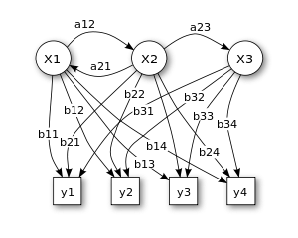
Other Learning Based Approaches
Hidden Markov Model (HMM) Based Approaches:
Number of hidden states is equal to the number of system events
P(Y) = P(Y|X) P(X)
Limitation:
No memory nor long dependencies: Observation at time t depends on observation at time t-1
52

Slide 61
Our Deep Learning Based Approach
For a given program, a code coverage is conducted to obtain all the possible execution traces.
An event e_{i} is defined defined as a function call (system or library call) in the execution trace of a program.
Each possible system event (function calls) is uniquely identified as they will form the vocabulary of system events.
The Deep Learning model (neural network) is trained with the obtained sequences of events.
The model is based on Recurrent Neural Networks: Long-Short Term Memory (LSTM) and Gated Recurrent Units (GRU.)
53

Slide 62
Our Deep Learning Based Approach
After training, given a sequence of events as input, the neural network produces as output an array of probabilities, one for each of the possible events in the system.
At any time t each possible event (system call or library call) in the system is assigned a probability estimated with respect to the sequences of events observed until time t-1.
At classification time t, the decision is made with respect to a pre-defined threshold of the top-k most likely events.
54

Slide 63
Our Deep Learning Based Approach
Set of all system events
Neural Network
55

Slide 64
Our Deep Learning Based Approach
Sequence of system events at t-1
Set of all system events
Neural Network
Input
55

Slide 65
Our Deep Learning Based Approach
Sequence of system events at t-1
Set of all system events
Neural Network
Input
Output
[p1, p2, p3, p4, p5, p6, p7]
Probabilities of
possible events
55

Slide 66
Our Deep Learning Based Approach
Sequence of system events at t-1
Set of all system events
Neural Network
Input
Output
[p1, p2, p3, p4, p5, p6, p7]
Probabilities of
possible events
At time t, classified as normal if the new event probability is in the top-k
probabilities; anomalous otherwise
55

Slide 67
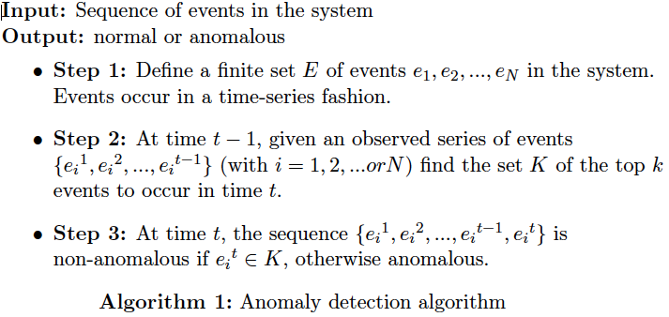
Our Deep Learning Based Approach
56

Slide 68
Benefits of Our Deep Learning Approach
Properties of Recurrent Neural Networks (RNN)
Stateful Representation
Memory
Long-Term Dependency
Variable Length Sequence
Stateful Representation: Maintenance of current state.
Memory: Update state based on previous events.
Long-Term Dependency: Track previous dependencies for long terms.
Variable Length Sequence: Functional with non-fixed-length sequences.
57

Slide 69
Benefits of Our Deep Learning Approach
Training datasets are full available: Dynamic code behaviors are learned by training the model with non-malicious program traces in isolation.
Flow sensitive anomaly detection: Given the execution paths P₁, P₂ and P₃, our technique captures the occurrence probabilities of each of their events; vital for high-precision anomaly detection.
Higher Power of Representation: Context attributes such as caller functions can be added (e.g., function call read@faa is different from function call read@foo)
Higher granularity of the execution traces: More granular traces are used for training, which improves precision in detection.
58

Slide 70
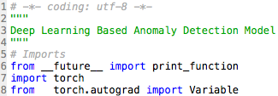
Platforms and Prototype
Model Implementation
MODEL
Model
Based on Recurrent Neural Networks (RNN): Long-Short Term Memory (LSTM) and Gated Recurrent Unit (GRU)
Programming Language: Python
Compatible with several numerical computing libraries suitable for the use of GPUs
Some examples: Pytorch, TensorFlow and Theano
Computing Library: PyTorch
Scientific computing package
Replacement of Numpy to take advantage of the power of GPUs
Python-friendly platform for neural networks (Deep Learning)
Parallel Computing Platform: CUDA
Programming model to use GPUs for general purpose computing
CUDA
GPU
59

Slide 71
Publications
1. G. Mani, B. Bhargava, B. Shivakumar, J. Kobes "Incremental Learning Through Graceful Degradations in Autonomous Systems", IEEE ICCC, June 2018 (In Submission).
2. G. Mani, B. Bhargava, P. Angin, M. Villarreal-Vasquez, D. Ulybyshev, J. Kobes "Machine Learning Models to Enhance the Science of Cognitive Autonomy", IEEE ICCC, June 2018 (In Submission)
3. G. Mani, B. Bhargava"Scalable Learning Through Error-correcting Codes based Clustering in Autonomous Systems", IEEE ICCC, June 2018 (In Submission)
4. G. Mani, D. Ulybyshev, B. Bhargava, J. Kobes, P. Goyal"Autonomous Aggregate Data Analytics in Untrusted Cloud", IEEE ICCC, June 2018 (In Submission).
5. Mani, Ganapathy, Bharat Bhargava. "Graceful Degradation in Autonomous Systems Based on Combinatorial Learning Model". (In Submission).
6. D. Ulybyshev, M. Villarreal-Vasquez, B. Bhargava, G. Mani, S. Seaberg, P. Conoval, D. Steiner, J. Kobes "Blockhub: Blockchain-based Software Development System for Untrusted Environments", IEEE CLOUD 2018, (In Submission).
7. D. Ulybyshev, B. Bhargava, A. Alsalem "Secure Data Exchange and Data Leakage Detection in Untrusted Cloud", ICACCT 2018 (Accepted, in-press).
60

