Slide 1

Northrop Grumman Cybersecurity
Research Consortium (NGCRC)
Secure Intelligent Autonomous Systems with Cyber Attribution
08 April 2019
Bharat Bhargava
Purdue University
Technical Champions: Paul Conoval, Jason Kobes, Jeffrey Ciocco, Justin King
1

Slide 2
  Motivation from NGC:
  Securing Intelligent Autonomous Systems
  This project achieves NGC’s goal on secure mission-deployable autonomous systems: develop and continuously monitor mission plans, react based on mission profile, and achieve mission objectives even under attacks¹.
  Autonomous operations and the rapid timing dynamics required of system responses present new challenges in security through cyber attribution and adversarial machine learning.
  The project operationalizes AI into practical deployable systems through an end-to-end systems-level design approach for security.
  We implement multi-faceted dimensions of AI/ML, and scaling the appropriate level of AI/ML for effectively and efficiently meeting mission objectives under attacks.
¹Paul Conoval, ”Integrating Artificial Intelligence Capabilities into Deployable
Systems”, Keynote given in IEEE AIKE 2018, Laguna Hills, California, USA
2

Slide 3
Collaboration with NGC, MIT, and
Purdue Faculty
  We are working on developing ML models for Adversarial Machine Learning and TrojAI that will contribute to NGC research proposals.
  This project’s goals are developed based on the discussions with Paul Conoval, Jason Kobes, and Justin King. We will continue to update this team on the projects.
  We are collaborating with Dr. Lalana Kegal from MIT on explanatory artificial intelligence (XAI) and provenance-based ML models to enhance trustworthiness of IAS.
  We are working with Prof. Christopher Clifton on poisoning attacks on ML model—offensive and defensive strategies.
3

Slide 4
Collaboration with NGC IRADs
  Secure IAS implementations contribute to the following IRADs with machine learning and data analytics to enhance security in autonomous systems.
    Adaptive Real-Time Detection and Examination Network IRAD
    Automated Mission Planning for Autonomous Systems IRAD
    Distributed Data Processing IRAD
    Enterprise Information Management System and Analytics IRAD
    Information Analytics IRAD
    Rapid Autonomy Prototype Implementation & Demonstration IRAD
    Reliability Analysis Data System IRAD
    Smart Autonomy IRAD
    Cyber Resilient DevOps IRAD
4

Slide 5
Implementation and Deliverables
Fuzzy Learning Implementation:
Source code: Online malware detection application based on instruction sequences. Link: https://bit.ly/2uFTTH2
The prototype is built with Windows 10 Intel threat monitoring framework and LiME framework is also used for exploring memory extraction. https://github.com/504ensicsLabs/LiME https://downloadcenter.intel.com/download/24075
Light-weight Machine Learning Models Implementation:
Source code: https://bit.ly/2VbkNSH
An offline analysis of light-weight machine learning models such as SVM, RF, and KNN is provided with PERF data and Samples of Instructions extracted from the memory.
Documentation & Data: Demo video and User manual for the prototype. Data: Data includes the malware signature instruction sequences used for fuzzy logic based detection and light-weight Machine learning models.
5

Slide 6
Publications
https://www.cs.purdue.edu/homes/bb/#research
https://www.cs.purdue.edu/homes/bb/#colloquia
G. Mani, B. Bhargava, J. Kobes, J. King. “Hardware Data based Behavior Profiling of Evasive Application Through Cyber Attribution”, in preparation.
G. Mani, B. Bhargava, J. Kobes, J. King. “Deep Learning Model for Intrusion Detection based on Instruction Sequences in Memory”, In preparation.
G. Mani, B. Bhargava, P. Angin, M. Villarreal-Vasquez, D. Ulybyshev, D. Steiner, J. Kobes. “Machine Learning Models to Enhance the Science of Cognitive Autonomy.” In IEEE International Conference on Artificial Intelligence and Knowledge Engineering (AIKE), Laguna Hills, 2018
G. Mani, B. Bhargava, B. Shivakumar, J. Kobes. “Incremental Learning Through Graceful Degradations in Autonomous Systems.” In IEEE International Conference on Cognitive Computing (ICCC), San Francisco, 2018.
G. Mani, B. Bhargava, J. Kobes. “Scalable Deep Learning Through Fuzzy-based Clustering in Autonomous Systems.” In IEEE International Conference on Artificial Intelligence and Knowledge Engineering (AIKE), Laguna Hills, 2018
G. Mani, D. Ulybyshev, B. Bhargava, J. Kobes, P. Goyal. “Autonomous Aggregate Data Analytics in Untrusted Cloud.” In IEEE International Conference on Artificial Intelligence and Knowledge Engineering (AIKE), Laguna Hills, 2018
6

Slide 7
  Secure Intelligent Autonomous Systems
  Autonomous Systems should be
  Able to continually perform complex tasks under attacks without or with limited ongoing connection to humans.
  Cognitive enough to act without a human’s judgment lapses or execution inadequacies.
  Intelligent Autonomous Systems (IAS) are highly Cognitive to predict attackers next steps, effective in Knowledge Discovery for attack patterns, Reflexive to adapt and self-heal, and Trusted.
  We are leveraging convergence of advanced analytics, cyber security, and AI, presenting new opportunities, issues, and threats, impacting mission deployable systems.
7

Slide 8
Comprehensive Secure IAS with Cyber Attribution Architecture
8

Slide 9
  Secure IAS: Overview
  This project will advance science of security in IAS through multifaceted advanced analytics, cognitive computing, adversarial machine learning, and cyber attribution.
  We are developing
    A cyber attribution module that monitors threats and performs intrusion detection sampling on system data.
    Adversarial machine learning model to deal with Trojans in Machine learning models (TrojanAI).
    A cognitive computing module with reasoning engine & anomaly / malware detection through light-weight ML algorithms and LSTM deep neural networks.
    Reflexive module to adapt and self-heal during attacks.
9

Slide 10
Secure Cognitive Computing
Solutions based on Cyber Attribution, deep learning, and light-weight Machine Learning models
10

Slide 11
  Cyber Attribution for Security Through
  ML based Application Profiling
  Behavior-based analytics is used to categorize adaptive / unknown cyber-attacks and poison attacks on ML.
  We are developing methodologies that use contextual information about the origin and transformation of data points in the training set.
  To enable cognitive autonomy for security, we are developing online detection of security threats using hardware/software/OS data (PERF counters, instructions, memory bytes, etc.).
  We are employing three models—fuzzy matching, light-weight ML, and Deep learning—to determine the best performing model in terms of accuracy and computing resources usage in mission-critical autonomous systems.
11

Slide 12
  Cyber Attribution for Security Through
  ML based Application Profiling
  Problem Statement:
    Detecting security anomalies and malicious applications before they execute their intended goal requires resource-efficient cyber attribution: Jason Kobes.
    In particular, profiling malicious agents that mimic benign agents (applications or users) is a non-trivial problem. E.g. Cryptojacking, Ransomware, and File-less malware.
    Triggers-assisted attribution is needed to determine when a benign agent becomes malicious and classify them.
    The autonomous system should spend minimalistic amount of computing power to detect malware and anomalies (e.g. less than 5% CPU usage).
12

Slide 13
  Cyber Attribution for Security Through
  ML based Application Profiling
  Research Approach:
    Facilitating cyber attribution through focused monitoring, collecting and analyzing data from immutable execution behavior, and learning from that data.
        Instructions data from memory (TRAP Frame)
        Last Branch Record (LBR) data
        Performance (PERF) Counters data
    Intrusion Detection Sampling through fixed and variable interval sampling by frequent itemset mining.
    Identifying unique & quality features on data to perform fuzzy, supervised, and unsupervised learning.
    Perform deep learning techniques on instruction sequences for classification.
13

Slide 14
  Cyber Attribution for Security Through
  ML based Application Profiling
  Application: Test Cases
  Cryptojacking: fastest growing evasive operation¹. Attack can render autonomous systems unusable, slow, and overheated.
  Attackers can trick the users and deploy Crypto-miners that can secretly use the computation resources of systems to mine crypto-currency.
  Malware Agents: Monero, Zcash, Coinhive—CryptoNight Algorithm Family.
14
¹https://www.symantec.com/blogs/threat-intelligence/cryptojacking-modern-cash-cow

Slide 15
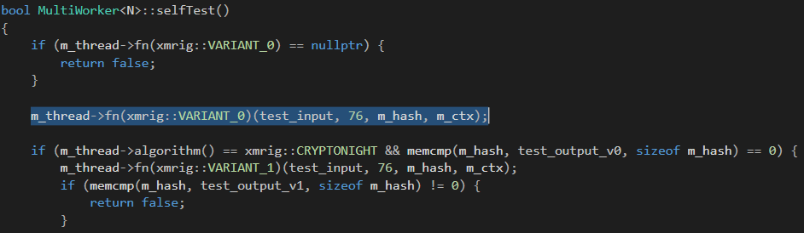
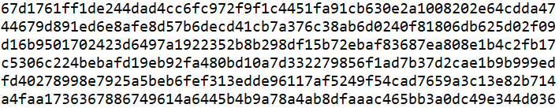
  Cyber Attribution for Security Through
  ML based Application Profiling
  Application: Implementation
  Capture the test case
  Issue inputs constantly
15

Slide 16
  Cyber Attribution for Security Through
  ML based Application Profiling
  Application: Data
  Last Branch Record (LBR^{)1—}A circular buffer: Top of Stack (TOS) starts at entry 0.
  Performance (PERF) Counters²
  Trap Frame (TRAP^{)3:} When an exception is raised, trap frame stores the instruction address.
0 (TOS) | 1 | 2 | 3 | … | … | 28 | 29 | 30 | 31
¹https://software.intel.com/en-us/node/676430
²https://docs.microsoft.com/en-us/windows/desktop/perfctrs/performance-counters-portal
³https://docs.microsoft.com/en-us/windows-hardware/drivers/debugger/-trap--display-trap-frame-
16

Slide 17






  Cyber Attribution for Security Through
  ML based Application Profiling
  Data Collection Tools:
    Linux Memory Extractor (LiME)¹
    Intel Extreme Tuning Utility (Intel® XTU) Driver²:
        Provides Hardware-based data collection
        Provides interrupt counters to sample data
        Provides a table of Process ID, Trap frame address, and Last Branch Record (LBR) Address.
Intel HW Kernel
SGX Interface
Data
¹https://github.com/504ensicsLabs/LiME
²https://downloadcenter.intel.com/download/24075
ML Models
17

Slide 18
  Cyber Attribution for Security Through
  ML based Application Profiling
  Data Collection Tools:
    Performance (PERF) Counters:
      Perf counters provide information on how well the operating system or an application, service, or driver is performing. Windows Powershell provides the counters.
\LogicalDisk(*)\% Disk Time
.
.
.
\Memory\Pages Output/sec
.
.
.
\Processor(*)\% Interrupt Time
.
.
.
\PhysicalDisk(*)\Avg. Disk Bytes/Read
.
.
18

Slide 19
  Cyber Attribution for Security Through
  ML based Application Profiling
  Application Behavior Profiling Workflow:
Detection
Trigger
Sampling
Frequently Occurring Signatures
Features
Extraction
Application Profiling
High CPU
Usages
Anomalous
Outputs
Untraceable Process
Executions
Fixed
Sampling of
Memory
Addresses
(e.g. 100k
instructions)
Sample Perf Counters
Find Hotspot Memory
Addresses
Extract Ins. & Memory
bytes
Selective
PERF
Counters
Unique Ins. & Crypto
Features
Unigram,
Bigram,
n-gram
features
Unique Perf
Counters
Is it malicious or benign?
Any particular attack?
SVM, k-NN, RF, etc.
CNN/RNN on ins. / Memory
Sequences
19

Slide 20
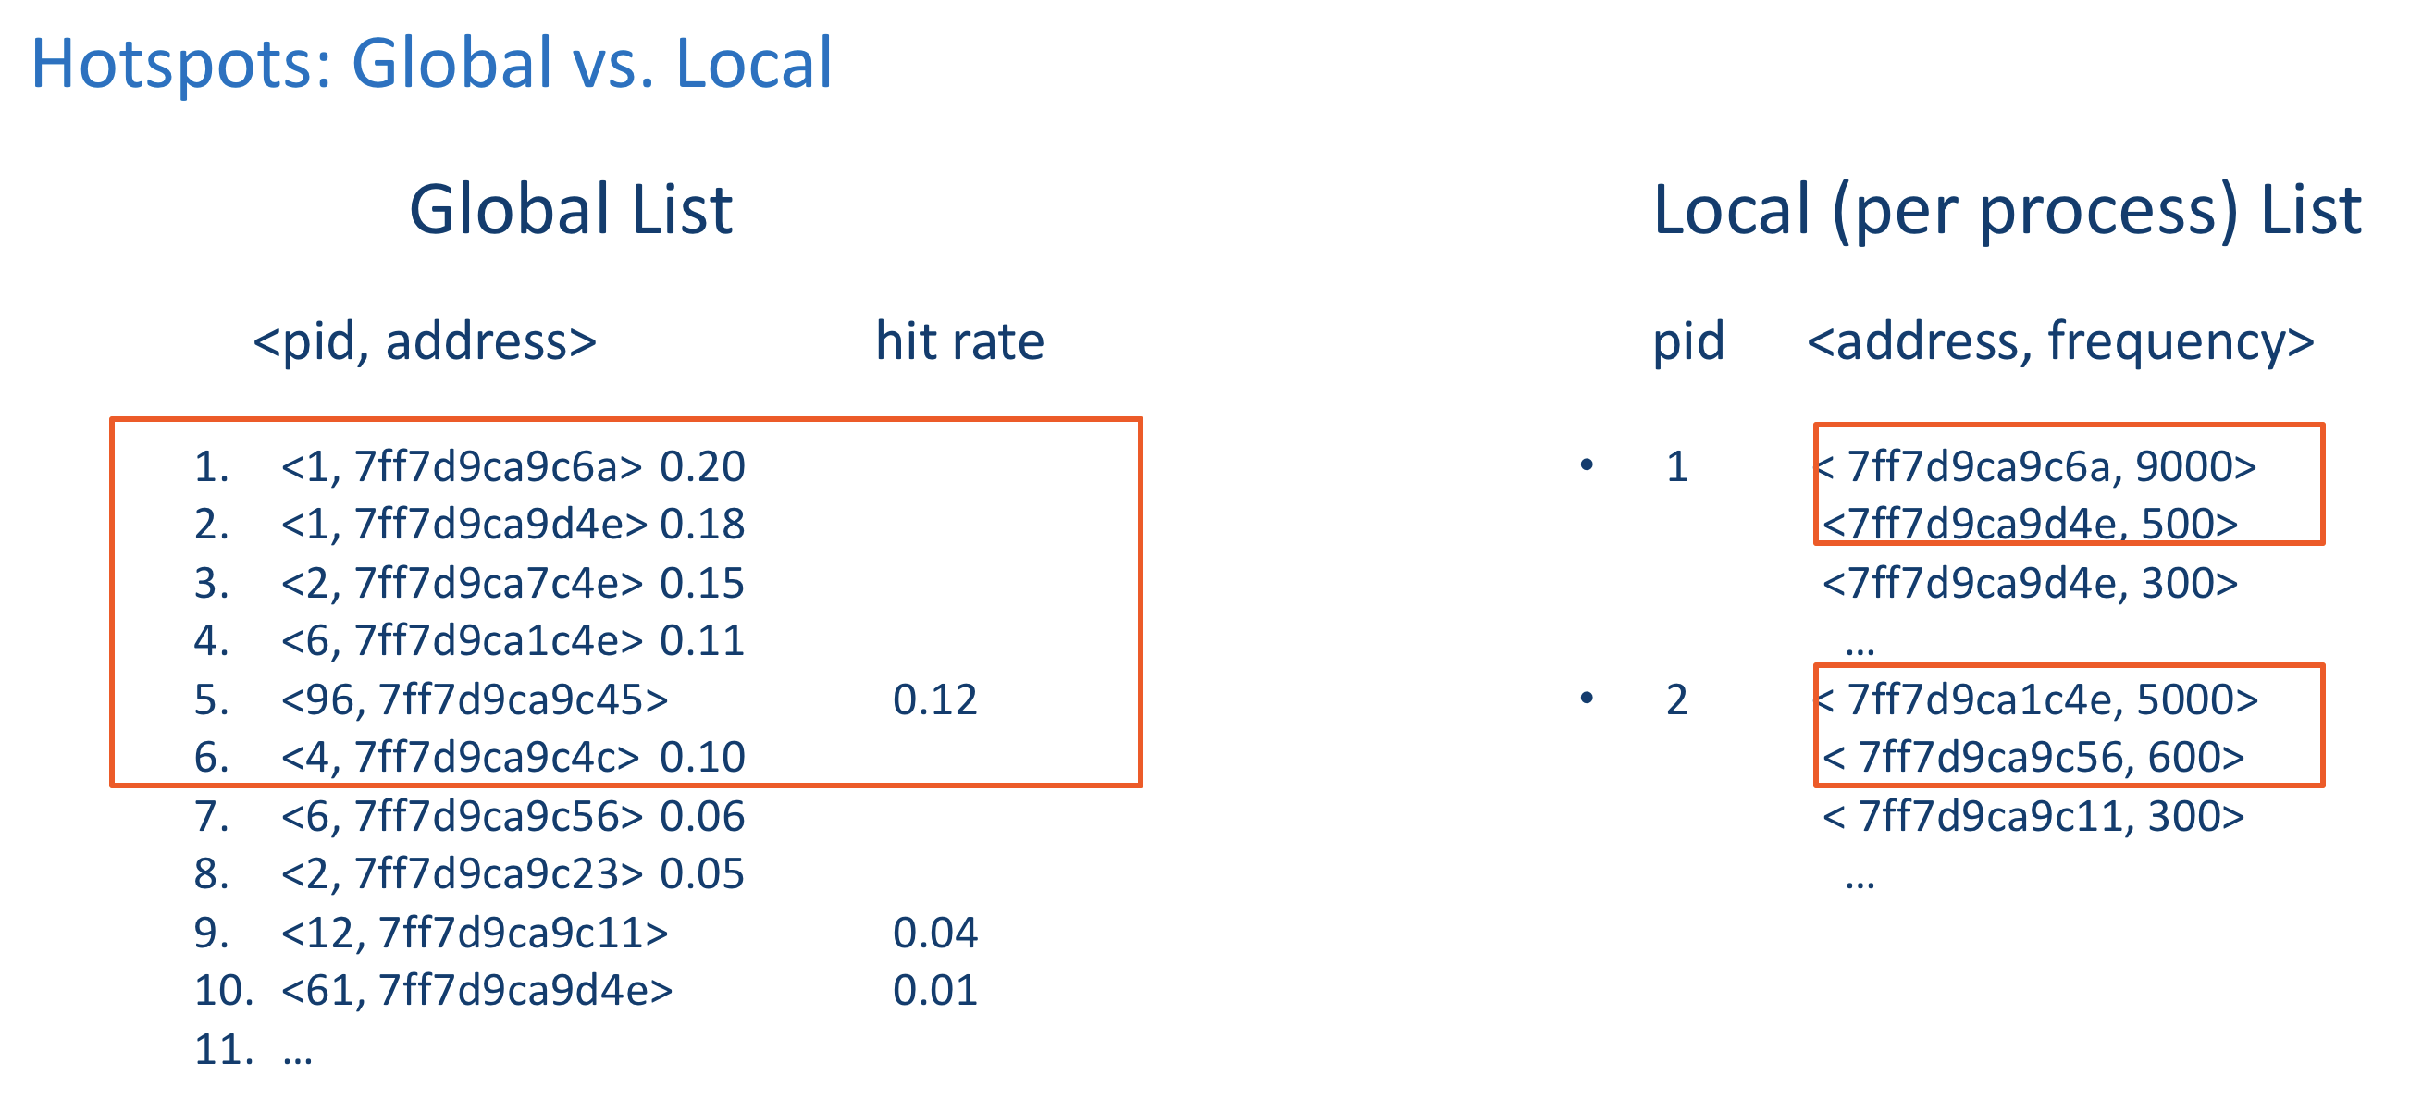
  Cyber Attribution for Security Through
  ML based Application Profiling
  Hotspot Identification Algorithm:
    Step 1: Monitor for Detection Triggers (high CPU usage, abnormal outputs, etc.)
    Step 2: Once the trigger is set off, start to sample data once every 10,000 – 10,000,000 instructions.
    Step 3: Calculate the frequency of occurrence for Frame addresses, LBR Addresses, and Perf Counters.
    Step 4: Pick top 10-15% of the frequently occurring addresses and perf counters (global hotspots).
    Step 5: Extract instructions, memory bytes, and perf information from memory for ML model.
Intrusion Detection Sampling
(Frequency Itemset)
20

Slide 21
  Cyber Attribution for Security Through
  ML based Application Profiling
  Demo Plan:
Experiment 1
Supervised Labeling with Local Database
Online Detection
With Fuzzy Logic
Experiment 2
Sampled Data
Featurization
Light-weight ML Models
(SVM, kNN, RF, k-means)
Experiment 3
Extract Sequential Ins. / Memory Bytes Data
Deep Neural Nets
(CNN, RNN)
21

Slide 22
  Cyber Attribution for Security Through
  ML based Application Profiling
  Experiment 1: Fuzzy Supervised Learning
    Objective: To detect malware and anomalous behavior in autonomous cyber systems using Fuzzy matching of labeled profiles.
    Input:
      Local database file with labeled application with relevant behavior profile.
    Output:
      Binary classification of whether a program is malicious or benign based on the features.
      Performance parameters: CPU Usage, percent of fuzzy matching required.
    Experimental Setup: Kernel drivers will be installed to extract data. Known malwares will be installed and tested.
22

Slide 23
  Cyber Attribution for Security Through
  ML based Application Profiling
  Fuzzy Supervised Learning : Data
    Instruction sample:
    Fuzzy matching technique to match the instructions: Customized Damerau–Levenshtein distance.
23

Slide 24

  Cyber Attribution for Security Through
  ML based Application Profiling
  Fuzzy Supervised Learning: Performance
  Detection rate is used as a performance metric
  After hotspots identification, memory is read and instructions are decoded, and checked against the miner signatures.
  Detection Rate = $\frac{Number of Detections}{Number of Memory Reads} ($Per detection, memory reads are 15-20).
24

Slide 25
  Cyber Attribution for Security Through
  ML based Application Profiling
  Cyber Attribution: Fuzzy Learning Demo Details
  CPU telemetry triggers are shown for evasive malware that mimics the execution of compression or encoding software.
  Using TRAP Frame instructions the online detection is performed and Detection Rate is Displayed.
  LBR instruction data is used for detection, in particular it shows unique instruction-level features.
  Coinhive malware with it’s evasive execution control over CPU throttle is still being detected.
  Cyber attribution model identifies mimicking malware when run side-by-by with benign software
25

Slide 26
  Cyber Attribution for Security Through
  ML based Application Profiling
  Cyber Attribution: Demo
26

Slide 27
  Cyber Attribution for Security Through
  ML based Application Profiling
  Experiment 2: Light-weight Machine Learning Models
    Objective: To detect malware and anomalous behavior in autonomous cyber systems using supervised / unsupervised learning.
    Input:
      HW / OS / PERF Counters Data Features
    Output:
      Binary classification of whether a program is malicious or benign based on the features.
      Performance parameters: CPU Usage, detection accuracy.
    Experimental Setup: Kernel drivers will be installed to extract data. Known malwares will be installed and tested.
27

Slide 28
  Cyber Attribution for Security Through
  ML based Application Profiling
  Light-weight ML Models: Featurization of Opcode Data
28

Slide 29
  Cyber Attribution for Security Through
  ML based Application Profiling
  Light-weight ML Models: Featurization of Opcode Data
29

Slide 30
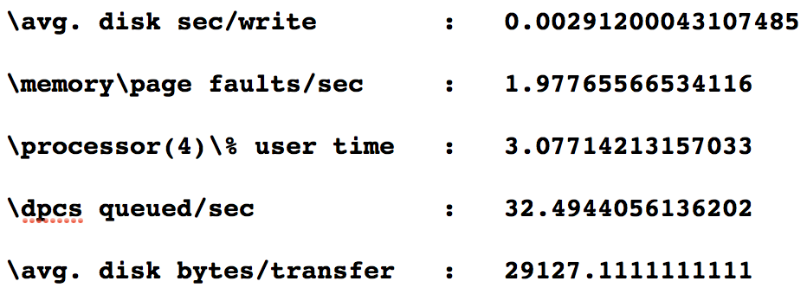
  Cyber Attribution for Security Through
  ML based Application Profiling
  Light-weight ML Models: PERF Data
    Data of PERF counters generated through PowerShell script (3 seconds per sample) to generate a dataset for testing and training.
30

Slide 31
  Cyber Attribution for Security Through
  ML based Application Profiling
  Light-weight Machine Learning Models: Binary Classification
      Multinomial Naive Bayes (MNB)
      Gaussian Naive Bayes (GNB)
      Bernoulli Naive Bayes (BNB)
      Multi-Layer Perceptron (MLP)
      K Nearest Neighbors (KNN)
      Support Vector Machine (SVM)
      Random Forests (RF)
31

Slide 32
  Cyber Attribution for Security Through
  ML based Application Profiling
  Light-weight Machine Learning Models: Accuracy
32

Slide 33
  Cyber Attribution for Security Through
  ML based Application Profiling
  Light-weight Machine Learning Models: Precision & Recall
    Important application specific metrics.
    Deal with class-imbalanced dataset in binary classification problems.
33

Slide 34
  Cyber Attribution for Security Through
  ML based Application Profiling
  Light-weight Machine Learning Models: F1 Score
    Used when precision and recall do not represent the underlying data in some cases.
34

Slide 35
  Cyber Attribution for Security Through
  ML based Application Profiling
  Experiment 3: Recurrent Neural Networks (RNN) Model
    Objective: To detect malware and anomalous behavior in autonomous cyber systems using Deep Neural Networks: CNN and RNN.
    Input:
      Executed instruction and memory bytes sequences
    Output:
      Binary classification of whether a program is malicious or benign based on the instruction sequences.
      Performance parameters: CPU Usage, detection accuracy.
    Experimental Setup: Kernel drivers will be installed to extract data. Known malwares will be installed and tested.
35

Slide 36
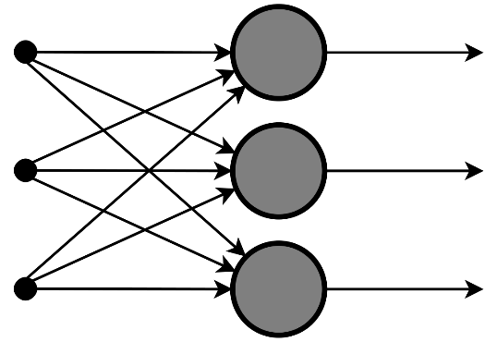
  Cyber Attribution for Security Through
  ML based Application Profiling
  Recurrent Neural Networks (RNN) Model:
Instruction sequences input (uni, bi, or n-grams):
AESENC, ADD, JMP, CMP, ..., PUSH
XOR, JMP, MOV, SHR, ..., CALL_RET
LEA, MOV, MUL, ADD, XOR, ..., XOR
Probabilities of Set of All Sequences (P_{SET}):
P_{S1}: p_{insS1,} p_{insS2}, …, P_{Sn}: p_{insSn,} p_{insSn}, …
Input
Output: p_{insSi,} p_{insSi,…}
Classification
RNN
Benign: Found in the P_{SET}
Malicious: Otherwise
36

Slide 37
  Cyber Attribution for Security Through
  ML based Application Profiling
  Research Contributions:
  Research approach relies on fundamental functionalities—memory and hardware data—that are hard to evade.
  Behavior telemetry based triggers avoid continuous and unnecessary monitoring.
  Intrusion detection sampling provides bounded guarantees to provide high quality samples for accurate prediction and detection.
  Cyber attribution model provides model selection options based on the operational context (known/unknown) and resource-awareness.
37

Slide 38
  Cyber Attribution for Security Through
  ML based Application Profiling
  Research Contributions:
  Dynamic behaviors are learned by the training model both with malicious and benign applications based on behavior artifacts.
  Streaming data sensitive classification: Given the instruction sequences, the RNN model computes the probabilities of each instruction in the given sequence—proving high precision.
  Higher granularity n-gram inputs (instruction sequences) are used for training to enhance the accuracy and robustness of the model .
38

Slide 39
  Cyber Attribution for Security Through
  ML based Application Profiling
  Future Work:
  Enhance the cyber attribution model with n-class classification with provenance data’s assistance.
  Employ cyber attribution model for adversarial machine learning—leveraging source-to-destination knowledge graphs with machine learning.
  Derive theoretical proofs for input sequence lengths for high accuracy, precision, and recall in deep learning models.
  Collaborate with Dr. Lalana Kagal in XAI and trustworthiness of secure IAS actions.
39

Slide 40
  Integration with NGCRC & IRADs
  Our research exclusively contributes to the following IRADs: Reliability Analysis Data System, Cyber Resilience, RADS, MINT Enterprise Analytics, RAPID, and Smart Autonomy.
  We have discussed these projects and research with Paul Conoval and obtained feedback from Justin King and Jason Kobes during our monthly meetings.
  We plan to participate with NGC in the IARPA proposals on Adversarial Machine learning, explainable AI (XAI), and Trojans in Artificial Intelligence (TrojAI).
40

Slide 41
Content Focus to Protect Against Trojan
Attacks on Neural Networks
A D e e p L e a r n i n g B a s e d S o l u t i o n

Slide 42
Outline
1
Collaborations with NGC
2
Secure IAS: Architecture
3
Problem Statement
4
Trojan Attacks on Neural Networks
5
Style Transfer
6
Proposed Defense Solution
7
Prototype and Demo

Slide 43
Collaboration with NGC
IRADs and Proposals:
Reliability Analysis Data System IRAD
Smart Autonomy IRAD
Cyber Resilient DevOps IRAD
IARPA proposal:
  https://www.iarpa.gov/index.php/research-programs/trojai/trojai-proposers-day
Researchers:
Miguel Villarreal-Vasquez¹
Bharat Bhargava¹
Jason Kobes²
Paul Conoval²
Justin King²
Institutions:
¹ Purdue University
² Northrop Grumman Corporation

Slide 44
Secure IAS: Architecture
Comprehensive Architecture of Secure Intelligent Autonomous Systems
Our proposed Secure Intelligent Autonomous Systems solution includes anomaly detection mechanisms based on Neural Network architectures. Neural Network Models need to be protected.

Slide 45



Problem Statement
Inputs
Neural Network
Classes
Correct!
Pedestrian Crossing
Correct!
Stop Sign
Incorrect!
Speed Limit
Correct!
Trigger

Slide 46
Problem Statement
One of the most recent attacks against these models are Trojan or backdoor attacks, in which the adversaries slightly modify the original models by either poisoning during the training phase or retraining it with adversarial data.
Adversarial training samples include a mark or trigger to cause the misbehavior (e.g. misclassification).
Adversaries tend to keep the same architecture modifying only the internal weights.
In testing time, any sample with the trigger in it is misclassified to a predetermined class chosen by the adversary.
Detecting the Trojan behavior is difficult because the models behave as expected when inputs do not include the trigger.

Slide 47
Problem Statement
Hypotheses (In collaboration with Justin King of NGC):
Is it possible to mitigate the influence of triggers at classification time when models are trained to focus on the content (silhouette) of interesting objects?
Does adding style to images during the training process increase the robustness of the model? How much?
Is it possible to detect adversarial inputs (inputs with a trigger), which lead to misclassification, following the approach described above?

Slide 48
Trojan Attacks
Training Samples
Label = Stop Sign Label = Speed Limit Label = Pedestrian Crossing
Training /Pre-training
Phase
Adversaries add trigger and mislabel sample
Neural Network
Trojan Neural Network
Adversarial Samples
Label = Speed Sign
Y. Liu, S. Ma, Y Aafer, W Lee, J Zhai, W Wang and X Zhang. “Trojanning Attack on Neural Networks.” NDSS, 2018. (PURDUE)
X. Chen, C. Liu, B. Li, K. Lu and D. Song. “Targeted Backdoor Attacks on Deep Learning Systems Using Data Poisoning.” ArXiv e-prints abs/1712.05526. 2017. (UC BERKLEY)

Slide 49
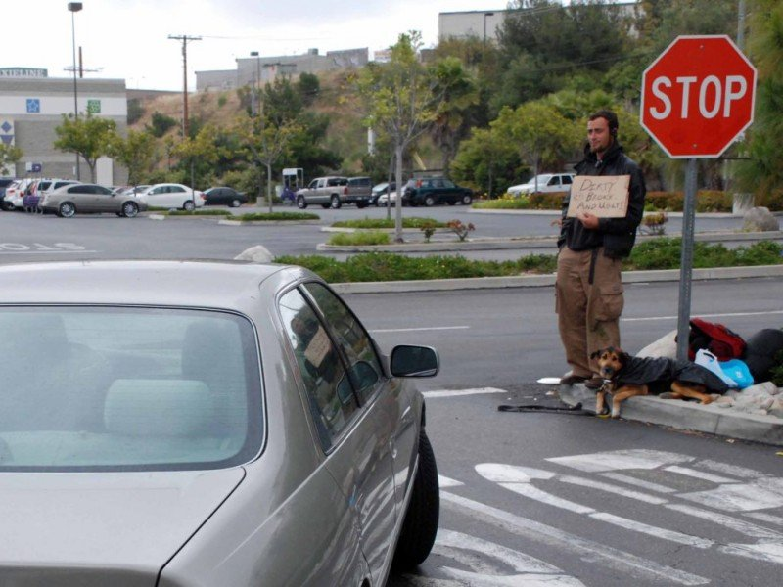

Trojan Attacks: Considerations
Why do we need object detection before object classification?
  Triggers are not necessarily small.
  Triggers can be moving targets (e.g. human sanding by a road sign).
Detected Object
Neural Network
Classes
Pedestrian Crossing
Moving Trigger
Correct!
Only detected objects are passed to the classifier
Stop Sign
Detected Object
Speed Limit

Slide 50
Adversarial Sample vs Trojan Attacks
Adversarial Sample Attacks
Type: Inference-time attack.
Strategy: Crafting adversarial samples that cause misclassification.
Objective: Detriment performance of classifier (increase misclassification rate)
Applicability: Modifications are not effective in all inputs. Any input X must be uniquely crafted to achieve an specific behavior.
Real-world scenario: Adversary needs to modify each sample with unperceivable changes before conducting the attack. Difficult to achieve.
Trojan or Backdoor Attacks
Type: Training-time attack.
Strategy: Poisoning or re-training.
Objective: Misclassification in a controlled manner. Benign inputs are classified as expected, while inputs with trigger are misclassified.
Applicability: Modifications are effective in any input. Any input X with trigger t will be misclassified as chosen by the adversary.
Real-world scenario: Adversaries can feed the model with an adversarial sample (e.g. a road stop sign with a sticker). Easy to achieve.
We will protect against both attacks (from discussion with Paul Conoval of NGC)

Slide 51
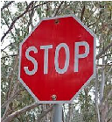
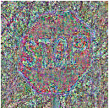
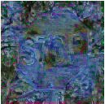
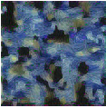

Style Transfer
Image features can be separated in content and style¹.
The style S of any image B can be passed to the input image X to form the styed image X_{S}. Styled image X_{S} gets the content from X (X_{C}).
Observation 1: The original style of input X is overridden. The only thing in common between X, and X_{S} is the content of X (X_{C}).
Input X
Content of X ( X_{C} )
Styled X ( X_{S} )
Style base (B)
Style (S)
¹L. Gatys, A. Ecker and M. Bethge. “A Neural Algorithm of Artistic Style.” arXiv:1508.06576 , 2015.

Slide 52

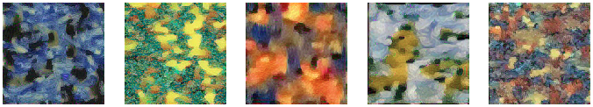
Style Transfer
Different styles can be obtained from a variety of bases.
Observation 2: Several approaches can be used to extract the style of images (from Jason Kobes of NGC) to increase randomness. Presented styles were obtained using the Gram matrix approach.
Style Base (B)
Style (S)

Slide 53
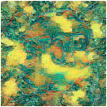
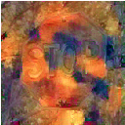
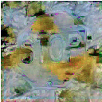
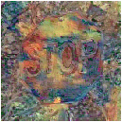
Style Transfer
Given input X and N style bases we generate N styled images.
Style Base (S)
Input X
Styled Input (X_{S})

Slide 54
Proposed Solution
Approach: Given the original Model M_{O}, create a new model M_{R} by retraining M_{O} with clean training data with a variety of styles to mitigate the effects of the trigger.
Intuition: Model will focus on the content or silhouette of the object instead surrounding shapes and colors.
Retraining Process
M_{R}
Set of Clean Content (X_{C}) and Styled Inputs ( X_{S} )
Retrained Model
M_{O}
Original
Model
Given N style bases, a set of N+1 training images is generated for each training input X: {X_{C}, X_{S1,} X_{S2},…, X_{SN}}.

Slide 55

Proposed Solution
An styled image generator G_{SI} has been implemented: This generator takes an image X and a chosen style base B and produces both an the content of X (X_{C}) and the styled image X_{S} .
The styled image generator G_{SI} is used in both the training and testing phase.
Input X
G_{SI}
Content of X ( X_{C} )
AND
Styled Image Generator
Styled Input ( X_{S} )
Style Base (B)

Slide 56
Proposed Solution
Trojan Attack Defense Categories:
Model Hardening: Intended to improve the robustness of DNNs, which is to prevent adversarial samples from causing DNN misbehaviors.
Adversarial input detection: Identifies adversarial samples during execution.
We propose a solution for both categories.

Slide 57
Proposed Solution
Model Hardening Solution (testing phase):
Every input X is transformed to either its content (X_{C}) or styled (X_{S}) version.
The retrained model M_{R} is used to do the classification after the transformation of input X.
G_{SI}
Content of X ( X_{C} )
M_{R}
Input X
OR
Classification Output
Styled Image Generator
Retrained Model
Chosen Style Base (B)
Styled Input ( X_{S} )

Slide 58
Proposed Solution
Adversarial Input Detection (testing phase):
Input X is classified by the original model M_{O}.
The content (X_{C}) or styled (X_{S}) version of the input X is classified by the retrained model M_{R}.
Input X is considered adversarial if there is a mismatch in the classification.
M_{O}
Y_{O}
Adversarial Input
Yes
Original
Model
Input X
Y_{O} == Y_{R} ?
G_{SI}
M_{R}
Y_{R}
No
OR
Benign
Input
Chosen Style Base (B)
Styled Image Generator
Retrained Model

Slide 59
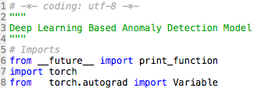


Prototype and Demo
Architecture Implementation
MODEL
Model
Based ConvolutionalNeural Networks (CNN): VGG16 and Resnet34.
Programming Language: Python
Compatible with several numerical computing libraries suitable for the use of GPUs (e.g. Pytorch)
Computing Library: PyTorch
Scientific computing package
Replacement of Numpy to take advantage of the power of GPUs
Python-friendly platform for neural networks (Deep Learning)
Parallel Computing Platform: CUDA
Programming model to use GPUs for general purpose computing
CUDA
GPU

Slide 60
Prototype and Demo
Data Collection Model Retraining Defense Techniques
S
S
Styled Image Generator
Hardening/Detection Architecture
Repository 1
Image
Dataset
Model Retraining
Testing of Architecture
Solution
Repository N
Original Model (Trojan)
Adversarial Input Generator

Slide 61
Prototype and Demo
Data Collection:
Selected datasets:
  The German Traffic Sign Recognition Benchmark (GTSRB): Includes single-image and multi-class images, with 43 classes and more than 50,000 images.
  Link: http://benchmark.ini.rub.de/?section=gtsrb&subsection=news
  Traffic Sign Recognition: The data are RGB traffic sign images of various sizes, cropped out of photos taken in real life scenarios. In total, there are 81 classes, each class belonging to one of 12 super classes.
  Link: https://www.kaggle.com/c/traffic-sign-recognition/data )
  LISA Traffic Sign Dataset: Set of videos and annotated frames containing US traffic signs. It is released in two stages, one with only the pictures and one with both pictures and videos. Includes: 47 US sign types, 7855 annotations on 6610 frames, sign sizes from 6x6 to 167x168 pixels and images obtained from different cameras with sizes that vary from 640x480 to 1024x522 pixels.
  Link: http://cvrr.ucsd.edu/LISA/lisa-traffic-sign-dataset.html

Slide 62
Prototype and Demo
Model Retraining:
Styled Image Generator G_{SI} already implemented
  VGG-XX based
Traffic Sign Classifier also implemented
  Resnet34 based
Replication of Trojan attacks (in progress)
  A Trojan sample generator is being implemented to create adversarial images (images with a trigger) in an efficient way.
  Triggers are inserted using a Deep Neural Network to customize them to be more efficient in activating the neurons related to the output label as suggested by Liu et al.¹
  Triggers are also generated by blending two images as suggested by X. Chen et al.²
  The insertion of triggers to clean images is crucial to replicate experiments of the state-of-the-art work.
Replication of Adversarial Sample attacks (in progress)
  Creation of adversarial sample generator
  Main library advertorch.
¹Y. Liu, S. Ma, Y Aafer, W Lee, J Zhai, W Wang and X Zhang. “Trojanning Attack on Neural Networks.” NDSS, 2018.
²X. Chen, C. Liu, B. Li, K. Lu and D. Song. “Targeted Backdoor Attacks on Deep Learning Systems Using Data Poisoning.” ArXiv e-prints abs/1712.05526. 2017.

Slide 63
Prototype and Demo
Defense Techniques:
Two architectures are being implemented:
  Model Hardening
  Adversarial Input Detection.
For both architectures a series of experiments are being conducted to test the following metrics:
  Model accuracy of model without our solution
  Model accuracy of model with our solution
  Attack success in model without our solution
  Attack success in model with our solution
  Even more important: Precision and Recall analysis

Slide 64
Content Focus to Protect Against Trojan Attacks on Neural Networks:
DEMO
File: NGCRC-2019-Bhargava-DEMO2.mp4

Slide 65
Thanks!

