Slide 1

Northrop Grumman Cybersecurity
Research Consortium (NGCRC)
Spring 2015 Symposium
Monitoring-based System for E2E Security Auditing and Enforcement in Trusted and Untrusted SOA
29/30 April 2015
PI: Prof. Bharat Bhargava
Purdue University
Technical Champion(s): Dr. Sunil Lingayat

Slide 2
Project Participants
Prof. Bharat Bhargava
Dr. Pelin Angin
Rohit Ranchal, PhD student
Denis Ulybyshev, PhD student
Prof. Leszek Lilien
Dr. Lotfi ben Othmane

Slide 3
2014/2015 Research Focus
High security assurance in SOA
  Agile defense
    Resilient and Adaptable service monitoring
    Anomaly detection (failed, compromised or malicious services)
    Service Trust management
    Dynamic service composition
    Ensure the enforcement of SLAs in real time
  Data privacy in SOA
    Secure cross-domain information exchange
    Privacy-preserving controlled data dissemination

Slide 4
Potential End-to-End Scenario using 3 NGCRC Projects (preliminary notional draft concept!)
High security
assurance in SOA
User Machine
Service Selection based on trust level of user
User
(1)
Secure Browser
(2)
Authenticate to browser
(trusted e.g. CAC or untrusted e.g. PIN)
Request data processing
Untrusted Service
Data Processing
Trusted Service
Encrypted Data Processing
(3)
 | NGCRC Projects | Univ.
(1) | Secure Hardware Tokens and Key Storage in the Browser | MIT
(2) | End to End Security Policy Auditing and Enforcement in Service Oriented Architecture | Purdue
(3) | Ensuring Privacy in Cloud-based Data Analysis | Purdue
Untrusted Cloud
Untrusted Cloud
Data (potentially corrupted)
Encrypted Data

Slide 5


Problem Domain: Service Attack
Trust Domain
Service B
PII
Service A
Service C
Service D

Slide 6

Problem Domain: Service Failure
Trust Domain
Service B
PII
Service A
Service C
Service D

Slide 7
Problem Domain: Data Leakage
Trust Domain
Service B
PII
PII
Service A
Service C
PII
Service D

Slide 8
Research Components
Policies
Passive Listener
Active
Listener
Active Bundle
Listener
Heartbeat Module
Trust Management
Agile Defense
Resiliency & Adaptability
Anomaly Detection

Slide 9
Agile Defense in SOA

Slide 10
Agile Defense
Goals:
  Replace anomalous services with reliable versions
  Reconfigure system service orchestrations to respond to anomalous service behavior
  Swiftly self-adapt to changes in context
  Enforce proactive and reactive response policies to achieve system security goals
  Continuous availability even under attacks
Components:
  Detection of anomalies
  Hot re-deployment of anomalous (failed/attacked) services
  Dynamic service composition

Slide 11
Adaptability for Increased Resilience
Dynamic service reconfiguration based on changes in context:
  Updated priorities (e.g. response time vs. level of detail/accuracy)
  Updated constraints (e.g. need to have trust levels of all services > x for critical mission)
  Replacing failed services in composition with healthy ones dynamically to avoid complete restart of process
Monitor services status and determine action
  Adapt services in a domain in response to attacks/failure
  Update service health status in case of significant deviations from normal behavior
  Create service backup in case of suspicion of anomaly
  Re-deploy service in case of complete failure
Controlled sharing of data:
  Determine sharing of data based on the requirements and authorization level of the subscriber
  Limit data shared based on trust level of subscriber
  Controlled dissemination based on contexts such as safe environment, attack scenario

Slide 12
Agile Defense Research Problems
How to detect changes in service context
  Centralized or distributed monitoring?
  What service behavior constitutes context change?
  What is the most effective and efficient way to detect anomalies?
How to react to changes in context across domains
  What is the most effective way to create fail-safe service orchestrations?
  How can we efficiently reconfigure an orchestration to take into account the new context?
  How can we tailor the response based on the extent, duration and type of anomalies?
How to balance costs and benefits of adaptability

Slide 13
Anomaly Detection by Service Monitoring
Service monitor in each domain tracks all incoming requests to service domain, which allows gathering of the following data:
  Service response time (excluding network delay) (increased delay in service response can be the sign of an attack)
  Service heartbeat data (each served request is a sign that the service is up and running)
  Service response status (particular response codes signify problems in the service)
  Service authorization/authentication failure data (consecutive authorization/authentication failures can signify attacks)
Active bundle interaction logs are also utilized to detect service anomalies (unauthorized data interactions, active bundle integrity violations etc.)

Slide 14
Distributed Service Monitoring for Cross-domain Anomaly Detection and Adaptability
S4
*
MB
*
S5
S1
S6
*
Domain B
*
*
S2
MC
*
S7
MA
*
S3
*
S9
Domain A
*
Domain C
*
*
S10
*
S11
*
MD
*
*
ME
*
S12
Domain D
Domain E
Central Monitor
*: service request data
*: summary service health data

Slide 15
Distributed Service Monitoring for Cross-domain Anomaly Detection and Adaptability
Distributed service monitoring allows for the collection, analysis and reaction to dynamic cyber events across all domains involved, and prevents propagation of threats within or outside the domain of the anomalous service by taking proactive measures (service isolation, replication).
The data (service requests, service performance data etc.) gathered by the monitor M_{x} of each service domain x is stored in the monitoring database of the domain.
Service monitoring is distributed across domains, with one monitor for each domain. Each monitor is responsible for reporting the health status of the services in its own domain to the central monitor.
Service monitor of each domain mines the data stored in its database to detect anomalies with services in the domain and takes measures accordingly (re-deployment, backup service creation).
Service monitor of each domain sends summary health status data of services to the central monitor, which is utilized for dynamic service composition.

Slide 16
Anomaly Detection Approach
Statistical analysis of multivariate time-series data collected by service monitors to detect significant deviations from normal behavior
Adjusts service threat levels based on duration, extent & type of anomalies
Correlation of time-series data from multiple services allows for detection of bigger threats (affecting the whole domain, collaborative attacks etc.)
Detecting previously unseen attacks as opposed to signature-based models
Threat level = 3
Threat level = 0
Threat level = 1

Slide 17
Anomaly Detection Approach
Diagnosis: Anomaly affecting S1
Response: replace S1
Diagnosis: Anomaly affecting whole
domain
Response: re-deploy all services in
different domain / switch to backup
versions in different domain

Slide 18
Hidden Markov Models for Anomaly Detection
Investigating Hidden Markov Models (HMMs) for detection of anomalies in time series data
HMM: The simplest dynamic Bayesian network
Model consists of states X and an observation sequence (output tokens) Y, whose probability of occurrence depends on the state
States are hidden, but outputs of each state is observed
Sequence of observations are related to each other rather than independent
Each state has a probability for generating certain output and probability of transition to another state
Task: Given the model’s parameters and a sequence of observations, compute the distribution over the hidden states of the last variable in the sequence

Slide 19
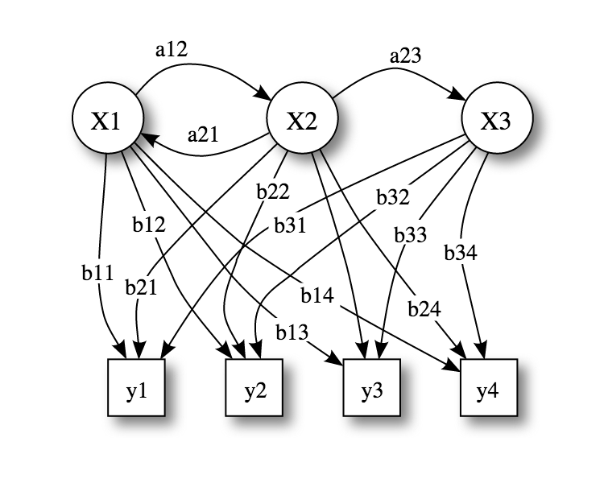
Hidden Markov Models for Anomaly Detection
a_{ij}: State transition probabilities
b_{ij}: Output probabilities
X_{i}: States (normal, attack, high load, failure etc.)
y_{i}: Observations ({low response time, high response time, normal response time},
{high CPU usage, no CPU usage, normal CPU usage}…)
Train HMM with service operation data under normal conditions (to detect anomalies)
Merge with measure of distance between different sets of time-series data to assess
significance of deviation from normal

Slide 20
Hot Re-deployment of Failed/Compromised Services
The service monitor of each domain stores a copy of each service implementation in its domain in a repository, so they can be re-deployed in case of failure.
Problems in the request of a failed service are also detected by the service monitor, which can redirect the request to a backup service with the same capability if one exists (otherwise re-deployment process is initiated)
Services in “failed” status (upon detection by the monitor) are replaced with a fresh copy from the repository, and their “deployment time” field in the database is updated to the time of deployment.
In case of detection of a possible service anomaly, the service monitor can initiate a backup service deployment in the same domain or in another domain (such as a cloud application server).
Service deployment takes place through copying the service bundle from the repository into the target service domain.
Upon service deployment, all relevant information about the new service is logged in the service monitor’s database. The dynamic service composition module utilizes this data to determine whether the service will be part of a specific orchestration.

Slide 21
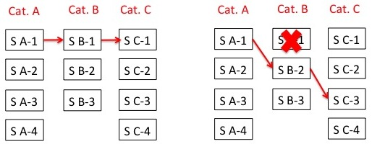
Dynamic Service Reconfiguration
An SOA service orchestration is composed of a series of services that interact with each other based on a service interaction graph
One of the multiple services in each service category can be selected for specific service functionality, e.g. category: weather, services: weather.com, Yahoo weather, accuweather
Challenge: Configuring set of services that conform to QoS and security policy requirements
Dynamically reconfigured service composition is based on changes in the context with respect to timeliness and accuracy of information as well as the type, duration, extent of attacks and the complexity of the environment

Slide 22
Dynamic Service Reconfiguration
Developed a module that dynamically determines the service endpoints involved in a specific composition
Given the description of a business process (service composition) including the categories of the services involved in the process, the dynamic service composition module updates the process with specific service endpoints to be utilized in that process.
The dynamic service composition mechanism allows services meeting specific requirements to be included in a composition
  Utilizes service and interaction data logged in the central database to create the best possible composition given a service request with policy specifications
  Enables the dynamic replacement of failed services in a composition with services of equivalent capability to prevent interruption of tasks
Dynamic replacement of service endpoints implemented in compliance with the BPEL standard for service composition, using dynamic partner links
Apache ODE engine used for the deployment of the composed processes

Slide 23
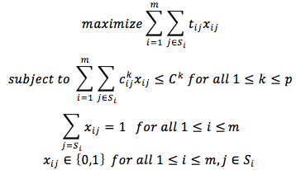
Dynamic Service Composition Approach
The problem is an instance of the multiple-choice multiply-constrained knapsack problem (MMKP):
t_{ij:} utility of service j in category i
x_{ij}: indicator for participation in a service composition (of service j in category i)
c_{ij}^{k}: value of service j in category i for constraint category k
C^{k}: threshold value for constraint category k
S_{i}: set of services in category i p: number of constraints m: number of service categories
MMKP is NP-hard, therefore we use a greedy heuristic-based approach to find near-optimal solutions

Slide 24
Dynamic Service Composition Algorithm
//Input: A set of m service categories S_{i}, each with a set of concrete services.
//Output: A set of services, one in each category, with near-optimal utility based on context.
sort services in every category in descending order of utility
for i: 1..m
x_{i1} = 1 // select the highest utility service for the initial composition
if
return current composition //solution satisfies constraints
else
while solution not feasible
//downgrade using the service with biggest aggregate saving in constraints
for each category i
for each service j in i
calculate aggregate saving of service in category i of the current composition with j
find service j with maximum aggregate saving
find service with max aggregate saving across all categories, include in the composition
return composition

Slide 25
Dynamic Service Composition Experiments
Dynamic service composition overhead is especially important in time-critical settings
Measure response time overhead of dynamic service composition for:
(1)Different number of service categories in a composition (2)Different number of services to choose from for each category
Setting: Central service monitor on Amazon EC2 m3.medium instance (1 vCPU, 3.75 GB memory)
Composition time dominated by the database access time and not affected significantly by the number of possible services in a category or the number of service categories involved in the composition.
Composition overhead reasonable for most settings.
Composition involving varying number
of service categories, with 3 possible
services for each category
Composition involving 3 service categories, with varying number of
services for each category

Slide 26
Adaptability Cost and Benefit Consideration
Benefits:
Increased availability of services (measured by up-time and throughput)
Increased performance by obviating the need to restart invocations of service compositions with failed/attacked services (measured by total response time)
Increased security and flexibility in service composition based on priorities and constraints in a specific environment (measured by success of avoiding attacks)
Costs:
Dynamic service composition time cost
Cost to maintain central service monitor
Service response delay due to monitoring
Increased resource usage in service domain
Overhead of re-deploying service in same/different domain

Slide 27
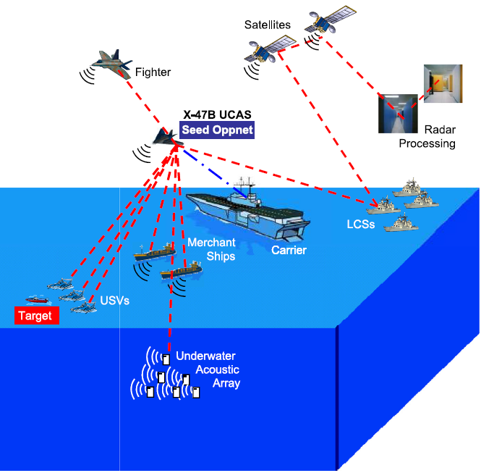
Demo Scenario
A Carrier Strike Group with one carrier and four Littoral Combat Ships (LCSs) is deployed for a surveillance mission in a dangerous area. A Northrop Grumman X-47B, an Unmanned Combat Air System (UCAS) is deployed from the carrier for the surveillance of the whole Area of Responsibility (AOR) of the LCS/CSG force. The surveillance mission also involves unmanned aerial vehicles (UAVs) that perform video surveillance functions in the AOR. The UCAS periodically contacts the gateway of the underwater acoustic array to receive a report from it. Radar plots from the ships and video frames from the UAVs are gathered by the UCAS and analyzed together for accurate identification of objects in the area.

Slide 28
Demo Scenario (cont.)
The analysis process is a composition of three services:
S1: Radar plot integrator: This service integrates together radar plots from multiple sources to present a unified plot of the whole area.
S2: Radar plot analyzer: This service analyzes a radar plot to detect locations of suspicious objects.
S3: Video frame analyzer: This service analyzes a stream of video frames to identify objects in a scene given their coordinates.
The analysis process invokes the radar plot integrator service first, which provides an integrated plot fed into the radar plot analyzer service. The radar plot analyzer service outputs the locations of significant objects from the plot, which are input to the video frame analyzer to identify the types of the objects and decide whether they pose any threat.

Slide 29
Demo Scenario (cont.)
Demonstration of system capabilities:
Adaptation to context changes: As long as the reports from the underwater acoustic array show a low threat level, the policy for the analysis process will be to perform detailed analysis with no or little preference for short response time. The context will change from “normal” to “emergency” when the report includes the presence of a suspicious watercraft. The context change will affect the service composition (as a result of dynamic service composition, services providing faster response will replace services providing very detailed analysis at the cost of longer response time).
Adaptation to attacks on services: The demo will show how the analysis process composition will change dynamically as a result of a DoS attack on one of the services involved.
Adaptation to service failures: We will show how the failure of one service in the composition will trigger the hot deployment of the same service and the redirection of the request to the newly deployed service to prevent interruption.

Slide 30
Further Research Tasks and Plans
Integrating more parameters into anomaly detection process (CPU usage, memory usage etc.)
Implementation of HMMs for anomaly detection
Experiments with anomaly detection:
  Time to detect anomaly after start of attack
  Accuracy of anomaly detection model
Experiments with service monitor:
  Scalability of central monitor
  Service response delay due to monitoring
  Service throughput with monitoring
Adaptability experiments:
  Multiple constraints in dynamic service composition
  Cost-benefit analysis of dynamic service composition (in terms of response time overhead)
  Overhead of re-deploying service in same/different domain

Slide 31
Privacy Preserving
Data Dissemination
in SOA

Slide 32
Problem Statement
Composite Web services
  Loosely coupled independent RESTful services composed to accomplish a task
  A composite service invocation translates into multiple interactions that may share user data
Opaque data sharing across unknown endpoints beyond primary service
  Undetected privacy violations due to data sharing with unauthorized services
Lack of policy infrastructure
  Inability of owner to specify data access policies for secondary services authorization
  Policy definition, communication, evaluation and enforcement
Message-based security mechanisms (HTTPS) are not applicable
  Provides point-to-point secure communication
  Unable to provide protection in remote domains

Slide 33
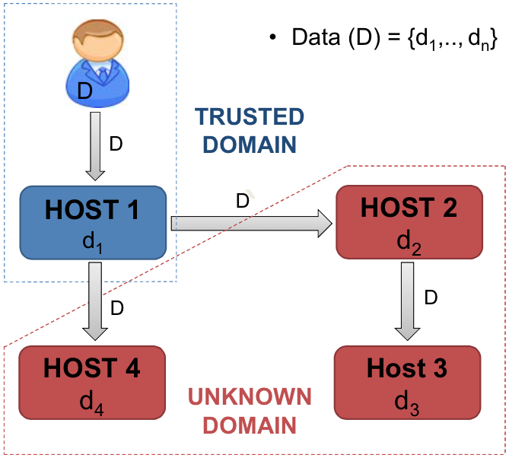
Motivation

Slide 34
Research Objectives
Demonstrate policy-based distributed data dissemination
Demonstrate distributed policy communication, evaluation and enforcement framework
Demonstrate scenarios for controlled cross-domain information exchange under various anomalies and attacks

Slide 35
Research Tasks
How to ensure that each authorized subscriber service only accesses the data for which it is authorized
How to prohibit data dissemination to an unauthorized subscriber service
Demonstrate applications (such as Electronic Healthcare Records, UAVs) under different data dissemination models:
  Publish-Subscribe
  Peer-to-Peer
  Mutable (interacting services can update data and policies in Active Bundle)
  Immutable
Demonstrate compatibility with existing service infrastructure such as RESTful services (HTTP)

Slide 36
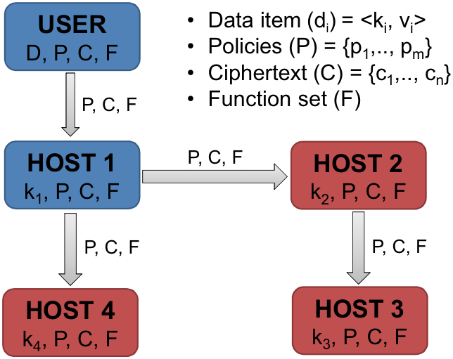
Proposed Solution
if (host == authorized)
F(k_{i}, P, C) = d_{i}

Slide 37
Proposed Solution
Practical implementation of function F, policy P, and ciphertext C
  Active Bundle approach for
  secure data dissemination
Active Bundle (AB)
  Self-protecting encapsulation
  mechanism for protecting data
  Provides secure cross-domain
  information exchange
Metadata
  Access control policies
  Operational policies
Virtual Machine
  Protection mechanism (self-integrity check)
  Policy evaluation, enforcement and data dissemination

Slide 38
Framework Components
Host authentication
  Password, Certificate, Biometric, PKI
Host request authorization (policy evaluation)
  Access control model such as Attribute/Role-based
  Policy specification language such as XACML/JSON
  Policy evaluation engine such as WSO2 Balana/Java-based
Key management methods
  Key inclusion (prone to attacks)
  Key management service (use of trusted third party for key storage and distribution)
  Key derivation based on the AB execution control flow path
    Key derivation based on the unique information generated in control flow steps only if the service is authenticated and authorized
Tamper Resistance
  Correct data dissemination depends on the correct execution of AB control flow steps
  Verify the integrity of the execution to ensure there is no difference from the original code
  Integrity verification is based on digest calculation using secure one-way hash function
  Each time an AB step is executed, the tamper resistance module calculates its digest and the digest of its resources
  Digests are used to derive decryption keys
  Any modification to AB changes the digest resulting in incorrect key derivation
Notes:
Flow-chart for tamper resistance

Slide 39
Data Dissemination Models
Publish-Subscribe Dissemination
  Data published by various sources to a central repository and shared with various subscribers by means of Active Bundles (AB)
Peer-to-Peer Dissemination
  Data shared among peers of different classification level by means of AB
Immutable Dissemination
  Fixed data shared by means of AB with various parties in an information flow chain
Mutable Dissemination
  Data shared by means of AB can be dynamically updated by the interacting parties in an information flow chain
Notes:
Data is coming from many sources to a central data storage (central server, e.g. Hospital Information System). Then AB is created with these data at a central server and then AB is sent to many subscribers (of the same classification)
It involves both client-server data exchange and peer-to-peer communications between sites
Data (AB) goes to a chain of subscribers. AB can't be updated by other parties once it has been created
AB can be updated by different parties. Every new AB incorporates all the previous ABs

Slide 40
Publish-Subscribe Dissemination
(Healthcare)
Nurse
Doctor
Active
Bundle
Active
Bundle
Active
Bundle
Medical
Information
System
Laboratory
Active
Bundle
Active
Bundle
Patient ID
Insurance ID
Medical data
Medical history
Medical test
prescription
Prescription
Treatment code
Pharmacy
Insurance

Slide 41
Publish-Subscribe Dissemination
(Healthcare)
Patient ID
Medical data
E(Insurance ID)
E(Medical history)
E(Medical test prescription)
E(Prescription)
E(Treatment code)
Patient ID
Medical data
Medical history
Medical test prescription
Prescription
E(Insurance ID)
E(Treatment code)
Nurse
Doctor
Active
Bundle
Active
Bundle
Active
Bundle
Medical
Information
System
Laboratory
Patient ID
Insurance ID
Treatment code
E(Medical data)
E(Medical history)
E(Medical test prescription)
E(Prescription)
Patient ID
Medical test prescription
E(Medical data)
E(Insurance ID)
E(Medical history)
E(Prescription)
E(Treatment code)
Active
Bundle
Active
Bundle
Patient ID
Insurance ID
Medical data
Medical history
Medical test
prescription
Prescription
Treatment code
Pharmacy
Insurance
Patient ID
Prescription
E(Medical data)
E(Insurance ID)
E(Medical history)
E(Medical test prescription)
E(Treatment code)
Notes:
Different hospitals

Slide 42
Peer-to-Peer Dissemination
(UAVs)
UAV 1
UAV 2
UAV 3
Command
& Control
Time period
Deployed personnel
Target locations
Intelligence reports
Mission expenses
Deployed weapons
Casualties
Press Release
Top Secret
Secret
Confidential
Unclassified

Slide 43
Peer-to-Peer Dissemination
(UAVs)
UAV 1
Infrared imagery
Location coordinates
UAV 2
Multispectral imagery
Location coordinates
UAV 3
Time period
Deployed personnel
Target locations
Intelligence reports
Mission expenses
Deployed weapons
Casualties
Press Release
Command
& Control
Time period
Deployed personnel
Target locations
Intelligence reports
Mission expenses
Deployed weapons
Casualties
Press Release
Top Secret
Secret
Confidential
Unclassified
Target locations
Intelligence reports
Mission expenses
Deployed weapons
Press Release
Mission expenses
Press Release
Press Release

Slide 44
Mutable Dissemination
(Healthcare)
Name
Patient ID
Medical data
History
Medical test prescription
Prescription
General Practitioner
AB2
AB3
AB1
Nurse
AB3
Laboratory
AB4
Surgeon
Name
Patient ID
Name
Patient ID
Medical data
Patient ID
Medical test prescription
Medical data
Name
Patient ID
Medical test prescription
Prescription
Medical data
History
Pharmacy
Purple – data update
Black – data access
Patient ID
Prescription

Slide 45
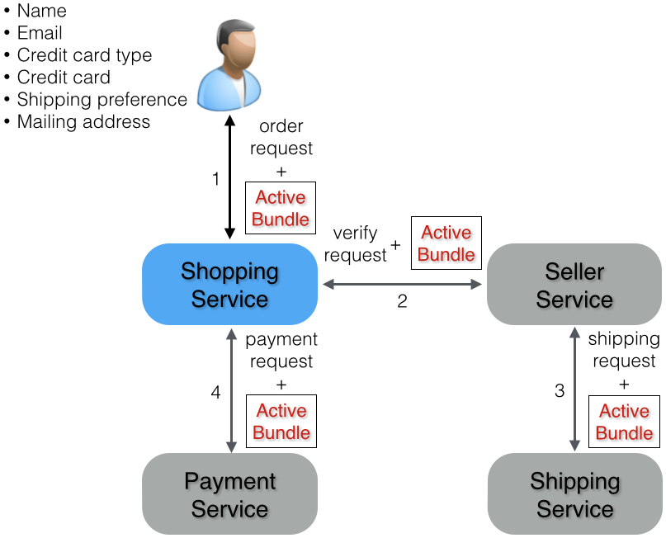
Immutable Data Dissemination
(Online Shopping)

Slide 46
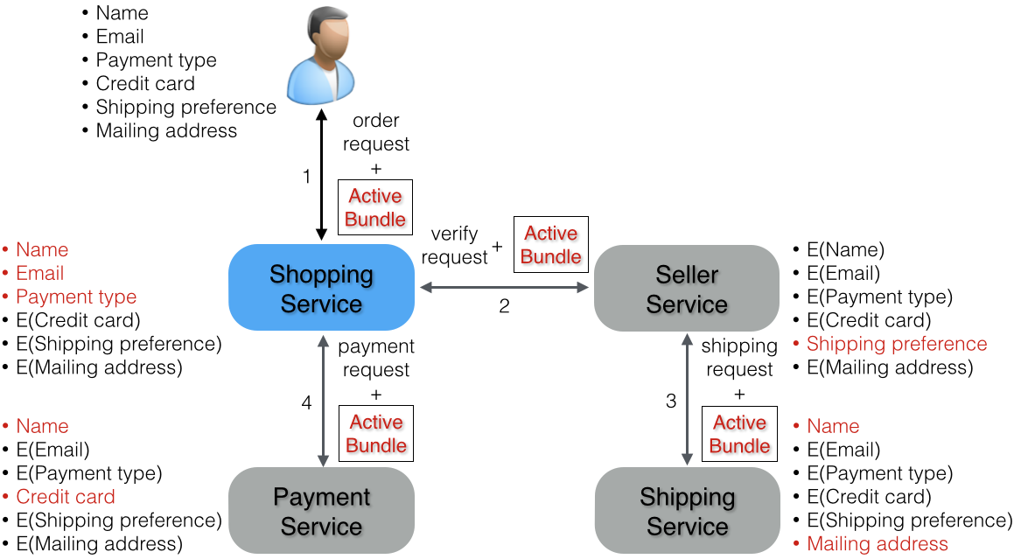
Immutable Data Dissemination
(Online Shopping)

Slide 47
Implementation
RESTful Web services
SOA implementation using Node.js
AB implementation as an executable JAR file
AB API implementation using Apache Thrift RPC framework
Policy specification in XACML/JSON
Policy evaluation using WSO2 Balana
AB transfer by means of REST message (HTTP body)
AB API exposed to services:
  getSLA()
  getValue(req, sigReq, cert)
  getSecureValue(req, sigReq, cert)

Slide 48
Access Policy Examples
Credit card access policy (Attribute-based):
Deny
Resource | Credit card
Subject: CA signed certificate | Visa payment services
Action | READ
Environment: Service trust | < 9
Medical data access policy (Role-based):
Deny
Resource | Medical prescription
Subject: Role | Doctor, Patient
Action | READ
Environment: Subject rating | < 4 star

Slide 49
Access Policy Examples
Cross-domain data access policy (Context-based):
Deny
Resource | Intelligence reports
Subject: Classification | Top secret
Action | READ
Environment: Attack context | Secret, Confidential
Medical data access policy (Context-based):
Deny
Resource | Medical prescription
Subject: Role | Dr. A, Patient
Action | READ
Environment: Emergency context | Paramedics, Doctors

Slide 50
Attack Resilience
Trusting the AB and its execution
  Digital signatures to validate the authenticity and integrity of AB
  Containerized execution of AB (e.g. using Docker containers)
  Cloud-based execution
Protecting AB against malicious receivers
  Tamper resistant code (code integrity checks)
  Correct secret key generation only in case of correct execution
  Cloud-based execution (third party code execution vs third party data broker)
Protecting AB execution against control flow hijacks
  Code obfuscation
  Write protected memory execution
  TPM - based remote attestation using chain of trust (Trusted Computing Group work) [https://www.trustedcomputinggroup.org/faq/TPMFAQ/]

Slide 51
Experimental Setup
Measurements
  Experiment 1: Growth in AB size with increasing number of policies
  Experiment 2: Growth in AB and Service interaction time with increasing number of policies
  Experiment 3: Tamper Resistance overhead in AB execution
Variations
  AB versions
    ABx – XACML-based policies and WSO2 Balana-based policy evaluation
    ABxt – ABx with tamper resistance capabilities
    ABc – JSON-based policies and JAVA-based policy evaluation
    ABct – ABc with tamper resistance capabilities
  Number of AB policies
Environment
  Amazon EC2 C3 Large and XLarge instances
Data collection
  5 runs of each experiment repeated
  100 requests per run

Slide 52
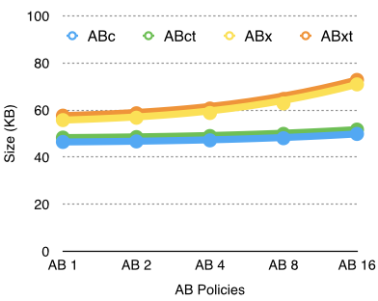
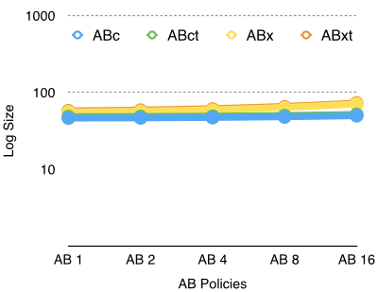
Experiment 1: AB Size vs Number of policies
Observations
  Linear growth in AB size with the increase in policies for all versions
  Tamper resistance adds a slight overhead to AB size (< 2 KB)
  79% reduction in policy size (0.79 KB) with JSON-based policies
    Additional reduction of 8.5 KB with Java-based policy engine

Slide 53
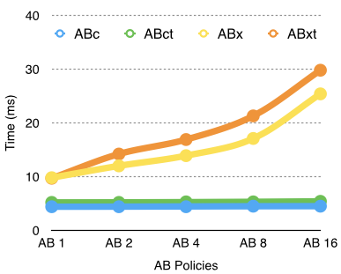
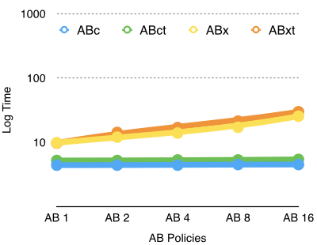
Experiment 2: AB-Service Interaction Time vs Number of policies
growth in interaction time with
Observations
  Linear growth in interaction time with increase in policies for ABx and ABxt
    Use of XACML-based policies and external library (WSO2 Balana) for policy evaluation
    Evaluation of XACML policies involve the traversal of XML policy and request trees
  Constant growth in interaction time with increase in policies for ABc and ABct
    Use of JSON-based policies and Java code for policy evaluation
    Highly optimized Java code evaluation

Slide 54
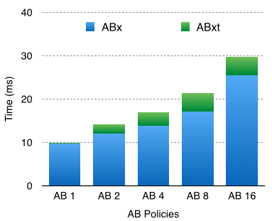
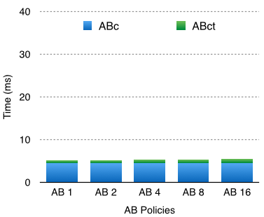
Experiment 3: AB Tamper Resistance Overhead
Observations
  Tamper Resistance has a linear overhead in ABxt
    Digest calculation of XACML-based policies (XML policies and requests)
  Tamper Resistance has a constant overhead in ABct
    Digest calculation of JSON-based policies (JSON policies)

Slide 55
Framework’s Cost and Benefit Considerations
Benefits:
  Policy-based access control
  Privacy preserving data dissemination
  Context-based controlled data dissemination
  Independent of trusted third parties
  Independent of source availability
  Ability to operate in unknown environment
  Reduced host liability for extra data
Costs:
  Message size and network overhead due to AB
  Service response delay due to interaction between AB and service
  Increased resource usage in service domain
  Tamper Resistance overhead
  Possible resource overhead for subscriber to maintain containers for isolation of AB execution
  Possible resource overhead for publishers to maintain third party execution of AB

Slide 56
Further Research Tasks
Cross domain data dissemination with monitoring capabilities
  AB logs state information with Service Monitor for each interaction:
    Authentication decisions
    Policy evaluation and data dissemination decisions
    Self-integrity check results
  AB receives state information from Service Monitor
    Service trust/ratings and certificate revocations
    Adaptable policies for context-based data dissemination
  Service Monitor uses AB log information to:
    Dynamic service trust/rating evaluation
    Anomaly detection in services (failures, attacks)
Comprehensive security and performance testing
  Scalability of AB-based interaction
    Resource usage
    Response time
    Request drop rate
    Container deployment cost
  AB resiliency testing against
    Tampering attacks
    Unauthenticated and unauthorized access

Slide 57
Presentations and Publications
“PD3: Policy-based Distributed Data Dissemination,” R. Ranchal, D. Ulybyshev, P. Angin, B. Bhargava.
“Consumer-Oriented Privacy-Preserving Access Control for Electronic Health Records in the Cloud,” R. Fernando, R. Ranchal, L. Othmane, B. Bhargava.
“SORT: A self- organizing trust model for peer-to-peer systems,” A. Can, B. Bhargava.
“A Trust-based Approach for Secure Data Dissemination in a Mobile Peer-to-Peer Network of AVs,” B. Bhargava, P. Angin, R. Ranchal, R. Sivakumar, A. Sinclair, M. Linderman.
“Protection of Identity Information in Cloud Computing without Trusted Third Party,” R. Ranchal, B. Bhargava, L. ben Othmane, M. Linderman, M. Kang, A. Kim, L. Lilien.

Slide 58
References
[AB12] M. Azarmi, B. Bhargava, P. Angin, R. Ranchal, N. Ahmed, A. Sinclair, M. Linderman, and L. ben Othmane, “An End-to-End Security Auditing Approach for Service Oriented Architecture,” 31st IEEE Symposium on Reliable Distributed System (SRDS), 2012.
[BC06] S. Berger, R. Cáceres, K. A. Goldman, R. Perez, R. Sailer, and L. van Doorn, “vTPM: virtualizing the trusted platform module,” USENIX-SS’06, Berkeley, CA, USA, 2006.
[BK08] A. Benameur, F. Kadir, and S. Fenet, “XML Rewriting Attacks: Existing Solutions and their Limitations,” IADIS Applied Computing, IADIS Press, Apr. 2008.
[CB13] A. Can and B. Bhargava, "SORT: A self- organizing trust model for peer-to-peer systems,” IEEE Trans. Dependable Secure Comput., 10:14- 27, 2013.
[VE06] J. Viega and J. Epstein, “Why applying standards to Web services is not enough,” IEEE Security & Privacy, 4(4):25-31, 2006.

Slide 59
References
[BG10] L Baresi, S Guinea, O Nano, “Comprehensive Monitoring of BPEL Processes,” Proc. IEEE Internet Computing Conference, vol. 14(3), June 2010, pp. 50-57.
[LJ06] Z. Li, Y. Jin, and J. Han “A Runtime Monitoring and Validation Framework for Web Service Interactions,” Proc. Australian Software Engineering Conference, Sydney, Australia, Apr. 2006, pp. 70–79.
[SG09] J. Simmonds, Y. Gan, M. Chechik, S. Nejati, B. O'Farrell, E. Litani, J. Waterhouse, “Runtime Monitoring of Web Service Conversations,” IEEE Transactions on Service Computing, vol. 2(3), , 2009, pp. 223-244.
[SL10] W. She, I. Yen, B. Thuraisingham, “Enhancing Security Modeling for Web Services Using Delegation and Pass-On,” Int. J. Web Service Res. vol. 7(1): 1-21 (2010).
[WH08] G. Wu, J. Wei, T. Huang, “Flexible Pattern Monitoring for WS-BPEL Through Stateful Aspect Extension,” Proc. IEEE International Conference on Web Services (ICWS '08), Sept. 2008, Beijing, China, pp. 577 – 584.
[XG12] R Xie, R Gamble, “A Tiered Strategy for Auditing in the Cloud,” Proc. IEEE 5th International Conference on Cloud Computing (CLOUD), June 2012, Honolulu, HI, pp. 945-946.

Slide 60
Thank you for your attention.
Any questions?

Slide 61


