Slide 1

Northrop Grumman Cybersecurity
Research Consortium (NGCRC)
Spring 2014 Symposium
End-to-End Security Policy - Auditing and Enforcement in Service-Oriented Architecture
28 May 2014
Bharat Bhargava
Purdue University

Slide 2
Project Participants
Prof. Bharat Bhargava
Prof. Leszek Lilien
Dr. Pelin Angin
Rohit Ranchal
Ruchith Fernando

Slide 3

Problem Domain: Typical SOA Scenario
PII
Service 1
Service 4
PII
Service 2
Service 5
PII
Service 3
Service Level Agreements /
Domain Policies
Trust Domain

Slide 4
Problem Statement
A new threat landscape (large attack surface)
  Diverse security administration domains
  Security across organizational boundaries
Any service may outsource part of its functionality to other services
  Chain of service invocations
Service consumer only interacts only with the first service in the invocation chain
  Businesses place a lot of trust in their partners (trust is not transitive!)
Consumer has no knowledge of or control over the invoked services in the invocation chain
  Some of these services may be untrusted for the consumer
  User cannot specify the service invocation policies
  Violations and malicious activities in a trusted service domain remain undetected
External services are not verified or validated dynamically (uninformed selection of services by user)

Slide 5
Benefits of Proposed Research
This research proposes a novel method of dealing with security problems in SOA:
  Monitoring all interactions among services in the enterprise
    Provides increased awareness of security violations
  Proactive treatment of potentially malicious service invocations
    Leads to increased security
  Dynamic trust management of services in an enterprise
    Enables timely detection of potentially compromised services
The proposed service monitoring and auditing framework provides easy integration of any service topology, trust management method and authorization policy into a SOA system
  To enable global enforcement of security requirements in various runtime environments (including clouds)
The proposed service monitoring techniques allow for easy detection of bottlenecks in an enterprise SOA
  Leading to increased performance

Slide 6
Approach
Technical Approach:
  A novel service invocation monitoring and control mechanism
    Passive monitoring for service feedback
    Active monitoring for service interaction authorization
  A trust management system that manages dynamic trust of services
    Pluggable trust management algorithms that can be turned on/off at the system level
  A policy subsystem for policy definition, monitoring, and enforcement
    Pluggable service interaction authorization policies
  Tracking of service health
    Using heartbeat data

Slide 7
Approach Overview
System Architecture
Service Monitor
Service 1
request
Instrumentation
Passive
Passive Listener
Passive Monitoring Algorithms
Active
Interaction Authorization Algorithms
Active Listener
Heartbeat & Inflow Listener
response
request
request
(if authorized)
Service 2
Policies
Anomaly Detection

Slide 8

Passive Monitoring
Service
Interaction Details
To Monitor
Operation 1
Operation 2
External Service Call
Invoke
Service 1
…
Operation n
Service Monitor invocation is transparent to regular service operation
Service Monitor does not return any information to the monitored service
Service Monitor maintains context information for each service
Useful for a system administrator to monitor the system in the production mode

Slide 9


Active Monitoring
Service Monitor
Int 1
Int 2
Int 3
Interaction:
Service -> Service 3
NO
Service 1
Service
Service 2
Service 3

Slide 10
Active Monitoring
Service
Interaction
Authorization
Request
Operation 1
Operation 2
OK
External Service Call
Invoke
Service 1
…
Operation n
Service Monitor invocation blocks regular service operation
Service Monitor returns interaction authorization results
Decision based on various contextual information
  - Such as trust levels, service load, clearance level of the invoker, etc.
Effective in policy enforcement and to guarantee service level agreements

Slide 11
Service Trust & Policy Management
Service Trust:
Service trust is a measure of service behavior over time
Service level agreements are based on trust values
Service Monitor evaluates service behavior and maintains dynamic trust values for monitored services
  Uses service interactions, service level agreements, whitelisting/blacklisting, service feedback
  Tracks invocation graphs
  Propagates changes in trust
Policy Management:
Policy definition: Service invocation policies are defined at the global (enterprise) level and registered with the Service Monitor
Policy monitoring: Active listeners monitor service invocations within a service invocation chain
Policy decision-making: Service Monitor decides which action must be taken based on a policy
Policy enforcement: Interaction Authorization algorithms are applied to allow/disallow service interactions based on system policies in the active monitoring case

Slide 12
Deliverables
Deliverables:
  Prototype implementation of the proposed service monitoring framework:
    Trust management service
    Service Monitor
    Trust and interaction authorization management console
    Different service configuration (topology) scenarios
    Trust management algorithms
Implementation:
  RESTful services:
    Implemented as node.js/express applications and registered with Service Monitor
    Exposes a REST API to be consumed by other services
    Message format: JSON
    Allowed operations: GET, PUT, POST, DELETE

Slide 13
Implementation Details
Instrumented “Request”:
  instr_request: Non-blocking instrumentation
    Sends all invocation metadata to service monitor before and after invocation [asynchronous]
  instr_request_block: Blocking implementation
    Waits for authorization from Service Monitor before allowing interaction
    When interaction allowed, carries out interaction and sends interaction metadata after the interaction [asynchronous]
  Optional service feedback data
Pluggable Trust Management Algorithms
  Each algorithm is a self-contained module
  Loaded by Service Monitor on bootstrap
  Ability to enable/disable algorithms
    Moving average trust
    SORT (A Self-Organizing Trust Model for P2P Systems) [CB13]

Slide 14
Trust Management Database Schema
Service
id
name
host
port
url
params
status
source_path
Interaction
id
from_service
to_service
start
end
data
feedback
timestamp
Interaction_Trust
interaction_id
trust_module
from_pre
from_post
to_pre
to_post
timestamp
Service_Trust
service_id
trust_module
trust_level
last_updated
Trust_Configurations
id
data

Slide 15
Moving Average Trust
This algorithm updates trust value of caller service A
- Based on its invocation of service B at time t+1
trust_level (A, t+1) =
trust_level (A, t) * moving_avg_weight
+ trust_level (B, t) * (1 – moving_avg_weight)
- moving_avg_weight ∈ [0,1]
Significance of past trust behavior decreases with each new invocation

Slide 16

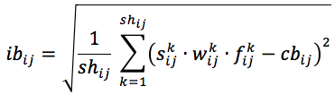

SORT (A Self-Organizing Trust Model for P2P Systems) [CB13]
Complements moving average trust
Caller service reports on a callee (a client feedback)
2 parameters for each service invocation i→j:
  Satisfaction (s_{ij}): i’s degree of satisfaction with j’s service
  Weight (w_{ij}): significance of this particular interaction
Fading factor f_{ij}^{k} = k / sh_{ij}
  k: order of (the most recent) interaction
  sh_{ij}: the total number of interactions between i and j
Competence belief (of i in j) :
Integrity belief (of i in j):
Trust level of j:

Slide 17
Pluggable Authorization Algorithms
Each algorithm is a self-contained module
Ability to enable multiple authorization algorithms
Trust-based authorization
XACML-based interaction authorization
  Resource: A target service
  User: Service invoking the target service
  Action: READ/WRITE
  Environment
    Conditions on which access is allowed or denied
  Based on WSO2 Balana XACML implementation

Slide 18
Authorization Policy Examples
No plaintext transport policy:
Deny
Resources | any
Subject | any
Action | READ
Env: http://endtoendsoa.cs.purdue.edu/policy/transport | plaintext
Block credit card number transmission:
Deny
Resource | any
Subject | any
Action | WRITE
Env: http://endtoendsoa.cs.purdue.edu/policy/trust_level | < 10
Env: http://endtoendsoa.cs.purdue.edu/policy/data | Includes (Credit Card #)

Slide 19
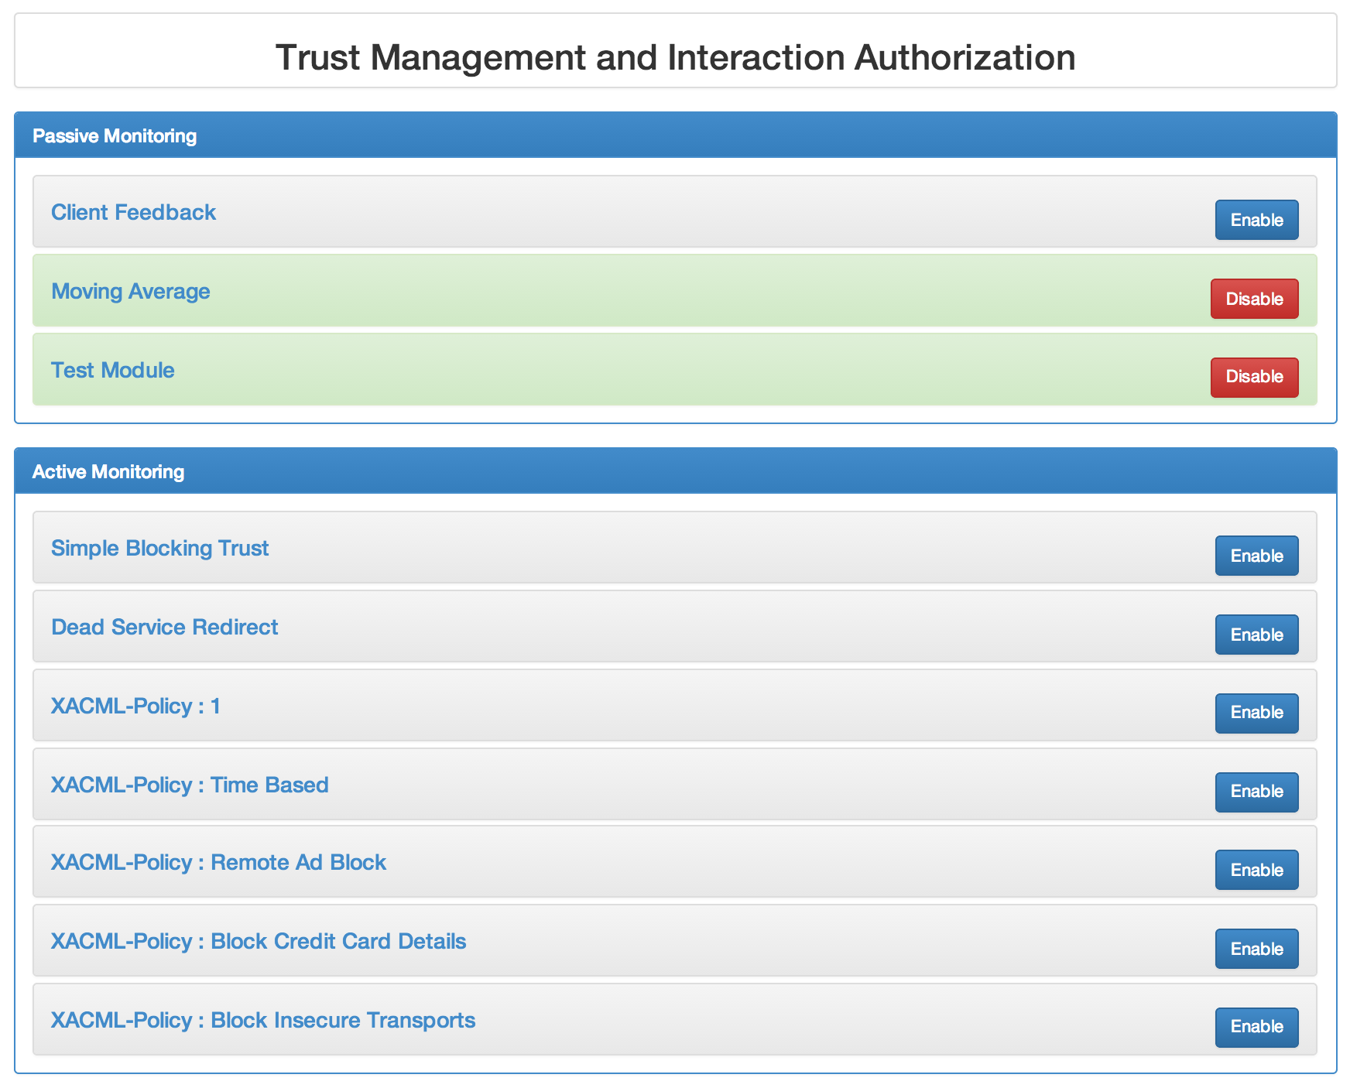
Trust Management and Interaction Authorization
Console

Slide 20
Current Results
Response time experiments
  Baseline (no monitoring)
  Passive monitoring
  Active monitoring
Experiments with different trust algorithms
  Moving average trust
  SORT (a Self-Organizing Trust Model for P2P Systems)
Experiments with a DoS attack
Experiments with different interaction authorization policies

Slide 21
Experiments:
Baseline scenario (without monitoring)
Client
Service A
Service B
request
communication
time
processing
time
request
communication
time
processing
time
response
communication
time
processing
time
response
communication
time

Slide 22
Experiments: Passive Monitoring
Client
Service A
Service B
request
communication time
processing
time
request
communication time
Service
Monitor
Instrumented Request Library
interaction
data
processing
time
response
communication time
processing
time
response
communication time

Slide 23
Experiments: Active Monitoring
Client
Service A
Service B
request
communication time
processing
time
request
Interaction
authorization
request
Service
Monitor
communication
time
Instrumented Request Library
Interaction
authorization
decision
communication
time
request
communication time
processing time
response
communication time
response
processing time
response
communication time

Slide 24
Response Time Experiment Results
 | Baseline | Passive | Active
Run 1 | 10.11 | 11.48 | 24.35
Run 2 | 10.09 | 10.77 | 15.62
Run 3 | 10.20 | 10.13 | 13.65
Run 4 | 10.83 | 9.34 | 13.56
Run 5 | 9.52 | 10.92 | 13.57
LAN-based setup
Testing based on Apache bench
50 concurrent requests per run
Negligible overhead in Passive Monitoring
Small overhead in Active Monitoring with 2 enabled policies
Insignificant increase in overhead with more policies

Slide 25
Moving Average Trust in Action
request
Payment Gateway: 13
Bank: 14
request
request
request
request
from_service | to_service | from_pre | from_post | to_pre | to_post
13 | 14 | 4 | 5.2 | 10 | 10
13 | 14 | 5.2 | 6.16 | 10 | 10
13 | 14 | 6.16 | 6.928 | 10 | 10
13 | 14 | 6.928 | 7.542 | 10 | 10
13 | 14 | 7.542 | 8.034 | 10 | 10
* Invocation of a service with a higher trust results in an increased trust for the invoker

Slide 26
SORT in Action
Car rental: 10
Payment Gateway: 13
DoS
1 sec delay
Hotel: 11
DoS
2 sec delay
Airline: 12
from_service | to_service | satisfaction | from_pre | from_post | to_pre | to_post
10 | 13 | 1 | 1 | 1 | 1 | 1
11 | 13 | 1 | 1 | 1 | 1 | 1
12 | 13 | 1 | 1 | 1 | 1 | 1
10 | 13 | 0.1 | 1 | 1 | 1 | 0.7
11 | 13 | 0.2 | 1 | 1 | 0.7 | 0.733
12 | 13 | 0.4 | 1 | 1 | 0.733 | 0.8
10 | 13 | 0.1 | 1 | 1 | 0.8 | 0.55
11 | 13 | 0.2 | 1 | 1 | 0.55 | 0.6
12 | 13 | 0.01 | 1 | 1 | 0.6 | 0.6025

Slide 27
SORT in Action
Car rental: 10
Payment Gateway: 13
DoS
2 sec delay
Hotel: 11
Airline: 12
from_service | to_service | satisfaction | from_pre | from_post | to_pre | to_post
10 | 13 | 0.1 | 1 | 1 | 0.6025 | 0.46
11 | 13 | 0.2 | 1 | 1 | 0.46 | 0.52
12 | 13 | 0.01 | 1 | 1 | 0.52 | 0.484
10 | 13 | 0.1 | 1 | 1 | 0.484 | 0.4
11 | 13 | 0.2 | 1 | 1 | 0.4 | 0.4666
12 | 13 | 0.01 | 1 | 1 | 0.4666 | 0.405
10 | 13 | 1 | 1 | 1 | 0.405 | 0.4857
11 | 13 | 1 | 1 | 1 | 0.4857 | 0.5428
12 | 13 | 1 | 1 | 1 | 0.5428 | 0.49

Slide 28
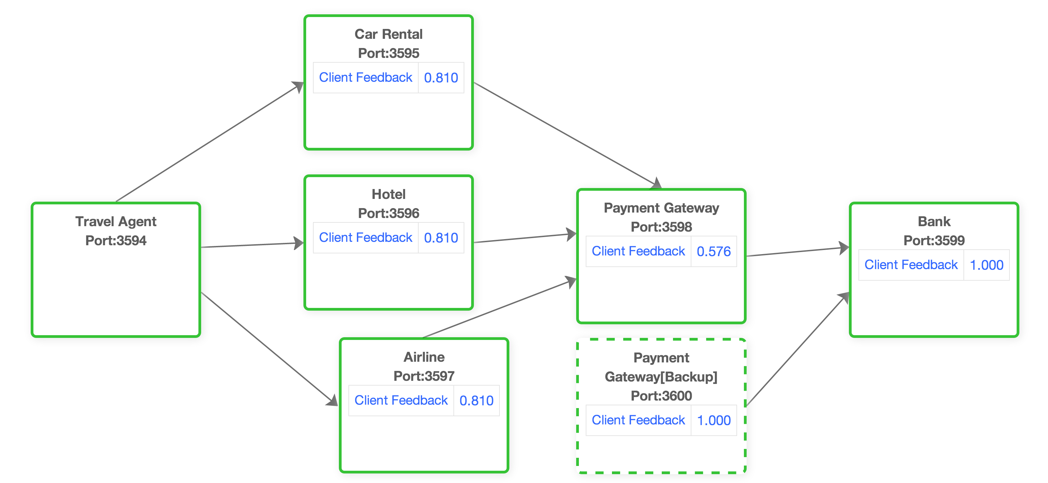
Demonstration
Travel Agent Scenario

Slide 29
Demonstration
SORT based “Client Feedback Trust Module” in action.
DoS attack on Payment Gateway
  Introduces processing delay
  Lowering of trust value of Payment Gateway
Interaction re-routing based on client feedback
Insider attack on Hotel service
  Changes transport from HTTPS to HTTP
  XACML-based interaction authorization policy blocks interaction
Data leakage prevention
  Credit card information allowed to be transmitted to trusted services (trust value > 1)
  XACML-based interaction authorization policy blocks invocation based on content and trust value

Slide 30
Future Work
Anomaly Detection
Service health analysis based on mining of heartbeat data
Mining of inflow data in a cloud setting
Context-based criticality rating
Context-based service orchestration management
System performance analysis under high load (scalability)
Experiments in cloud settings
Distributed Service Monitor for high availability
Adaptable service composition for better SLA (security/privacy, performance, reliability)

Slide 31
Future Work (Cont.)
Active Bundles (self-protecting data)
  Provide secure data dissemination in distributed environments for cross-domain information exchange to control access to shared data and prevent data leakage
  Use case: Access control and identity management in SOA/cloud using Active Bundles
EPHI
  Electronic health records (EHRs) address the issue of providing access to EPHI in a cloud-based repository in a privacy-preserving manner
  Monitoring framework can be applied for monitoring access to EHRs
Offloading of sensitive computations
  Service Monitor can offload some sensitive computations (e.g. related to trust) to an untrusted cloud platform

Slide 32
Anomaly Detection
Types of anomalies:
Service behavior under abnormal conditions (service failures)
Information leakage (service response, verbose error messages)
Insecure communication
External attacks
  DDoS
  Injection attacks
Internal attacks
  Service misconfiguration, e.g., exposing internal services to public
  Service misbehavior, e.g., anomalous external service communication

Slide 33
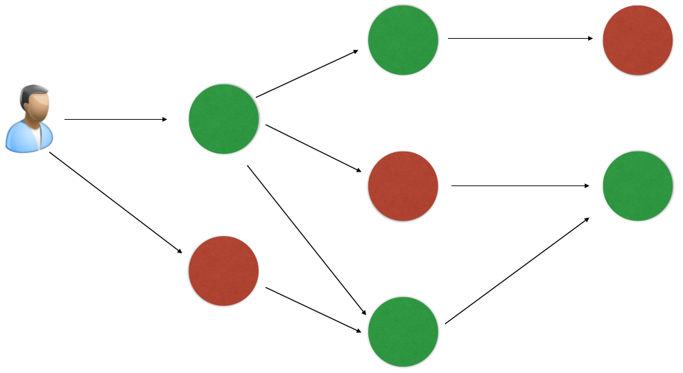
Anomaly Detection Process
3 perspectives of topology operation
  Interaction data
  Incoming request data
  Service health data
Define relevant anomalies
Develop mechanisms to detect anomalies
Take remedial actions

Slide 34
Presentations and Publications
“Privacy-Preserving Identity Claims with Complex Service Provider Policies,” Ruchith Fernando, Bharat Bhargava.
“SORT: A self- organizing trust model for peer-to-peer systems,” A. Can, B. Bhargava.
“A Trust-based Approach for Secure Data Dissemination in a Mobile Peer-to-Peer Network of AVs,” B. Bhargava, P. Angin, R. Ranchal, R. Sivakumar, A. Sinclair, M. Linderman.
“Protection of Identity Information in Cloud Computing without Trusted Third Party,” R. Ranchal, B. Bhargava, L. ben Othmane, M. Linderman, M. Kang, A. Kim, L. Lilien.

Slide 35
References
[AB12] M. Azarmi, B. Bhargava, P. Angin, R. Ranchal, N. Ahmed, A. Sinclair, M. Linderman, and L. ben Othmane, “An End-to-End Security Auditing Approach for Service Oriented Architecture,” 31st IEEE Symposium on Reliable Distributed System (SRDS), 2012.
[BC06] S. Berger, R. Cáceres, K. A. Goldman, R. Perez, R. Sailer, and L. van Doorn, “vTPM: virtualizing the trusted platform module,” USENIX-SS’06, Berkeley, CA, USA, 2006.
[BK08] A. Benameur, F. Kadir, and S. Fenet, “XML Rewriting Attacks: Existing Solutions and their Limitations,” IADIS Applied Computing, IADIS Press, Apr. 2008.
[CB13] A. Can and B. Bhargava, "SORT: A self- organizing trust model for peer-to-peer systems,” IEEE Trans. Dependable Secure Comput., 10:14- 27, 2013.
[VE06] J. Viega and J. Epstein, “Why applying standards to Web services is not enough,” IEEE Security & Privacy, 4(4):25-31, 2006.

Slide 36
Thank you for your attention.
Any questions?

