Slide 1
TESSA - a system to aid communication with deaf people
Stephen Cox, Michael
Lincoln and Judy
Tryggvason
School of Information
Systems,
University of East Anglia,
Norwich NR4 7TJ, U.K.
Melanie Nakisa
Royal National Institute for
Deaf People,
19–23 Featherstone Street,
London EC1Y 8SL U.K.
Mark Wells, Marcus Tutt
and Sanja Abbott
Televirtual Ltd.
Anglia House,
Agricultural Hall Plain,
Norwich, U.K.

Slide 2
What is TESSA ?
TESSA is an experimental system that aims to aid transactions between a deaf person and a clerk in a post office.
A speech recognizer recognizes the clerks speech
A phrase lookup identifies a sequence of British Sign Language (BSL) that relates to this speech
A 3-d digital avatar TESSA signs these sequences to the deaf user.

Slide 3
Scope and Aim of TESSA
This system deals with a fairly limited vocabulary that is limited to PO transactions.
Defines a limited set of phrases that will be identified and translated
It’s important to not that it while it may be simpler to simply display speech on a screen, a major part of the deaf community has been profoundly deaf from the beginning.
This means that BSL was their primary language and English was secondary.
Hence, Signing is more effective than English plaintext.

Slide 4
System Design
The post office clerk wears a headset microphone
The speech recognizer is constantly active and responds when the clerk utters a phrase
Prior to system design, they obtained transcripts of PO transactions and found a list of 115 phrases that depicted 90% of daily business transactions.
Speaker Adaptation :- The speech recognizer can be trained within an hour to eliminate all doubts when converting speech to text.

Slide 5
System Design
More sophisticated systems in the futue will adapt to a wider and unrestricted range of words
Currently, the clerk can use any of the words from the ”legal” list and based on a probabilistic model, the intended phrase can be identified.
The system can also be adapted to another spoken language and therefore has a lot of potential for translating text too.

Slide 6
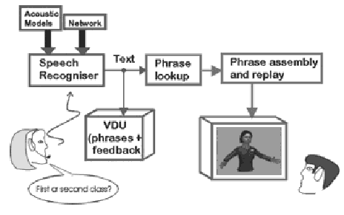
System Design
This diagram explains the interactions between the PO clerk and the deaf customer.

Slide 7
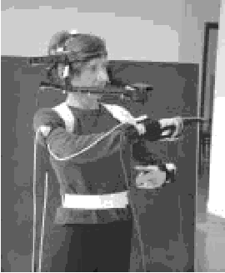
TESSA – The Avatar
The simplest way to sign phrases would be to have video recordings of signs for words play consecutively.
This is not the best way to do it since a system with a large vocabulary would require a very large library of such videos.
Instead, we have the virtual entity, TESSA, that is capable of seamlessly connecting various signing phrases.
The exact position of the avatar can be manipulated
Using 18 motion sensors for each hand, magnetic sensors on the wrist and upper arms, and 18 sensors on the signers face, movements for the 115 phrases were recorded for the avatar

Slide 8
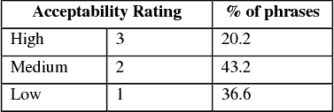
TESSA – The Avatar Evaluated
The researchers evaluated:-
The quality of the signs
Difficulty of performing a transaction with TESSA
Scope for improvement for interface with the deaf as well as the clerks.
Quality of signs :-
Measured how self-explanatory the signs were
Measured how acceptable they were in what they were trying to explain

Slide 9
TESSA – The Avatar Evaluated
Difficulty of transactions
Transactions did take twice as long but this can be attributed to the lack of training for the PO clerks.
Researchers believe that this can be alleviated with a little more training time for the clerks
Feedback from both sides
All clerks said communication with TESSA was “slightly easier” or “much easier”
The deaf participants said TESSA would be extremely helpful in explaining mildly to extremely complex problems at the PO
Both sides look forward to a more encompassing TESSA which would dramatically simplify transactions.

