Slide 1
Data in the Cloud: Authentication Without Leaking
Ashish Kundu
Joint work with: Elisa Bertino, Mike Atallah
Guest Lecture: CS 590 B
Department of Computer Science, Purdue University
November 09, 2010

Slide 2
Overview
Structural Leakages &
Privacy
Problem: Authentication
Without Leaking
Formal Security Model
Structural Signatures
Leakage-free Redactable Signatures
Trees
DAGs
Graphs
Trees
DAGs, Graphs
Forests

Slide 3
Ordered Trees/Graphs/Forests
Structural Leakages &
Privacy
Problem: Authentication
Without Leaking
Formal Security Model
Structural Signatures
Leakage-free Redactable Signatures
Trees
DAGs
Graphs
Trees
DAGs, Graphs
Forests

Slide 4
Our solutions
Structural Leakages &
Privacy
Problem: Authentication
Without Leaking
Efficient: single signature
Provably secure
Wide range of applications
Formal Security Model
Structural Signatures
Leakage-free Redactable Signatures
Trees
DAGs
Graphs
Trees
DAGs, Graphs
Forests

Slide 5
Extensions of our work
Structural Leakages &
Privacy
Problem: Authentication
Without Leaking
Formal Security Model
Structural Signatures
Leakage-free Redactable Signatures
Brzuska et al. (ACNS ’10)
Based on our idea of
Structural signatures: VLDB ’08
Trees
DAGs
Graphs
Trees
DAGs, Graphs
Forests

Slide 6
Broad scope
Structural Leakages &
Privacy
Problem: Authentication
Without Leaking
Formal Security Model
Structural Signatures
Leakage-free Redactable Signatures
Trees
DAGs
Graphs
Trees
DAGs, Graphs
Forests
Secure XML pub/sub
Error recovery
Encrypted data
Authentication of objects
Authentication of paths

Slide 7
This Talk
Structural Leakages &
Privacy
Problem: Authentication
Without Leaking
Formal Security Model
Structural Signatures
Leakage-free Redactable Signatures
Trees
DAGs
Graphs
Trees
DAGs, Graphs
Forests
Secure XML pub/sub
Error recovery
Encrypted data
Authentication of objects
Authentication of paths

Slide 8
Next
Structural Leakages &
Privacy
Problem: Authentication
Without Leaking
Formal Security Model
Structural Signatures
Leakage-free Redactable Signatures
Trees
DAGs
Graphs
Trees
DAGs, Graphs
Forests
Secure XML pub/sub
Error recovery
Encrypted data
Authentication of objects
Authentication of paths

Slide 9
Structural Leakages & Privacy

Slide 10
Third-party distribution
Economies-of-Scale
Core-Competencies
Data Explosion
Personal Devices
Healthcare Devices
Sensors
System Monitors
Services: Data Delivery, Mining, Analytics, Archival

Slide 11
A common scenario
Cloud Healthcare Services
EMR
EMR
Doctor’s System
Nurse’s Device
Doctor’s system uploads the EMR
Nurse’s device receives EMR
Event notification, pub/sub
“Retrieve EMR for patient name=…”

Slide 12
What are the threats
Cloud Healthcare Services
EMR
EMR
Doctor’s System
Nurse’s Device

Slide 13
Threat - I
Cloud Healthcare Services
EMR
EMR
Doctor’s System
Nurse’s Device
EMR data: tampered
When on network (man-in-the-middle attacks)
Third party service provider: data tampering attacks

Slide 14
Threat - I
Cloud Healthcare Services
EMR
EMR
Doctor’s System
Nurse’s Device
EMR data: tampered
When on network (man-in-the-middle attacks)
Third party service provider: data tampering attacks
EMR from unauthorized sources

Slide 15
Threat - II
Cloud Healthcare Services
EMR
Doctor’s
System
Nurse’s Device
Private information: inference
By nurse’s device

Slide 16
Sample EMR in XML
<HealthRecord>
…
<CriticalDiseases>
<Disease name=Cancer>
<Chemotherapy instance=1>
<Details date=…
intensity=…/>
</Chemotherapy>
</Disease>
<Disease name=KidneyStone> …
</Disease>
<Disease name=HeartAttack> …
</Disease>
</CriticalDiseases>
…
</HealthRecord>
Healthrecord
g₁
CriticalDiseases
g₂
Cancer
HeartAttack
g₃
g₄
g₅
KidneyStone
g₆
Chemotherapy
g₇
Details

Slide 17
Security requirement - I
Nurse’s device needs to
Verify authenticity of the received EMR

Slide 18
What is authenticity
No un-authorized modification of
Contents in nodes
Parent-child relationship
Ordering between siblings
e.g., temporal order
EMR is genuine

Slide 19
Security requirement - II
Privacy protection
Nurse’s device receives part(s) of EMR
Other parts are hidden – not leaked

Slide 20
EMR subtree – accessible to nurse
<HealthRecord>
…
<CriticalDiseases>
<Disease name=Cancer>
<Chemotherapy instance=1>
<Details date=…
intensity=…/>
</Chemotherapy>
</Disease>
<Disease name=KidneyStone> …
</Disease>
<Disease name=HeartAttack> …
</Disease>
</CriticalDiseases>
…
</HealthRecord>
Healthrecord
g₁
CriticalDiseases
g₂
Cancer
HeartAttack
g₃
g₄
g₅
KidneyStone
g₆
Chemotherapy
g₇
Details

Slide 21
How are XML trees authenticated
Merkle hash technique (MHT)
Widely used, even for healthcare records
e.g., Devanbu et al. JCS’04, Thompson et al. PETS’09

Slide 22
How are XML trees authenticated
Merkle hash technique (MHT)
Widely used, even for healthcare records
e.g., Devanbu et al. JCS’04, Thompson et al. PETS’09
Problem: MHT leaks structural information

Slide 23
MHT authentication
Signer computes and signs
Merkle hash of the root
Receiver computes and verifies
Merkle hash of root against signature

Slide 24
Computation of Merkle Hash (MH)
Bottom up, Left to right
MH of parent is computed from
Merkle hashes of its children

Slide 25
MH computation
h: collision resistant
hash function
g₁
g₂
MH(g₂) = h(g₂, MH(g₃), MH(g₄), MH(g₅))
g₃
g₄
g₅
g₆
g₇

Slide 26
Signature of EMR tree
Signature of EMR tree
Signature of Merkle Hash of g₁
MH(g₁)
g₁
g₂
g₃
g₄
g₅
g₆
g₇

Slide 27
EMR to the cloud
Cloud Healthcare Services
Doctor’s system
Signs and uploads (EMR, Signature) to the cloud
EMR,
Signature
Doctor’s System
Nurse’s Device

Slide 28
Service sends EMR subtree
Cloud Healthcare Services
EMR
Subtree
Doctor’s System
Nurse’s Device
g₁
Healthrecord
CriticalDiseases
g₂
Cancer
g₃
MH(g₄)
MH(g₅)
g₆
Chemotherapy
g₇
Details

Slide 29
Information received by device
EMR subtree
For authenticity verification
Signature of EMR
Merkle hashes of g₄, g₅
g₂ is parent of g₄, g₅
g₃ is left of g₄
g₄ is left of g₅
g₁
g₂
g₃
MH(g₄)
MH(g₅)
g₆
g₇

Slide 30
Information received
EMR subtree
For authenticity verification
Signature of EMR
Merkle hashes of g₄, g₅
g₂ is parent of g₄, g₅
g₃ is left of g₄
g₄ is left of g₅
g₁
g₂
g₃
MH(g₄)
MH(g₅)
g₆
g₇
Necessary to compute
Merkle hash of g₂

Slide 31
Here is the problem
Security issue: Leakage of information
Nurse’s device can infer private information

Slide 32
What are the leakages
Leakages
g₂: parent of g₄, g₅
g₃: left of g₄
g₄: left of g₅
g₆ has one child
Merkle hashes of g₄, g₅
Healthrecord
g₁
CriticalDiseases
g₂
Cancer
g₃
MH
MH
g₆
Chemotherapy
g₇
Details
Leakages

Slide 33
What can be inferred - I
Leakages
g₂: parent of g₄, g₅
g₃: left of g₄
g₄: left of g₅
Healthrecord
g₁
CriticalDiseases
g₂
Cancer
g₃
MH
MH
Two more critical diseases
Temporal order among them
g₆
Chemotherapy
g₇
Details

Slide 34
What can be inferred - II
Leakage
g₆: has only one child
Healthrecord
g₁
CriticalDiseases
g₂
Cancer
g₃
MH
MH
Only one chemotherapy session
g₆
Chemotherapy
g₇
Details

Slide 35
What can be inferred - III
Leakage
Merkle hashes of g₄, g₅
Healthrecord
g₁
CriticalDiseases
g₂
Cancer
g₃
MH
MH
Dictionary attacks possible
g₆
Chemotherapy
g₇
Details

Slide 36
Privacy not protected
Second security requirement – privacy
Not fulfilled
Not compliant with HIPAA, Privacy Acts

Slide 37
Summary: MHT leaks
MHT leaks structural information
This work is the first study of
Privacy & structural leakages
Solutions to the problem

Slide 38
EMR subtree received
Healthrecord
Healthrecord
g₁
g₁
CriticalDiseases
CriticalDiseases
g₂
g₂
Cancer
Cancer
g₃
MH
MH
g₃
g₆
g₆
Chemotherapy
Chemotherapy
g₇
g₇
Details
Details

Slide 39
EMR subtree received
How to authenticate the
EMR subtree without any leakage?
Healthrecord
g₁
CriticalDiseases
g₂
Cancer
g₃
g₆
Chemotherapy
g₇
Details

Slide 40
The problem
How to authenticate a subtree without leaking?

Slide 41
The problem
Cloud Service
Tree-structured
data: T
Data subtree: T_{δ}
Authorized owner
Consumer
How to authenticate a subtree T_{δ} without leaking (T \ T_{δ}) ?

Slide 42
State of the Art
Authenticated Data Structures
Merkle ’79, Naor and Nissim ’98, Goodrich et al. ’00,
Martel ’04, Papamonthou et al. ’08, Goodrich et al. ’09
Focus on directories, trees, graphs; leak
Homomorphic and Transitive Signatures
Rivest ’00, Chari et al. ’02, Micali and Rivest ’02
Johnson et al. ’02, Bellare and Neven ’02 ’05, Yi ’07
Neven ’08
Focus on paths, routing topologies; leak

Slide 43
State of the Art
Redactable and Content Extraction Signatures
Steinfeld et al ’02, Haber ’08, Chang et al ’09
Slamanig and Rass ’10
Focus on sequences; leak
Brzuska et al ’10: based on our work
Sanitizable Signatures
Ateniese et al ’05, Brzuska et al ’09 ’10, Miyazaki et al ’06
Only designated entities can redact
Focus on sequences; leak

Slide 44
Possible Approaches
Alice dynamically signs each query result X
Alice pre-signs each possible query result X
Alice outsources signing and query processing X
Alice pre-signs complete tree/graph, servers process queries

Slide 45
Our overall approach
Encode structural information in nodes
Parent-child relationships
Order among siblings
Sign encoded tree
Compute signature of a subtree

Slide 46
Next
Structural Leakages &
Privacy
Problem: Authentication
Without Leaking
Formal Security Model
Structural Signatures
Leakage-free Redactable Signatures
Trees
DAGs
Graphs
Trees
DAGs, Graphs
Forests
Secure XML pub/sub
Error recovery
Encrypted data
Authentication of objects
Authentication of paths

Slide 47
Formal security model
Definition: Leakage-free redactable signatures
rGen, rSign, Redact, rVrfy
Probabilistic polynomial time (PPT) adversary

Slide 48
Formal security model
Definition: Leakage-free redactable signatures
rGen, rSign, Redact, rVrfy
Probabilistic polynomial time (PPT) adversary
Unforgeability
Existentially unforgeable against chosen message attack over subset operations

Slide 49
Formal security model
Definition: Leakage-free redactable signatures
rGen, rSign, Redact, rVrfy
Probabilistic polynomial time (PPT) adversary
Unforgeability
Existentially unforgeable against chosen message attack over subset operations
Leakage-free: no leakage of hidden nodes/edges
Transparency, Privacy

Slide 50
Formal security model
Definition: Secure names
rNameGen, rNameVrfy
Leakage-free: no leakage of hidden siblings
Transparency

Slide 51
Next
Structural Leakages &
Privacy
Problem: Authentication
Without Leaking
Formal Security Model
Structural Signatures
Leakage-free Redactable Signatures
Trees
DAGs
Graphs
Trees
DAGs, Graphs
Forests
Secure XML pub/sub
Error recovery
Encrypted data
Authentication of objects
Authentication of paths

Slide 52
How to authenticate a subtree without leaking?
Structural Signatures for Trees

Slide 53
Central observation
A (rooted) non-binary tree
Uniquely represented by
Post-order and pre-order sequences of its vertices
g₁
g₂
g₃
g₄
g₅
g₆
g₇

Slide 54
Central observation
A (rooted) non-binary tree
Uniquely represented by
Post-order and pre-order sequences of its vertices
g₁
(7, 1)
(post, pre)
g₂
(6, 2)
g₃
g₄
g₅
(3, 3)
(4, 4)
(5, 5)
g₆
(2, 6)
g₇
(1, 7)

Slide 55
Post/Pre-order numbers leak
(post, pre)
g₁
(7, 1)
g₂
(6, 2)
g₃
g₄
g₅
(3, 3)
(4, 4)
(5, 5)
g₆
(2, 6)
g₇
(1, 7)

Slide 56
Randomized traversal numbers
Randomized counterparts
post-order numbers: RPONs
pre-order numbers: RRONs
(RPON, RRON)
g₁
(538, 143)
g₂
(378, 430)
g₃
g₄
g₅
(48, 521)
(89, 645)
(134, 722)
g₆
(20, 758)
g₇
(13, 837)

Slide 57
Structural position
Structural position of a node
Pair of RPON and RRON
η_{g1} = (538, 143)
(p_{x}, r_{x})
g₁
(538, 143)
g₂
g₃
g₄
g₅
g₆
g₇

Slide 58
How RPONs/RRONs are computed
Order-preserving symmetric encryption
Boldyreva et al, Eurocrypt ’09
Security of order-preserving encryption: POPF-CCA
Pseudo-random Order-Preserving Function against Chosen Ciphertext Attacks

Slide 59
Integrity verifiers
Integrity verifier of a node
Hash of structural position, contents
Integrity
Verifier
Str. Position, Node contents
Hash

Slide 60
How to sign integrity verifiers
Condensed-RSA
Aggregate signatures using Bilinear maps
BGLS: Boneh et al. ’03

Slide 61
Signed data upload
Cloud Service
Tree T
Tree: T, its signature,
(Signature, Structural Position) of each node
Healthrecord
g₁
CriticalDiseases
g₂
Cancer
HeartAttack
g₃
g₄
g₅
Authorized owner
KidneyStone
g₆
Chemotherapy
g₇
Details

Slide 62
Query
“Select the EMR.CriticalDiseases from … where insurance_provider=B and name=…”
Cloud Service
Query
Insurance provider B

Slide 63
Query result
Cloud Service
“Select the EMR.CriticalDiseases from … where insurance_provider=B and name=…”
Cancer and Heart Attacks are covered by B
Subtree T_{δ}
CriticalDiseases
g₂
Cancer
HeartAttack
g₃
g₅
g₆
Chemotherapy
g₇
Details

Slide 64
Result
Cloud Service
Subtree: T_{δ},
Its aggregate signature σ_{δ},
Structural position of nodes,
Verification object: VO_{δ}
Subtree T_{δ}
g₂
(378, 430)
g₃
g₅
(48, 521)
(134, 722)
g₆
Insurance provider B
(20, 758)
g₇
(13, 837)

Slide 65
Consumer verifies
Content authenticity using
Signature of tree, of subtree, verification object
Structural authenticity
RPONs, RRONs

Slide 66
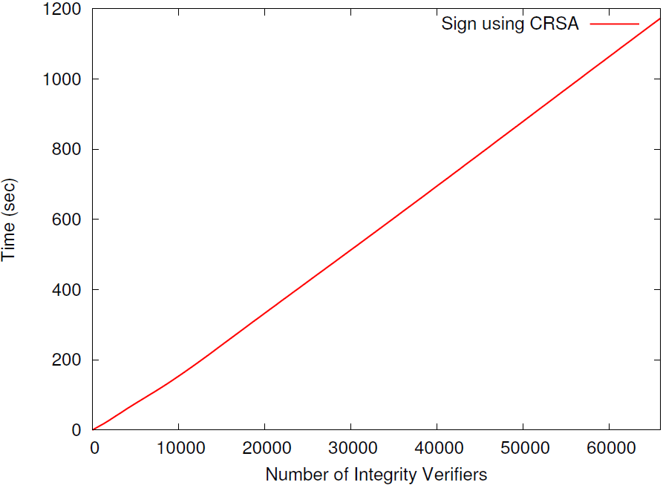
Signing: CRSA

Slide 67
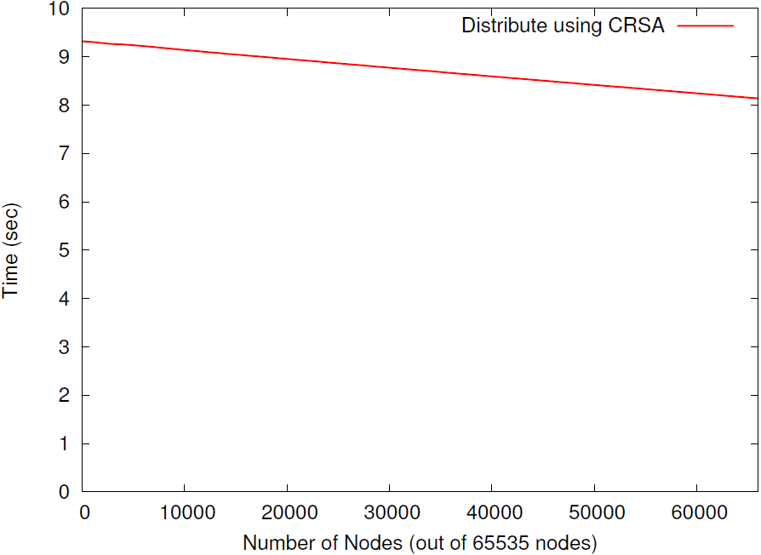
Redaction: CRSA

Slide 68
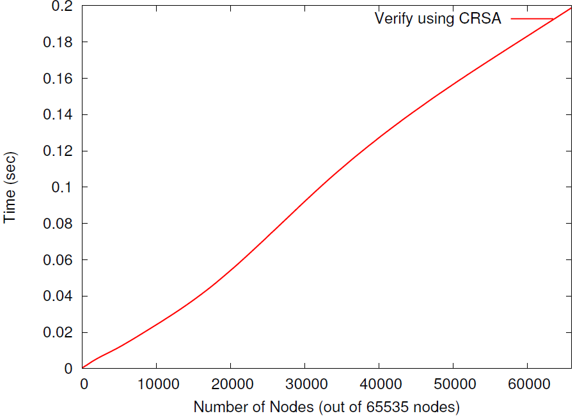
Verification: CRSA

Slide 69
Summary
‘n+1’ signatures computed
Expensive
Consumer receives: 2 signatures
Efficient
Leakage-free: based on POPF-CCA
Unforgeable: based on RSA

Slide 70
Many subtrees
Structural signatures
for “a subtree”
Can it handle
“many subtrees” as query results?

Slide 71
Many subtrees
Query - 1
g₁
g₂
g₃
g₄
g₅
g₆
g₇

Slide 72
Many subtrees
Query - 1
Query - 2
g₁
g₁
g₂
g₂
g₃
g₄
g₅
g₃
g₄
g₅
g₆
g₆
g₇
g₇

Slide 73
Many subtrees
Consumer learns
Query - 1
Query - 2
Induced subtree
g₁
g₁
g₁
g₂
g₂
g₂
g₃
g₄
g₅
g₃
g₄
g₅
…
g₆
g₆
g₆
Path
g₇
g₇
g₇
Due to properties of post- and pre-order numbers

Slide 74
Individual subtrees
Query - 1
Query - 2
Consumer should learn “individual subtrees”
g₁
g₁
g₂
g₂
g₆
g₁
g₃
g₄
g₅
g₃
g₄
g₅
g₇
g₂
g₆
g₆
g₇
g₇

Slide 75
Next
Structural Leakages &
Privacy
Problem: Authentication
Without Leaking
Formal Security Model
Structural Signatures
Leakage-free Redactable Signatures
Trees
DAGs
Graphs
Trees
DAGs, Graphs
Forests
Secure XML pub/sub
Error recovery
Encrypted data
Authentication of objects
Authentication of paths

Slide 76
How to authenticate many subtrees without leaking?
Leakage-Free Redactable Signatures for Trees

Slide 77
Approach
Encode nodes with secure names
Order among siblings
Parent-child relationships separately
No leakage of edge/path information
Signing
JMSW homomorphic set signature scheme

Slide 78
Secure names
Secure name of each node
Establish order among siblings
Provably leakage-free
Overcomes the issue of
distance between RPONs/RRONs

Slide 79
Left part
N bits
L bits
R bits
Left part of secure name
Initially “unused”
Two bits used for each sibling

Slide 80
Right part
N bits
L bits
R bits
Right part of secure name
Random

Slide 81
Construction of secure name
N bits
L bits
R bits
(L- 2k), R: security parameters
e.g., L = 768, R = 256
k = maximum branching factor of a tree
e.g., 250 is large
g
u
…
x
k

Slide 82
Sibling order
g
“u” is left-of “x”:
How secure names help
u
x

Slide 83
Sibling order test
Bits at positions j and j' in left-parts
XOR of bits at j < XOR of bits at j'

Slide 84
Sibling order test
Bits at positions j and j' in left-parts
XOR of bits at j < XOR of bits at j'
g
u
x
u: sec name
XOR = 0
<
XOR = 1
x: sec name

Slide 85
Computing bit positions
Left-most sibling u
Right-part set to a random rU
Left-part set to “unused”
g
u
x
u: sec name
rU
unused

Slide 86
Right sibling
Right sibling x
Right-part set to a random rX
Left-part set to “unused”
g
u
x
u: sec name
rU
unused
x: sec name
rX
unused

Slide 87
Compute bit position j
Concatenation order: rU, rX
g
u
x
u: sec name
rU
L bits
j = h(rU, rX) mod L
x: sec name
rX

Slide 88
Is j used
If bit at j “used” for u or x
Assign a new random to ‘rX’ and repeat.
u: sec name
rU
j = h(rU, rX) mod L
x: sec name
rX

Slide 89
Compute bit position j'
Concatenation order - reverse: rX, rU
g
u
x
u: sec name
rU
L bits
j
j' = h(rX, rU) mod L
x: sec name
rX

Slide 90
Is j used
If bit at j' “used” for u or x
Assign a new random to ‘rX’ and repeat from j.
u: sec name
rU
j
j' = h(rX, rU) mod L
x: sec name
rX

Slide 91
Assign values to bits at j, j'
u: sec name
rU
XOR = 0
<
XOR = 1
x: sec name
rX

Slide 92
Secure names: leakage-free
Transparent
Knowledge of secure names for g₃ and g₅
Does not leak anything about g₄
g₁
g₂
g₃
g₄
g₅
g₆
g₇

Slide 93
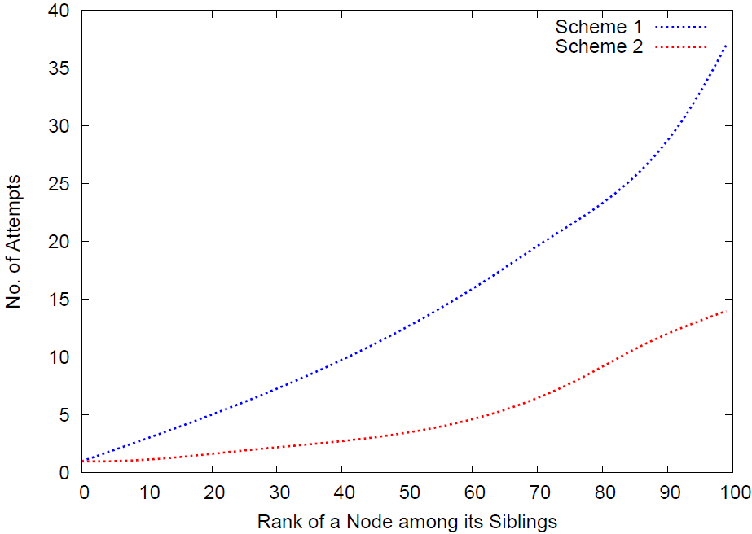
Secure name: number of tries

Slide 94
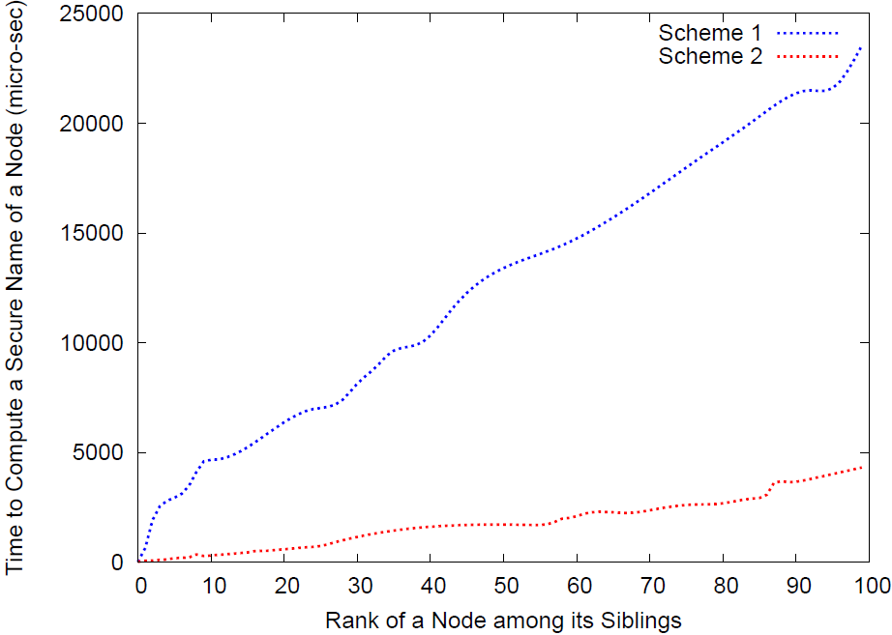
Secure name: time

Slide 95
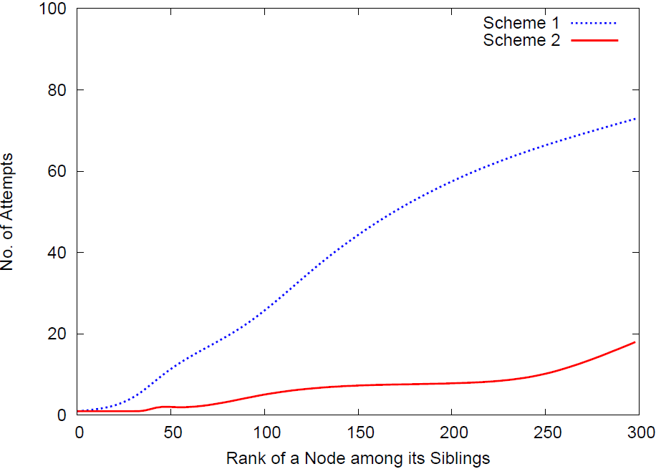
Secure name: number of tries

Slide 96
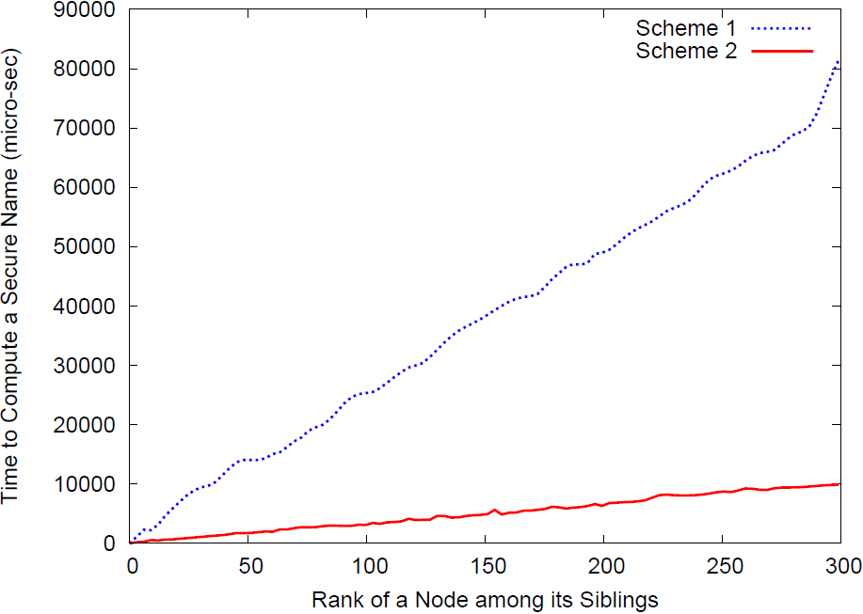
Secure name: time

Slide 97
Integrity Verifiers
Integrity verifier – as earlier
Hash of secure name and contents
ξ_{g1} = h(η_{g1}, c_{g1})
g₁
g₂
g₃
g₄
g₅
g₆
g₇
Integrity
Verifier
Secure Name, Node contents
Hash

Slide 98
Parent-child relationships
Edge verifier
Hash of the secure names of nodes
ξ_{(g2,g3)} = h(η_{g2}, η_{g3})
g₁
g₂
g₃
g₄
g₅
g₆
g₇

Slide 99
Signing
Condensed-RSA
BGLS
Expensive
Linear number of signatures

Slide 100
Graphs

Slide 101
Ordered DAGs
Previous scheme handles DAGs
g₁
g₂
g₃
g₄
g₅
g₆
g₆
g₇

Slide 102
Graphs with Cycles
Back-edges are “reference” edges
e.g., XML href attribute creates such edge
Order between siblings may exist
Such graphs
Scheme can be applied
g₁
g₂
g₃
g₄
g₅
g₆
g₆
href
g₇

Slide 103
Forests

Slide 104
K disconnected components
g1
f1
g2
f2
g3
f3
g4
g5
g6
f4
f5
g7

Slide 105
Connect them
g12
g11
g10
g1
f1
g2
f2
g3
f3
g4
g5
g6
f4
f5
g7

Slide 106
Sign as earlier
Using the leakage-free scheme
g12
g11
g10
g1
f1
g2
f2
g3
f3
g4
g5
g6
f4
f5
g7

Slide 107
Leakage-free
Scheme does not leak
g12
g11
g10
g1
f1
g2
f2
g3
f3
g4
g5
g6
f4
f5
g7

Slide 108
Thank You!
Questions?

