Slide 1
An Overview of Cloud Security and Privacy
Presenter: YounSun Cho
Sep. 9, 2010
CS 590, Fall 2010

Slide 2
What we are going to do today
A high-level discussion of the fundamental challenges and issues of cloud computing security and privacy
It is impossible to consider all issues today
The goal is to give you a big picture rather than focus on a particular topic or a paper
Note that some of these slides, especially part I, re-used/modified some slides in the Internet (References are in the last slides)

Slide 3
Part1: Introduction
Why do you still hesitate to use cloud computing?
Threat Model

Slide 4
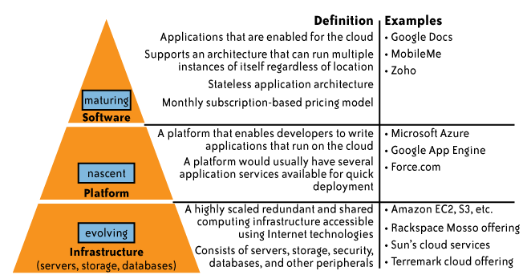
Cloud services delivery model
While cloud-based software services are maturing,
Cloud platform and infrastructure offering are still in their early stages !

Slide 5
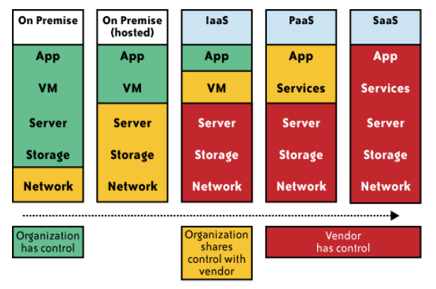
Impact of cloud computing on the governance structure of IT organizations

Slide 6
If cloud computing is so great, why aren’t everyone doing it?
The cloud acts as a big black box, nothing inside the cloud is visible to the clients
Clients have no idea or control over what happens inside a cloud
Even if the cloud provider is honest, it can have malicious system admins who can tamper with the VMs and violate confidentiality and integrity
Clouds are still subject to traditional data confidentiality, integrity, availability, and privacy issues, plus some additional attacks

Slide 7
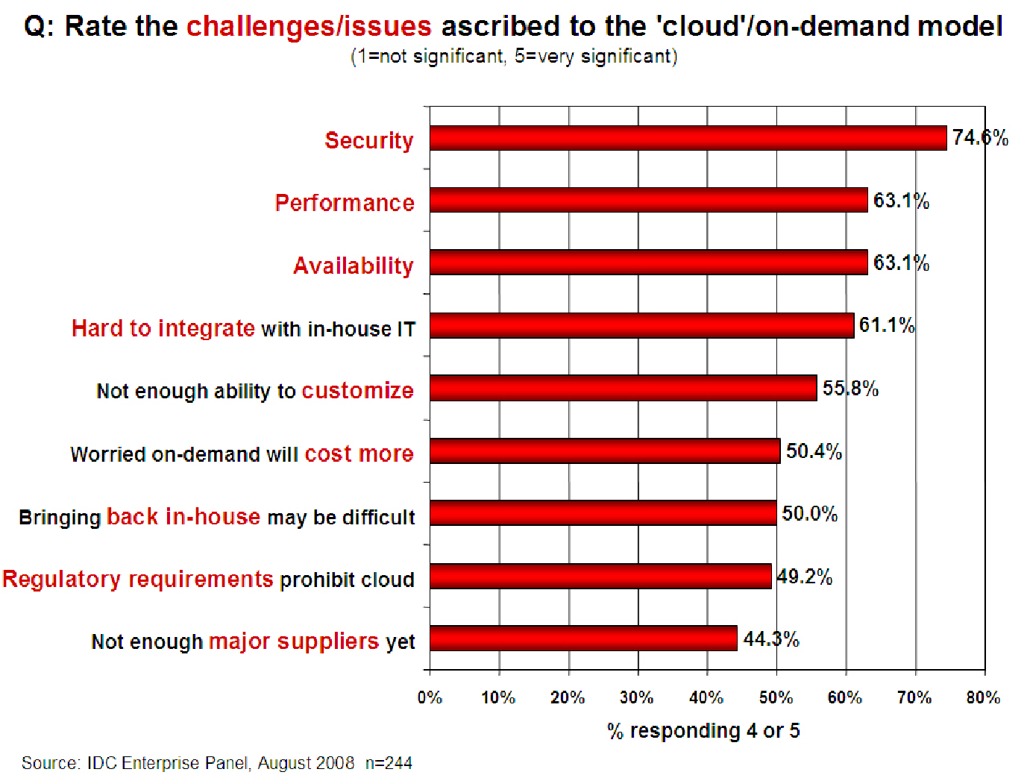
Companies are still afraid to use clouds
[Chow09ccsw]

Slide 8
Taxonomy of Fear
Confidentiality
  Fear of loss of control over data
    Will the sensitive data stored on a cloud remain confidential?
    Will cloud compromises leak confidential client data
  Will the cloud provider itself be honest and won’t peek into the data?
Integrity
  How do I know that the cloud provider is doing the computations correctly?
  How do I ensure that the cloud provider really stored my data without tampering with it?

Slide 9
Taxonomy of Fear (cont.)
Availability
  Will critical systems go down at the client, if the provider is attacked in a Denial of Service attack?
  What happens if cloud provider goes out of business?
  Would cloud scale well-enough?
  Often-voiced concern
    Although cloud providers argue their downtime compares well with cloud user’s own data centers

Slide 10
Taxonomy of Fear (cont.)
Privacy issues raised via massive data mining
  Cloud now stores data from a lot of clients, and can run data mining algorithms to get large amounts of information on clients
Increased attack surface
  Entity outside the organization now stores and computes data, and so
  Attackers can now target the communication link between cloud provider and client
  Cloud provider employees can be phished

Slide 11
Taxonomy of Fear (cont.)
Auditability and forensics (out of control of data)
  Difficult to audit data held outside organization in a cloud
  Forensics also made difficult since now clients don’t maintain data locally
Legal quagmire and transitive trust issues
  Who is responsible for complying with regulations?
    e.g., SOX, HIPAA, GLBA ?
  If cloud provider subcontracts to third party clouds, will the data still be secure?

Slide 12
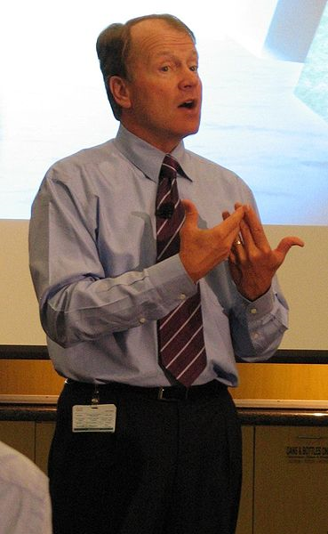
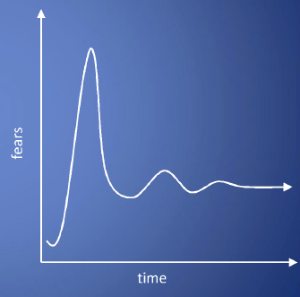
Taxonomy of Fear (cont.)
Cloud Computing is a security nightmare and it can't be handled in traditional ways.
John Chambers
CISCO CEO
Security is one of the most difficult task to implement in cloud computing.
  Different forms of attacks in the application side and in the hardware components
Attacks with catastrophic effects only needs one security flaw
(http://www.exforsys.com/tutorials/cloud-computing/cloud-computing-security.html)

Slide 13
Threat Model
A threat model helps in analyzing a security problem, design mitigation strategies, and evaluate solutions
Steps:
  Identify attackers, assets, threats and other components
  Rank the threats
  Choose mitigation strategies
  Build solutions based on the strategies

Slide 14
Threat Model
Basic components
  Attacker modeling
    Choose what attacker to consider
      insider vs. outsider?
      single vs. collaborator?
    Attacker motivation and capabilities
  Attacker goals
  Vulnerabilities / threats

Slide 15
What is the issue?
The core issue here is the levels of trust
  Many cloud computing providers trust their customers
  Each customer is physically commingling its data with data from anybody else using the cloud while logically and virtually you have your own space
  The way that the cloud provider implements security is typically focused on they fact that those outside of their cloud are evil, and those inside are good.
But what if those inside are also evil?

Slide 16
Attacker Capability: Malicious Insiders
At client
  Learn passwords/authentication information
  Gain control of the VMs
At cloud provider
  Log client communication
  Can read unencrypted data
  Can possibly peek into VMs, or make copies of VMs
  Can monitor network communication, application patterns
  Why?
    Gain information about client data
    Gain information on client behavior
    Sell the information or use itself

Slide 17
Attacker Capability: Outside attacker
What?
  Listen to network traffic (passive)
  Insert malicious traffic (active)
  Probe cloud structure (active)
  Launch DoS
Goal?
  Intrusion
  Network analysis
  Man in the middle
  Cartography

Slide 18
Why Cloud Computing brings new threats?
Clouds allow co-tenancy
  Multiple independent users share the same physical infrastructure
  Thus an attacker can legitimately be in the same physical machine as the target

Slide 19
Challenges for the attacker
How to find out where the target is located?
How to be co-located with the target in the same (physical) machine?
How to gather information about the target?

Slide 20
Part2: Considerations - Big Picture
Infrastructure Security
Data Security and Storage
Identity and Access Management (IAM)
Privacy
And more…

Slide 21
Infrastructure Security

Slide 22
Infrastructure Security
Network Level
Host Level
Application Level

Slide 23
The Network Level
Ensuring confidentiality and integrity of your organization’s data-in-transit to and from your public cloud provider
Ensuring proper access control (authentication, authorization, and auditing) to whatever resources you are using at your public cloud provider
Ensuring availability of the Internet-facing resources in a public cloud that are being used by your organization, or have been assigned to your organization by your public cloud providers
Replacing the established model of network zones and tiers with domains

Slide 24
The Network Level - Mitigation
Note that network-level risks exist regardless of what aspects of “cloud computing” services are being used
The primary determination of risk level is therefore not which *aaS is being used,
But rather whether your organization intends to use or is using a public, private, or hybrid cloud.

Slide 25
The Host Level
SaaS/PaaS
  Both the PaaS and SaaS platforms abstract and hide the host OS from end users
  Host security responsibilities are transferred to the CSP (Cloud Service Provider)
    You do not have to worry about protecting hosts
  However, as a customer, you still own the risk of managing information hosted in the cloud services.

Slide 26
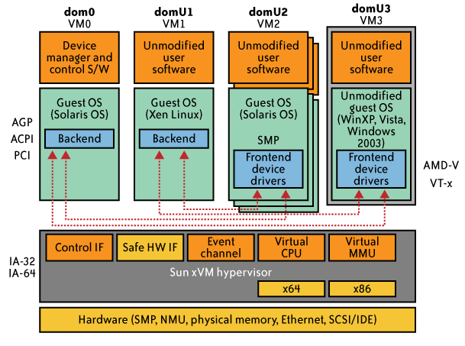
The Host Level (cont.)
IaaS Host Security
  Virtualization Software Security
    Hypervisor (also called Virtual Machine Manager (VMM)) security is a key
      a small application that runs on top of the physical machine H/W layer
      implements and manages the virtual CPU, virtual memory, event channels, and memory shared by the resident VMs
      Also controls I/O and memory access to devices.
    Bigger problem in multitenant architectures
  Customer guest OS or Virtual Server Security
    The virtual instance of an OS
    Vulnerabilities have appeared in virtual instance of an OS
    e.g., VMWare, Xen, and Microsoft’s Virtual PC and Virtual Server
    Customers have full access to virtual servers.

Slide 27
Case study: Amazon's EC2 infrastructure
“Hey, You, Get Off of My Cloud: Exploring Information Leakage in Third-Party Compute Clouds”
  Multiple VMs of different organizations with virtual boundaries separating each VM can run within one physical server
  "virtual machines" still have internet protocol, or IP, addresses, visible to anyone within the cloud.
  VMs located on the same physical server tend to have IP addresses that are close to each other and are assigned at the same time
  An attacker can set up lots of his own virtual machines, look at their IP addresses, and figure out which one shares the same physical resources as an intended target
  Once the malicious virtual machine is placed on the same server as its target, it is possible to carefully monitor how access to resources fluctuates and thereby potentially glean sensitive information about the victim

Slide 28
The Application Level
DoS
EDoS(Economic Denial of Sustainability)
  An attack against the billing model that underlies the cost of providing a service with the goal of bankrupting the service itself.
End user security
Who is responsible for Web application security in the cloud?
SaaS/PaaS/IaaS application security
Customer-deployed application security

Slide 29
Data Security and Storage

Slide 30
Data Security and Storage
Several aspects of data security, including:
  Data-in-transit
    Confidentiality + integrity using secured protocol
    Confidentiality with non-secured protocol and encryption
  Data-at-rest
    Generally, not encrypted , since data is commingled with other users’ data
    Encryption if it is not associated with applications?
      But how about indexing and searching?
      Then homomorphic encryption vs. predicate encryption?
  Processing of data, including multitenancy
    For any application to process data, not encrypted

Slide 31
Data Security and Storage (cont.)
  Data lineage
    Knowing when and where the data was located w/i cloud is important for audit/compliance purposes
    e.g., Amazon AWS
      Store <d1, t1, ex1.s3.amazonaws.com>
      Process <d2, t2, ec2.compute2.amazonaws.com>
      Restore <d3, t3, ex2.s3.amazonaws.com>
  Data provenance
    Computational accuracy (as well as data integrity)
    E.g., financial calculation: sum ((((2*3)*4)/6) -2) = $2.00 ?
      Correct : assuming US dollar
      How about dollars of different countries?
      Correct exchange rate?
Where is (or was) that system located?
What was the state of that physical system?
How would a customer or auditor verify that info?

Slide 32
Data Security and Storage
  Data remanence
  Inadvertent disclosure of sensitive information is possible
Data security mitigation?
  Do not place any sensitive data in a public cloud
  Encrypted data is placed into the cloud?
Provider data and its security: storage
  To the extent that quantities of data from many companies are centralized, this collection can become an attractive target for criminals
  Moreover, the physical security of the data center and the trustworthiness of system administrators take on new importance.

Slide 33
Identity and Access Management (IAM)

Slide 34
Why IAM?
Organization’s trust boundary will become dynamic and will move beyond the control and will extend into the service provider domain.
Managing access for diverse user populations (employees, contractors, partners, etc.)
Increased demand for authentication
  personal, financial, medical data will now be hosted in the cloud
  S/W applications hosted in the cloud requires access control
Need for higher-assurance authentication
  authentication in the cloud may mean authentication outside F/W
  Limits of password authentication
Need for authentication from mobile devices

Slide 35
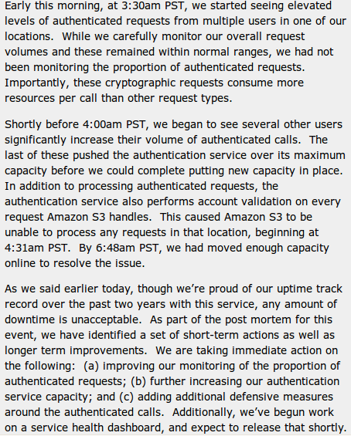
IAM considerations
The strength of authentication system should be reasonably balanced with the need to protect the privacy of the users of the system
  The system should allow strong claims to be transmitted and verified w/o revealing more information than is necessary for any given transaction or connection within the service
Case Study: S3 outage
  authentication service overload leading to unavailability
    2 hours 2/15/08
    http://www.centernetworks.com/amazon-s3-downtime-update

Slide 36
Privacy

Slide 37
What is Privacy?
The concept of privacy varies widely among (and sometimes within) countries, cultures, and jurisdictions.
It is shaped by public expectations and legal interpretations; as such, a concise definition is elusive if not impossible.
Privacy rights or obligations are related to the collection, use, disclosure, storage, and destruction of personal data (or Personally Identifiable Information—PII).
At the end of the day, privacy is about the accountability of organizations to data subjects, as well as the transparency to an organization’s practice around personal information.

Slide 38
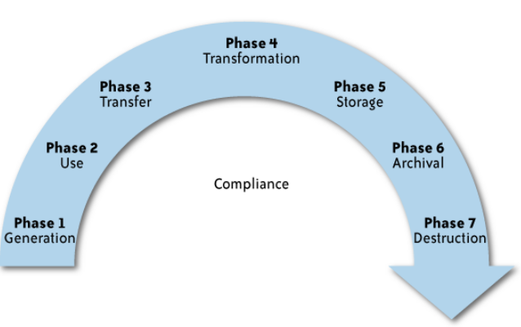
What is the data life cycle?
Personal information should be managed as part of the data used by the organization
Protection of personal information should consider the impact of the cloud on each phase

Slide 39
What Are the Key Privacy Concerns?
Typically mix security and privacy
Some considerations to be aware of:
  Storage
  Retention
  Destruction
  Auditing, monitoring and risk management
  Privacy Breaches
  Who is responsible for protecting privacy?

Slide 40
Storage
Is it commingled with information from other organizations that use the same CSP?
The aggregation of data raises new privacy issues
  Some governments may decide to search through data without necessarily notifying the data owner, depending on where the data resides
Whether the cloud provider itself has any right to see and access customer data?
Some services today track user behaviour for a range of purposes, from sending targeted advertising to improving services

Slide 41
Retention
How long is personal information (that is transferred to the cloud) retained?
Which retention policy governs the data?
Does the organization own the data, or the CSP?
Who enforces the retention policy in the cloud, and how are exceptions to this policy (such as litigation holds) managed?

Slide 42
Destruction
How does the cloud provider destroy PII at the end of the retention period?
How do organizations ensure that their PII is destroyed by the CSP at the right point and is not available to other cloud users?
Cloud storage providers usually replicate the data across multiple systems and sites—increased availability is one of the benefits they provide.
  How do you know that the CSP didn’t retain additional copies?
  Did the CSP really destroy the data, or just make it inaccessible to the organization?
  Is the CSP keeping the information longer than necessary so that it can mine the data for its own use?

Slide 43
Auditing, monitoring and risk management
How can organizations monitor their CSP and provide assurance to relevant stakeholders that privacy requirements are met when their PII is in the cloud?
Are they regularly audited?
What happens in the event of an incident?
If business-critical processes are migrated to a cloud computing model, internal security processes need to evolve to allow multiple cloud providers to participate in those processes, as needed.
  These include processes such as security monitoring, auditing, forensics, incident response, and business continuity
Transparency, compliance controls, and auditability are key criteria in the evaluation of any cloud service provider

Slide 44
Privacy breaches
How do you know that a breach has occurred?
How do you ensure that the CSP notifies you when a breach occurs?
Who is responsible for managing the breach notification process (and costs associated with the process)?
If contracts include liability for breaches resulting from negligence of the CSP?
  How is the contract enforced?
  How is it determined who is at fault?

Slide 45
Who is responsible for protecting privacy?
e.g., Suppose a hacker breaks into Cloud Provider A and steals data from Company X.
Assume that the compromised server also contained data from Companies Y and Z.
Who investigates this crime?
Is it the Cloud Provider, even though Company X may fear that
the provider will try to absolve itself from responsibility?
Is it Company X and, if so, does it have the right to see other data on that server,
including logs that may show access to the data of Companies Y and Z?
Data breaches have a cascading effect
Full reliance on a third party to protect personal data?
In-depth understanding of responsible data stewardship
Organizations can transfer liability, but not accountability
Risk assessment and mitigation throughout the data life cycle is critical.
Many new risks and unknowns
  The overall complexity of privacy protection in the cloud represents a bigger challenge.

Slide 46
References
Security and Privacy in Cloud Computing, Dept. of CS at Johns Hopkins University. www.cs.jhu.edu/~ragib/sp10/cs412
Cloud Security and Privacy: An Enterprise Perspective on Risks and Compliance by Tim Mather and Subra Kumaraswamy
Afraid of outside cloud attacks? You're missing the real threat. http://www.infoworld.com/d/cloud-computing/afraid-outside-cloud-attacks-youre-missing-real-threat-894
Amazon downplays report highlighting vulnerabilities in its cloud service. http://www.computerworld.com/s/article/9140074/Amazon_downplays_report_highlighting_vulnerabilities_in_its_cloud_service
Targeted Attacks Possible in the Cloud, Researchers Warn. http://www.cio.com/article/506136/Targeted_Attacks_Possible_in_the_Cloud_Researchers_Warn
Vulnerability Seen in Amazon's Cloud-Computing by David Talbot. http://www.cs.sunysb.edu/~sion/research/sion2009mitTR.pdf
Cloud Computing Security Considerations by Roger Halbheer and Doug Cavit. January 2010. http://blogs.technet.com/b/rhalbheer/archive/2010/01/30/cloud-security-paper-looking-for-feedback.aspx
Security in Cloud Computing Overview.http://www.halbheer.info/security/2010/01/30/cloud-security-paper-looking-for-feedback
Hey, You, Get Off of My Cloud: Exploring Information Leakage in Third-Party Compute Clouds by T. Ristenpart, E. Tromer, H. Shacham and Stefan Savage. CCS’09
Cloud Computing Security. http://www.exforsys.com/tutorials/cloud-computing/cloud-computing-security.html
Update From Amazon Regarding Friday’s S3 Downtime by Allen Stern. Feb. 16, 2008. http://www.centernetworks.com/amazon-s3-downtime-update

