Slide 1
A Mobile-Cloud Collaborative Approach for Context-Aware Blind Navigation
Pelin Angin, Bharat Bhargava
Purdue University, Department of Computer Sciences
{pangin, bb} @cs.purdue.edu
(765) 430 2140 – (765) 494 6013
Sumi Helal
University of Florida, Computer and Information Science & Engineering Department

Slide 2
Outline
Problem Statement
Goals
Challenges
Context-aware Navigation Components
Existing Blind Navigation Aids
Proposed System Architecture
Advantages of Mobile-Cloud Approach
Traffic Lights Detection
  Related Work
  System Developed
  Experiments
Work In Progress

Slide 3
Problem Statement
Indoor and outdoor navigation is becoming a harder task for blind and visually impaired people in the increasingly complex urban world
Advances in technology are causing the blind to fall behind, sometimes even putting their lives at risk
Technology available for context-aware navigation of the blind is not sufficiently accessible; some devices rely heavily on infrastructural requirements

Slide 4
Demographics
314 million visually impaired people in the world today
45 million blind
More than 82% of the visually impaired population is age 50 or older
The old population forms a group with diverse range of abilities
The disabled are seldom seen using the street alone or public transportation

Slide 5
Goals
***Make a difference***
Bring mobile technology in the daily lives of blind and visually impaired people to help achieve a higher standard of life
Take a major step in context-aware navigation of the blind and visually impaired
Bridge the gap between the needs and available technology
Guide users in a non-overwhelming way
Protect user privacy

Slide 6
Challenges
Real-time guidance
Portability
Power limitations
Appropriate interface
Privacy preservation
Continuous availability
No dependence on infrastructure
Low-cost solution
Minimal training

Slide 7
Discussions
Cary Supalo: Founder of Independence Science LLC (http://www.independencescience.com/)
T.V. Raman: Researcher at Google, leader of Eyes-Free project (speech enabled Android applications)
American Council of the Blind of Indiana State Convention, 31 October 2009
Miami Lighthouse Organization

Slide 8
Mobility Requirements
Being able to avoid obstacles
Walking in the right direction
Safely crossing the road
Knowing when you have reached a destination
Knowing which is the right bus/train
Knowing when to get off the bus/train
All require SIGHT as primary sense

Slide 9
Context-Aware Navigation Components
Outdoor Navigation (finding curbs -including in snow, using public transportation, interpreting traffic patterns/signal lights…)
Indoor Navigation (finding stairs/elevator, specific offices, restrooms in unfamiliar buildings, finding the cheapest TV at a store…)
Obstacle Avoidance (both overhanging and low obstacles…)
Object Recognition (being able to reach objects needed, recognizing people who are in the immediate neighborhood…)

Slide 10
Existing Blind Navigation Aids –
Outdoor Navigation
Loadstone GPS (http://www.loadstone-gps.com/)
Wayfinder Access (http://www.wayfinderaccess.com/)
BrailleNote GPS (www.humanware.com)
Trekker (www.humanware.com)
StreetTalk (www.freedomscientific.com)
DRISHTI [1]
…

Slide 11
Existing Blind Navigation Aids –
Indoor Navigation
InfoGrid (based on RFID) [2]
Jerusalem College of Technology system (based on local infrared beams) [3]
Talking Signs (www.talkingsigns.com) (audio signals sent by invisible infrared light beams)
SWAN (audio interface guiding user along path, announcing important features) [4]
ShopTalk (for grocery shopping) [5]

Slide 12
Existing Blind Navigation Aids –
Obstacle Avoidance
RADAR/LIDAR
Kay’s Sonic glasses (audio for 3D representation of environment) (www.batforblind.co.nz)
Sonic Pathfinder (www.sonicpathfinder.org) (notes of musical scale to warn of obstacles)
MiniGuide (www.gdp-research.com.au/) (vibration to indicate object distance)
VOICE (www.seeingwithsound.com) (images into sounds heard from 3D auditory display)
Tactile tongue display [6]
…

Slide 13
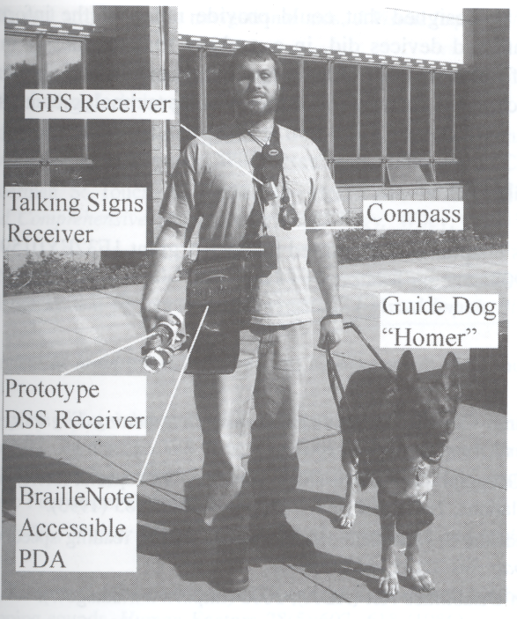
Putting all together…
Gill, J. Assistive Devices for People with Visual Impairments.
In A. Helal, M. Mokhtari and B. Abdulrazak, ed., The Engineering Handbook of Smart Technology for Aging, Disability and Independence.
John Wiley & Sons, Hoboken, New Jersey, 2008.

Slide 14
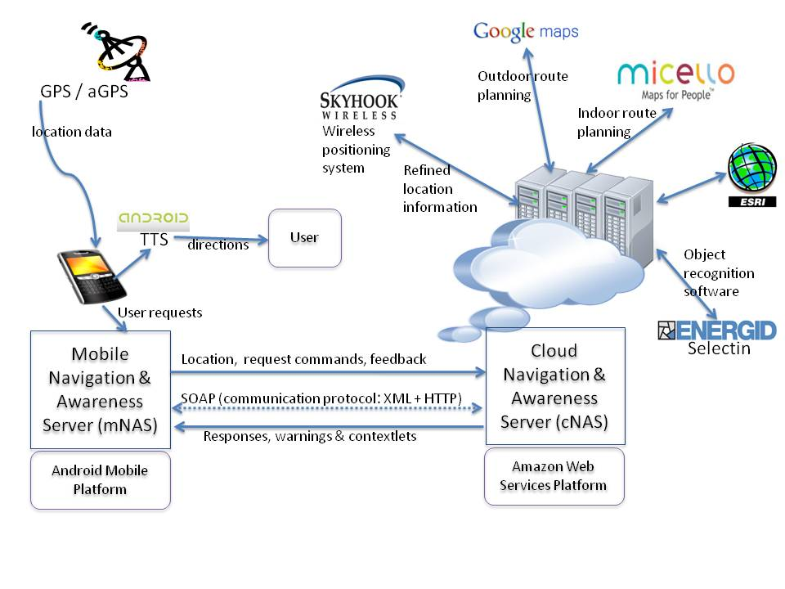
Proposed System Architecture

Slide 15
Proposed System Architecture
Services:
Google Maps (outdoor navigation, pedestrian mode)
Micello (indoor location-based service for mobile devices)
Object recognition (Selectin software etc)
Traffic assistance
Obstacle avoidance (Time-of-flight camera technology)
Speech interface (Android text-to-speech + speech recognition servers)
Remote vision
Obstacle minimized route planning

Slide 16
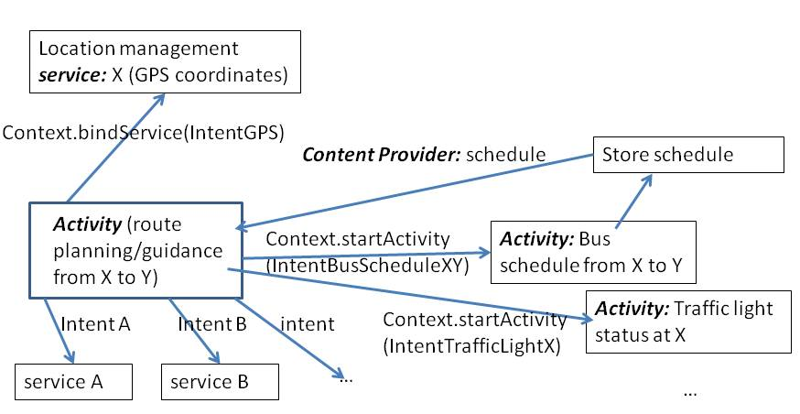
Use of the Android Platform

Slide 17
Advantages of a Mobile-Cloud Collaborative Approach
Open architecture
Extensibility
Computational power
Battery life
Light weight
Wealth of context-relevant information resources
Interface options
Minimal reliance on infrastructural requirements

Slide 18
Traffic Lights Status Detection Problem
Ability to detect status of traffic lights accurately is an important aspect of safe navigation
  Color blind
  Autonomous ground vehicles
  Careless drivers
Inherent difficulty: Fast image processing required for locating and detecting the lights status → demanding in terms of computational resources
Mobile devices with limited resources fall short alone

Slide 19
Attempts to Solve the Traffic Lights Detection Problem
Kim et al: Digital camera + portable PC analyzing video frames captured by the camera [7]
Charette et al: 2.9 GHz desktop computer to process video frames in real time[8]
Ess et al: Detect generic moving objects with 400 ms video processing time on dual core 2.66 GHz computer[9]
Sacrifice portability for real-time, accurate detection

Slide 20
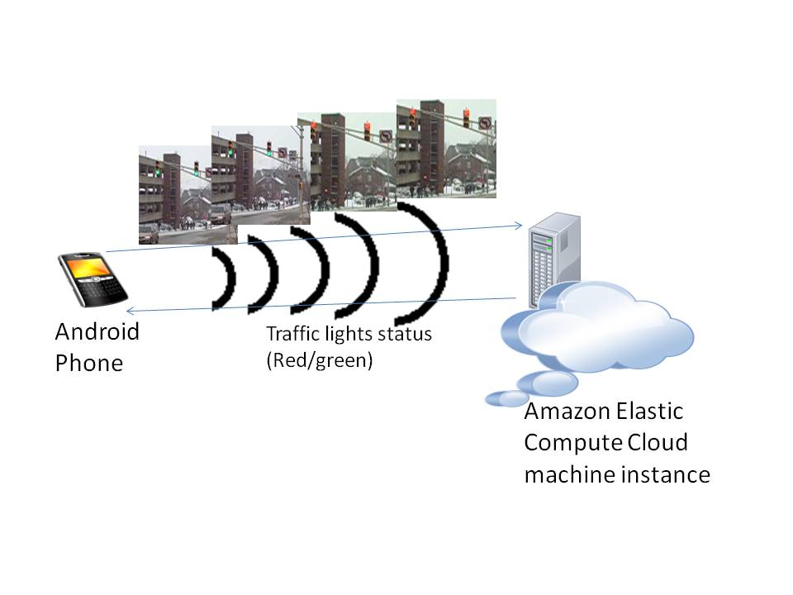
Mobile-Cloud Collaborative Traffic Lights Detector

Slide 21
Adaboost Object Detector
Adaboost: Adaptive Machine Learning algorithm used commonly in real-time object recognition
Based on rounds of calls to weak classifiers to focus more on incorrectly classified samples at each stage
Traffic lights detector: trained on 219 images of traffic lights (Google Images)
OpenCV library implementation

Slide 22
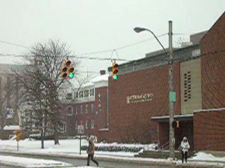
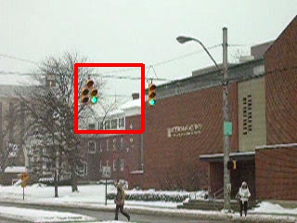
Experiments: Detector Output

Slide 23
Experiments: Response time

Slide 24
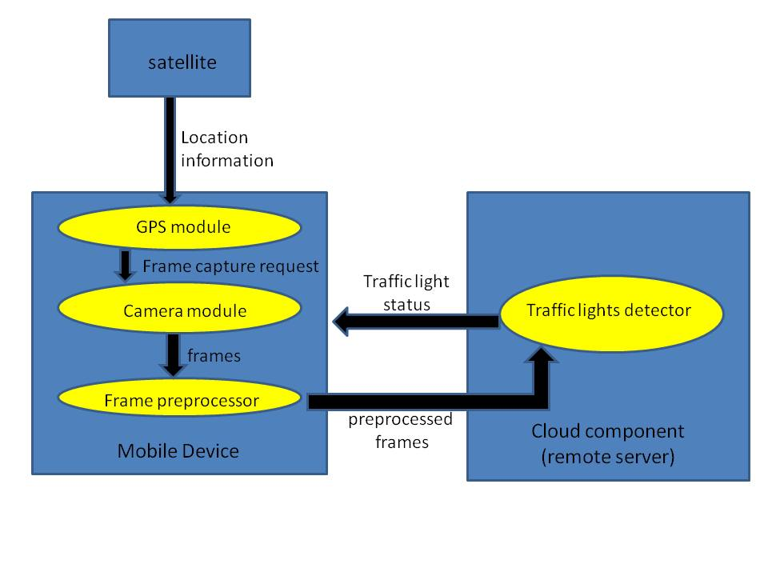
Enhanced Detection Schema

Slide 25
Work In Progress
Develop fully context-aware navigation system with speech/tactile interface
Develop robust object/obstacle recognition algorithms
Investigate mobile-cloud privacy and security issues (minimal data disclosure principle) [10]
Investigate options for mounting of the camera

Slide 26
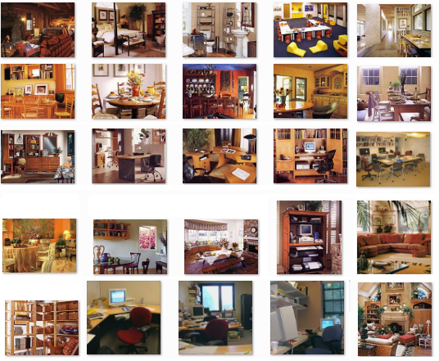
Collective Object Classification in Complex Scenes
LabelMe Dataset (http://labelme.csail.mit.edu)

Slide 27
Relational Learning with Multiple Boosted Detectors for Object Categorization
Modeling relational dependencies between different object categories
Multiple detectors running in parallel
Class label fixing based on confidence
More accurate classification than AdaBoost alone
Higher recall than classic collective classification
Minimal decrease in recall for different classes of objects

Slide 28
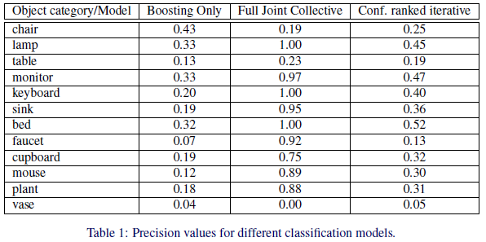
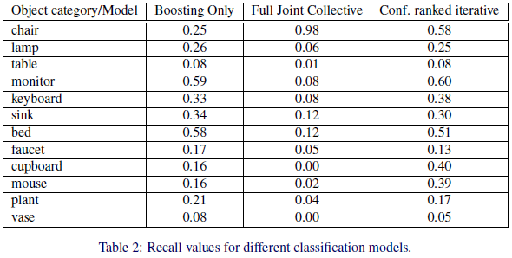
Object Classification Experiments

Slide 29
References
L. Ran, A. Helal, and S. Moore, “Drishti: An Integrated Indoor/Outdoor Blind Navigation System and Service,” 2nd IEEE Pervasive Computing Conference (PerCom 04).
S.Willis, and A. Helal, “RFID Information Grid and Wearable Computing Solution to the Problem of Wayfinding for the Blind User in a Campus Environment,” IEEE International Symposium on Wearable Computers (ISWC 05).
Y. Sonnenblick. “An Indoor Navigation System for Blind Individuals,” Proceedings of the 13th Annual Conference on Technology and Persons with Disabilities, 1998.
J. Wilson, B. N. Walker, J. Lindsay, C. Cambias, F. Dellaert. “SWAN: System for Wearable Audio Navigation,” 11th IEEE International Symposium on Wearable Computers, 2007.
J. Nicholson, V. Kulyukin, D. Coster, “ShopTalk: Independent Blind Shopping Through Verbal Route Directions and Barcode Scans,” The Open Rehabilitation Journal, vol. 2, 2009, pp. 11-23.
Bach-y-Rita, P., M.E. Tyler and K.A. Kaczmarek. “Seeing with the Brain,” International Journal of Human-Computer Interaction, vol 15, issue 2, 2003, pp 285-295.
Y.K. Kim, K.W. Kim, and X.Yang, “Real Time Traffic Light Recognition System for Color Vision Deficiencies,” IEEE International Conference on Mechatronics and Automation (ICMA 07).
R. Charette, and F. Nashashibi, “Real Time Visual Traffic Lights Recognition Based on Spot Light Detection and Adaptive Traffic Lights Templates,” World Congress and Exhibition on Intelligent Transport Systems and Services (ITS 09).
A.Ess, B. Leibe, K. Schindler, and L. van Gool, “Moving Obstacle Detection in Highly Dynamic Scenes,” IEEE International Conference on Robotics and Automation (ICRA 09).
P. Angin, B. Bhargava, R. Ranchal, N. Singh, L. Lilien, L. B. Othmane, “A User-centric Approach for Privacy and Identity Management in Cloud Computing,” submitted to SRDS 2010.

Slide 30
We would greatly appreciate your suggestions!

