Slide 1
Research in Cloud Computing
Bharat Bhargava
bbshail@purdue.edu
Computer Science
Purdue University
Anya Kim
anya.kim@nrl.navy.mil
Naval Research Lab
YounSun Cho
cho52@cs.purdue.edu
Computer Science
Purdue University

Slide 2
Talk Objectives
A high-level discussion of the fundamental challenges and issues/characteristics of cloud computing
Identify a few security and privacy issues within this framework
Propose some approaches to addressing these issues
  Preliminary ideas to think about

Slide 3
Introduction
Cloud Computing Background
Cloud Models
Why do you still hesitate to use cloud computing?
Causes of Problems Associated with Cloud Computing
Taxonomy of Fear
Threat Model

Slide 4
Cloud Computing Background
From [1] NIST
Features
  Use of internet-based services to support business process
  Rent IT-services on a utility-like basis
Attributes
  Rapid deployment
  Low startup costs/ capital investments
  Costs based on usage or subscription
  Multi-tenant sharing of services/ resources
Essential characteristics
  On demand self-service
  Ubiquitous network access
  Location independent resource pooling
  Rapid elasticity
  Measured service
“Cloud computing is a compilation of existing techniques and technologies, packaged within a new infrastructure paradigm that offers improved scalability, elasticity, business agility, faster startup time, reduced management costs, and just-in-time availability of resources”
Notes:
4
Government and Military sectors: complicated procurement rules and stringent security requirements
Cloud-based categories:
Cloud-based applications (SAAS)
Cloud-based development (e.g. Google App Engine)
Cloud-based infrastructure (e.g. Amazon’s EC2)

Slide 5
A Massive Concentration of Resources
Also a massive concentration of risk
  expected loss from a single breach can be significantly larger
  concentration of “users” represents a concentration of threats
“Ultimately, you can outsource responsibility but you can’t outsource accountability.”
From [2] John McDermott, ACSAC 09

Slide 6
Cloud Computing: who should use it?
Cloud computing definitely makes sense if your own security is weak, missing features, or below average.
Ultimately, if
  the cloud provider’s security people are “better” than yours (and leveraged at least as efficiently),
  the web-services interfaces don’t introduce too many new vulnerabilities, and
  the cloud provider aims at least as high as you do, at security goals,
then cloud computing has better security.
From [2] John McDermott, ACSAC 09

Slide 7
Cloud Models
From [1] NIST
Delivery Models
  SaaS
  PaaS
  IaaS
Deployment Models
  Private cloud
  Community cloud
  Public cloud
  Hybrid cloud
We propose one more Model: Management Models (trust and tenancy issues)
  Self-managed
  3rd party managed (e.g. public clouds and VPC)
Notes:
Trust and tenancy issues as well as loss of control related to the management model

Slide 8
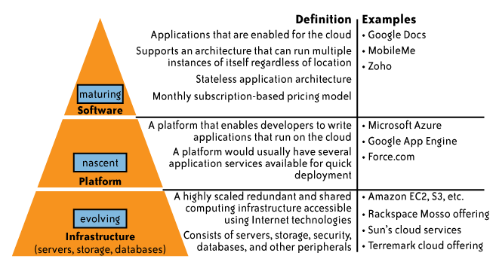
Delivery Models
While cloud-based software services are maturing,
Cloud platform and infrastructure offering are still in their early stages !
From [6] Cloud Security and Privacy by Mather and Kumaraswamy

Slide 9
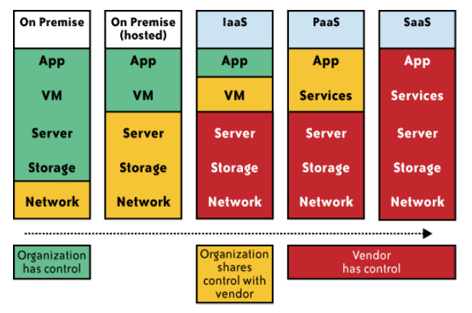
Impact of cloud computing on the governance structure of IT organizations
From [6] Cloud Security and Privacy by Mather and Kumaraswamy

Slide 10
If cloud computing is so great, why isn’t everyone doing it?
The cloud acts as a big black box, nothing inside the cloud is visible to the clients
Clients have no idea or control over what happens inside a cloud
Even if the cloud provider is honest, it can have malicious system admins who can tamper with the VMs and violate confidentiality and integrity
Clouds are still subject to traditional data confidentiality, integrity, availability, and privacy issues, plus some additional attacks

Slide 11
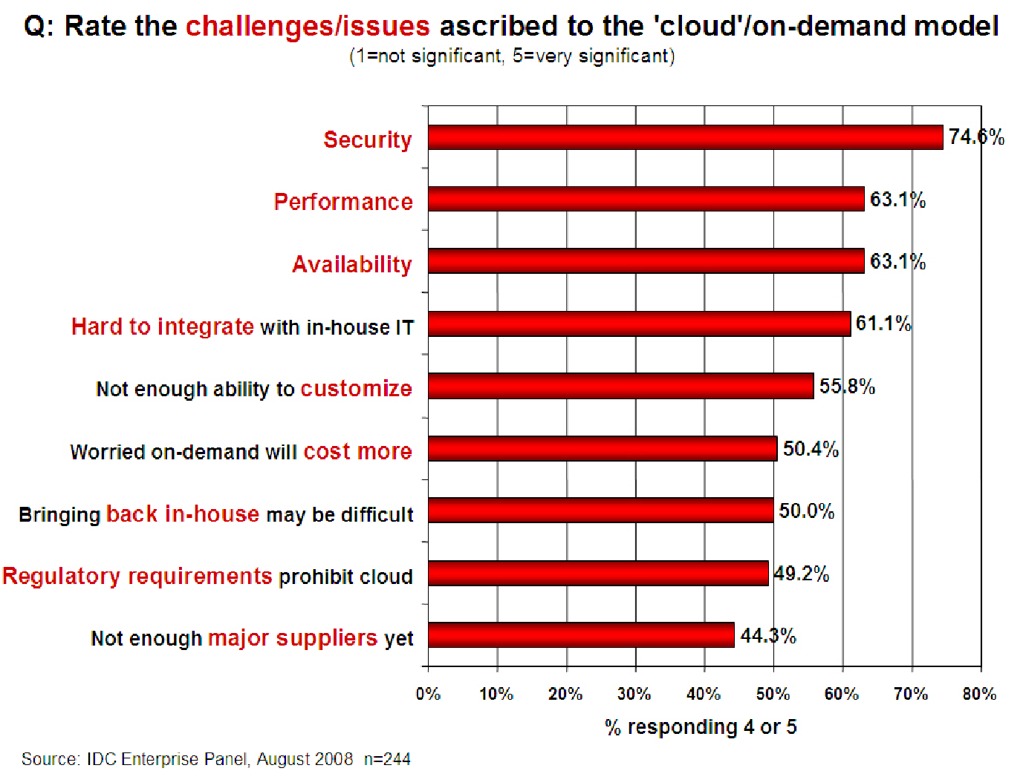
Companies are still afraid to use clouds
[Chow09ccsw]

Slide 12
Causes of Problems Associated with Cloud Computing
Most security problems stem from:
  Loss of control
  Lack of trust (mechanisms)
  Multi-tenancy
These problems exist mainly in 3rd party management models
  Self-managed clouds still have security issues, but not related to above
Notes:
12
Data mobility: the ability to share data between cloud services
Where does data reside?
- out-of-state, out-of-country issues
Security Concerns for government in particular
FISMA
How to certify and accredit cloud computing providers under FISMA
(e.g. ISO 27001)

Slide 13
Loss of Control in the Cloud
Consumer’s loss of control
  Data, applications, resources are located with provider
  User identity management is handled by the cloud
  User access control rules, security policies and enforcement are managed by the cloud provider
  Consumer relies on provider to ensure
    Data security and privacy
    Resource availability
    Monitoring and repairing of services/resources

Slide 14
Lack of Trust in the Cloud
A brief deviation from the talk
  (But still related)
  Trusting a third party requires taking risks
Defining trust and risk
  Opposite sides of the same coin (J. Camp)
  People only trust when it pays (Economist’s view)
  Need for trust arises only in risky situations
Defunct third party management schemes
  Hard to balance trust and risk
  e.g. Key Escrow (Clipper chip)
  Is the cloud headed toward the same path?
Notes:
Chiles and McMakin (1996) define trust as increasing one’s vulnerability to the risk of opportunistic behavior of another whose behavior is not under one’s control in a situation in which the costs of violating the trust are greater than the benefits of upholding the trust.
Trust here means mostly lack of accountability and verifiability

Slide 15
Multi-tenancy Issues in the Cloud
Conflict between tenants’ opposing goals
  Tenants share a pool of resources and have opposing goals
How does multi-tenancy deal with conflict of interest?
  Can tenants get along together and ‘play nicely’ ?
  If they can’t, can we isolate them?
How to provide separation between tenants?
Cloud Computing brings new threats
  Multiple independent users share the same physical infrastructure
  Thus an attacker can legitimately be in the same physical machine as the target
Notes:
Who are my neighbors? What is their objective? They present another facet of risk and trust requirements

Slide 16
Taxonomy of Fear
Confidentiality
  Fear of loss of control over data
    Will the sensitive data stored on a cloud remain confidential?
    Will cloud compromises leak confidential client data
  Will the cloud provider itself be honest and won’t peek into the data?
Integrity
  How do I know that the cloud provider is doing the computations correctly?
  How do I ensure that the cloud provider really stored my data without tampering with it?
From [5] www.cs.jhu.edu/~ragib/sp10/cs412

Slide 17
Taxonomy of Fear (cont.)
Availability
  Will critical systems go down at the client, if the provider is attacked in a Denial of Service attack?
  What happens if cloud provider goes out of business?
  Would cloud scale well-enough?
  Often-voiced concern
    Although cloud providers argue their downtime compares well with cloud user’s own data centers
From [5] www.cs.jhu.edu/~ragib/sp10/cs412

Slide 18
Taxonomy of Fear (cont.)
Privacy issues raised via massive data mining
  Cloud now stores data from a lot of clients, and can run data mining algorithms to get large amounts of information on clients
Increased attack surface
  Entity outside the organization now stores and computes data, and so
  Attackers can now target the communication link between cloud provider and client
  Cloud provider employees can be phished
From [5] www.cs.jhu.edu/~ragib/sp10/cs412

Slide 19
Taxonomy of Fear (cont.)
Auditability and forensics (out of control of data)
  Difficult to audit data held outside organization in a cloud
  Forensics also made difficult since now clients don’t maintain data locally
Legal quagmire and transitive trust issues
  Who is responsible for complying with regulations?
    e.g., SOX, HIPAA, GLBA ?
  If cloud provider subcontracts to third party clouds, will the data still be secure?
From [5] www.cs.jhu.edu/~ragib/sp10/cs412

Slide 20
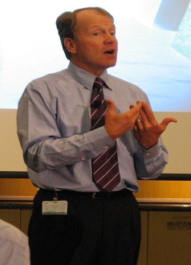
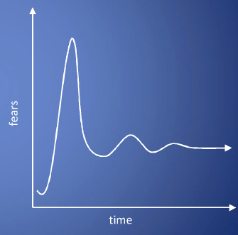
Taxonomy of Fear (cont.)
Cloud Computing is a security nightmare and it can't be handled in traditional ways.
John Chambers
CISCO CEO
Security is one of the most difficult task to implement in cloud computing.
  Different forms of attacks in the application side and in the hardware components
Attacks with catastrophic effects only needs one security flaw
(http://www.exforsys.com/tutorials/cloud-computing/cloud-computing-security.html)

Slide 21
Threat Model
A threat model helps in analyzing a security problem, design mitigation strategies, and evaluate solutions
Steps:
  Identify attackers, assets, threats and other components
  Rank the threats
  Choose mitigation strategies
  Build solutions based on the strategies
From [5] www.cs.jhu.edu/~ragib/sp10/cs412

Slide 22
Threat Model
Basic components
  Attacker modeling
    Choose what attacker to consider
      insider vs. outsider?
      single vs. collaborator?
    Attacker motivation and capabilities
  Attacker goals
  Vulnerabilities / threats
From [5] www.cs.jhu.edu/~ragib/sp10/cs412

Slide 23
What is the issue?
The core issue here is the levels of trust
  Many cloud computing providers trust their customers
  Each customer is physically commingling its data with data from anybody else using the cloud while logically and virtually you have your own space
  The way that the cloud provider implements security is typically focused on they fact that those outside of their cloud are evil, and those inside are good.
But what if those inside are also evil?
From [5] www.cs.jhu.edu/~ragib/sp10/cs412

Slide 24
Attacker Capability: Malicious Insiders
At client
  Learn passwords/authentication information
  Gain control of the VMs
At cloud provider
  Log client communication
  Can read unencrypted data
  Can possibly peek into VMs, or make copies of VMs
  Can monitor network communication, application patterns
  Why?
    Gain information about client data
    Gain information on client behavior
    Sell the information or use itself
From [5] www.cs.jhu.edu/~ragib/sp10/cs412

Slide 25
Attacker Capability: Outside attacker
What?
  Listen to network traffic (passive)
  Insert malicious traffic (active)
  Probe cloud structure (active)
  Launch DoS
Goal?
  Intrusion
  Network analysis
  Man in the middle
  Cartography
From [5] www.cs.jhu.edu/~ragib/sp10/cs412

Slide 26
Challenges for the attacker
How to find out where the target is located?
How to be co-located with the target in the same (physical) machine?
How to gather information about the target?
From [5] www.cs.jhu.edu/~ragib/sp10/cs412

