Slide 1
PhD Prelim Exam
Dept. of Computer Science
Purdue University
Rohit Ranchal

Slide 2
Outline
Motivation
Problem Statement
Related Work
Managed Information Object
Active Bundle Scheme
Extending Active Bundle Scheme
Identity Management
References

Slide 3
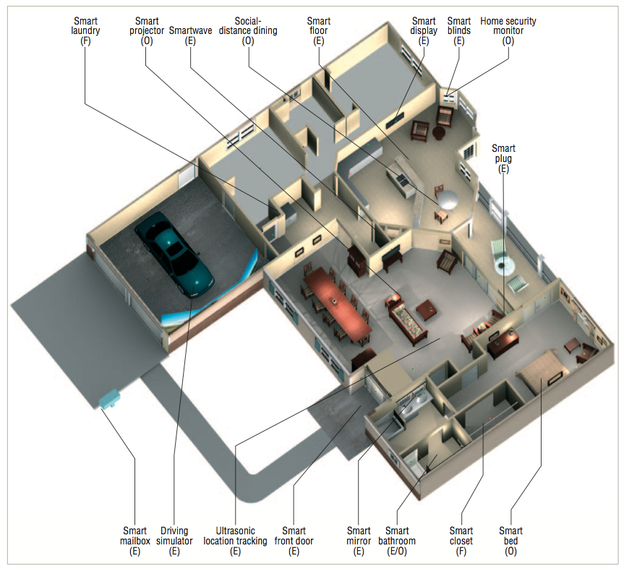
Motivation
E – existing F – future
O – ongoing
Smart Home [2]

Slide 4
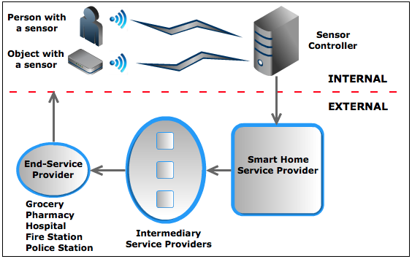
Motivation
Smart Home Data Flow Model

Slide 5
Motivation
Problems with the current model
  Loss of control
  No access control
  No sharing control
  Information gathering/aggregation
  Information selling to interested parties
  Information disclosures for Subpoenas
  Hacking attacks
  Insider abuse
  Lack of trust

Slide 6
Motivation
Any non-trivial application requires protecting confidentiality of disseminated data
Examples
  Pervasive healthcare monitoring
  Smart Grid
  Service Oriented Architecture (SOA)
  Digital Rights Management (DRM)
  Cloud Computing
  Digital Supply Chain Management
  Data sharing in Military scenarios
  Smart Homes

Slide 7
Problem Statement
Research Problem
  How to securely share sensitive data, control its dissemination, minimize unnecessary disclosure and protect them throughout their lifecycle?
Research Goal
  Propose a solution to control data disclosure and minimize the risk of unauthorized disclosure

Slide 8
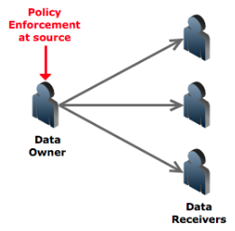
Related Work
Policy enforcement at owner
Traditional approach – uses encryption for protection (interactive protocols) e.g. Servers
A lot of exchange of messages
Source can become bottleneck
Not scalable
Digibox [5] – uses multiple keys

Slide 9
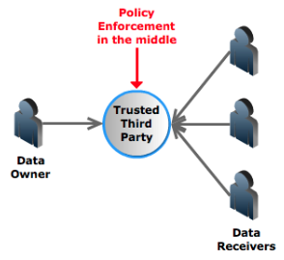
Related Work
Policy enforcement in the middle
Trusted Third Party – e.g. pub/sub
Single point of failure
Information aggregation - caches and stores data
Can sell data to interested parties
Data disclosure during Subpoenas
Prone to hacking attacks and insider abuse
Casassa Mont et al [9] – uses time vault service

Slide 10
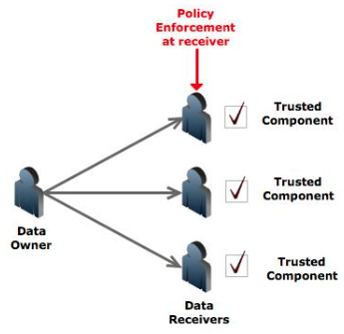
Related Work
Policy enforcement at receiver
Requires a Trusted component
Eg – Digital Rights Management solutions, Document-sharing solutions Adobe, Microsoft etc
Distribution issues of Trusted component
Not applicable on unknown or untrusted hosts
Montero et al [6] – uses sticky policies

Slide 11
Related Work
Data are considered passive entities unable to protect themselves
Require another active and trusted entity to protect them – a trusted processor, a trusted memory module, a trusted application or a trusted third party

Slide 12
We challenge this assumption by proposing an approach that transforms passive data into an active entity that can protect itself

Slide 13
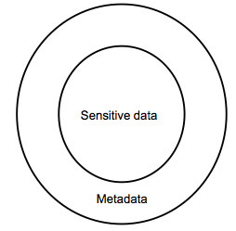
Managed Information Object (MIO)
MIOs [10] enclose data and policies together
Traditionally used in Networks (for resource management in SNMP, content and policy based routing)
MIO provides capabilities to control the behavior of data in a trusted domain

Slide 14
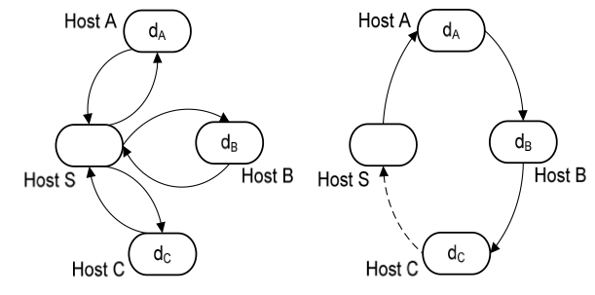
Managed Information Object (MIO)
Asynchronous, reduces network load
What if environment is untrusted or unknown?
Policies alone are not sufficient
Client-server
architecture
MIO
architecture

Slide 15
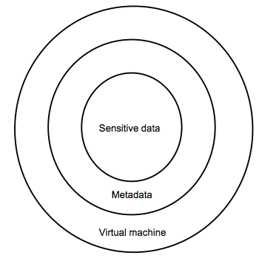
Secure MIO
Need a protection and policy enforcement mechanism
Add a VM layer that enforces policies and protects data
Secure MIOs are realized as Active Bundles [12]
Data-centric approach - Data is protected from within instead of outside

Slide 16
Active Bundle
Active bundle (AB)
    Encapsulation mechanism for protecting data
    Includes metadata used for controlled dissemination
    Includes Virtual Machine (VM)
      Policy enforcement mechanism
      Protection mechanism
Active Bundle Operations
    Self-Integrity check
    Filtering
      Selective dissemination based on policies
    Apoptosis
      Self-destructs AB completely

Slide 17














AB Creation and Distribution
AB information disclosure
Active Bundle Destination
User Application
Active Bundle
Active Bundle Creator
Active
Bundle (AB)
Security Services
Agent (SSA)
Audit Services
Agent (ASA)
Directory
Facilitator
Trust Evaluation
Agent (TEA)
Active Bundle Coordinator
Active Bundle Services

Slide 18
Enabling AB
A Trust-based Approach for Secure Data Dissemination in a Mobile Peer-to-Peer Network of AVs. B. Bhargava, P. Angin, R. Ranchal, R. Sivakumar, M. Linderman, A. Sinclair, In International Journal of Next Generation Computing 2012.

Slide 19
Problems with current scheme
Relies on TTP (TTP related issues)
Unable to do selective dissemination
VM is prone to attacks from the host executing the VM.
Simulates policies but no work on inclusion of policies
No performance evaluation
Not tested in any application scenario

Slide 20
Improving the AB scheme
Improve the AB scheme by making it independent of TTP
Provide a mechanism for policy based selective dissemination
Include actual policies in the scheme
Providing resilience against malicious hosts
Application specific development and experimentation

Slide 21
Improving AB Scheme
Decrease dependence on TTP and provide selective dissemination
  Organize data in AB into separate items
  Encrypt each item with a different key
  Use Shamir’s threshold secret sharing technique [16] to split each of the decryption keys into N shares
  Set a threshold t such that t shares are required for key reconstruction
  Store the key shares in a distributed hash table (DHT) built on top of P2P system (Vuze)
  Each share is stored at a random node

Slide 22
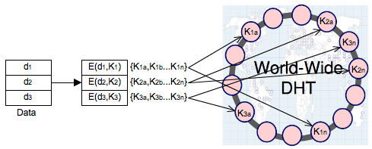
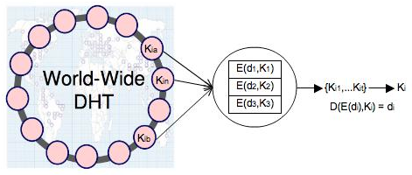
DHT scheme for AB
AB Key distribution
AB Key reconstruction

Slide 23
Advantages of using DHT
Huge scale - millions of geographically distributed nodes
Decentralized – individually owned nodes with no single point of trust
Load reduction and Asynchronous communication – no synchronization issues
Hard to deduce all the shares (atleast t)
Hard to compromise all the nodes that store the shares
Use continuous splitting to protect against dynamic adversaries (Zhou et al [30])

Slide 24
Improvement in DHT
DHT loses key shares over time
  Nodes crash or leave
  Republish the shares for availability
  Use a hybrid DHT (combination of reliable* DHT (openDHT in planet lab) and public DHT)
  Split K into K’ and K’’
  Split K’ into n shares and store in reliable DHT
  Split K’’ into n shares and store in public DHT

Slide 25
AB Policies
Extend the AB approach with a formal language for specifying policies
Developed simple XML based policies and their enforcement
Need efficient policy negotiation mechanism
OASIS eXtensible Access Control Markup Language (XACML) [17]
Role Based Access Control (RBAC) [18]

Slide 26
AB Policies
A sample XML based policy constructed for specifying sensitive data using custom defined DTD
<data type="target">
<property name="color">blue</property> <property name="coordinates">location</property> <property name="type">type</property>
</data>
<policy>
<metaData type="Sensitivity">
<data type="target" property="color" value="1" />
<data type="target" property="coordinates" value="2" /> <data type="target" property="type" value="3" /> </metaData>
<metaData type="AccessControl">
</metaData> <metaData type="Dissemination”></metaData>
<metaData type="Trust">0</metaData> <metaData type="Role">Role</metaData> </policy>

Slide 27
Protection against Malicious Hosts
Use TPM [7] to ensure that host is not already compromised
Intertwine code and data together – hide data within the code to make it incomprehensible
Use polymorphic code [25] – code changes itself each time it runs but its semantics don't change
Can store the control flow information in random DHT nodes
Perform code obfuscation - hide data and real program code within a scrambled code

Slide 28
Application specific Experimentation
Extend the AB prototype with the proposed enhancements
  How variations in splitting affects the performance of the system (Average Refresh time for shares)
  Effect of using multiple DHTs on the performance
Adapt the scheme for an application specific scenario like Smart Home
Performance evaluation of the scheme under varying network conditions
  Compare the size of an active bundle with data size in other approaches
  Compare the time of the AB scheme with other approaches

Slide 29
Active Bundles
Capabilities
Controlled and Selective Dissemination: Control the dissemination and selectively share the data based on the policies
Quantifiable Data Dissemination: Track the amount of data disclosed to a particular host and decide to further disclose or deny data requests
Contextual Dissemination: Context aware dissemination
Dynamic Metadata Adjustment: Update the policies based on a context, host, history of interactions, trust level etc.

Slide 30
Active Bundles
Do not require hosts to have a policy enforcement engine or a trusted component
Doesn’t rely on a TTP
No trusted destination host assumption – works on unknown hosts

Slide 31
References
Y. Gall, A. Lee and A. Kapadia, “PlexC: A Policy language for exposure control,” in proceedings of SACMAT 2012.
S. Helal, W. Mann, H. El-Zabadani, J. King, Y. Kaddoura, & E. Jansen, “The gator tech smart house: A programmable pervasive space,” Computer, 38(3), 50- 60, 2005.
K. L. Courtney, "Privacy and senior willingness to adopt smart home information technology in residential care facilities," Methods of information in medicine, 2008.
J. Park, R. Sandhu, J. Schifalacqua, “Security Architectures for Controlled Digital Information Dissemination”, Proc. 16th Annual Computer Security Applications, Dec. 2000, pp.224-233.
O.Sibert, D.Bernstein, and D. Van Wie, “DigiBox:Aself- Protecting Container for Information Commerce,” Proc. USENIX Workshop on Electronic Commerce, New York, Jul. 1995 pp. 15-15.
S. Montero, P. Díaz, I. Aedo, J. M. Dodero, “Towards Accountable Management of Identity and Privacy: Sticky Policies and Enforceable Tracing Services,” Proc. of the 14th International Workshop on Database and Expert Systems Applications (DEXA), Prague, Czechia, Sep. 2003, pp. 377–382.
Trusted Computing Group, “Cloud Computing and Security – A Natural Match,” April 2010. Online at: http://www.trustedcomputinggroup.org/resources/cloud_computing_and_security__a_ natural_match

Slide 32
References
B. Parno, “Trust Extension as a Mechanism for Secure Code Execution on Commodity Computers,” Ph.D. Thesis, Carnegie Mellon University, Pittsburgh, PA, May 2010.
M. Casassa Mont, K. Harrison, M. Sadler, “The HP Time Vault Service: Innovating the Way Confidential Information is Disclosed, at the Right Time,” Sep. 2002. Online at: http://www.hpl.hp.com/techreports/2002/HPL-2002-243.pdf
J. P. Loyall, et al. "QoS enabled dissemination of managed information objects in a publish-subscribe-query information broker." SPIE Defense, Security, and Sensing. International Society for Optics and Photonics, 2009.
Managed Object, Wikipedia. http://en.wikipedia.org/wiki/Managed_object
L. ben Othmane and L. Lilien, Protecting privacy of sensitive data dissemination using active bundles," in World Congress on Privacy, Security, Trust and the Management of e-Business (CONGRESS '09), Aug. 2009, pp. 202-213.
L. ben Othmane, Active bundles for protecting confidentiality of sensitive data throughout their lifecycle," Ph.D. dissertation, Western Michigan University, December 2010.
D. B. Lange and M. Oshima, “Seven Good Reasons for Mobile Agent,” Communication of the ACM, vol. 42(3), Mar. 1999, pp.88- 89.

Slide 33
References
F. L. Bellifemine, G. Caire, D. Greenwood, Developing Multi-Agent Systems with JADE, John Wiley & Sons Ltd, West Sussex, England, 2007.
A. Shamir, “How to Share a Secret,” Communications of the ACM, vol. 22(11), 1979, pp. 612–613.
eXtensible Access Control Markup Language (XACML), Version 2.0; OASIS Standard, Feb. 2005. Available at http://www.oasis- open.org/committees/tc_home.php?wg_abbrev=xacml.
G. Karjoth, M. Schunter, and M. Waidner, “Platform for Enterprise Privacy Practices: Privacy-enabled Management of Customer Data.” Proc. of the 2nd international Conference on Privacy Enhancing Technologies, San Francisco, CA, Apr. 2002, pp. 69-84.
T. Sander and C.F. Tschudin, "Protecting Mobile Agents Against Malicious Hosts," LCNS, Mobile Agent Security, pp. 44-60, 1998.
M. Brenner, J. Wiebelitz, G. Voigt, and M. Smith, "Secret Program Execution in the Cloud Applying Homomorphic Encryption," in IEEE International Conference on Digital Ecosystems and Technologies, 2011.
L. Carter, J. Ferrante and C. Thomborson, “Folklore Confirmed: Reducible Flow Graphs are Exponentially Larger,” Proc. of the 30th ACM Symposium on Principles of Programming Languages, New Orleans, LA, Jan. 2003, pp. 106-114.

Slide 34
References
S. Hohenberger, “Lecture 18: Program Obfuscation,” accessed in Feb. 2009. Online at: www.cs.jhu.edu/~susan/600.641/scribes/lecture18.pdf
K Heffner and C Collberg, "The Obfuscation Executive," Information Security, vol. 3225, pp. 428-440, 2004.
JObfuscator. [Online]. http://jobfuscator.sourceforge.net/
Polymorphic Code. Wikipedia. http://en.wikipedia.org/wiki/Polymorphic_code
P. Angin, B. Bhargava, R. Ranchal, N. Singh, L. ben Othmane, L. Lilien, and M. Linderman, “An Entity-centric Approach for Privacy and Identity Management in Cloud Computing,” in 29th IEEE SRDS, 2010.
R. Ranchal, B. Bhargava, L. Othmane, L. Lilien, A. Kim, M. Kang, and M. Linderman, “Protection of Identity Information in Cloud Computing without Trusted Third Party,” In: 29th IEEE SRDS, 2010.
B. Bhargava, P. Angin, R. Ranchal, R. Sivajumar, M. Linderman, and A. Sinclair, “A Trust based approach for Secure Data Dissemination in a Mobile Peer-to-Peer Network of AVs,” IJNGC, 2012.
“Microsoft's Digital Rights Management Scheme - Technical Details,” http://cryptome.org/ms-drm.htm
Lidong Zhou, Fred B. Schneider, and Robbert Van Renesse. Apss: proactive secret sharing in asynchronous systems. ACM Trans. Inf. Syst. Secur., 8:259–286, August 2005.

Slide 35
Thank you!

