Slide 1
Protecting and Securing PLM and Supply Chain Data
Rohit Ranchal
PI: Bharat Bhargava
CERIAS
Computer Sciences
PLM Center of Excellence
Purdue University

Slide 2
Outline
Background
Problem Statement
Related Work
Managed Information Object
Active Bundle Scheme
Extending Active Bundle Scheme
Possible Projects

Slide 3
Background: Modern Enterprises
Globally distributed operations e.g. Boeing, Cummins, Dow Agro Sciences
Focus on core competencies and outsource auxiliary tasks to partner organizations
Rely on Supply Chain to collaborate with partners in transforming raw materials into products
Use PLM Information Systems to manage the information flow that facilitates the movement of physical product related entities in the supply chain
PLM systems continuously receive, process and share dynamic supply chain information (sensitive data)
  Commercial information shared with advisors and lawyers
  Personally identifiable information about customers and employees
  Intellectual property shared with partners

Slide 4
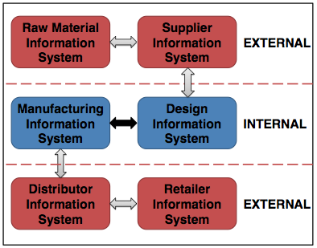
Background: Supply Chain Interaction
Information Flow in Supply Chain

Slide 5
Information Flow in Supply Chain
Globally distributed supply chain processes
Information not confined to a single domain but distributed among and controlled by multiple partners
Outsourcing of shared information by partner organizations
No way to track the information access and usage in external domain (organization has no control over the processes in external domain)
Intermediate steps of information flow might expose information to hostile threats
Unauthorized disclosure and data leakage of information shared among partners across multiple domains
Violations and malicious activities in a trusted domain remain undetected

Slide 6
Impact of Security Threats
Leakage of sensitive information - list of customers, product secrets etc to competitors, malicious entities, government institutions or attackers
  High financial losses
  Damage to the reputation of organization and its partners
  Criminal activities
  Affect on National Security

Slide 7
Challenges for Supply Chain Security
Lack of mechanisms to communicate information owner’s policies to the protection frameworks of the partners
Lack of information sharing standards for protecting data in distributed supply chains
  Custom security requirements and controls applied by partners
  Incompatibility and reduced ability to ensure policy enforcement leaves security gaps
Disparate, evolving and changing Information security standards to satisfy changing business models, regulatory and geographical law requirements

Slide 8
Related Work
Generalized approach to protect shared data
  Secure data e.g. using encryption
  Define Policies for data sharing and usage e.g. access control policies
  Setup Policy enforcement mechanism to enforce policies on data
Classification of available solutions
  Policy Enforcement at the Sender
  Policy Enforcement in the middle
  Policy Enforcement at the Receiver

Slide 9
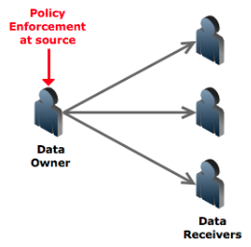
Related Work
Policy enforcement at owner
Traditional approach – uses encryption for protection (interactive protocols) e.g. Servers
A lot of exchange of messages
Source can become bottleneck
Problem if source becomes unavailable
Digibox [5] – uses multiple keys

Slide 10
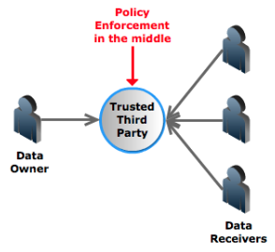
Related Work
Policy enforcement in the middle
Trusted Third Party – e.g. pub/sub
Single point of trust and failure
Information aggregation - caches and stores data
Can sell data to interested parties
Data disclosure during Subpoenas
Prone to hacking attacks and insider abuse
Casassa Mont et al [9] – uses time vault service

Slide 11
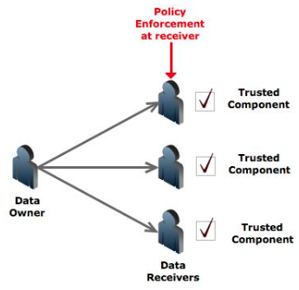
Related Work
Policy enforcement at receiver
Requires a Trusted component
Eg – Digital Rights Management solutions, Document-sharing solutions - Adobe, Microsoft etc
Distribution issues of Trusted component
Restricted to known/trusted hosts
Montero et al [6] – uses sticky policies

Slide 12
Proposed Approach
Existing approaches that rely on the use of standards, service level agreements, and legal contracts are insufficient
Propose an end-to-end approach for protecting shared data in digital supply chains
  Self-protecting data centric approach for policy based controlled data dissemination
  Security auditing of business processes that compose supply chains
  Enables tracking the information flows of shared data
  Detecting malicious interactions and compromised business processes of partners
  Tracks the data flow and actions upon them and enables auditing, detecting and reporting policy violations

Slide 13
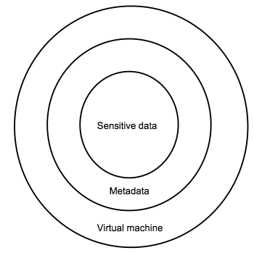
Approach 1: Self-Protecting Data
Active bundle (AB) [12, 13]
    Encapsulation mechanism for protecting data
    Includes metadata for controlled dissemination
    Includes Virtual Machine
      Policy enforcement mechanism
      Protection mechanism
Active Bundle Operations
    Self-Integrity check
    Filtering
      Selective dissemination based on policies
    Apoptosis
      Self-destructs AB completely

Slide 14













AB based on TTP [13]
AB information disclosure
Active Bundle Destination
User Application
Active Bundle
Active Bundle Creator
Active
Bundle (AB)
Security Services
Agent (SSA)
Audit Services
Agent (ASA)
Directory
Facilitator
Trust Evaluation
Agent (TEA)
Active Bundle Coordinator
Active Bundle Services

Slide 15
Enabling AB

Slide 16







AB Updates
  Supply Chain entities in the information flow receive AB and update its information
  Scenario – 1: Send update request to owner
Distributor
Retailer
Sensitive data
Information addition
Sensitive data

Slide 17
Problems with updating an AB
    Advantage
      Simple
      The owner can control every update
    Disadvantage
      The update request may be rejected or partially rejected by the owner
      The new privacy policy for the updated AB is created by the owner which may conflict with the updater’s policy
      The updater may not want the original owner to know the appended data
      The owner may get a lot of requests for updates

Slide 18











AB Update Solution
Nested Structure
An active bundle autonomously grows into a bigger active bundle including both the original active bundle and the appended information with new metadata and virtual machine
$${AB}_{P}$$
$$a, b$$
$$a, b$$
Sensitive data
$$x, y$$
Sensitive data
$${MD}_{P}$$
Appended
information
$${MD}_{P}$$
$${VM}_{P}$$
$${VM}_{P}$$
$${MD}_{D}$$
$${VM}_{D}$$

Slide 19
AB Update Solution
      Advantage
    Any entity with the permission to append information can append and specify the new privacy policy for the appended information
    Existing policies are still effective on the existing data and new policies are only enforced on the appended data and the existing data
    The nested structure of an active bundle naturally represents the history of updates
      Disadvantage
    AB’s size grows linearly with every update
    The new policies may be more restrictive than the original policies which may restrict access to the original data
    Possible Solution: VMs of Nested ABs are redundant. A single common VM can serve all Nested ABs

Slide 20
Improving the AB Implementation
Improve the AB implementation by making it less dependent on TTP
Provide a mechanism for policy based selective dissemination
Use a policy language to define policies
Providing resilience against malicious hosts
Application specific development and experimentation

Slide 21
Improving AB Implementation
Provide selective dissemination
  Organize data in AB into separate items
  Encrypt each item with a different key
Decrease dependence on TTP
  Use Shamir’s threshold secret sharing technique [16] to split each of the decryption keys into N shares
  Set a threshold t such that t shares are required for key reconstruction
  Store the key shares in a distributed hash table (DHT) built on top of P2P system (Vuze) [26]
  Each share is stored at a random node

Slide 22
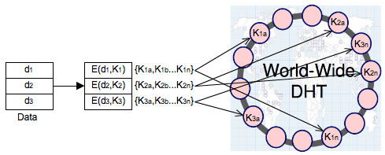
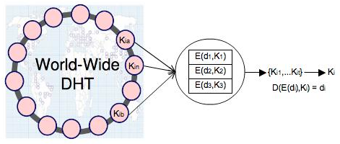
DHT scheme for AB
AB Key distribution
AB Key reconstruction

Slide 23
Advantages of using DHT
Huge scale - millions of geographically distributed nodes
Decentralized – individually owned nodes with no single point of trust
Load reduction and Asynchronous communication – no synchronization issues
Hard to deduce all the shares (atleast t)
Hard to compromise all the nodes that store the shares
Use periodic splitting to protect against dynamic adversaries

Slide 24
Improvement in DHT
DHT loses key shares over time
  Nodes crash or leave
  Need to republish the shares for availability
  Use a hybrid DHT (combination of reliable* DHT and public DHT) [26]
  Split K into K’ and K’’
  Split K’ into n shares and store in reliable DHT
  Split K’’ into n shares and store in public DHT

Slide 25
AB Policies
Extend the AB approach with a formal language for specifying policies
Need efficient policy negotiation mechanism
OASIS eXtensible Access Control Markup Language (XACML) [17]
Role Based Access Control (RBAC) [18]

Slide 26
Protection against Malicious Hosts
Use TPM [7] to ensure that host is not already compromised
Perform code obfuscation – hide data and real program code within a scrambled code
Intertwine code and data together – hide data within the code to make it incomprehensible
Use of polymorphic code [25] – code changes itself each time it runs but its semantics don't change
Can store the control flow information in random DHT nodes

Slide 27
Active Bundles Capabilities
Capabilities
Controlled and Selective Dissemination: Control the dissemination and selectively share the data based on the policies
Quantifiable and Contextual Data Dissemination: Track the amount of data disclosed to a particular host and decide to further disclose or deny data requests
Dynamic Metadata Adjustment: Update the policies based on a context, host, history of interactions, trust level etc.

Slide 28
Active Bundles Advantages
Do not require hosts to have a policy enforcement engine or a trusted component
Doesn’t rely on a dedicated TTP
No trusted destination host assumption – works on unknown hosts
Decentralized Distributed Asynchronous communication

Slide 29
Approach 2: End to End Auditing
Trust Broker
  Trusted third party responsible for maintaining end-to-end auditing in information flow chain
  Maintains a list of certified business processes that use the Taint Analysis Module and ensure their compliance with the required security controls
  Manages end-to-end client/process-invocation session
Taint Analysis
  Low level layer that monitors the interactions of business processes (at runtime)
  Inspects the data exchanges (information flow) and reports policy violations

Slide 30
Trust Broker
Certifies business processes upon certification by an external trusted authority
  Certification assures that the business process allows tracking of information flow and ensures secure messaging
Maintains an end-to-end session of business processes’ interactions
  Collects and audits the activities of the business processes of the collaborating partners
  Logs warnings of illegal interactions and informs the client process about the detected violation

Slide 31
Taint Analysis
Independent of processes
  No need to change the processes or access the source code of processes
  Interception of process execution (Process remains transparent)
  Uses program instrumentation to gain control upon the occurrence of certain events
Two possible deployment options
  Only in Trusted Domains
    Detection of insider attacks
    Detection of compromised processes
    Detection of outbound interactions
  In Public Domains
    Enforcing service composition policies

Slide 32
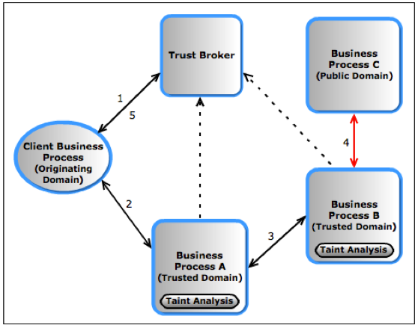
Secure Supply Chain Interaction using the Approach

Slide 33
Information Flow using the Approach
Client Business Process decides sharing information with a Trusted Business Process A and requests a session in the Trust Broker (TB) to keep track of this interaction’s activities for end-to-end information flow
Client Business Process shares information with Trusted Business Process A
Trusted Business Process A uses this information and shares it with Trusted Business Process B. During this exchange, the Taint Analysis (TA) module intercepts the communications and reports any illegal external interaction to the TB
Trusted Business Process B shares data with (possibly untrusted) Public Business Process C. TA detects the interaction and reports the activity to TB
TB informs the Client Business Process about the activity of Trusted Business process B

Slide 34
Capabilities of the Approach
Controlled information sharing
Information flow tracking
Monitoring information usage and detecting illegal sharing
No interference between the security mechanisms and supply chain operations
Scalable and reliable to be used for large supply chains
Reporting unauthorized information usage and disclosure by entities while in transit between the partners

Slide 35
References
R. Shirey, “Internet Security Glossary, Version 2,” The Internet Engineering Task Force (IETF), RFC4949, August 2007. Online at http://tools.ietf.org/html/rfc4949
“iPad Mini Heist: $1.5 Million Stash Of Apple Devices Reportedly Stolen From JFK Airport,” Nov. 2012, online at: http://www.huffingtonpost.com/2012/11/15/ipad-mini-heist-million- stolen-jfk-airport_n_2137799.html
“Hackers attack Foxconn for the laughs,” Feb. 2012, online at: http://www.macworld.com/article/1165298/foxconn_reportedly_hacked _by_group_critical_of_working_conditions.html
H. Livingston, T. Telesco, L. Gardner, R. Loeslein, E. Zelinski, and W. Pumford, “Counterfeit Parts Safeguards and Reporting – U.S. Government and Industry Collaboration to Combat the Threat,” Defense Standardization Journal, pp.9-16, Jan/Mar 2010.
“Verizon 2012 Data Breach Investigations Report,” http://www.verizonbusiness.com/resources/reports/rp_data-breach- investigations-report-2012_en_xg.pdf?CMP=DMC- SMB_Z_ZZ_ZZ_Z_TV_N_Z037
World Economic Forum, “New Models for Addressing Supply Chain and Transport Risk,” 2011.
Insider Threat Center at Cert, “Examining Insider Threat Risk at the US Citizenship and Immigration Services,” Dec. 2010, online at: http://www.dhs.gov/xoig/assets/mgmtrpts/OIG_11-33_Jan11.pdf
N. Browne, M. de Crespigny, J. Reavis, K. Roemer, and R. Samani, “Business Assurance for the 21st Century: Navigating the Information Assurance landscape,” white paper, Information Security Forum, 2011.

Slide 36
References
B. Fabian, and O. Günther, “Security Challenges of the EPCglobal Network,” Communications of the ACM, v.52 n.7, July 2009.
M. Swanson, N. Bartol, and R. Moorthy, “Piloting Supply Chain Risk Management Practices for Federal Information Systems,” Draft NISTIR 7622. NIST, 2010.
M. Atallah, H. Elmongui, V. Deshpande, and L. Schwarz, "Secure supply-chain protocols," in IEEE International Conference on E- Commerce, pp. 293-302, 2003.
R. Ranchal, and B. Bhargava, “Protecting PLM data throughout their lifecycle,” in 9th International Conference on Heterogeneous Networking for Quality, Reliability, Security and Robustness (Qshine), 2013.
M. Azarmi, B. Bhargava, P. Angin, R. Ranchal, N. Ahmed, A. Sinclair, M. Linderman, and L. ben Othmane, “An End-to-End Security Auditing Approach for Service Oriented Architecture,” In 31st IEEE Symposium on Reliable Distributed Systems (SRDS), 2012.
G. Kiczales, J. Lamping, A. Mendhekar, C. Maeda, C. Lopes, J. Loingtier, and J. Irwin, “Aspect-oriented programming,” European Conference on Object-Oriented Programming (ECOOP’97), pp. 220– 242, 1997.
L. Othmane, and L. Lilien, “Protecting Privacy in Sensitive Data Dissemination with Active Bundles,” In The 7th Annual Conference on Privacy, Security and Trust, Saint John, NB, Canada, 2009.
L. ben Othmane, “Active bundles for protecting confidentiality of sensitive data throughout their lifecycle,” Theses, Western Michigan University Kalamazoo, MI, USA, December 2010.

