Slide 1
Application of Active Bundles
Bharat Bhargava

Slide 2
A. Identity Management (IDM) Service-Oriented Architecture (SOA)
IDM in traditional application-centric IDM model
  Each application keeps trace of identities of the entities it uses.
IDM in SOA
  Entities have multiple accounts associated with a single or multiple service providers (SPs).
  Sharing sensitive identity information along with associated attributes of the same entity across services can lead to mapping of the identities to the entity.

Slide 3
Goals of IDM
Authenticate without disclosing data (Unencrypted data)
Use service on untrusted hosts (hosts not owned by user)
Minimal disclosure and minimize risk of disclosure during communication between user and service provider (Man in the Middle, Side Channel and Correlation Attacks)
Independence of Trusted Third Party

Slide 4


Anonymous Identification
  Use of Zero-knowledge proofing for user authentication without disclosing its identifier.
User VM on Amazon Cloud
ZKP Interactive Protocol
User Request for service
Function f and number k
E-mail
Password
f_{k}(E-mail, Password) = R
E-mail
Password
Authenticated R is correct

Slide 5







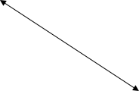


Interaction using Active Bundle
AB information disclosure
Active Bundle Destination
User Application
Active Bundle
Active Bundle Creator
Active
Bundle (AB)
Key Management
Security Services
Agent (SSA)
Trust Evaluation
Agent (TEA)
Active Bundle Services

Slide 6


Predicate over Encrypted Data
  Verification without disclosing unencrypted identity data.
Predicate Request*
E-mail
Password
E(Name)
E(Shipping Address)
E(Billing Address)
E(Credit Card)
E(Name)
E(Billing Address)
E(Credit Card)
  *Credit Card Verification Request

Slide 7
Multi-Party Computation
  To become independent of a trusted third party
    Multiple Services hold shares of the secret key
    Minimize the risk
Predicate Request
E(Name)
E(Billing Address)
E(Credit Card)
K’₁
K’₂
K’₃
K’_{n}
Key Management Services
  * Decryption of information is handled by the Key Management services

Slide 8
Multi-Party Computation
  Credit Card Verified
Predicate Reply*
Name
Billing Address
Credit Card
K’₁
K’₂
K’₃
K’_{n}
Key Management Services

Slide 9

Selective Disclosure
  User Policies in the Active Bundle dictate dissemination
Selective disclosure*
E-mail
Password
E(Name)
E(Shipping Address)
E(Billing Address)
E(Credit Card)
E-mail
E(Name)
E(Shipping Address)
*e-bay shares the encrypted information based on the user policy

Slide 10

Selective Disclosure
Selective disclosure*
E-mail
E(Name)
E(Shipping Address)
E(Name)
E(Shipping Address)
*e-bay seller shares the encrypted information based on the user policy

Slide 11
Selective Disclosure
Selective disclosure
E-mail
E(Name)
E(Shipping Address)
Name
Shipping Address
  Decryption handled by Multi-Party Computing as in the previous slides

Slide 12

Selective Disclosure
Selective disclosure
E-mail
E(Name)
E(Shipping Address)
Name
Shipping Address
  Fed-Ex can now send the package to the user

Slide 13

Identity revealed to Vendors
User on Amazon Cloud
E-mail
Password
Name
Billing Address
Credit Card
Name
E-mail
Password
Billing Address
Shipping Address
Credit Card
E-mail
Name
Shipping Address

Slide 14
Advantage of AB for IDM
Ability to use Identity data on untrusted hosts
  Self Integrity Check against Corruption of AB content
  Compromised AB leads to apoptosis
Establishes the trust of users in Requesters
  Through putting the user in control of who has her data and how it is disseminated
Independent of Third Party
  Minimizes identity correlation attacks
Minimal disclosure to the requester.

Slide 15
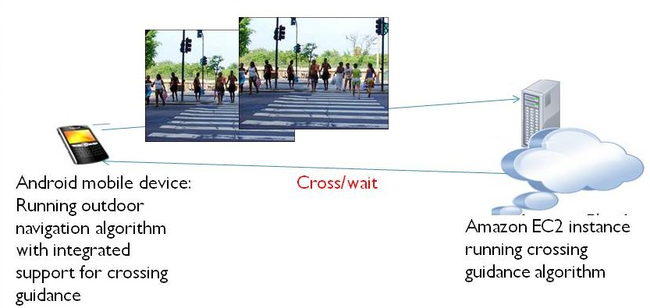
B. Mobile-Cloud Pedestrian Crossing Guide for the Blind
Bundle the image, position, and destination as well as the computation in an active bundle; send the AB to the cloud service
Process the code and return the AB to the mobile
Ensure data are protected; e.g., removed from the cloud when processing finishes.
Notes:
One problem we picked within this domain was helping blind people cross at street intersections. The Mobile-Cloud computing solution we propose for this problem has the simple system architecture we see on this slide. The two main components are the Android device with integrated GPS receiver and compass, and the cloud server, which is responsible for processing the image frames received from the mobile device.
The proposed crossing guidance system works as follows:
The Android Application captures the GPS signal and communicates with the Google Maps Server, to determine the current location of the blind user.
Once the application detects that the blind user is at an urban intersection, it triggers the phone camera to take a picture, and send the picture to the Server running on the Amazon EC2 Cloud.
The server then does the image processing, applying the Pedestrian Signal Detection algorithm, and returns the result about whether it is safe for the blind user to cross the intersection.
If the result is positive, the Android Application notifies the blind user to cross the intersection with speech feedback.

Slide 16
C. A Trust-based Approach for Secure Data Dissemination in a Mobile Peer-to-Peer Network of UAVs
Mobile peer-to-peer networks of unmanned aerial vehicles (UAVs) have become significant in collaborative tasks including military missions and search and rescue operations
Data communication (over shared media) between the nodes in a UAV network makes the disseminated data prone to interception by malicious parties, which could cause serious harm for the designated mission of the network
A scheme for secure dissemination of data between UAV nodes is needed

Slide 17



Proposed Data Protection Scheme
Trust Evaluation Server
Producer
Consumer
Application
Security Server
Filtered Data
Data Protection
Mechanism (Active Bundle)
Identity Management
1.Data producer UAV (publisher) invokes its data sharing application
Middleware
2.The application gets the desired data from the data folder and bundles it along with the policy for data protection in the protection structure proposed (active bundle)
Data Folder
Services provided by
Trusted Third Parties
3.The active bundle consults trusted third party services to determine the trust level of the destination UAV(consumer)
4.The active bundle filters its data based on the trust level of the consumer and the matching of policies between the producer and consumer and presents the filtered data to the consumer.

Slide 18
Dynamic Trust Calculation
The trust calculation component works like a reputation system, where the trustworthiness of a node is evaluated based on various dynamic parameters
Trust parameters vary with the scenario in which the UAVs communicate, and have different weights
Computed trust value is used to determine whether it is safe to share the data and the degree of filtering to apply on the data before sharing
Trust value T for a particular UAV u at time t also depends on previous interactions with that UAV and is calculated using the below formula, where α determines how important previous interactions are and P is the trust value determined by the dynamic parameters
T_{u}(t) = α ∙ T_{u}(t-1) + (1- α) ∙ P

Slide 19
Trust Evaluation
Trust level for the destination UAV (data consumer) can be evaluated and verified by a Trusted Third Party and can be based on different parameters such as:
Location: USA, Middle East, Iraq, etc
Security Clearance Level: Top-secret, Secret, Confidential, Unclassified
Bandwidth: High Bandwidth, Low Bandwidth
History of Obligations: Satisfactory, Unsatisfactory
Distance: Not necessarily based on metric distance, i.e. more trusted entities are closer
Authentication Level: Fully authenticated, Partially authenticated, Not authenticated
Context: Emergency, Disaster, Normal etc.

Slide 20



Example of Data Filtering
EPHI (Electronic Private Health Information):
Stored in a relational database, data filtering for different data consumers performed through SQL queries run in the Active Bundle VM
a. Data consumer verified as doctor at the hospital can get all patient data
b. Hospital Receptionist gets filtered data
c. Insurance company gets only the minimal required data

Slide 21
Image Data Filtering Techniques
Low Dynamic Range Rendering: This method applies the reverse of high dynamic range rendering on an image to degrade image quality and hide details.
Pattern Recognition and Blurring: This method involves recognition of specific patterns in the image to black out those high sensitivity areas.
Data Equivalence Techniques: Image can be transformed such that the information content of the image remains the same while the fine grain details change (such as replacing the model number of an aircraft with another model’s).

Slide 22
Data Dissemination Models
Direct Link: UAVs discover each other through broadcast of ALIVE messages and initiate data transfer without involvement of third-party nodes.
Publish-Subscribe: This model requires a third-party (ground controller) called the information broker (IB) to mediate data dissemination between UAVs. The publisher node registers an active bundle with the IB and subscriber receives data from IB after evaluation of its trustworthiness by the IB.

Slide 23
Simulation
Fig.a. UAV Network. Data transfer is initiated from UAV₃ to UAV_{1.} Available bandwidths are displayed on the lines connecting pairs of AVs.
Fig.b. Policy of data sharing is at the top, original data in the middle and the virtual machine status at the bottom. Policy is based on the trust level of the AV: If above 2.5, original data is shared; if below 2.5 but above 2.3, minimal filtering is applied; if between 2.3 and 2.0 greater filtering is applied and if below the threshold of 2.0, no data is shared, in which case the active bundle destroys itself.

Slide 24
Simulation (cont.)
Fig.c. The trust level of the receiver AV is calculated as 2.09, which is higher than the threshold trust level, but not high enough to share the original data.
Fig.d. Data transformed by the virtual machine according to the policy and the transformed data shared with the receiver node. The data shared provides a narrower view of the environment than the original image.

Slide 25
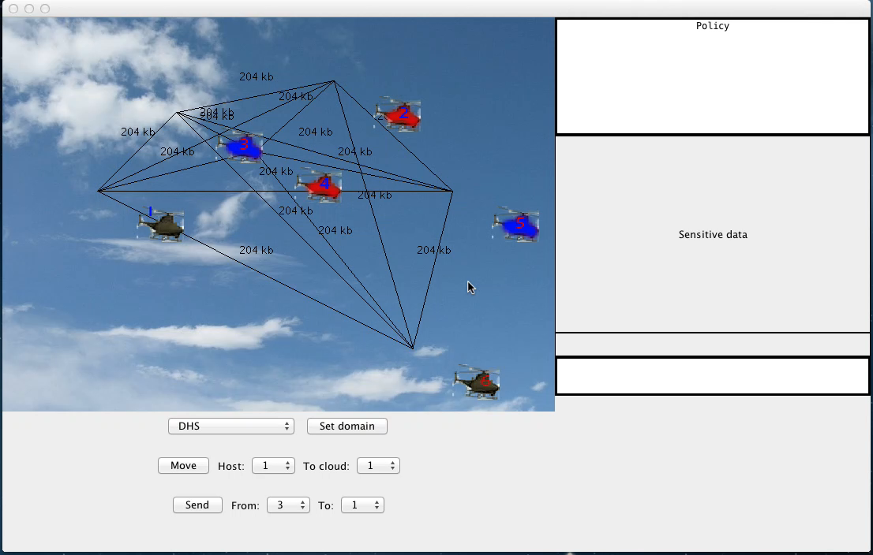
Simulation

