Slide 1



IUCRC New Site Planning Grant
Purdue University
Net-Centric Software and
Systems Research Center
Joining Existing NSFcenters at Univ. of North Texas, Arizona State, and Missouri Institute of Science and Technology

Slide 2
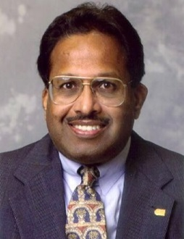
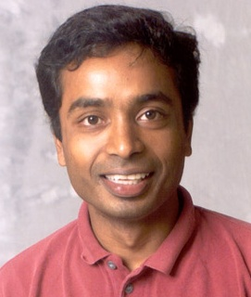


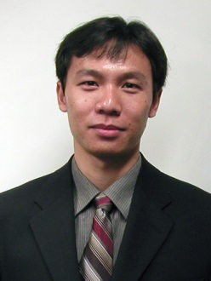
Industry and Purdue and NSF
BharatBhargava (PI) | Security | bb@cs.purdue.edu
Ananth Grama | Distributed Systems | ayg@cs.purdue.edu
Suresh Jagannathan | Distributed Systems | suresh@cs.purdue.edu
Yung-Hsiang Lu | Embedded and Mobile Systems | yunglu@purdue.edu
Xiangyu Zhang | Security | xyzhang@cs.purdue.edu

Slide 3
Projects
Attribution in Cyberspace through calling context encoding (Zhang)
Data-centric programming beyond data parallelism (Grama and Jagannathan)
Data sharing and dissemination security (Bhargava)
Energy management for mobile systems (Lu)
Reliable distributed storage (Grama and Jagannathan)
Secure mobile and cloud computing (Bhargava and Lu)
Security auditing in service oriented architecture (Bhargava and Zhang)

Slide 4
Need Industry support
Planning grant funded by NSF ( $14,000) Allows us to visit and organize a workshop with industry.
We seek your support to obtain total of $150K from industry combined to allow us to submit full proposal to NSF.
NSF will match $60K per year
http://www.nsf.gov/eng/iip/iucrc/
http://www.nsf.gov/eng/iip/iucrc/sample_agreement_form.jsp
Research Projects will be selected by You
Will Organize a workshop one day before corporate partner’s meeting in Fall 2013 to present projects in detail ( NSF and directors of affiliated centers and you will be invited to attend).

Slide 5
About the Industry/University Cooperative Research (I/UCRC) Program From NSF web site
About the I/UCRC Program - partnerships, structure, how the program works. Each center is established to conduct research that is of interest to both the industry and the university with which it is involved, with the provision that the industry must provide major support to the center at all times. The centers rely primarily on the involvement of graduate students in their research projects, thus developing students who are knowledgeable in industrially relevant research.
Position Statement
To industry, government, and other organizations with research needs; the NSF I/UCRC program provides the means to leverage research and development (R&D) investments with multi-university centers renown for their innovative research capabilities.
To colleges and universities with research capabilities; the NSF I/UCRC program provides opportunities to partner with other leading institutions to conduct industrially relevant research, receive seed funding and recognition as a National Science Foundation (NSF) research center with access to professional resources and guidance aimed towards enhancing global competitiveness.

Slide 6
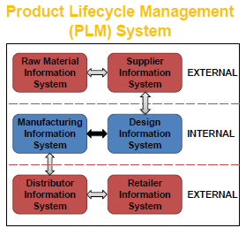
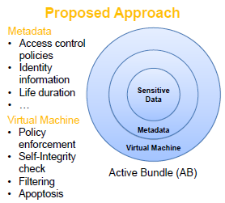
1. Secure Information Sharing and Access Control in Supply-Chain

Slide 7
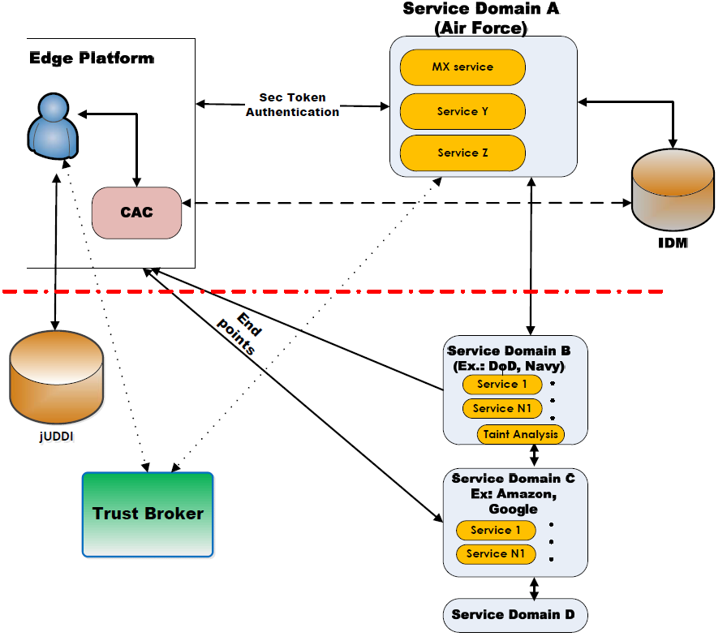
2. An End-to-End Security Auditing Approach for Service Oriented Architectures

Slide 8
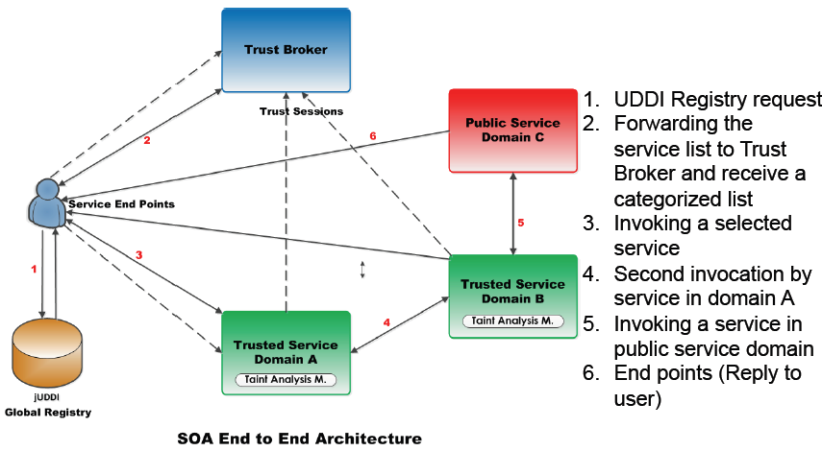
SOA End to End Security

Slide 9
3. Active Bundle for Protecting Sensitive Data
Controlled and Selective Dissemination: Control the dissemination and selectively share the
Quantifiable and Contextual Data Dissemination: Track the amount of data disclosed to a particular host and decide to further disclose or deny data requests
Dynamic Metadata Adjustment: Update the policies based on a context, host, history of interactions, trust ...
Do not require hosts to have a policy enforcement engine or a trusted component
No trusted destination host assumption – works on unknown hosts
Decentralized Distributed Asynchronous communication

Slide 10
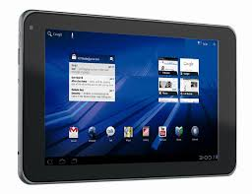
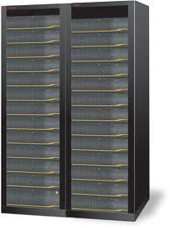
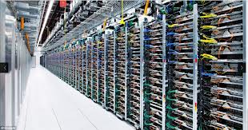
4. Mobile Intelligence using Cloud Computing
3. analyze data
make intelligent decisions
1. mobile systems
acquire information
4. retrieve additional
information + perform
massive computation
using cloud servers
2. send to server
5. send results
6. user feedback
to continuous improvement
of computation results

Slide 11
Software Architecture
(A General Approach for Mobile Intelligence)
Why is this approach different?
It is general to any type of mobile intelligence
that requires heavy computation
Mobile System
User Interface and Feedback
Information Clusters
Offloader
Profiler
Program | Network | Data | ...
Run-Time System
Server
Information Clusters
Analysis Algorithms
Mobile Interface | Cloud Interface
Graphics Processor
Multicore Processor

Slide 12
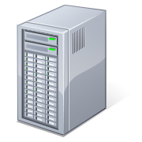
5. Secure and Adaptable Mobile-Cloud
Trusted server
Untrusted server
Cloud computing outsources services.
What cloud services can be trusted?
What information would be exchanged?
How to detect malicious servers?
What is the cost of protection?
Internet
(untrusted communication)
Trusted Parties
Untrusted Parties

