Slide 1

Toward an End-to-end Anomaly Discovery System
Lei Cao
Data Systems and AI Lab (DSAIL)
MIT CSAIL
Notes:
Hello, welcome to my talk. I am Lei Cao, a postdoc at MIT CSAIL. I work with Professor Sam Madden and Professor Mike Stonebraker. The tile of my talk is toward an end-to-end anomaly discovery system.

Slide 2
What is an Anomaly?
Anomaly: an object that does not conform to the expected behavior
Credit card fraud detection
Massachusetts
Unusual location
California
Credit card transaction

Slide 3






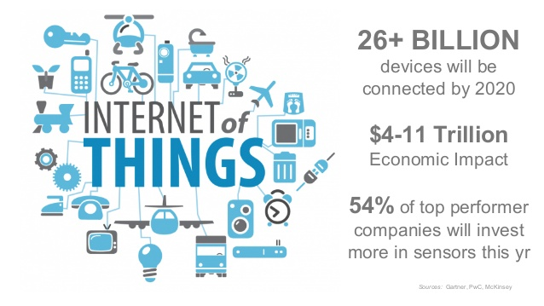

Objective: an Effective Anomaly Discovery System
Philips lighting
Brain diseases
Device failures
Spoofing
Anomaly discovery system

Slide 4
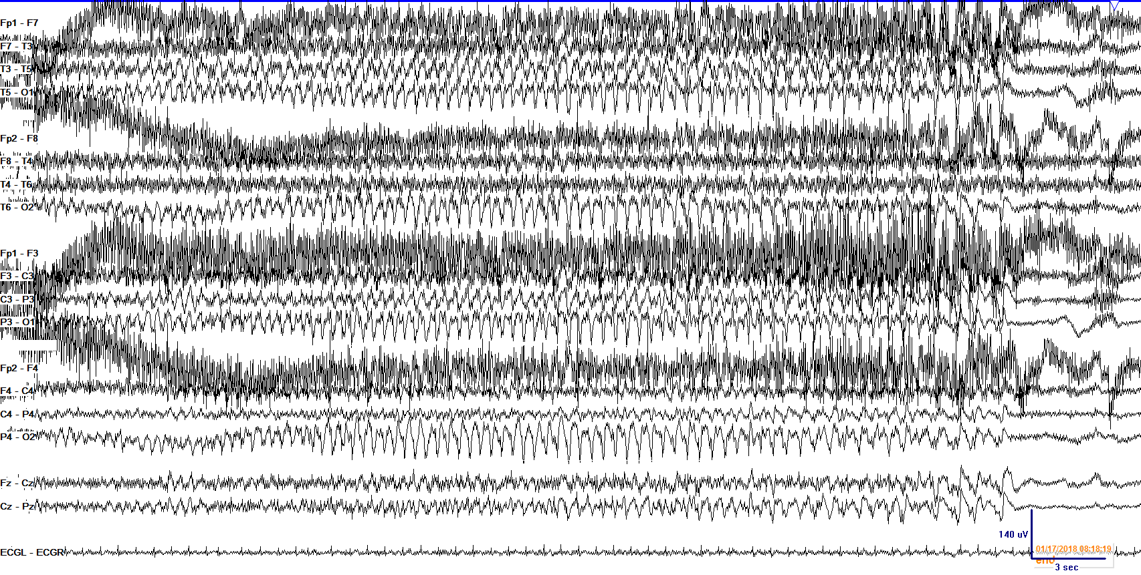


MGH Project: Automatic Seizure Detection
EEG
data
Dr. Brandon Westover
Seizure pattern (short duration)
Automatic detection in real time
[1] L. Cao, et al. Smile: A System to Support Machine Learning on EEG Data at Scale, PVLDB’19

Slide 5
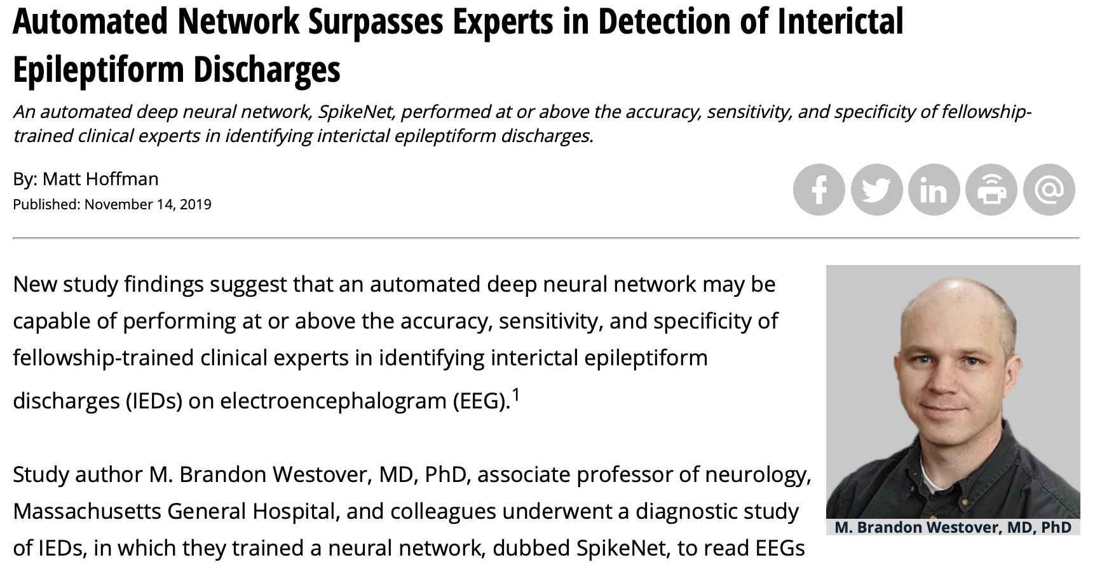

Initial Success

Slide 6
Effective Anomaly Detection is Necessary for Labeling Seizures
Massive Training Data
(Large number of
seizure labels)
450M EEG segments
Labeled seizures
Normal pattern
Doctors
Seizure pattern
Training
Seizure patterns
(anomalies)
Accurate yet robust
deep learning model
Anomaly detection

Slide 7
Anomaly Detection Desiderata
Interactivity
Scalability
Ideal System
Automatability

Slide 8
Scalability: My Previous Research
  30+ TB
  450M EEG segments
  The largest EEG dataset in the world
Big data problem
  5+ TB
  Billions of users

Slide 9
Automatability : Tuning Free Anomaly Detection
Doctors and their teams
Input data
Results
Technically
Novice
Users
Anomaly detection
system
Anomaly detection
techniques
Default Config

Slide 10
Challenge for Automatability: Method Selection
An evaluation of the most popular anomaly detection methods on benchmark datasets
No method outperforms the others in all cases
[2] L. Cao, et al. Tuning free anomaly detection, In submission
[3] G.Campos, et al. On the Evaluation of Unsupervised Outlier Detection: Measures, Datasets, and an Empirical Study, Data Min. Knowl. Discov.’16

Slide 11




Challenge for Automatability: Parameter Tuning
Distance-based outliers^{[3]}
The distance to the kth nearest neighbor is larger than a distance threshold r
Two parameters: k and r
$$p_{2}$$
r
kNN-Dist($p_{2}$) > r
Tuning parameter r
r’’
r’
Small
More outliers, low precision
$$p_{1}$$
r
Large
Fewer outliers, high precision
kNN-Dist($p_{1}$) > r
kth NN
[4] S. Ramaswamy, et al. Efficient Algorithms for Mining Outliers From Large Data Sets , SIGMOD’00

Slide 12
Summary of Challenges & Contributions
Challenges
Contributions
How to avoid manual
selection of detection method and parameters?
First approach for tuning-free anomaly detection
More accurate than any individual detection algorithm with ideal parameters
AutoAD
[In Sub.]

Slide 13

Interactivity: Human in the Loop
Feedback on some detected anomaly patterns
Some examples of seizure patterns
Domain related
Domain experts
Evaluation
AutoAD
Detection results

Slide 14

Challenge for Interactivity: How to Leverage Domain Related Input?
Domain related Input
Users
Not sufficient
Supervised methods
Labeled data (small)
Unsupervised methods
Not usable

Slide 15
Summary of Challenges & Contributions
Challenges
Solutions
How to avoid manual
selection of detection method and parameters?
First approach for tuning free anomaly detection
More accurate than any individual detection algorithm with ideal parameters
AutoAD
[In Sub.]
How to leverage a small amount of domain related input to improve the quality of anomaly detection?
First approach to continuously adapt data representation and index with near real time responsiveness
60 percent improvement in the accuracy of anomaly detection
OASIS
[SIGMOD’20]

Slide 16


Interactivity: Evaluate Large Result Sets
Summarization
& interpretation
Detection results
(big)
Challenge: diversity of anomalies
Cluster 1
Group 1
Group 2
Cluster X
Cluster 2
Group 3
Cluster 3
Easier
Faster
How to summarize anomalies?
Different patients show different seizure patterns
Take the human forever to evaluate
Notes:
.

Slide 17
Summary of Challenges & Contributions
Challenges
Solutions
How to avoid manual
selection of detection method and parameters?
First approach for tuning free anomaly detection
More accurate than any individual detection algorithm with ideal parameters
AutoAD
[In Sub.]
How to leverage a small amount of domain related input to improve the quality of anomaly detection?
First approach to continuously adapt data representation and index with near real time responsiveness
60 percent improvement in the accuracy of anomaly detection
OASIS
[SIGMOD’20]
How to summarize and interpret large anomaly detection results?
First approach for summarizing the anomalies with human interpretable rules
One rule covers hundreds of objects; largely reduce human evaluation effort
HOD
[SIGMOD’20]

Slide 18
Integrated Anomaly Discovery Solution
Domain related input
OASIS
[SIGMOD’20]
Detection
Results
AutoAD
HOD
Representation & index
[In submission]
[SIGMOD’20]
Input data
Summarization &
interpretation
Distributed Platform
Philips lighting

Slide 19
Overview
Previous work
OASIS
Interactivity
Scalability
Our Solution
HOD
Automatability
AutoAD
Notes:
Step by step these approaches eventually get us an anomaly discovery solution with strong scalability, automatablity, and interactivity

Slide 20
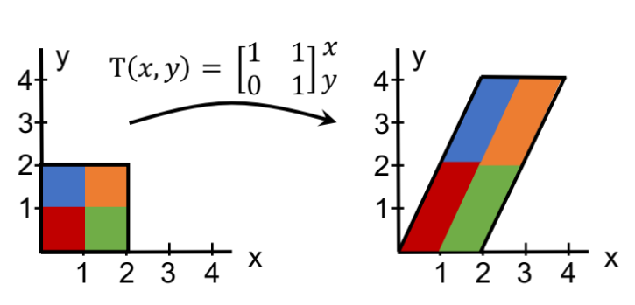
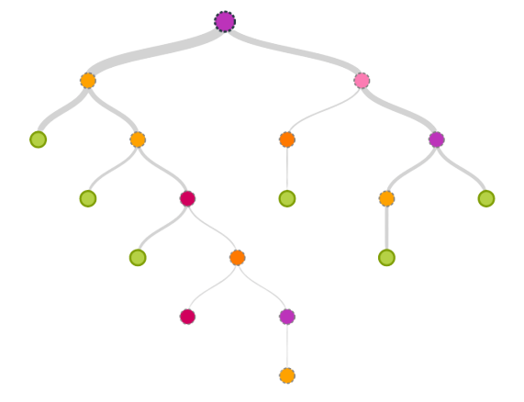

Toward an end-to-end Anomaly Discovery System
AutoAD
Tuning free anomaly detection
OASIS
Effectively leverage domain related input
HOD
Anomaly summarization & interpretation
AutoAD
Cao, et al. In submission
Cao, et al. SIGMOD’20
Cao, et al. SIGMOD’20
Notes:
In the rest of this talk, I will present the AutoAD and OASIS. Due to time constraint, I won’t cover HOD. Finally, I will briefly describe plans for future work.

Slide 21

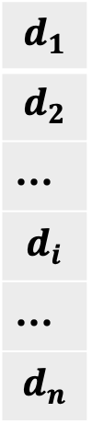








A Naive Approach: Ensemble
$${setting}_{1}^{1}$$
$$p$$
$${setting}_{1}^{2}$$
$$d_{1}$$
$$d_{2}$$
…
$$d_{i}$$
…
$$d_{n}$$
yes
no
…
yes
…
yes
$$M_{1}$$
$$⋯$$
…
…
yes
Majority vote
$$M_{t}$$
$${setting}_{t}^{1}$$
Detection methods
$${setting}_{t}^{2}$$
Detectors
$$⋯$$
Parameter settings

Slide 22
Ensemble Performance is Poor
55 percentage
points lower
Small
Large
Settings: 152 detectors
Datasets: 10 benchmark datasets (with ground truth)
Method: Best detector: found by an oracle
[2] L. Cao, et al. Tuning free anomaly detection, In submission

Slide 23
Why Do Ensembles Not Work?
Recall
Good
Bad
detector
Precision
The accuracies of most detectors are low; many of them agree with each other

Slide 24
AutoAD: Better Than the Best Detector
40 percentage
points higher
55 percentage
points lower
Small
Large
The best detector is found by an oracle who knows the ground truth beforehand
In reality it is impossible to find by human

Slide 25

AutoAD: Tuning Free Anomaly Detection
Label independent
Detection
results
High quality labels
Unsupervised anomaly detection
Supervised classification techniques
AutoAD
Highly Accurate
Insight: unify the merits of unsupervised anomaly detection and supervised classification

Slide 26

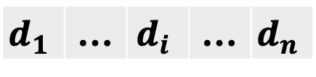
The AutoAD Approach
Unsupervised detectors
Uncertain labels
Classifier
$$d_{1}$$ | … | $$d_{i}$$ | … | $$d_{n}$$
Testing data
AutoAD
Reliable labels
Training data
Classification
technique
Input data
Detection results
Initial: small but reliable
Initial: large but noisy
Augmentation-
based method
Cleaning-based method
Augmentation
Cleaning

Slide 27


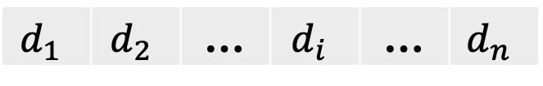
Augmentation-based Method
Detectors
Discover
reliable results
Prune
poor detectors
$$d_{1}$$ | $$d_{2}$$ | … | $$d_{i}$$ | … | $$d_{n}$$
Input data
Classification model
All agree
Stable outlier
yes | $$\text{yes}$$ | … | yes | … | yes
Stable inlier
no | no | … | no | … | no
Training data
Stable outlier
Unsure result
yes | $$\text{yes}$$ | … | no | … | yes

Slide 28


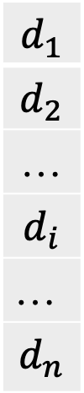



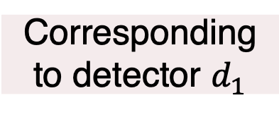
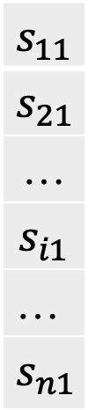
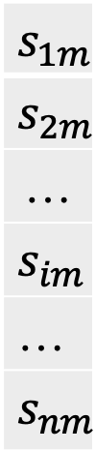



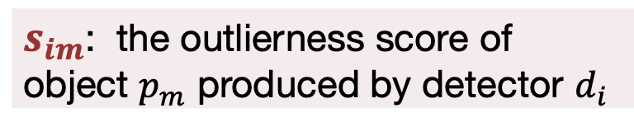


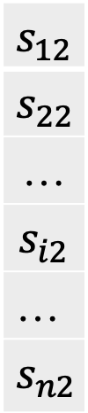




Prune Poor Detectors
Objects
$$p_{1}$$
$$p_{2}$$
…
$$p_{m}$$
$$f(x)$$
$$d_{1}$$
$$d_{2}$$
…
$$d_{i}$$
…
$$d_{n}$$
$$s_{11}$$
$$s_{21}$$
…
$$s_{i1}$$
…
$$s_{n1}$$
$$s_{12}$$
$$s_{22}$$
…
$$s_{i2}$$
…
$$s_{n2}$$
$$s_{1m}$$
$$s_{2m}$$
…
$$s_{im}$$
…
$$s_{nm}$$
$$w_{1}x_{1}$$
Corresponding to detector $d_{1}$
$$+$$
$$w_{2}x_{2}$$
Training
$$+$$
…
…
$$+$$
$$w_{i}x_{i}$$
$$+$$
Small $w_{i}$
…
$$+$$
$$w_{n}x_{n}$$
Detectors
Outlierness scores
Logistic
regression
$s_{im}$: the outlierness score of object $p_{m}$ produced by detector $d_{i}$

Slide 29
Effectiveness of AutoAD: Comparing Against State-of-the-art
95 percentage
points high
Settings: 152 detectors; AutoAD applies the default config to all datasets
Datasets: 10 benchmark datasets (with ground truth)
Method: Snorkel: weighting the detectors based on the agreement rate
[5] A. Ratner, et al. Snorkel: Rapid Training Data Creation with Weak Supervision, PVLDB’17
[6] A. Ratner, et al. Training Complex Models with Multi-Task Weak Supervision, AAAI’19
29

Slide 30
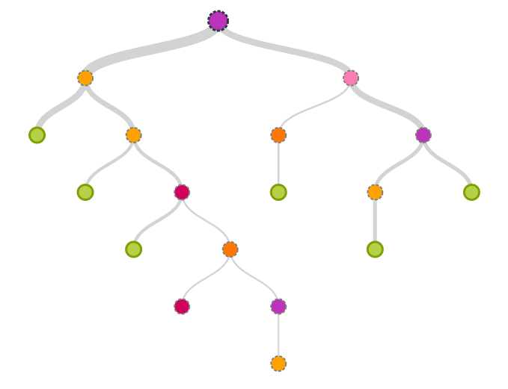
Toward an End-to-end Anomaly Discovery System
AutoAD
Tuning free anomaly detection
OASIS
Effectively leverage domain related input
HOD
Anomaly summarization & interpretation
AutoAD
Cao, et al. In submission
Cao, et al. SIGMOD’20
Cao, et al. SIGMOD’20
Notes:
Next, I will present OASIS that effectively leverages domain related input to …

Slide 31
OASIS: Learn a Good Representation
Not sufficient
Supervised methods
Domain related
Input
Labeled data (small)
Unsupervised methods
Not usable
Representation learning
A representation that makes anomaly detection easier

Slide 32


Anomaly Detection: Distance Matters
User provided
outliers
Small kNN distance
Large kNN-Dist($o_{1}$)
$$o_{1}$$
Outlier
[4] S. Ramaswamy, et al. Efficient Algorithms for Mining Outliers From Large Data Sets , SIGMOD’00
[7] M. Breunig, et al. LOF: Identifying Density-Based Local Outliers, SIGMOD’00

Slide 33


A Better Representation
Original space
New space
$$p_{i}$$
$$p_{i}$$
Inlier neighbors
Local neighborhood
Inlier
Outlier
Notes:
The idea here is that if we can learn a new representation of the data that makes sure the outliers are far away from their neighbors and the inliers are close to their neighbors, it will greatly improve the accuracy of anomaly detection.

Slide 34


OASIS: Anomaly Detection on Learned Representations
Detector 1
Detector 2
Detector n
$$⋯$$
Neighbor search
Index
Efficiency
Learned representation
Effectiveness
Representation & indexing
Detector agnostic: no change to the detectors

Slide 35




Challenge: New Labels Continuously Arrive
New examples
Anomaly detection
system
User
Update representation
$$R_{t}$$
$$R_{t+1}$$
Update Index
$${IDX}_{t}$$
$${IDX}_{t+1}$$

Slide 36



OASIS: Continuous Adaptive Similarity Search
New examples
Update representation
Update
index
User
Index
Naïve solution
Re-compute representation
Re-build index
Time complexity
Typically $O(n^{2})$
At least $O(n)$
Too expensive
Continuous learning
Incremental Update
OASIS
Time complexity
$$O\left(d^{2}\right)$$
Sub-linear
Near real time

Slide 37
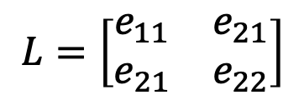


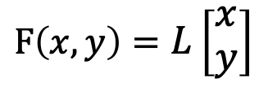

Learning the Representation: Distance Metric Learning
y
$$F\left(x,y\right)=L\left[\begin{matrix}x \\ y\end{matrix}\right]$$
$$y^{′}$$
4
4
Distance metric learning
3
3
2
2
1
$$L=\left[\begin{matrix}e_{11} & e_{21} \\ e_{21} & e_{22}\end{matrix}\right]$$
1
1
2
3
4
x
$$x^{′}$$
1
2
3
4
Original space
New space
Learning
Process
$$L$$
Widely used in the literature
[8] K. Weinberger, et al. Distance Metric Learning for Large Margin Nearest Neighbor Classification, JLMR’09
[9] P. Jain, et al. Online Metric Learning and Fast Similarity Search, NIPS’08

Slide 38




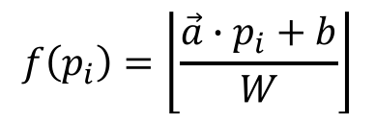








Index: Locality Sensitive Hashing (LSH)
Hash function
Query object
q
$$f\left(p_{i}\right)=\left\lfloor \frac{\vec{a}∙p_{i}+b}{W}\right\rfloor$$
$$B_{0}$$
$$B_{1}$$
$$B_{2}$$
$$B_{3}$$
Dataset
$$p_{i}$$
Amenable to update
$$\vec{a}$$
$$B_{0}$$
$$B_{1}$$
$$B_{2}$$
Scalable to big data
$$W$$
$$2W$$
$$3W$$
Normal distribution
[10] M. Datar, et al. Locality-sensitive Hashing Scheme Based on P-stable Distributions , SOCG’04

Slide 39
OASIS Overview
New example
Transform matrix L
Continuous distance metric learning
Locality sensitive hashing update
User
Updated index
Discuss in more detail
An example of new DB problems introduced by machine learning

Slide 40

LSH Update Strategy in OASIS
LSH Update
Invariance
property
Have to update?
Do not have to update LSH in most cases
Transform matrix $L_{t}$
Yes
Incremental
update
Only rehash the objects that most likely would move to different buckets
Update strategy
Notes:
t.

Slide 41





Invariance Property
Locality
preserving
New space
$$p_{i}′=L_{t}p_{i}$$
Old LSH
0
$${eg}_{i}$$
$$α$$
$$β$$
x
Reason：
The transformation is not too skewed to avoid overfitting the examples
$${eg}_{i}\text{: }\text{eigenvalue} \text{of} M={L_{t}}^{T}L_{t}$$
Condition
Do not have to update in most cases
[11] L. Cao, et al. Continuously Adaptive Similarity Search, SIGMOD’20

Slide 42



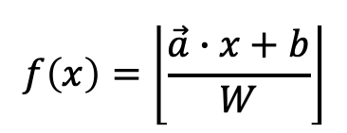

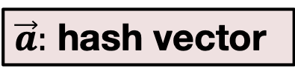




LSH Update Strategy: Inner Product Similarity Search
Key insight:
the object most likely to move to a different bucket can be found via inner product similarity search
$$p_{i}$$
$$f\left(x\right)=\left\lfloor \frac{\vec{a}∙x+b}{W}\right\rfloor$$
Large inner product similarity with q
$$p_{i}^{′}$$
Old location ($L_{t}$)
New location ($L_{t+1}$)
Moving to a different bucket with high probability
$$p_{i}$$
$$q$$
$$q=\vec{a}L_{delta}$$
Inner product
$\vec{a}:$ hash vector
$$L_{delta}=L_{t+1}−L_{t}$$
Only rehash the objects that most likely would move to different buckets

Slide 43
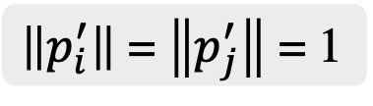

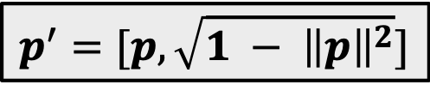










Efficient Inner Product Similarity Search
Inner product similarity
$$p_{i}$$
$$p_{j}$$
$${p_{j}}^{′}$$
$$inner(q,p)=\left\|q\right\|\left\|p\right\|cos{θ}$$
$${p_{i}}^{′}$$
Cosine similarity
$$q^{′}$$
$$q$$
Cosine similarity-based LSH^{[12]}
Data
augmentation
$$p$$
$$p^{′}=[p,\sqrt{1 − {\left\|p\right\|}^{2}}]$$
$\left\|p_{i}^{′}\right\|$ = $\left\|p_{j}^{′}\right\|$ = 1
$$q$$
$$q^{′}=[q, 0]$$
$$inner\left(q^{′},p^{′}\right)=inner\left(q,p \right)$$
Leverage popular Cosine similarity-based LSH to support inner product similarity search
[12] A. Andoni, et al. Practical and Optimal LSH for Angular Distance, NIPS’15

Slide 44
Experiments: Continuous Distance Metric Learning
60 percentage points higher in accuracy
3 to 4 orders of magnitude faster
Dataset: Benchmark data (KDD99; network intrusion)
Metric: CPU time, F1 score (accuracy)
[9] P. Jain, et al. Online Metric Learning and Fast Similarity Search, NIPS’08

Slide 45
Experiments: LSH Update
Real data
Synthetic data
4 to 5 orders of magnitude faster
Similar accuracy to rebuilding LSH
Datasets: Real data, large synthetic data; Metric: CPU time, accuracy; Setting:100 queries, 100 matrix update

Slide 46
Future Work: Overall Scope
Make machine learning scalable and easy to tune for users
Systems for machine learning
Data Systems
Machine Learning
Machine learning for systems
Leverage machine learning to improve the quality and automation of the data systems
Notes:
Next, my future work. I will continue to work at the intersection of data systems and machine learning. I plan to investigate ideas around both. That is, I will build systems to make machine learning scalable and easy to tune for users; and I will leverage machine learning to improve the quality and automation of data systems.

Slide 47
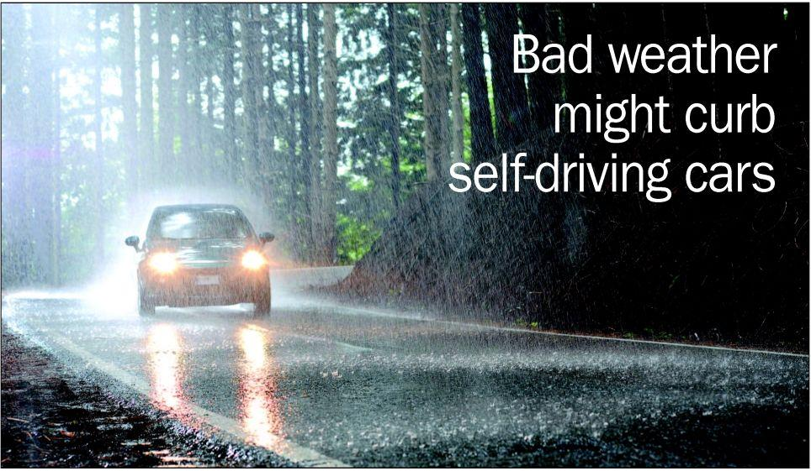


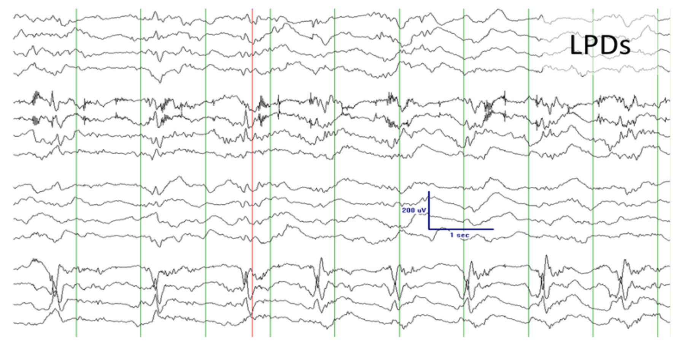
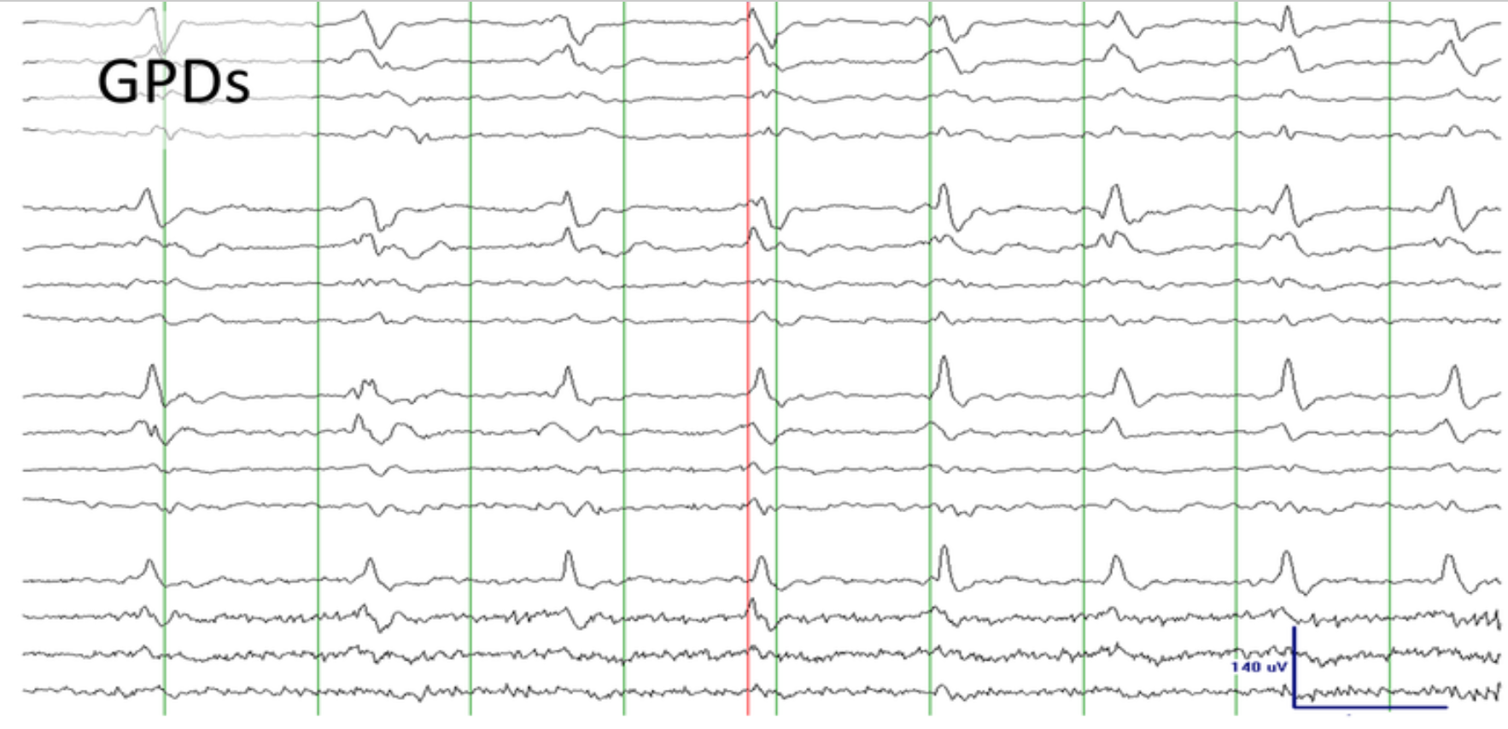

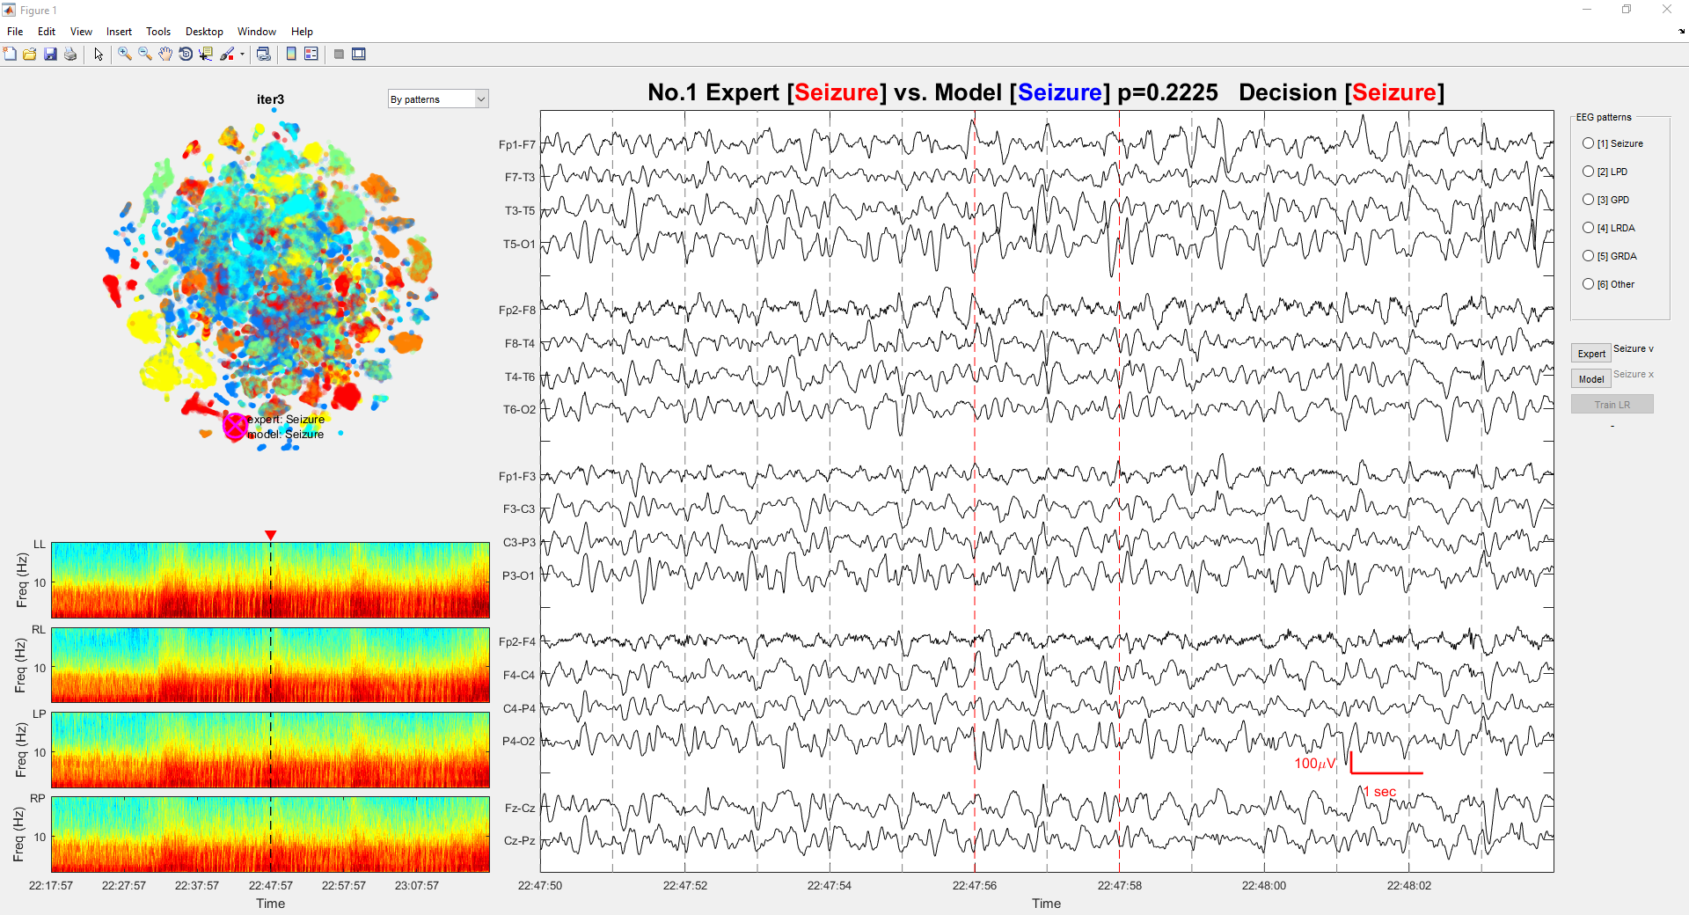
Systems for ML: Labeling Complex Data at Scale
Millions of labels
…
Active learning
Challenges
Data
preparation
The same class?
Viz system
Make this process scalable and automatic
Challenges
ML modeling
Class 1
Class 3
Feature embedding
Distance function
Similarity threshold
Class 2
Class 4
An end-to-end data science
platform for effective labeling
Automatic label generation
Produce sufficient labels with minimal human efforts

Slide 48


ML for Systems: Distributed OLTP
Machine Learning
Satisfy the latency and throughput requirements with minimal labor costs and computing resources
Virtual DBA
App.
Data partitioning
Scheduling
Concurrency control
Workload
Record
x
Y
Low conflict
rate
High conflict
rate
Conflicts
Transaction
Transactions
$$T_{A}$$
$$T_{B}$$
Optimistic
Pessimistic
Continuously automatic tuning

Slide 49

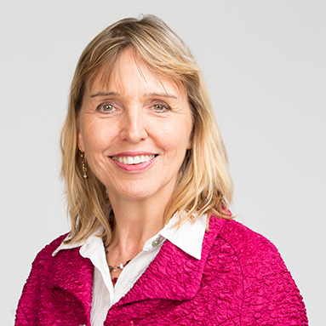

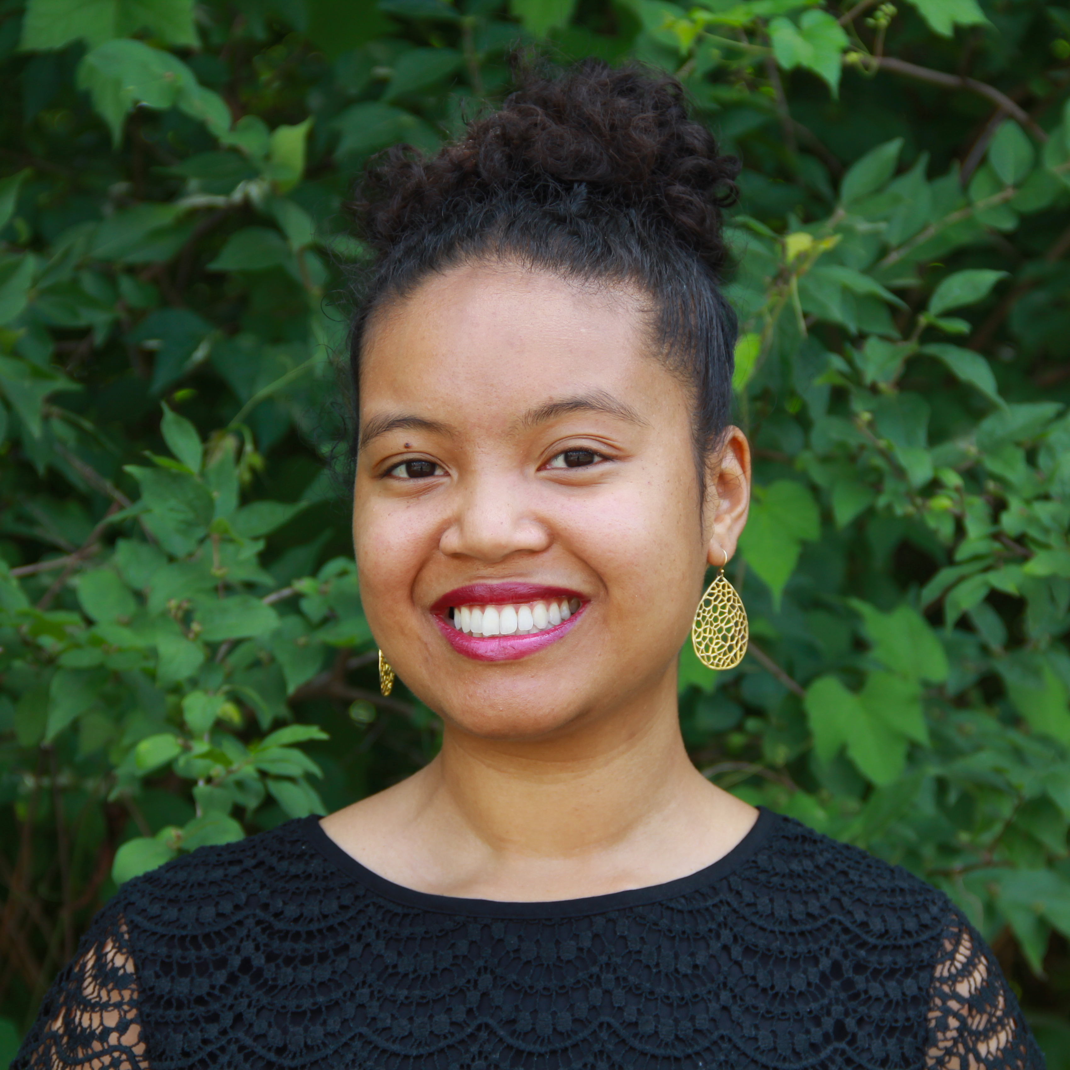

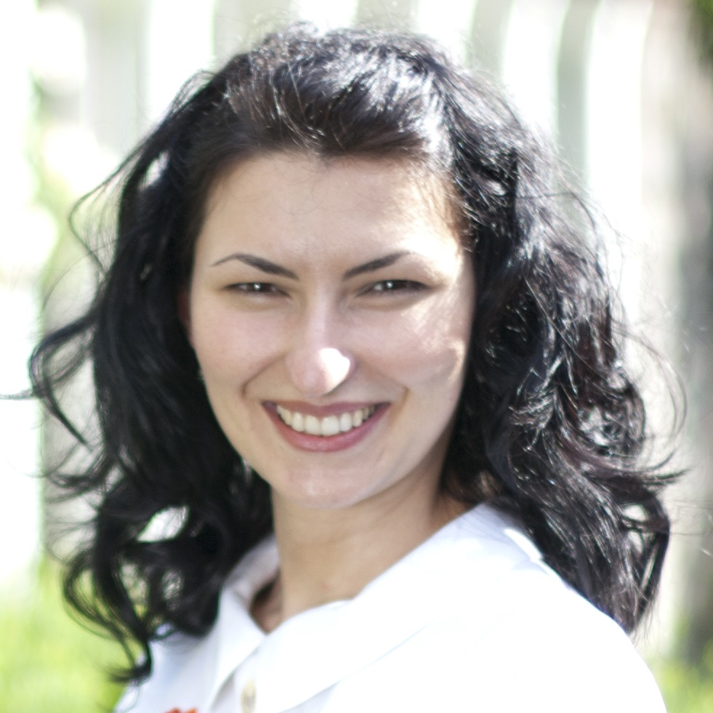


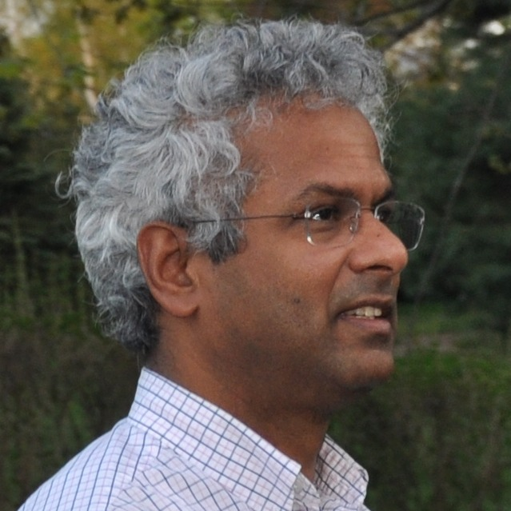




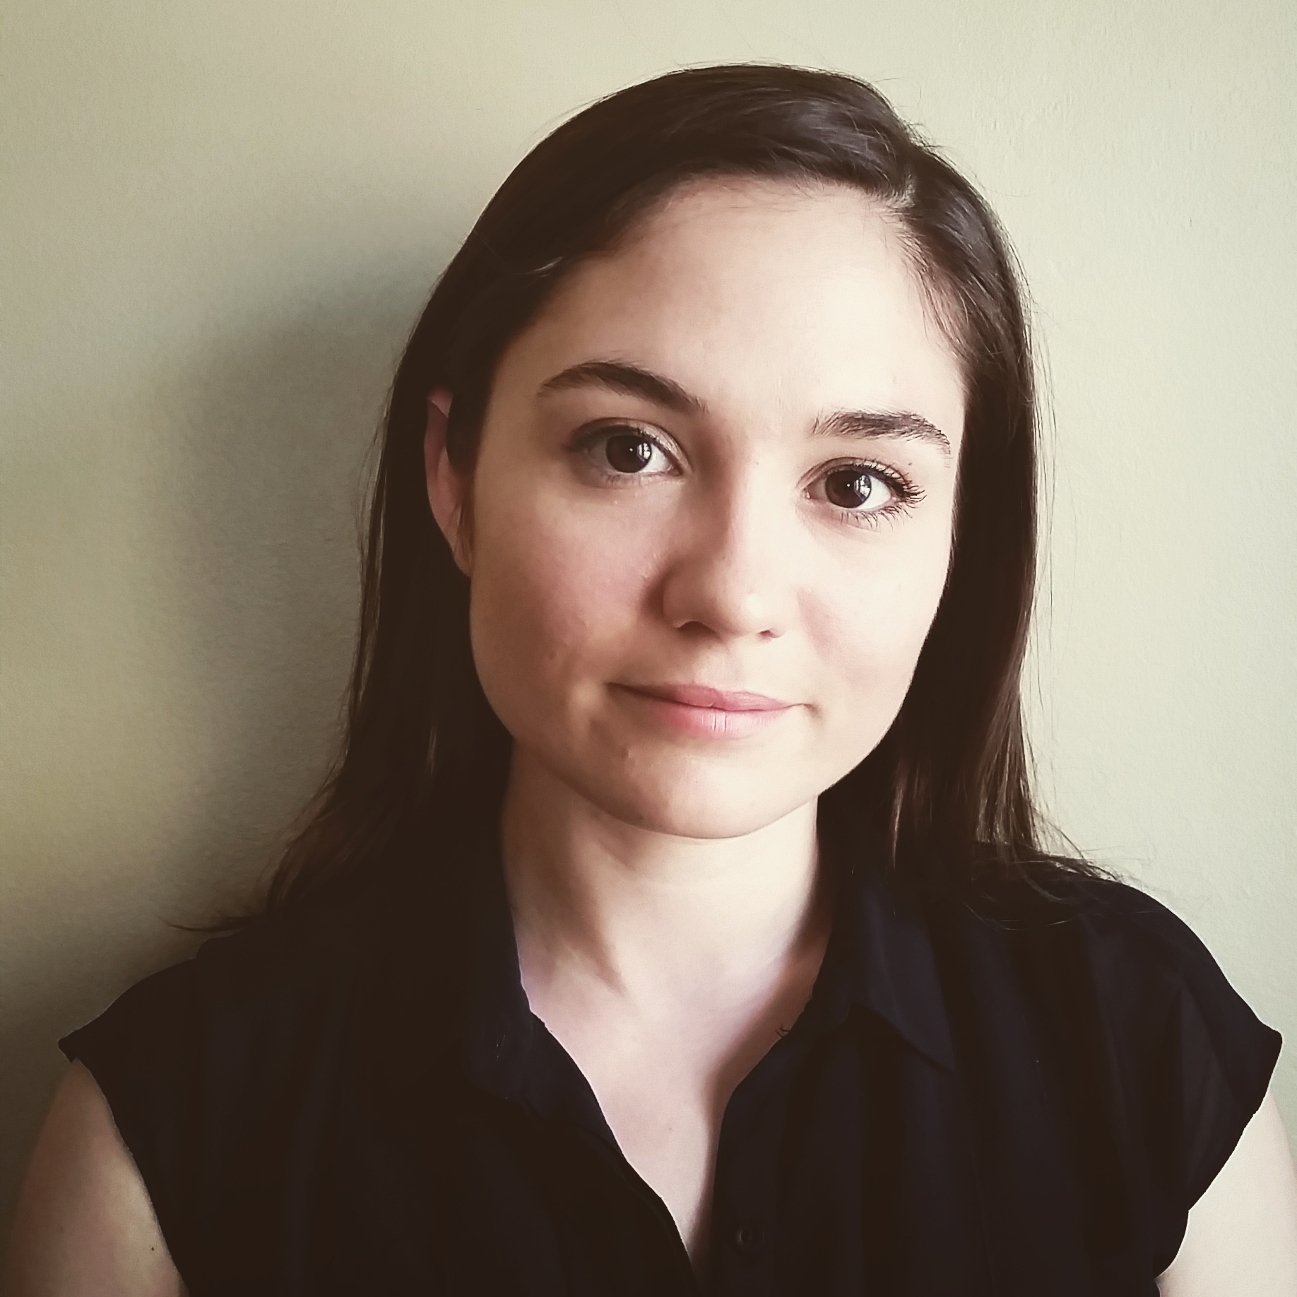
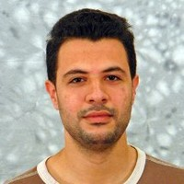
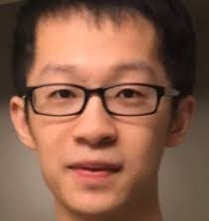

Acknowledgements
Thanks to collaborators from MIT, WPI, WISC, UMD, UIUC, UMICH, TUFTS, THU, IBM, MGH, QCRI, FACEBOOK, Google, MS
Notes:
Finally, I would like to thank many of my collaborators at different universities and research institutes. The first row is the faculties I have worked with. The second row is the my collaborators from industry. The third row is the Postdoc, PhD, master, and undergraduate students I have worked with.

Slide 50

Core DB optimization
Query optimization
Distributed OLTP
Multi-query [SIGMOD’16]
CMR [VLDB’14]
A-Seq [SIGMOD’14]
Aria [In Revision]
COCO [Under sub.]
Data preparation
Data cleaning
& integration
Autotuning
Smile [VLDB’19]
Civilizer 2.0 [VLDB’19]
Dagger [CIDR’20]
Kiva [in preparation]
ONION [KDD’15,CIKM’17]
VSOutlier [VLDB’14]
AutoAD [under sub.]
Systems & algorithms
Data
analytics
Human-in-the-loop
Feature embedding
Sequence [in prep.]
Graph [in prep.]
Semi-GAN [in prep.]
OASIS [SIGMOD’20]
Large scale analytics
TOP [VLDB’19]
LOF [KDD’17]
DOD[KDD’17, ICDE’17]
Top-n[ECML’17, Bigdata’17]
Seq-DB [under sub.]
Summarization
& interpretation
Domain specific ML
Summarize. & Interpret.
HOD [SIGMOD’20]
HAIL [under sub.]
Data science for social good
Streaming analytics
MARAS [KDD’17]
Economy [IBM J. ’17]
SWIFT [VLDB’19]
LEAP [ICDE’14, EDBT’19]
Trajectory [TODS’17, KDD’14]
Context-aware ML
UND [under sub.]
ConCNN [under sub.]
Notes:
This summarizes my research during my PHD and postdoc and concludes my presentation. My research focuses on developing end-to-end tools for data scientists to effectively make sense of data. These tools automatically address the low level performance and scaling bottleneck at each step of the data analytics and modeling pipeline. With these tools at hands, data scientists do not have to worry about the low level engineering details and instead can focus on addressing the needs of applications. My research is thus broad. It spans data preparation, core DB optimization, data analytics, Domain specific machine learning and the summarization and interpretation of analytics results
I’m happy to answer questions. Thank you!

