Slide 1

Explainable AI (ExAI)
In
Foundation Models
Rajiv Ranjan
PhD. Scholar: Geospatial AI & Foundation Models

Slide 2

What is Explainable AI?

Slide 3
What is Explainable AI?
Which AI Model to select!

Slide 4
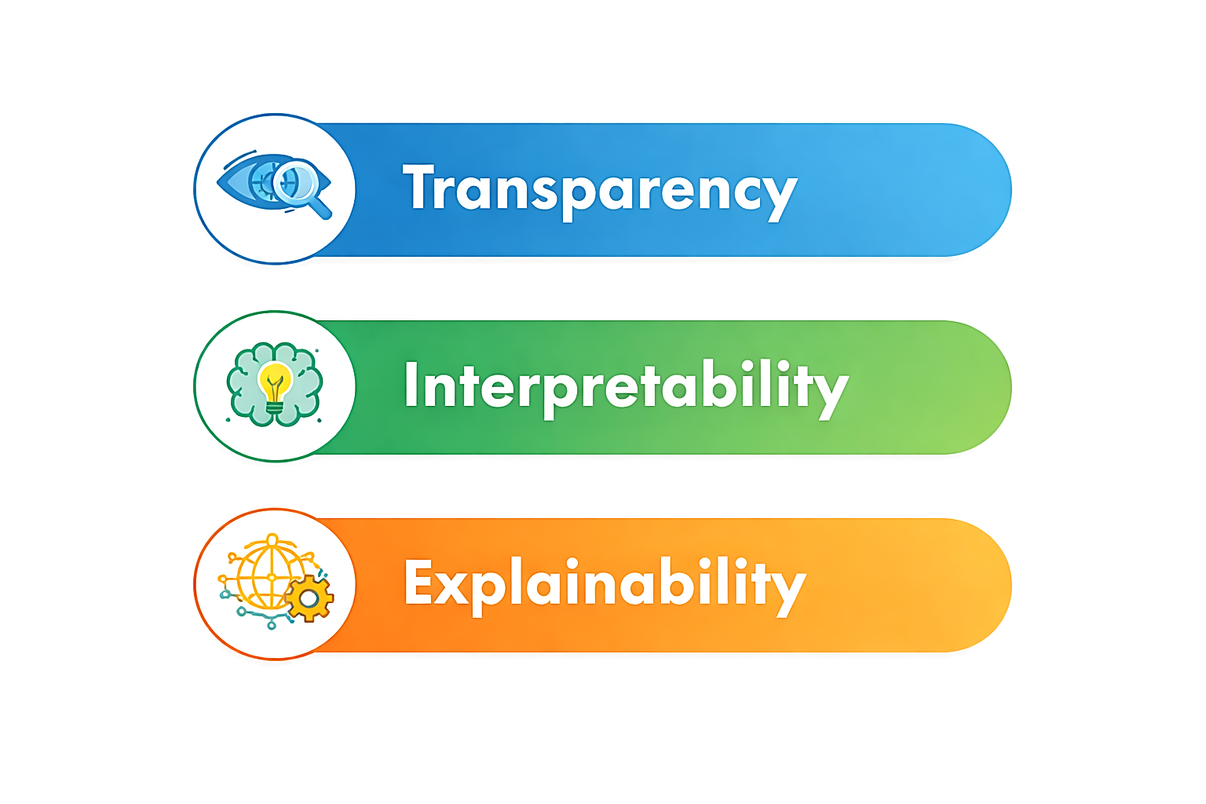
What is Explainable AI?
Which AI Model to select!

Slide 5
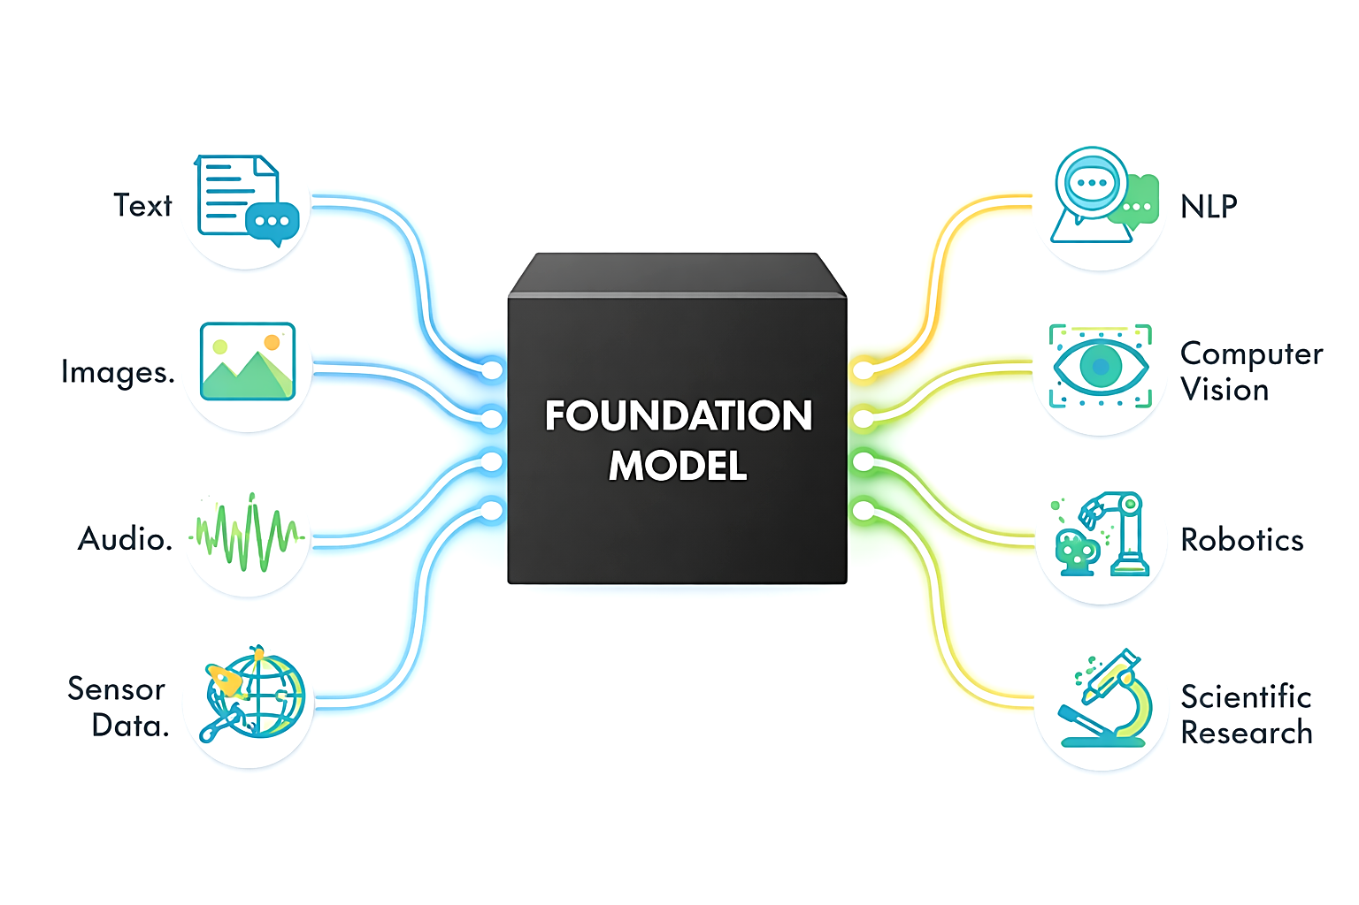

Slide 6
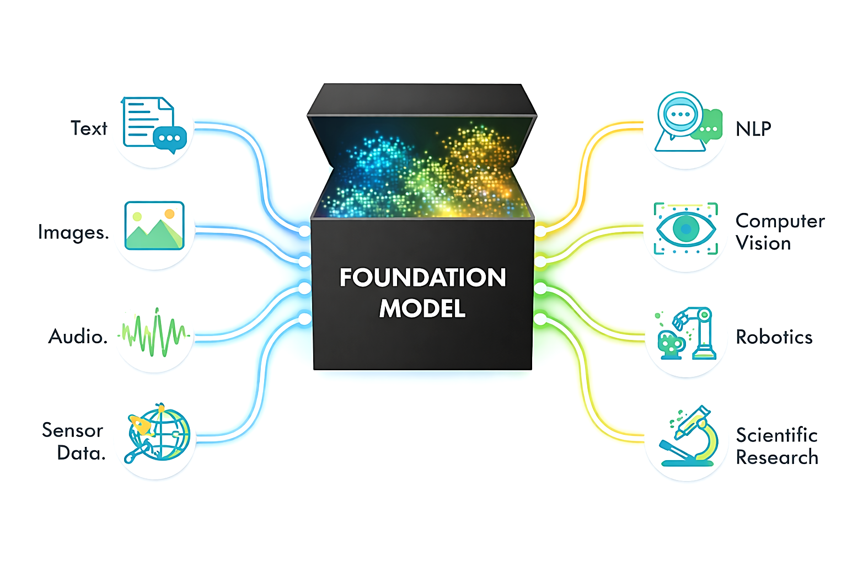
Explainable AI in Foundation Models

Slide 7
Explainable AI in Foundation Models

Slide 8
Explainable AI Foundation Models
Knowing what the model is, how it was trained
Data Transparency
What Data Modalities
Data Distribution
Data Scaling
Missing Data Handling
Outliers Handling
Architectural Transparency
Encoder Only
Decoder Only
Transformers Based
Attention Mechanism
Multimodal Fusion Model
Training Transparency
Self-Supervised Learning
Masked autoencoder
Contrastive Learning
Predictive Encoding

Slide 9

Explainable AI in Foundation Models

Slide 10
Explainable AI in Foundation Models
Ability to understand and analyze the structure, meaning, and invariances of learned representations independent of any specific task.
Representation Interpretability
PCA
T-SNE/UMAP
Linear probes
Pretext Tasks
Reconstruction
Solve Jigsaw Puzzle
Similarity Matching
Notes:
2. Concept alignment
Do internal features correspond to human concepts?
Examples:
Syntax vs semantics in language
Texture vs shape in vision
Seasonal vs structural signals in geospatial data
Tools
Concept Activation Vectors (TCAV)
Linear probes
Concept classifiers
Interpretability gain
You can say which concepts are encoded where.
3. Feature sensitivity & invariance
What changes the representation—and what doesn’t?
Robust to noise?
Invariant to irrelevant transformations?
Sensitive to causal features?
Tools
Input perturbation
Counterfactual edits
Data augmentation stress tests
Interpretability gain
You learn what the model pays attention to.

Slide 11

Explainable AI in Foundation Models

Slide 12
Explainable AI in Foundation Models
Ability to generate human-understandable reasons for a model’s outputs, behaviors, or failures relative to a specific task or decision.
Attributions
Saliency Maps
Gradient map
Attention Rollout
Ablation & Reasoning
Input editing
Latent space traversal
Contrastive examples
Error Analysis
Notes:
1. Attribution (credit assignment)
Which inputs influenced the output and how much?
Which tokens mattered in text?
Which regions mattered in images?
Which modalities dominated in multimodal settings?
Tools
Saliency maps
Gradients / Integrated Gradients
Attention rollout
Occlusion methods
Explainability gain
You can point to what drove the decision.
2. Local explanations (instance-level)
Explain this prediction, not the model in general.
Questions:
Why this output instead of another?
What minimal change would flip the result?
Tools
LIME
SHAP
Counterfactual explanations
Explainability gain
You get explanations tied to specific cases, which is critical for trust.

Slide 13
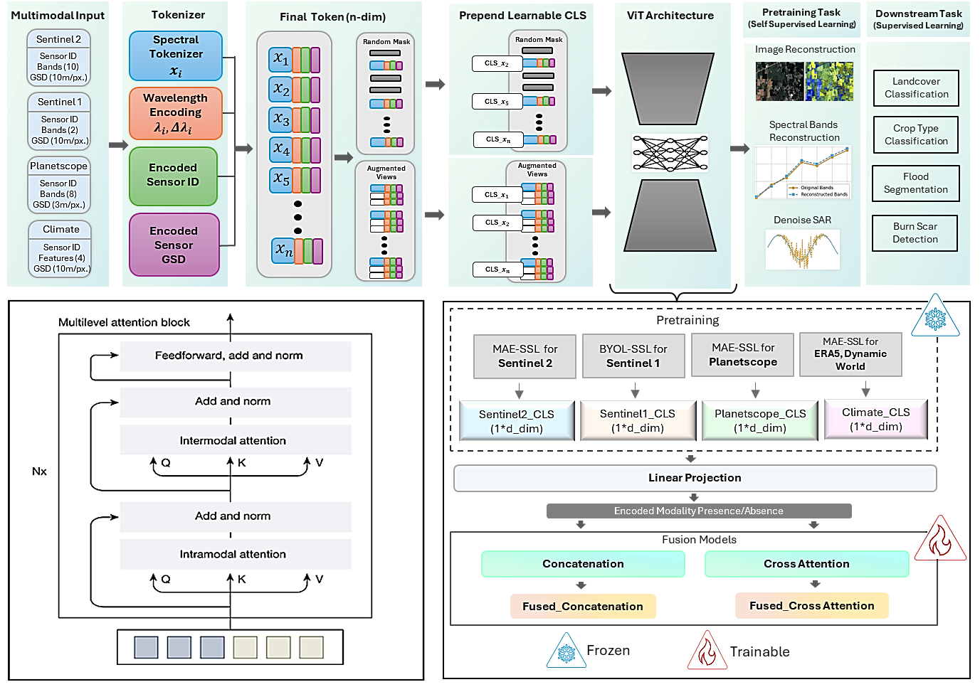
SPEAR: Self-Supervised Sample Efficient Pixel-Level
Multi-Modal Spectral Fusion for Earth Observation Applications (Accepted : CV4EO-WACV (CVF) 2026)

Slide 14
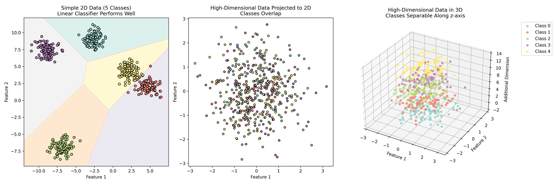

Slide 15
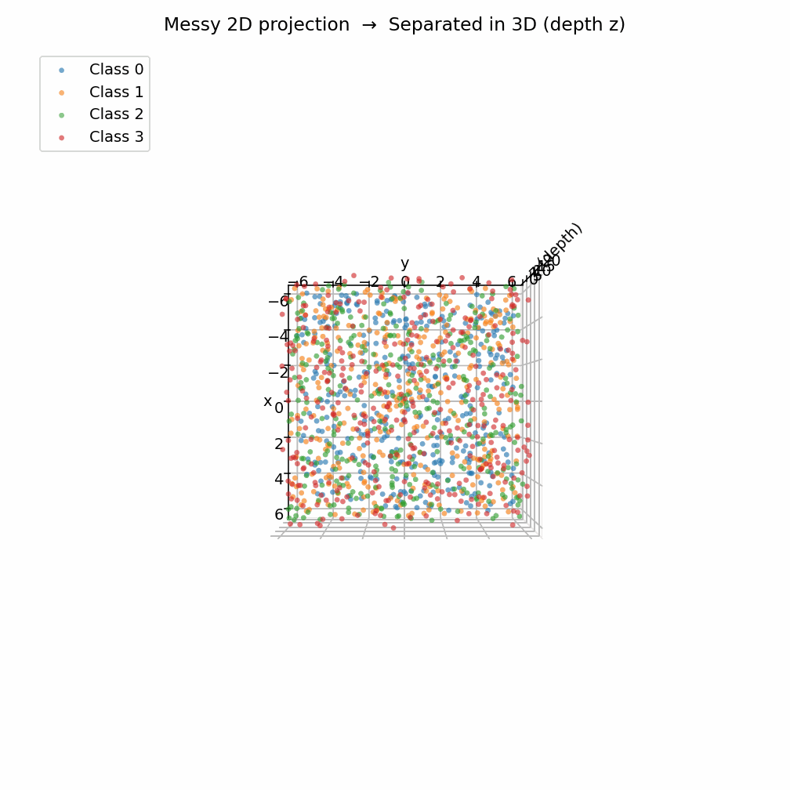
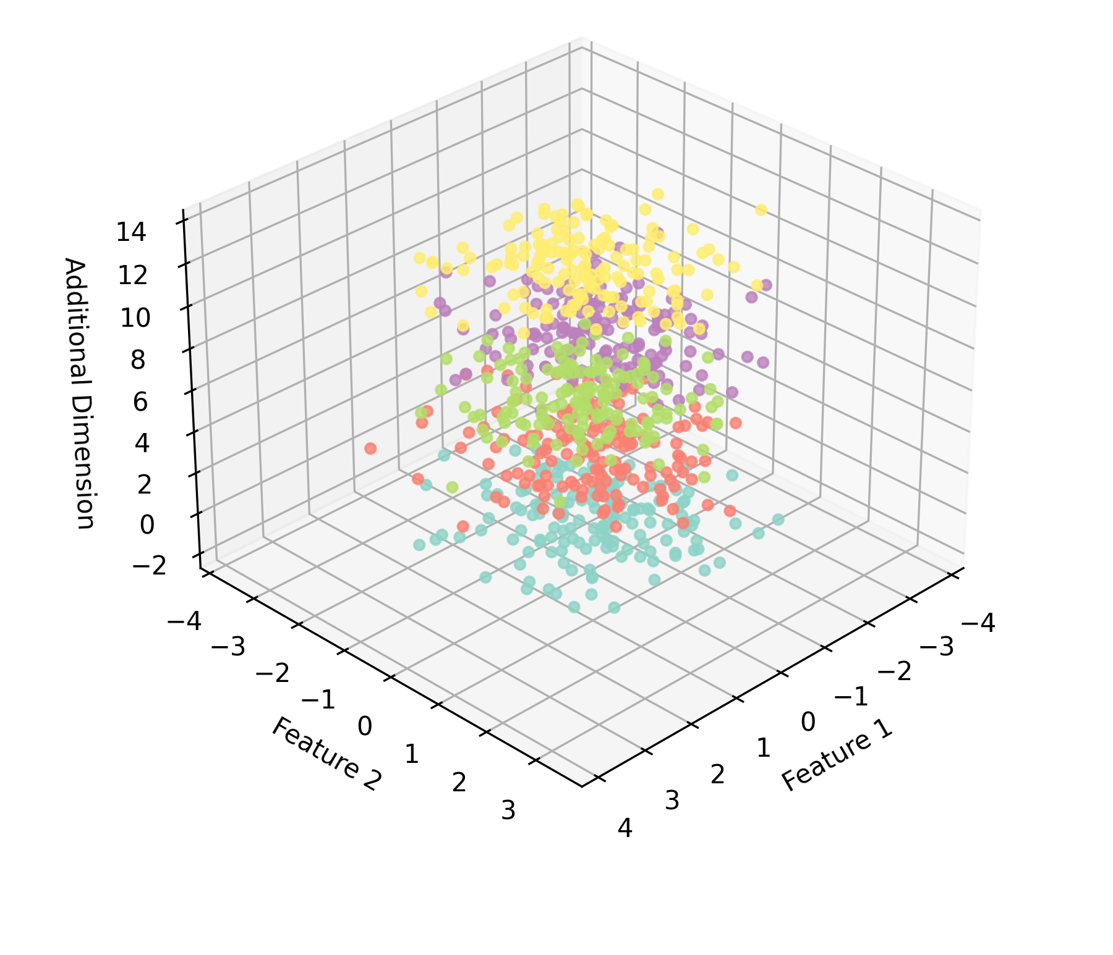

Slide 16
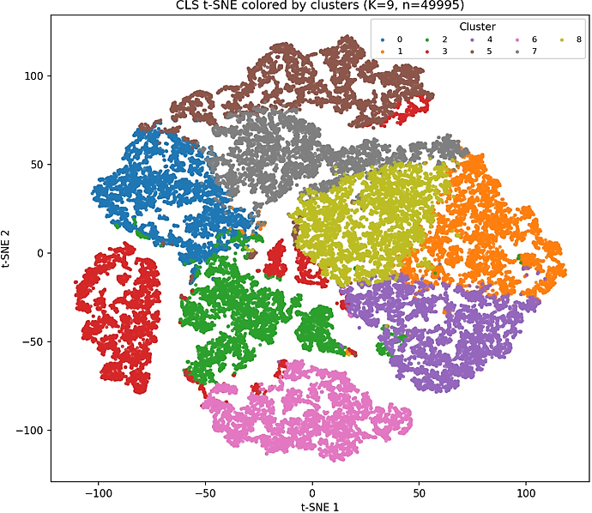
T-SNE Visualization of
Geo-embeddings

Slide 17
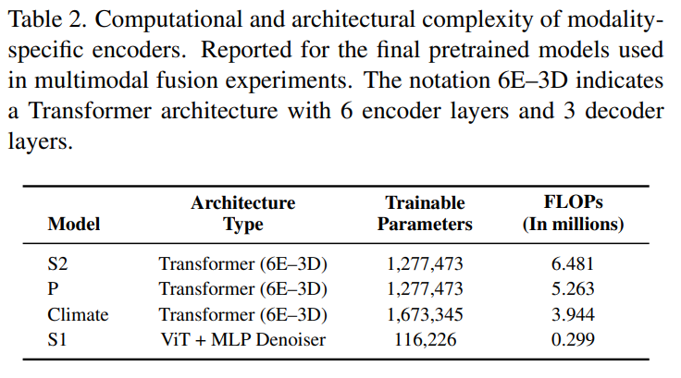
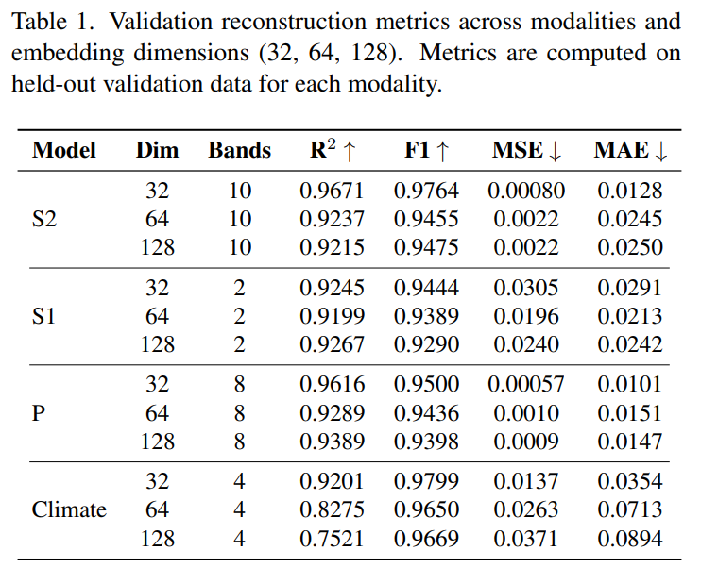
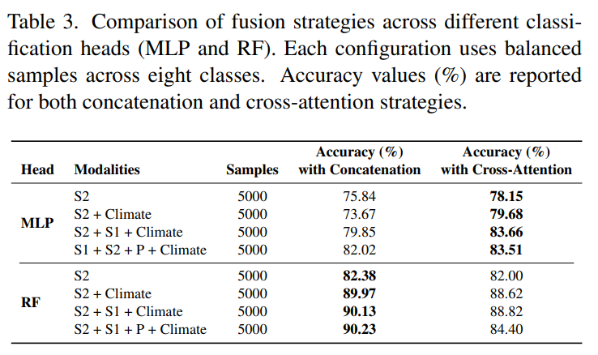
Ablations Study

Slide 18
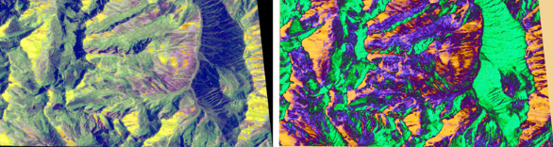
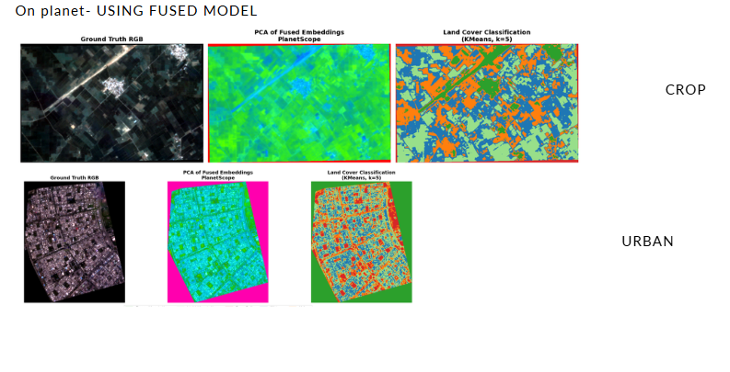
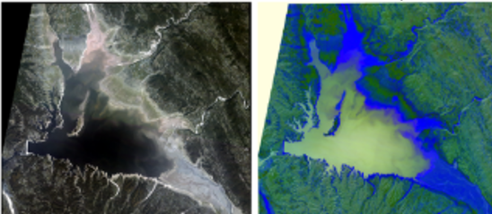
Original
Reconstructed
Original
Vs.
Reconstructed

Slide 19
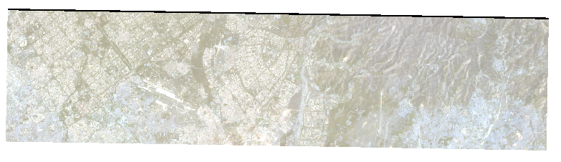
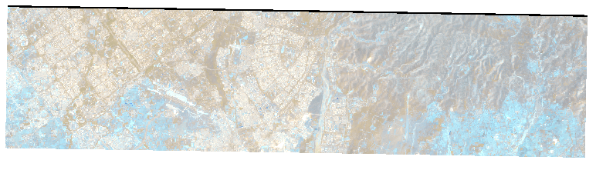
Original vs. Reconstructed Image
Original
Reconstructed

Slide 20
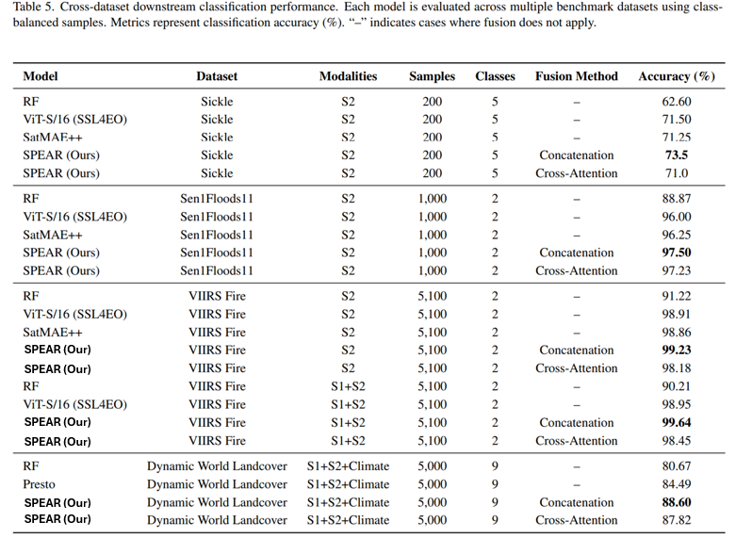
Results on
Downstream Task

Slide 21
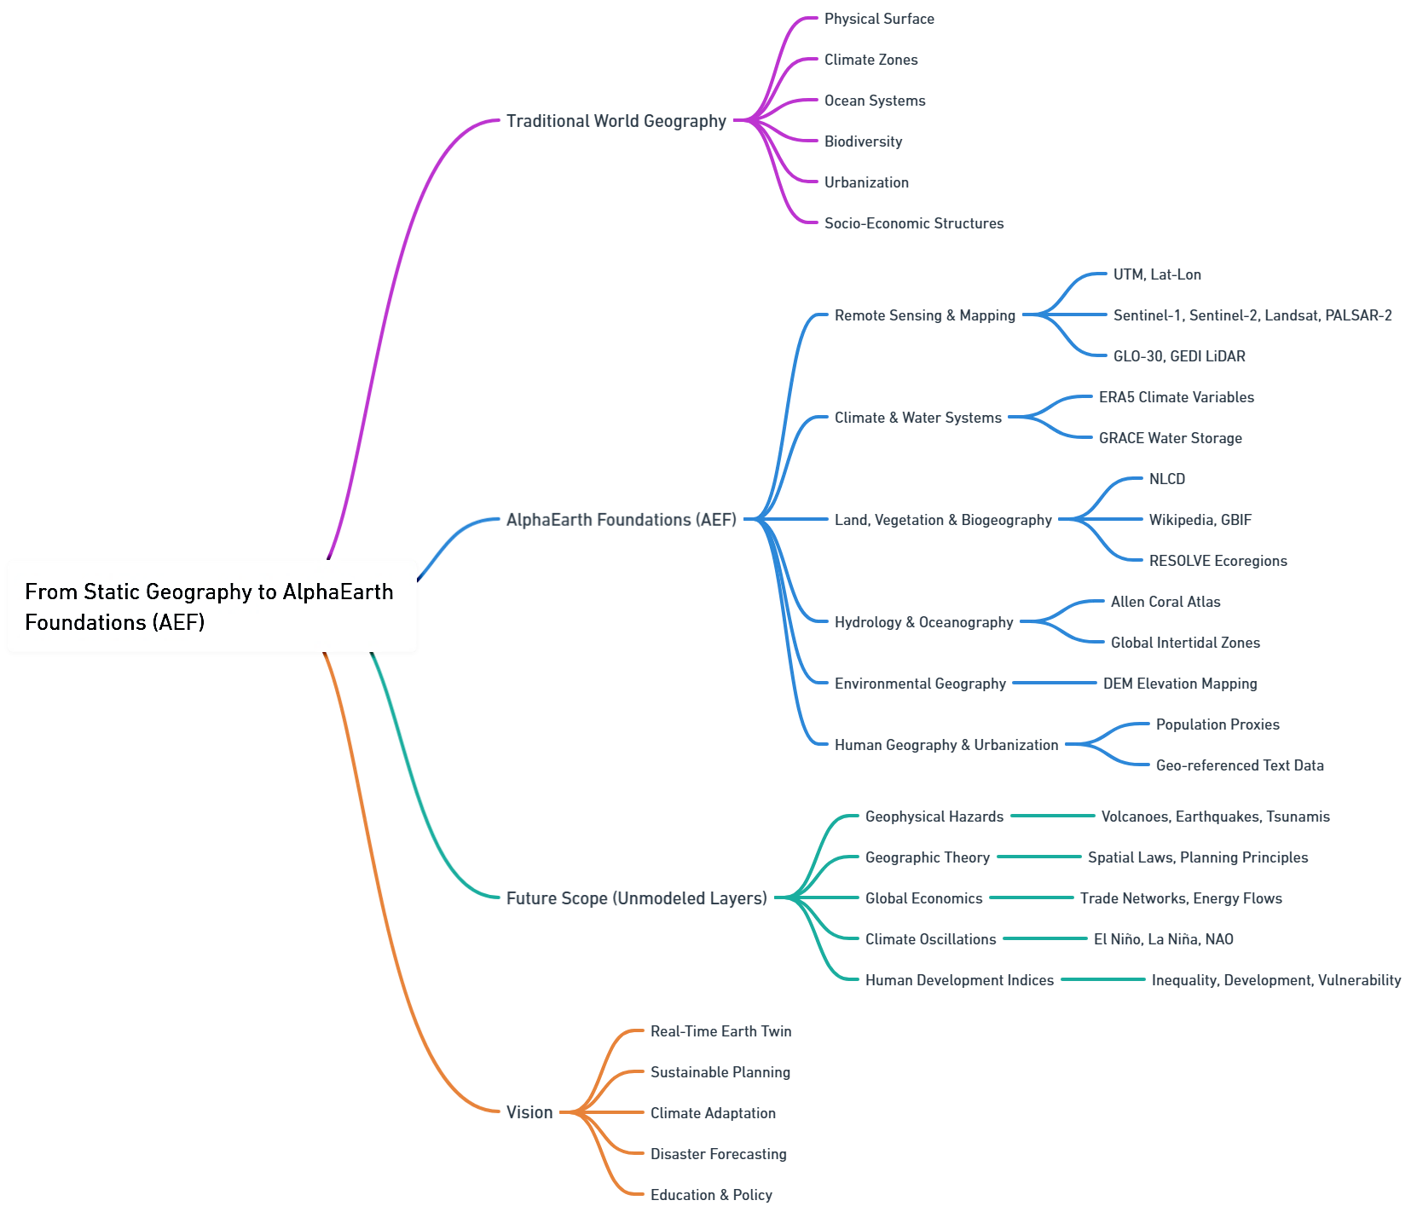
Future Scope

Slide 22
THANK YOU
ranjan44@purdue.edu

