Slide 1
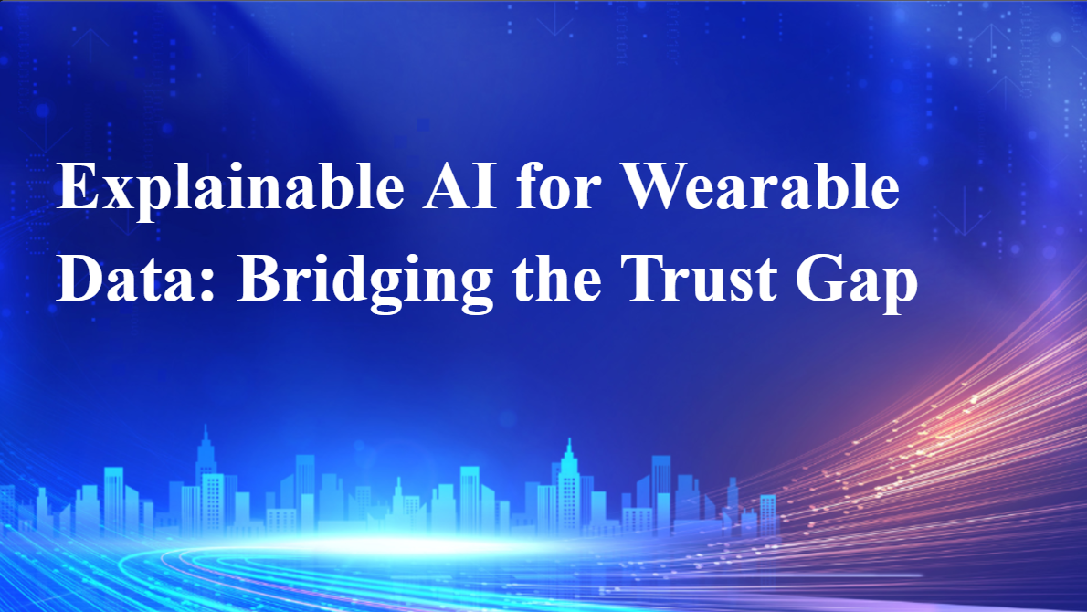
Notes:
Slide 1: Title – Explainable AI for Wearable Data: Bridging the Trust Gap
Context: The integration of AI in healthcare has created "black box" models that medical professionals and users find difficult to understand.
The Problem: While wearables are ubiquitous, there is a "trust deficiency" because users can't see the "why" behind an algorithm's health prediction.
Goal: This presentation critiques the current state of XAI in wearables, focusing on how we move from technical transparency to genuine clinical trust.

Slide 2
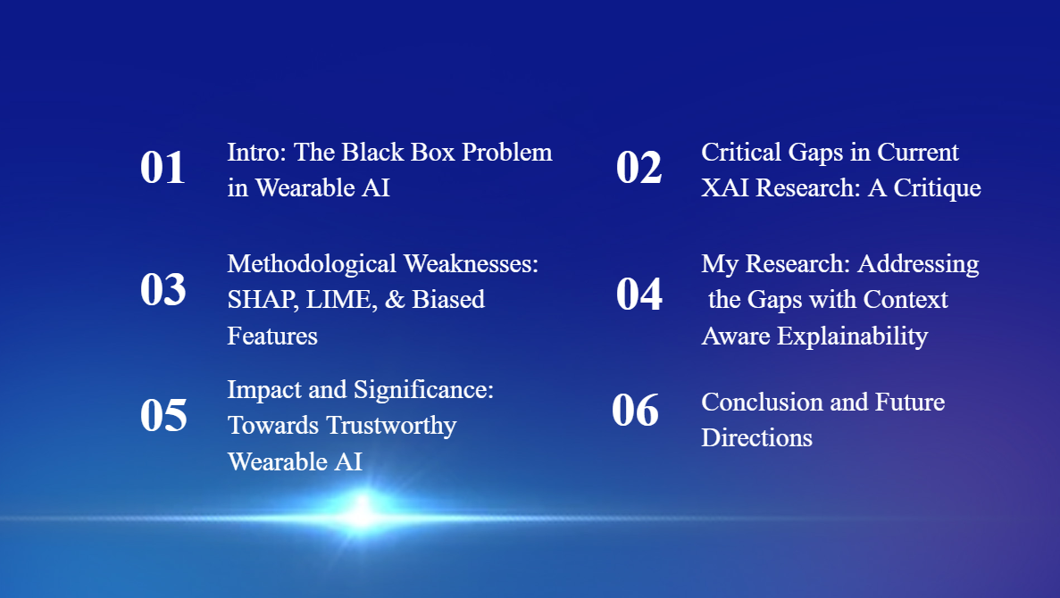
Notes:
Slide 2: Presentation Agenda
Roadmap: We will start with the "Black Box" problem, move into a critique of current research gaps (specifically the temporal and logic gaps), and conclude with future directions for context-aware explainability.
Key Question: How do we ensure that an explanation is not just a "window into a flaw" but a medically relevant insight?.

Slide 3

Notes:
Slide 3: Part 01 – Intro: The Black Box Problem in Wearable AI
Transition: Let's look at why the "Black Box" is particularly dangerous in a medical context.

Slide 4
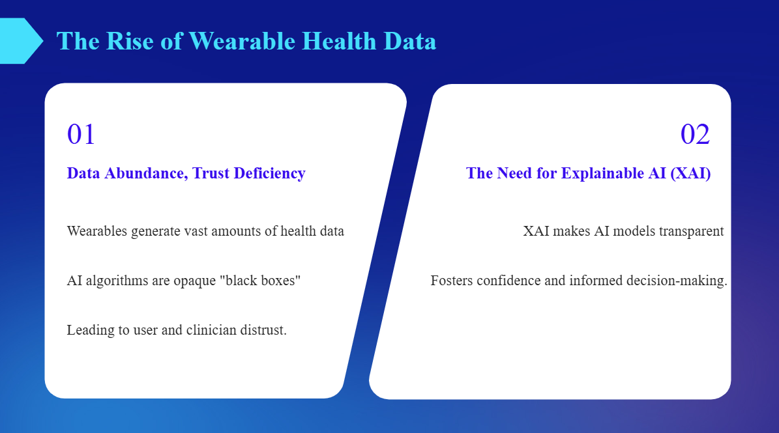
Notes:
Slide 4: The Rise of Wearable Health Data
Abundance vs. Trust: We are in an era of "Data Abundance" where devices like Fitbit and Apple Watch capture granular physiological signals.
The Gap: Despite this data, algorithms remain opaque. This leads to distrust from clinicians who cannot justify an AI-driven diagnosis to a patient without understanding the underlying process.
Data Abundance, Trust Deficiency
Wearables are generating vast amounts of health data; however, the AI algorithms interpreting this data are often opaque "black boxes", leading to user and clinician distrust.
The Need for Explainable AI (XAI)
XAI aims to make these AI models transparent and understandable, fostering confidence and enabling informed decision-making.

Slide 5
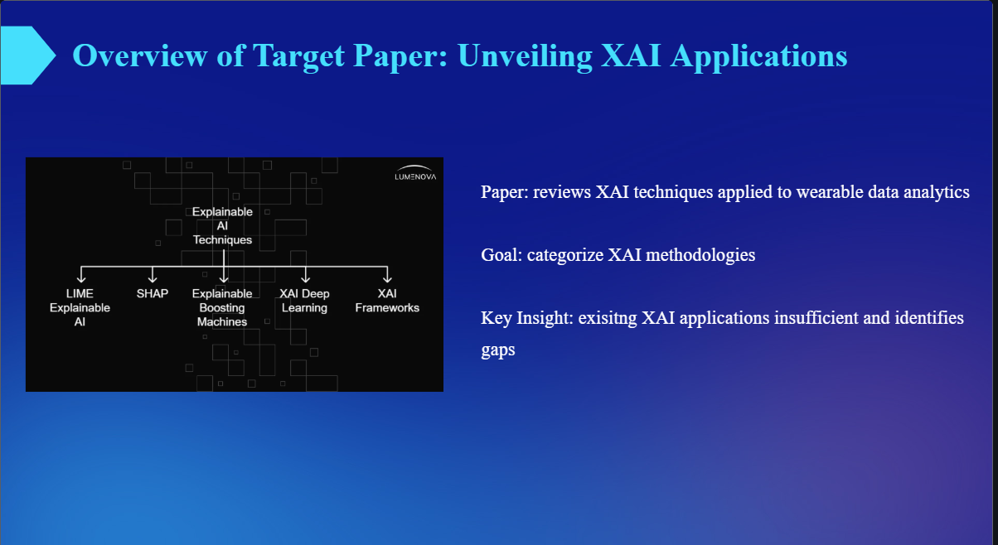
Notes:
Slide 5: Overview of Target Paper: Unveiling XAI Applications
Scope: This critique is based on a systematic review of 25 research papers exploring XAI techniques like SHAP and LIME.
Methodology: The target paper categorizes how these methods (like feature importance) are applied to 1D biosignals.
Finding: Most existing XAI applications are still insufficient; they provide visual graphs but often lack deep user evaluation.
The paper systematically reviews XAI techniques applied to wearable data analytics. Goal: to categorize how XAI methodologies enhance wearabale data model transparency and trustworthiness
Key Insight:
The paper argues that many existing XAI applications in this field are sufficient and identifies critical gaps that need to be addressed

Slide 6

Notes:
Slide 6: Part 02 – Critical Gaps in Current XAI Research: A Critique
Transition: Now we move into the "Logic Flaws" identified in my critical evaluation of the literature.

Slide 7
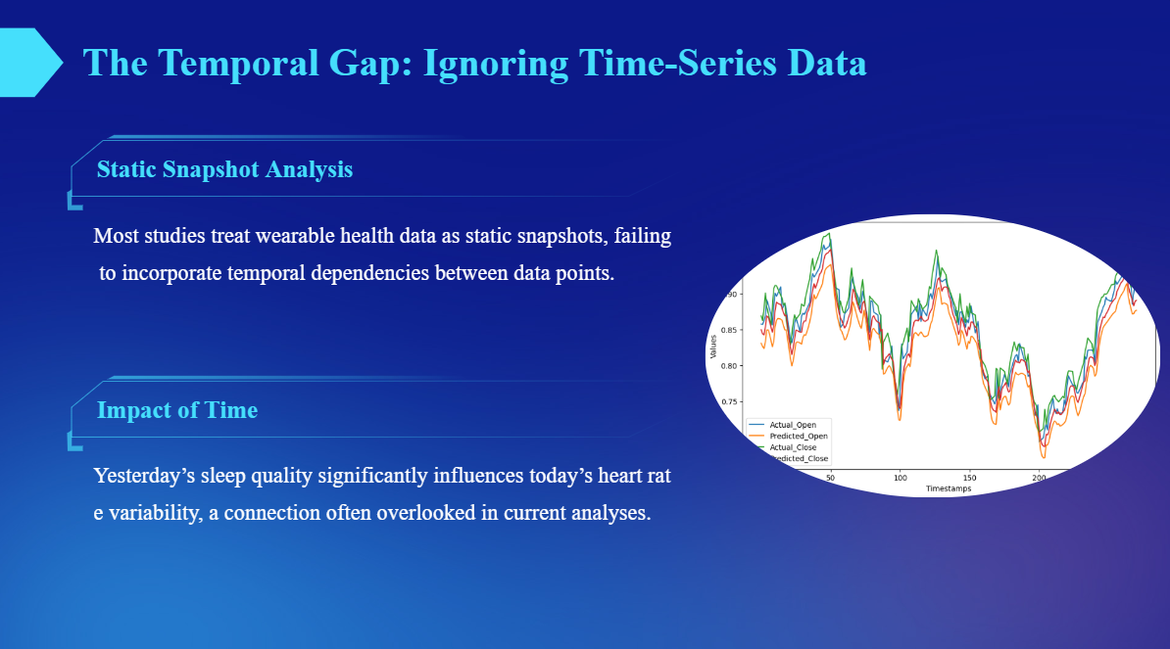
Notes:
Slide 7: The Temporal Gap: Ignoring Time-Series Data
Static Snapshots: Current XAI often treats health data as a "static snapshot," failing to account for how data points are connected over time.
Real-World Impact: In reality, yesterday’s sleep duration or stress levels directly influence today’s heart rate variability. Ignoring these "temporal dependencies" results in an explanation that is technically accurate for a moment but medically incomplete for a person's life.

Slide 8
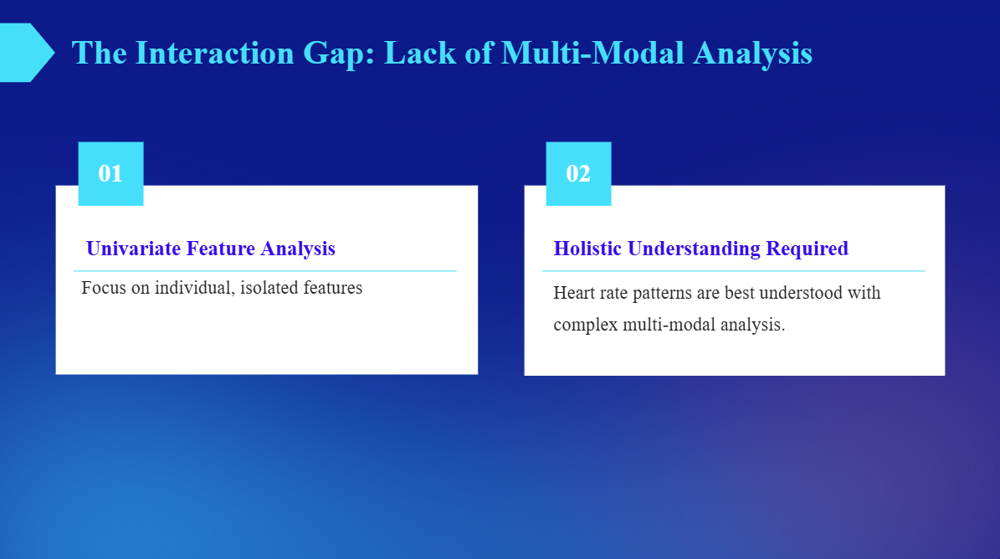
Notes:
Slide 8: The Interaction Gap: Lack of Multi-Modal Analysis
Isolation is the Problem: Many studies perform "Univariate Feature Analysis"—looking at heart rate or steps individually.
Holistic Need: Physiological signals don't happen in a vacuum. Heart rate patterns are best understood through "multi-modal analysis," where we see how activity, mood, and sleep interact together.
Univariate Feature Analysis: Analyses predominantly focus on individual, isolated features, neglecting valuable interactions between feature pairs.
Hollistic Understdning Required: Heart rate patterns are best understood in the context of movement data and other physiological signals, requiring more complex multi-modal analysis.

Slide 9
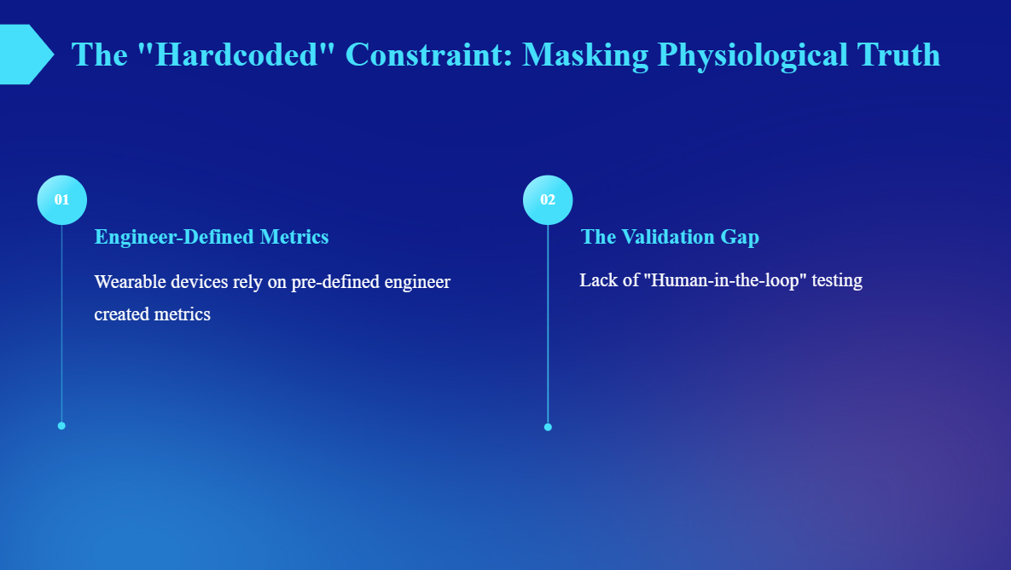
Notes:
Engineer-Defined Metrics: A systemic issue is that wearable metrics are often "hardcoded" by engineers rather than being derived from the unique physiological truth of the user.
The Validation Gap: There is a distinct lack of "Human-in-the-loop" testing. We don't have enough proof that these new explanations actually improve user actions or long-term wellbeing.

Slide 10

Notes:
Transition: Finally, let’s look at the actual tools being used—SHAP and LIME—and why they might be leading us down the wrong path.

Slide 11
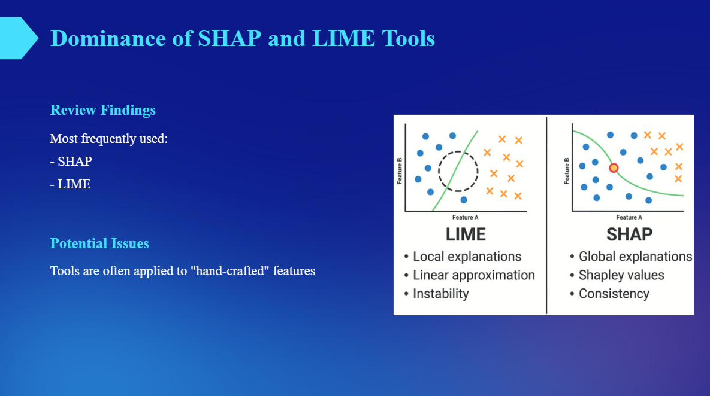
Notes:
The Tools: The review found that SHAP (Shapley Additive Explanations) and LIME are the most frequently used post hoc methods.
The Weakness: These tools are often applied to "hand-crafted" features.
Comparison: As the diagram shows, LIME provides local, linear approximations which can be unstable. SHAP provides global consistency through Shapley values, but both can still be "fooled" if the input features themselves are biased.
The Takeaway: If the input is biased, XAI merely "explains the bias" rather than providing a genuine medical insight.

Slide 12
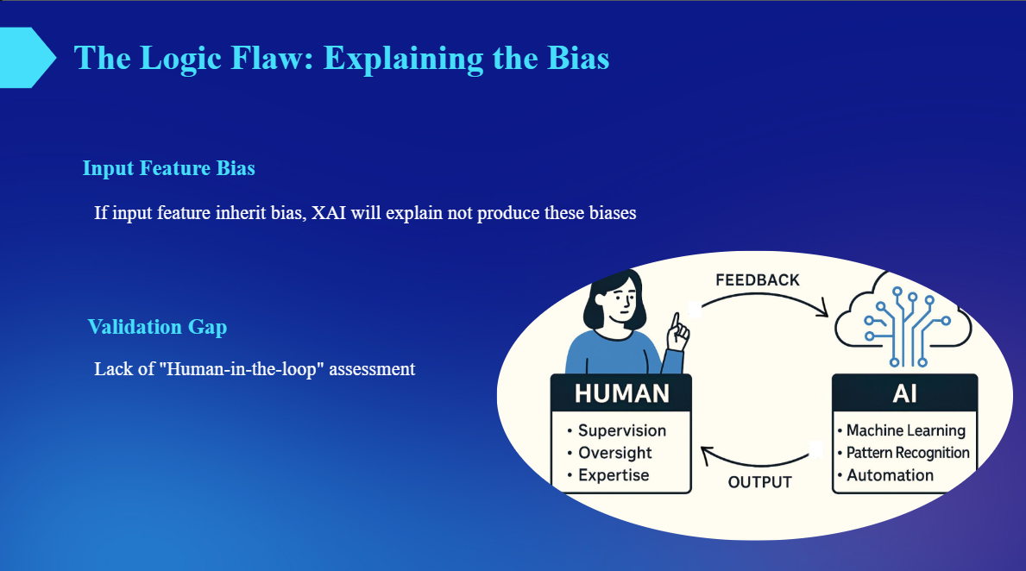
Notes:
The Mirror Effect: XAI is not a magic fix for bad data. If the input features inherit biases (like sensor inaccuracies), the XAI merely "explains the bias".
Conclusion: Transparency does not equal accuracy. Without addressing the "Validation Gap" and the human impact of these alerts, XAI remains a technical exercise rather than a medical solution.

Slide 13

Notes:
Transition: To move forward, we need a framework that respects the complexity of human biology.

Slide 14
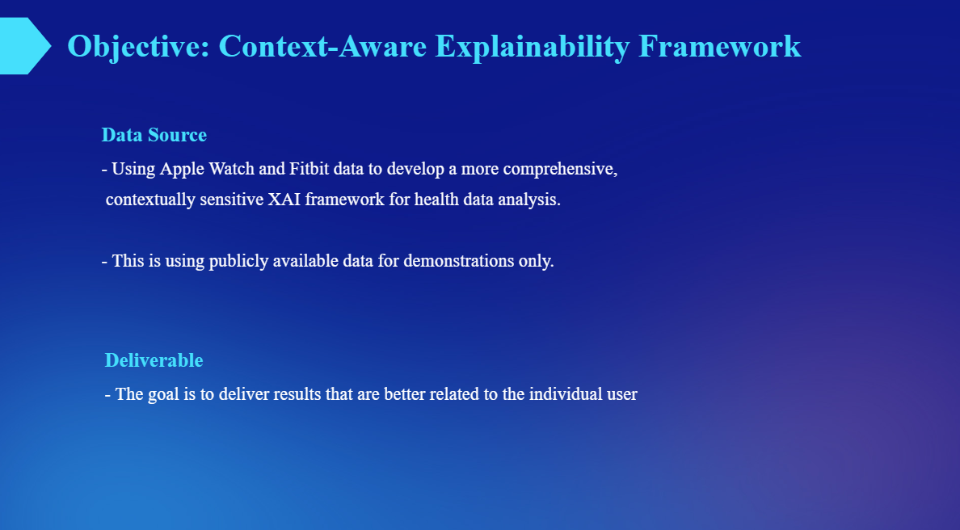
Notes:
Data Source: My research uses Apple Watch and Fitbit data to develop a more comprehensive, contextually sensitive XAI framework.
Deliverable: The goal is to move away from generic explanations and deliver results that are better related to the individual user’s unique lifestyle and physiological trends.

Slide 15
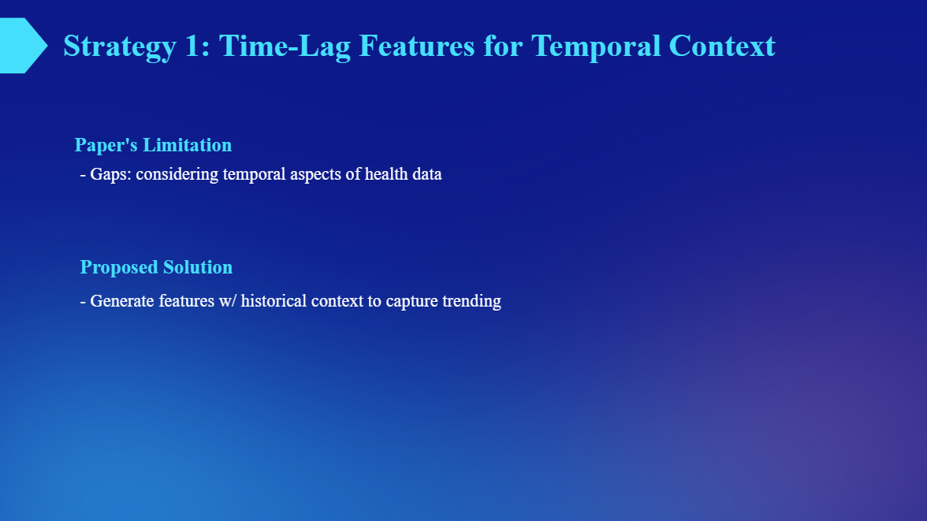
Notes:
Limitation: As discussed, current papers fail to consider the temporal aspects of health data.
Proposed Solution: I propose generating features with historical context. By using time-lag features, the model can capture trending patterns over days or weeks, rather than just isolated spikes.

Slide 16
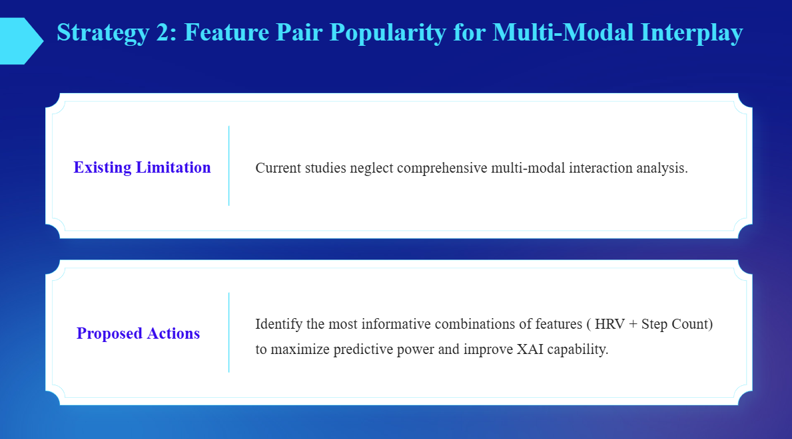
Notes:
Existing Limitation: Current studies neglect how different health metrics interact.
Proposed Actions: I am identifying the most informative combinations of features—such as Heart Rate Variability plus Step Count. Maximizing the interplay between these modes improves the predictive power and the quality of the XAI capability.

Slide 17


