Slide 1
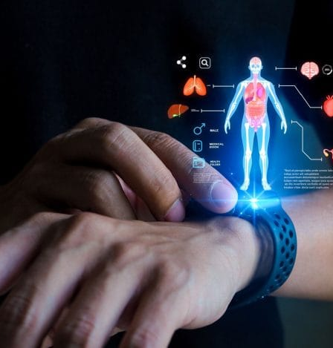
Bridging the trust gap in the medical field
Notes:
Before we dive into the code, let’s talk about the 'Trust Gap.' We have AI, but doctors are often hesitant to use it because they don’t know when to trust it. My research creates a digital 'Stress Test'—similar to how we crash-test cars—to measure exactly how reliable an AI diagnosis is before it ever reaches a patient

Slide 2
The problem: trust the gap
Current Wearables : Models take in vitals like blood pressure, temperature, steps, etc.
Output: AI is embedded in wearables to produce alerts
The Gap: Models do not specify when the most significant change occurred

Slide 3
methodology
Identify which features (e.g., Temperature vs. Steps) moved the needle toward a "Critical Mode" classification
Using Attention Mechanisms to highlight the specific time windows in the data stream that the AI "focused" on before triggering the alert
Patients and doctors can see the "evidence" behind the notification

Slide 4
Current research
SHAP and LIME: These rank which features (e.g., Blood Pressure vs. Heart Rate) were most important for a specific prediction
FIT (Feature Importance in Time): A specialized framework that calculates how much the "importance" of a vital sign shifts from one minute to the next
WinIT (Window-based Importance): An algorithm that accounts for the fact that a vital sign isn't just important as a single point, but as a trend over a specific window of time

Slide 5
GAP I want to focus on
Develop an XAI model that explains Inter-feature Correlations
Question: Is the AI alert triggered because of the Heart Rate alone, or because the Heart Rate rose while Blood Pressure fell (a classic sign of shock)?
Notes:
This is a sophisticated research pivot. You are moving from Feature Importance (which variables matter) to Relational Importance (how variables interact over time). In clinical terms, this is the difference between seeing a symptom and understanding a syndrome (like shock).
Here are the step-by-step phases to develop an XAI model for Inter-feature Correlations.
Phase 1: Data Structuring & Temporal Alignment
Before explaining correlations, the data must be synchronized so the AI can see the "overlap."
Time-Syncing: Align Blood Pressure (BP) and Heart Rate (HR) into identical time steps (e.g., 1-second intervals).
Windowing: Create "look-back" windows (e.g., the last 30 minutes of data) to serve as the input for the prediction.
Normalization: Use $Z$-score normalization so that a "rise" in HR is mathematically comparable to a "fall" in BP.
Phase 2: Modeling for Interaction (The Architecture)
A standard AI might ignore the relationship. You need an architecture that captures dependencies.
Transformer-based Models: Use "Self-Attention" mechanisms. Attention heads are designed to calculate how much one feature (HR) relates to another (BP) at any given time.
Graph Neural Networks (GNNs): Treat each vital sign as a "node" in a graph. The "edge" between the nodes represents the correlation strength.
Phase 3: Building the "Relational" Explainer
This is where the XAI happens. You need to extract the "Interaction Effect."
SHAP Interaction Values: Instead of standard SHAP, use SHAP Interaction Values. This decomposes the prediction into:
The effect of HR alone.
The effect of BP alone.
The combined effect of HR + BP.
Partial Dependence Plots (PDP): Create 2D maps showing the risk score. If the risk is highest only when HR is high and BP is low, you have mathematically proven the "Shock" correlation.
Phase 4: The "Clinical Logic" Validation
Now, you map the math back to medical reality.
Rule-Based Constraints: Compare AI correlations against known medical heuristics (e.g., the Shock Index, calculated as $SI = \frac{HR}{SBP}$).
Contrastive Explanations: Generate "What-if" scenarios.
Scenario A: HR increases, BP stays stable $\rightarrow$ AI Alert level?
Scenario B: HR increases, BP decreases $\rightarrow$ AI Alert level?
If Scenario B triggers a significantly higher alert, the model has successfully learned the inter-feature correlation.
Phase 5: Output Generation (The User Interface)
Convert the math into a "Human-Readable" explanation for the wearable.
Visual Output: A heatmap showing the two vitals diverging.
Textual Output: "Alert: High Risk of Shock. Analysis shows a divergent trend: Heart Rate increased by 20% while Systolic BP decreased by 15% over the last 10 minutes."
Summary Table: Proving the Correlation
MethodWhat it tells the ResearcherExample Clinical FindingSelf-Attention WeightsWhich features the model "looked at" together."The model heavily weighted HR and BP simultaneously at $T-5$ mins."SHAP InteractionThe mathematical "bonus" score of two features combined."The risk score increased by +0.4 specifically due to the HR/BP interaction."CounterfactualsWhat happens if you "fix" one variable but not the other."If BP had remained stable, the HR rise alone would not have triggered an alert."
We will generate "Trigger Heatmaps" that highlight the exact parts of the heartbeat the AI is relying on. This transforms the AI from a silent "Black Box" into a transparent assistant, allowing doctors to see if the AI is focused on the actual heart or just a technical artifact.
Script: "We don't just want a 'Yes' or 'No' from the AI. We want a map. Our 'Trigger Heatmap' shows exactly which part of the heartbeat the AI is obsessed with. If the AI is making decisions based on the empty space between beats, we can immediately tell the doctor: 'Ignore this alarm; the AI is confused by static.'"
Script: "We are opening the 'Black Box.' Our system will highlight exactly where the AI is looking. If it's obsessed with a static spike instead of the actual heartbeat, the doctor will know immediately."
This slide focuses on interpretability. By showing 'Trigger Heatmaps', we allow clinicians to look under the hood. They can see exactly which part of the heartbeat the AI used to make its decision, verifying that it's looking at real biology (like the QRS complex) and not just background noise.

Slide 6
DATABASES
Use multiple devices and multiple features to find the inter-feature combination

Slide 7

Clinical Impact: Ending Alarm Fatigue
Alerting Personnel and Family
Reduce time before Attack
Predict future attacks
Prevent future attacks

Slide 8

THANK YOU

