Slide 1

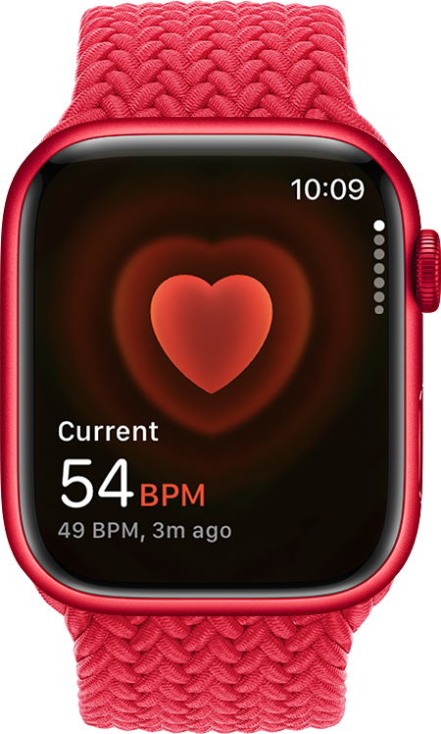
WatchStress
A practical, personalized wellness score from Apple Watch vitals
By Winston Lin
Notes:
[Sources]
- https://developer.apple.com/news/?id=04202020a (HealthKit image)
- https://cdsassets.apple.com/live/7WUAS350/images/health/watchos-10-series-8-heart-rate.png (Apple Watch image)
[/Sources]

Slide 2
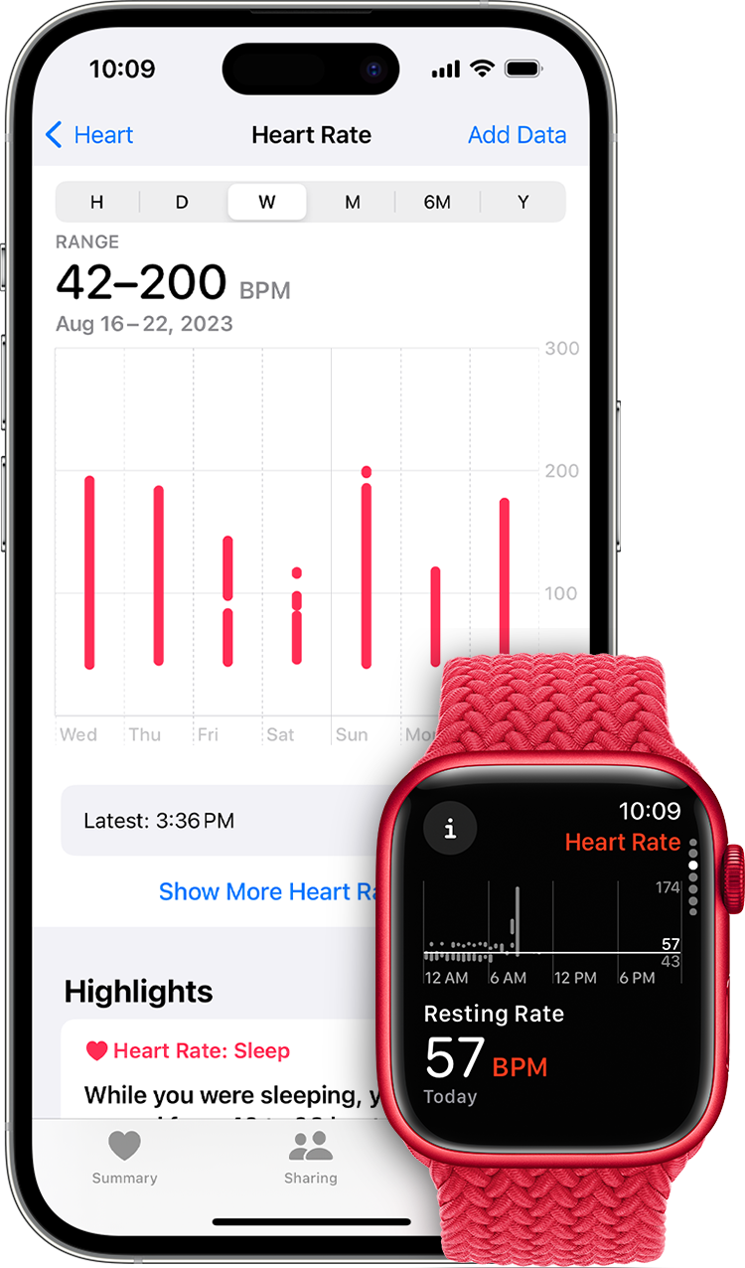
Problem
Raw vitals are useful… but hard to interpret moment-to-moment
What users see today
What users want
Heart rate, HRV, sleep, temperature, etc. (lots of numbers)
Spikes from food, caffeine, exercise, focus, and sensor noise
Hard to answer: “Am I okay right now?”
One simple score that updates through the day
A quick explanation of what changed
Privacy-first (health data stays on device)
Notes:
[Sources]
- https://cdsassets.apple.com/live/7WUAS350/images/health/ios-17-iphone-14-pro-watchos-10-series-8-health-heart-rate.png (Apple image)
[/Sources]

Slide 3
Core Idea
Turn “lots of vitals” into a ring score + a clear why
WatchStress Score
Optional: “Ask AI”
On-device assistant summarizes the score and gives next steps
Explains uncertainty (e.g., after exercise / caffeine)
Keeps the user in the loop (not a diagnosis)
82
Good day
Why (top drivers):
• HR a bit higher than usual
• HRV slightly lower
• Temp normal
Notes:
[Sources]
- https://cdsassets.apple.com/live/7WUAS350/images/health/watchos-10-series-8-heart-rate.png (Apple Watch image)
[/Sources]

Slide 4
Inputs
Use existing sensors + research priors (no extra hardware)
Apple Watch / HealthKit signals
Cold start: WESAD dataset
Resting heart rate, HRV (SDNN), sleep, temperature, respiration, SpO₂ (when available)
We treat movement/exercise as “context” (avoid false alarms)
Everything stays on device by default
Public wearable dataset with labeled baseline vs stress
Gives initial “direction” for signals (e.g., HR up, HRV down)
We then adapt to each user’s normal
Notes:
[Sources]
- https://ubi29.informatik.uni-siegen.de/usi/data_wesad.html (WESAD description)
- https://dl.acm.org/doi/10.1145/3242969.3242985 (WESAD paper)
[/Sources]

Slide 5
How it works
Simple pipeline: snapshot → compare to baseline → combine → explain
HealthKit
Snapshot
Normalize
ScoreEngine
Ring + “Why”
HR, HRV, sleep…
vs your baseline
weighted combine
top drivers
Design choices for “real life”
Smooth short spikes (food, caffeine, focus) so the ring doesn’t whiplash
Down-weight missing data and show a confidence label
Log optional self-reports to improve priors later (no training yet)

Slide 6
Personalization
Useful on day 1; improves quietly over time
Day 1 (cold start)
Over time
Use WESAD priors to produce an initial score immediately
Keep score conservative + show low confidence if signals are missing
Learn your baseline from your own historical vitals
Optional daily “Log now” prompts build better calibration
Later: blend family pilot data into priors (still privacy-first)
Confidence increases as baselines mature
Day 1
Week 1
Month 1+

Slide 7
Data logging (pilot)
Make it easy for family testers to help
What we log (opt-in)
Low-effort routine
Timestamp + vitals snapshot used for the score
Optional 0–10 “How stressed do you feel?” slider
Export to CSV/JSONL (user-controlled)
Once per day: open app → tap “Log now” → (optional) slider → Save
After a week: export and share file
No accounts, no cloud required
Pilot success = consistent daily logs + qualitative feedback
We’ll use pilot data to improve priors (WESAD + family) before any personalized ML.

Slide 8
Privacy & Safety
Health data is sensitive → design for trust
Privacy-first defaults
Safety boundaries
All processing on device by default
No accounts; users control export/sharing
Only health metrics needed for the score are accessed
Not a medical diagnosis (display a clear disclaimer)
Confidence label + “why” reduces over-trust
Encourage users to seek care for concerning symptoms
Notes:
[Sources]
- https://developer.apple.com/documentation/healthkit/protecting-user-privacy (HealthKit privacy guidance)
[/Sources]

Slide 9
Evaluation plan
Measure usefulness, not just accuracy
Pilot study (you?)
Success criteria
Daily log prompts + optional self-report
Check: score direction matches user perception
Identify common failure modes (exercise, caffeine, sleep debt)
Users understand “what changed” (top drivers)
Score stable (no extreme swings without reason)
Opt-in logging completion rate over 1–2 weeks

Slide 10
Thank you!

