Slide 1
How do I know that dude?
Explainable Link Prediction GNN System for Connection Recommendation.
Tri Vo

Slide 2
People You May Know
The main features for lots of famous companies: Meta, X, LinkedIn, Google, etc.
  LinkedIn’s PYMK is reported to create 600k new jobs. Stanford, 2022
  Twitter’s PYMK is responsible for 15% daily growth rate. Su, 2016
  Responsible for some viral videos that have changed a person life …
Notes:
wtf.pdf

Slide 3
People You May Know
It’s constrained by regulations, since it would reveal company’s algorithms – their money machine => limit OS contribution
Individual bad suggestions are often low-cost => less business motivation
Notes:
Interpretability in the recommendation system is very interesting. However, I feel like this has been neglected, or at least doesn’t live up it its attention in recent days.
There are a few reasons for it

Slide 4
Problem Statement
1) Build a RecSys: Given a knowledge graph of authors and their publications in the past, predict possible co-authorship in the future.
2) Interpret the result: Show “recommendation patterns” in the prediction.

Slide 5
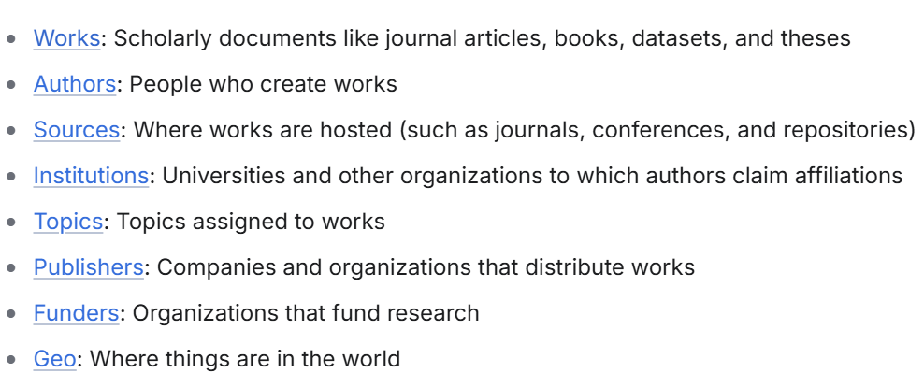
Build a RecSys
Dataset: OpenAlex ,a spin-off project from the paper Priem, 2022
  Big:
    Articles published between 2010 and 2020
    Offer lots of entities: Works, Authors, Institutions, etc.
  Fast: Access via API calling
  Free

Slide 6
Build a RecSys
Architecture choice: GraphSAGE on Link prediction
Training objective: hard-negative sampling

Slide 7
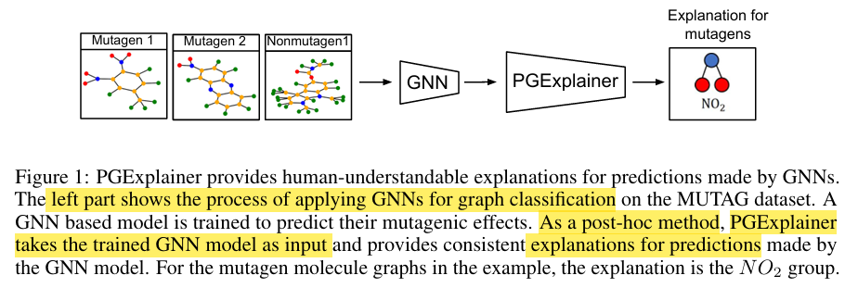
Interpret the Recommendation
Approach: Integrate PGExplainer from Luo, 2024
  Model-agnostic approach for CNNs
  A trainable MLP module that focuses on explanation on graph structures
  Find relevant patterns in the training knowledge graph that are embedded in the prediction’s structure.
Notes:
For example, if we consider the context of my problem about professional recommendation (Link prediction). Here, the GNN connects 2 red nodes with a blue node because the PGExplainer shows that there are repetitive patterns of the same structure in the training dataset. In other words, it could be 2 authors in Purdue University, CS Department tend to collaborate on a new publications because professors in Purdue, CS Department tend to work with each other.

Slide 8
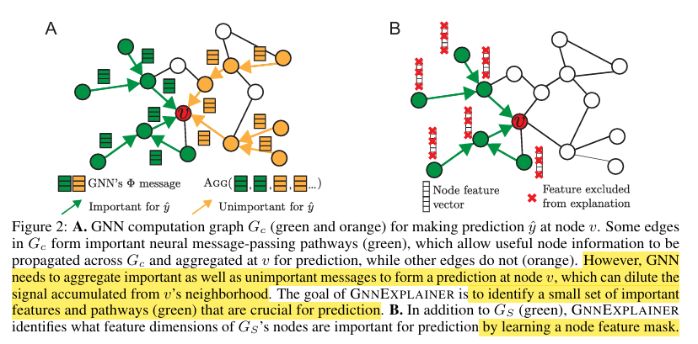
Interpret the Recommendation
Training objective:
Borrow idea from the paper GNNExplainer (Ying, 2019)

Slide 9
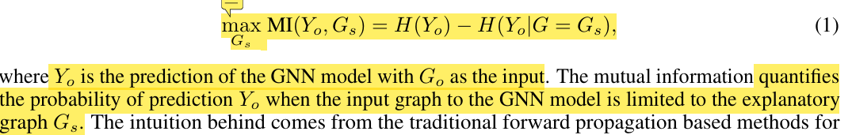
Interpret the Recommendation
Training objective:
But with some improvements:
  Reduce the direct optimization of the search function using an approximation
  Make the objective discrete -> continuous (differentiable)
  Faster inference

Slide 10
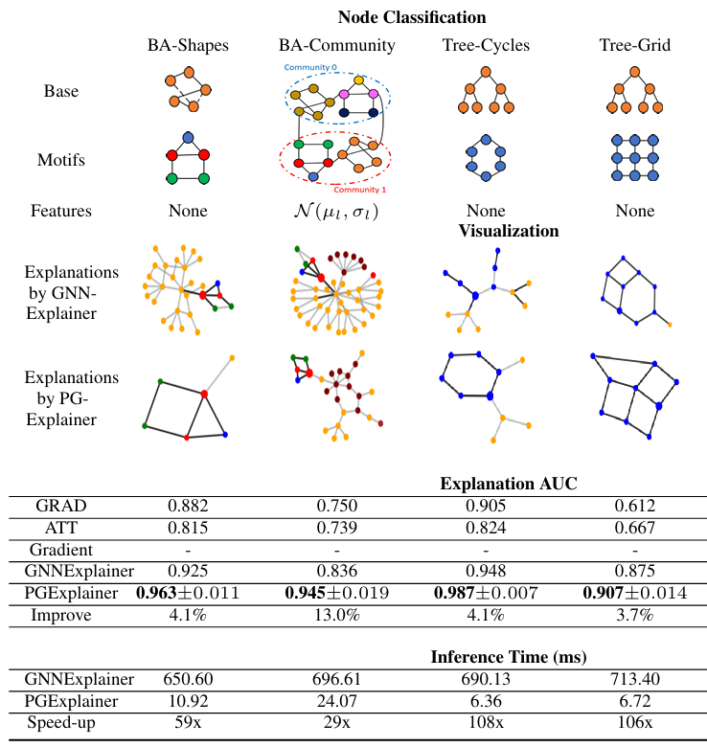
Interpret the Recommendation

Slide 11
Possible Limitation
PGExplainer doesn’t have implementation for Link Prediction (only for Node and Graph prediction)
Github is not highly maintainced
Technical challenges related to Graph Theory

