Slide 1
Research in Applications for Learning Machines (REALM) Consortium
Situational Knowledge On Demand (SKOD)
24 January, 2020
Bharat Bhargava
Purdue University
Technical Champion: Dr. James MacDonald

Slide 2
Collaborations
Researchers
  Bharat Bhargava (Purdue)
  Michael Stonebraker (MIT)
  Michael Cafarella (MIT)
  Aarti Singh (CMU)
  Peter Bailis (Stanford)
Students
  KMA Solaiman
  Alina Nesen
  Pelin Angin
  Ganapathy Mani
  Zachary Collins (MIT)
  Aaron Sipser (MIT)
  Tao Sun (MIT)
  Servio Palacios
  Miguel Villarreal-Vasquez
  Denis Ulybyshev
  Daniel Kang (Stanford)

Slide 3
Collaborations
NG: SKOD proposal is developed with the guidance of Dr. Jim MacDonald. His suggestions on situational awareness and real time adaptive ML models with multimodal data helped us formalize the science on this project.
Purdue/MIT: Building a real time Urban Information system for city of Cambridge and to assist West Lafayette Police.
Joint weekly meeting with West Lafayette police Sargent Troy Greene.
CMU: CMU is working with us for building the offline model construction for feature extraction from video dataset, Efficient labeling, transfer learning.
Stanford is working on real-time content reduction and object association.

Slide 4
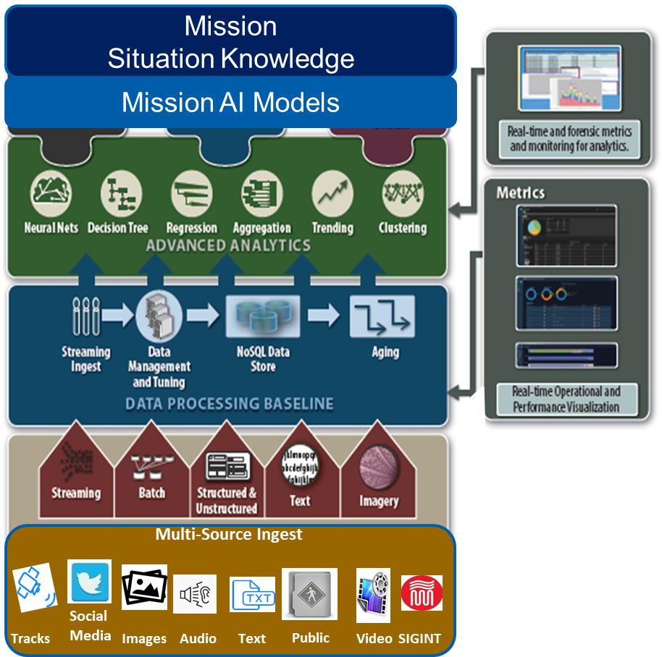
The project is applicable across a variety of industries, military to commercial to academic. ( Jim MacDonald, Northrup Grumman)

Slide 5

Integration with Paradigm (System at NG)
Multiple Data Sources
SKOD
Novel Sources
Ingestion & Preprocessing
SKOD
Data Processing Pipeline
Analytic Post-Processing
SKOD
Relevant Tweet Extraction
Object Detection
Video Feature Extraction
Title & Entity Extraction
Subj, Verb, Obj Extraction
Knowledge Graph
Indexing
Alerting
SKOD
User Profiling
Data Profiling
Alerts

Slide 6
Outline
Architecture Modules
Possible Scenarios
Objectives
Problem Statement
Datasets
SKOD Architecture
Summary
Deliverables and Demo
Future Plans
Data Streaming
Feature Extraction
Knowledge Graph
User Profiling
PostgreSQL Database
Graph-based Indexing Layer
Front End

Slide 7
Develop learning algorithms to establish mission based situational awareness
NGC View
Model the User
Data Management
Mission Relevance
Scaling
Techniques to model the user, specifically their mission-needs, preferences, and capabilities
Resource aware management
Content Reduction to event association
Metadata Tagging
Security Policies
Identify the relevance to user’s needs
Assess patterns in data
Connect disaggregate data sources
Techniques to support millions of users
Automatically extract data relevant to significant events, identify patterns related to a mission, and push relevant information efficiently to interested parties

Slide 8
Objective: Automatically extract data relevant to significant events, identify patterns related to a mission, and push relevant information efficiently to interested parties (e.g. analysts, cyber security experts, and decision makers)
NGC Guidelines and NEEDS:
  Techniques to model the user, specifically their mission-needs, preferences, and capabilities
  Data management techniques:
    Efficient management, storage, and retrieval of multi-modal data that is aware of infrastructure, storage, bandwidth, and compute resources
    Data mining algorithms to reduce content by association to event attributes
    Novel metadata tagging and indexing of data from heterogeneous sources
    Enforcement of security and data sharing policies
  Determination of Mission Relevance:
    Algorithms that identify the relevance of data to the user’s information needs and can process data of varying levels of confidence and provenance
    Means to assess data patterns for rate of occurrence and generalization for predictive value of information to mission
    Collaboration through virtual communities of interest to discover new user-relevant information
  Techniques that support scaling to 1000s of users

Slide 9
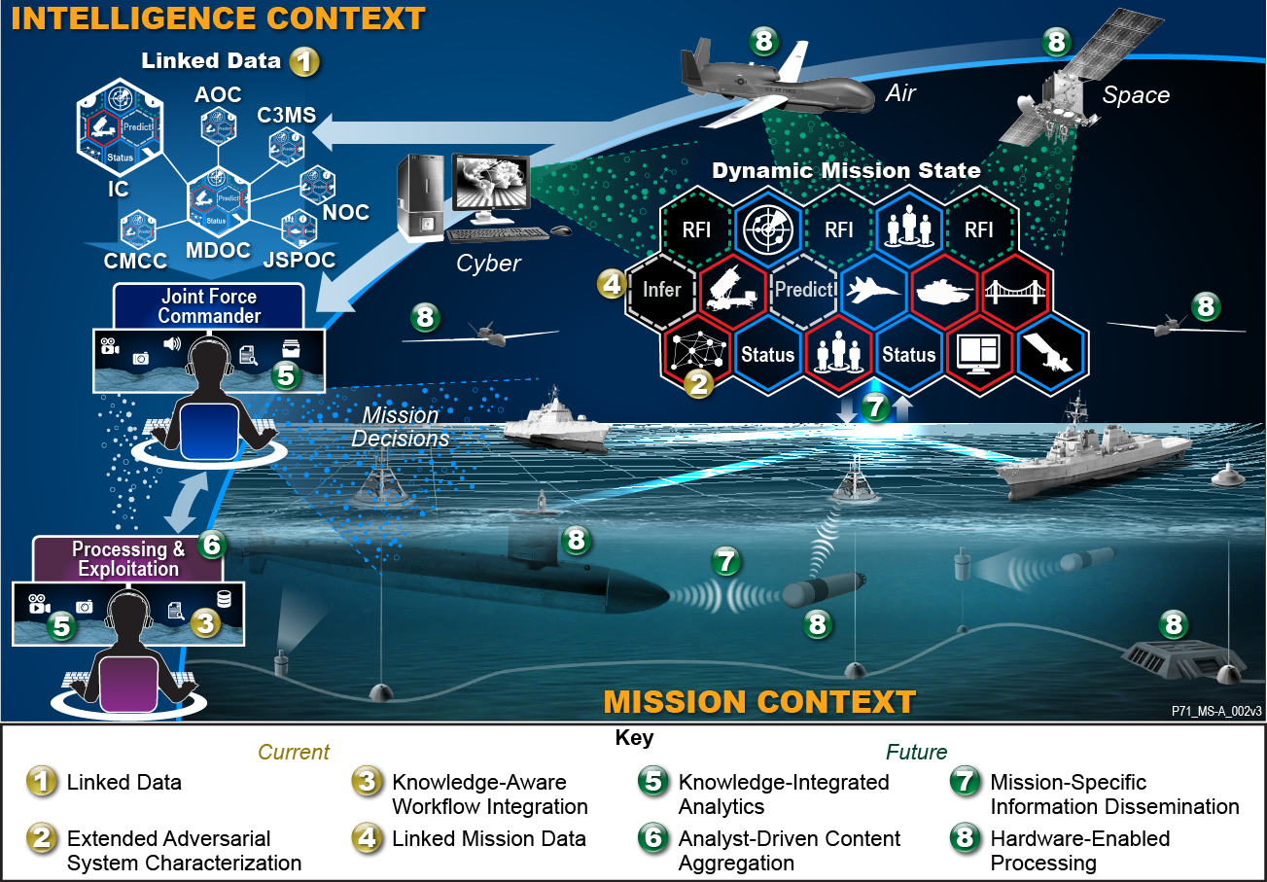
NGC Plans
Observe and collect user behavior through unobtrusive multi-modal interfaces
Model the mission interests, preferences, context, priority and capabilities
Novel streaming metadata tagging and indexing of data from heterogeneous source
Data mining algorithms that identify mission content by association to event attributes (e.g. by clustering, regression and rules) of streaming sources
Push context-aware relevant information to the mission user.
Adapting Mission Information and Processes to Allow Trusted, Collaborative Participation.
Notes:
Linked Mission Data
Enterprise-level content integration of multi-int, multi-source data within the context of a mission and a set of federated common models
Augmentation of base content with correlation and aggregation algorithms that create links based on temporal, spatial, semantic, or mission-specific rules
Human and machine interfaces for cognitive and analytic augmentation of base data and decision support analysis
Critical Element Identification:
Objective: Automatically identify critical components in complex systems (and systems of systems) by analyzing semantic graph models of the system
Current State of the Art:
Target analysis is currently carried out by teams of subject matter experts
Requires months to complete analysis
Business Case
Entry point to analytics on semantic graphs
Augment Linked Data capabilities for Air Force Customers
Mission Impact:
Near Term: Reduction in time and labor required for critical component analysis
Long Term: Key Technology for automated mission planning
Automated Ontology generation
Enables Long Term Objective: Fully autonomous agents capable of reasoning about and adapting to unexpected entities in their environment
Enables Near Term Objective: Automatic update and augmentation of model ontologies increasing system flexibility and reducing manpower requirements

Slide 10
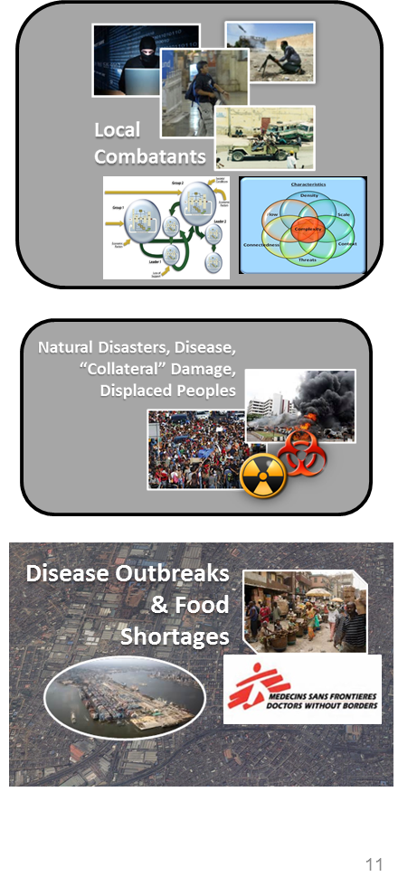
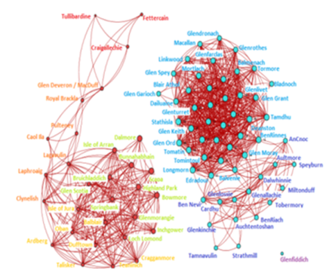
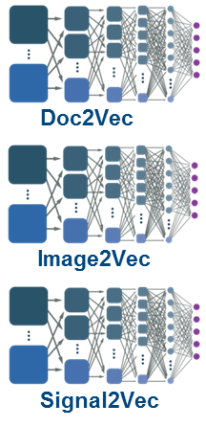
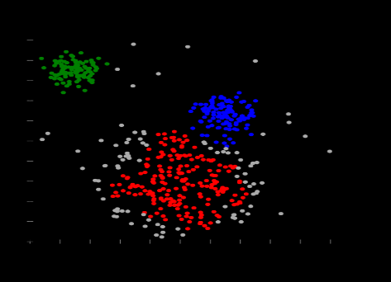
Use Cases Northrup Grumman
Mission Situational Knowledge
Data Correlation
Resolved entities, activities and events
Multi-Intelligence Sources
Text
Audio
Video
Social Media
News
SAR
GMTI
EO/IR
Hyperspectral
RF

Slide 11
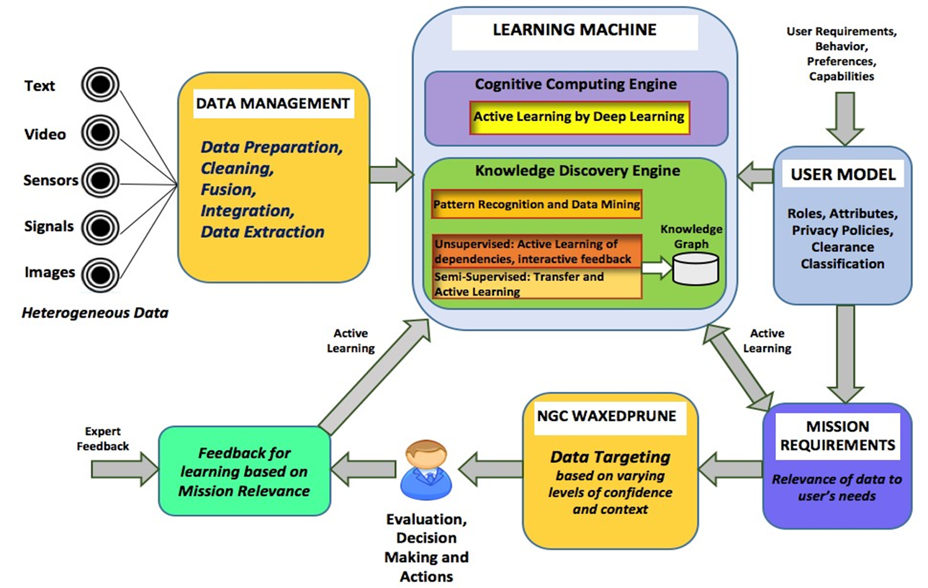
Situational Knowledge on Demand : SKOD Team-Operational Plans

Slide 12
Spectrum of Machine Learning Tasks Applied for SKOD:
Natural Language Processing for Text Data:
  LDA (Latent Dirichlet allocation) for topic modeling
  LSA (Latent semantic analysis) for relationships between documents
Deep Neural Networks for Video Data:
  YOLO for object detection and classification
  Action detection with R-C3D neural network
Recommendation Engine and Building User Profiles:
  Variational Bayesian methods for user modeling

Slide 13
Research Directions and Algorithms
CNN based Neural Networks and Transfer Learning for objects from Video.
Label-efficient learning (Aarti at CMU), Data Completion (Vaneet at Purdue)
LSA, LDA and Deep Learning (encapsulating Word2Vec) models for topics, ontologies and triplets from Text and to build knowledge base.
DL model combining attention based Bi-LSTM and CNN [4] to classify tweets for Disaster Resource Management and similar scenarios.
BlazeIt [5] for complex queries over video related to objects of interest.
Research DAWN’s End-to-End ML Systems [6] for Recommendation.
Research reinforcement learning and active learning for User Profiling.
Apply models to other NG large databases (sensors, signals, text, phone calls, videos, images, voice)
Notes:
Scalable and real time
* six (Rescue needed, DECW, Water needed, Injured, Sick, Flood). Disabled, Elderly, Children and Women. "Water Needed" as drinkable water identified as a vital resource during any disasterr. food plays a critical role during hurricanes and. Those six classes help in determining the rescue situation, and their priorities along with the resources needed or requested in a tweet. To classify a tweet, the tweet text along with a processed set of auxiliary features fed into the classification algorithm.
* BlazeIt, a system with a query language and optimizer to accelerate complex queries over video. FrameQL’s schema contains extracting spatiotemporal and content information related to objects of interest, as well as metadata (class, identifiers). Each record is associated with a frame, but a frame may have no or many records.
Object class (e.g. bus, car, person)
sceneid - Unique identifier for a continuous time segment when the object is visible
globalid - Unique global identifier for object (e.g. license plate number)
* Research DAWN’s End-to-End ML Systems for Classification over massive streams, Personalized recommendations, or Unifying SQL, Graphs, and Linear Algebra.

Slide 14
Proposed Solution
Perform data fusion for heterogeneous data resources
Clean data from fuzziness and clutter.
Perform automatic data labeling.
Identify patterns.
Push information to the relevant party with or without input from experts in a context-aware, timeless manner.
Push the relevant information to parties based on their profiles, preferences and context of interactions.

Slide 15
Proposed Solution
Components:
Data Management
Data Completion
Knowledge Graphs
User Profiles and Target Information Propagation
Profiling and Data Propagation with WAXEDPRUNE
Machine Learning Toolkit

Slide 16
Data Management
Vision of Professor Mike Stonebraker at MIT

Slide 17
Problem Statement
Discover and extract relevant data for a data scientist from multiple sources
Clean data from fuzziness and clutter
Perform data fusion for multiple heterogeneous data sources
Prepare heterogeneous data for Learning Machine Engine

Slide 18
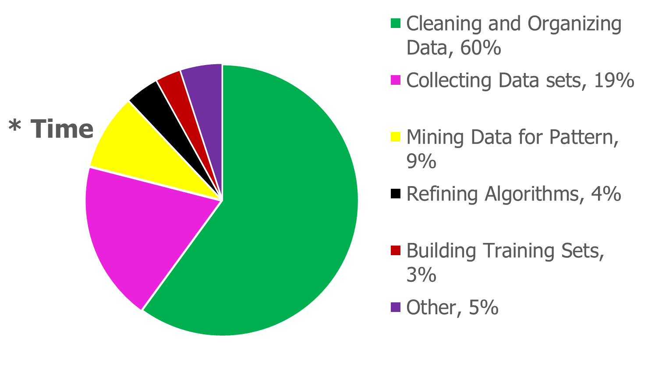
How Data Scientists Spend Their Day
NOBODY REPORTS LESS THAN 80% “MUNG WORK”
* Diagram taken from https://visit.figure-eight.com/rs/416-ZBE-142/images/CrowdFlower_DataScienceReport_2016.pdf

Slide 19
Activities
Relevant Publications:
S. Palacios and K. Solaiman, P. Angin, A. Nesen, B. Bhargava, Z. Collins, A. Sipser, M. Stonebraker, J. Macdonald. SKOD: A Framework for Situational Knowledge on Demand. In Polystores and other Systems for Heterogeneous Data (Poly), at VLDB 2019, LA, California, August 30, 2019.
K. Solaiman, B. Bhargava, J. MacDonald. Multi-modal Information Retrieval via Joint Embedding. In NGC TechFest 2019, October 23 2019.
K. Solaiman, B. Bhargava, J. Macdonald. DT2Vec:Partial Framework for building a multi-modal knowledge base, In Submission, 2020.
A. Nesen, B. Bhargava, J. MacDonald. Explainable Anomaly Detection in Surveillance Video With Deep Learning and Knowledge Graphs. (To be submitted)
M. Kabir and S. Madria. A Deep Learning Approach for Tweet Classification and Rescue Scheduling for Effective Disaster Management. In 27th ACM SIGSPATIAL International Conference on Advances in Geographic Information Systems, Chicago, Illinois, Nov 7, 2019.
D. Kang, P. Bailis, and M. Zaharia. Blazeit: Fast exploratory video queries using neural networks. (2018).
Peter Bailis, et al. Infrastructure for Usable Machine Learning: The Stanford DAWN Project. (2017).
Notes:
ONR = Office of Naval research
Alina's MILCOM paper, if added make 2 pages for achievements
Do you want other milcom papers?
Sandia Proposal (SDN) ?

Slide 20
Proposals
DARPA award on Science of Artificial Intelligence and Learning for Open-world Novelty (SAIL-ON) initiative of DoD (JOINT with Information Science Institute)
  Generating Novelty in Open-world Multi-agent Environments (GNOME)
Awards from FORD (SDN and Vanets), Sandia Lab (MTD to Harden Space systems), JPL (Security), Northrup Grumman (two projects: ML attacks and Explainable AI and REALM)
White papers submitted for DoD, ONR, Plans for NSF proposal

Slide 21
AFRL, Rome Request for Information
The Air Force Research Laboratory, Information Directorate (AFRL/RI) is seeking information to better understand existing vendor offerings within the landscape of research and development (R&D) that could later drive the development of prototypes of Machine Learning (ML) enabled Operational Command & Control (C2) functions and assess their notional value1, 2 to Operational C2.
The Air Force is investigating the incorporation of Machine Learning capabilities into Air Force C2 applications. As such, it is interested in the identification of C2 applications that can benefit from the incorporation of these capabilities, an understanding of how these applications and operations can notionally benefit, and the algorithms, and necessary data that will be a part of these implementations. This RFI is requesting information to better understand those AF C2 applications that have incorporated ML, those that could incorporate ML in the future and the algorithms which support these advanced capabilities. The C2 applications should fall into one of the following categories: Operational C2 supporting the air tasking process, battle management supporting operations execution, tactical-level C2 supporting the end-user, and Multi Domain C2.

Slide 22
Army Research Lab
STRONG addresses a critical objective within a broader Army goal to enable effective integration of Artificial Intelligence / Machine Learning (AI/ML) in the battlefield. This program has been developed in coordination with other related ARL-funded collaborative efforts (see descriptions of ARL collaborative alliances at https://www.arl.army.mil/www/default.cfm?page=93) and shares a common vision of highly collaborative academia-industry-government partnerships; however, it will be executed with a program model different than previous ARL Collaborative Research/Technology Alliances.

Slide 23
Long Term Objectives of Research
Retrieve knowledge for multiple users’ changing needs and mission. Relate multi-modal data and dynamically update/build the knowledge base for users. Utilize users' queries to build knowledge on top of a relational database and cache appropriate data and queries to improve performance. Lean about Knowledge graphs from ISI research.
Integrate new streaming data with knowledge queries already used by mission. Complete the unfulfilled data needs for missions. Discover new knowledge that can benefit mission
Conduct research in learning machines to make this efficient at large scale
Research transfer learning, reinforcement learning, active learning and apply to NG large databases ( sensors, signals, text, phone calls, videos, images, voice) Some of these are long term objectives. Include efficient labeling, NLP
Make system practical and responsive and efficient by using systems, ML, and tools already available and used in industry
Slide 23

Slide 24
Data Management
Data at rest.
Segments of video as tuples in the DB.
Feature analysis.
Queries model the knowledge.
Postgres
Slide 24

Slide 25
Queries model the knowledge
Related queries build knowledge.
All queries can relate to one event.
Mission changes with the data stream.
Query engine
Queries -> Knowledge
Slide 25

Slide 26
Queries model the knowledge
Alerts
Triggers
Cached queries
Query engine
Cache hot queries
Cache recently used data
Slide 26

Slide 27
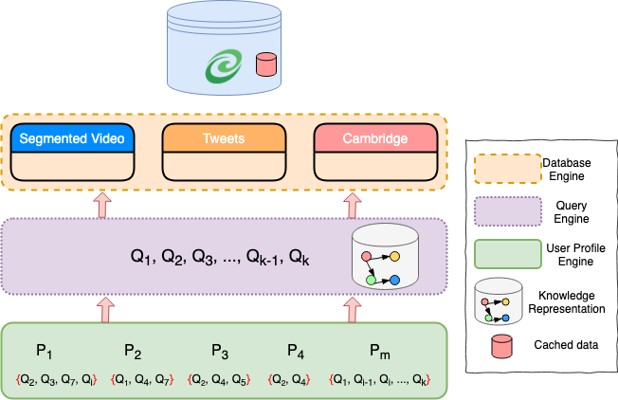
Situational Knowledge Query Engine Architecture
Slide 27

Slide 28



Scenario: Save Child Left Alone in Car in heat or cold
In 2019, 51 children died from heatstroke after being left in a hot vehicle, 2 in Indiana.*
Context & User | Mission | Contextual Info. Propagation
Normal Day & Regular Petrol | Finding an Unattended Child in Car | Send to Appropriate User
During an Earthquake & Rescue Personnel | Finding an Unattended Child in Car | Send to Appropriate User
Situational Information forwarded to Appropriate User
SKOD
Bad
Good
City Data
* https://injuryfacts.nsc.org/motor-vehicle/motor-vehicle-safety-issues/hotcars/

Slide 29
Situational Information forwarded to Appropriate User
SKOD
City Data

Slide 30
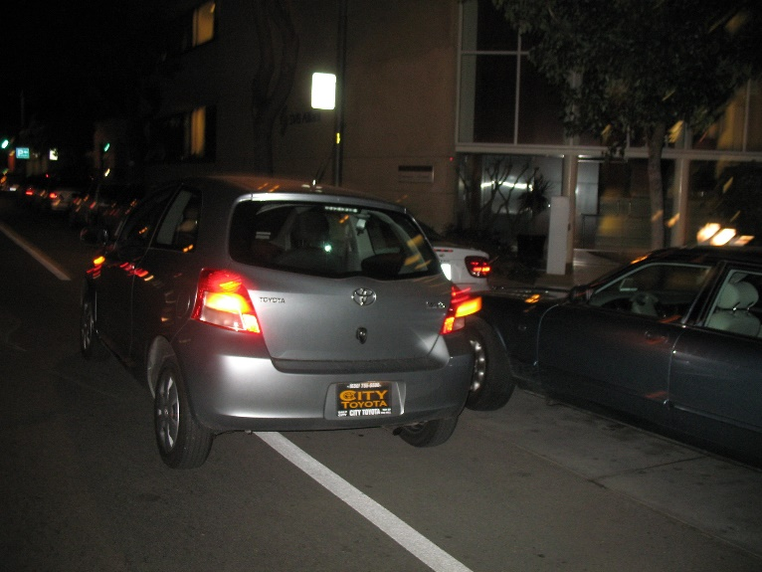

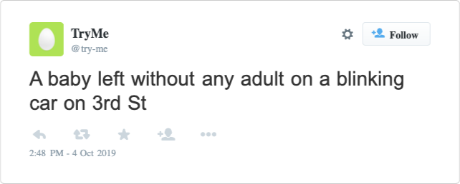
Child Left Alone in Car (Context: Earthquake)
Image of a Flashing Car
Child left alone on 3rd St
Mission-relevant info forwarded to police & fire fighters!

Slide 31
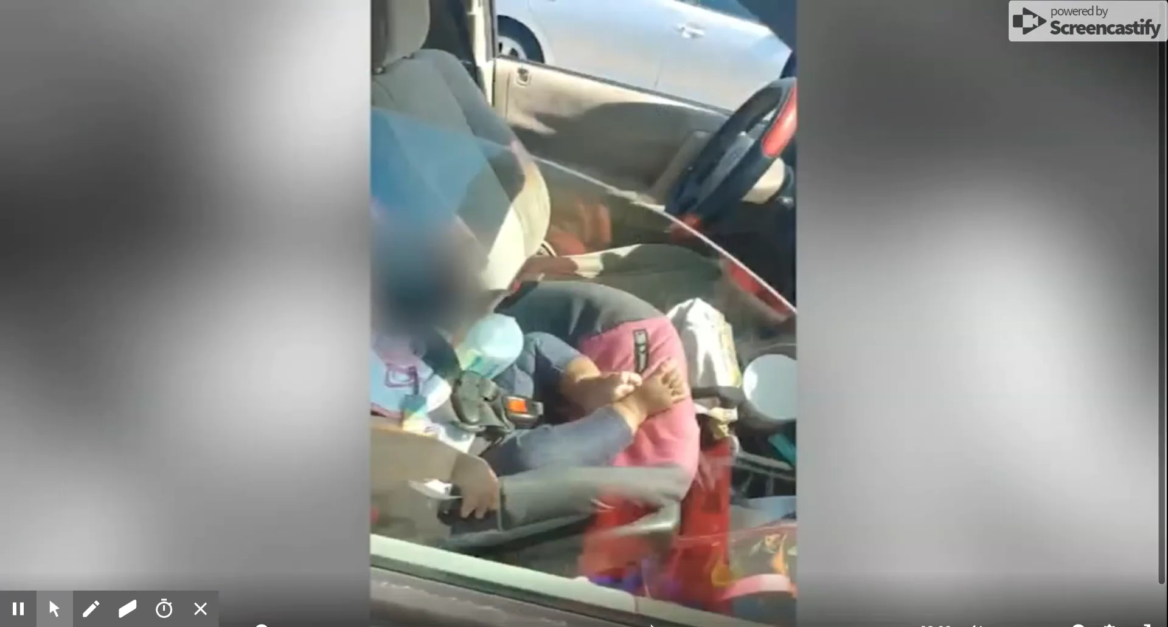

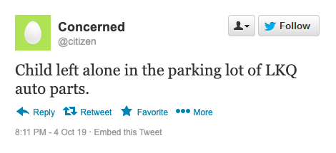
Child Left Alone in Car (Context: Normal Condition)
Child left alone in LKQ parking lot
Child left alone in blue van
Mission-relevant info forwarded to police!
https://www.wral.com/wake-county-sheriff-s-office-investigating-after-viral-video-of-child-left-alone-in-car/18656144/
Notes:
Say, we have these information coming form different data sources
We can see a child left alone in a hot summer day in a parking lot. The video will keep playing in loop. We want to answer the question – who was the culprit and we want to identify incidents like this and notify the appropriate authorities to save life
From first level of information we get that Child was left alone in LKQ parking lot and in a blue van
Second video and that derived information gives us the culprit.
Importance of the research

Slide 32
Scenario: Stop Suspected Person from Violence
NY Police needs to Know
Context:
New Years Evening
ATF Records
Record of people buying guns and ammunitions in an area
BMV Records
crimemapping.com
GPS tracking
Census Records
Record of DUI Convictions
Is involved in Assault / Disturbing the peace / Homicide / Vandalism
Headed to NYC times square
No Family Connection to NYC or close by
Suspected Person
Notes:
Bureau of Alcohol, Tobacco, Firearms and Explosives
Another example can be this – identifying person of interest in dangerous situation
Data .. Comes from sources ….
Waco massacure
We fill in the gaps and identify the person
Importance of the research

Slide 33
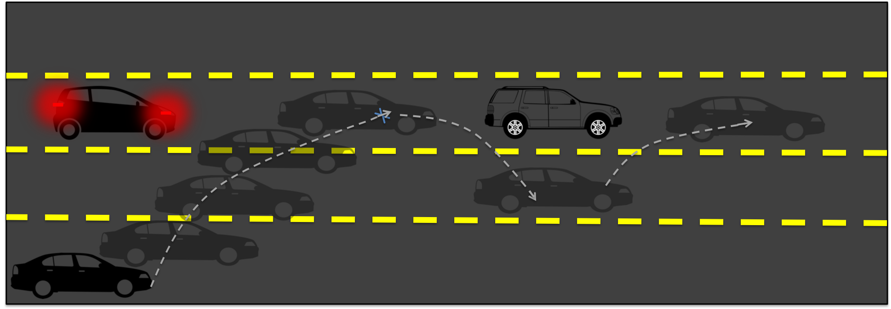
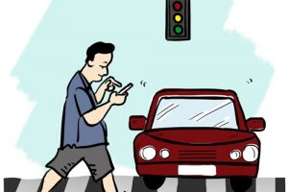
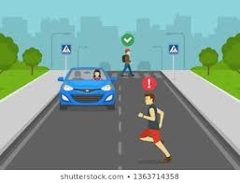
Urban Information System Scenarios
Identify Unsafe Lane Changes
Identify Jaywalking
Notes:
Two more scenarios that can be of interest is this – identify jay walking (China is already doing it using facial recognition)
Unsafe lane changes, data comes from different videos or images at different point of time, we want to connect those and identify the cars that are doing it and notify the user, in this case correct authority.
Importance of the research

Slide 34
City of Cambridge: Agents
Numerous agents with different missions in a city (i.e., Cambridge)
  Cambridge police
  University (Harvard, MIT) police
  TRANSIT police
  Cambridge public works
  Citizens
  FEMA ( Emergency personnel)
  Homeland Security
Notes:
SKOD Framework focuses on agents in a city which includes different law enforcement agencies, city councils, general mass or emergency personnel.
They have different mission based on different situations such as detecting unsafe lane change or detecting a chasing car.

Slide 35
Missions
Missions with various needs for information
  MIT police (pedestrians in the middle of the road, unsafe lane changes, ”choke” points, Child left alone in parked car, purple Cadillac used by a bad guy identified …)
  Cambridge public works (potholes, down or occluded street signs)
  Citizens (crane or car illegally blocking the sidewalk in front of house)
Notes:
So our objectives of the research is ….
Scope of the research

Slide 36

SKOD Objectives
SKOD Service
SKOD Service
Retrieve knowledge needed by multiple users with changing needs based on Situational Awareness
Relate multi-modal data and update the knowledge for users
Integrate new streaming data with queries already used by mission
Complete the unfulfilled data needs for missions based on the Situation and User Preference
Data Repository
Learning Machine Engine
Data Repository
Learning Machine Engine
All available data
All available data
Data Requests
Access
Pattern DB
Data Requests
Knowledge Discovery Engine
Access
Pattern DB
Knowledge Discovery Engine
Deep Learning Module
Deep Learning Module
Pattern Recognition
Pattern Recognition
New data item
User 1
User 1
Recommended data after processing
User Profiling
Recommended data for User 1
User Profiling
User 2
Data Controller
User 2
Preferences
Roles
Context
Data Controller
Preferences
Roles
Context
Objective 1: Relevant data is efficiently passed to users based on their requests
Objective 2: New data items are directed to interested users based on User Profiling.
Notes:
SKOD aims to extract required knowledge for an user with changing needs and situations
For doing that we have to relate multi-modal data. SKOD not only aims to work for data at rest, but also it will update the knowledge base with new streaming data, and deliver the correct incoming data to the correct user based on the user profiling. Based on data modeling, SKOD wants to fill the info. gap for missions.

Slide 37
Datasets Collected for City of Cambridge
Video
  100+ hours of dashcam video collected at MIT
  Raw video can be retrieved from MIT database at Cambridge
    Split into chunks of 30 seconds
    Metadata collected: geolocation and timestamp for each 30 seconds
Unstructured Text (Twitter data)
  Collected ~200K tweets (Target ~ 1 million)
  Automatic tweet parsing and recording system into Postgres in place
Structured data
  Cambridge public datasets
  Automatic weekly updates into Postgres in place
Data from drones and dashcams
Notes:
Currently SKOD has 3 main modalities of data 0 video, unstructured and structured text. MIT collected 100+ hours of dashcam video to build the video database. Purdue collected more than 200K tweets to build the UT database. There is an automatic parsing and recording system in place for tweets and Cambridge public datasets.

Slide 38
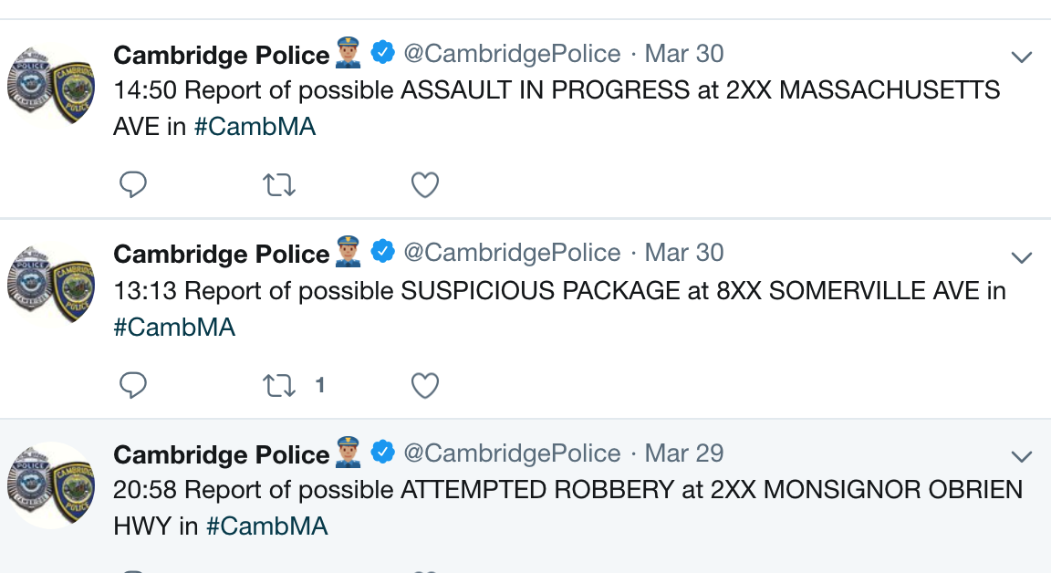
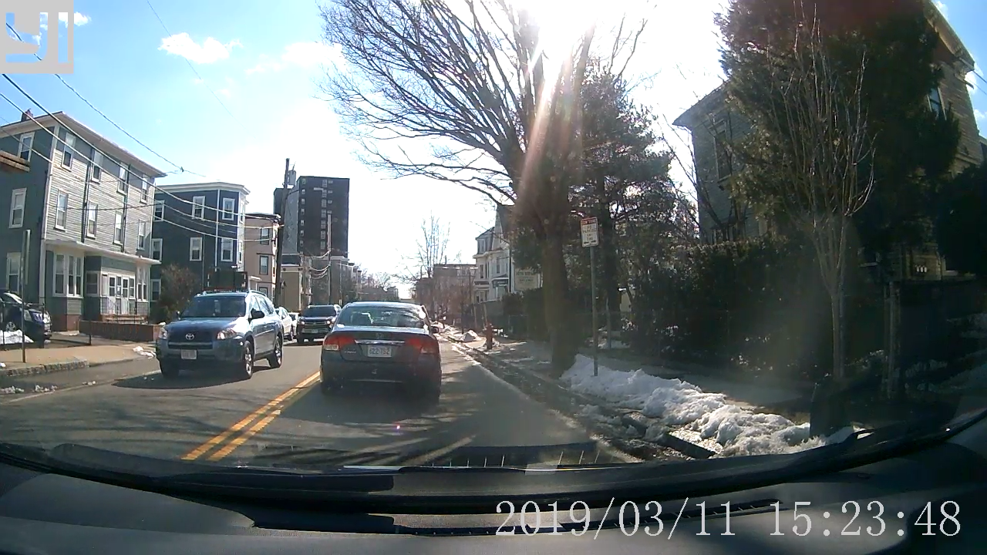
Datasets Example
Tweets from Cambridge Police
A video that has a bicyclist without helmet on it 00:01 to 00:27

Slide 39
Future Datasets
Waymo Open Dataset
  Sensor data
    Synchronized lidar and camera data from 1,000 segments (20s each)
  Labeled data
    Labels for 4 object classes - Vehicles, Pedestrians, Cyclists, Signs
Yelp Dataset
  Reviews
  Businesses
  Pictures
  Metropolitan Areas
News Articles
  https://www.cambridgema.gov/news?page=2&ResultsPerPage=10
  Google News
Notes:
LIDAR – light detection and ranges
Sensor data
1 mid-range lidar
4 short-range lidars
5 cameras (front and sides)
Synchronized lidar and camera data
Lidar to camera projections
Sensor calibrations and vehicle poses
Labeled data
Labels for 4 object classes - Vehicles, Pedestrians, Cyclists, Signs
High-quality labels for lidar data in all 1,000 segments
12M 3D bounding box labels with tracking IDs on lidar data
High-quality labels for camera data in 100 segments (more to be added soon)
1.2M 2D bounding box labels with tracking IDs on camera data

Slide 40
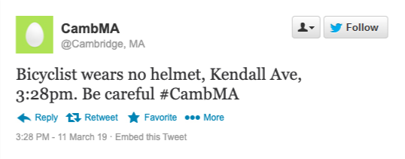
Example Mission on Datasets
Goal:
  Discover bicyclists riding without helmet
  Find location and timestamp of the violation
Connect the tweets and the video
Tweet is retrieved for the desired search query “Bicyclist”
  Tweet contains timestamp and geolocation
  Tweet contains location in text
Find videos that contain “bicycle” from nearby locations with a timestamp within an hour
  A video that has a bicyclist without helmet on it from second 1 to 27

Slide 41
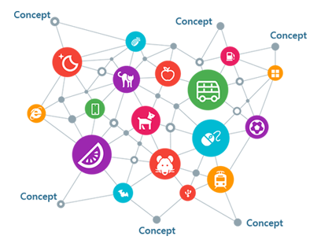



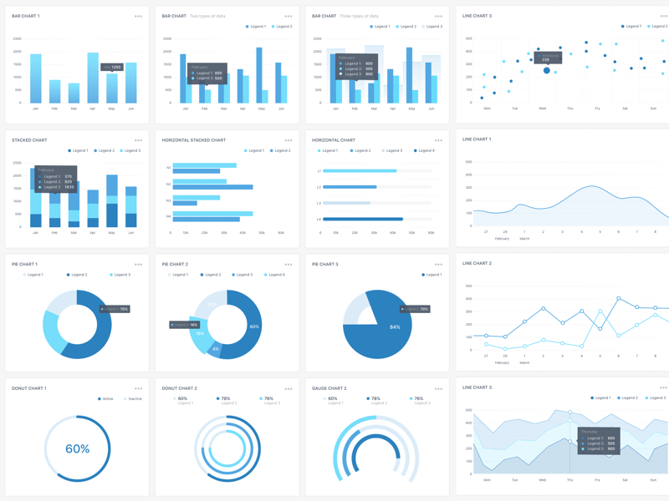

Architecture
Feature Extraction
ML, NLP
Index Constructor
Multimodal Streaming Data
Data Sources:
Video: Traffic Cam, Static Cam
Social Media: Twitter
Text: Cambridge / WL City Data
Data type Processors
NLP (Text)
Knowledge Graph
2
Vision (Video)
3
Kafka Topics
1
PostgreSQL
Indexing Layer
Video
ES Writer/Mapper
Text
4
5
Front End
Microservice
User Profiling
Users’ queries
Triggers
Heterogeneous Data Streams
Active Learning
Knowledge derived from queries
Situation-aware Recommendation
Situational Aware Indexed Data
Relevant patterns of data
Notes:
Corerct this

Slide 42

Architecture
Feature Extraction
ML, NLP
Index Constructor
Multimodal Streaming Data
Data Sources:
Video: Traffic Cam, Static Cam
Social Media: Twitter
Text: Cambridge / WL City Data
Data type Processors
NLP (Text)
Knowledge Graph
2
Vision (Video)
3
Kafka Topics
1
PostgreSQL
Indexing Layer
Video
ES Writer/Mapper
Text
4
5
Front End
Microservice
User Profiling
Users’ queries
Triggers
Heterogeneous Data Streams
Active Learning
Knowledge derived from queries
Situation-aware Recommendation
Situational Aware Indexed Data
Relevant patterns of data
Notes:
Corerct this

Slide 43
Demo Video
In the demo video, we demonstrate as follows.
  How twitter data is consumed and processed via Data Streaming Module
  Extracting objects from Videos
  Extracts the tweets that discusses about Object in Question
  Tie features from different modality using the Indexing Layer
    Build Index on the objects from videos and tweets
  Functionality of the Front End with Graph Analytics
  User Profiling extracts other objects that can be of users’ interest
  Allows user to see those objects from all modalities
Notes:
The goal of our feature extraction module is to answer user queries on demand. We have a simplified query like this –
We want to
From our earlier example, if we want to find unattended child, we need to make a query like this to our DB, user might not make it, and directly ask for childs unattended in car
And Feature extraction module is going to handle it.

Slide 44
Demo Video
Simplified Query
Select * from tweets, videos where tweets.objects_discussed == "car" videos.objects_detected == "car”
Demo Video URL
  https://youtu.be/5TqWKzy5SqI
Notes:
The goal of our feature extraction module is to answer user queries on demand. We have a simplified query like this –
We want to
From our earlier example, if we want to find unattended child, we need to make a query like this to our DB, user might not make it, and directly ask for childs unattended in car
And Feature extraction module is going to handle it.

Slide 45
Architecture
Feature Extraction
ML, NLP
Index Constructor
Data type Processors
NLP (Text)
Knowledge Graph
2
Vision (Video)
Data Streaming
3
1
PostgreSQL
Indexing Layer
Kafka Topics
Video
ES Writer/Mapper
Text
4
5
Front End
Users’ queries
Microservice
Heterogeneous Data Streams
Knowledge derived from queries
Situational Aware Indexed Data
Relevant patterns of data

Slide 46
Feature Extraction Module
Example Query
Select * from tweets, videos where tweets.objects_discussed == "car" and tweets.objects_discussed == "child" and videos.objects_detected == "car" and videos.objects.detected == "child"
Answer queries such as above
Find interesting features from incoming data and data at rest
Relate data from different modalities
Notes:
The goal of our feature extraction module is to answer user queries on demand. We have a simplified query like this –
We want to
From our earlier example, if we want to find unattended child, we need to make a query like this to our DB, user may use natural language queries and directly ask for childs unattended in car
And Feature extraction module is going to handle it.

Slide 47
Extracting Features from Video with Deep Learning
Object detection and classification: best result achieved with deep learning architectures:
  Faster RCNN
  YOLO
  SSD
Manual annotation and labeling
  Time-consuming and expensive for large datasets
  Outsourced human labor can be employed (MTurk)
We use pre-trained YOLO neural network to extract knowledge, detect and label objects in video
Retrain YOLO with Transfer Learning for detecting classes outside of pretrained ones
Notes:
RCNN – REGIONS WITH CNN features

Slide 48
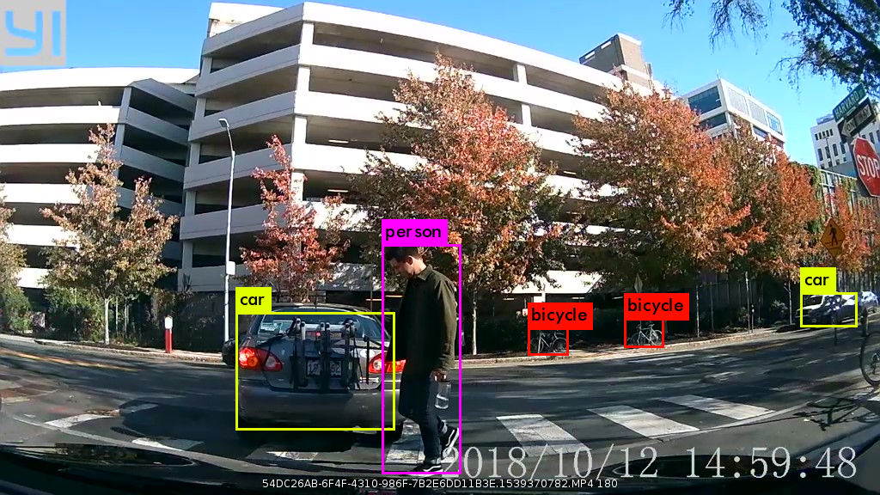
CNN-ROI based Architecture For Object Detection and Classification
YOLO detects 100+ classes
Our raw video dataset contains about 15 of the objects from these classes
YOLOv3 object detection algorithm
  Regions of interests (ROI) proposals are generated
  For each region, features are extracted and classified with Convolutional Neural Network
  Apply non-maximum suppression: all candidate regions where probability of certain object detection is not max are dismissed

Slide 49
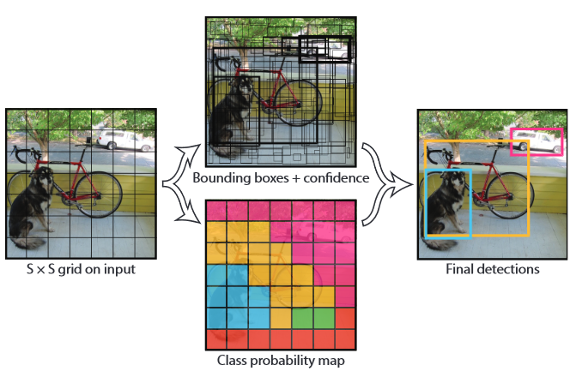
YOLO (You Only Look Once) Architecture
1. The image is split into an SxS grid of cells.
2. Each grid predicts B bounding boxes with C class probabilities
SxSxBx5 outputs in total
3. Conditional class probabilities are predicted Pr(Class(i)/Object):
SxSxC class probabilities
SxSx(B*5+C) output tensor
S=7, B=2, C=20 => (7,7,30)
Train a CNN to predict (7,7,30) tensor
Image source: You Only Look Once: Unified, Real-Time Object Detection
Joseph Redmon, Santosh Divvala, Ross Girshick, Ali Farhadi
https://arxiv.org/abs/1506.02640

Slide 50
YOLO (You Only Look Once) Architecture
Objective: fast object recognition and detection
Problem: CNN, R-CNN and modifications perform these tasks in multiple steps
Solution: YOLO determines the object location and classifies it in one go
Optimal for streaming video
Input image is divided into SxS grid
Each grid cell predicts bounding boxes (B) and class probabilities (C)
Bounding box coordinates and class probabilities are encoded in an ouput tensor predicted by YOLO
Boxes with less than optimal confidence scores are omitted after training
Image source: You Only Look Once: Unified, Real-Time Object Detection
Joseph Redmon, Santosh Divvala, Ross Girshick, Ali Farhadi
https://arxiv.org/abs/1506.02640

Slide 51









Detected Classes In the MIT Video Dataset
CAR
TRUCK
PERSON
BICYCLE
TRAFFIC LIGHT
STOP SIGN
FIRE HYDRANT
PARKING METER
… AND MORE!

Slide 52



Detected Classes In the MIT Video Dataset
CAR
TRUCK
PERSON
BICYCLE
TRAFFIC LIGHT
STOP SIGN
FIRE HYDRANT
PARKING METER
… AND MORE!

Slide 53




Knowledge Extraction From MIT Video Data
Frame-by-frame recognition for every 1 minute video
Saving: FrameID, list of objects’ bounding boxes coordinates, list of corresponding object tags, confidence level for each object, list of unique objects per frame and per video up to the current moment
Each frame is saved in jpeg format with the bounding boxes
Saving the extracted information with the video and frame IDs as indices

Slide 54
Datasets : Unstructured Text (Tweets)
For unstructured text, we are collecting Twitter data
Final target: 1 million tweets about Cambridge, MA
As data source, we use official hashtags and user profiles
Currently ~200K tweets has been collected
Automatic tweet parsing and recording system into Postgres in place
Parsed and processed tweets can be retrieved from MIT database:
  contains metadata with actual Tweet text
  Twitter object and User objects are stored in different tables

Slide 55
Preprocessing Tweets
Social media text has jargon, misspellings, special slangs, emojis
15:45 I luv my &lt;3 iphone &amp; you’re awsm apple, love you 3XXX. DisplayIsAwesome, sooo happppppy 🙂 🙏 http://www.apple.com #apple @sjobs
Cleaning process –
  HTML decoding
  Expanding Contractions
  Removing URL, Emoji, Reserved words, Smiley, User-mentions (or replace), hashtags
Preprocessing before tokenization
  Remove punctuation, space, stop word

Slide 56
Additional tasks for Social Media Texts
Normalization of Noisy Text
Awsm ~ awesome, luv ~ love
Methodologies
  Lexical normalization
  Normalization with edit scripts and recurrent neural embeddings
  Find balance between precision and recall

Slide 57
Topic Modeling with Tweets
Given a query keyword, we want to find similar tweets
We can do that by finding latent topics in tweets
Approach: Latent Semantic Analysis, or LSA
Raw counts do not work well as they do not account for the significance of each word in the document
  ‘a’ has little significance in determining topic
Instead calculates the tf-idf score, w_{i,j}
  Takes the number of documents the word appears in into consideration
Document-term matrix is very sparse
So Dimensionality reduction is performed with SVD (Singular Value Decomposition)
From Document-term matrix, A, we retrieve
  Term-topic matrix, V
  Document-topic matrix, U
Document is represented with Term-topic matrix
Finally, Apply cosine similarity, sim(q, d) to evaluate:
  similarity of terms (or “queries”) and documents (we want to retrieve passages most relevant to our search query).

Slide 58
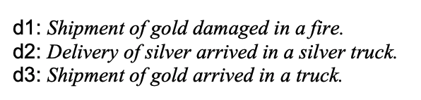
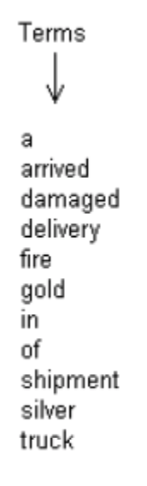
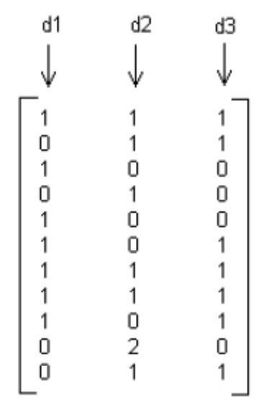
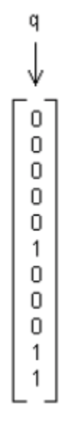


Topic Modeling with Tweets
Given a query keyword, we want to find similar tweets
We can do that by finding latent topics in tweets
Approach 1:
  Latent Semantic Analysis, or LSA
query: gold silver truck
Initially, we only have documents with terms
tf_{i,j}$=$
q$=$
Calculate the document-term Matrix, tf_{i,j}
Word count for each document
Notes:
The core idea is to take a matrix of what we have — documents and terms — and decompose it into a separate document-topic matrix and a topic-term matrix.
raw counts do not work particularly well because they do not account for the significance of each word in the document.

Slide 59
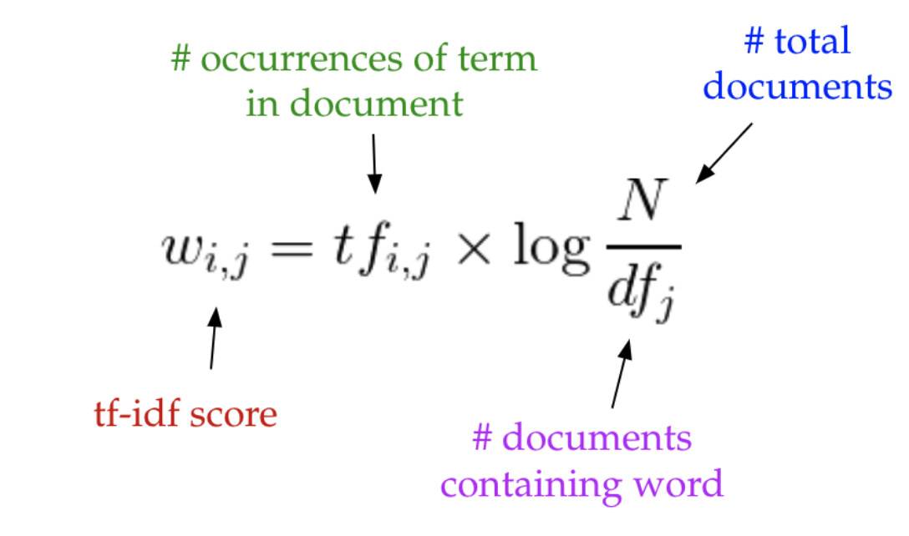
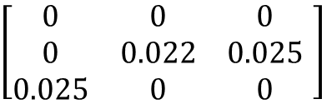

Topic Modeling with Tweets
Raw counts do not work well as they do not account for the significance of each word in the document
  ‘a’ has little significance in determining topic
Instead calculates the tf-idf score, w_{i,j}
  Takes the number of documents the word appears in into consideration
$$\left[\begin{matrix}0 & 0 & 0 \\ 0 & 0.022 & 0.025 \\ 0.025 & 0 & 0\end{matrix} \right]$$
w_{i,j}$=$
Effect of ‘a’ is diminished

Slide 60
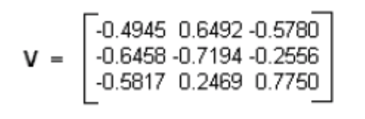

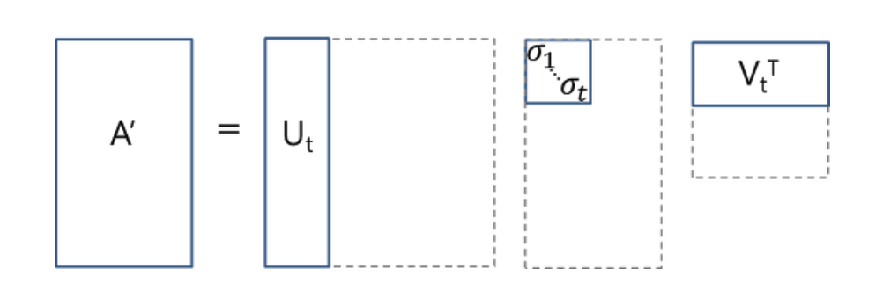
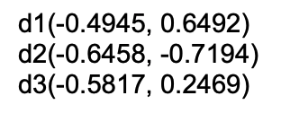
Topic Modeling with Tweets
Document-term matrix is very sparse
So Dimensionality reduction is performed with SVD (Singular Value Decomposition)
From Document-term matrix, A, we retrieve
  Term-topic matrix, V
  Document-topic matrix, U
Document is represented with Term-topic matrix
Dimensionality = 2, instead of 3
Retains top 2 Approximation to represent the document

Slide 61

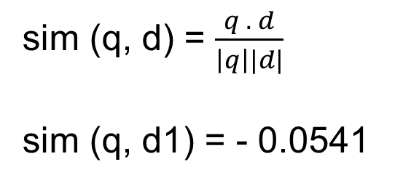
Topic Modeling with Tweets
Finally, Apply cosine similarity, sim(q, d) to evaluate:
  the similarity of terms (or “queries”) and documents (we want to retrieve passages most relevant to our search query).
sim (q, d) = $\frac{q . d}{\left|q\right||d|}$
sim (q, d1) = - 0.0541

Slide 62
Topic Modeling for Ontologies (Generative Models)
Even though LSA finds similar documents to user query, it has less efficient representation for topics.
Topics are necessary for ontologies while building our knowledge graph
LDA (Latent Dirichlet Allocation)
  Generative Model
  Uses Dirichlet priors for the document-topic and word-topic distributions
  Results in better generalization for new documents
  Allows online learning

Slide 63
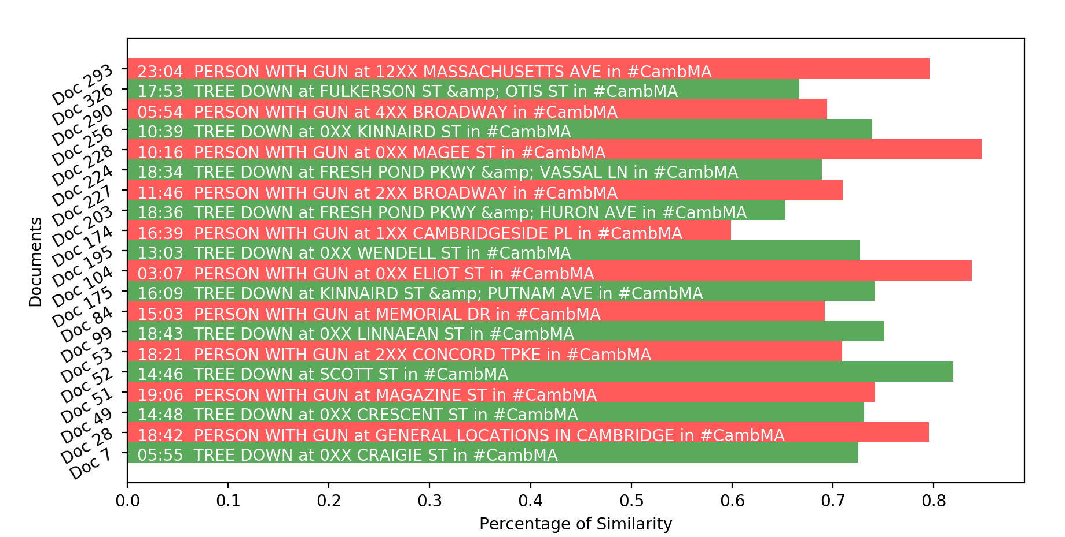
Same User with Different Levels of Interest
U₁
U₂
PERSON with GUN
TREE DOWN
D₀ | D₁ | D₂ | D₃
D₄ | D₅ | D₆ | D₇
D₈ | D₉ | D₁₀ | D₁₁
D₁₂ | D₁₃ | D₁₄ | D₁₅
Data at Rest
Notes:
Here is a demo for the whole process. We have a lot of documents at rest. We have 2 users, one with interest in query TREE down, another with person with gun. Now after we run our LSA, we will be able to tell how much each user is interested in those documents. User 1 is 72% interested in Doc 7, user 2 is 79% interested in Doc 28.

Slide 64
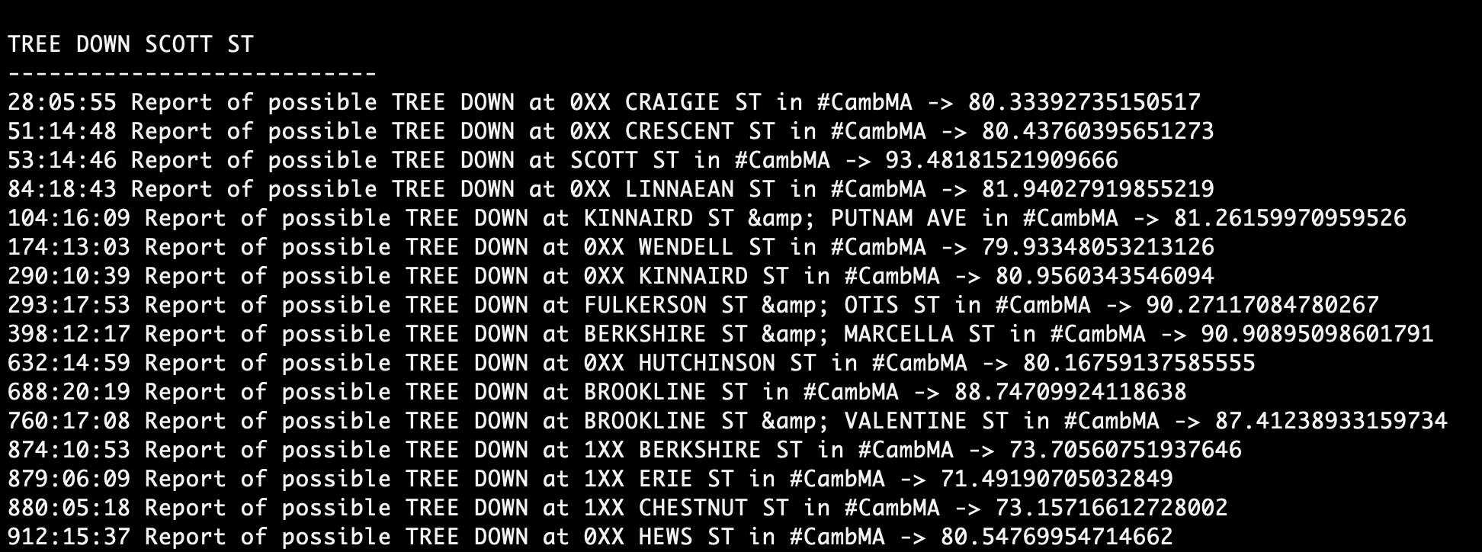
Results: Similar Documents to Query
U₁
Exact Key (93% Similar)
U₂
TREE DOWN SCOTT ST
PERSON WITH GUN MASSACHUSETTS AVE
Notes:
Here is a demo for the whole process. We have a lot of documents at rest. We have 2 users, one with interest in query TREE down, another with person with gun. Now after we run our LSA, we will be able to tell how much each user is interested in those documents. User 1 is 72% interested in Doc 7, user 2 is 79% interested in Doc 28.

Slide 65
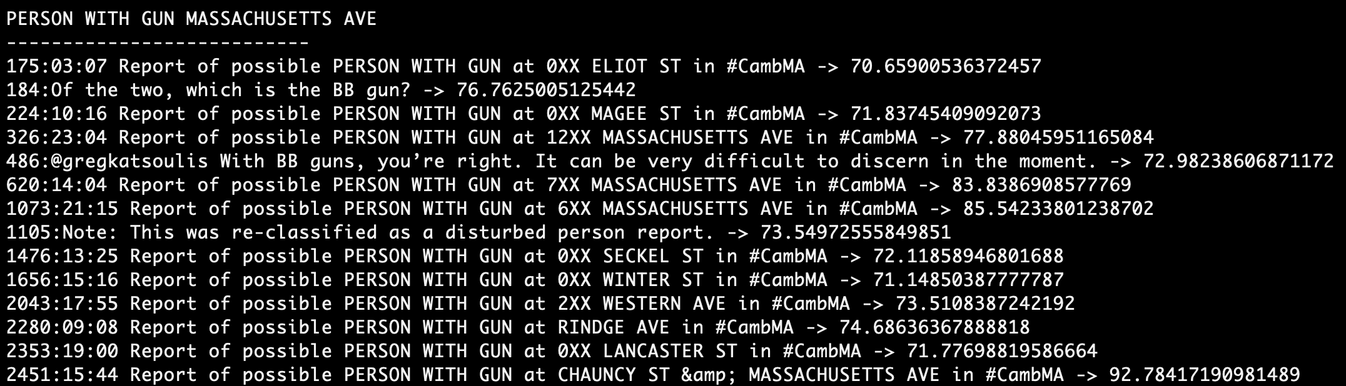
Results: Similar Documents to Query
U₁
Relevant Key
(70% Similar)
U₂
TREE DOWN SCOTT ST
PERSON WITH GUN MASSACHUSETTS AVE
Notes:
Here is a demo for the whole process. We have a lot of documents at rest. We have 2 users, one with interest in query TREE down, another with person with gun. Now after we run our LSA, we will be able to tell how much each user is interested in those documents. User 1 is 72% interested in Doc 7, user 2 is 79% interested in Doc 28.

Slide 66
Topic Modeling for Ontologies (Generative Models)
Even though LSA finds similar documents to user query, it has less efficient representation for topics.
Topics are necessary for ontologies while building our knowledge graph
LDA (Latent Dirichlet Allocation)
  Generative Model
  Uses Dirichlet priors for the document-topic and word-topic distributions
  Results in better generalization for new documents
  Allows online learning

Slide 67
Multiple Data of Interest to Different Users
U₁
U₂
U₃
Extract human-interpretable topics from a document corpus
Each topic characterized by words most strongly associated with
Documents as mixtures of topics that spit out words with certain probabilities.
Uses variational Bayes for inference, no need to re-train
Streaming
Data
D₁₆
D₁₆
D₀ | D₁ | D₂ | D₃
D₄ | D₅ | D₆ | D₇
D₈ | D₉ | D₁₀ | D₁₁
D₁₂ | D₁₃ | D₁₄ | D₁₅
D₃₁
Data at Rest
D₃₁
D₄₃
D₄₃
T_{A}
T_{B}
T_{c}
Notes:
Topic A: 30% broccoli, 15% bananas, 10% breakfast, 10% munching, … (at which point, you could interpret topic A to be about food)
Topic B: 20% chinchillas, 20% kittens, 20% cute, 15% hamster, … (at which point, you could interpret topic B to be about cute animals)
LDA assumes the following generative process for each document w in a corpus D:
Choose N ∼ Poisson(ξ).
Choose θ ∼ Dir(α).
For each of the N words w_{n}:
(a) Choose a topic z_{n} ∼ Multinomial(θ).
(b) Choose a word w_{n} from p(w_{n} | z_{n} ,β), a multinomial probability conditioned on the topic z_{n}.

Slide 68
Multiple Data of Interest to Different Users
U₁
U₂
U₃
Extract human-interpretable topics from a document corpus
Each topic characterized by words most strongly associated with
Documents as mixtures of topics that spit out words with certain probabilities.
Uses variational Bayes for inference, no need to re-train
Streaming
Data
D₁₆
D₁₆
D₀ | D₁ | D₂ | D₃
D₄ | D₅ | D₆ | D₇
D₈ | D₉ | D₁₀ | D₁₁
D₁₂ | D₁₃ | D₁₄ | D₁₅
D₃₁
Data at Rest
D₃₁
T_{A}
T_{B}
T_{c}
Notes:
Topic A: 30% broccoli, 15% bananas, 10% breakfast, 10% munching, … (at which point, you could interpret topic A to be about food)
Topic B: 20% chinchillas, 20% kittens, 20% cute, 15% hamster, … (at which point, you could interpret topic B to be about cute animals)
LDA assumes the following generative process for each document w in a corpus D:
Choose N ∼ Poisson(ξ).
Choose θ ∼ Dir(α).
For each of the N words w_{n}:
(a) Choose a topic z_{n} ∼ Multinomial(θ).
(b) Choose a word w_{n} from p(w_{n} | z_{n} ,β), a multinomial probability conditioned on the topic z_{n}.

Slide 69
Multiple Data of Interest to Different Users
U₁
U₂
U₃
Extract human-interpretable topics from a document corpus
Each topic characterized by words most strongly associated with
Documents as mixtures of topics that spit out words with certain probabilities.
Uses variational Bayes for inference, no need to re-train
T_{A}
T_{c}
T_{B}
Streaming
Data
D₁₆
D₁₆
D₀ | D₁ | D₂ | D₃
D₄ | D₅ | D₆ | D₇
D₈ | D₉ | D₁₀ | D₁₁
D₁₂ | D₁₃ | D₁₄ | D₁₅
D₃₁
Data at Rest
D₃₁
D₄₃
D₄₃
Notes:
Topic A: 30% broccoli, 15% bananas, 10% breakfast, 10% munching, … (at which point, you could interpret topic A to be about food)
Topic B: 20% chinchillas, 20% kittens, 20% cute, 15% hamster, … (at which point, you could interpret topic B to be about cute animals)
LDA assumes the following generative process for each document w in a corpus D:
Choose N ∼ Poisson(ξ).
Choose θ ∼ Dir(α).
For each of the N words w_{n}:
(a) Choose a topic z_{n} ∼ Multinomial(θ).
(b) Choose a word w_{n} from p(w_{n} | z_{n} ,β), a multinomial probability conditioned on the topic z_{n}.

Slide 70
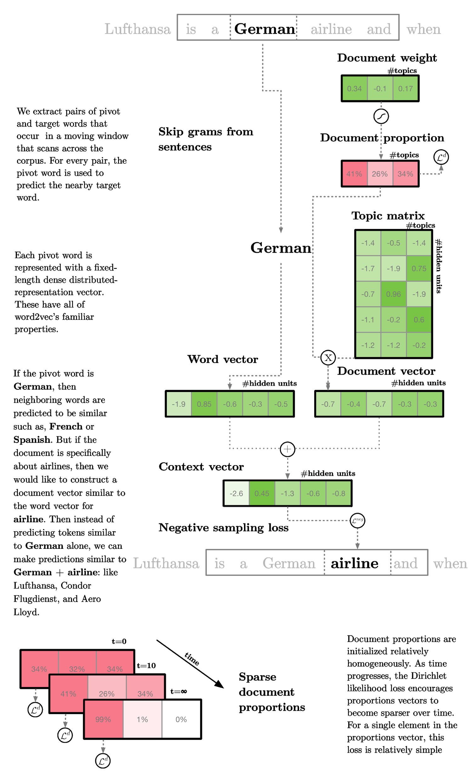
Further Extension
Twitter data has metadata
Metadata bears a lot of information
Metadata can be used as context
Lda2Vec leverages a context vector to make topic predictions
We will adapt lda2vec
Context they used : sum of the word vector and the document vector
https://multithreaded.stitchfix.com/blog/2016/05/27/lda2vec/

Slide 71
Architecture
Feature Extraction
ML, NLP
Index Constructor
Data type Processors
NLP (Text)
Knowledge Graph
2
Vision (Video)
Data Streaming
3
1
PostgreSQL
Indexing Layer
Kafka Topics
Video
ES Writer/Mapper
Text
4
5
Front End
Users’ queries
Microservice
Heterogeneous Data Streams
Knowledge derived from queries
Situational Aware Indexed Data
Relevant patterns of data

Slide 72
Knowledge Graph ( Need to learn from ISI research)
Ontologies / Concepts are extracted from LDA
Extract Triplets <Subject, Relation, Object> to represent Events
Entities are represented by Nodes
Entities have Attributes (Labels)
Entities are connected by Relations (Edges)

Slide 73
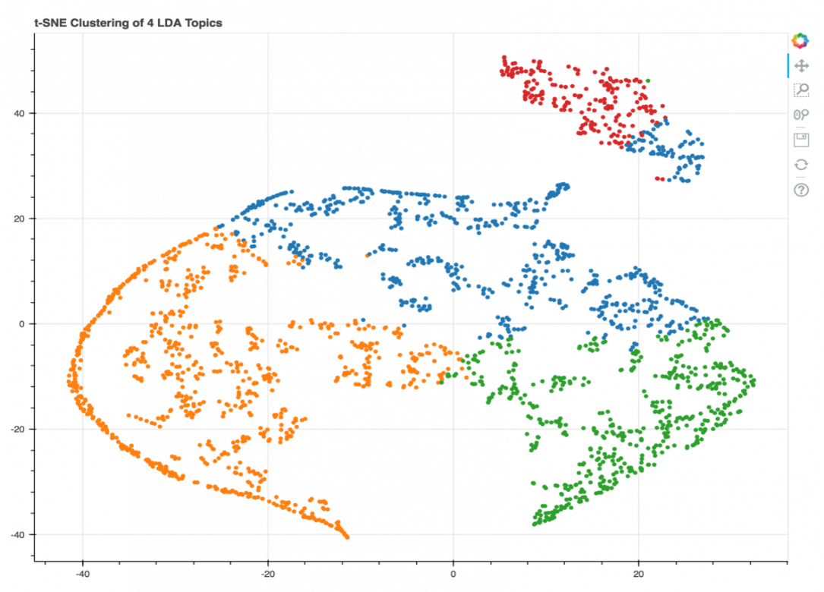
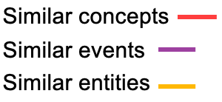


Work In Progress with KG: Multi-modality
Multi-modal Information Retrieval
Poster represented In Northrop Grumman University Research Student Poster Competition
Notes:
is a data agnostic engine for processing user searches (in the form of database SQL queries). The model
Most recommendation models operate on the data level, while ours operates at the query level. This allows us to be more generalizable with heterogeneous data sources.

Slide 74
Architecture
Feature Extraction
ML, NLP
Index Constructor
Multimodal Streaming Data
Data Sources:
Video: Traffic Cam, Static Cam
Social Media: Twitter
Text: Cambridge / WL City Data
Data type Processors
NLP (Text)
Knowledge Graph
2
Vision (Video)
3
Kafka Topics
1
PostgreSQL
Indexing Layer
Video
ES Writer/Mapper
Text
4
5
Front End
Microservice
User Profiling
Users’ queries
Triggers
Heterogeneous Data Streams
Active Learning
Knowledge derived from queries
Situation-aware Recommendation
Situational Aware Indexed Data
Relevant patterns of data
Notes:
Corerct this

Slide 75
Architecture
Feature Extraction
ML, NLP
Index Constructor
Data type Processors
NLP (Text)
Knowledge Graph
2
Vision (Video)
Data Streaming
3
1
PostgreSQL
Indexing Layer
Kafka Topics
Video
ES Writer/Mapper
Text
4
5
Front End
Users’ queries
Microservice
Heterogeneous Data Streams
Knowledge derived from queries
Situational Aware Indexed Data
Relevant patterns of data

Slide 76
Work In Progress: User Interest Modeling
User Interest Modeling
Record the query history for each agent to represent knowledge already obtained
Data subscription model takes user queries and converts them into triggers, which will report back to the user when new, relevant, information arrives at the database.
Use Active learning to narrow/expand the intention model as each user interacts with the system
Data will be filtered based on privacy policy and context before being sent.
Notes:
is a data agnostic engine for processing user searches (in the form of database SQL queries). The model
Most recommendation models operate on the data level, while ours operates at the query level. This allows us to be more generalizable with heterogeneous data sources.

Slide 77
User Modeling: Intention-aware Recommendation Engine
Sends users streaming data that corresponds to their interests
Builds User Profiles using the history of user queries
Active Learning to narrow/expand intention model with more interaction
Expands user queries with word embedding models to fetch relevant data from the database
Analyze user queries for user profiling
Expand result of queries with word2vec
Active Learning to improve intention model with time
User1
Cars of specific make & model (purple Cadillac)
Interested in info. about crimes in a specific district
SELECT * FROM video_data WHERE object = ‘car’ and attribute=‘purple’
User2
SELECT * FROM crash_data WHERE
date_hit = TODAY
Looks for pedestrians in the video data
Interested in traffic, accidents, violations

Slide 78
Architecture
Feature Extraction
ML, NLP
Index Constructor
Data type Processors
NLP (Text)
Knowledge Graph
2
Vision (Video)
Data Streaming
3
1
PostgreSQL
Indexing Layer
Kafka Topics
Video
ES Writer/Mapper
Text
4
5
Front End
Users’ queries
Microservice
Heterogeneous Data Streams
Knowledge derived from queries
Situational Aware Indexed Data
Relevant patterns of data

Slide 79
Data Streaming Module
Retrieve RESTFUL and Streaming Tweets
Populate Postgres with all data
Parse collected metadata to extract targeted information and store in Postgres
Replicable, fault tolerant, scalable and continuous
Build a Data Processing Pipeline with all features

Slide 80




Data Processing Pipeline
Cambridge Public data (DB, CSV …)
Parser
Engines
Video Data
Kafka Producer
Kafka Consumer
Kafka Producer
Data Extraction Engine
Twitter Search API
Twitter Topic
Kafka Consumer
Kafka Producer
Twitter Streaming API
#Hashtag
@User Profile
Twitter
Notes:
The whole architecture for the data pipeline would look like this. You can receive data from any number of producers and make that data available for consumption by any number of applications. Data is consumed at a time into RDBMS, graph database and into LSI-Mining module.
After the twitter data is consumed by Kafka, one of the consumers takes the raw data and parses it to extracts targeted information from there such as, text, user mentions, hashtags, geo-location etc and puts in postgres. Another consumer takes the raw metadata and puts it in postgres. In the parser engine, we also separate between orginal tweets, retweets and quoted tweets.
Kafka is run as a cluster on one or more servers that can span multiple datacenters. Those servers are usually called brokers.
Kafka uses Zookeeper to store metadata about brokers, topics and partitions.
---
The core separation Kafka provides for a stream of records — is the topic.
Think of each topic as a message log.
A producer of data sends a stream of records which are appended to this log, and any number of consumers can continually stream these updates off the tail of the log with millisecond latency.
Each of these data consumers has its own position in the log and advances independently. This allows a reliable, ordered stream of updates to be distributed to each consumer.
Each record in a topic consists of a key, a value, and a timestamp. A topic can have zero, one, or many consumers that subscribe to the data written to it. The Kafka cluster durably persists all published records using a configurable retention period — no matter if those records have been consumed or not.

Slide 81

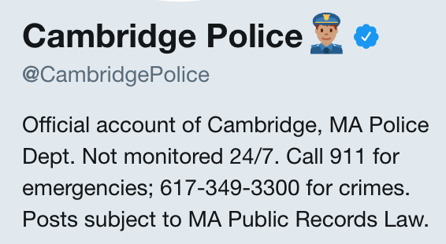
Retrieve Tweets : Implementation Choices
Search tweets by
  Keyword / Hashtag (i.e, CambMA)
  User Timeline (i.e, CambridgePolice)
81
Notes:
Our objective was to retrieve twitter data that mentions Cambridge. We wanted to find tweets that talks about different things in Cambridge, MA. We can search tweets by keywords, user profiles and geo locations. So we made a choice of searching tweets by keywords and user timelines.
For finding the hashtags or user profiles relevant to Cambridge, MA, we analyzed the profile descriptions attached to the user timelines. For example, cambridge police warns about any possible crimes or street law change. Or like @bostonfire talks about fire related incidents in boston. Or in a much broader scale, hashtags like #CambMA includes all tweets by many Cambridge, MA departments.
If we include, tweets like the @CambridgePolice or @bostonfire, in future we can have good use cases like Disaster Resources dispatch or predicting about possible crimes.

Slide 82
Compatibility with other sources of data
Add new sources
  JDBC
  From file
  Audio
Kafka Connect provides a framework (extra layer between source and Kafka) to develop connectors importing data from various sources and exporting it to multiple targets
Kafka Clients allow us to pass and retrieve messages directly to and from Kafka

Slide 83
Benefits of the Data Processing Pipeline
Provides dataset for use cases, i.e., Unattended Child Identification, Crime Detection and prediction
A pipeline to consume data from heterogeneous sources and then dispatch to disparate systems
  Fault-tolerant
  Scalable
  Asynchronous
  Capable of stream processing

Slide 84
Architecture
Feature Extraction
ML, NLP
Index Constructor
Data type Processors
NLP (Text)
Knowledge Graph
2
Vision (Video)
Data Streaming
3
1
PostgreSQL
Indexing Layer
Kafka Topics
Video
ES Writer/Mapper
Text
4
5
Front End
Users’ queries
Microservice
Heterogeneous Data Streams
Knowledge derived from queries
Situational Aware Indexed Data
Relevant patterns of data

Slide 85
Representing Knowledge
Build a tree for each index which point to the corresponding frames in Videos
  Car, Person, Bicycle, Traffic light
Build a tree for each index which point to the corresponding mentions in Tweets
  Car, Person, Bicycle, Traffic light
User Profiling: Built based on similar types of information
Build triggers in Postgres
  Data comes in with similar index
  Deliver to User
Model all our indices in GraphDB (ArangoDB)
Notes:
ArangoDB provides the flexibility of a multi-model data store (document, graph, key/value)

Slide 86
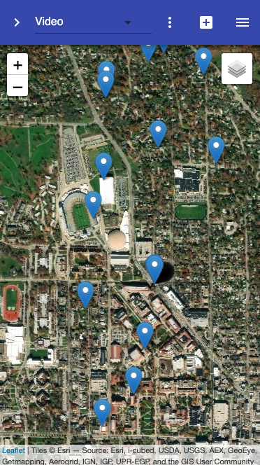





SKOD Web Framework
Extract data from Heterogeneous Sources and expose data via Apache Kafka Topics
Consume data from Kafka Microservice and populate the RDBMS and the Index Layer (Elasticsearch and Graph Database)
Utilizing geolocation to visualize real-time streams on Leaflet map
Analyze data relationships through graph analytics (clustering)
We utilize the OADA/Trellis framework to build the PoC of the Web App.
86

Slide 87
SKOD Framework Features
Open source @
Distributed Compute Engine (Apache Spark GraphX) and Motif analysis
ArangoDB Graph Database
Multiple layers of Cache (PouchDB)@
Eventual Consistent
Easy to setup (using Docker containers)
React based Analytics Web-UI
@ https://github.com/purdue-gask/skod/
@ https://github.com/OADA/oada-cache
87

Slide 88

Deliverables
Microservices for all modules
Source Codes
https://github.com/purdue-gask https://github.com/OADA

Slide 89
Demo Video
In the demo video, we demonstrate as follows.
  How twitter data is consumed and processed via Data Streaming Module
  Extracting objects from Videos
  Extracts the tweets that discusses about Object in Question
  Tie features from different modality using the Indexing Layer
    Build Index on the objects from videos and tweets
  Functionality of the Front End with Graph Analytics
  User Profiling extracts other objects that can be of users’ interest
  Allows user to see those objects from all modalities
Notes:
The goal of our feature extraction module is to answer user queries on demand. We have a simplified query like this –
We want to
From our earlier example, if we want to find unattended child, we need to make a query like this to our DB, user might not make it, and directly ask for childs unattended in car
And Feature extraction module is going to handle it.

Slide 90

Demo Video
Simplified Query
Select * from tweets, videos where tweets.objects_discussed == "car" videos.objects_detected == "car”
Demo Video URL
  https://youtu.be/5TqWKzy5SqI
Notes:
The goal of our feature extraction module is to answer user queries on demand. We have a simplified query like this –
We want to
From our earlier example, if we want to find unattended child, we need to make a query like this to our DB, user might not make it, and directly ask for childs unattended in car
And Feature extraction module is going to handle it.

Slide 91
Demo Video
Simplified Query
Select * from tweets, videos where tweets.objects_discussed == "car" videos.objects_detected == "car”
Demo Video URL
  https://youtu.be/5TqWKzy5SqI
Notes:
The goal of our feature extraction module is to answer user queries on demand. We have a simplified query like this –
We want to
From our earlier example, if we want to find unattended child, we need to make a query like this to our DB, user might not make it, and directly ask for childs unattended in car
And Feature extraction module is going to handle it.

Slide 92
Serving the Community
Collaboration with West Lafayette Police Department
Another Novel Use-Case
Extending SKOD Framework
Digs Deeper into Features, Knowledge Base and User Profiling

Slide 93
Problem Definition
Extract targeted search results from heterogeneous data (i.e., video, police dispatch reports, social media) at rest and deliver relevant information from incoming data streams based on context awareness.

Slide 94
Solution Framework

Slide 95
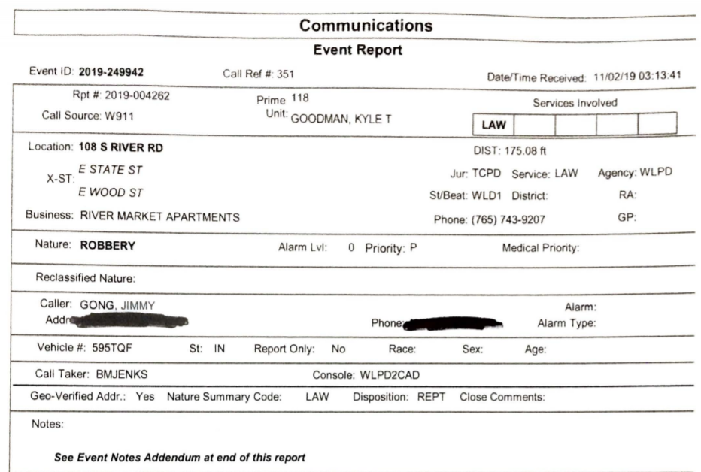
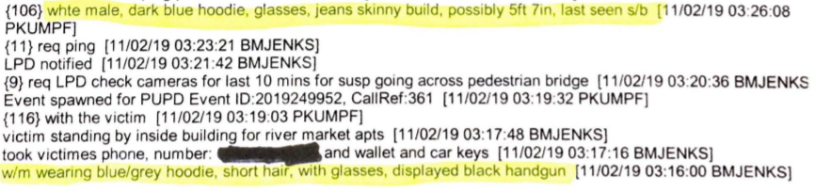
Police Dispatch Report
Notes:
Incident Report PIctures

Slide 96


Incident Report to Features
Identified 31 Features after interviewing Sargent Green
Incident Querying System
Includes UI for entering police query for fetching related information
  Videos,
  Similar Incident Reports, and
  Social Information
Functions as a data collection module
Describing Suspect Attributes

Slide 97

Incident Report to Search Results
Inquired features are input into Incident Report table in Postgres
From these features, system builds
  Postgres Query: For fetching existing videos and reports matching the criteria
  Postgres Trigger: Created for fetching incoming videos and incidents which will match the criteria

Slide 98
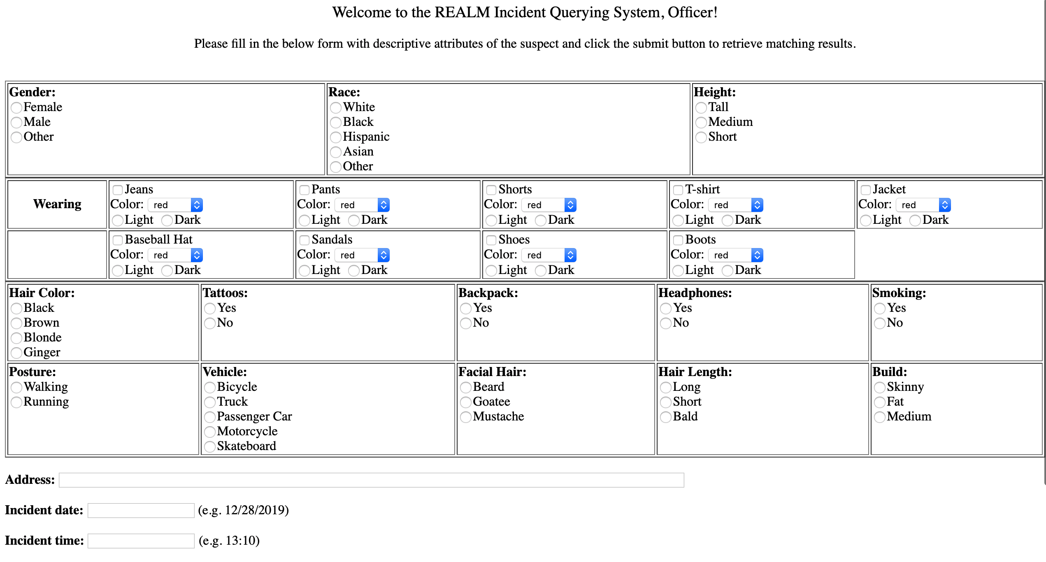

Slide 99
Feature Extraction from Incident Report
Parsing Incident Report for automatic extraction of Features
Beneficial for creating Postgres Triggers to identify similarity of incoming incidents to previous queries
Approach 1: Build Regular expressions to filter out features and feature values. Assumptions -
Reports are highly regular
Report follows grammar and is correctly structured

Slide 100
Feature Extraction from Incident Report
Approach 2: Build separate classifiers for each features separately and build an ensemble of classifiers
Find related sentences that mentions selected features
Classifiers based on each features separately
Latent Semantic Analysis (LSI)
SVM, DTL
Improve upon basic BoW features with
Embeddings
PoS, Feature Names
BERT[2], Glove[1]

Slide 101
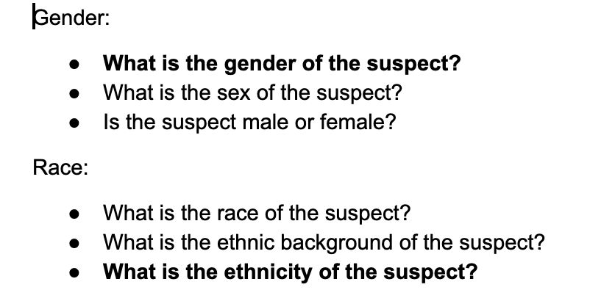
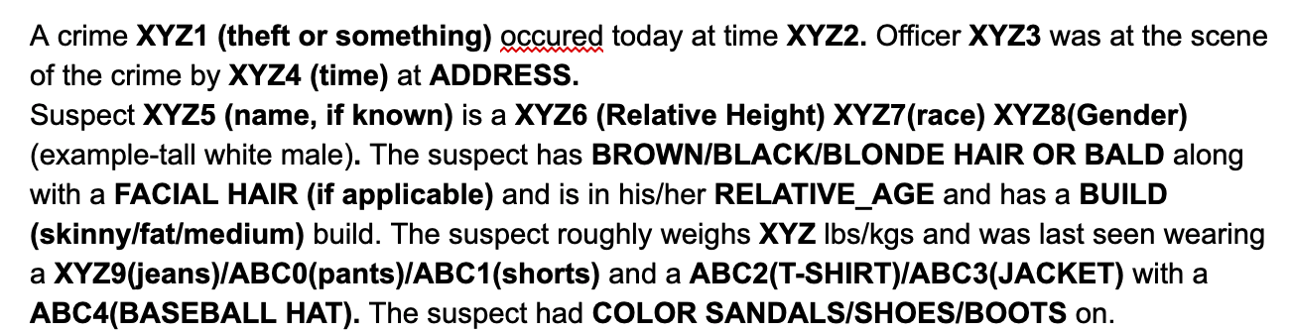

Feature Extraction from Incident Report
Approach 3: Formulate as Reading Comprehension Problem
Formulate Questions based on the selected features
Formulate a fixed structure for the incident report
Notes:
Add Results after this slide

Slide 102

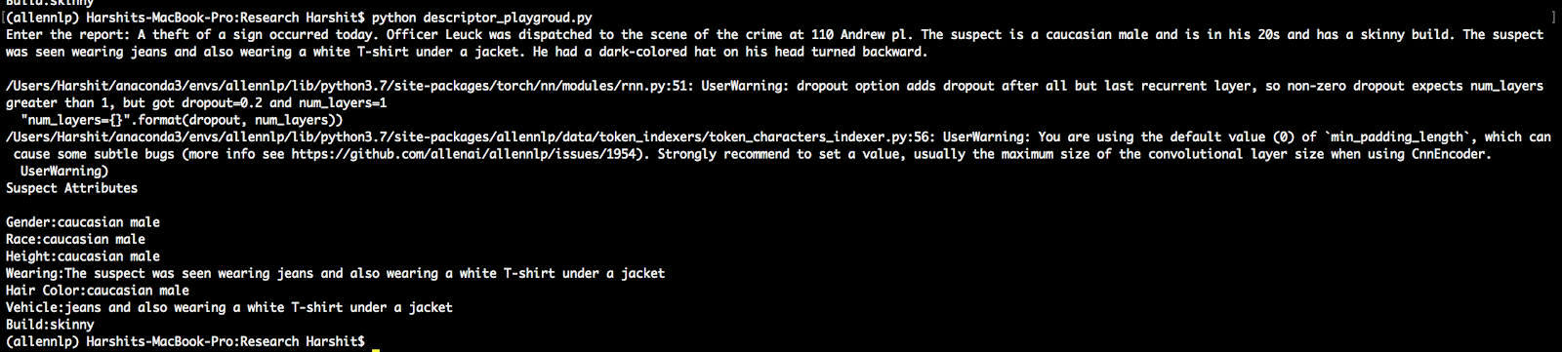
Result: As Machine Comprehension

Slide 103
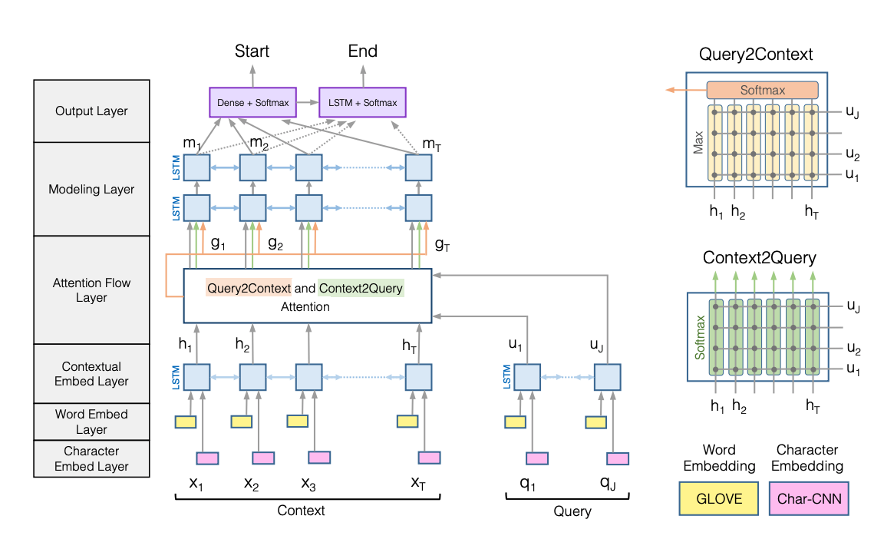
Bi-Directional Attention Flow Model *
SQuAD : Dataset on a large set of Wikipedia articles
More than 100,000 questions
Answer to each question is always a span in the context
API from AllenNLP [5]
PyTorch [4]
* Seo M et al (2017) Bidirectional Attention Flow for Machine Comprehension, in ICLR 2017 [3].

Slide 104
Approach 3

Slide 105
Feature Identification from Videos
Color Segmentation
Jeans/Pants, Shoe, Hat, Shirt/Jacket, Hair Color
DNN classifier trained for custom classes
Male/Female
Action Recognition
Walking/
Running/
In Pursuit

Slide 106
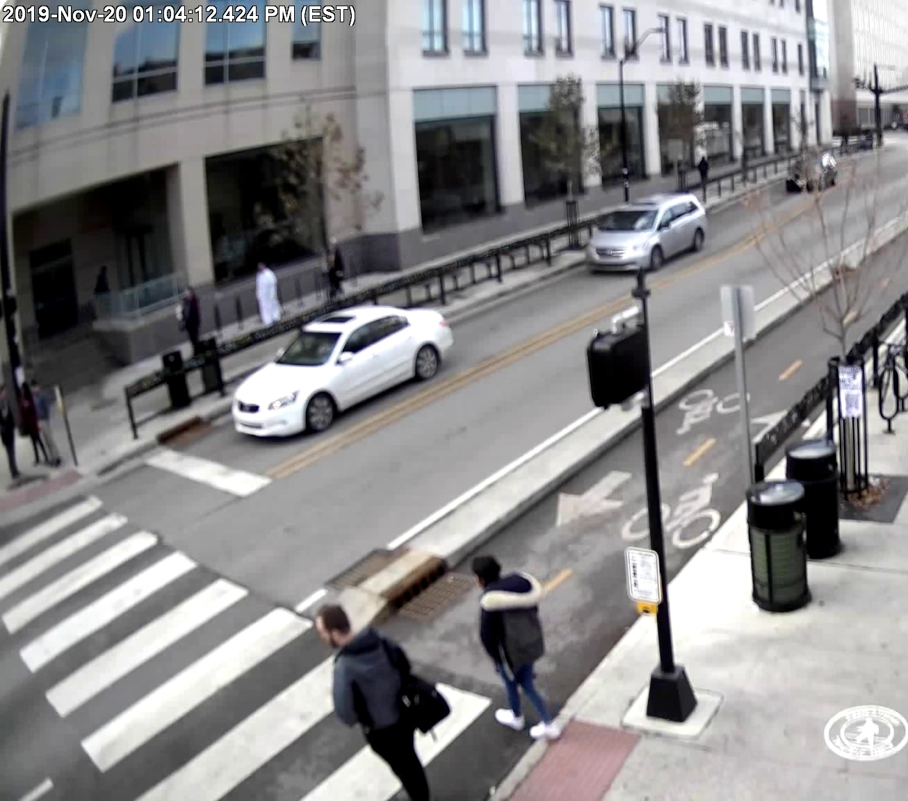
Search for Suspect in the Video
Matching the features extracted from text with features extracted from video
Relate objects with similar features in Report Text and surveillance video

Slide 107
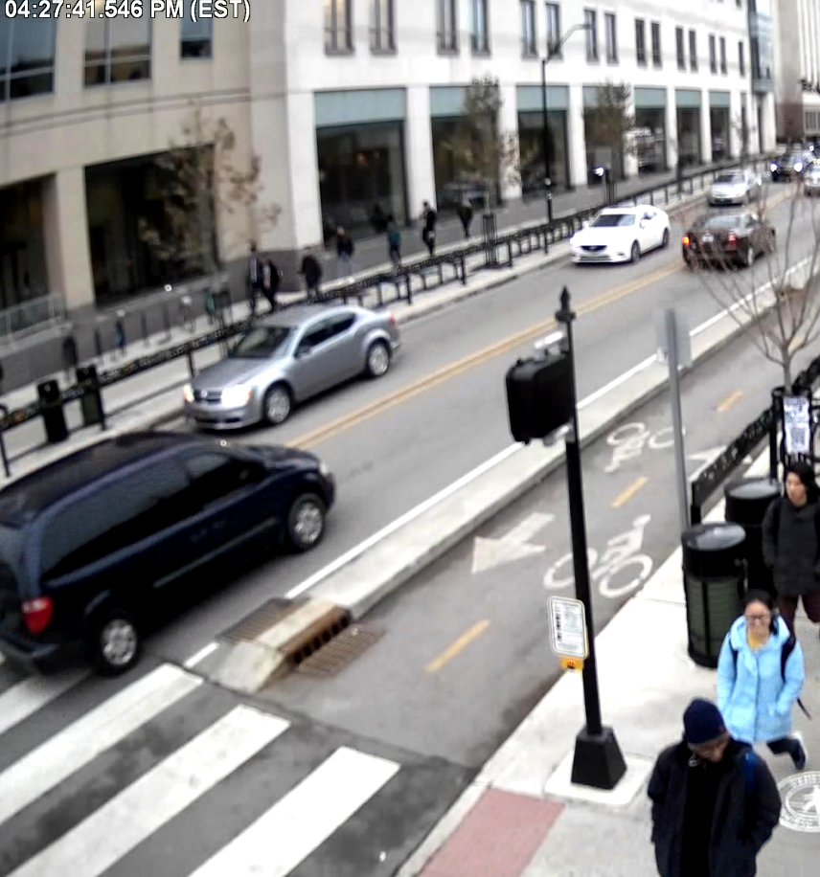
Surveillance Camera Video Datasets
Videos from HD surveillance cameras in main streets and high-traffic areas (WL)
Busy streets close to campus
Bar district with over 10 cameras down the State street
Over a month of archived video from dozens of cameras

Slide 108

Data Annotation
Yolo video processing tool — Yolo_mark **
  Automatically sample the video file into images
  Manually label the images and output the label in text files
  Compatible with Darknet framework
Used Yolo_mark to process video files at 1 frame / sec.
Manually identify images containing persons first
Depending on the “person”, label more refined attributes, e.g. male/female, jeans/pant, hat etc.
  Extensive dataset needed for training (1000+ examples/class)
For compensation of different locations, angles, distances, time and weather conditions, 1/100 frames are chosen for annotation
** https://github.com/AlexeyAB/Yolo_mark

Slide 109


Yolo v3 with 53 layers [6]
https://medium.com/@hirotoschwert/reproducing-training-performance-of-yolov3-in-pytorch-part1-620140ad71d3

Slide 110

Small Objects Detection
In surveillance video, objects tend to be of small size relative to the captured image
Short cut connections to skip layers are used for better detection of the small objects
The output of a shortcut layer is obtained by adding feature maps from the previous layer and 3rd layer backwards
Shortcut connections strengthen feature propagation, reduce the number of feature maps to increase generalization

Slide 111

Color Segmentation
Goals:
  Features: Jeans/ Jacket/ Shirt/ Hat
  Values: Black Jeans / Blue Shirt
  Avoid overhead DNN computation
Modified Yolo boxing codes to segment person into
  head, upper half, bottom half, and foot
Sampling position is important to not include background colors
Notes:
Results pic

Slide 112

Detecting Clothes Color by Segmentation Analysis
Notes:
Results
pic

Slide 113

Detecting Clothes Color by Segmentation Analysis
Notes:
Results

Slide 114
Result Frames
Notes:
Results
pic

Slide 115
Result Frames
Notes:
Results

Slide 116
Color Segmentation
Bottom body is trickier due to different gestures and position
Run color analysis on different parts to extract color attributes
  multiple shades of the same color,
  night-time video colors are different
Rule Based Final Judgement of Color
  Dark-colored or Light-colored
  Multiple Shades of same color

Slide 117

Custom Training YOLO
Goals: Gender/ Race/ Wearables
Training on custom labelled dataset
Re-train with darknet**
Results are combined with color-segmented attributes
* https://pjreddie.com/darknet/yolo/

Slide 118
Video Data Processing Module
Raw video data is split in 1-minute segments
Each segment is stored in RDBMS
Each segment is processed by custom-trained DNN and color segmentation module
Extracted features are stored in RDBMS with links to corresponding video segments
VideoID | Extracted Features/Colors | Location Coordinates | Timestamp
1 | ‘Male’, ‘Female’, ‘Red Jacket’, ‘Green Jacket’, ‘White Pants’ | 40.423994, -86.909224 | 11:35 AM, 15-Nov-2019
2 | ‘Female’, ‘Red Jacket’, ‘White Pants’ | 40.423994, -86.909224 | 11:36 AM, 15-Nov-2019
3 | ‘Male’, ‘Female’, ‘Red Jacket’, ‘Black Hat’ | 40.423994, -86.909224 | 11:35 AM, 15-Nov-2019

Slide 119


Query Results
Video segments with the requested features are displayed:
Person with the searched attributes:
Suspect
Dispatch Report Query searching for features:
gender=female, jacket=true,
jacket color=red, incident_date=
'2019-11-15' incident_time=
'20:00:00'

Slide 120

Action Recognition
Process Videos instead of frames
R-C3D [7] predicts activity labels with segment boundaries
WIP: Re-train R-C3D module for surveillance video
Future Works: Adapt YOLO for action recognition to limit computation overhead
[7] R-C3D: Region Convolutional 3D Network for Temporal Activity Detection - H. Xu et al, arXiv2017.

Slide 121

Query Result UI

Slide 122

Query Result UI

Slide 123
Deliverables and Demo
GitHub Repository:
Demo
Incident Querying System - http://18.191.242.90/index.php
Query Result UI - http://35.239.251.13:3000/
https://github.com/skod-ng

Slide 124
http://35.239.251.13:3000/
Video samples extracted

Slide 125
REALM Incident Querying System For Policeman
http://18.191.242.90/index.php

Slide 126
Summary
SKOD aims at delivering right information to the right user at the right time based on situational awareness
There are numerous users with different missions
Missions with various needs for information
SKOD is an end-to-end system to empower such users with relevant knowledge from streaming or stored data
SKOD is general purpose and can be specialized to NG use cases

Slide 127
Research Tasks
Processing (Removing irrelevant tweets and noises) large tweets corpus (around 6 million tweets and hundreds or attributes of each tweet).
Help or Rescue needed Tweets classification. Location extraction of the persons who need help.
Priority determination based on the tweets text and classification.
Finding out the most effective rescue scheduling algorithm for various scenarios.

Slide 128
Future Plans for SKOD : Feature Identification
Feature Identification from Video
Pedestrians, Occluded traffic signs, Crane blocking a sidewalk, Child left in unattended car outside school
Offline model construction (based on video and open street map)
On-line execution
Feature Identification from Text
Interesting subset identification based on keywords
Parse to an entity-attribute model of interesting info

Slide 129
More SKOD Benefit Scenarios
Inform Drivers about
  relevant obstacles and hazards: road closures, potholes, fallen trees and tree branches, ice, dumpster violations, downed road signs, not working traffic lights;
  routes to avoid obstacles and hazards;
  relevant POIs;
  collision probability for a given date, time, weather conditions; recommend the speed.
Inform blind / differently abled people via a mobile app about:
  relevant obstacles and hazards;
  routes to avoid obstacles and hazards;
  relevant POIs.

Slide 130
More SKOD Benefit Scenarios
Inform Law Enforcement about
  suspicious activity (especially in crime-prevalent areas), illegal road constructions, downed road signs, blocked sidewalks, graffiti;
  relevant obstacles and hazards;
  routes to avoid obstacles and hazards;
  collision probability for a given date, time, weather conditions; recommend the speed;
  detected human faces in crime incidents and car accidents;
  homeless people detected in certain areas.

Slide 131
References for WLPD
Jeffrey Pennington, Richard Socher, and Christopher D. Manning. 2014. GloVe: Global Vectors for Word Representation
Devlin, Jacob and Chang, Ming-Wei and Lee, Kenton and Toutanova, Kristina. 2018. BERT: Pre-training of Deep Bidirectional Transformers for Language Understanding
Seo. M et al (2017) Bidirectional Attention Flow for Machine Comprehension, in ICLR 2017
Paszke, A.; Gross, S.; Chintala, S.; Chanan, G.; Yang, E.; DeVito, Z.; Lin, Z.; Desmaison, A.; Antiga, L.; and Lerer, A. 2017. Automatic differentiation in pytorch.
AllenNLP: A Deep Semantic Natural Language Processing Platform. Matt Gardner, Joel Grus, Mark Neumann, Oyvind Tafjord, Pradeep Dasigi, Nelson Liu, Matthew Peters, Michael Schmitz, Luke Zettlemoyer. 2017
Yolov3: An incremental improvement. J Redmon, A Farhadi
R-C3D: Region Convolutional 3D Network for Temporal Activity Detection - H. Xu et al, arXiv2017.

Slide 132
Selected Interesting References
ReXCam: Resource-Efficient, Cross-Camera Video Analytics at Scale, S. Jain, X. Zhang et al. https://arxiv.org/abs/1811.01268
You’re being watched: there’s one cctv camera for every 32 people in uk. https://www.theguardian.com/uk/2011/mar/02/cctv-cameras-watching-surveillance. Accessed:2018-10-27.
Absolutely everywhere in beijing is now covered by police video surveillance. https://qz.com/518874/. Accessed: 2018-10-27.
Can 30,000 cameras help solve chicago’s crime problem? https://www.nytimes.com/2018/05/26/us/chicago-police-surveillance.html. Accessed: 2018-10-27.
https://github.com/PurdueCAM2Project (Prof. Yung Hsiang Lu at Purdue)
https://www.cam2project.net/
Cross-dataset Training for Class Increasing Object Detection, Y. Yao, Y. Wang et al. https://arxiv.org/abs/2001.04621
http://usc-isi-i2.github.io/knoblock/,
https://usc-isi-i2.github.io/kejriwal/
PROTECTING AMERICA’S SCHOOLS A U.S. SECRET SERVICE ANALYSIS OF TARGETED SCHOOL VIOLENCE, 2019,
https://www.policyinsider.org/2019/10/protecting-americas-schools-a-us-secret-service-analysis-of-targeted-school-violence.html

Slide 133


Slide 134
Data Completion
Professor Vaneet Aggarwal at Purdue

Slide 135
Problem Statement
Data Completion and Classification
For mission-relevant learning it is important to find structures in the data.
Use those structures to complete data with reduced number of observations.
Utilize multidimensional data to complete, classify, and predict data items and further conduct anomaly detection.
Conducting text classification through deep learning methodologies to determine the mission relevant information.

Slide 136
Proposed Solution
Finding structures in data and Use the structure for completing data with lower observations Completion.
In addition, we will introduce multi-dimensional data structures for Completion, Classification, Prediction, Anomaly Detection.
We will develop an efficient mission (particularly rescue missions during disasters) relevant scheduling algorithm using Twitter data.
Identify the tweets which are seeking for help or rescue.

Slide 137



Solution Overview
  Finding structures in data
  Use the structure for completing data with lower observations
  Completion, Classification, Prediction, Anomaly Detection
  Multi-tasks Hybrid Scheduling
  Utilizing the multi-dimensional Data Structure is important.

Slide 138
Benefits of the Approach
The number of parameters in neural network (both fully connected and convolution layers) can be compressed by the tensor ring structure.
The compression leads to faster training and testing times. Further, can improve the error due to less overfitting.
Improves MNIST error to 0.69% using 11X lower parameters as compares to standard Lenet-5.
Multi-tasks Hybrid Scheduling algorithm combines the priority and balances the load. For the same priority and load it acts like FCFS scheduling.

Slide 139

Solution Details
Data Completion ( Research of Vaneet Aggarwal at Purdue):
Multiple features across different OS and times have dependency
Missing entries due to lower data collection can be interpolated across towers, OS, features, time.

Slide 140

Solution Details
Data Completion:
Complete Rankings – can be used for recommendations
Correlation across movie categories, rankings, users

Slide 141



Solution Details
Tensor Ring Completion:
Structure in the data leads to recovery of the data from a small number of entries.
The matrix-based approaches fail to work at these sampling rates.
Proposed Tensor ring structure based algorithm demonstrates superior performance in missing data completion.
Numerical results: Video Completion
Video
Video with Recovered by Our Approach
Video with 90% missing entries

Slide 142
Solution Details
Application: Scheduling Resources to Flood Victims (Research by Sanjay Madria at MST)
Tweet Classification
2500 tweets labeled manually into 6 classes (Rescue needed, DECW, water needed, Injured, Sick, flood) from the 68574 preprocessed tweets.
A multiclass classifier was developed using Convolutional Neural Network and text embedding to classify every single tweet. A tweet can belong to more than one class at the same time.
The CNN only trained for hurricane Harvey dataset and tested on both Harvey and Irma data.
We have compared the accuracy of CNN with Support Vector Machine and Logistic Regression. CNN outperformed the methods with the accuracy of 90.7% on hurricane Harvey and 88.5% on hurricane Irma tweets.

Slide 143

Solution Details
Priority Determination

Slide 144


Datasets
MNIST and Twitter
LeNet-300-100: Two FCLs with 300 and 100 hidden neurons
LeNet-5: Two ConvLs followed by two FCLs
Sentiment140 dataset with 1.6 million tweets: https://www.kaggle.com/kazanova/sentiment140

Slide 145
Backup Slides

Slide 146
Tweets-Parser-Engine
Parses metadata to extract
  Full tweet text
  User Information
  Hashtags, URLs, User mentions
  Geolocation (latitude, longitude)
Separates and processes
  Original tweets
  Retweets
  Quoted tweets

Slide 147

Feature Extraction Module
3
Data Streaming
Feature Extraction
PostGRES
Indexing Layer
Index Constructor
2
5
Data type Processors
ES Writer/Mapper
NLP (Text)
Kafka Topics
Vision (Video)
4
1
1
Front End
Heterogeneous Data Streams
Situational Aware Indexed Data
Users’ queries
Feature extraction from videos using manual tagging for features
Relevant patterns of data

Slide 148

Manual Feature Extraction from Videos
Features targeted
  Objects in Video
  Attributes of the objects
Amazon Mechanical Turk (Mturk)
  For task design
  For annotation collection
  For task distribution
Steps
  Run Object detection algorithms
  Segment video into frames
  Modify the existing annotations

Slide 149

Task Design Sample: Instance Segmentation

Slide 150

Task Design Sample: Attribute Tagging

