Slide 1

Developing Attack Defense Ideas for Ad Hoc Wireless Networks
Bharat Bhargava
Computer Science Department/CERIAS, Purdue University, West Lafayette, IN, USA
bbshail@purdue.edu
765-413-7312

Slide 2
Outline
Motivation
Objectives
Attacks
Impact of Attacks on Safety
Impact of Implementing Security Features
  5.1 Case of Study: Security vs. Safety
6. References
2

Slide 3
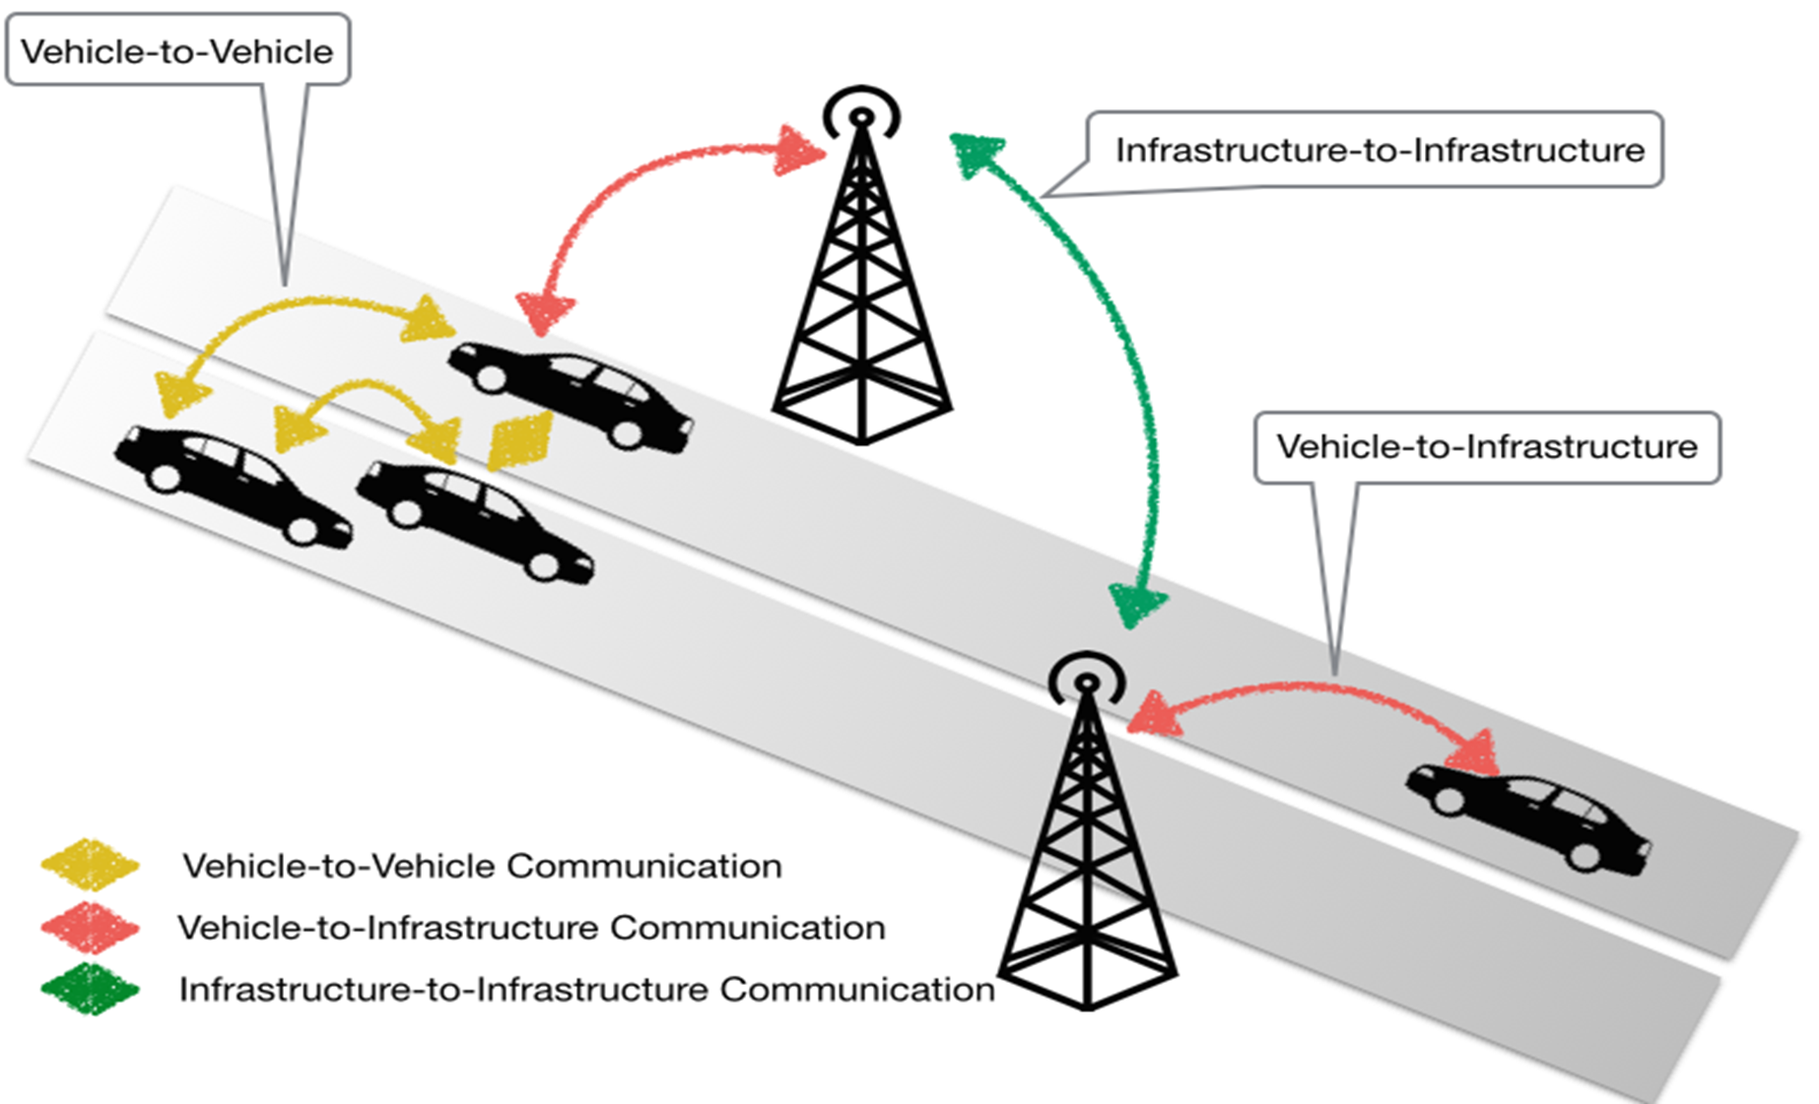
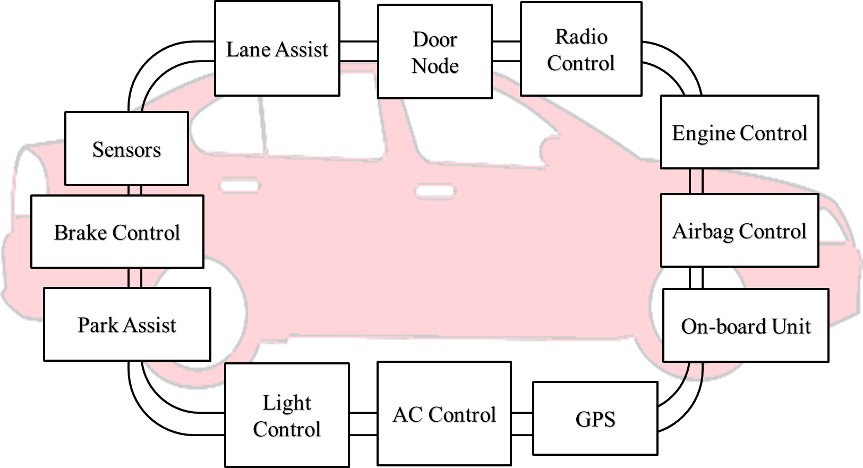

Motivation
Vehicle has more than 60 sensors and 30 or more Electronic Control Units (ECUs), i.e. Brake Control, Engine Control, GPS, Airbag Control, etc [6]
OBU allows heterogeneous and homogenous communications between vehicles and infrastructures (roadside equipment)
CAN (Control
Area
Network) Bus
Radio Interface or On-Board Unit
(OBU) enables short-range wireless
ad hoc networks to be formed
3

Slide 4
Motivation
Connected vehicles deploy signals to communicate with other vehicles, roadside units, personal devices and cloud services
  Goal: provide assistance to drivers and prevent collisions
Connected vehicle consists of electronic control units (ECUs) communicating via CAN (Controller Area Network) bus to transfer messages and execute queries sent from other ECUs
Vehicle-to-vehicle (V2V) and vehicle-to-infrastructure (V2I) communications are prone to security threats
4

Slide 5
Objectives
Measure the cost/overhead associated with providing security in V2V communication and its impact on safety
Monitor, Identify, and Mitigate Attacks
5

Slide 6
Attacks in Ad Hoc Wireless Networks
Distributed Denial-of-service Attacks
Spoofing Attacks
Replay Attacks
Worm hole Attacks
Eavesdropping
Interception
Masquerade Attack
Malware Attack
Message Tampering
Collaboartive Attacks

Slide 7
Details of Attacks
Replication attacks
  Adversaries can insert additional replicated hostile nodes into the network after obtaining some secret information from the captured nodes or by infiltration. Sybil attack is one form of replicated attacks
Sybil attacks
  A malicious user obtains multiple fake identities and pretends to be multiple, distinct nodes in the system. This way the malicious nodes can control the decisions of the system, especially if the decision process involves voting or any other type of collaboration

Slide 8
Details of Attacks
Denial-of-Messages (DoM) attacks
  Malicious nodes may prevent other honest ones from receiving broadcast messages by interfering with their radio
Blackhole attacks
  A node transmits a malicious broadcast informing that it has the shortest and most current path to the destination aiming to intercept messages
Wormhole attacks
  An attacker records packets (or bits) at one location in the network, tunnels them to another location, and retransmits them into the network at that location

Slide 9
Details of Attacks
Denial-of-Messages (DoM) attacks
  Malicious nodes may prevent other honest ones from receiving broadcast messages by interfering with their radio
Blackhole attacks
  A node transmits a malicious broadcast informing that it has the shortest and most current path to the destination aiming to intercept messages
Wormhole attacks
  An attacker records packets (or bits) at one location in the network, tunnels them to another location, and retransmits them into the network at that location

Slide 10
Details of Attacks
Rushing attacks
  An attacker disseminates a malicious control messages fast enough to block legitimate messages that arrive later (uses the fact that only the first message received by a node is used preventing loops)
Malicious flooding
  A bad node floods the network or a specific target node with data or control messages

Slide 11
Protection Against Collaborative Attacks
Characterizing collaborative/coordinated attacks
Types of collaborative attacks
Identifying Malicious activity
Identifying Collaborative Attack

Slide 12
Collaborative Attacks
Informal definition:
“Collaborative attacks (CA) occur when more than one attacker or running process synchronize their actions to disturb a target network”

Slide 13
Examples of Attacks that can Collaborate
Denial-of-Messages (DoM) attacks
Blackhole attacks
Wormhole attacks
Replication attacks
Sybil attacks
Rushing attacks
Malicious flooding
We are investigating the interactions among these forms of attacks
Example of probably
incompatible attacks:
Wormhole attacks need fast connections, but DoM attacks reduce bandwidth!

Slide 14
Current Proposed Solutions
Blackhole attack detection
  Reverse Labeling Restriction (RLR)
Wormhole Attacks: defense mechanism
  E2E detector and Cell-based Open Tunnel Avoidance (COTA)
Sybil Attack detection
  Light-weight method based on hierarchical architecture
Modeling Collaborative Attacks using Causal Model

Slide 15
Problem Statement
Focus on collaborative packet drop attacks. Why?
Secure and robust data delivery is a top priority for many applications
The proposed approach can be achieved as a reactive method: reduce overhead during normal operations
Can be applied in parallel to secure routing

Slide 16
Ideas
Detecting packet drop attacks
Audit based approaches
  Whether or not the next hop forward the packets
  Use both first hand and second hand evidences
  Problems:
    Energy consumption of eavesdropping
    Can be cheated by directional antenna
    Authenticity of the evidence
Incentive based approaches
  Nuggets and credits
Multi-hop acknowledgement

Slide 17
Proposed approach
Hash based approach:
S1 sends out the packet to n1:
Every node will add a fingerprint into the packet
S → n1: (S, D, data packet, random number t0)
Node n1 will combine the received packet and its random number r1 to calculate the new fingerprint:
t1 = h( r1 || S || D || data packet || t0 || r1 )
n1 → n2: (S, D, data packet, t1 )
The audited node will generate the bloom filter based on the data packets and the fingerprints
The source will generate its own bloom filter and compare it to the value of the audited node

Slide 18
Impact of Attacks on Safety
Miller and Valasek demonstrated in DEF CON 21 a set of attacks including very serious attacks.
Hard braking/ no braking attack
  Locked brake
  Sudden stop
  Braking distance increase
Acceleration attack
  Sudden uncontrollable acceleration
Steering wheel attack
  Sudden uncontrollable rotation of a steering wheel
Engine shutdown
Light out attack
  Dashboard indication is misrepresented
  Dashboard indication is off
18

Slide 19
Impact of Deploying Security
Mechanism | Security | Safety
Digital Signature | Data comes from a known trusted node | Delay: validating undetected data
Encryption | Security depends on the key size | Delay: Undetected modifications can compromise safety
19

Slide 20
Impact of Implementing Security Features
V2V |  | Security | Safety
No security features | No attacks | Do nothing
 | Under attacks | Misleading dashboard and gps; firmware and data wiped out; compromised vehicle’s sensors, part of botnet framework | Human damage, collisions, delays in traffic
With security features | No attacks | Power consumption and computation overhead | Do nothing
 | Under attacks | Isolate intruder, warn other nodes about attack, deviate attacks to targets with less damage | Faster response time
20

Slide 21

CASE OF STUDY: SECURITY VS SAFETY
Category of traffic messages:
Traffic information messages: Used to disseminate the current conditions of specific areas and they indirectly affect safety
General safety messages: Used for cooperative driving and collision avoidance, and require an upper bound on the delivery delay of messages
Liability-related messages: Exchanged after an accident occurs
21

Slide 22
CASE OF STUDY: SECURITY VS SAFETY
Scenario 1: Sudden stop on a highway
  Vehicles move to same speed on the highway
  Pre-determined distance between them
  Reaction time with and without V2V
  Reaction time with secured V2V
High way scenario with only two vehicles involved
22

Slide 23
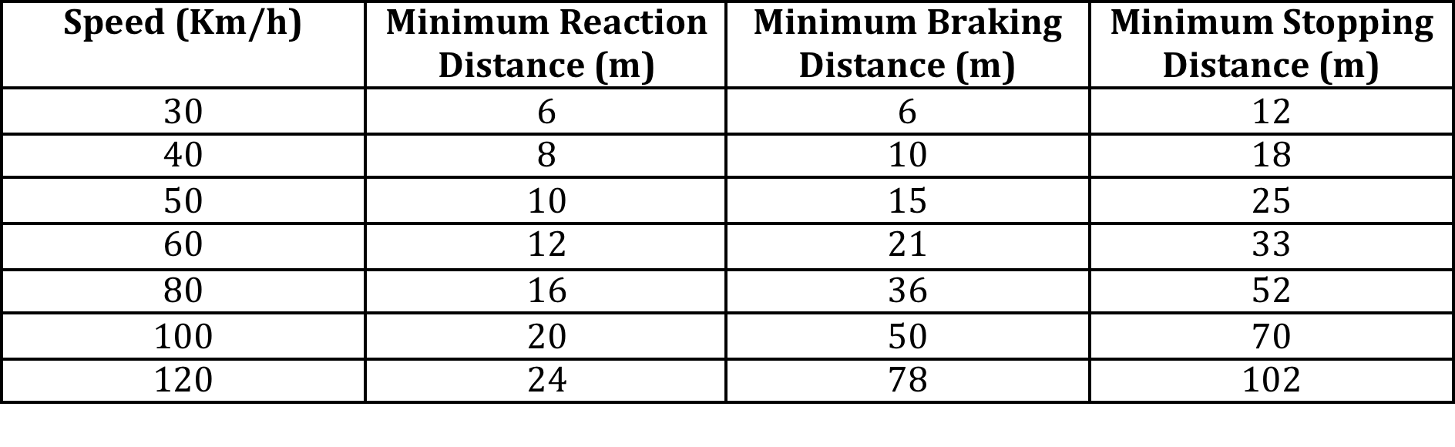
CASE OF STUDY: SECURITY VS SAFETY
Stopping distance:
  Driver’s perception time
  Driver’s reaction time
  Vehicle’s reaction time
  Vehicle’s braking capability
Table 1 – The RSA recommended minimum stopping distance under dry conditions
23

Slide 24
CASE OF STUDY: SECURITY VS SAFETY
System Model:
Network:
  IEEE 802.11a compliant
  6Mbps minimum
Security mechanism on V2V:
  PKI infrastructure
  Every vehicle is assigned a public and private key
  Public key distributed through a certificated signed by the CA
  Authenticated message:
24

Slide 25
CASE OF STUDY: SECURITY VS SAFETY
System Model:
Security costs on V2V:
  Processing cost
  Communication cost:
    Distance: 120m
    Bandwidth: 6Mbps
    Speed of communication link: 3x10^8m/s
25

Slide 26
CASE OF STUDY: SECURITY VS SAFETY
Experiment 1: Measurement of delays of V2V messages with and without security
  Speed: 120Km/h
  Distance: 120m
26

Slide 27
CASE OF STUDY: SECURITY VS SAFETY
Experiment 2: Measurement of the capacity of the link
  Speed: 120Km/h
  Distance: 120m
27

Slide 28
CASE OF STUDY: SECURITY VS SAFETY
Experiment 3: Reaction time with V2V
  Size of the message: 200 bytes
  Distance: 120m
28

Slide 29
CASE OF STUDY: SECURITY VS SAFETY
Conclusion:
  Vehicular networks strictly require integrity and authentication but not confidentiality.
  Reaction times achieved via V2V (with or without security) are significantly smaller than a those of systems without V2V.
  V2V without security allows shorter reaction times than V2V with security.
  Lightweight cryptography must be applied to speed up processing.
  Alternative mechanisms for key management need to be explored.
29

Slide 30
References
[9] P. Angin, B. Bhargava, R. Ranchal, N. Singh, L. Lilien, L. Othmane and M. Linderman. "An entity-centric approach for privacy and identity management in cloud computing." 29th IEEE Symp. on Reliable Distributed Systems, Oct. 2010.
[10] R. Ranchal, B. Bhargava, L. Othmane, L. Lilien, A. Kim, M. Kang and M. Linderman. "Protection of identity information in cloud computing without trusted third party." 29th IEEE Symp. on Reliable Distributed Systems, Oct. 2010.
[11] B. Bhargava, P. Angin, R. Ranchal, R. Sivakumar, A. Sinclair and M. Linderman. "A trust based approach for secure data dissemination in a mobile peer-to-peer network of AVs." Intl. J. of Next-Generation Computing, vol.3(1), Mar. 2012.
[12] L. Ben Othmane and L. Lilien, “Protecting Privacy in Sensitive Data Dissemination with Active Bundles,” .Seventh Annual Conf. on Privacy, Security and Trust (PST 2009), Saint John, New Brunswick, Canada, Aug. 2009, pp. 202-213.
[13] L. Ben Othmane, “Protecting Sensitive Data throughout Their Lifecycle,” Ph.D. Dissertation, Dept. of Computer Science, Western Michigan University, Kalamazoo, Michigan, Dec. 2010.
[14] Lei Yao, Tao Gong, Jin Fan, Bharata Bhargava, “Research on ARM9-Based Intelligent Immune System for Avoiding Rear-End Collision”, Intl. Journal of Immune Computation (IC) Vol. 1, No. 1, pp. 4-8, 2013
[15] G. Izera M., A. Johnson, B. Bhargava, “Secure protection methods in vehicle-to-vehicle networks”, submitted, 2017
30

