Slide 1
PuReMD: Purdue Reactive Molecular Dynamics Software Ananth Grama Center for Science of Information Computational Science and Engineering Department of Computer Science ayg@cs.purdue.edu

Slide 2
ReaxFF vs. Classical MD
ReaxFF is classical MD in spirit
basis: atoms (electron & nuclei)
parameterized interactions: from DFT (ab-initio)
atomic movements: Newtonian mechanics
many common interactions
bonds
valence angles (a.k.a. 3-body interactions)
dihedrals (a.k.a. 4-body interactions)
hydrogen bonds
van der Waals, Coulomb

Slide 3
ReaxFF vs. Classical MD
Static vs. dynamic bonds
reactivity: bonds are formed/broken during simulations
consequently: dynamic multibody interactions
complex formulations of bonded interactions
additional bonded interactions
multi-body: lone pair & over/under-coordination – due to imperfect coord.
3-body: coalition & penalty – for special cases like double bonds
4-body: conjugation – for special cases
Static vs. dynamic charges
Charge equilibration -- large sparse linear system (NxN) – N = # of atoms
updates at every step!
Shorter time-steps (femtoseconds vs. tenths of femtoseconds)
Result: a more complex and expensive force field

Slide 4
Generation of Neighbors List
atom list
3D Neighbors grid
atom list: reordered

Slide 5
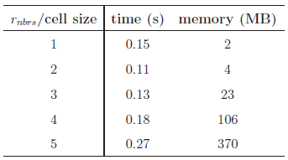
Neighbors List Optimizations
Size of the neighbor grid cell is important
r_{nbrs}: neighbors cut-off distance
set cell size to half the r_{nbrs}
Reordering reduces look-ups significantly
Atom to cell distance
Verlet lists for delayed re-neighboring
neighbors grid
No need to check these cells with reordering!
Looking for the neighbors of atoms in this box
Just need to look inside these cells
d
If d > r_{nbrs}, then no need to look into the cell

Slide 6
Elimination of Bond Order Derivative Lists
BO_{ij}: bond order between atoms i and j
at the heart of all bonded interactions
dBO_{ij}/dr_{k}: derivative of BO_{ij} wrt. atom k
non-zero for all k sharing a bond with i or j
costly force computations, large memory space needed
Analogy
Eliminate dBO list
delay computation of dBO terms
accumulate force related coef. into CdBO_{ij}
compute dBO_{ij}/dr_{k} at the end of the step
f_{k} += CdBO_{ij} x dBO_{ij}/dr_{k}

Slide 7
Look-up Tables
Expensive non-bonded force computations
Large number of interactions: r_{nonb} ~ 10A vs. r_{bond} ~ 4-5A
but simple, pair-wise interactions
Reduce non-bonded force computations
create look-up tables
cubic spline interpolation: for non-bonded energy & forces
Experiment with a 6540 atom bulk water system
Significant performance gain, high accuracy

Slide 8
Linear Solver for Charge Equilibration
QEq Method: used for equilibrating charges
approximation for distributing partial charges
solution using Lagrange multipliers yields
N = # of atoms
H: NxN sparse matrix
s & t fictitious charges: used to determine the actual charge q_{i}
Too expensive for direct methods → Iterative (Krylov sub-space) methods

Slide 9
Basic Solvers for QEq
Sample systems
bulk water: 6540 atoms, liquid
lipid bilayer system: 56,800 atoms, biological system
PETN crystal: 48,256 atoms, solid
Solvers: CG and GMRES
H has heavy diagonal: diagonal pre-conditioning
slowly evolving environment : extrapolation from prev. solutions
Poor Performance:
# of iterations = # of matrix-vector multiplications
actual running time in seconds
fraction of total computation time
tolerance level = 10⁻⁶
which is fairly satisfactory
due to cache effects
much worse at 10⁻¹⁰ tolerance level
more pronounced here

Slide 10
ILU-based preconditioning
ILU-based pre-conditioners: no fill-in, 10⁻² drop tolerance
effective (considering only the solve time)
no fill-in + threshold: nice scaling with system size
ILU factorization is expensive
bulk water system
cache effects are still evident
bilayer system
system/solver | time to compute preconditioner | solve time (s) | total time (s)
bulk water/ GMRES+ILU | 0.50 | 0.04 | 0.54
bulk water/ GMRES+diagonal | ~0 | 0.11 | 0.11

Slide 11
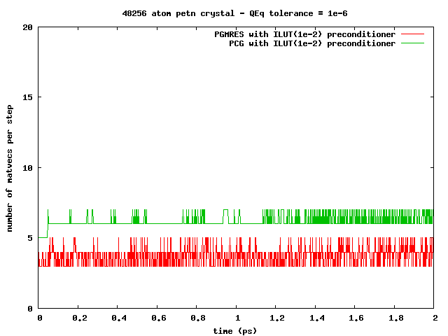
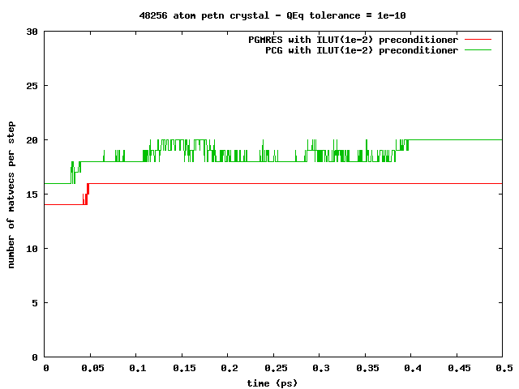
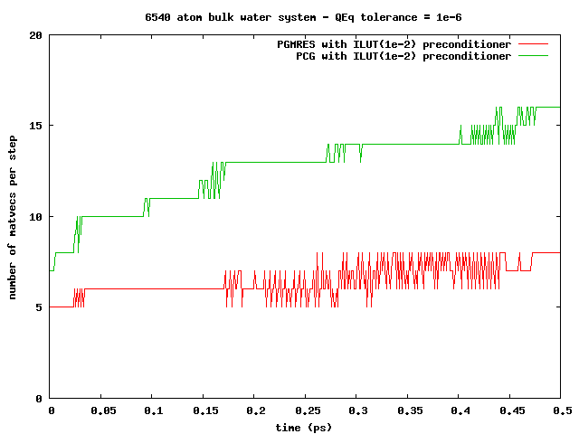
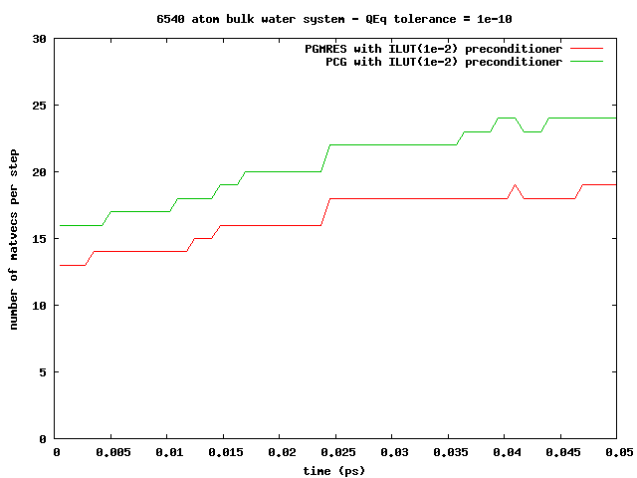
ILU-based preconditioning
Observation: can amortize the ILU factorization cost
slowly changing simulation environment ⇒re-usable pre-conditioners
PETN crystal:
solid, 1000s of steps!
Bulk water:
liquid, 10-100s of steps!

Slide 12
Memory Management
Compact data-structures
Dynamic and adaptive lists
initially: allocate after estimation
at every step: monitor & re-allocate if necessary
Low memory foot-print, linear scaling with system size
n-1
n
n-1
n
n-1’s data
n’s data
n-1’s data
n’s data
in CSR format
neighbors list
Qeq matrix
3-body interactions
reserved for n-1
reserved for n
in modified CSR
bonds list
hbonds list

Slide 13
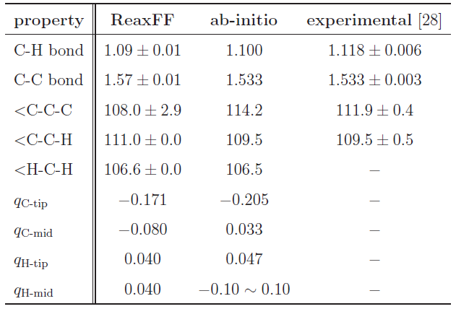
Validation
Hexane (C₆H₁₄) Structure Comparison
Excellent agreement!

Slide 14
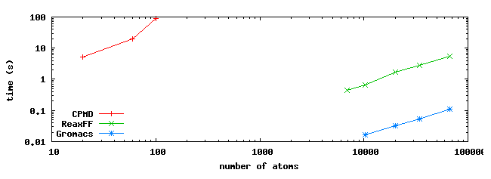
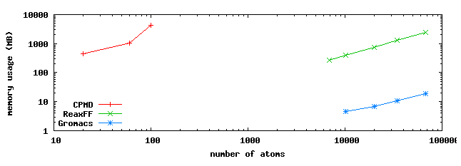
Comparison to MD Methods
Comparisons using hexane: systems of various sizes
Ab-initio MD: CPMD
Classical MD: GROMACS
ReaxFF: SerialReax

Slide 15
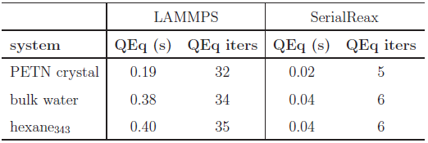
Comparison with LAMMPS-Reax
Time per time-step comparison
Qeq solver performance
Memory foot-print
different QEq formulations
similar results
LAMMPS:
CG / no preconditioner

Slide 16
Parallel Realization: PuReMD
Built on the SerialReax platform
Excellent per-timestep running time
Linear scaling memory footprint
Extends its capabilities to large systems, longer time-scales
Scalable algorithms and techniques
Demonstrated scaling to over 9K cores
Parallel Reactive Molecular Dynamics: Numerical Methods and Algorithmic Techniques, Akgulta et al., 2013.

Slide 17
Parallelization: Outer-Shell
choose full-shell due to dynamic bonding despite the comm. overhead
r
r
b
b
full shell
half shell
r/2
r
b
b
midpoint-shell
tower-plate shell

Slide 18
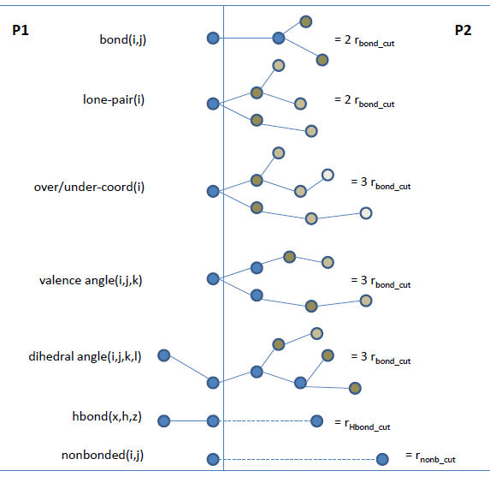
Parallelization: Boundary Interactions
r_{shell}= MAX (3xr_{bond_cut}, r_{hbond_cut}, r_{nonb_cut})

Slide 19
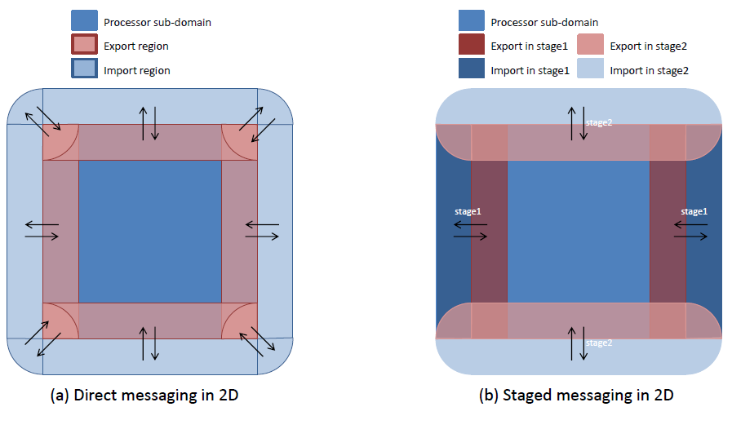
Parallelization: Messaging

Slide 20
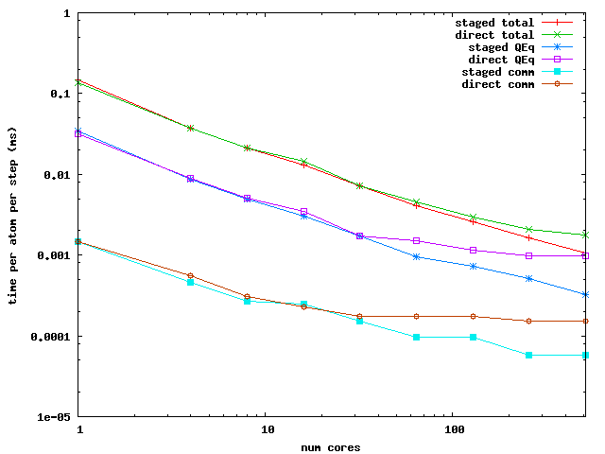
Parallelization: Messaging Performance
Performance Comparison: PuReMD with direct vs. staged messaging

Slide 21
PuReMD-GPU Design
Initialization
neighbor-list, bond-list, hydrogen bond-list and Coefficients of QEq matrix
Bonded interactions
Bond-order, bond-energy, lone-pair, three-body, four-body and hydrogen-bonds
Implementation of Non-bonded interactions
Charge Equilibration
Coulombs and Van der Waals forces

Slide 22
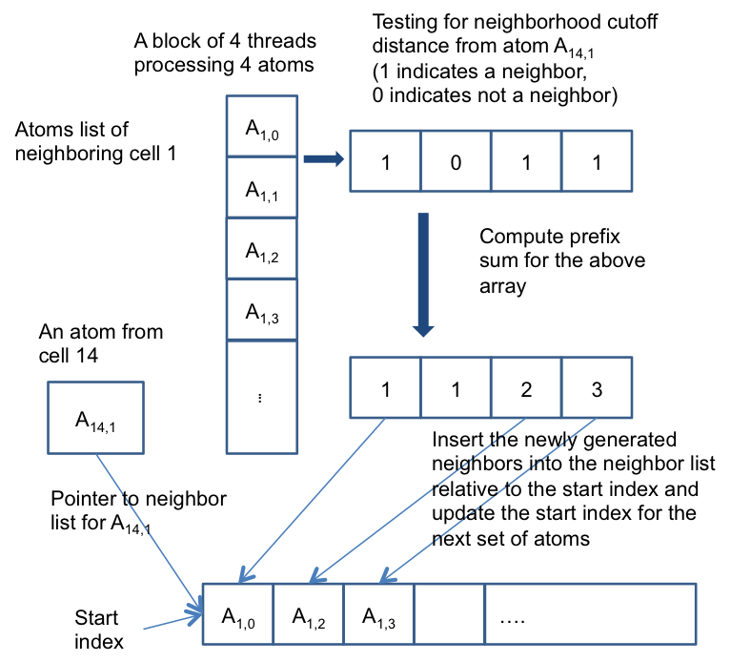
Neighbor List Generation
Each cell with its neighboring cells and neighboring atoms
Processing of neighbor list generation

Slide 23
Other Data Structures
Iterating over the neighbor list to generate bond/hydrogen-bond/QEq coefficients
All the above lists are redundant on GPUs
Three kernels, one for each list
Redundant traversal of neighbor list by kernels
One kernel for generating all the list entries per atom pair

Slide 24
Bonded and Non-bonded Interactions
Bonded interactions are computed using one thread per atom
Number of bonds per atom typically low (< 10)
Bond-list iterated to compute force/energy terms
Expensive three-body and four body interactions because of number of bonds involved (three-body list)
Hydrogen-bonds use multiple threads per atom (h-bonds per atom usually in 100’s)

Slide 25
Nonbonded Interactions
Charge Equilibration
One warp (32 threads) per row SpMV, CSR Format
GMRES implemented using CUBLAS library
Van der Waals and Coulombs interactions
Iterate over neighbor lists
Multiple thread per atom kernel

Slide 26
PG-PuReMD
Multi-node, multi-GPU implementation
Problem decomposition
3D Domain decomposition with wrap around links for periodic boundaries (Torus)
Outer shell selection
PG-PuReMD uses full-shell
r_{shell} = max(3 x r_{bond}, r_{hbond}, r_{nonb})

Slide 27
Experimental Results
LBNL’s GPU Clusters: 50 node GPU cluster interconnected with QDR Infinitiband switch
GPU Node: 2 Intel 5530 2.4 GHz QPI Quadcore Nehalem processors (8 cores/node), 24 GB RAM and Tesla C2050 Fermi GPUs with 3GB global memory
Single CPU : Intel Xeon E5606, 2.13 GHz and 24 GB RAM

Slide 28
Experimental Setup
CUDA 5.0 development environment
“-arch=sm 20 -funroll-loops –O3” compiler options
GCC 4.6 compiler, MPICH2 openmpi
Cuda object files are linked with openmpi to produce the final executable
10⁻⁶ Qeq tolerance, 0.25 fs time step and NVE ensemble

Slide 29
Weak Scaling Results

Slide 30
Weak Scaling Results

Slide 31
Conclusions
PuReMD is available for public download at
https://www.cs.purdue.edu/puremd
Thank You!

