Slide 1
PuReMD: Purdue Reactive Molecular Dynamics Software
Ananth Grama
Center for Science of Information
Computational Science and Engineering
Department of Computer Science ayg@cs.purdue.edu

Slide 2
Outline
Introduction
  Molecular Dynamics Methods vs. ReaxFF
Sequential Realization: SerialReax
  Algorithms and Numerical Techniques
  Validation
  Performance Characterization
Parallel Realization: PuReMD
  Parallelization: Algorithms and Techniques
  Performance and Scalability
  GPU and Multiple-GPU Implementations
Applications
  Strain Relaxation in Si/Ge/Si Nanobars
  Water-Silica Interface
  Oxidative Stress in Lipid Bilayers

Slide 3
Molecular Dynamics Methods vs. ReaxFF
mm
Statistical & Continuum methods
μm
Classical MD methods
nm
ReaxFF
Ab-initio methods
ps
ns
μs
ms

Slide 4
ReaxFF vs. Classical MD
ReaxFF is classical MD in spirit
  basis: atoms (electron & nuclei)
  parameterized interactions: from DFT (ab-initio)
  atomic movements: Newtonian mechanics
  many common interactions
    bonds
    valence angles (a.k.a. 3-body interactions)
    dihedrals (a.k.a. 4-body interactions)
    hydrogen bonds
    van der Waals, Coulomb

Slide 5
ReaxFF vs. Classical MD
Static vs. dynamic bonds
  reactivity: bonds are formed/broken during simulations
  consequently: dynamic multibody interactions
  complex formulations of bonded interactions
  additional bonded interactions
    multi-body: lone pair & over/under-coordination – due to imperfect coord.
    3-body: coalition & penalty – for special cases like double bonds
    4-body: conjugation – for special cases
Static vs. dynamic charges
  Charge equilibration -- large sparse linear system (NxN) – N = # of atoms
  updates at every step!
Shorter time-steps (femtoseconds vs. tenths of femtoseconds)
Result: a more complex and expensive force field

Slide 6
Sequential Realization: SerialReax
Excellent per-timestep running time
  efficient generation of neighbors lists
  elimination of bond order derivative lists
  cubic spline interpolation: for non-bonded interactions
  highly optimized linear solver: for charge equilibration
Linear scaling memory footprint
  fully dynamic and adaptive interaction lists
Reactive Molecular Dynamics: Numerical Methods and Algorithmic Techniques, Aktulga et al, SIAM SISC 2013.

Slide 7
SerialReax Components
SerialReax
Initialization
Read input data
Initialize data structs
Neighbor Generation
3D-grid based O(n) neighbor generation
Several optimizations for improved performance
System
Geometry
Reallocate
Fully dynamic and adaptive memory management:
efficient use of resources
large systems on a single processor
Control
Parameters
Init Forces
Initialize the QEq coef matrix
Compute uncorr. bond orders
Generate H-bond lists
Force Field
Parameters
QEq
Large sparse linear system
Solved using preconditioned
Krylov subspace solvers
Compute Bonds
Corrections are applied after all
uncorrected bonds are computed
Program Log
File
Bonded Interactions
Bonds
Lone pairs
Over/UnderCoord
Valence Angles
Hydrogen Bonds
Dihedral/ Torsion
vd Waals & electrostatics
Single pass over the
far nbr-list after
charges are updated
Interpolation with cubic
splines for nice speed-up
System Status
Update
Trajectory
Snapshots
Evolve the System
F_{total} = F_{nonbonded} + F_{bonded}
Update x & v with velocity Verlet
NVE, NVT and NPT ensembles

Slide 8
Generation of Neighbors List
atom list
3D Neighbors grid
atom list: reordered

Slide 9
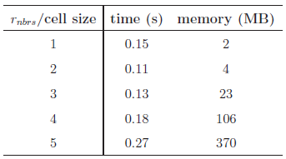
Neighbors List Optimizations
Size of the neighbor grid cell is important
  r_{nbrs}: neighbors cut-off distance
  set cell size to half the r_{nbrs}
Reordering reduces look-ups significantly
Atom to cell distance
Verlet lists for delayed re-neighboring
neighbors grid
No need to check these cells with reordering!
Looking for the neighbors of atoms in this box
Just need to look inside these cells
d
If d > r_{nbrs}, then no need to look into the cell

Slide 10
Elimination of Bond Order Derivative Lists
BO_{ij}: bond order between atoms i and j
  at the heart of all bonded interactions
dBO_{ij}/dr_{k}: derivative of BO_{ij} wrt. atom k
  non-zero for all k sharing a bond with i or j
  costly force computations, large memory space needed
Analogy
Eliminate dBO list
  delay computation of dBO terms
  accumulate force related coef. into CdBO_{ij}
  compute dBO_{ij}/dr_{k} at the end of the step
  f_{k} += CdBO_{ij} x dBO_{ij}/dr_{k}

Slide 11
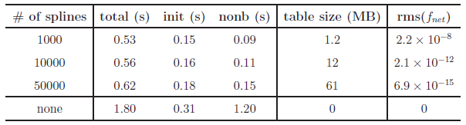
Look-up Tables
Expensive non-bonded force computations
  Large number of interactions: r_{nonb} ~ 10A vs. r_{bond} ~ 4-5A
  but simple, pair-wise interactions
Reduce non-bonded force computations
  create look-up tables
  cubic spline interpolation: for non-bonded energy & forces
Experiment with a 6540 atom bulk water system
Significant performance gain, high accuracy

Slide 12




Linear Solver for Charge Equilibration
QEq Method: used for equilibrating charges
  approximation for distributing partial charges
  solution using Lagrange multipliers yields
    N = # of atoms
    H: NxN sparse matrix
    s & t fictitious charges: used to determine the actual charge q_{i}
Too expensive for direct methods → Iterative (Krylov sub-space) methods

Slide 13
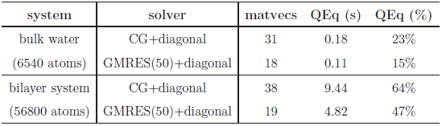
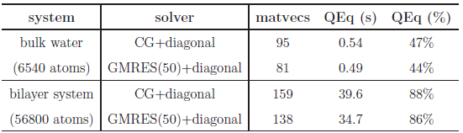
Basic Solvers for QEq
Sample systems
  bulk water: 6540 atoms, liquid
  lipid bilayer system: 56,800 atoms, biological system
  PETN crystal: 48,256 atoms, solid
Solvers: CG and GMRES
  H has heavy diagonal: diagonal pre-conditioning
  slowly evolving environment : extrapolation from prev. solutions
Poor Performance:
# of iterations = # of matrix-vector multiplications
actual running time in seconds
fraction of total computation time
tolerance level = 10⁻⁶
which is fairly satisfactory
due to cache effects
much worse at 10⁻¹⁰ tolerance level
more pronounced here

Slide 14
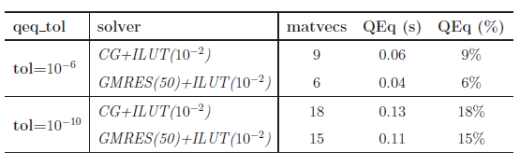
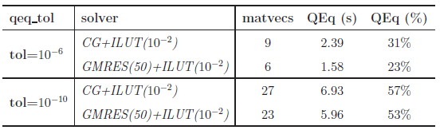
ILU-based preconditioning
ILU-based pre-conditioners: no fill-in, 10⁻² drop tolerance
  effective (considering only the solve time)
  no fill-in + threshold: nice scaling with system size
  ILU factorization is expensive
bulk water system
cache effects are still evident
bilayer system
system/solver | time to compute preconditioner | solve time (s) | total time (s)
bulk water/ GMRES+ILU | 0.50 | 0.04 | 0.54
bulk water/ GMRES+diagonal | ~0 | 0.11 | 0.11

Slide 15
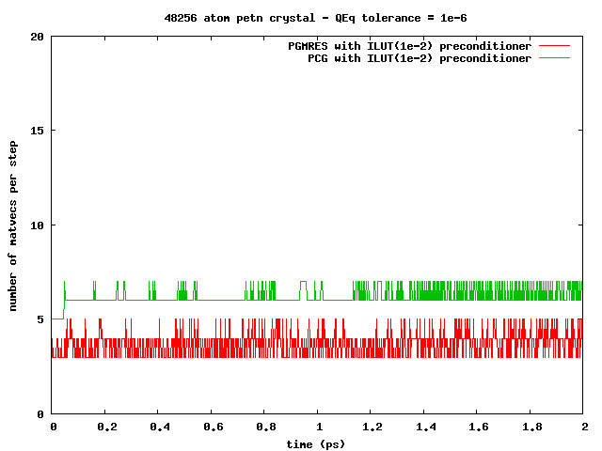
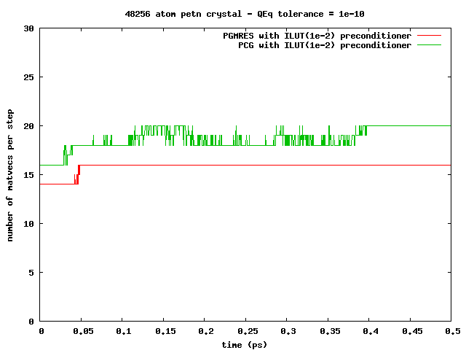
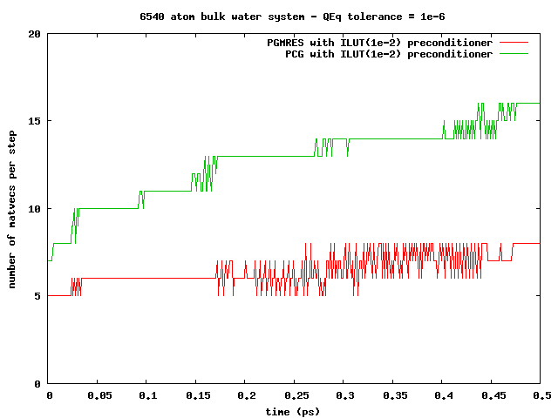
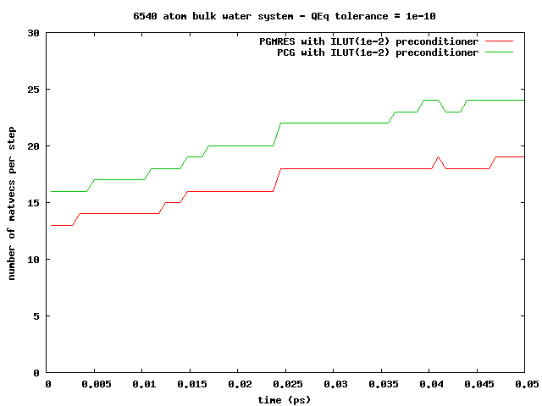
ILU-based preconditioning
Observation: can amortize the ILU factorization cost
slowly changing simulation environment ⇒re-usable pre-conditioners
PETN crystal:
solid, 1000s of steps!
Bulk water:
liquid, 10-100s of steps!

Slide 16
Memory Management
Compact data-structures
Dynamic and adaptive lists
  initially: allocate after estimation
  at every step: monitor & re-allocate if necessary
Low memory foot-print, linear scaling with system size
n-1
n
n-1
n
n-1’s data
n’s data
n-1’s data
n’s data
in CSR format
neighbors list
Qeq matrix
3-body interactions
reserved for n-1
reserved for n
in modified CSR
bonds list
hbonds list

Slide 17
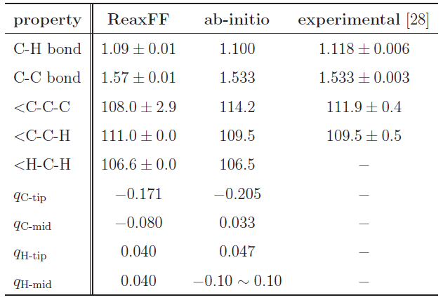
Validation
Hexane (C₆H₁₄) Structure Comparison
Excellent agreement!

Slide 18
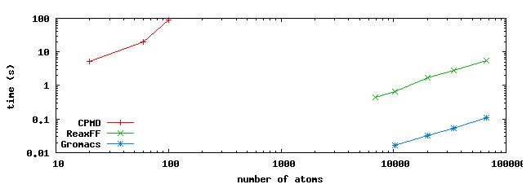
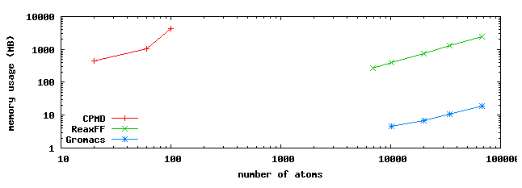
Comparison to MD Methods
Comparisons using hexane: systems of various sizes
  Ab-initio MD: CPMD
  Classical MD: GROMACS
  ReaxFF: SerialReax

Slide 19
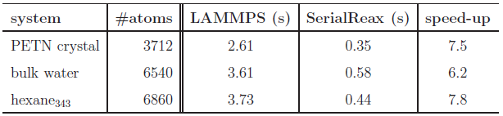
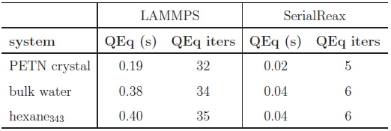
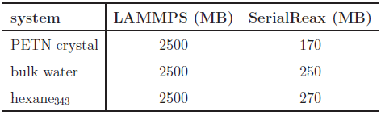
Comparison with LAMMPS-Reax
Time per time-step comparison
Qeq solver performance
Memory foot-print
different QEq formulations
similar results
LAMMPS:
CG / no preconditioner

Slide 20
Outline
Introduction
  Molecular Dynamics Methods vs. ReaxFF
Sequential Realization: SerialReax
  Algorithms and Numerical Techniques
  Validation
  Performance Characterization
Parallel Realization: PuReMD
  Parallelization: Algorithms and Techniques
  Performance and Scalability
Applications
  Strain Relaxation in Si/Ge/Si Nanobars
  Water-Silica Interface
  Oxidative Stress in Lipid Bilayers

Slide 21
Parallel Realization: PuReMD
Built on the SerialReax platform
  Excellent per-timestep running time
  Linear scaling memory footprint
Extends its capabilities to large systems, longer time-scales
  Scalable algorithms and techniques
  Demonstrated scaling to over 9K cores
Parallel Reactive Molecular Dynamics: Numerical Methods and Algorithmic Techniques, Akgulta et al., 2013.

Slide 22
Parallelization: Outer-Shell
r
r
b
b
full shell
half shell
r/2
r
b
b
midpoint-shell
tower-plate shell

Slide 23
Parallelization: Outer-Shell
choose full-shell due to dynamic bonding despite the comm. overhead
r
r
b
b
full shell
half shell
r/2
r
b
b
midpoint-shell
tower-plate shell

Slide 24
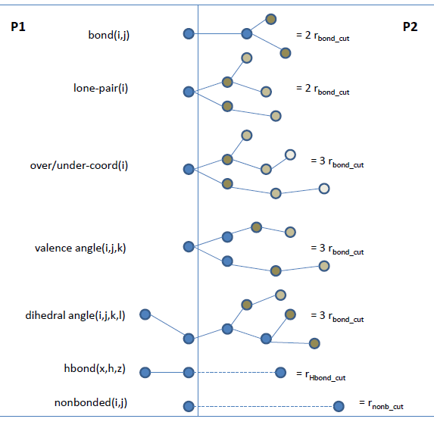
Parallelization: Boundary Interactions
r_{shell}= MAX (3xr_{bond_cut}, r_{hbond_cut}, r_{nonb_cut})

Slide 25
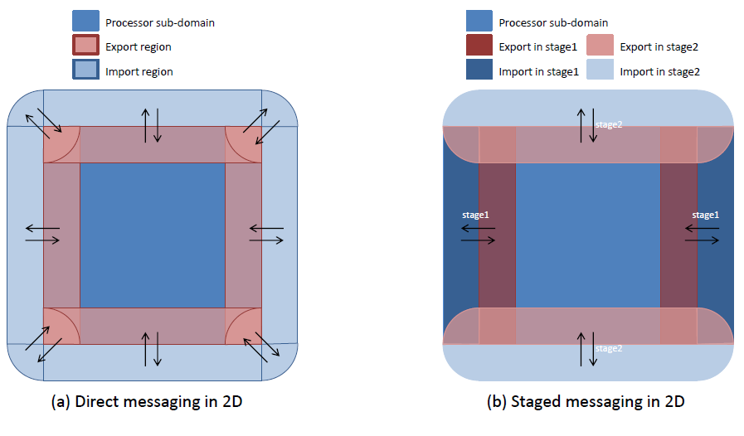
Parallelization: Messaging

Slide 26
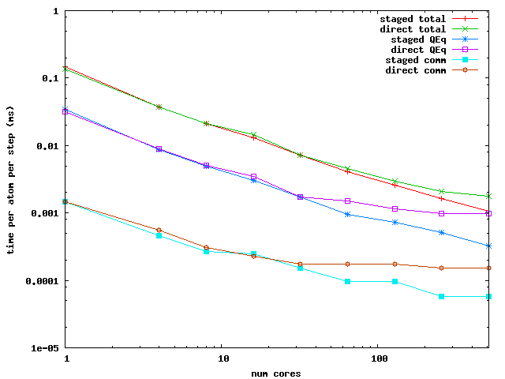
Parallelization: Messaging Performance
Performance Comparison: PuReMD with direct vs. staged messaging

Slide 27
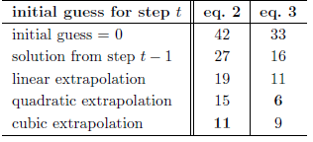
Parallelization: Optimizations
Truncate bond related computations
  double computation of bonds at the outer-shell
  hurts scalability as the sub-domain size shrinks
  trim all bonds that are further than 3 hops or more
Scalable parallel solver for the QEq problem
  GMRES/ILU factorization: not scalable
  use CG + diagonal pre-conditioning
  good initial guess:
  redundant computations: to avoid reverse communication
  iterate both systems together

Slide 28
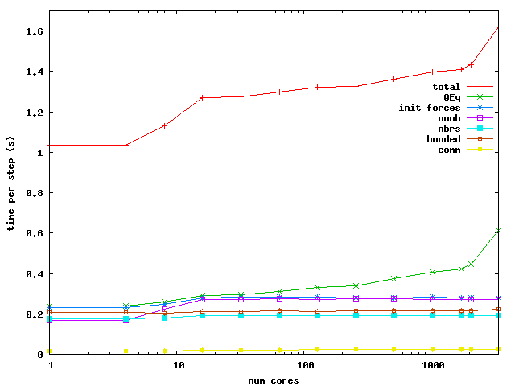
PuReMD: Weak Scaling
Bulk Water: 6540 atoms in a 40x40x40 A³ box / core

Slide 29
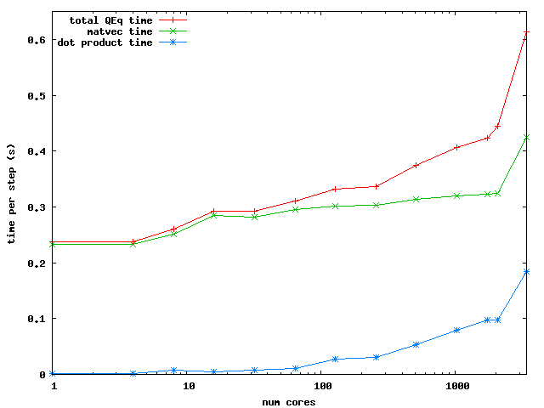
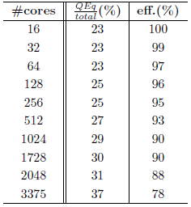
PuReMD: Weak Scaling
QEq Scaling
Efficiency

Slide 30
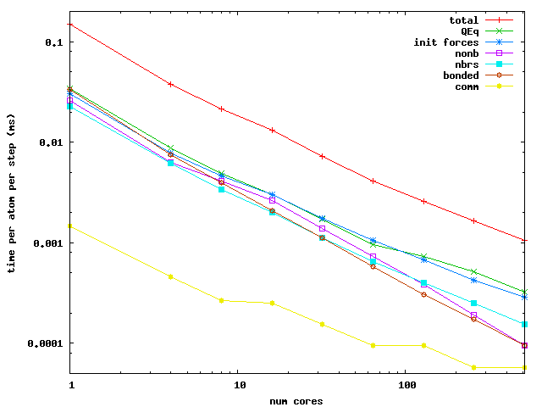
PuReMD: Strong Scaling
Bulk Water: 52320 atoms in a 80x80x80 A³ box

Slide 31
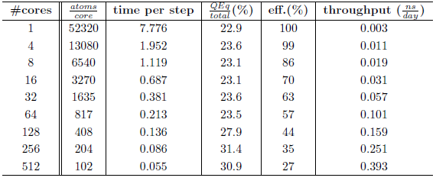
PuReMD: Strong Scaling
Efficiency and throughput

Slide 32
PuReMD-GPU Design
Initialization
  neighbor-list, bond-list, hydrogenbond-list and Coefficients of QEq matrix
Bonded interactions
  Bond-order, bond-energy, lone-pair, three-body, four-body and hydrogen-bonds
Implementation of Non-bonded interactions
  Charge Equilibration
  Coulombs and Van der Waals forces

Slide 33
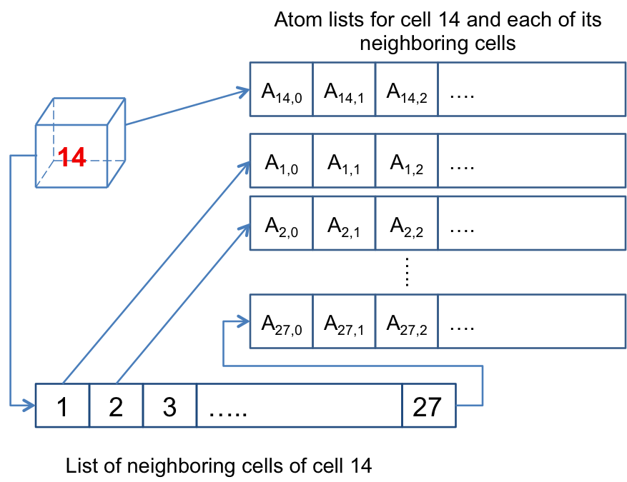
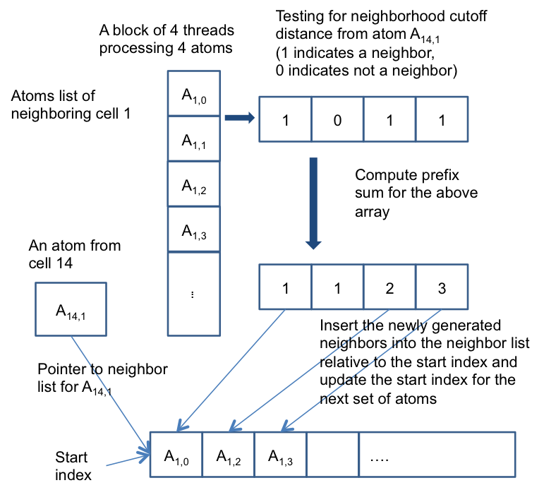
Neighbor List Generation
Each cell with its neighboring cells and neighboring atoms
Processing of neighbor list generation

Slide 34
Other Data Structures
Iterating over the neighbor list to generate bond/hydrogen-bond/QEq coefficients
All the above lists are redundant on GPUs
Three kernels, one for each list
  Redundant traversal of neighbor list by kernels
One kernel for generating all the list entries per atom pair

Slide 35
Bonded and Non-bonded Interactions
Bonded interactions are computed using one thread per atom
  Number of bonds per atom typically low (< 10)
  Bond-list iterated to compute force/energy terms
  Expensive three-body and four body interactions because of number of bonds involved (three-body list)
  Hydrogen-bonds use multiple threads per atom (h-bonds per atom usually in 100’s)

Slide 36
Nonbonded Interactions
Charge Equilibration
  One warp (32 threads) per row SpMV, CSR Format
  GMRES implemented using CUBLAS library
Van der Waals and Coulombs interactions
  Iterate over neighbor lists
  Multiple thread per atom kernel

Slide 37
Experimental Results
Intel Xeon CPU E5606, 2.13 GHz, 24 GB RAM, Linux OS and Tesla C2705 GPU
CUDA 5.0 Environment
“-funroll-loops -fstrict-aliasing -O3” Compiler options (same as serial implementation)
Double precision arithmetic and NO fused multiply add (fmad) operations
Time step: 0.1 fs and 10⁻¹⁰ tolerance, NVE ensemble

Slide 38
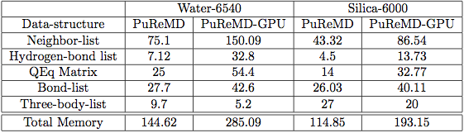
Memory footprint
(All the numbers are in MBs)
All data structures are redundant on GPU
Three body interaction estimates the number of entries in the three-body list before executing the kernel, because of which memory is allocated as needed
C2075/6GB can handle as large as 50K system

Slide 39
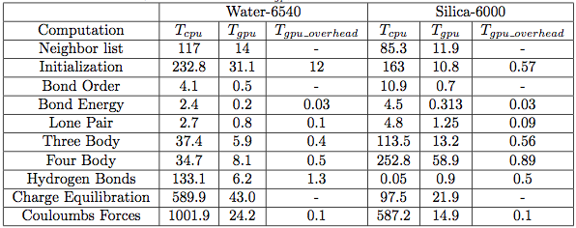
GPU Overhead per interaction
PuReMD-GPU uses additional memory to store temporary results and performs a final reduction for energy/force computation
PuReMD-GPU uses additional kernels to compute reduction on lists to compute effective forces and energies for each interaction. These are not incurred if atomic operations are used in these computations.

Slide 40
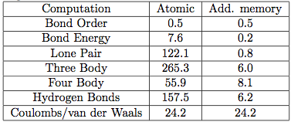
Atomic vs. Redundant Memory
Performance of kernels is severely impacted by atomic operations on GPUs. 64 bit atomic operations are NOT supported on TESLA GPU, needs 2 32 bit operations. Results in serialization of competing threads.
Additional memory provides dedicated memory to each thread. After the interaction kernel is completed, additional kernels are used to perform reductions to compute the final result.

Slide 41
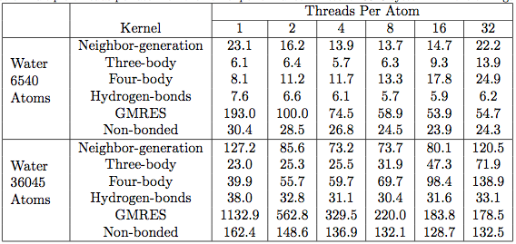
Multiple thread Kernels performance
(all timings are in milliseconds)
Allocating multiple threads per atom yields significant speedups.
Allocating more threads than needed, increases the scheduling overhead (increases the total number of blocks to be executed).

Slide 42
Performance of PuReMD-GPU

Slide 43
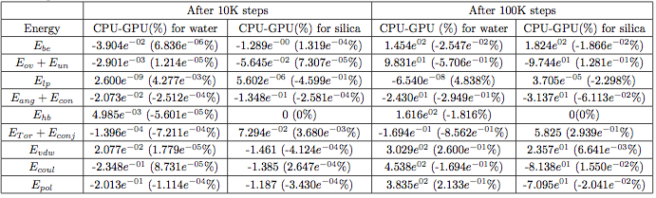
Accuracy Results
Double precision arithmetic
NO FMAD (fused multiply-add) operations
Million time steps of simulation executed

Slide 44
Accuracy Results

Slide 45
Accuracy Results

Slide 46
PG-PuReMD
Multi-node, multi-GPU implementation
Problem decomposition
  3D Domain decomposition with wrap around links for periodic boundaries (Torus)
Outer shell selection
  PG-PuReMD uses full-shell
  r_{shell} = max(3 x r_{bond}, r_{hbond}, r_{nonb})

Slide 47
Experimental Results
LBNL’s GPU Clusters: 50 node GPU cluster interconnected with QDR Infinitiband switch
GPU Node: 2 Intel 5530 2.4 GHz QPI Quadcore Nehalem processors (8 cores/node), 24 GB RAM and Tesla C2050 Fermi GPUs with 3GB global memory
Single CPU : Intel Xeon E5606, 2.13 GHz and 24 GB RAM

Slide 48
Experimental Setup
CUDA 5.0 development environment
“-arch=sm 20 -funroll-loops –O3” compiler options
GCC 4.6 compiler, MPICH2 openmpi
Cuda object files are linked with openmpi to produce the final executable
10⁻⁶ Qeq tolerance, 0.25 fs time step and NVE ensemble

Slide 49
Weak Scaling Results

Slide 50
Weak Scaling Results

Slide 51
Outline
Introduction
  Molecular Dynamics Methods vs. ReaxFF
Sequential Realization: SerialReax
  Algorithms and Numerical Techniques
  Validation
  Performance Characterization
Parallel Realization: PuReMD
  Parallelization: Algorithms and Techniques
  Performance and Scalability
Applications
  Strain Relaxation in Si/Ge/Si Nanobars
  Water-Silica Interface
  Oxidative Stress in Lipid Bilayers

Slide 52
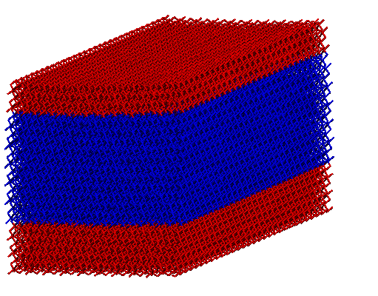
Si/Ge/Si nanoscale bars
Motivation
  Si/Ge/Si nanobars: ideal for MOSFETs
  as produced: biaxial strain, desirable: uniaxial
  design & production: understanding strain behavior is important
[001], Vertical
[010] , Longitudinal
[100], Transverse
Si
Height (H)
Ge
Si
Periodic boundary
conditions
Strain relaxation in Si/Ge/Si nanoscale bars from molecular dynamics simulations
Park et al. Journal of Applied Physics 106, 1 (2009)
Width (W)

Slide 53
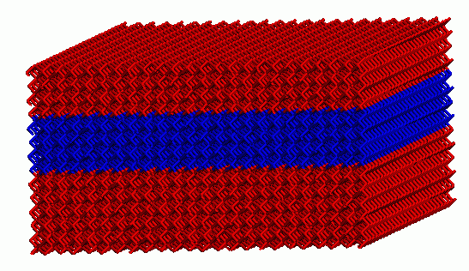
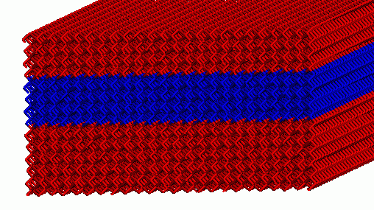
Si/Ge/Si nanoscale bars
Key Result:
When Ge section is roughly square shaped, it has almost uniaxial strain!
average strains for Si&Ge in each dimension
average transverse Ge strain
Ge
Si
Si
W = 20.09 nm
Simple strain model derived from MD results

Slide 54
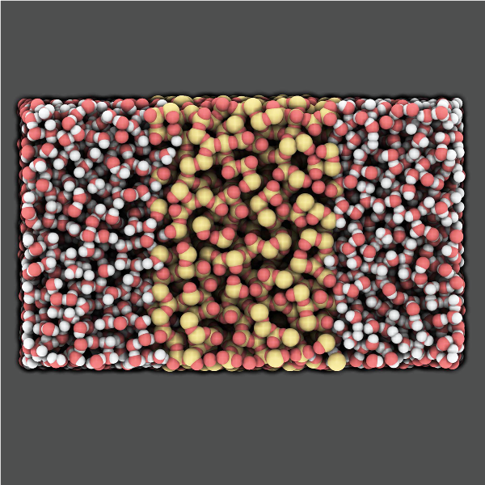
Water-Silica Interface
Motivation
  a-SiO2: widely used in nano-electronic devices
  also used in devices for in-vivo screening
  understanding interaction with water: critical for reliability of devices
A Reactive Simulation of the Silica-Water Interface
Fogarty et al., Journal of Chemical Physics 132, 174704 (2010)

Slide 55
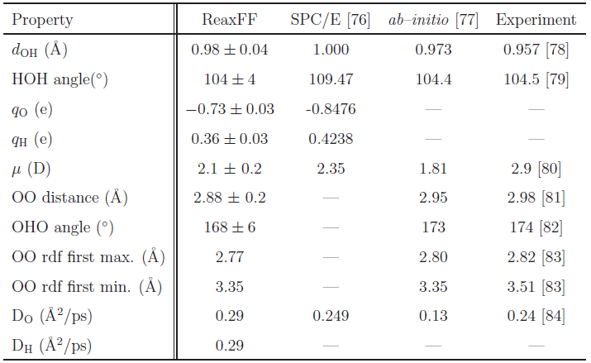
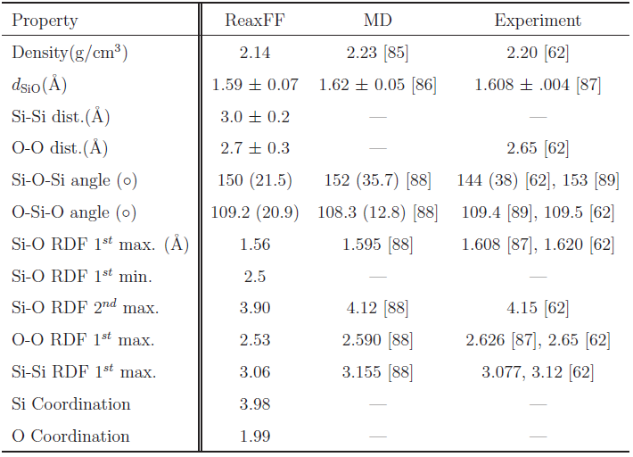
Water-Silica Interface
Water model validation
Silica model validation

Slide 56
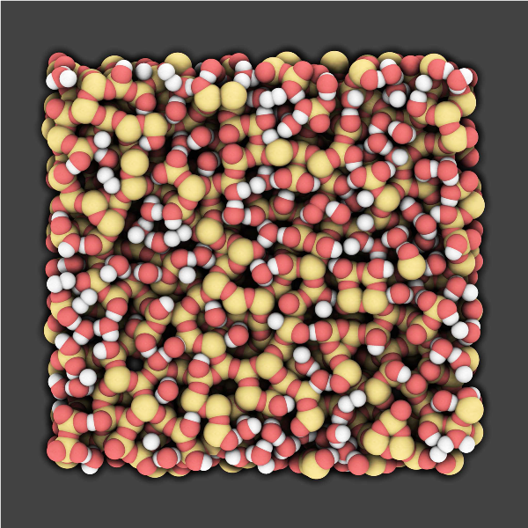
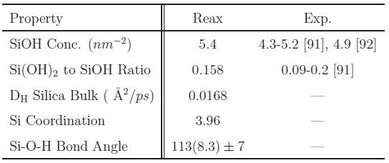
Water-Silica Interface
Key Result
Silica surface hydroxylation as evidenced by experiments is observed.
Proposed reaction:
H2O + 2Si + O ⇔ 2SiOH
Water
H
O
H
Silica
O
Si
O

Slide 57
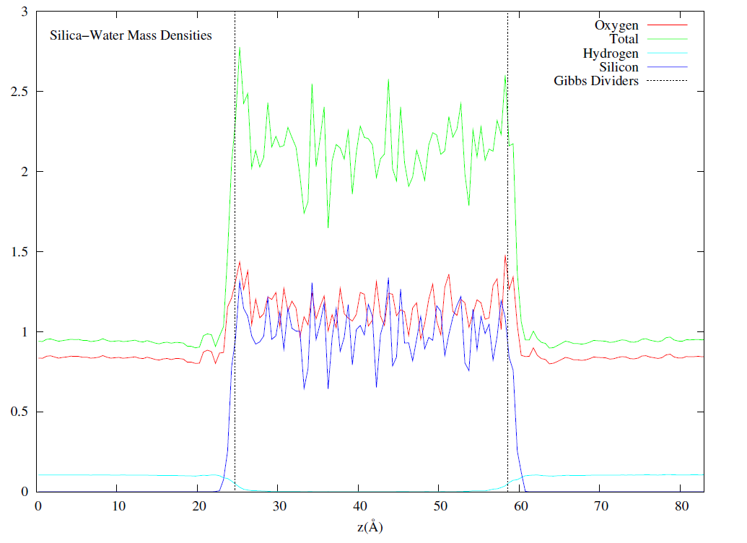
Water-Silica Interface
Key Result
Hydrogen penetration is observed: some H atoms penetrate through the slab.
Ab-initio simulations predict whole molecule penetration.
We propose: water is able to diffuse through a thin film of silica via hydrogen hopping, i.e., rather than diffusing as whole units, water molecules dissociate at the surface, and hydrogens diffuse through, combining with other dissociated water molecules at the other surface.

Slide 58
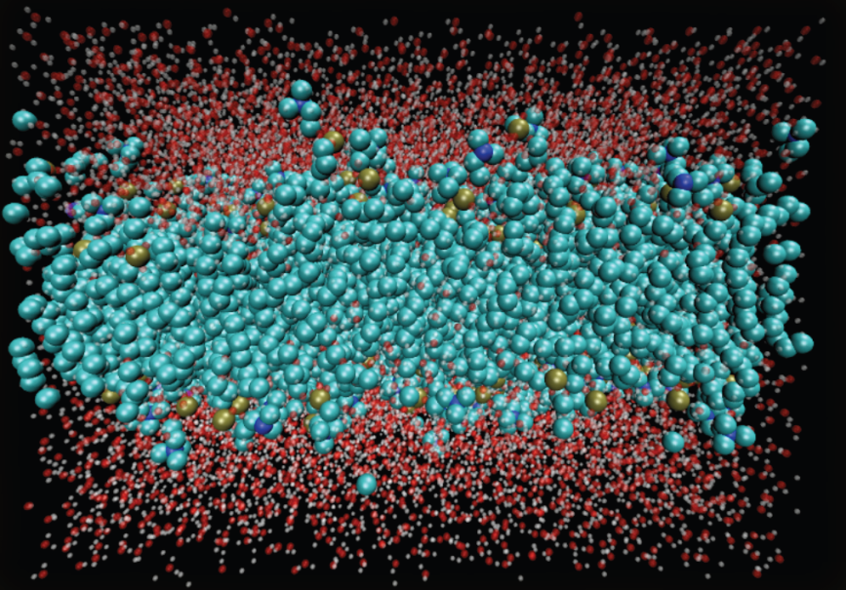
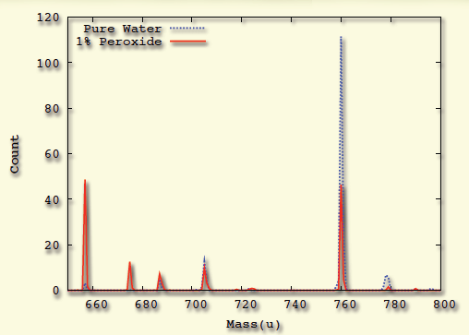
Oxidative Damage in Lipid Bilayers
Motivation
Modeling reactive processes in biological systems
ROS→ Oxidative stress→ Cancer & Aging
System Preparation
200 POPC lipid + 10,000 water molecules
and same system with 1% H₂O₂ mixed
Mass Spectograph:
Lipid molecule weighs 760 u
Key Result
Oxidative damage observed:
In pure water: 40% damaged
In 1% peroxide: 75% damaged

Slide 59
Conclusions
PuReMD is available for public download. Its GPU version will be marketed by SCM Inc., Amsterdam.
Over 150 labs use it for a diverse set of systems.
Thank You!

