Slide 1
PuReMD Design
Initialization
  neighbor-list, bond-list, hydrogenbond-list and Coefficients of QEq matrix
Bonded interactions
  Bond-order, bond-energy, lone-pair, three-body, four-body and hydrogen-bonds
Implementation of Non-bonded interactions
  Charge Equilibration
  Coulombs and Van der Waals forces

Slide 2
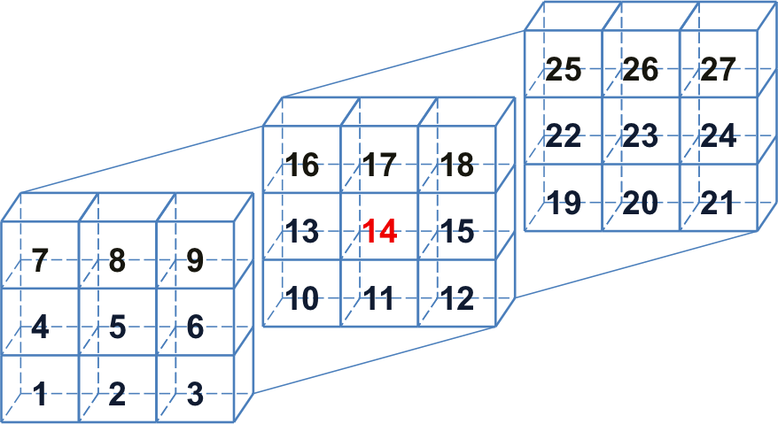
Neighbor-list generation
3D grid structure is built by dividing the simulation domain into small cells
Atoms binned into cells
Larger neighborhood cutoff, usually couple of hundreds of neighbors per atom

Slide 3
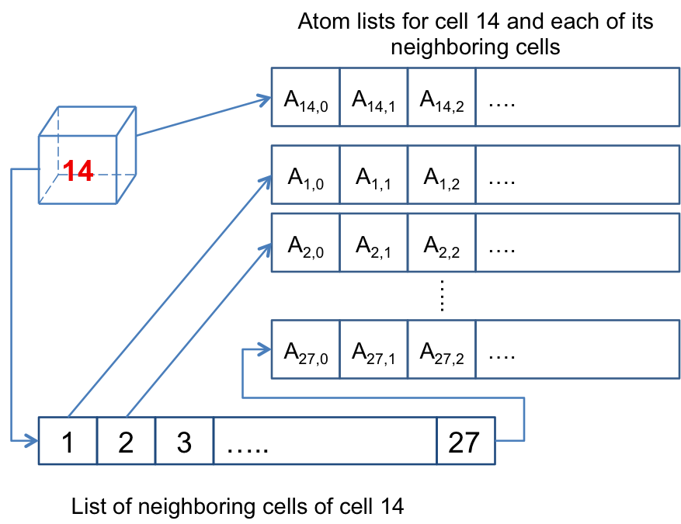
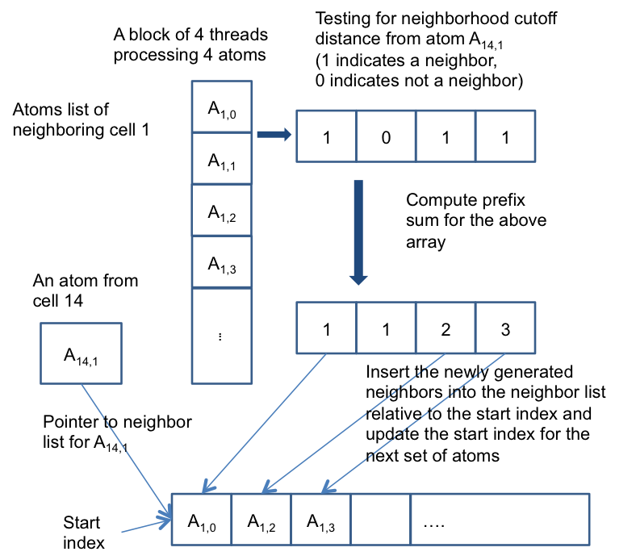
Neighbor-list generation
Each cell with its neighboring cells and neighboring atoms
Processing of neighbor list generation

Slide 4
Other data structures
Iterating over the neighbor list to generate bond/hydrogen-bond/Qeq coefficients
All the above lists are redundant on GPUs
3 Kernels one for each list
  Redundant traversal of neighbor list by kernels
One kernel for generating all the list entries per atom pair

Slide 5
Bonded and Non-bonded interactions
Bonded interactions are computed using one thread per atom
  Number of bonds per atom typically low (< 10)
  Bond-list iterated to compute force/energy terms
  Expensive three-body and four body interactions because of number of bonds involved (three-body list)
  Hydrogen-bonds use multiple threads per atom (hbonds per atom usually in 100’s)

Slide 6
Nonbonded interactions
Charge Equilibration
  One warp (32 threads) per row SpMV, CSR Format
  GMRES implemented using CUBLAS library
Van der Waals and Coulombs interactions
  Iterate over neighbor lists
  Multiple thread per atom kernel

Slide 7
Experimental Results
Intel Xeon CPU E5606, 2.13 GHz, 24 GB RAM, Linux OS and Tesla C2705 GPU
CUDA 5.0 Environment
“-funroll-loops -fstrict-aliasing -O3” Compiler options (same as serial implementation)
Double precision arithmetic and NO fused multiply add (fmad) operations
Time step: 0.1 fs and 10⁻¹⁰ tolerance, NVE ensemble

Slide 8
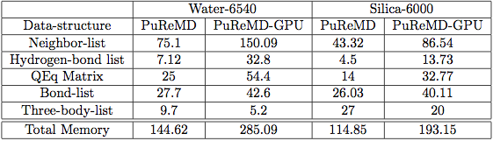
Memory footprint
All the numbers are in MBs
All data structures are redundant on GPU
Three body interaction estimates the number of entries in the three-body list before executing the kernel because of which memory is allocated as needed with excessive over estimation – as in the case of PuReMD
C2075/6GB can handle as large as 50K system

Slide 9
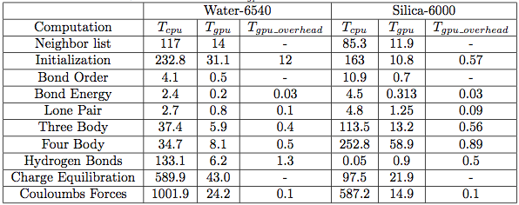
GPU Overhead per interaction
PuReMD-GPU uses additional memory to store temporary results and performs a final reduction for energy/force computation
PuReMD-GPU uses additional kernels to compute reduction on lists to compute effective forces and energies for each interaction. These will NOT be incurred if atomic operations are used in these computations

Slide 10
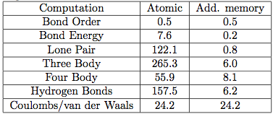
Atomic vs. Redundant Memory
Performance of kernels is severely impacted by using atomic operations on GPUs. 64 bit atomic operations are NOT supported on TESLA GPU, needs 2 32 bit operations. Results in serialization of competing threads.
Additional memory provides dedicated memory to each thread. After the interaction kernel is completed, additional kernels are used to perform reductions to compute the final result.

Slide 11
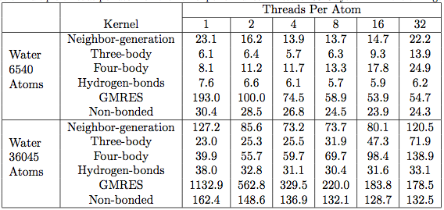
Multiple thread Kernels performance
All timings are in milliseconds
Allocating multiple threads per atom yields tremendous speedups.
Allocating more threads than needed, increases the scheduling overhead (increases the total number of blocks to be executed.

Slide 12
Performance of PuReMD-GPU

Slide 13
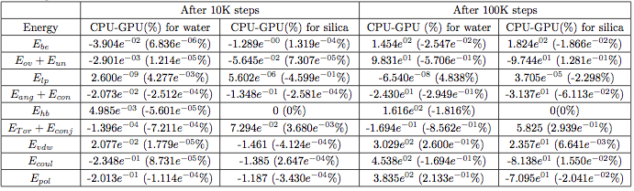
Accuracy Results
Double precision arithmetic
NO FMAD (fused multiply-add) operations
Deviation of 4% after 100K time steps
Million time steps of simulation executed

Slide 14
Accuracy Results

Slide 15
Accuracy Results

Slide 16
PG-PuReMD
Multi-node, multi-gpu implementation
Problem decomposition
  3D Domain decomposition with wrap around links for periodic boundaries (Torus)
Outer shell selection
  Full-shell, half-shell, midpoint-shell, neutral territory (zonal) methods etc…
  PG-PuReMD uses full-shell
  r_{shell} = max(3 x r_{bond}, r_{hbond}, r_{nonb})

Slide 17
Inter process communication
3D domain decomposition and full-shell as outer-shell for processes, we can use direct messaging or staged messaging
Our experiments show that staged messaging is efficient as number of processors is increased
Each process sends atoms in +x, -x, then +y, -y and finally in +z, -z dimensions

Slide 18
Experimental Results
LBNL’s GPU Clusters: 50 node GPU cluster interconnected with QDR Infinitiband switch
GPU Node: 2 Intel 5530 2.4 GHz QPI Quadcore Nehalem processors (8 cores/node), 24 GB RAM and Tesla C2050 Fermi GPUs with 3GB global memory
Single CPU : Intel Xeon E5606, 2.13 GHz and 24 GB RAM

Slide 19
Experimental Setup
CUDA 5.0 development environment
“-arch=sm 20 -funroll-loops –O3” compiler options
GCC 4.6 compiler, MPICH2 openmpi
Cuda object files are linked with openmpi to produce the final executable
10⁻⁶ Qeq tolerance, 0.25 fs time step and NVE ensemble

Slide 20
Strong Scaling Results

Slide 21
Strong Scaling Results

Slide 22
Weak Scaling Results

Slide 23
Weak Scaling Results

